Slide 1
SaveWise
Stop tracking. Start growing.
The intelligent, fully automated personal finance tracker.

Slide 2
SITUATION: The Problem
Manual expense tracking is dead.
Digital payments (UPI) are growing exponentially.
People make dozens of micro-transactions daily.
Manual tracking is tedious, leading to lost financial clarity and broken budgets.

Slide 3
TASK: The Objective
Total financial clarity with zero friction.
Build a fully automated personal finance tracker.
Eliminate manual data entry completely.
Unify daily cash flow management with long-term wealth building (stocks/investments).

Slide 4
ACTION: The SaveWise Solution
Intelligent parsing & real-time insights.
Built a custom engine that parses standard bank SMS alerts instantly.
Integrated live Yahoo Finance data for real-time stock portfolio tracking.
Engineered an AI Advisor that analyzes real spending habits for actionable feedback.

Slide 5

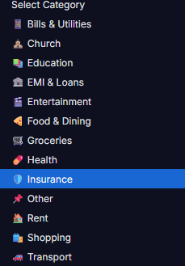
ACTION: The Platform
Beautiful, intuitive, and lightning fast.

Slide 6
RESULT: The Outcome
A production-ready financial ecosystem.
100% automated expense tracking achieved for users.
Bank-grade security with AES-256-GCM encryption and robust SQLite fallback.
16 comprehensive automated health checks running daily ensuring maximum reliability.
100% test coverage across core engines.

Slide 7
THE ASK: Let's Scale SaveWise
Engineered for the next generation.
Built by Soloking (2nd-Year CSE B.Tech Student) with a passion for FinTech and automation.
Seeking seed funding and mentorship to scale infrastructure and integrate direct banking APIs.
Ready to drive user acquisition among students and young professionals.

