Slide 1
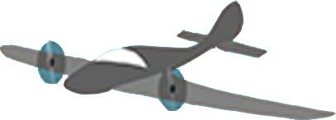
b
w
b
Z₀=1
Y₀
w
Z₀=0
Time lag = t

