Slide 1



Observer 2 location when
observer 1 passes animal.
Animal location when
passed by observer 1.
Animal location when
passed by observer 2.
$$t=k+y$$
$$k$$
$$y$$

Slide 2
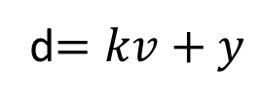

Observer 2 location when
observer 1 passes animal.
Animal location when
passed by observer 1.
Animal location when
passed by observer 2.
d$=kv+y$
$$kv$$
$$y$$

