Slide 1
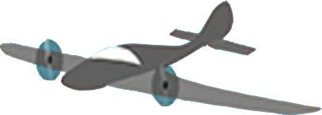
b
w
U₀=1
Y₀
w
b
U₀=0
Time lag = t

