Slide 1
IMU-Only Indoor Positioning: Calibration, ESKF and Zero-Velocity Updates
Staged 60 Hz inertial filtering evaluated on a 9.36 m phone walk and 58.58 m EuRoC drone flight
Problem 4 | Team Pineapple | 25 October 2026
Notes:
We are Team Pineapple, presenting our work on Problem 4: IMU-based indoor positioning for drones and robots. Our goal was to estimate 2D and 3D position using only a 60 Hz accelerometer and gyroscope, building our pipeline in stages so we could measure what each stage adds. We tested every stage on a 9.36 m smartphone square walk and on the 58.58 m EuRoC V1_01 drone dataset, and we report both what worked and which performance tiers were not met.

Slide 2
1. PROBLEM STATEMENT & SCORING CRITERIA
Double integration makes raw IMU errors grow as t² against strict tier targets
Performance Tier | Problem Statement Requirement | Evaluation Weights (100 pts)
1. Core Tier | Calibrate bias, scale, misalignment; orientation filter (Madgwick, Mahony, or EKF); error < 1 m in first 30 s. | Accuracy: 35 pts | Filter Design: 20 pts
2. Main Target | Position error <= 3% of distance on a marked 50 m path (~1.5 m), with return-to-start error reported. | Calibration & Drift: 15 pts | Embedded: 15 pts
3. Bonus Tier | Add low-cost aid to keep error < 0.3 m, or run fixed-point on a microcontroller. | Documentation & Demo: 15 pts
Why raw IMU drifts without bound: Rotating 60 Hz accelerometer samples by gyro-integrated orientation and integrating twice causes any bias or tilt leakage to grow as t² (ending 211 m away on our 9.36 m walk).
Allowed aiding rule: Magnetometer, barometer, ZUPT, wheel odometry, optical flow, map constraints, or low-cost anchors — teams must state exactly what was used.
Team Pineapple | Section 1: Problem Statement & Evaluation Tiers (2/25)
Notes:
Indoors we have no GPS, and an inertial measurement unit on its own drifts quickly because we rotate accelerometer samples into the room frame, subtract gravity, and integrate twice. Under double integration, any small accelerometer bias or gravity leaking through a tilt error grows with time squared. The problem statement sets three tiers: under 1 m in the first 30 seconds for Core, 3% of a 50 m path—about 1.5 m—for Main, and under 0.3 m with a low-cost aid or a fixed-point microcontroller port for Bonus.

Slide 3
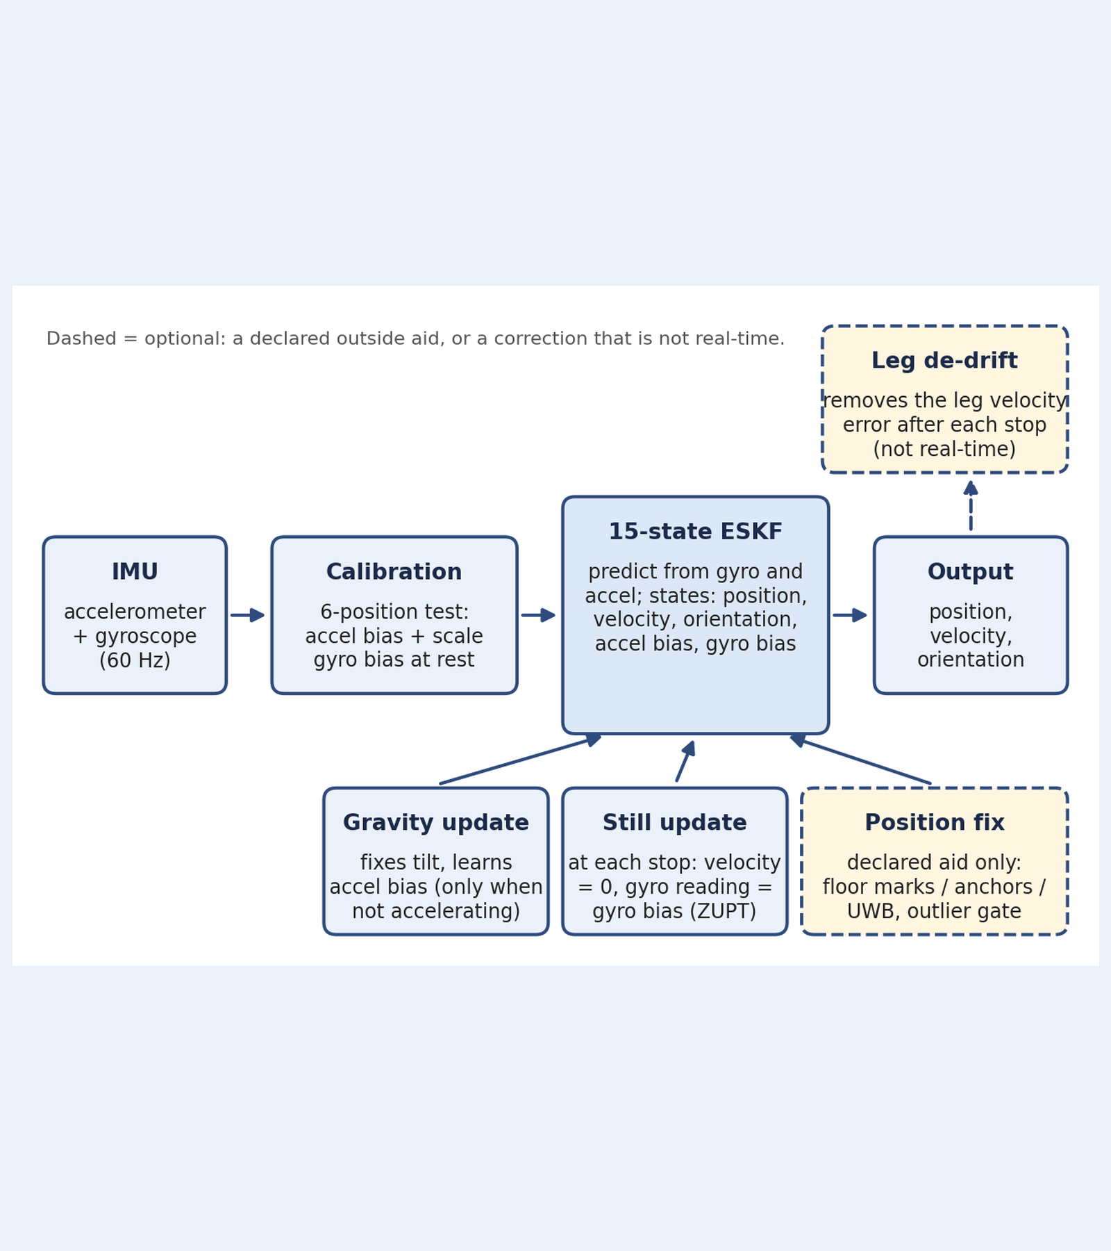
2. SYSTEM ARCHITECTURE (FIGURE 02)
Calibrated 60 Hz IMU feeds a 15-state ESKF with optional leg de-drift
Primary 60 Hz chain: IMU (60 Hz) -> 6-position static calibration -> 15-state error-state Kalman filter (ESKF) -> position, velocity, orientation.
Gravity update (IMU-only): Fixes roll/pitch tilt and learns accelerometer bias when not accelerating much (at most every 0.5 s).
Still update / ZUPT (IMU-only): At each detected stop, velocity is forced to zero and the gyro reading updates the gyro bias estimate.
Declared position fix (cream): Used only in declared-aid runs (floor marks or simulated EuRoC anchors/UWB) with a 99% chi-square outlier gate.
Leg de-drift (cream, not real-time): Removes residual leg velocity error after the next stop arrives; effective on stop-and-go walks but delayed.
Team Pineapple | Figure 02: Filter Architecture (3/25)
Notes:
Figure 02 shows our complete pipeline in one picture. Resampled 60 Hz IMU readings pass through offline calibration into a 15-state error-state Kalman filter tracking position, velocity, orientation, and both sensor biases. Two corrections come purely from the IMU itself: a gravity update when not accelerating much, and a zero-velocity still update at stops. The dashed cream boxes mark what goes beyond real-time IMU-only operation: optional position fixes from declared aids, and a leg de-drift step that runs only after the next stop is detected and is therefore not real-time.

Slide 4
2. EXACT AIDING DECLARATION (PROBLEM STATEMENT REQUIREMENT)
Only declared floor marks and simulated EuRoC sensors add outside aid
Run Family | Mode | Outside Information Used (Stated Exactly)
raw, bias removed, Mahony, ZUPT, all combined | Real-time | None. Strictly 60 Hz accelerometer and gyroscope only.
ESKF (no aiding) | Real-time | None. Gravity direction and zero-velocity at stops come from the IMU itself.
leg de-drift (Mahony / ESKF) | NOT real-time | None (IMU only), but corrects each leg after the next stop is detected.
ESKF + corner marks, leg de-drift + marks | Declared aid | Taped floor marks at corners 1, 2, 3 (sigma = 0.05 m) + flat floor. Stop 4 left un-aided as independent test.
EuRoC aided runs (fixes, UWB, baro) | SIMULATED aid | Simulated sensors only (ground truth + noise, sigma = 0.10 m). Shows filter potential, not real hardware.
Team Pineapple | Section 2: Outside Information Used per Run Family (4/25)
Notes:
Because the problem statement requires stating all aiding explicitly, this table separates every run family. All plain runs, Mahony, ZUPT, and the unaided ESKF use zero outside information—gravity direction and stop detection come strictly from the IMU. Leg de-drift also uses no outside sensors, though it waits for the next stop and is not real-time. For the phone corner-mark runs, we gave taped coordinates at corners 1, 2, and 3 but left the final stop back at the start un-aided as an honest test. On EuRoC, all aiding is simulated from ground truth plus noise.

Slide 5
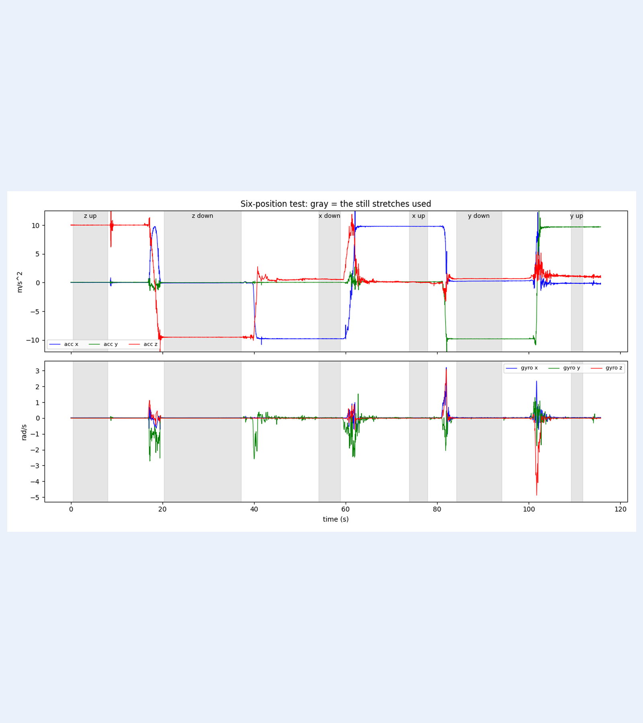
4. REPRODUCIBLE SIX-POSITION CALIBRATION (FIGURE 01)
Six-position calibration fits accel bias and scale within 0.01 m/s² of cross-checks
Six-hold static test (~15 s/axis): Phone held still with z, x, y axes pointing up and down; resting vector norm must equal 1 g (9.80665 m/s²).
Low-wiggle still detector: Still stretches found by low signal wiggle (not vector length, since an uncalibrated sensor is off by design), trimmed 0.5 s each end.
Fitted accel bias & scale (x, y, z): Bias: +0.0053, -0.0447, +0.2462 m/s² (dominant z bias ~0.25 m/s²). Scale: 0.9985, 0.9966, 0.9952.
Fitted gyro bias & noise densities: Gyro bias (x, y, z): +0.0244, +0.0076, -0.0071 rad/s (varies <= 0.0029 rad/s across holds). Noise: accel 2.24e-3 m/s²/sqrt(Hz), gyro 5.1e-4 rad/s/sqrt(Hz).
Duration limit on y-axis: The y-up hold lasted only ~2.5 s (shortest window in Figure 01), slightly limiting y-axis precision.
Team Pineapple | Section 4 & Figure 01: Six-Position Calibration (5/25)
Notes:
Figure 01 shows our six-position calibration test where we held the phone still with each axis pointing up and down for about 15 seconds, finding still stretches by low wiggle rather than vector length. Least-squares fitting found a large +0.2462 m/s² bias on the z-axis and a mean gyro bias over all still stretches. Note that the y-up hold lasted only about 2.5 seconds, which slightly limits how well the y-axis is determined.

Slide 6
4. CALIBRATION VERIFICATION & OPENLY STATED GAPS
Independent per-axis formulas confirm least-squares biases within 0.01 m/s²
Calibration Check Metric | x-axis | y-axis | z-axis
Bias: least-squares fit (m/s²) | 0.0053 | -0.0447 | 0.2462
Bias: (up + down) / 2 (m/s²) | 0.0065 | -0.0577 | 0.2461
Scale: least-squares fit | 0.9985 | 0.9966 | 0.9952
Scale: (up - down) / (2g) | 0.9980 | 0.9940 | 0.9951
Pre-cal norm err: up / down | -0.012 / -0.009 | -0.053 / +0.025 | +0.199 / -0.294
Norm RMS: before -> after | 0.147 m/s² | -> | 0.0000 m/s²
Why 'after = 0' is not proof: Six static positions solve six unknowns exactly by construction; the true check is the per-axis formula (agrees to ~0.01 m/s² and 0.003).
Gap 1 — Accel misalignment: Not calibrated. Six static holds cannot determine off-diagonal crooked-axis terms named in the Core tier.
Gap 2 — Gyro scale & misalignment: Not calibrated (no known-rate turntable test); only static gyro bias is removed.
Gap 3 — Processed phone signal: The smartphone outputs a pre-processed accelerometer stream rather than raw sensor counts.
EuRoC calibration handling: Phone table is NOT applied to EuRoC; gyro bias uses a startup window (wiggle 0.158 m/s²) and ESKF learns biases online.
Team Pineapple | Section 4: Cross-Check Table & Calibration Limitations (6/25)
Notes:
Because six static positions determine six unknowns exactly, getting zero residual error after calibration proves nothing by itself. Our real verification is the independent per-axis formula cross-check on the left, which agrees with least squares to about 0.01 m/s² in bias and 0.003 in scale. On the right, we state our calibration gaps openly: we did not calibrate accelerometer misalignment or gyro scale because six static holds cannot observe off-diagonal axis coupling or rotation scale factors.

Slide 7
5. STAGED FILTER DESIGN (STAGES A, B, C, E)
Five incremental filter stages isolate tilt control, ZUPT, ESKF, and de-drift
Pipeline Stage | Mode | Algorithmic Mechanism & Exact Thresholds
Stage A: Plain Integration | Real-time | Rotate accelerometer into room frame using gyro orientation, subtract g, integrate twice (trapezoid rule). Errors grow as t².
Stage B: Mahony Filter | Real-time | Integrate gyro, pull tilt toward 'up' using accelerometer when norm is near g (gain Kp = 0.5). Stops tilt drift.
Stage C: Zero-Velocity (ZUPT) | Real-time | When gyro < 0.05 rad/s and |accel - g| < 0.3 m/s² for >= 0.2 s, clamp velocity directly to zero.
Stage D: 15-State ESKF | Real-time | Fuses gravity updates, still updates, and optional gated position fixes while learning 3D accel & gyro biases online.
Stage E: Leg De-Drift | NOT real-time | Velocity at both ends of a stop-to-stop leg is truly zero, so end-of-leg velocity is pure error; removes constant accel error over each leg.
Team Pineapple | Section 5: Incremental Filter Stages A–E (7/25)
Notes:
Rather than presenting a black-box filter, we built five stages from plain trapezoid-rule double integration up to leg de-drift. Stage B uses a Mahony filter with gain Kp equal to 0.5 so gravity keeps roll and pitch from drifting. Stage C clamps velocity to zero whenever the gyro is below 0.05 rad/s and acceleration is within 0.3 m/s² of gravity for at least 0.2 seconds. Stage E removes residual end-of-leg velocity error after the next stop is detected, which gives our lowest stop errors but is not real-time.

Slide 8
5. STAGE D DEEP DIVE: 15-STATE ERROR-STATE KALMAN FILTER
The 15-state ESKF learns sensor biases online using gated gravity and stop updates
Core IMU-Only ESKF Mechanics
15 error states (3 each): Position, velocity, orientation (roll/pitch/yaw tilt), accelerometer bias, and gyroscope bias.
Gravity update (<= 2 Hz): Fixes tilt & learns accel bias only when not accelerating (|a - g| < 0.5 m/s², filter accel < 1.0 m/s², at most every 0.5 s).
Still update at stops (ZUPT): Forces velocity = 0 (sigma = 0.02 m/s) and treats gyro reading as gyro bias (sigma = 0.01 rad/s); requires window accel std < 0.15 m/s².
Gates, Tuning & Startup Correlation
Optional position-fix gate: Used only for declared floor marks (sigma = 0.05 m) or simulated EuRoC aids (sigma = 0.10 m) with a 99% chi-square outlier gate.
Noise inflation (engineering guess): Datasheet noise inflated x20 (accel) and x10 (gyro) to cover vibration and model error — tuned by judgement, not fitted.
Startup tilt-bias correlation: Initial tilt comes from the same still accel reading as bias; one virtual measurement seeds the covariance with the exact correlation.
Team Pineapple | Section 5: 15-State ESKF Equations, Gates & Tuning (8/25)
Notes:
Slide 8 details the internal design of our 15-state error-state Kalman filter. On the left, the filter updates itself without external aids using gravity direction at most every 0.5 seconds when acceleration is quiet, and still updates at stops where velocity is zeroed with 0.02 m/s uncertainty and gyro bias is updated with 0.01 rad/s uncertainty. On the right, we note two crucial practical details: we inflated white-noise densities by 20 times on the accelerometer and 10 times on the gyro as engineering guesses to handle vibration, and we apply one virtual measurement at startup so the covariance matrix knows initial tilt and accelerometer bias are correlated.

Slide 9
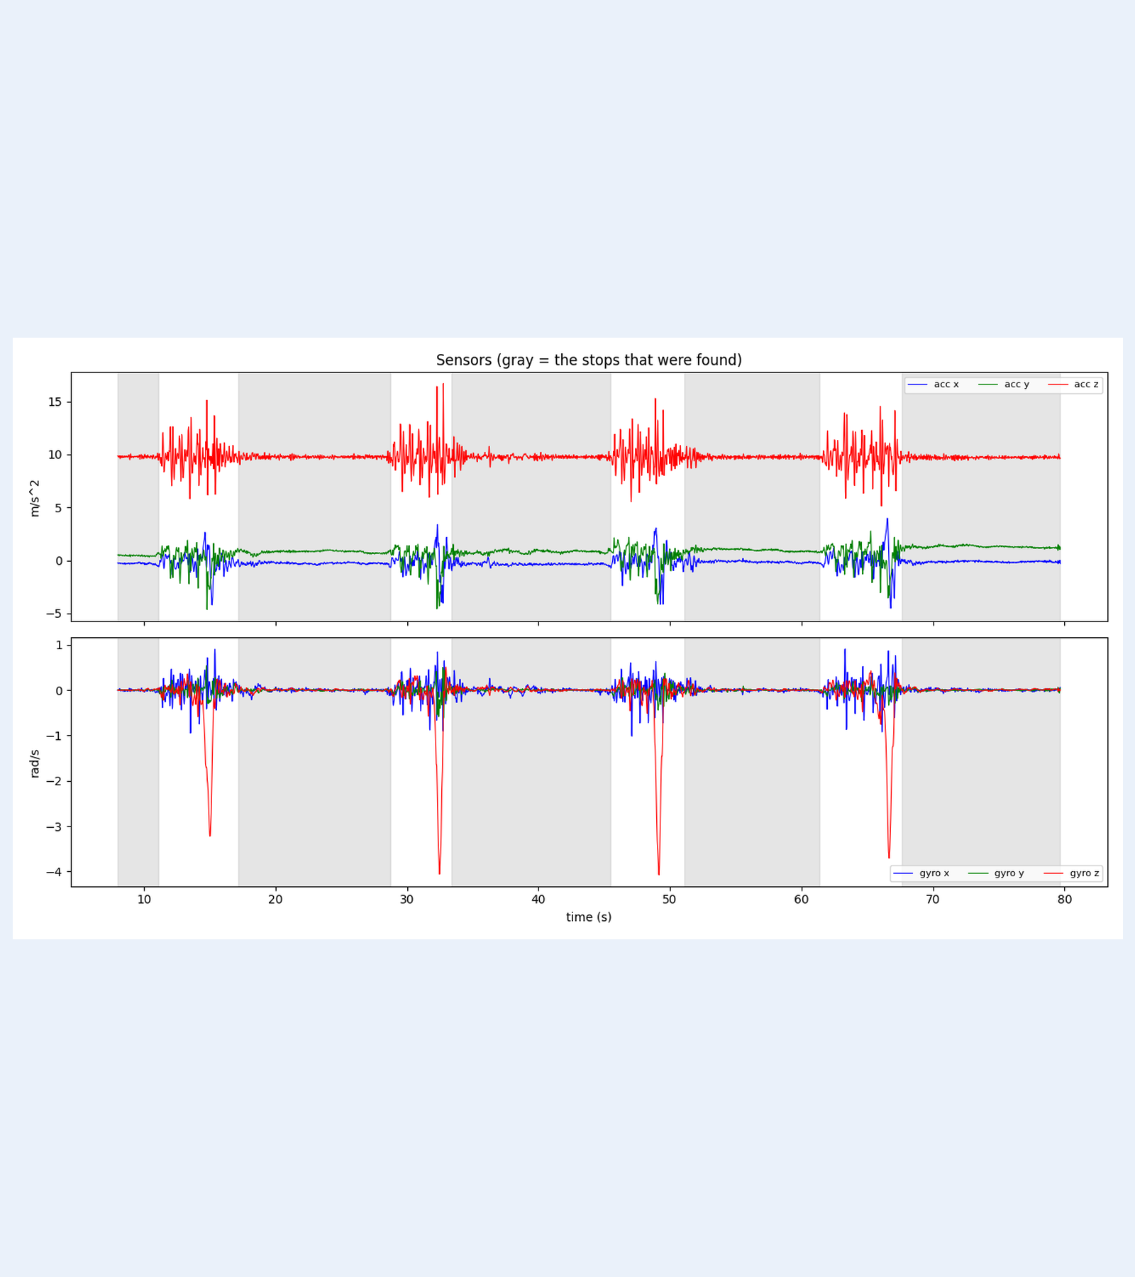
3 & 6. SMARTPHONE TEST SETUP & STOP DETECTION (FIGURE 03)
A 9.36 m five-stop square phone walk at 60 Hz tests corner stop accuracy
Recording & path: Smartphone IMU resampled to 60 Hz; 79.7 s duration (4,782 samples). Tape-measured 2.34 m square sides = 9.36 m total path.
Five detected stops (shaded gray): Requires still stretch >= 0.8 s and bridges hand-tremor blips <= 1.0 s: found at 8.0–11.1 s, 17.2–28.7 s, 33.4–45.5 s, 51.1–61.4 s, and 67.6–79.7 s.
Four 90° corner turns: Visible as four sharp negative dips in gyro-z (bottom panel of Figure 03) between the stationary gray windows.
Ground-truth evaluation rule: True position is known only at the 5 corners (read 0.3 s after arriving at each stop), not continuously along legs.
Fitted heading limitation: With no magnetometer, the first leg's room heading is fitted from our data (71°, fit quality 0.99), making stop errors slightly flattering.
Team Pineapple | Figure 03: Phone Sensor Traces & Stops (9/25)
Notes:
For our smartphone experiment, we walked a tape-measured 2.34 m square—9.36 m in total—recording 4,782 samples at 60 Hz over 79.7 seconds. Figure 03 shows the raw accelerometer and gyroscope signals with the five detected corner stops shaded in gray, and the four 90-degree turns clearly visible as four sharp negative spikes in gyro z. We score position error 0.3 seconds after arriving at each corner, and we state openly that fitting the first leg's 71-degree heading from the data makes stop errors slightly flattering.

Slide 10
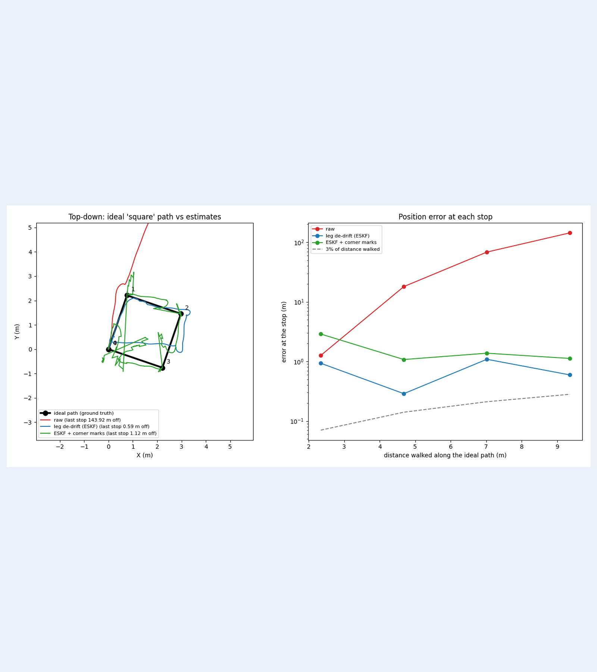
6. PHONE TRAJECTORY VS IDEAL SQUARE (FIGURE 04)
Staged filtering and leg de-drift cut walk end error from 211 m to 0.59 m
Raw double integration drift: Drifts to 143.92 m off at Stop 4 (mean stop error 57.91 m) and ends 211 m from the start by the end of the recording.
Best honest run — leg de-drift (ESKF): Reaches 0.59 m final return-to-start error (6.3% of path) and 0.72 m mean stop error (7.7% of path); stops 1–4 = 0.93, 0.29, 1.09, 0.59 m.
Real-time ESKF (no aiding): Achieves 1.15 m final stop error (12.2%) and 1.68 m mean stop error (stops 1–4 = 2.88, 1.42, 1.27, 1.15 m).
Marks run instability: ESKF + corner marks ended at 0.29 m in one configuration and 1.12 m in another with sharp pull spikes; we report 1.12 m honestly.
Wobbly square leg lengths (vs 2.34 m): ESKF: 0.78, 1.91, 0.90, 0.83 m | De-drift (Mahony): 1.69, 2.13, 1.21, 2.93 m | De-drift (ESKF): 2.43, 1.67, 1.32, 2.57 m (~1 m inconsistency).
Team Pineapple | Figure 04: Top-Down Paths & Leg Lengths (10/25)
Notes:
Figure 04 compares the ideal 2.34 m square against our raw run, our ESKF leg de-drift run, and the corner-marks run. While raw integration flies off to 143.92 m at the final stop and 211 m by the end of the file, ESKF leg de-drift returns to within 0.59 m of the start and averages 0.72 m across all four corners. However, even when stop errors look good, individual leg lengths for ESKF leg de-drift are 2.43, 1.67, 1.32, and 2.57 m instead of 2.34 m, forming a rough, wobbly square.

Slide 11
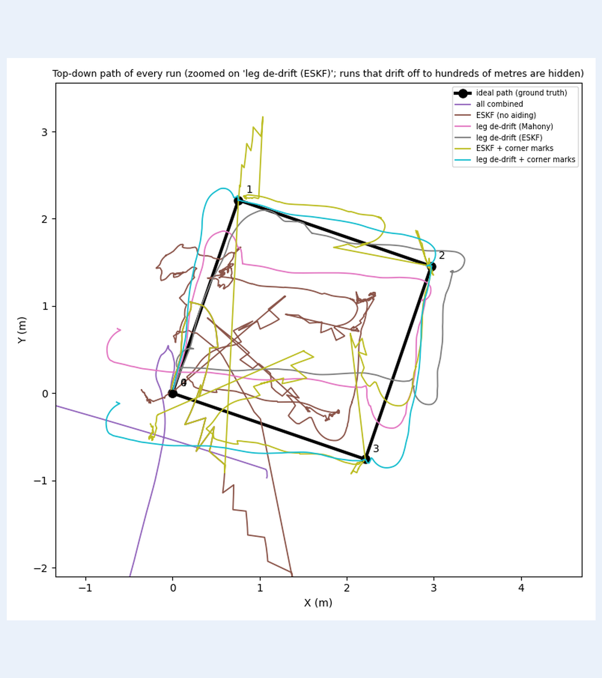
6. STAGE-BY-STAGE CONTRIBUTION ANALYSIS (FIGURE 05)
Combining Mahony, ZUPT, ESKF, and de-drift cuts mean error from 57.91 m to 0.72 m
Bias removal alone worsened drift: Mean error rose from 57.91 m (raw) to 318.44 m (797.78 m end) because uncompensated tilt leaks gravity.
Mahony + ZUPT synergy: Mahony (67.82 m) holds tilt; ZUPT (29.08 m) caps stop velocity; combined drops mean error to 7.21 m (1.96 m end = 20.9%).
Real-time 15-state ESKF: Learns biases online, cutting mean error to 1.68 m (1.15 m end = 12.2%) across 1,370 still-updates (0 rejected).
Per-leg de-drift & internal checks: Cuts mean error to 0.77 m (Mahony) and 0.72 m (ESKF, 0.59 m end = 6.3%); final tilt check is 0.66° (<2°), fit quality 0.99.
Team Pineapple | Figure 05: Every-Run Overlay & Stage Breakdown (11/25)
Notes:
Slide 11 pairs the zoomed overlay of every bounded run in Figure 05 with what each stage contributed. Removing static bias by itself actually made double integration worse—318.44 m mean error—showing how sensitive un-aided integration is to residual tilt. Mahony and ZUPT together cut the final error from 1538% down to 20.9% of the path, online bias learning in the real-time ESKF brought mean stop error down to 1.68 m, and post-stop leg de-drift halved it to 0.72 m.

Slide 12
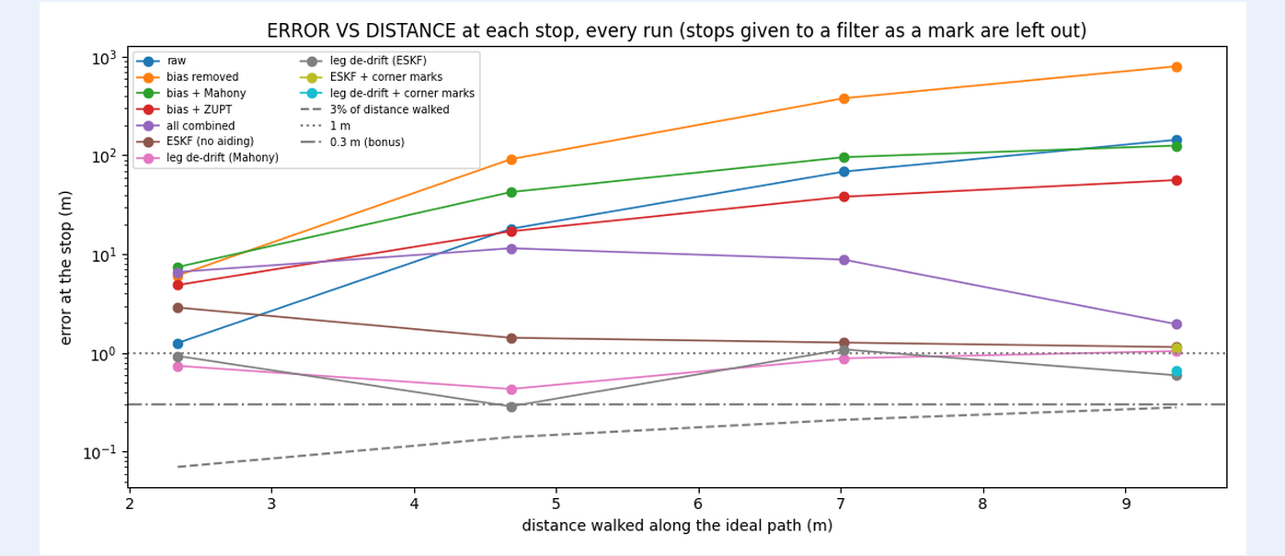
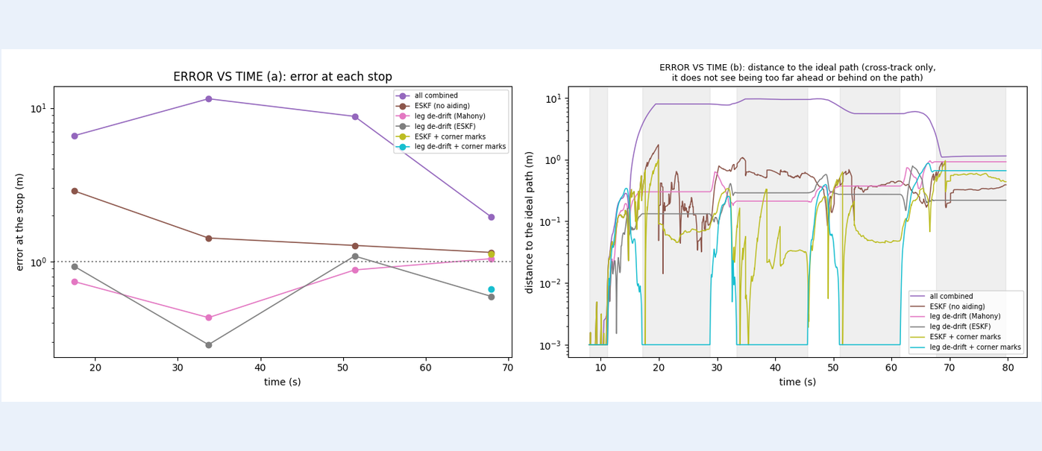
6. ERROR VS DISTANCE & TIME AGAINST TIER LINES (FIGURES 06 & 07)
Stop resets keep phone-walk errors near 0.3 to 1.1 m, but the 3% target (0.28 m) is missed
Core tier (<1 m in first 30 s): At Stop 1 (~17.2 s), leg de-drift passes at 0.74 m (Mahony) and 0.93 m (ESKF); real-time unaided ESKF is 2.88 m (fails Core, then converges to 1.15 m).
Main (3% = 0.28 m) & Bonus (<0.3 m): Best final error 0.59 m (6.3%) misses 0.28 m; independent Stop 4 with floor marks is 1.12 m (ESKF) and 0.66 m (de-drift) — both missed.
Start-time robustness check: Shifting filter start from 2.0 s (handled) to 8.0 s (still window) changes best mean stop error by only 0.04 m (0.68 m -> 0.72 m).
Team Pineapple | Section 6 & Figures 06–07: Error vs Distance & Time (12/25)
Notes:
Figures 06 and 07 plot stop error against distance walked and time alongside the 1 m Core, 3% Main, and 0.3 m Bonus lines. Why didn't we hit the 3% Main target? Because our test path was 9.36 m rather than 50 m, 3% at the end is only 0.28 m, which our best 0.59 m result misses. We also checked start-time sensitivity: moving the start from 2.0 seconds to 8.0 seconds changed the best mean error by just 0.04 m, confirming that initial handling is not the dominant error source.

Slide 13
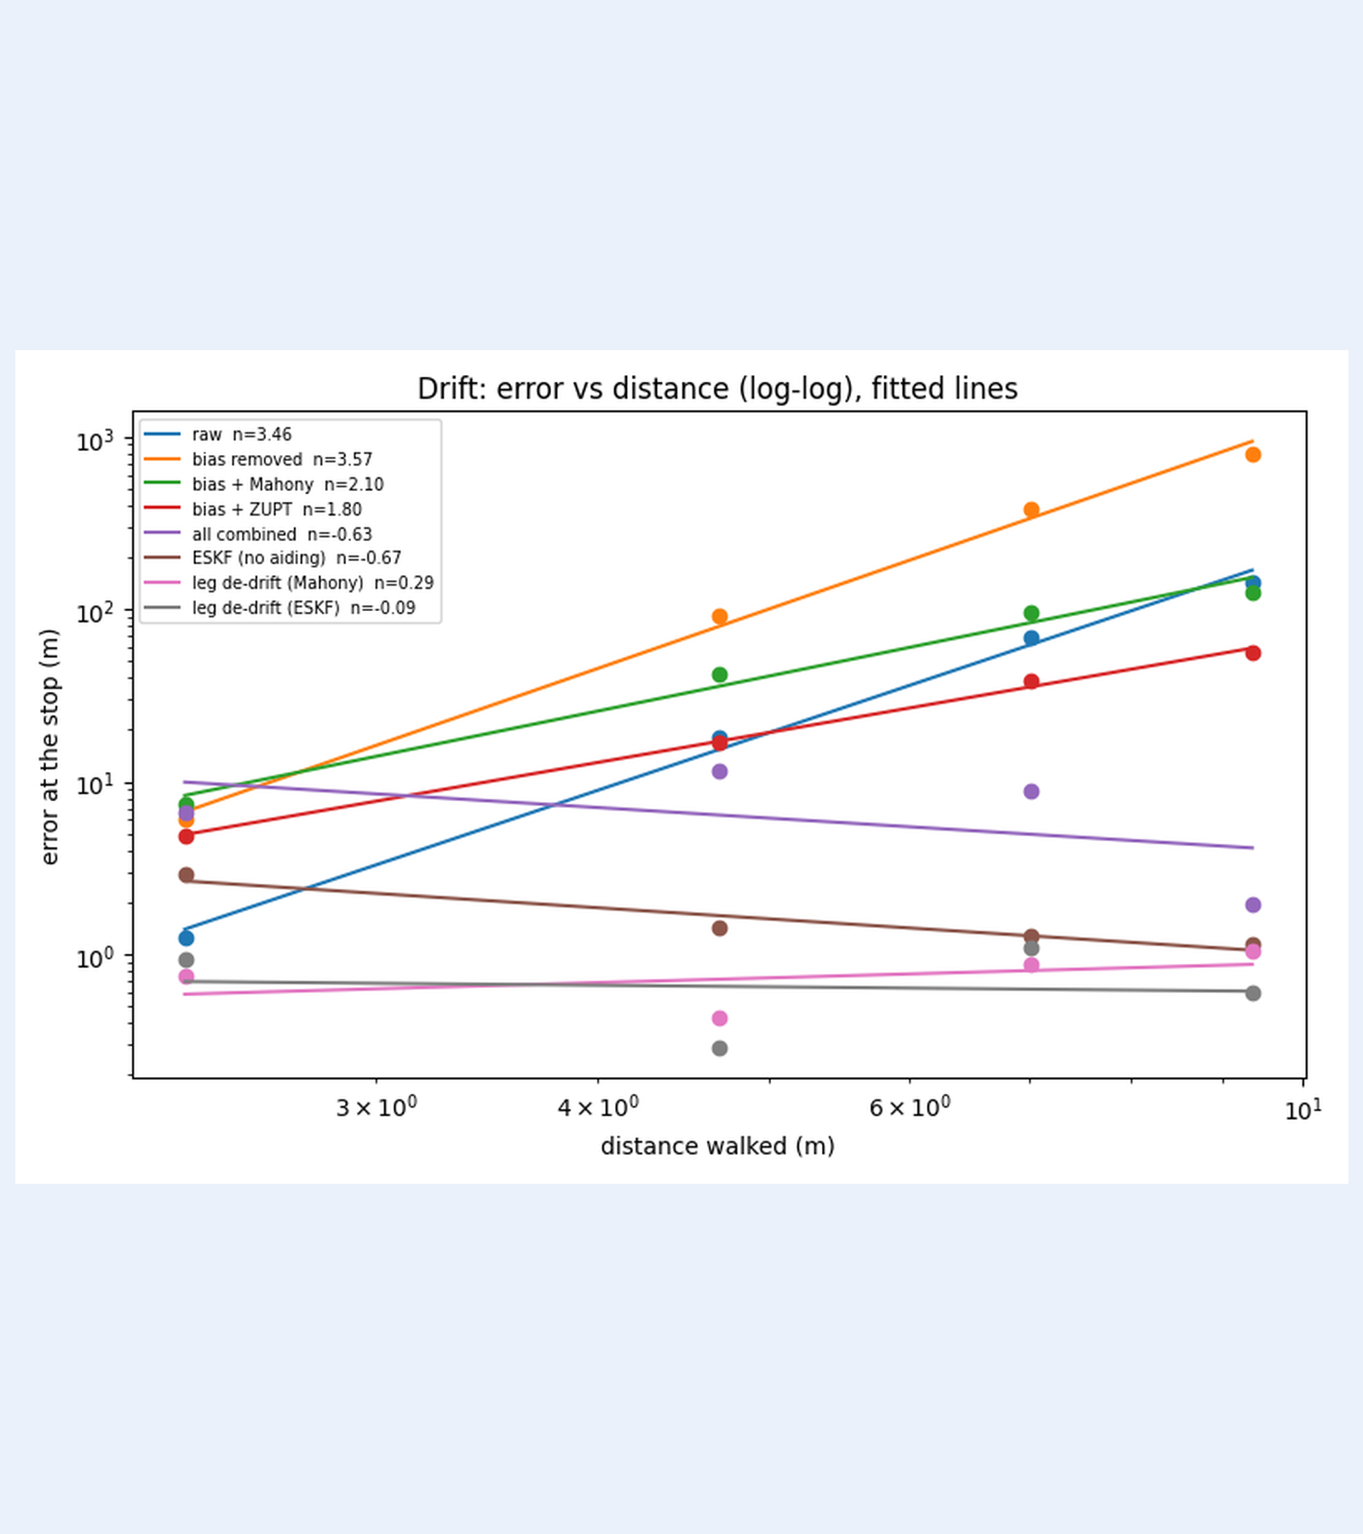
9. SHORT DRIFT ANALYSIS: LOG-LOG POWER-LAW FITS (FIGURE 09)
Stop updates flatten distance drift exponent near zero; unaided drone grows near t²
Power-law model (error = c · d^n): n ≈ 1 indicates steady velocity error; n ≈ 2 constant acceleration or tilt leakage; n > 2 growing tilt error.
Phone plain runs (calibrated [cal off]): raw n = 3.46 [3.42], bias removed 3.57 [3.65], bias + Mahony 2.10 [2.12], bias + ZUPT 1.80 [1.88].
Stop-reset runs flatten n near zero: all combined -0.63 [-0.64], ESKF -0.67 [-0.67], de-drift (Mahony) 0.29 [0.28], de-drift (ESKF) -0.09 [0.01] — stops prevent error growth with distance.
EuRoC unaided time exponents (t^n): raw 2.23, bias removed 2.59 (6.5° tilt), Mahony 1.85 (0.26° tilt — proves tilt control matters), ZUPT 2.60, all combined 1.86, ESKF 2.13.
Four sources of remaining ~0.7 m error: (a) Unmodelled accel misalignment & gyro scale, (b) turn yaw drift, (c) hand motion at stops, (d) processed phone accel signal.
Team Pineapple | Figure 09: Power-Law Drift Exponents (13/25)
Notes:
Section 9 fits error as distance or time to the power n. An exponent near 2 indicates constant acceleration or tilt leakage under double integration, while n above 2 means tilt error itself is growing. On both the phone and EuRoC, adding Mahony drops n from above 2.5 down to about 1.85 to 2.10—the clearest evidence in our data that holding tilt matters. On the phone walk, adding ZUPT and ESKF drives n to between -0.67 and +0.29 because every stop resets velocity error, leaving about 0.7 m from misalignment, turn yaw drift, and hand motion.

Slide 14
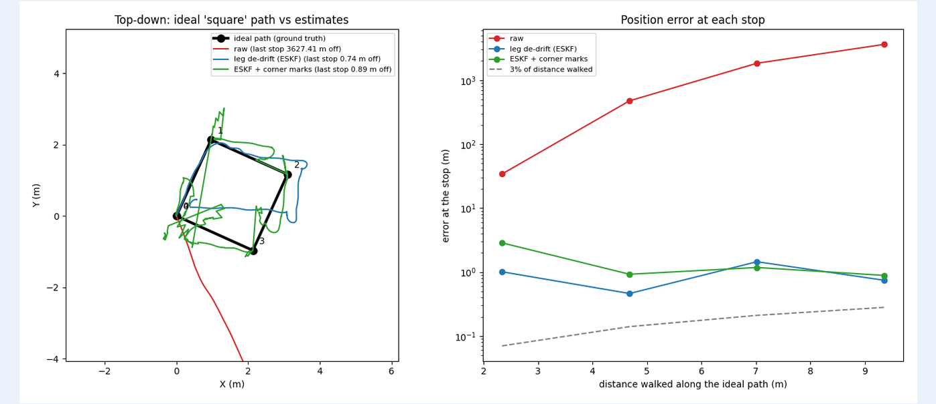
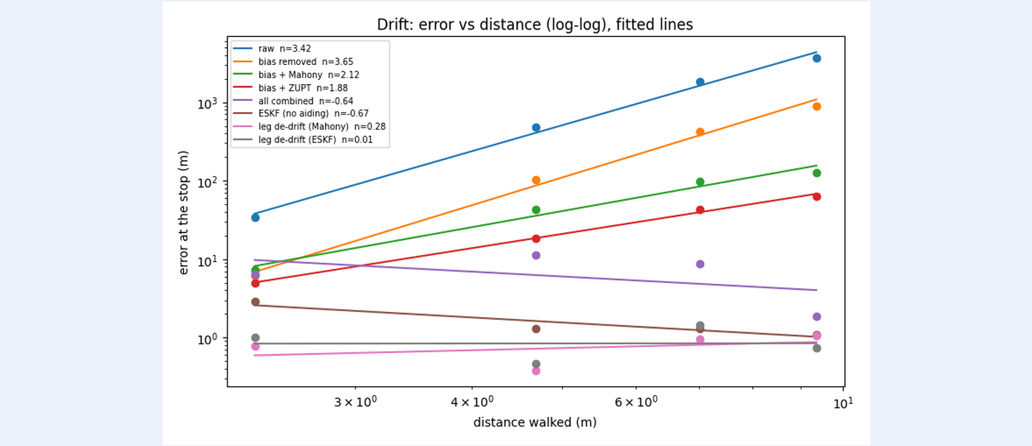
6. EFFECT OF OFFLINE CALIBRATION: CALIBRATION OFF STUDY (FIGURES 10 & 11)
Offline calibration makes raw 25× better, while self-calibrating filters barely change
Raw run is 25x worse without calibration: Mean stop error jumps from 57.91 m to 1493.84 m (final stop 143.92 m -> 3627.41 m) because the resting phone reads 9.995 m/s² instead of 9.81 m/s².
Filtered runs calibrate themselves online: Mean error barely changes: all combined 7.21 -> 7.08 m; unaided ESKF 1.68 -> 1.64 m (final 1.15 -> 1.10 m); de-drift (Mahony) 0.77 -> 0.80 m.
Honest note — ESKF Core pass is marginal: Best run (leg de-drift ESKF) shifts from 0.72 m to 0.92 m mean error without calibration, and its Stop 1 error moves from 0.93 m to 1.01 m (missing 1 m Core by 0.01 m).
Team Pineapple | Section 6 & Figures 10–11: Calibration On vs Off Comparison (14/25)
Notes:
Figures 10 and 11 show what happens when we re-run the exact same phone recording with offline calibration switched off. The raw run becomes 25 times worse—ending 3,627 m away—because the uncalibrated z-axis reads 9.995 m/s² at rest. By contrast, the filtered runs hardly move because they estimate gyro bias and gravity from the startup window, learn accelerometer bias online, and zero velocity at every stop. However, without calibration, leg de-drift ESKF reaches 1.01 m at Stop 1, missing Core by 1 cm and proving its Core pass is marginal.

Slide 15
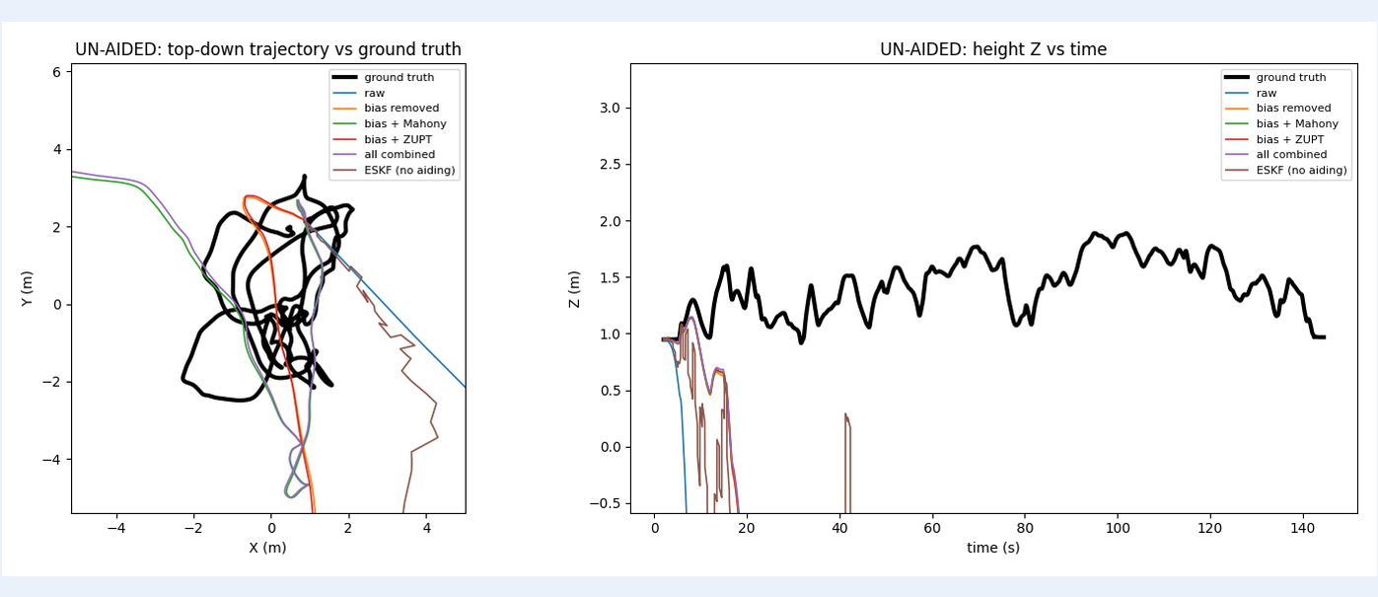
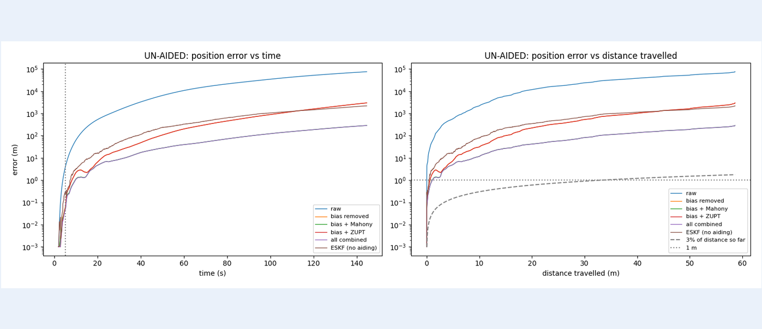
8. EUROC V1_01 DRONE DATASET: UN-AIDED RUNS (FIGURES 12 & 13)
On the 58.58 m EuRoC flight, even the best unaided run ends 287 m away; simulated UWB reaches 0.16 m
Setup & best-case alignment: 58.58 m flight over 145 s (motion starts at 5.2 s). Unaided runs had heading matched to ground truth over the first 30 s; offline phone calibration table is OFF.
All unaided runs fail every tier: At 30 s / End: raw = 2256 m / 75,323 m; bias removed = 31.97 m / 2979 m; bias + Mahony = 11.97 m / 287.73 m; all combined = 11.89 m / 286.84 m.
Why unaided ESKF (80.51 m @30s, 2194.80 m end) trails Mahony: The flying drone never stops! The stop test passed on only 1% of samples (101 still-updates total), so ZUPT cannot clamp velocity drift in flight.
Team Pineapple | Section 8 & Figures 12–13: EuRoC V1_01 Unaided Trajectories & Errors (15/25)
Notes:
We next evaluated our pipeline on the 58.58 m, 145-second EuRoC V1_01 drone flight with real ground truth. Even with best-case heading alignment over the first 30 seconds, every unaided run fails all tiers, with Mahony ending 287 m away. Why is the unaided ESKF worse than Mahony on the drone—80.5 m versus 12.0 m at 30 seconds? Because a flying drone never stops: the stop test passed on only 1% of samples and applied just 101 still-updates, so zero-velocity updates do nothing here.

Slide 16
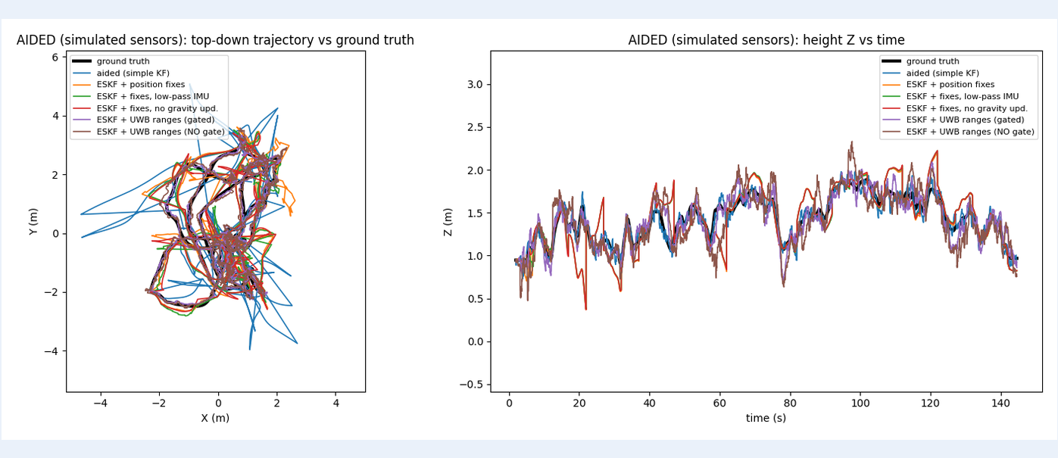
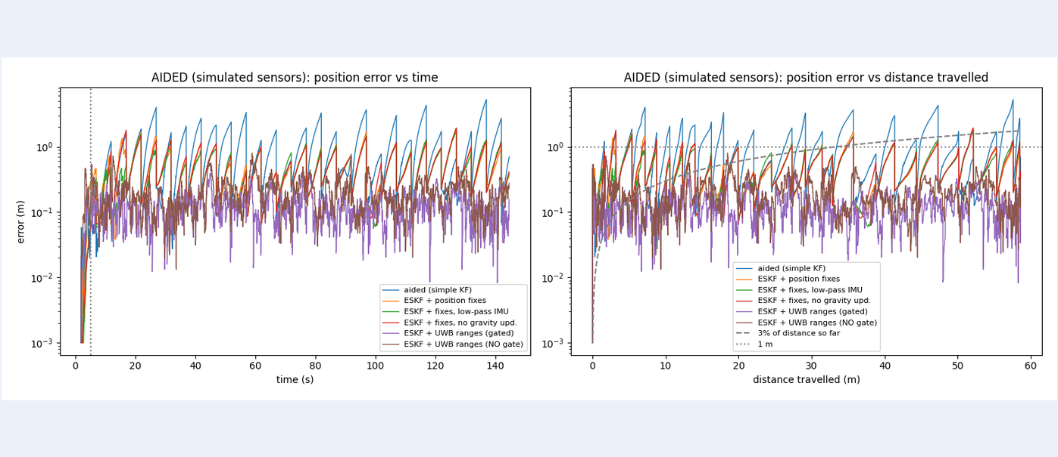
8. EUROC V1_01 AIDED RUNS — SIMULATED SENSORS ONLY (FIGURES 14 & 15)
Simulated 5 s position fixes and gated UWB cut EuRoC end error to 0.36 m and 0.16 m
SIMULATED position fixes (every 5 s, sigma = 0.10 m): ESKF + fixes achieves 0.34 m at 30 s (Core PASS) and 0.36 m end error = 0.6% of path (Main PASS), but saw-tooth drift between fixes hits 1.95 m max (Bonus FAIL).
Filter ablations with simulated fixes: Low-pass IMU reaches 0.33 m @30s / 0.39 m end (1.73 m max); removing the gravity update degrades @10s error from 0.43 m to 0.85 m (0.41 m end).
Best run — SIMULATED UWB ranges (gated): Reaches 0.08 m @30s, 0.16 m end (0.3%), 0.12 m mean, 0.24 m 95th pct, and 0.43 m max — missing the 0.3 m Bonus limit by 0.13 m.
Team Pineapple | Section 8 & Figures 14–15: EuRoC Aided Runs (Simulated Sensors) (16/25)
Notes:
Figures 14 and 15 show the aided EuRoC runs, where we state clearly that all position fixes, UWB ranges, and barometer readings are simulated from ground truth plus noise. With simulated 5-second position fixes, the ESKF passes Core at 0.34 m and Main at 0.36 m or 0.6% of the path, though error grows in a saw-tooth pattern up to 1.95 m between fixes. With gated simulated UWB ranges, mean error drops to 0.12 m and end error to 0.16 m, but the maximum error of 0.43 m still misses the 0.3 m Bonus target by 0.13 m.

Slide 17
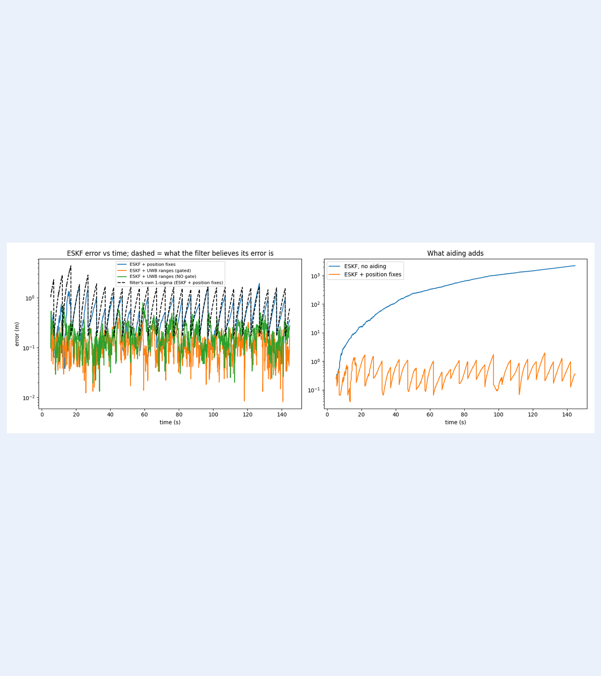
8. FILTER UNCERTAINTY CALIBRATION & OUTLIER GATE (FIGURE 16)
ESKF 1-sigma bounds actual error while chi-square gating cuts UWB peak error in half
Filter knows its uncertainty: In Figure 16 (left), the black dashed 1-sigma envelope for ESKF + simulated fixes tracks the 5 s saw-tooth growth and stays mostly above actual error.
Chi-square 99% outlier gate: On simulated UWB ranges (with blocked readings), the gate rejected 297 outliers, cutting max error from 0.80 m (no gate) to 0.43 m (gated) and end error from 0.28 m to 0.16 m.
What aiding adds (right panel): Comparing unaided ESKF (blue, drifting to 2,195 m) vs simulated fixes (orange, <2 m) shows continuous flight requires outside fixes.
Remaining EuRoC limits: Online y-accel bias stays underestimated (0.13 vs 0.55 m/s²), leaving 2.45° mean tilt error and ~10° final yaw drift (Appendix A2).
Team Pineapple | Figure 16: 1-Sigma & Outlier Gate (17/25)
Notes:
Figure 16 demonstrates two key filter properties on EuRoC. First, the black dashed curve shows what the ESKF believes its own 1-sigma position error is during the 5-second position-fix run; it rises between fixes, drops at each update, and mostly stays above the actual error, showing the covariance is well calibrated. Second, the 99% chi-square outlier gate rejected 297 corrupted simulated UWB range readings, reducing the maximum error from 0.80 m without gating down to 0.43 m.

Slide 18
10 & 12. LIVE / RECORDED DEMO & REAL-TIME EMBEDDED CONSIDERATIONS
Five Colab cells in order reproduce calibration, filtering, scoring and the result plots
Live / Recorded Demo Workflow
1. Setup & 2. Calibration cells: Mounts Drive, unzips EuRoC, runs 6-position least-squares & per-axis cross-check, writes calibration.json (Figure 01).
3. Cell 1 (Core Filter Engine): Loads 60 Hz data, finds 5 stops (STOP_MIN_S=0.8, STOP_BRIDGE_S=1.0), runs Stages A–E, prints health checks.
4. Cell 2 & 5. Cell 3 (Scoring & Plots): Runs corner marks (MARK_SIGMA=0.05) and simulated EuRoC aids (SEED=0), then renders all 18 report figures.
Embedded Implementation Assessment
Sample-by-sample 60 Hz structure: The ESKF processes one sample at a time using fixed-size 15x15 matrices at 60 Hz, making a microcontroller port plausible.
Honest embedded status: NOT implemented or tested on a microcontroller; all runs execute in floating-point Python in Google Colab.
What a fixed-point MCU port needs: Requires scaling the 15x15 covariance matrix, replacing matrix solve with fixed-operation updates, and verifying numerical stability.
Team Pineapple | Sections 10 & 12: Demo Placeholder & Microcontroller Feasibility (18/25)
Notes:
This slide serves as our demonstration anchor and covers Section 10 on embedded considerations. In Google Colab, five sequential cells run everything from calibration.json generation to all 18 plots with fixed random seed zero. Regarding the embedded criterion: our ESKF processes one sample at a time at 60 Hz with fixed 15 by 15 matrices, so a microcontroller port is plausible, but we state clearly that we did not implement or test fixed-point hardware—that remains future work.

Slide 19
7. HONEST PERFORMANCE TIER SCORECARD (SECTION 7)
Core passed only with non-real-time leg de-drift; Main and Bonus were not met, with or without floor marks
Tier | Problem Statement Target | Team Pineapple Honest Assessment
Core | Calibrate bias, scale, misalignment; orientation; error < 1 m in first 30 s | Bias & scale calibrated; misalignment NOT calibrated. Phone: PASSED by non-real-time leg de-drift (0.74 m Mahony, 0.93 m ESKF — marginal: 1.01 m w/o cal); FAILED by real-time unaided ESKF (2.88 m). EuRoC: passed only with simulated aids.
Main | Position error <= 3% on marked 50 m path (~1.5 m), return-to-start reported | NOT MET. Walked path was 9.36 m (3% = 0.28 m); best final stop error 0.59 m (6.3%). No 50 m path available. EuRoC reaches 0.6% (0.36 m on 58.58 m) only with simulated fixes.
Bonus | Add low-cost aid < 0.3 m, or run fixed-point on a microcontroller | NOT MET. With floor marks, independent Stop 4 error was 0.66 m (de-drift) and 1.12 m (ESKF); simulated gated UWB max was 0.43 m. No microcontroller port was done.
Team Pineapple | Section 7: Honest Performance Tier Scorecard (19/25)
Notes:
Slide 19 presents our honest tier scorecard from Section 7 of the report. We passed the 1 m Core target on the phone walk only with non-real-time leg de-drift at 0.74 m and 0.93 m, while our real-time unaided ESKF had 2.88 m error at the first stop. Neither Main nor Bonus was met in hardware: our 9.36 m path meant 3% was just 0.28 m compared to our 0.59 m best final stop, floor marks ended at 0.66 m, simulated UWB had a 0.43 m maximum, and no microcontroller port was built.

Slide 20
1, 11 & 13. DELIVERABLE TRACKER, EXPERIMENTAL LIMITATIONS & NEXT STEPS
Every required deliverable is verified while six experimental limitations guide future work
Problem-Statement Deliverable Tracker
Code & calibration procedure: Slides 5–6, 18 & Figure 01 (least-squares + per-axis cross-check, 5-cell Colab reproduction).
Trajectory plots vs ground truth: Phone walk: Slides 10–11 (Figures 04, 05). EuRoC drone flight: Slides 15–16 (Figures 12, 14).
Error vs time & distance + drift: Phone: Slides 12–14 (Figures 06, 07, 09, 10, 11). EuRoC: Slides 15–17 (Figures 13, 15, 16).
Filter design, exact aids & embedded: Slides 3–4, 7–8 (Figure 02), Slide 18 (embedded not implemented; stated openly).
Limitations & Future Work
Single recording (~0.1 m noise floor): Only one phone recording was evaluated (no error bars); differences of ~0.1 m are within noise.
Parameters tuned on this recording: Noise inflation factors (x20/x10), gates, and thresholds were chosen by judgement while inspecting this dataset (risk of overfitting).
Corner-only truth & fitted 71° heading: Ground truth is 4 tape-measured corners on a 9.36 m path (not 50 m), with initial heading fitted from data.
Concrete next steps: (1) Multi-orientation misalignment calibration, (2) 50 m marked course, (3) foot-mounted IMU for every-step ZUPTs, (4) fixed-point 15x15 MCU port.
Team Pineapple | Sections 1, 11 & 13: Deliverables, Limitations & Next Steps (20/25)
Notes:
Slide 20 maps every deliverable required by the problem statement on the left and states our experimental limitations and next steps on the right. Are our parameters overfit? Possibly—because we chose our noise inflation factors, gates, and stop thresholds by engineering judgement while inspecting this single recording, reported errors may be optimistic for new data, and differences of about 0.1 m are within noise. Calibrating misalignment, testing on a 50 m path with a foot-mounted sensor, and implementing a fixed-point port are our next steps.

Slide 21
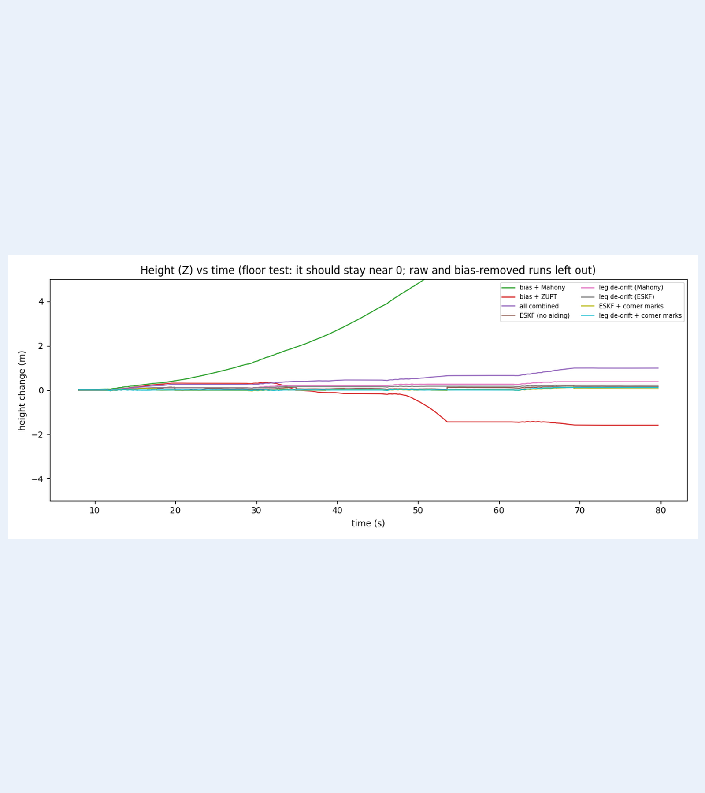
APPENDIX A1. PHONE WALK VERTICAL STABILITY CHECK (FIGURE 08)
Height should stay near zero on a floor walk; this plot checks it
Flat-floor ground truth (Z ≈ 0 m): Because the 9.36 m square walk was performed on a level floor, vertical displacement Z provides a continuous sanity check that requires no horizontal truth.
Unbounded runs omitted from scale: Raw and bias-removed runs drift hundreds to thousands of metres vertically because the uncalibrated z-axis bias is +0.2462 m/s².
Mahony vs ZUPT alone: Bias + Mahony (green) still climbs past +5 m without velocity resets; Bias + ZUPT (red) drifts to about -1.6 m.
Combined, ESKF & de-drift stability: All combined (purple), unaided ESKF (brown), leg de-drift, and corner-mark runs clamp vertical velocity at every stop and hold Z near 0 m across all 80 s.
Team Pineapple | Appendix A1 & Figure 08: Height Z vs Time (21/25)
Notes:
In Appendix A1, Figure 08 checks vertical position Z over the 80-second flat-floor walk. Raw and bias-removed runs drift far off scale and are omitted. Even with Mahony orientation correction, vertical position climbs past 5 m without zero-velocity updates, whereas combining tilt correction with ZUPT in the ESKF and leg de-drift keeps vertical height tightly bounded near zero.

Slide 22
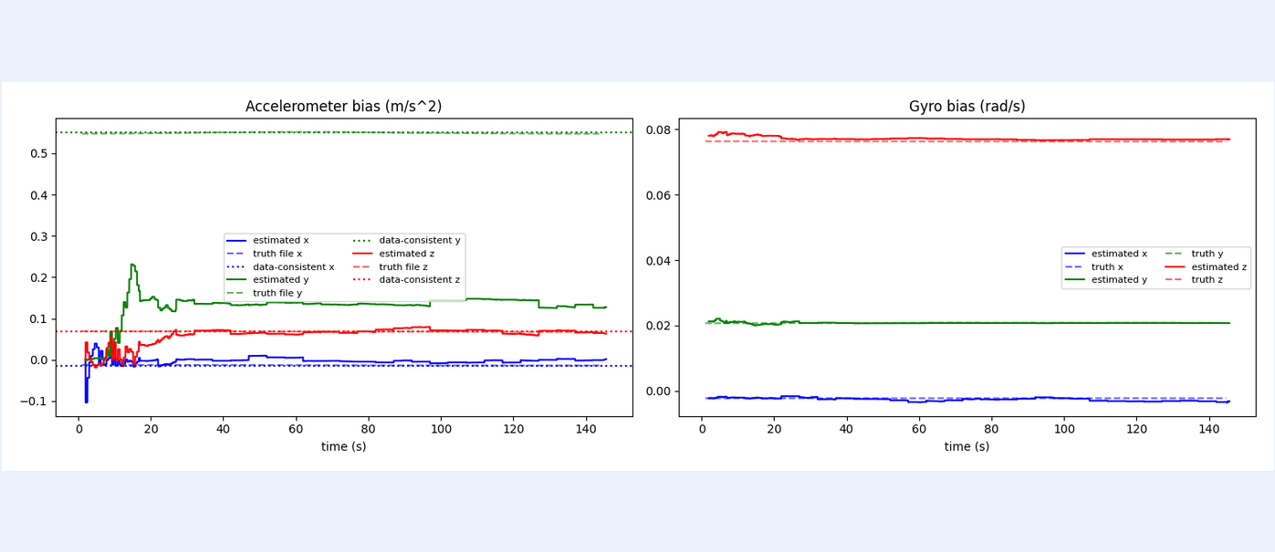
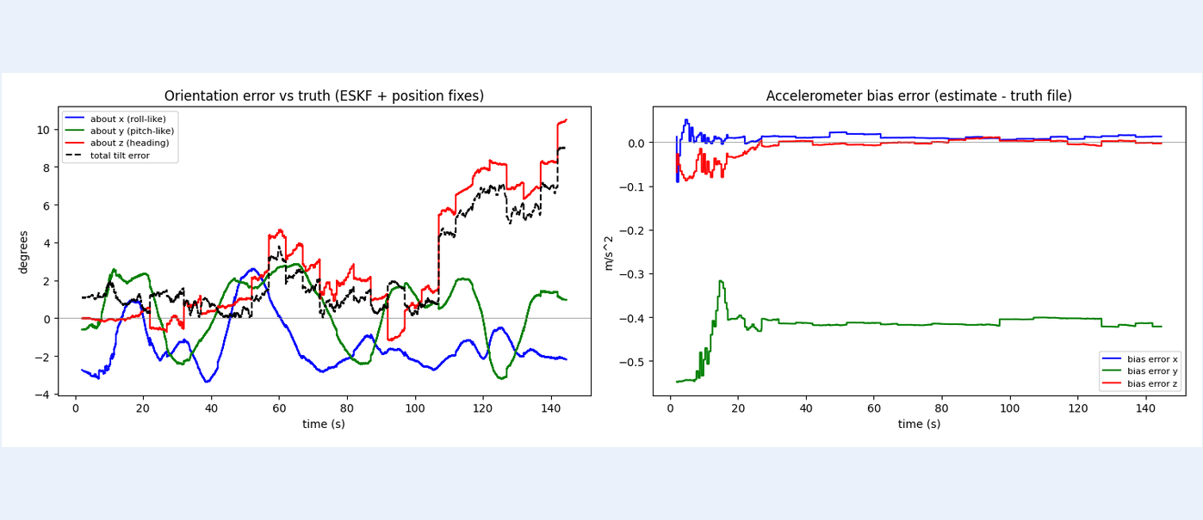
APPENDIX A2. EUROC V1_01 BIAS & ORIENTATION DIAGNOSTICS (FIGURES 17 & 18)
ESKF bias estimates are tracked against the truth file; y accel bias stays under-estimated
Gyroscope & x/z accel biases lock onto truth: In Figure 17 (right), all three online gyro bias estimates converge rapidly to the EuRoC ground-truth lines and remain flat across 145 s; x and z accel biases also match truth.
Why y-accel bias stays under-estimated (0.13 vs 0.55 m/s²): In Figure 17 (left) and Figure 18 (right), estimated y-accel bias settles near 0.13 m/s² vs ~0.55 m/s² data-consistent truth because roll/pitch tilt and horizontal bias are coupled at startup.
Orientation error vs truth (Figure 18 left): Mean total tilt error is 2.45°, while heading error (red) grows to ~10° by 145 s because neither gravity nor position fixes constrain yaw.
Team Pineapple | Appendix A2 & Figures 17–18: EuRoC Bias & Orientation Diagnostics (22/25)
Notes:
Figures 17 and 18 compare the ESKF's online bias and orientation estimates against the EuRoC truth file during the simulated position-fix run. While all three gyro biases and the x and z accelerometer biases lock onto the truth, the y accelerometer bias is estimated at 0.13 m/s² instead of the 0.55 m/s² supported by the data because tilt and horizontal accelerometer bias are hard to separate at start-up. That leaves a mean tilt error of 2.45 degrees, while heading error grows to about 10 degrees because no sensor constrains yaw.

Slide 23
APPENDIX A3. COMPLETE SMARTPHONE SQUARE-WALK NUMERICAL REFERENCE (SECTION 6)
Complete phone walk stop-error table across all ten calibrated and uncalibrated runs
Run Family | Stop 1 | Stop 2 | Stop 3 | Stop 4 | Mean Err | Mean % | Final % | Cal Off: Mean / Stop 4
raw | 1.26 | 18.03 | 68.44 | 143.92 | 57.91 m | 618.7% | 1537.6% | 1493.84 m / 3627.41 m
bias removed | 6.08 | 91.37 | 378.52 | 797.78 | 318.44 m | 3402.1% | 8523.3% | 359.85 m / 903.21 m
bias + Mahony | 7.41 | 42.48 | 95.82 | 125.57 | 67.82 m | 724.6% | 1341.5% | 68.49 m / 127.15 m
bias + ZUPT | 4.87 | 17.04 | 38.16 | 56.27 | 29.08 m | 310.7% | 601.2% | 32.50 m / 63.53 m
all combined | 6.60 | 11.48 | 8.81 | 1.96 | 7.21 m | 77.0% | 20.9% | 7.08 m / 1.88 m
ESKF (no aiding) | 2.88 | 1.42 | 1.27 | 1.15 | 1.68 m | 18.0% | 12.2% | 1.64 m / 1.10 m
leg de-drift (Mahony) | 0.74 | 0.43 | 0.88 | 1.04 | 0.77 m | 8.3% | 11.2% | 0.80 m / 1.05 m
leg de-drift (ESKF) | 0.93 | 0.29 | 1.09 | 0.59 | 0.72 m | 7.7% | 6.3% | 0.92 m / 0.74 m (S1: 1.01)
ESKF + corner marks | 2.88* | 1.08* | 1.37* | 1.12 | 1.61 m | 17.2% | 12.0% | Cal off Stop 4: 0.89 m
leg de-drift + marks | 0.00* | 0.00* | 0.00* | 0.66 | N/A* | N/A* | 7.0% | Cal off Stop 4: 0.64 m
Team Pineapple | Appendix A3: Complete Phone Walk Stop-Error & Cal-Off Table (* = mark given to filter) (23/25)
Notes:
Appendix A3 compiles the complete stop-by-stop error table from Section 6 of our report across all ten configurations, alongside the calibration-off results in the right-hand column. Note the asterisks on Stops 1, 2, and 3 for the corner-mark runs: because those corner coordinates were fed to the filter with 0.05 m uncertainty, only Stop 4 back at the origin is an independent test, where ESKF with marks lands at 1.12 m and leg de-drift with marks lands at 0.66 m.

Slide 24
APPENDIX A4. COMPLETE EUROC V1_01 NUMERICAL REFERENCE (SECTION 8)
Complete EuRoC V1_01 tier scorecard across unaided and simulated-aid filter runs
EuRoC V1_01 Run (58.58 m) | Err @10s | Err @30s | End Err | End % | Return | Mean / 95% / Max | Core / Main / Bonus
raw (unaided) | 247.18 | 2256.39 | 75322.93 | 128571% | 75323.16 | 24826 / 68503 / 75323 | fail / fail / fail
bias removed (unaided) | 2.25 | 31.97 | 2979.24 | 5085.3% | 2979.65 | 728.0 / 2522.7 / 2979.2 | fail / fail / fail
bias + Mahony (unaided) | 1.67 | 11.97 | 287.73 | 491.1% | 287.84 | 90.87 / 258.11 / 287.73 | fail / fail / fail
bias + ZUPT (unaided) | 2.20 | 31.84 | 2972.48 | 5073.8% | 2972.88 | 727.7 / 2522.2 / 2972.5 | fail / fail / fail
all combined (unaided) | 1.66 | 11.89 | 286.84 | 489.6% | 286.94 | 90.65 / 257.65 / 286.84 | fail / fail / fail
ESKF (no aiding) | 8.49 | 80.51 | 2194.80 | 3746.4% | 2194.82 | 727.0 / 1966.3 / 2194.8 | fail / fail / fail
aided (simple KF, sim) | 0.79 | 1.10 | 0.70 | 1.2% | 0.48 | 0.97 / 2.76 / 5.27 | fail (1.10) / PASS / fail
ESKF + pos fixes (sim) | 1.12 | 0.34 | 0.36 | 0.6% | 0.72 | 0.48 / 1.10 / 1.95 | PASS / PASS / fail
ESKF + fixes, low-pass (sim) | 0.43 | 0.33 | 0.39 | 0.7% | 0.71 | 0.46 / 1.08 / 1.73 | PASS / PASS / fail
ESKF + fixes, no grav (sim) | 0.85 | 0.37 | 0.41 | 0.7% | 0.75 | 0.48 / 1.11 / 1.91 | PASS / PASS / fail
ESKF + UWB (gated, sim) | 0.12 | 0.08 | 0.16 | 0.3% | 0.45 | 0.12 / 0.24 / 0.43 | PASS / PASS / fail (0.43)
ESKF + UWB (no gate, sim) | 0.09 | 0.10 | 0.28 | 0.5% | 0.48 | 0.19 / 0.40 / 0.80 | PASS / PASS / fail (0.80)
Team Pineapple | Appendix A4: Complete EuRoC V1_01 Error & Tier Scorecard Table (All Aided Rows = Simulated) (24/25)
Notes:
Appendix A4 provides the complete 12-row EuRoC V1_01 error table and tier scorecard from Section 8 of our report. Note that the unaided ESKF path jumps back to about 70 m from the start in the very last samples after the ground-truth file ends; as stated in the report, the table reads the end error of 2,194.80 m before that post-truth jump. All six aided rows use simulated sensors and show that gated UWB comes within 0.13 m of the 0.3 m Bonus ceiling.

Slide 25
Staged IMU calibration and filtering cut drift by two orders of magnitude.
Thank You — Questions & Discussion
Team Pineapple | Problem 4: IMU-Based Indoor Positioning
Notes:
Thank you for listening to Team Pineapple's presentation on Problem 4. We have all 18 figures, full numerical tables, and our Google Colab notebook ready, and we welcome any questions from the judges.

