Slide 1
Anagrams
By
Thomas Durkin (durkim)
Bohan Wu (wub4)

Slide 2
Anagrams
Description: Anagrams is a game in which the player must create words formed by rearranging the randomly given letters.
License: GPL v3.0
Language: Java
Repository: Centralized
Website: https://github.com/tdurkin18/Anagrams

Slide 3
Anagrams
Goals:
  1. Create a server to support two players
  2. no GUI issues/server lag
Future goals:
  1. Make a web version
Progress:
  The home screen is working.
  Basic layout for the game board is done
  Random letters generator is working

Slide 4
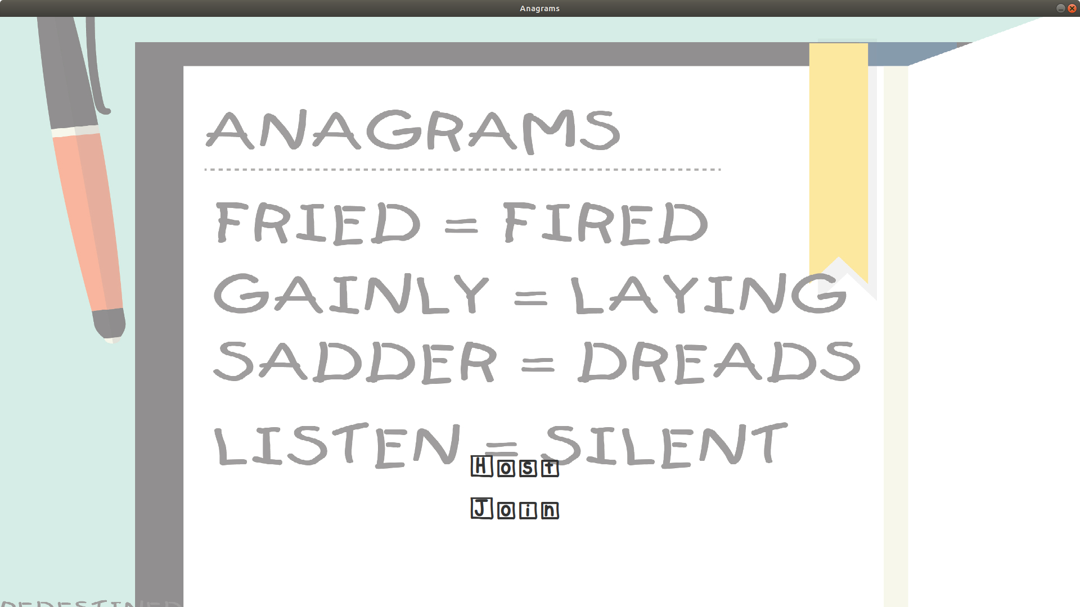
Progress

Slide 5
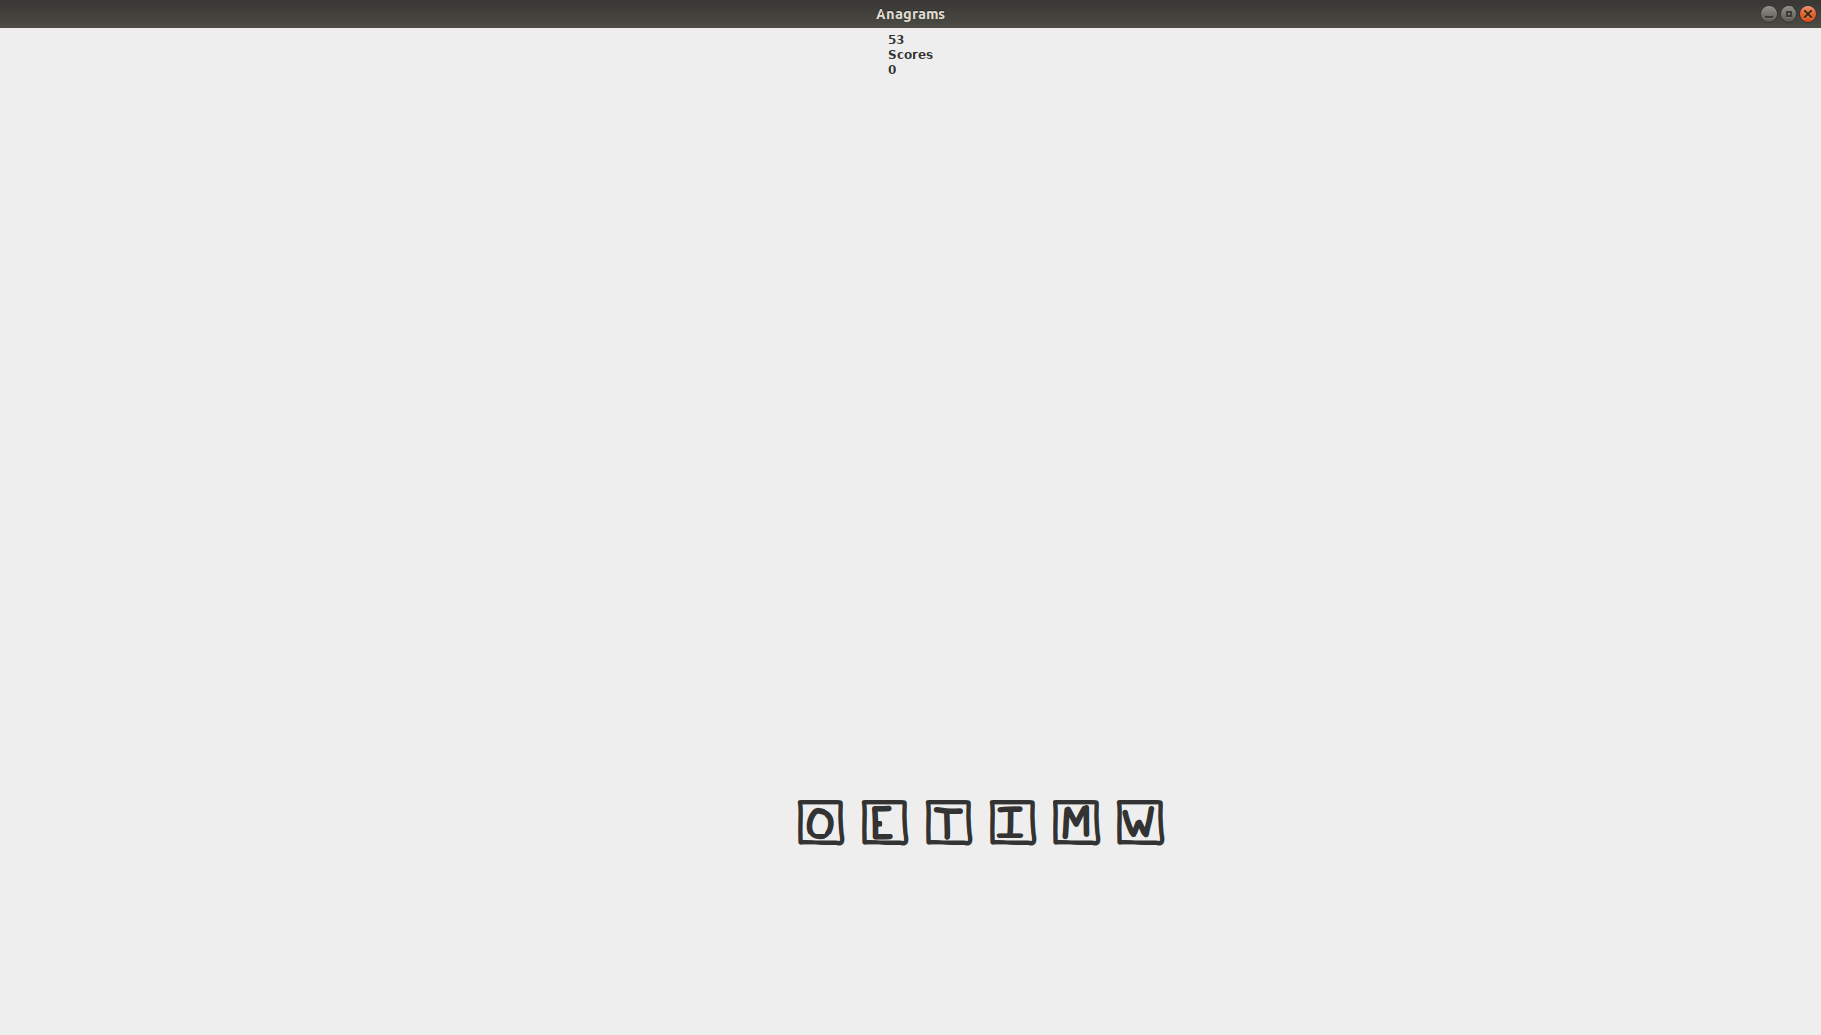
Progress

