Slide 1

Aerocom System 2
Alessio Di Ricco
Edoardo Geraci
Mariella Melechì

Slide 2
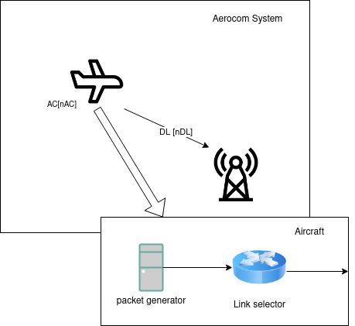
Modelling
Aircraft (AC): Main module of the analysis composed of:
Packet Generator
Link Selector
Data Link (DL): A DL is the link between ACs and the CT. There is a fixed number of DLs available to all the ACs.
Control Tower (CT): Receives packets and drops them.
Packet: Created by the packet generator, it’s sent to the CT.

Slide 3
Main model informations
Main factors:
Capacity malus: X;
Number of aircrafts: nAC;
Mean packet generation: kMean;
Number of Data Links: nDL;
Setting capacity time: t;
Operation mode: monitored, unmonitored.
Assumptions:
DLs are ideal channels;
ACs are independent;
Fixed packet size of 100 byte;
3 different RNGs;
Infinite queues.
Two modes of operation:
Monitored: the Data Link with the highest capacity is selected whenever a new message needs to be sent
Unmonitored: At the start of a simulation a random Data Link will be selected

Slide 4
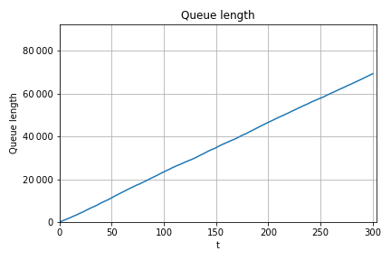
Stability Condition
The system is stable for values of kMean > 0.009. The value chosen for the simulation is kMean = 0.05, to avoid any limit condition possible.
To validate the model, the following test were performed:
Memory analysis
Degeneracy test
Packet loss test
Variation of the number of ACs
Continuity test
Little’s law test
kMean | Service Time | Mean Response Time | Mean Queue Length
0.003 | 0.008407 | 31.294345 | ~∞
0.009 | 0.008567 | 0.387522 | 43.141522
0.02 | 0.008606 | 0.021300 | 1.301352
0.05 | 0.008626 | 0.018495 | 0.729679
queue length with kMean = 0.003

Slide 5
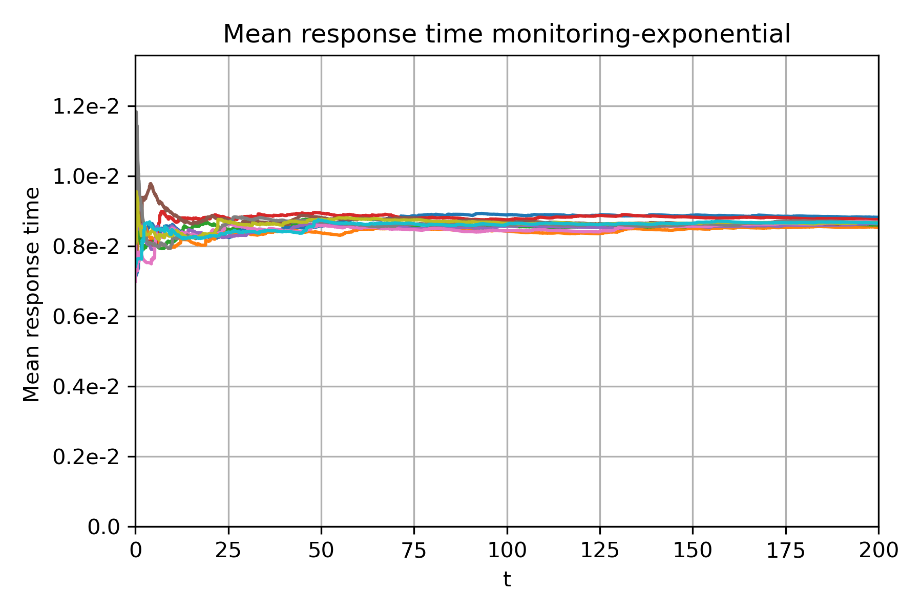
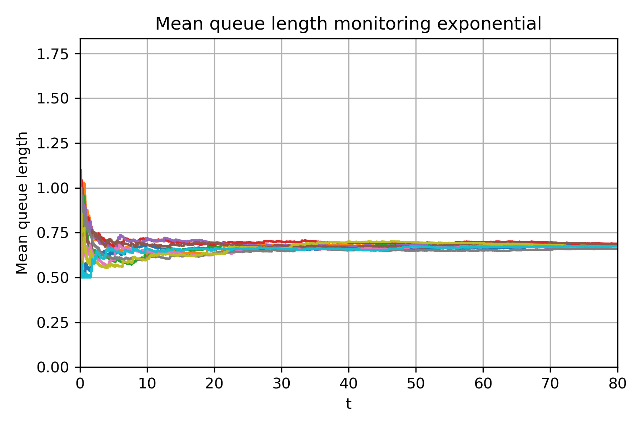
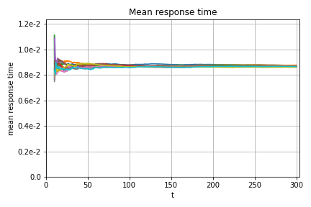
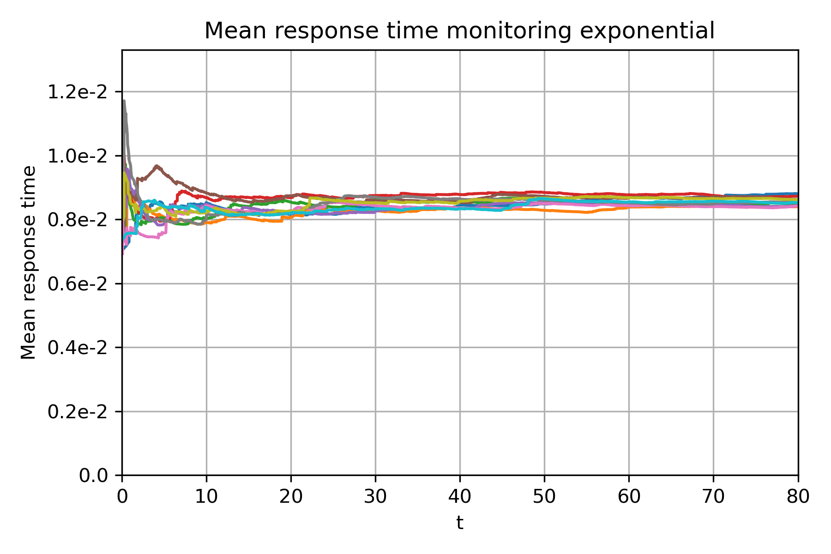
Warmup time and continuity test
In order to define the warm-up period, two main factors need to be considered: queue length and response time.
The plots were obtained from simulations which consisted of 10 repetitions each. This number of repetitions is a good enough indicator of warm-up behavior.We can see that after 10s the behavior is stable, so we can set our warm-up time like so.
After having chosen the kMean, a number of simulations were performed to prove that, after reaching stability, no critical conditions or unexpected behaviors are encountered.

Slide 6
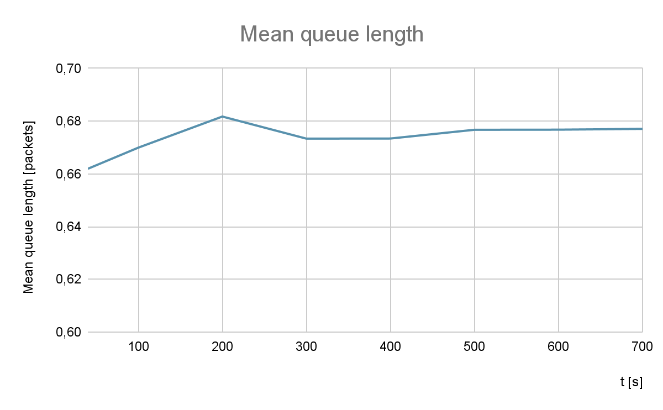
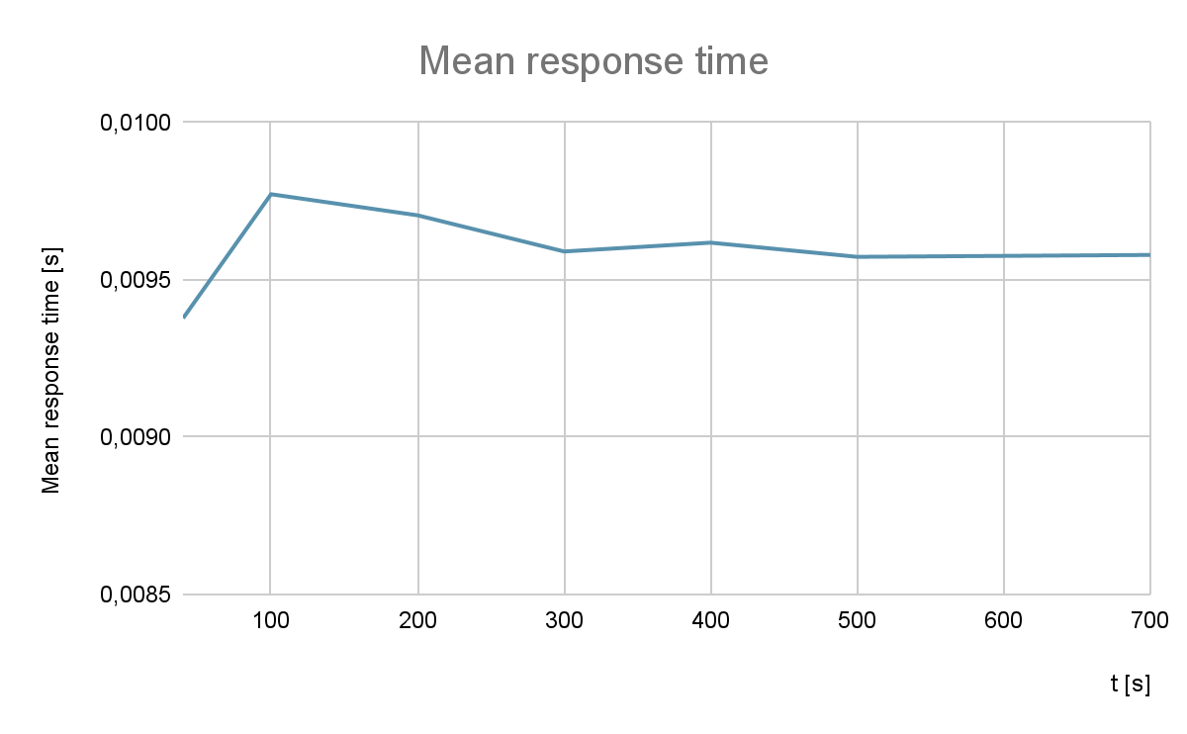
Simulation Length Analysis
The behavior of the system was tested with different simulation lengths. The mean value and the standard deviation of queue length and response time vary when the simulation length gets increased, up to ~300s. The amount of samples collected in this interval of time seems to be enough to represent the system variability.
In the graphs are reported the queue length and response time behaviors related to the duration of the simulation in monitored mode, with exponential time generation

Slide 7
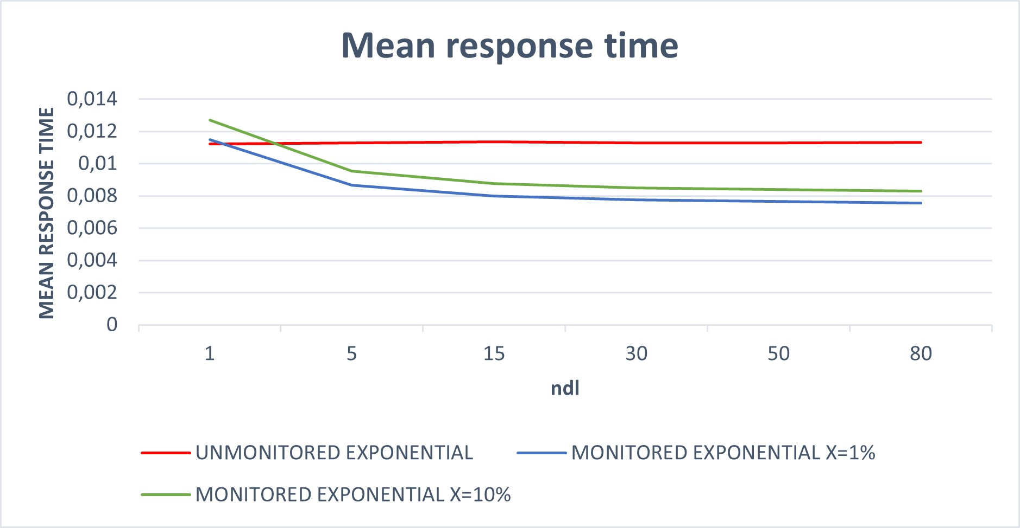
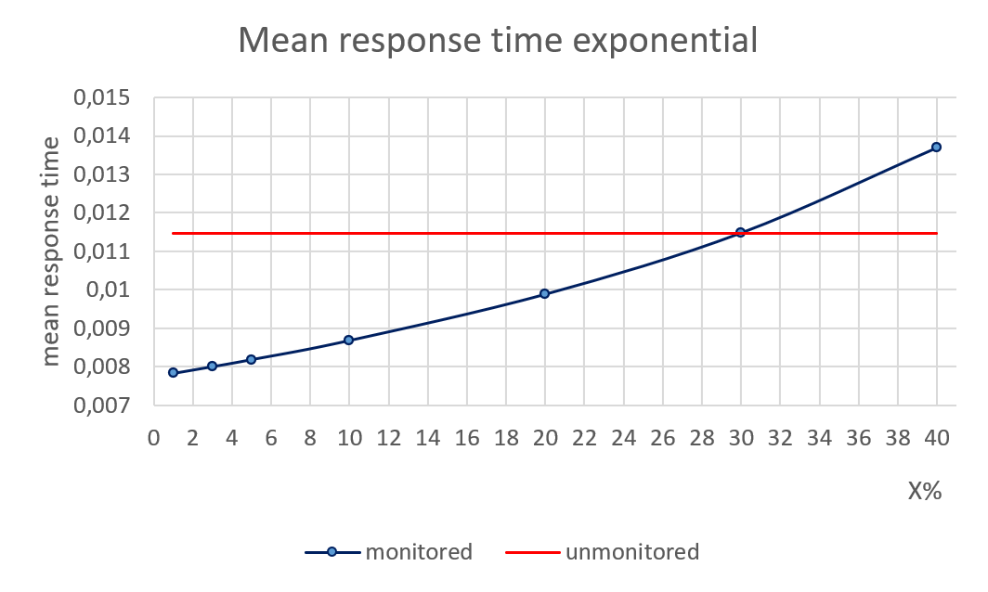
Analysis varying X% and nDL
To achieve better performance in monitored mode, compared to the unmonitored one, given that nDL=15, a malus lower than the 30% of the DL capacity is needed. Otherwise the system wastes more capacity monitoring than the one it gains by selecting the optimal DL. With lower values of nDL, for instance with values lower than 3, there’s no gain at all in using a monitored system, even with a malus of only 10% of the transmission capacity.

Slide 8
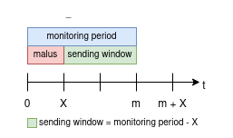
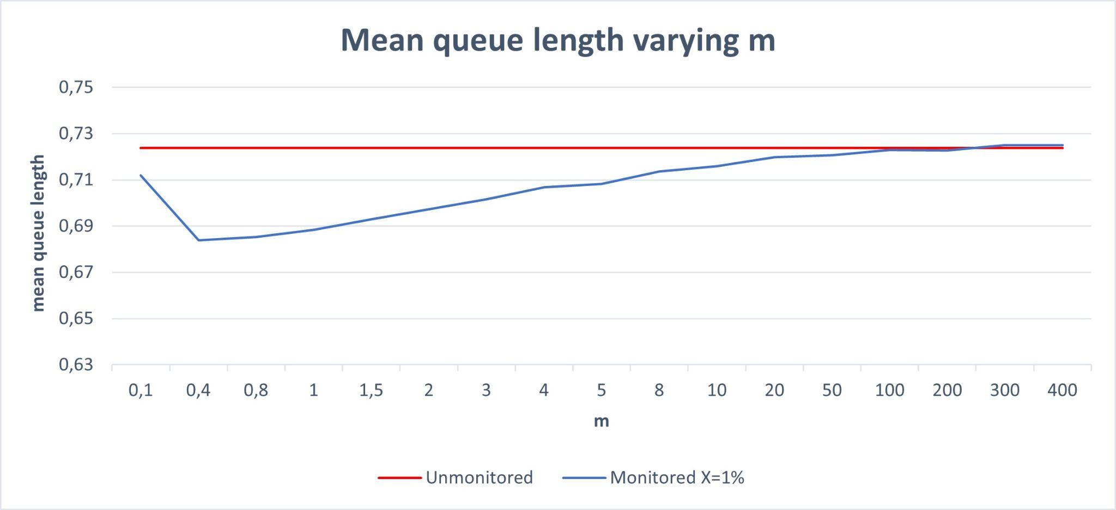
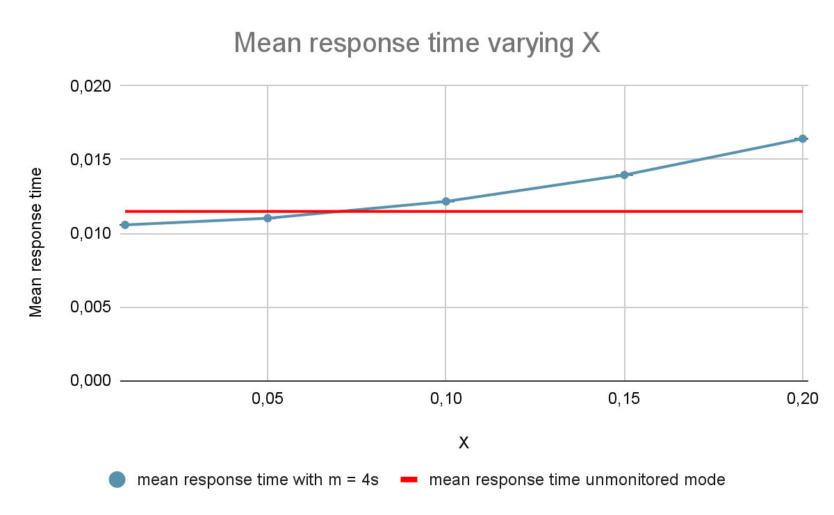
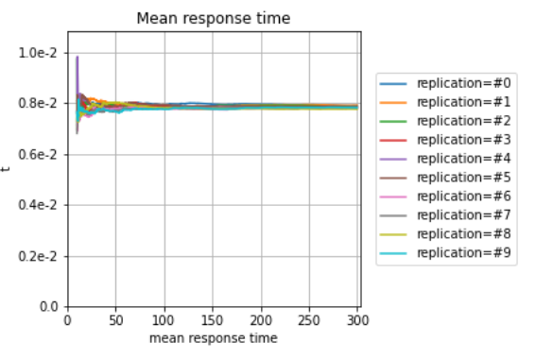
Different implementation
Another possible interpretation of the malus and of the overall monitored mode is discussed. In this version, there isn’t a constant X% malus on the capacity, but instead an X seconds monitoring time (malus) every m seconds, where m is the monitoring period of the system.
The system monitors the capacity of all the DLs every m seconds, and the monitoring takes X seconds to complete, where X = k + nDL*c ;

Slide 9
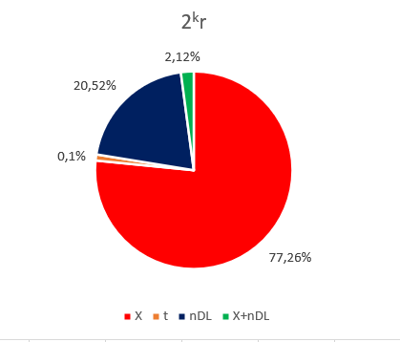
Factorial analysis
As expected, and as can be seen in the graph, t mean is negligible, while X and nDL are the main parameters influencing the results. Moreover, X is clearly the most important one, as well as the easiest to work on.
In a real implementation of such a system, nDL won’t probably vary that much.
As such, the best way to achieve better performance would be trying to reduce the capacity occupancy of the monitoring stream of data as much as possible, either by reducing the size of packets as much as possible or by finding a less capacity consuming monitoring algorithm.

Slide 10
Conclusion
We can conclude that the choice between the two implementations is mostly influenced by the value of nDL and X%.
To achieve better performance in monitored mode, compared to the unmonitored one, given that nDL = 15, a malus lower than the 30% of the DL capacity is needed. Otherwise the system wastes more capacity monitoring than the one it gains by selecting the optimal DL.
With lower values of nDL, there’s no gain at all in using a monitored system, even with a malus of only 10% of the transmission capacity.
The simulated system was built using the infinite queue abstraction, but, with a malus below 30%, the queue stabilizes around a size of 4 packets.

