Slide 1
Introduction to Quantum Computing - Lab
Department of Information Engineering
MSc in Computer Engineering (a.y. 2022/2023)
Computer Architecture (Prof. Cosimo Antonio Prete)
Leonardo Bacciottini
PhD student
leonardo.bacciottini@phd.unipi.it

Slide 2
Outline
What is a quantum computer?
How to run quantum circuits
Introduction to Qiskit
Qiskit Exercises
Quantum Algorithms

Slide 3
What is a quantum computer?
A quantum computer is a machine that performs calculations based on the laws of quantum mechanics instead of the laws of classical physics.
As the bit is the computational unit of a classical computer, the qubit is the computational unit of a quantum computer.
The logical operations that a classical computer can perform on bits (e.g. AND, OR, NOT, NAND, …) are mapped by its instructions set.
Current operating systems abstract this low-level API and provide users with applications and advanced programming languages.

Slide 4
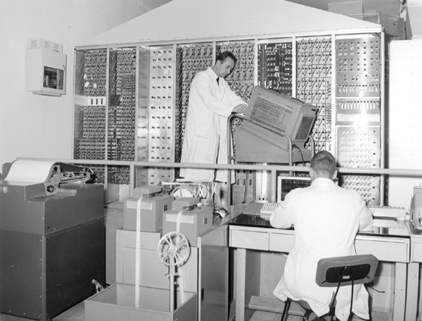
What is a quantum computer? (2)
Quantum computers have an instructions set composed of quantum gates (e.g. {H, Z, X, Y QNOT, CX, SWAP, MEASURE}).
They don’t provide (at least currently) any high-level abstraction. They can be seen as mainframes which execute an ordered list of instructions on a set of qubits and output some measurement results.
Calcolatrice Elettronica Pisana – 1961.

Slide 5


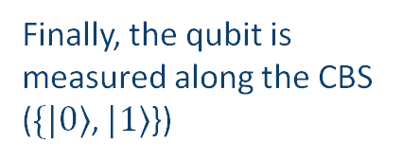






Quantum Program: Example
H
Z
S
T
$$|0⟩$$
$$|ψ^{′}⟩$$
$$|ψ^{′′}⟩$$
$$|ψ^{′′′}⟩$$
$$|ψ^{′′′′}⟩$$
$$|ψ^{(pm)}⟩$$
Qubits are always initialized to state $|0⟩$
A series of gates are applied to the qubit
Finally, the qubit is measured along the CBS ($\{|0⟩$, $|1⟩$})
This quantum program (or quantum circuit) is run multiple times. At the end, the quantum computer returns the measurement result of each independent shot.

Slide 6












Quantum Program: Example (2)
Exercise: compute the intermediate state vectors $|\left.ψ^{′}\right\rangle$, $|\left.ψ^{′′}\right\rangle$, $|\left.ψ^{′′′}\right\rangle$, $|\left.ψ^{′′′′}\right\rangle$, and the post measurement state (along the CBS) $|\left.ψ^{(pm)}\right\rangle$.
H
Z
S
T
$$|0⟩$$
$$|ψ^{′}⟩$$
$$|ψ^{′′}⟩$$
$$|ψ^{′′′}⟩$$
$$|ψ^{′′′′}⟩$$
$$|ψ^{(pm)}⟩$$
$$|\left.0\right\rangle = \left[\begin{matrix}1 \\ 0\end{matrix}\right]$$
$$H= \frac{1}{\sqrt{2}}\left[\begin{matrix}1 & 1 \\ 1 & −1\end{matrix}\right]$$
$$Z=\left[\begin{matrix}1 & 0 \\ 0 & −1\end{matrix}\right]$$
$$S=\left[\begin{matrix}1 & 0 \\ 0 & i\end{matrix}\right]$$
$$T=\left[\begin{matrix}1 & 0 \\ 0 & e^{iπ/4}\end{matrix}\right]$$

Slide 7
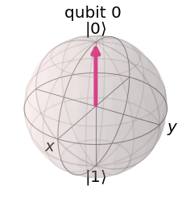
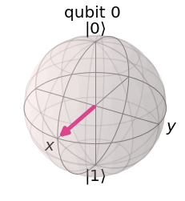

Exercise
$\left|\left.ψ^{′}\right\rangle =H\right|\left.0\right\rangle = \frac{1}{\sqrt{2}}\left[\begin{matrix}1 & 1 \\ 1 & −1\end{matrix}\right]\left[\begin{matrix}1 \\ 0\end{matrix}\right]=\frac{1}{\sqrt{2}}\left[\begin{matrix}1 \\ 1\end{matrix}\right]=|\left.+\right\rangle$

Slide 8
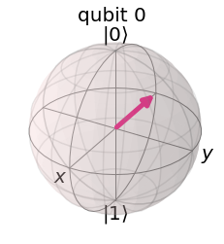

Exercise
$\left|\left.ψ^{′′}\right\rangle =Z\right|\left.+\right\rangle =\left[\begin{matrix}1 & 0 \\ 0 & −1\end{matrix}\right]\left[\begin{matrix}1/{\sqrt{2}} \\ 1/{\sqrt{2}}\end{matrix}\right]=\frac{1}{\sqrt{2}}\left[\begin{matrix}1 \\ −1\end{matrix}\right]=|\left.−\right\rangle$

Slide 9
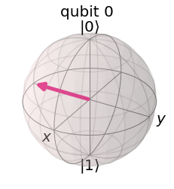

Exercise
$\left|\left.ψ^{′′′}\right\rangle =S\right|\left.−\right\rangle =\left[\begin{matrix}1 & 0 \\ 0 & i\end{matrix}\right]\left[\begin{matrix}1/{\sqrt{2}} \\ {−1}/{\sqrt{2}}\end{matrix}\right]=\frac{1}{\sqrt{2}}\left[\begin{matrix}1 \\ −i\end{matrix}\right]$

Slide 10
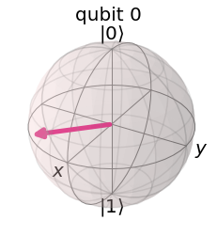

Exercise
$\left|\left.ψ^{′′′′}\right\rangle =T\right|\left.ψ^{′′}′\right\rangle =\left[\begin{matrix}1 & 0 \\ 0 & e^{iπ/4}\end{matrix}\right]\frac{1}{\sqrt{2}}\left[\begin{matrix}1 \\ −i\end{matrix}\right]=\frac{1}{\sqrt{2}}\left[\begin{matrix}1 \\ e^{−iπ/4}\end{matrix}\right]$

Slide 11


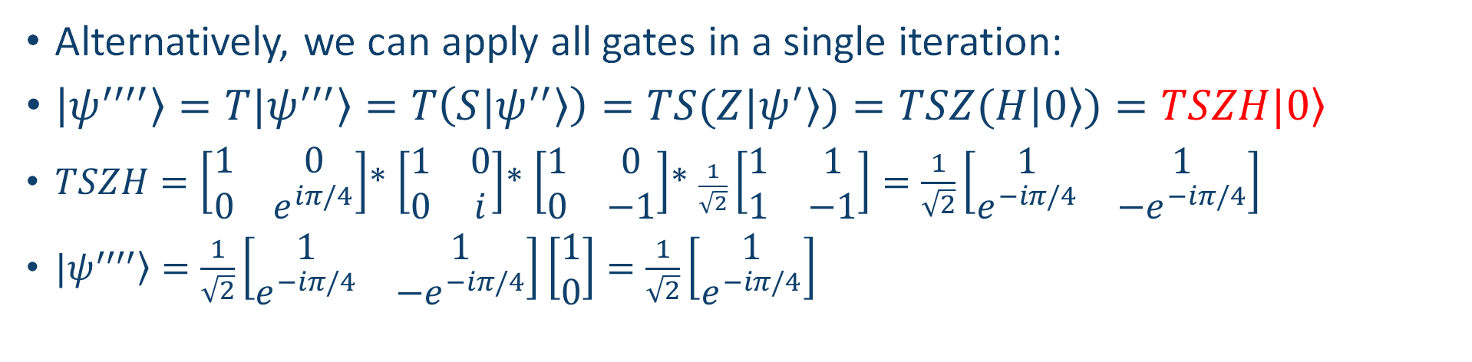

Exercise: Alternative
H
Z
S
T
$$|0⟩$$
$$|ψ^{′}⟩$$
$$|ψ^{′′}⟩$$
$$|ψ^{′′′}⟩$$
$$|ψ^{′′′′}⟩$$
$$|ψ^{(pm)}⟩$$
Alternatively, we can apply all gates in a single iteration:
$\left|\left.ψ^{′′′′}\right\rangle =T|\left.ψ^{′′′}\right\rangle =T\left(S\left.{|ψ}^{′′}\right\rangle \right)=TS(Z\left.{|ψ}^{′}\right\rangle )=TSZ(H\right|\left.0\right\rangle )=\left.TSZH|0\right\rangle$
$TSZH=\left[\begin{matrix}1 & 0 \\ 0 & e^{iπ/4}\end{matrix}\right]$* $\left[\begin{matrix}1 & 0 \\ 0 & i\end{matrix}\right]$* $\left[\begin{matrix}1 & 0 \\ 0 & −1\end{matrix}\right]$* $\frac{1}{\sqrt{2}}\left[\begin{matrix}1 & 1 \\ 1 & −1\end{matrix}\right]=\frac{1}{\sqrt{2}}\left[\begin{matrix}1 & 1 \\ e^{−iπ/4} & −e^{−iπ/4}\end{matrix}\right]$
$\left.{|ψ}^{′′′′}\right\rangle =\frac{1}{\sqrt{2}}\left[\begin{matrix}1 & 1 \\ e^{−iπ/4} & −e^{−iπ/4}\end{matrix}\right]\left[\begin{matrix}1 \\ 0\end{matrix}\right]=\frac{1}{\sqrt{2}}\left[\begin{matrix}1 \\ e^{−iπ/4}\end{matrix}\right]$

Slide 12
Exercise, measurement
$\left.{|ψ}^{(pm)}\right\rangle = ?$
$\left.{|ψ}^{′′′′}\right\rangle =\frac{1}{\sqrt{2}}\left[\begin{matrix}1 \\ e^{−{iπ}/4}\end{matrix}\right]=\frac{1}{\sqrt{2}}|\left.0\right\rangle +\frac{e^{−{iπ}/4}}{\sqrt{2}}|\left.1\right\rangle$
${p\left(0\right)=\left\|\frac{1}{\sqrt{2}}\right\|}^{2}= \frac{1}{2},{ p\left(1\right)=\left\|\frac{e^{−{iπ}/4}}{\sqrt{2}}\right\|}^{2}= \frac{1}{2}$
$\left.{|ψ}^{(pm)}\right\rangle =|\left.0\right\rangle$ with 50% probability and $\left.{|ψ}^{(pm)}\right\rangle =|\left.1\right\rangle$ with 50% probability.
Note that the post measurement state $\left.{|ψ}^{(pm)}\right\rangle$is a CBS state: measuring destroys the previous state!

Slide 13
Quantum Noise
Quantum Noise is a destructive, unpredictable effect acting on qubits stored in a quantum computer. It has two main components:
Quantum Decoherence: the state of a qubit progressively collapses due to the unavoidable interaction with external environment.
Physical Gates: Quantum gates are not ideal. This leads to an error component that is proportional to the number of gates applied to the qubit.

Slide 14
NISQ Era
In 2018 John Preskill wrote a paper (available here) where he defined a new era of quantum computing that would be available in the near future:
Noisy Intermediate-Scale Quantum (NISQ) Era, where “quantum computers with 50-100 qubits may be able to perform tasks which surpass the capabilities of today's classical digital computers, but noise in quantum gates will limit the size of quantum circuits that can be executed reliably”.
Thanks to the recent advancements of academic research, IBM, Google and other companies, we have now entered the NISQ era.

Slide 15


Running quantum circuits
Is it possible to program and run a quantum circuit on a real quantum computer?
Yes, thanks to Qiskit and IBM Quantum Experience! More on this later.

Slide 16
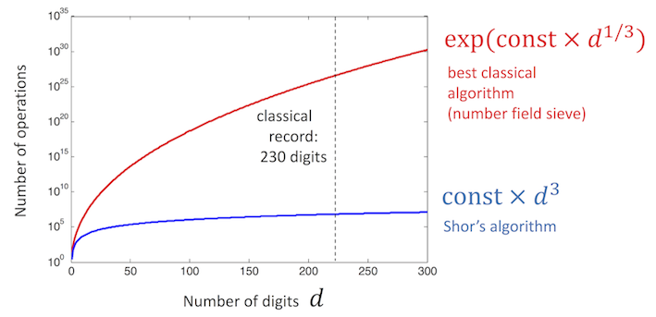
Quantum Algorithms
What is the advantage of quantum algorithms?
How are quantum algorithms structured?
Shor’s algorithm performances (IBM)

Slide 17
Church-Turing Thesis
Problems
Computable
“Hard”
O(2^{N})
Non computable
“Easy”
O(N^{k})

Slide 18
Church-Turing Thesis
Problems
Computable
“Hard”
O(2^{N})
Non computable
“Easy”
O(N^{k})

Slide 19
Church-Turing Thesis
Problems
Computable
“Hard”
O(2^{N})
Non computable
“Easy”
O(N^{k})
Q.C.

Slide 20
Quantum Algorithms
What problems are efficiently solved by quantum algorithms?
As a rule of thumb, quantum algorithms are much more efficient than classical algorithms when the problem is to determine a global property of an input function f: {0,1}^{N} → {0,1}^{M}
Examples:
Problem: is f constant or balanced? -> Deutsch-Josza algorithm
Problem: what is the period of f? -> Period finding algorithm

Slide 21
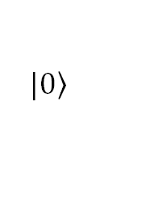
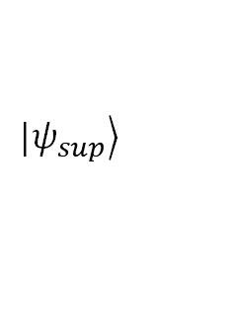
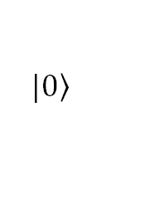
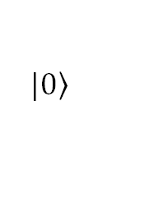
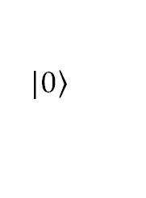
Quantum Algorithms (2)
$$|\left.0\right\rangle$$
U_{SP}
U_{f}
N input
qubits
$$|\left.0\right\rangle$$
…
$$|\left.0\right\rangle$$
$$|\left.0\right\rangle$$
V_{SP}
L ancillas
$$|\left.0\right\rangle$$
…
$$|\left.0\right\rangle$$
$$|\left.ψ_{sup}\right\rangle$$
N + L
Possibly iterated K times
outcome
A superposition of all input states

Slide 22
Quantum Algorithm Complexity
The complexity of a quantum algorithm is computed as the number of atomic gates necessary to realize U_{f} w.r.t. the number of inputs N (i.e. the size of the problem)
U_{f}
Possibly iterated K times

Slide 23
How to run quantum circuits
Classical simulators: any classical computer can simulate the behavior of a quantum computer (with a limited number of qubits).
Real quantum devices: We can (and we will) exploit IBM-Q network to test our circuits on real quantum computers.

Slide 24
Classical simulators
Simulators are the simplest backend for quantum programs. They are classical computers reproducing the behaviour of a quantum device.
Since quantum operations have exponential complexity if performed on a classical device, tests on simulators cannot include more than a limited number of qubits.
Pros: Easily accessible, can test quantum algorithms without any noise.
Cons: Computationally very heavy.

Slide 25



Real Quantum Computers
Pros: Real quantum hardware. Algorithms are tested on their native platform.
Cons: Currently very noisy (NISQ era). Queues to access a capable quantum computer can take up to a few hours.
Main companies in this field:

Slide 26
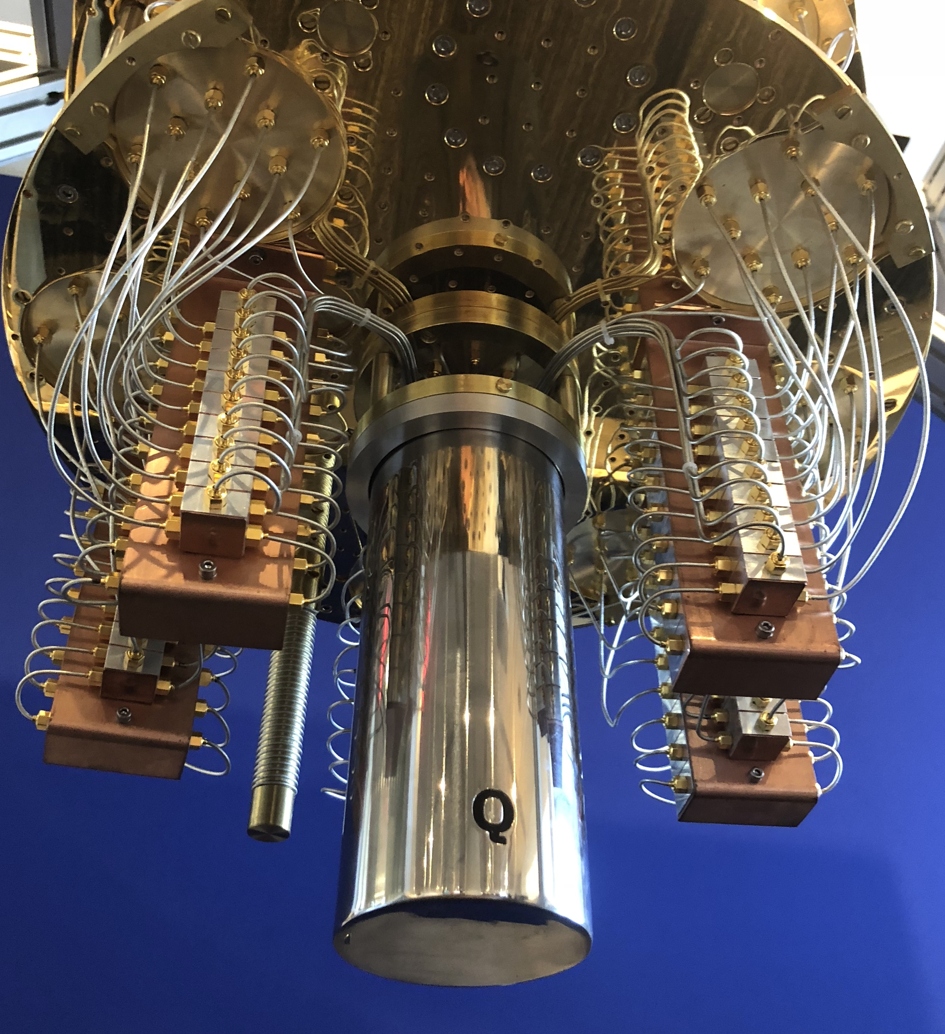
IBM Quantum Experience
IBM offers a cloud of real quantum computers and classical simulators called IBM-Q.
This cloud can be accessed by all users, but only IBM official partners have access to the most powerful quantum devices.
The capabilities of a device in the IBM-Q cloud are measured by a value called Quantum Volume (QV), which takes into account the number of qubits supported by the device and the noise parameters.
Regular users can access quantum computers with up to 5 qubits and QV=32.
Source: IBM

Slide 27
Introduction to Qiskit
An open-source SDK for working with quantum computers

Slide 28
Introduction to Qiskit
Qiskit is an open-source software framework (on Python) for working with quantum computers at the level of circuit, pulses and algorithms.
It also allows to build domain specific APIs on top of its modules abstracting the underlying complexity.
It’s built on top of OpenQASM, the most popular assembly language for quantum computers (I told you they are like mainframes!).
IBM-Q can be accessed directly from Qiskit.

Slide 29
Roadmap
In this introduction to Qiskit we will cover:
Qiskit software structure
A Tutorial for Qiskit installation
How to build quantum circuits with Qiskit
How to run circuits on simulators
How to run circuits on an IBM-Q device

Slide 30
Qiskit structure
On top of OpenQASM, Qiskit has built a high level, open source framework comprehensive of four main software modules, each responsible for a different layer of quantum software development:
Terra: This module is Qiskit skeleton for building quantum circuits.
Aer: A high performance simulator framework for the Qiskit software stack. It contains optimized C++ simulator backends for executing compiled circuits.
Ignis: An advanced framework to perform experiments involving noise characterization and mitigation in quantum devices.
Aqua: It allows users to work at a higher level w.r.t. Terra, and deploy well-known quantum algorithms implementations in any custom application.

Slide 31
Qiskit installation tutorial
Qiskit is a Python framework. To ensure modularity and isolation we will install it into a virtual environment.
First of all, install Miniconda (a lightweight version of Anaconda) following the instructions in the official website (here).
At this point we create a new conda environment:
We will install Qiskit inside this environment.
conda create -n qiskitEnv python=3

Slide 32
Qiskit installation tutorial (2)
Activate the new environment with:
If the command has been executed, you should now see (qiskitEnv) at the beginning of your prompt line. Every package installed will be confined to this environment.
On Windows or Linux:
On MacOS:
conda activate qiskitEnv
pip install qiskit[visualization]
pip install 'qiskit[visualization]'

Slide 33
Qiskit installation tutorial (3)
If you have any issues during the installation, check the official Qiskit installation page here, a guide about conda environments like this one, or send me an email explaining your problem.

Slide 34
Programming environment
We can use Qiskit from any IDE, but a very useful tool to program is to use Jupyter Notebooks.
Create a new folder in which you will save your Qiskit programs.
Open the conda prompt, cd into the new folder and activate the virtual environment (qiskitEnv).
Then, enter the following command:
It will start a jupyter server and it will open your default browser. Do not close the terminal!
jupyter notebook

Slide 35
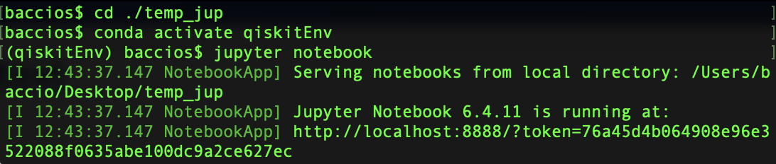
Example

Slide 36
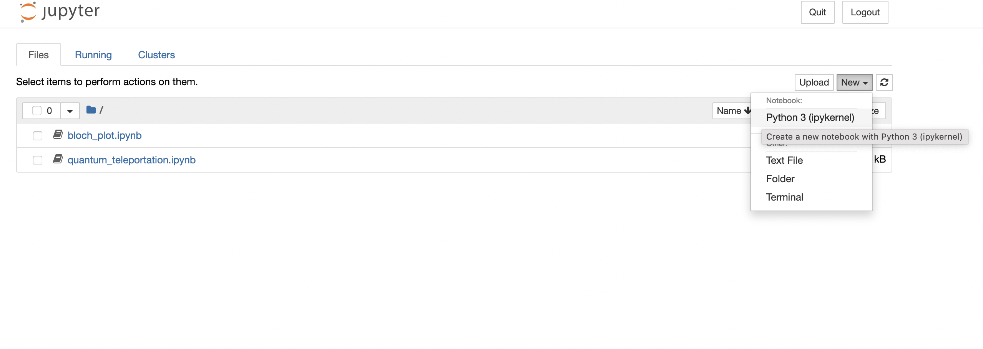
Example: a new notebook

Slide 37
Register to IBM-Q
Finally, to use IBM-Q devices, we have to sign up to their system.
Go to https://quantum-computing.ibm.com and follow the instructions to create an IBMid account.

Slide 38
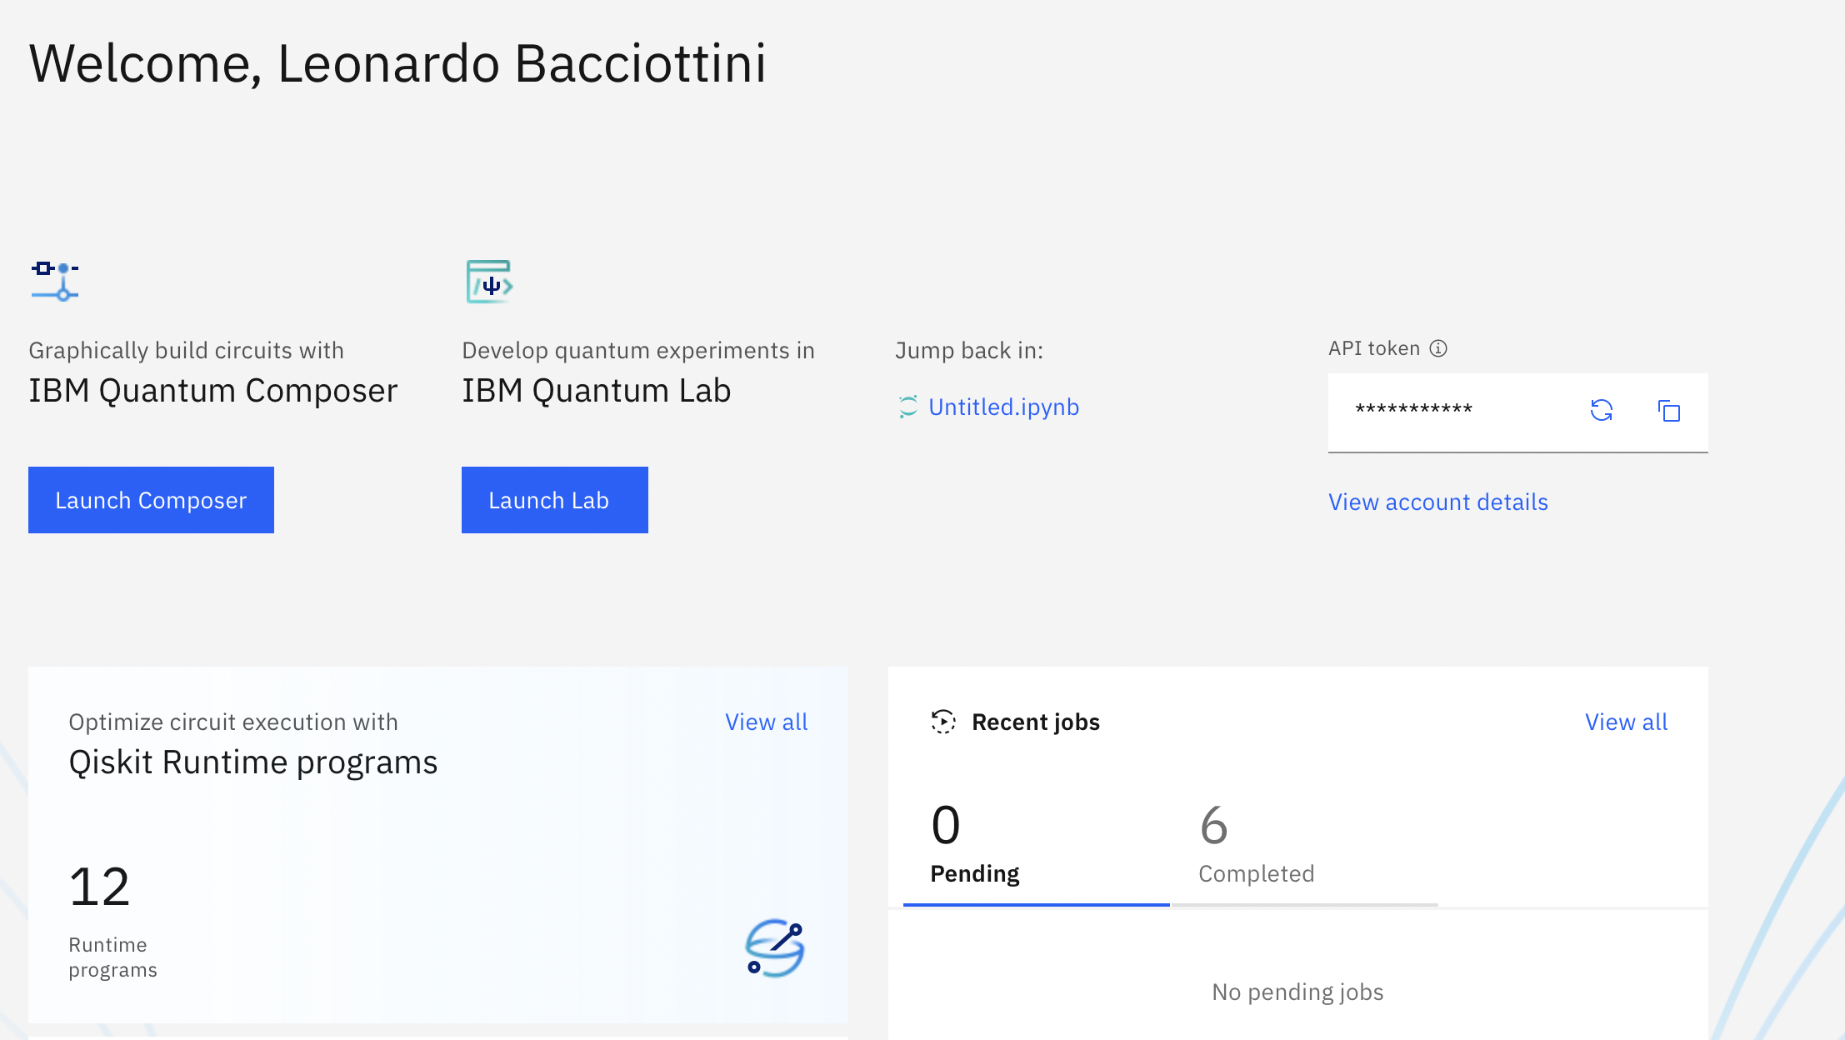

API Token
You will need this
To access IBM-Q
From Qiskit!

Slide 39
Conclusions
Feel free to play with the Quantum Composer in the IBM-Q website and navigate through the quantum computers specifications.
Next time you will build and run you first circuits with Qiskit.
Again, if you have any issues with one of these steps, you can send me an email.

