Slide 1

Introduction to Object-Oriented Programming
Week 1

Slide 2
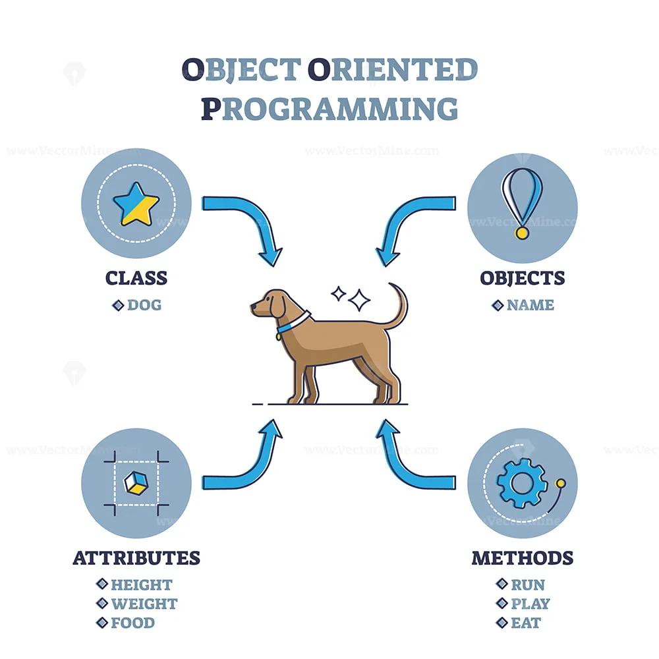
What is Object-Oriented Programming?
Object-oriented programming (OOP) is a way of writing programs that organizes the code into reusable pieces called “objects”
These objects represent real-world things.
They have both data (attributes) and actions (methods) associated with them.

Slide 3
Features of OOP
https://www.online-python.com

Slide 4
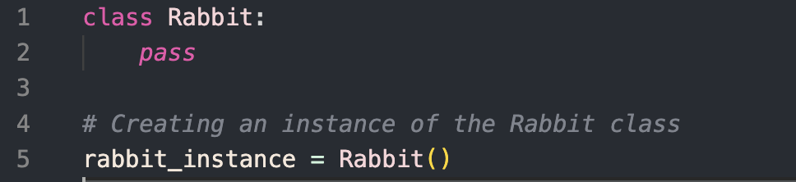
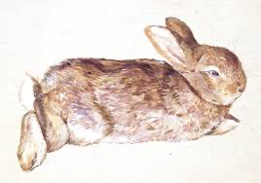
Classes & Objects
Classes
Blueprint for creating objects, providing initial value (variables) and implementations of behaviour (methods)
Objects
Instance of a class.
Do not have to know all the internal details of the code.
More than one instance of the same class can exist at any one time -> multiple objects from the same class.

Slide 5

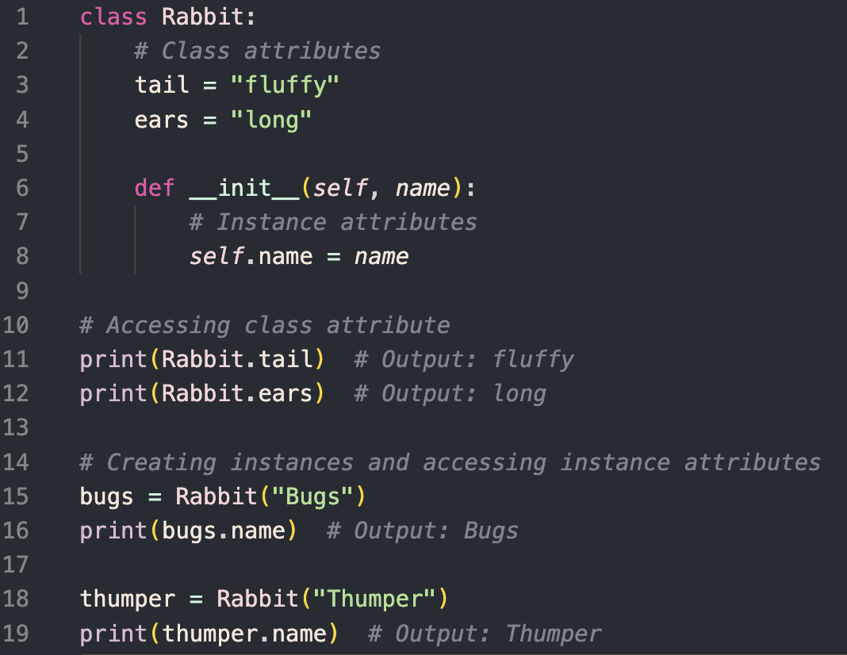
Variables/Attributes
Characteristics of an object
Passed in as arguments to an object
For example, a Rabbit object has several pieces of information associated with it that a user can extract
A class attribute, which is the same for every rabbit, i.e. fluffy tail and long ears
An instance variable, i.e. name, which is unique to every rabbit

Slide 6
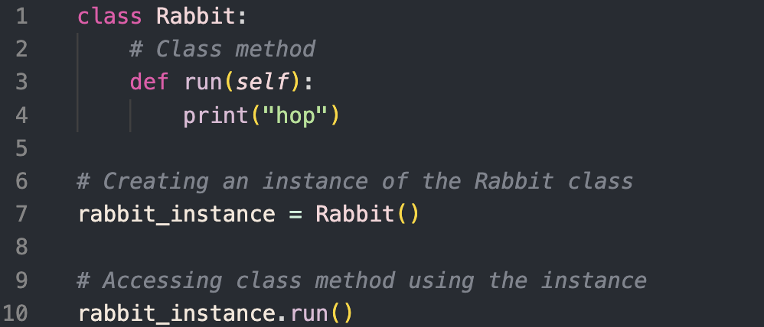
Methods/Procedures
Equivalent to a function.
E.g., the Rabbit object might have a method for running (hop).

Slide 7
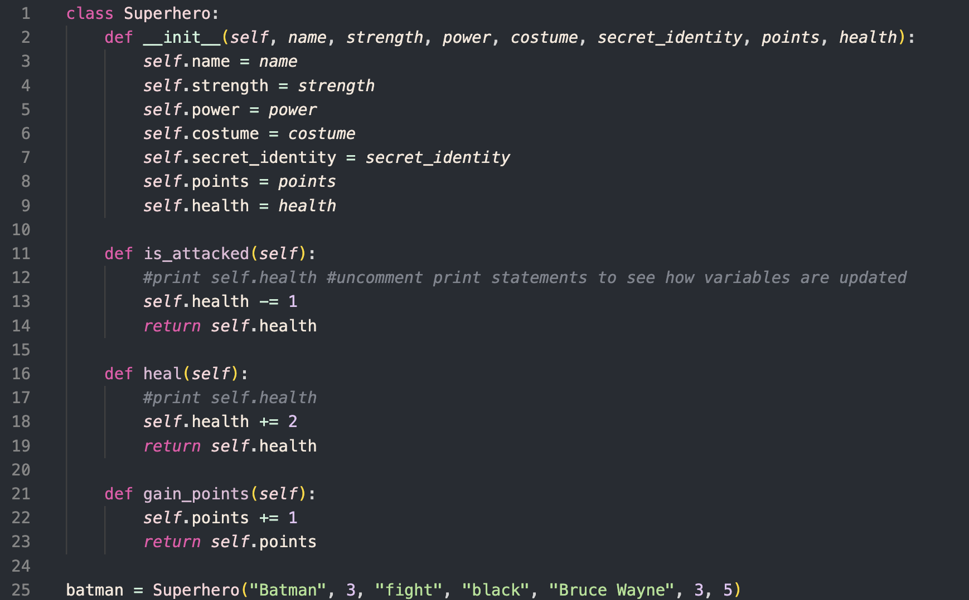
For Example

Slide 8
Exercise
Task 1: Define the Dog Class
Create a Python class named Dog with the following specifications:
Add a class attribute named attr1 and set its value to the string "mammal".
Define an instance attribute name which will be initialised through the constructor.
Implement a method named speak() which prints "My name is [dog's name]" where [dog's name] is replaced with the value of the name attribute.
Task 2: Create Dog Instances
Instantiate two objects of the Dog class with the following names:
Rodger
Tommy
Task 3: Access Class Methods
Call the speak() method on each object created in Task 2.
Challenge: Create a new class
Create a new class (of your choosing)! And add in class attributes, instance attributes and methods that describe the class

Slide 9
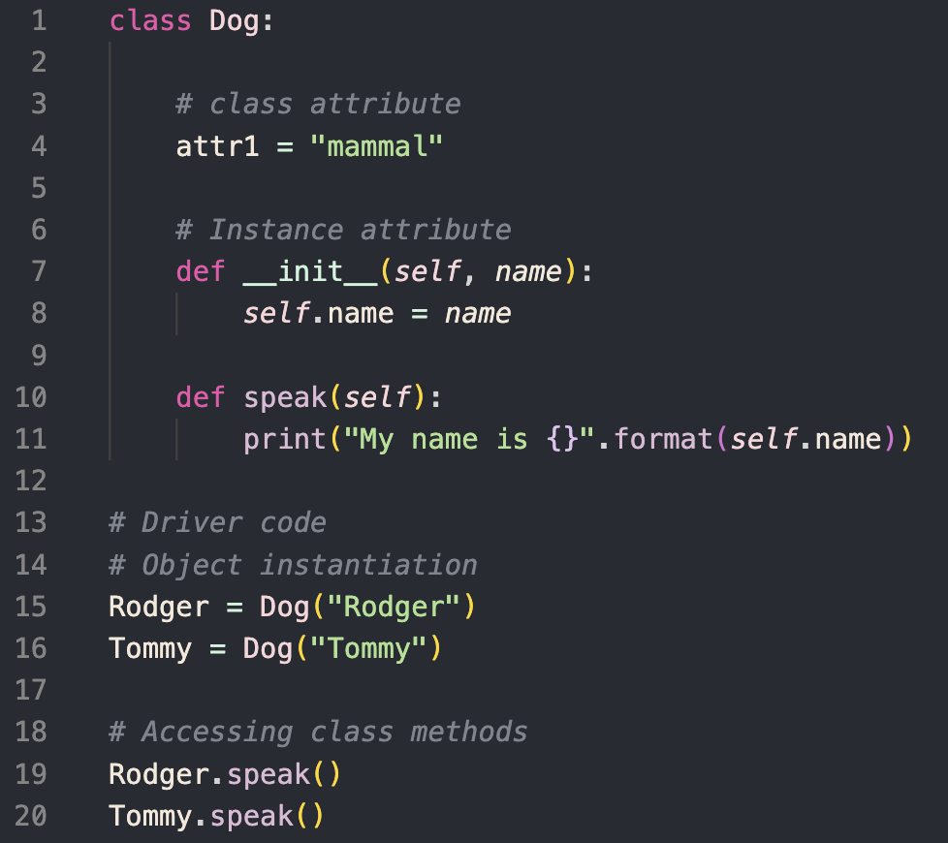
Solution

Slide 10
Sources
GeeksforGeeks (2016). Python OOPs Concepts. [online] GeeksforGeeks. Available at: https://www.geeksforgeeks.org/python-oops-concepts/.
‌brilliant.org. (n.d.). Object-Oriented Programming | Brilliant Math & Science Wiki. [online] Available at: https://brilliant.org/wiki/object-oriented-programming/.
ocoyucanpuebla.gob.mx. (n.d.). Ayuntamiento de Ocoyucan. [online] Available at: https://ocoyucanpuebla.gob.mx/?q=object-oriented-programming-or-oop-paradigm-explanation-outline-diagram-zz-EMjmo0Hz [Accessed 5 Apr. 2024].
GIPHY. (n.d.). Rabbit Hopping GIFs - Find & Share on GIPHY. [online] Available at: https://giphy.com/explore/rabbit-hopping [Accessed 5 Apr. 2024].
Press, A. (n.d.). Today in History, July 27, 1940: Bugs Bunny first appeared in Warner Bros. cartoon. [online] The Enquirer. Available at: https://eu.cincinnati.com/story/aerial-journalism/2019/07/27/today-history-july-27-1953-armistice-ends-korean-war/1827764001/ [Accessed 5 Apr. 2024].
‌Disneyclips. (n.d.). Thumper Clip Art. [online] Available at: https://www.disneyclips.com/images5/bambi4.html [Accessed 5 Apr. 2024].
‌Batman Wiki. (n.d.). Batman (Lego Movie). [online] Available at: https://batman.fandom.com/wiki/Batman_(Lego_Movie) [Accessed 5 Apr. 2024].
Sinker, M. (n.d.). Beatrix Potter. [online] 4columns.org. Available at: https://4columns.org/sinker-mark/beatrix-potter [Accessed 5 Apr. 2024].

