Slide 1

Inheritance
Week 2

Slide 2
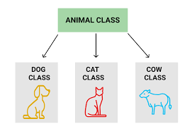
What is Inheritance?
Inheritance is a hierarchy of classes within OOP that allows us to derive properties from one class to another
This represents real-world relationships well
Promotes the reusability of code

Slide 3
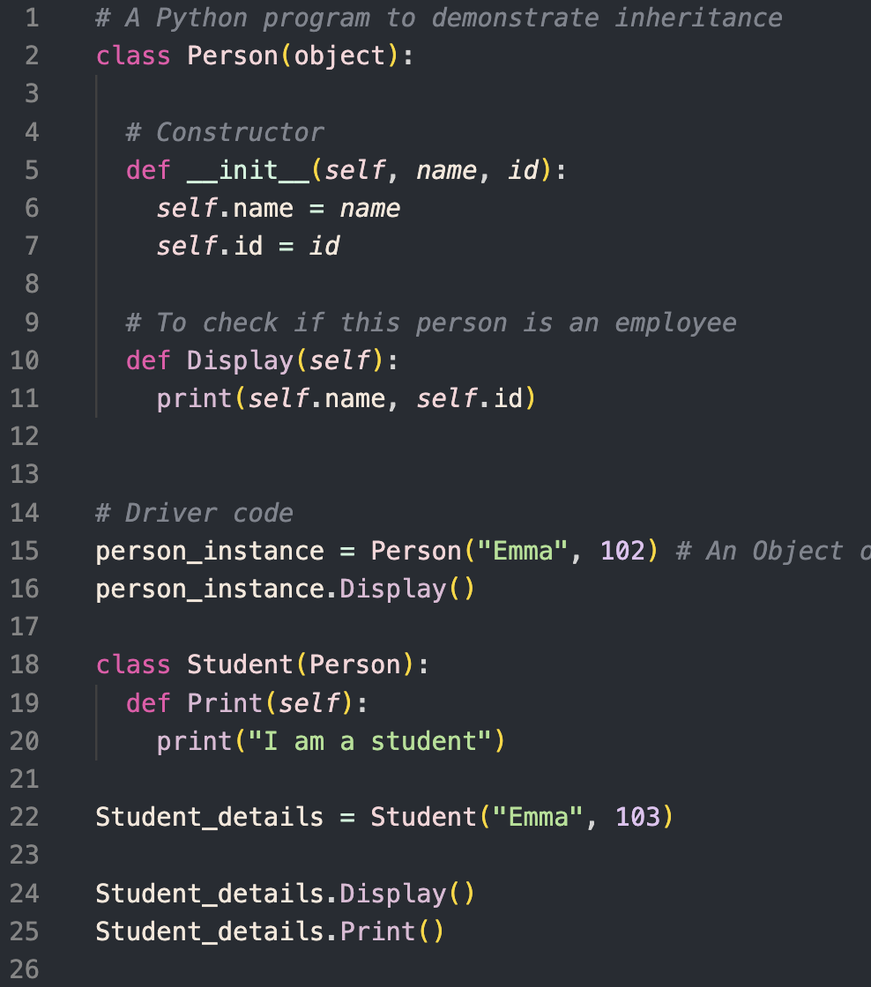
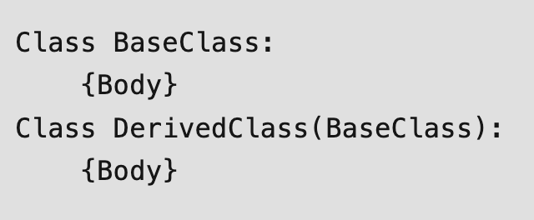
Example 1
Notice how the the properties of the `Person` class are inherited in the `Student` class

Slide 4
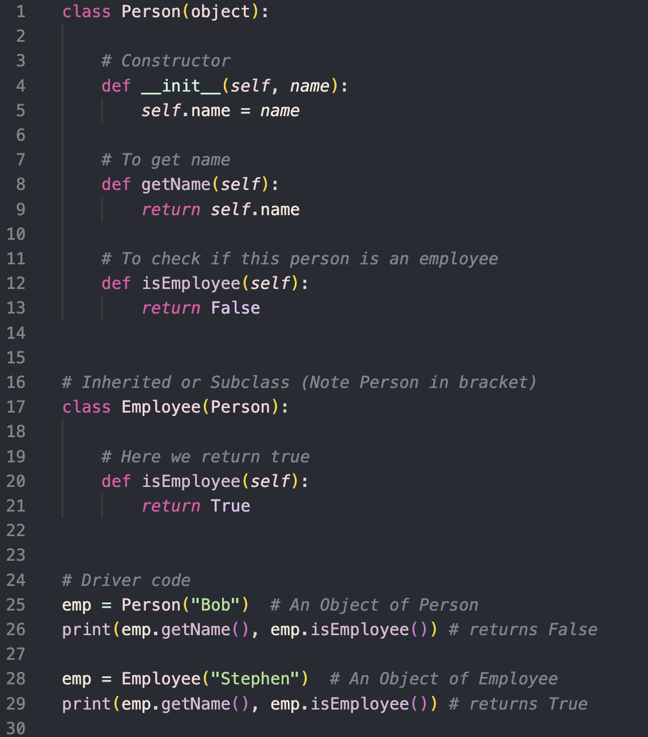
Example 2
We can also create new methods within the child class, that is only accessible to the child class

Slide 5
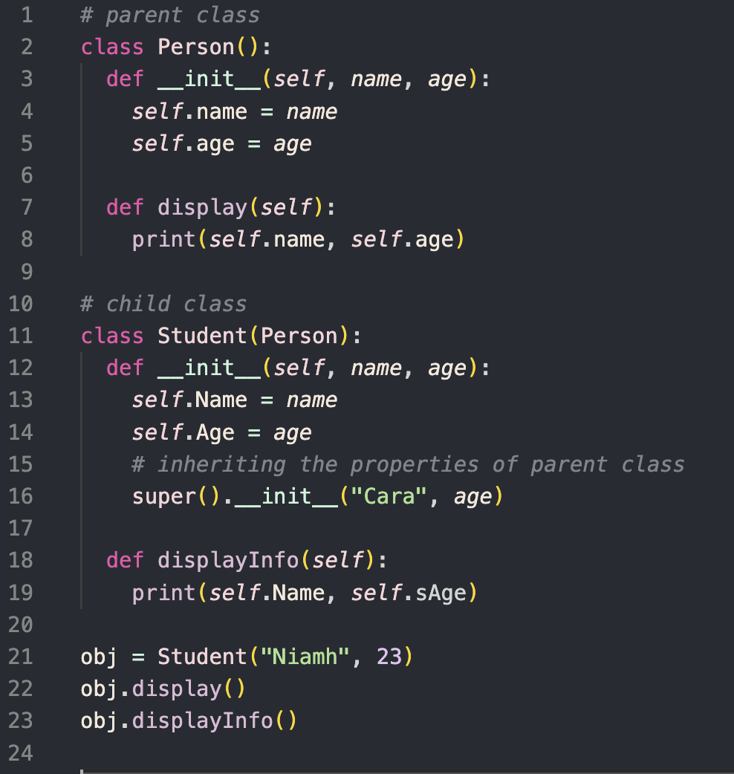
Example 3
We can inherit the `__init__` from the parent class

Slide 6
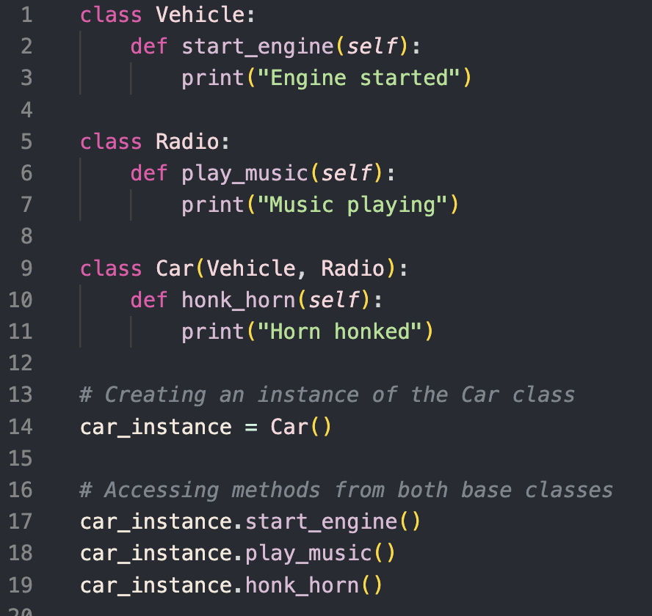
Example 4
We can inherit from multiple classes at the same time

Slide 7
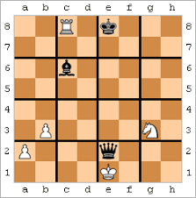
Exercise
Create a `ChessPiece` parent class with the variables initialized of xpos, ypos and colour (with the xpos and ypos being the position of the piece in a 2D array of the chess board)
Create a `Pawn` child class that inherits the variables from the chess piece parent class. Create a function called ‘IsLegalMove’ that determines whether an inputted x and y variable is legal for the pawn to move to, based on its current x and y position (self.xpos, self.ypos)
Create two instances of a pawn:
a. black_pawn, with colour white, xpos 3 and ypos 2
b. white_pawn, with colour white, xpos 5 and ypos 7

Slide 8
References
https://akshayraut.medium.com/inheritance-in-object-oriented-programming-8c61b93ca5a8
https://www.geeksforgeeks.org/inheritance-in-python/
https://en.wikipedia.org/wiki/Grid_chess

