Slide 1



sprocket
View in Power BI
Last data refresh:
20/11/2023 06:53:23 UTC
Downloaded at:
20/11/2023 07:43:08 UTC

Slide 2
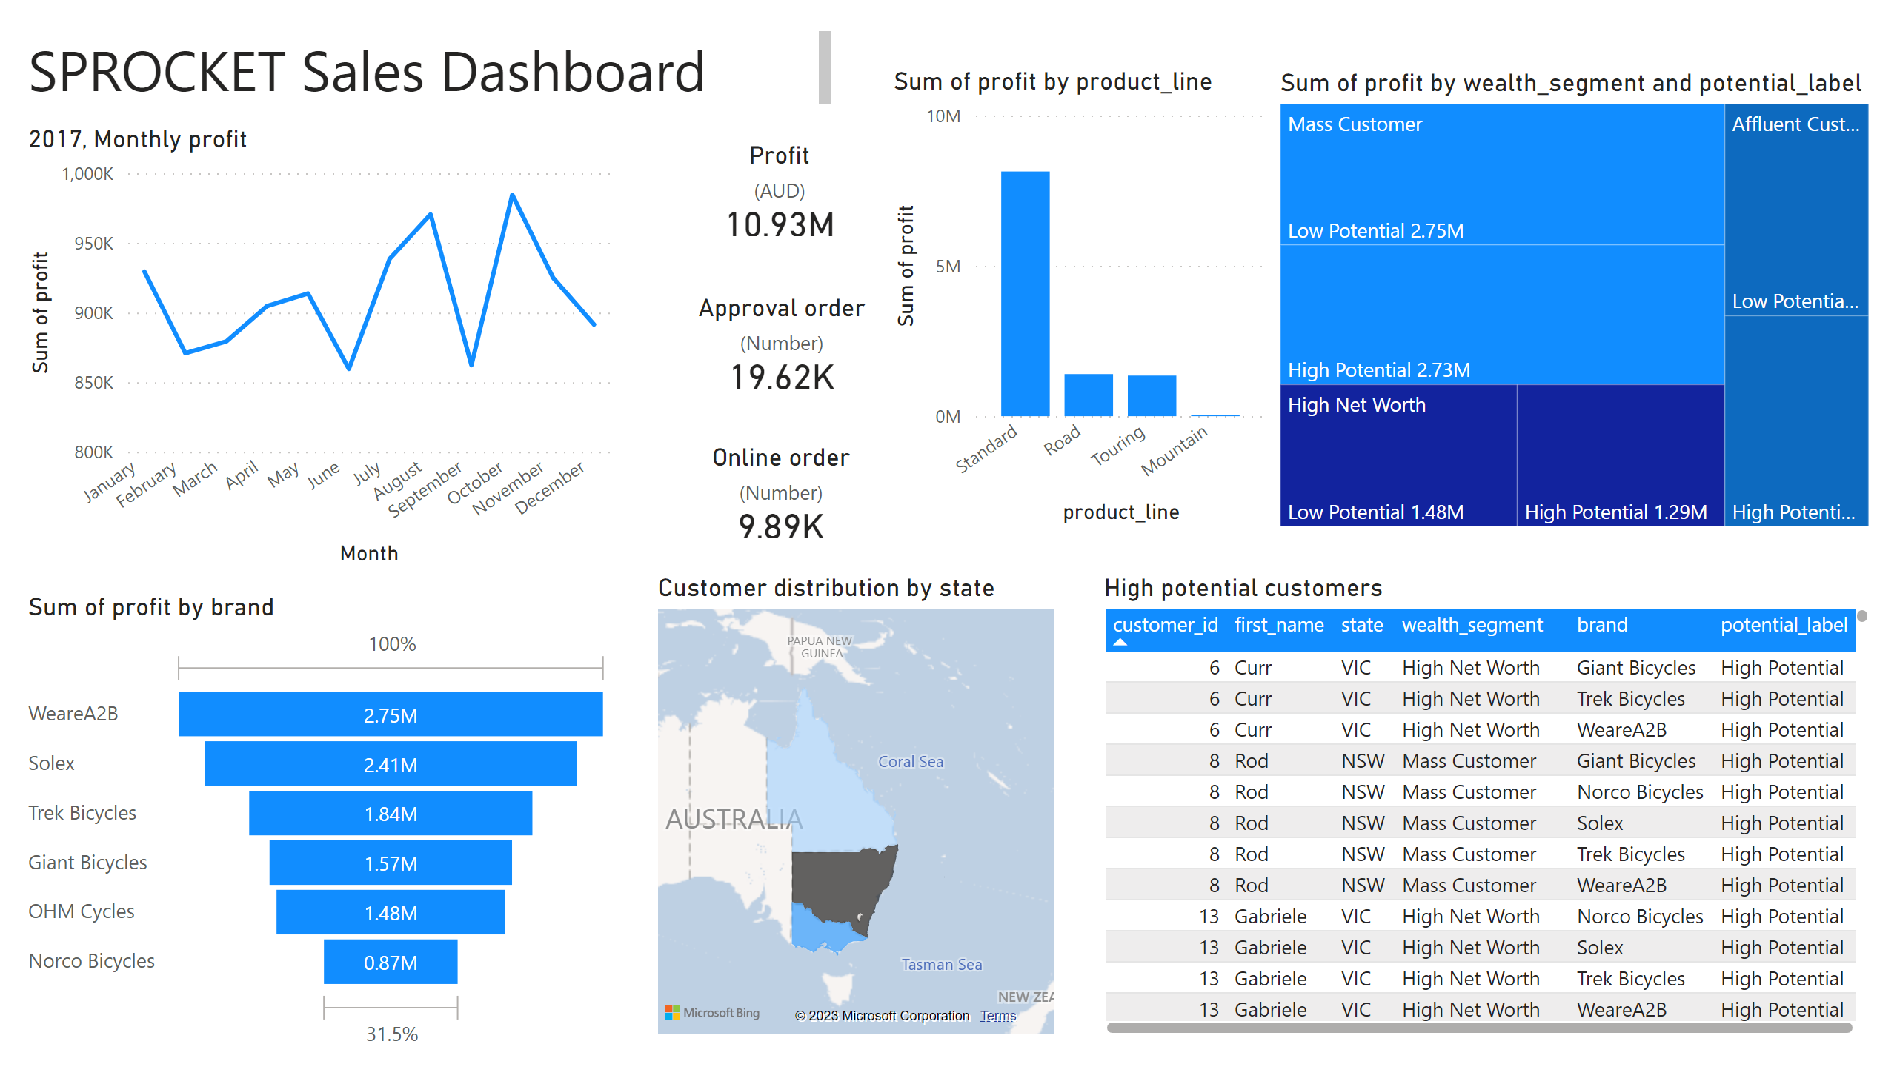
Page 1
Notes:
Online order
No alt text provided
Approval order
No alt text provided
Profit
No alt text provided
2017, Monthly profit
No alt text provided
High potential customers
No alt text provided
funnel
No alt text provided
Customer distribution by state
No alt text provided
textbox
No alt text provided
columnChart
No alt text provided
treemap
No alt text provided

