Slide 1
Decomposed Gaussian Process Regression

Slide 2
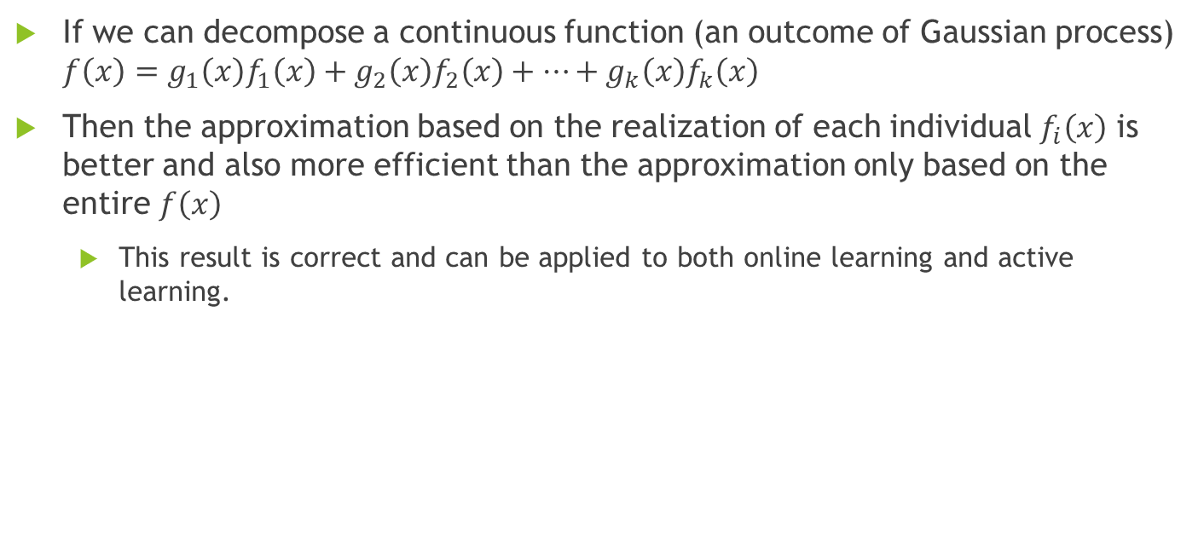
What we want to sell
If we can decompose a continuous function (an outcome of Gaussian process) $f\left(x\right)=g_{1}\left(x\right)f_{1}\left(x\right)+g_{2}\left(x\right)f_{2}\left(x\right)+…+g_{k}\left(x\right)f_{k}\left(x\right)$
Then the approximation based on the realization of each individual $f_{i}\left(x\right)$ is better and also more efficient than the approximation only based on the entire $f\left(x\right)$
This result is correct and can be applied to both online learning and active learning.

Slide 3
Theorem
Theorem 1 (not restricted to online learning)
Approximating the target function via individual subfunctions would give a better approximation (lower variance).
Theorem 2
If we apply the GP-UCB algorithm to approximate the individual subfunctions, the whole algorithm is also a no-regret algorithm.
We have the same regret order as directly approximating the entire function. But empirically our method beats the naïve one.

Slide 4
Story
Imperfect!
SEIS model optimization
(Bryan 2018)
Hybrid method
Use the structure of SEIS and the method of GP-UCB (in online learning).
Black box optimization
GP regression, online learning (Srinivas 2010)
TB prevention
Expensive!
Controlled input: clearance rate

Slide 5
Story
Imperfect!
Structural behavior analysis and optimization
Hybrid method
Based on the structural behavior, we can use the non-structural method to correct the model.
Black box function approximation and optimization
Target function
Expensive!
Controlled input

Slide 6

Story
The policy (clearance rate) is in groups-level. So we should try to approximate the function in groups-level, which is our $f_{i}\left(x\right)$.
This leads to a

Slide 7
Online Learning
Problem statement (modified):
We want to minimize the total infected population in the following 100 years.
We assume the disease behalves roughly like the SEIS population model (see the next slide) but not perfectly. So we add correction term to capture the error.
We can change the policy yearly (or monthly) based on the observations.

Slide 8
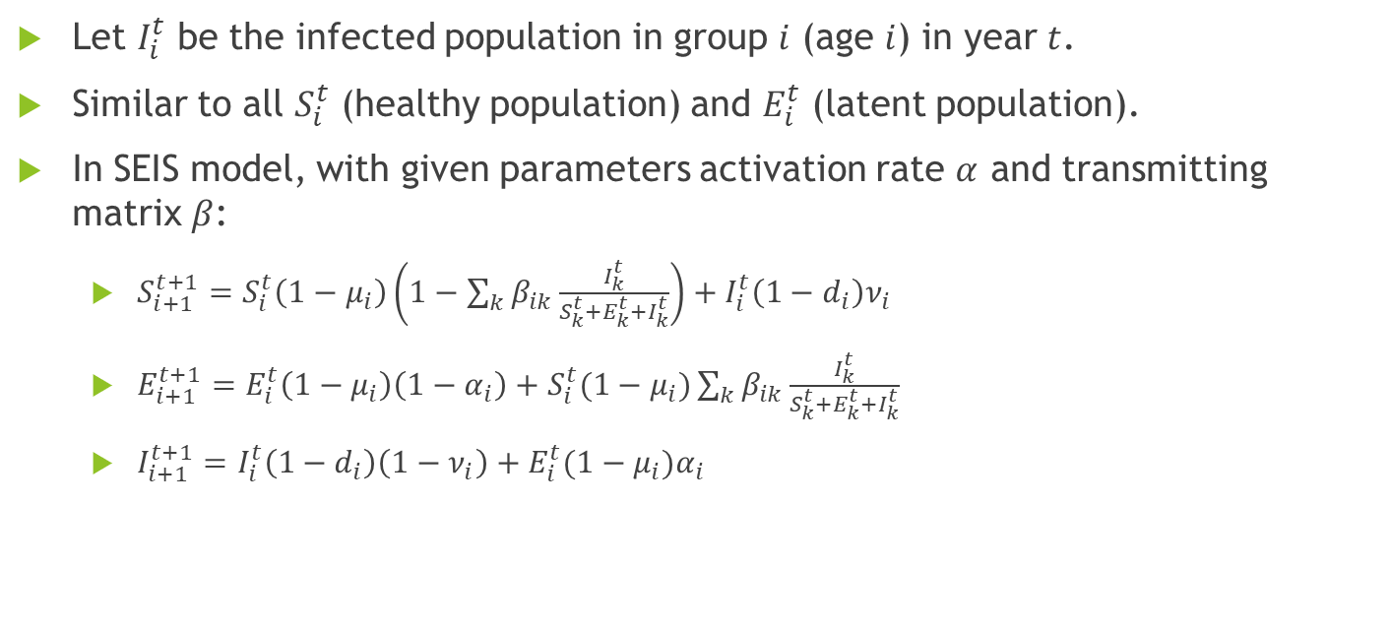
SEIS Population Model
Let $I_{i}^{t}$ be the infected population in group $i$ (age $i$) in year $t$.
Similar to all $S_{i}^{t}$ (healthy population) and $E_{i}^{t}$ (latent population).
In SEIS model, with given parameters activation rate $α$ and transmitting matrix $β$:
$S_{i+1}^{t+1}=S_{i}^{t}\left(1−μ_{i}\right)\left(1−\sum_{k}{β_{ik}\frac{I_{k}^{t}}{S_{k}^{t}+E_{k}^{t}+I_{k}^{t}}}\right)+I_{i}^{t}\left(1−d_{i}\right)ν_{i}$
$E_{i+1}^{t+1}=E_{i}^{t}\left(1−μ_{i}\right)\left(1−α_{i}\right)+S_{i}^{t}(1−μ_{i})\sum_{k}{β_{ik}\frac{I_{k}^{t}}{S_{k}^{t}+E_{k}^{t}+I_{k}^{t}}}$
$I_{i+1}^{t+1}=I_{i}^{t}\left(1−d_{i}\right)\left(1−ν_{i}\right)+E_{i}^{t}(1−μ_{i})α_{i}$

Slide 9
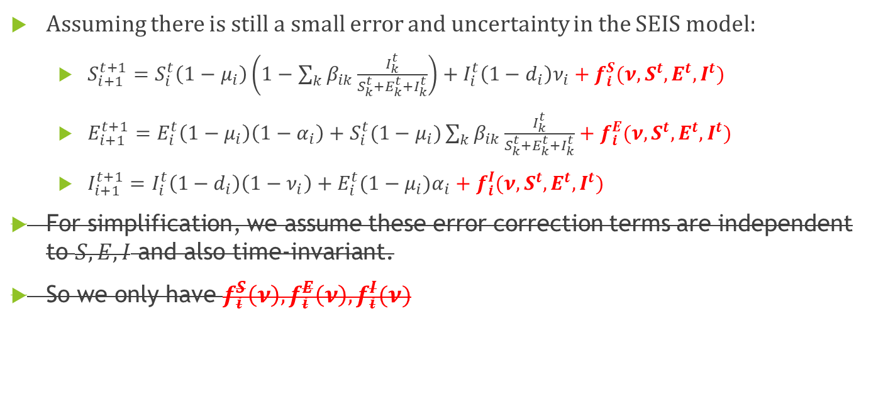
SEIS Population Model
Assuming there is still a small error and uncertainty in the SEIS model:
$S_{i+1}^{t+1}=S_{i}^{t}\left(1−μ_{i}\right)\left(1−\sum_{k}{β_{ik}\frac{I_{k}^{t}}{S_{k}^{t}+E_{k}^{t}+I_{k}^{t}}}\right)+I_{i}^{t}\left(1−d_{i}\right)ν_{i}+f_{i}^{S}(ν,S^{t},E^{t},I^{t})$
$E_{i+1}^{t+1}=E_{i}^{t}\left(1−μ_{i}\right)\left(1−α_{i}\right)+S_{i}^{t}(1−μ_{i})\sum_{k}{β_{ik}\frac{I_{k}^{t}}{S_{k}^{t}+E_{k}^{t}+I_{k}^{t}}}+f_{i}^{E}(ν,S^{t},E^{t},I^{t})$
$I_{i+1}^{t+1}=I_{i}^{t}\left(1−d_{i}\right)\left(1−ν_{i}\right)+E_{i}^{t}(1−μ_{i})α_{i}+f_{i}^{I}(ν,S^{t},E^{t},I^{t})$
For simplification, we assume these error correction terms are independent to $S,E,I$ and also time-invariant.
So we only have $f_{i}^{S}\left(ν\right),f_{i}^{E}\left(ν\right),f_{i}^{I}(ν)$

Slide 10
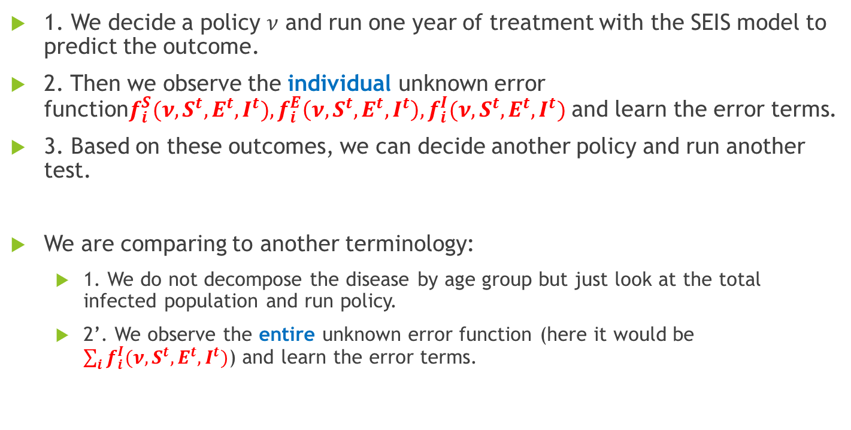
Terminology
1. We decide a policy $ν$ and run one year of treatment with the SEIS model to predict the outcome.
2. Then we observe the individual unknown error function$f_{i}^{S}(ν, S^{t},E^{t},I^{t}),f_{i}^{E}\left(ν, S^{t},E^{t},I^{t}\right),f_{i}^{I}(ν,S^{t},E^{t},I^{t})$ and learn the error terms.
3. Based on these outcomes, we can decide another policy and run another test.
We are comparing to another terminology:
1. We do not decompose the disease by age group but just look at the total infected population and run policy.
2’. We observe the entire unknown error function (here it would be $\sum_{i}{f_{i}^{I}(ν,S^{t},E^{t},I^{t})}$) and learn the error terms.

Slide 11
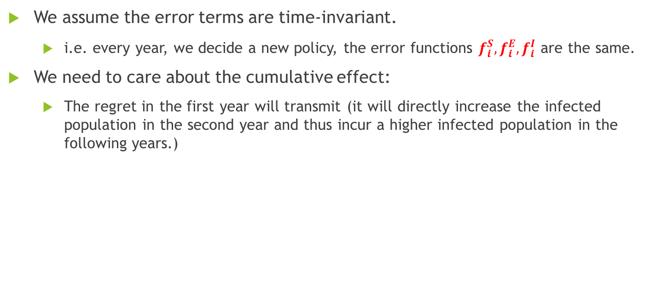
Some Assumption
We assume the error terms are time-invariant.
i.e. every year, we decide a new policy, the error functions $f_{i}^{S},f_{i}^{E},f_{i}^{I}$ are the same.
We need to care about the cumulative effect:
The regret in the first year will transmit (it will directly increase the infected population in the second year and thus incur a higher infected population in the following years.)

Slide 12
Some Assumption
The whole thing is actually the same as previous except we change the treatment period from 25 years to 1 year.
And we are aiming to minimizing over the following 100 years (i.e. run 100 trials and learn from them to continuously update the policy)

Slide 13
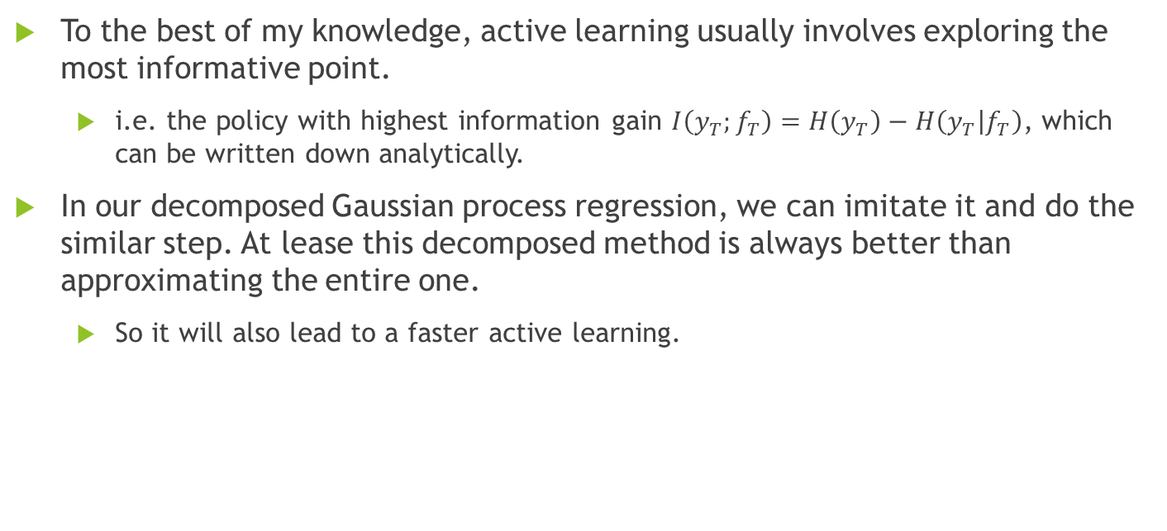
Active Learning (todo)
To the best of my knowledge, active learning usually involves exploring the most informative point.
i.e. the policy with highest information gain $I\left(y_{T};f_{T}\right)=H\left(y_{T}\right)−H\left(y_{T} | f_{T}\right)$, which can be written down analytically.
In our decomposed Gaussian process regression, we can imitate it and do the similar step. At lease this decomposed method is always better than approximating the entire one.
So it will also lead to a faster active learning.

