Slide 1
How to Utilize Side Information: Decomposed Gaussian Process Regression
Kai Wang, Bryan Wilder, Sze-Chuan Suen, Milind Tambe, Bistra Dilkina

Slide 2

Problem Background
Goal: we want to minimize the total Tuberculosis infected population in the following 25 years.
Input: policy $ν∈R^{n}, n=110$
Where $ν_{i}$ refers to what proportion of people in age $i$ would catch the information about Tuberculosis (so that they will seek a treatment and get cured.)
Budget constraint: $\sum{ν_{i}}≤B$

Slide 3
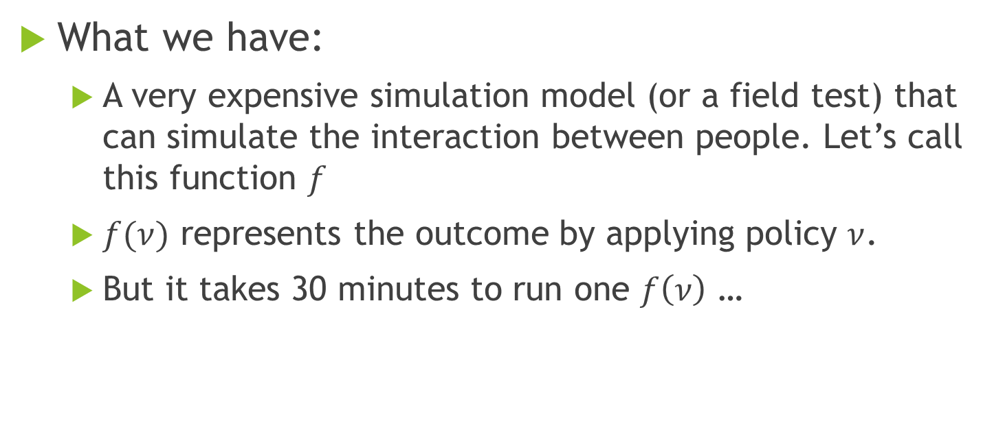
Problem Background
What we have:
A very expensive simulation model (or a field test) that can simulate the interaction between people. Let’s call this function $f$
$f(ν)$ represents the outcome by applying policy $ν$.
But it takes 30 minutes to run one $f\left(ν\right)$ …

Slide 4
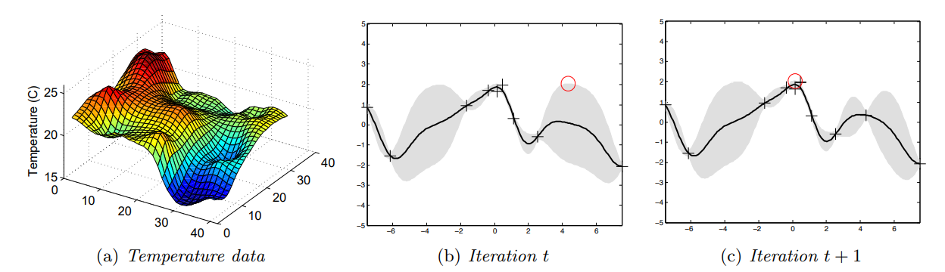
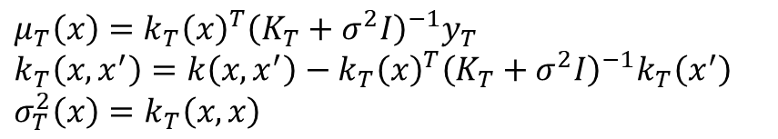
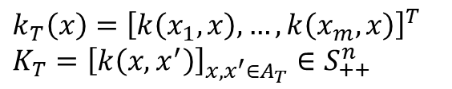
Gaussian Process Upper-confidence Based
$μ_{T}\left(x\right)=k_{T}{\left(x\right)}^{T}{\left(K_{T}+σ^{2}I\right)}^{−1}y_{T}$
$k_{T}\left(x,x^{′}\right)=k\left(x,x^{′}\right)−k_{T}{\left(x\right)}^{T}{\left(K_{T}+σ^{2}I\right)}^{−1}k_{T}\left(x^{′}\right)$
$σ_{T}^{2}\left(x\right)=k_{T}\left(x,x\right)$
$k_{T}\left(x\right)={\left[k\left(x_{1},x\right),…, k\left(x_{m},x\right)\right]}^{T}$
$K_{T}={\left[k\left(x,x^{′}\right)\right]}_{x,x^{′}∈A_{T}}∈S_{++}^{n}$
Gaussian Process Optimization in the Bandit Setting: No Regret and Experimental Design, 2010

Slide 5

In our problem
We can use Gaussian process regression to approximate our $f\left(ν\right), ν∈R^{n}$
But we don’t know the kernel $k\left(x,x^{′}\right)$…

Slide 6
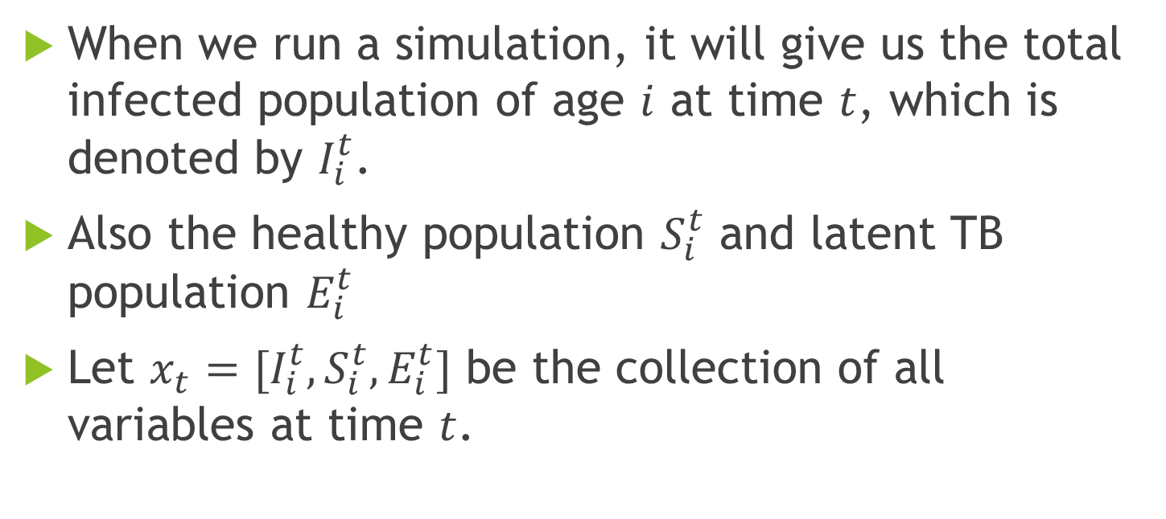
Markov property
When we run a simulation, it will give us the total infected population of age $i$ at time $t$, which is denoted by $I_{i}^{t}$.
Also the healthy population $S_{i}^{t}$ and latent TB population $E_{i}^{t}$
Let $x_{t}=[I_{i}^{t}, S_{i}^{t},E_{i}^{t}]$ be the collection of all variables at time $t$.

Slide 7
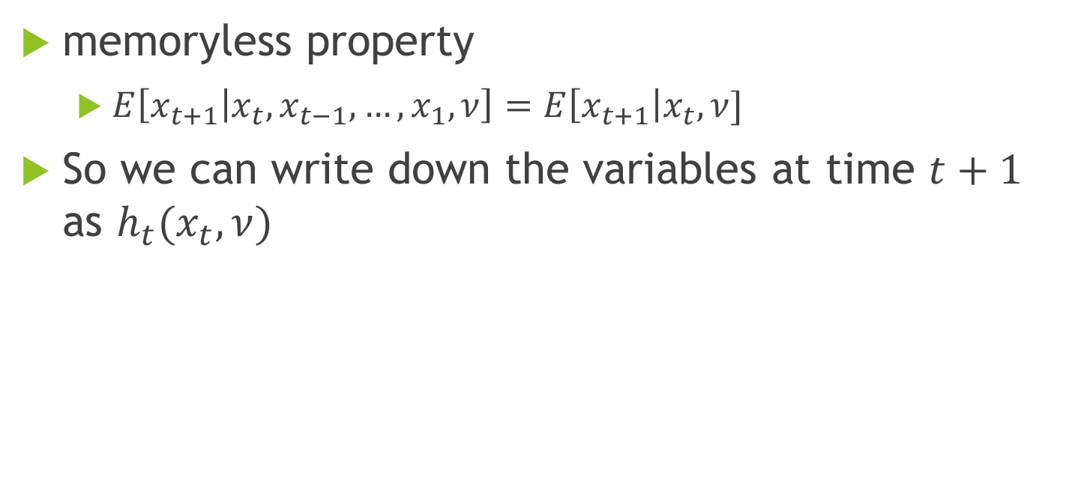
Markov property
memoryless property
$E\left[x_{t+1} | x_{t},x_{t−1},…,x_{1},ν\right]=E\left[x_{t+1}\right|x_{t},ν]$
So we can write down the variables at time $t+1$ as $h_{t}(x_{t},ν)$

Slide 8
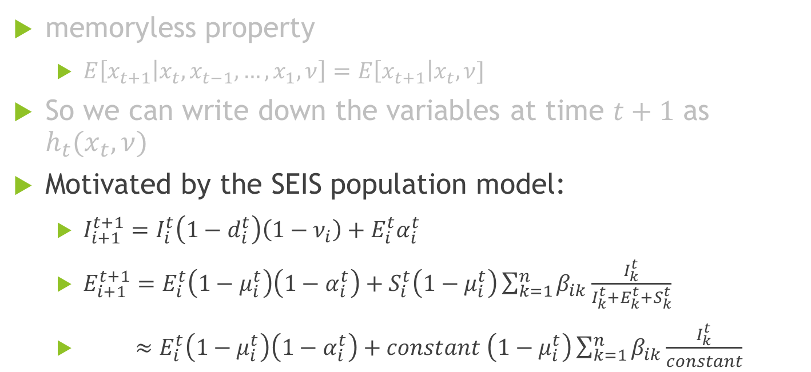
Markov property
memoryless property
$E\left[x_{t+1} | x_{t},x_{t−1},…,x_{1},ν\right]=E\left[x_{t+1}\right|x_{t},ν]$
So we can write down the variables at time $t+1$ as $h_{t}(x_{t},ν)$
Motivated by the SEIS population model:
$I_{i+1}^{t+1}=I_{i}^{t}\left(1−d_{i}^{t}\right)\left(1−ν_{i}\right)+E_{i}^{t}α_{i}^{t}$
$E_{i+1}^{t+1}=E_{i}^{t}\left(1−μ_{i}^{t}\right)\left(1−α_{i}^{t}\right)+S_{i}^{t}\left(1−μ_{i}^{t}\right)\sum_{k=1}^{n}{β_{ik}\frac{I_{k}^{t}}{I_{k}^{t}+E_{k}^{t}+S_{k}^{t}}}$
$≈E_{i}^{t}\left(1−μ_{i}^{t}\right)\left(1−α_{i}^{t}\right)+constant \left(1−μ_{i}^{t}\right)\sum_{k=1}^{n}{β_{ik}\frac{I_{k}^{t}}{constant}}$

Slide 9

Linear approximation
$x_{t+1}=h_{t}\left(x_{t},ν\right)=A_{t}\left(ν\right)x_{t}+f_{t}(ν)$
Where $A_{t}\left(ν\right)∈R^{n×n}$ is a matrix of linear function in terms of $ν$
And $f_{t}\left(ν\right)$ is the difference (error) of $x_{t+1}$ and $A_{t}\left(ν\right)x_{t}$

Slide 10
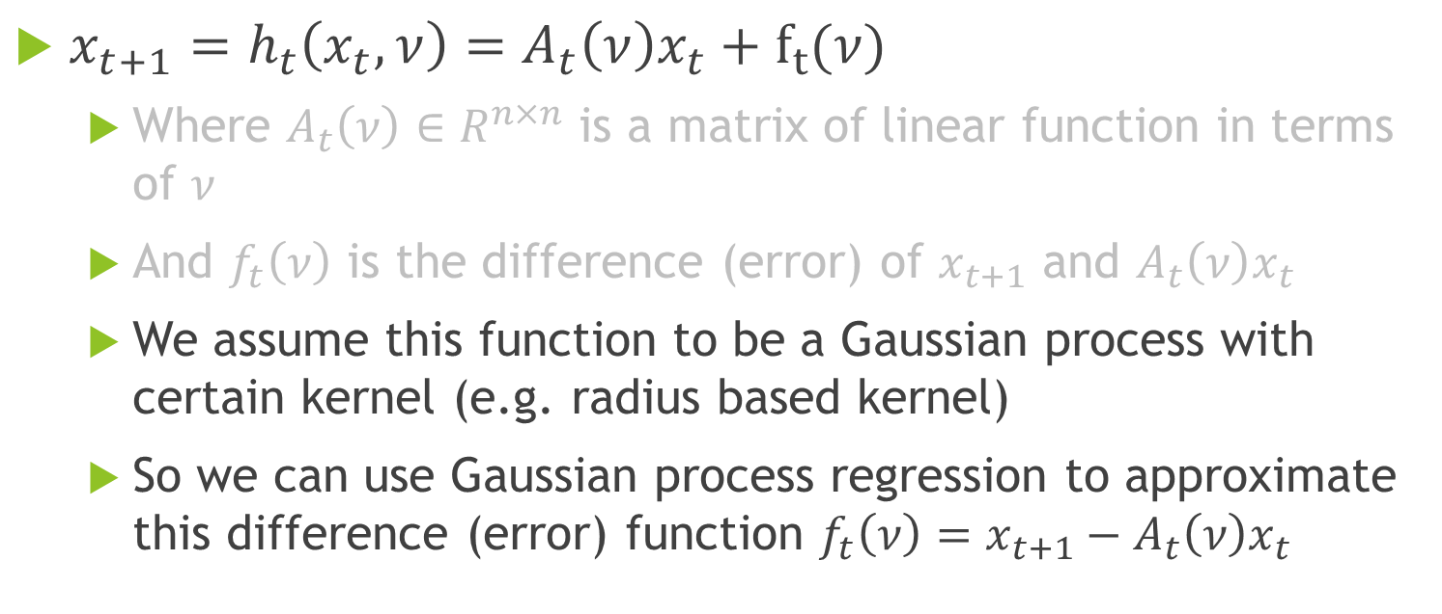
Linear approximation
$x_{t+1}=h_{t}\left(x_{t},ν\right)=A_{t}\left(ν\right)x_{t}+f_{t}(ν)$
Where $A_{t}\left(ν\right)∈R^{n×n}$ is a matrix of linear function in terms of $ν$
And $f_{t}\left(ν\right)$ is the difference (error) of $x_{t+1}$ and $A_{t}\left(ν\right)x_{t}$
We assume this function to be a Gaussian process with certain kernel (e.g. radius based kernel)
So we can use Gaussian process regression to approximate this difference (error) function ${f_{t}\left(ν\right)=x}_{t+1}−A_{t}\left(ν\right)x_{t}$

Slide 11







Fragmentation model
$$A_{1}(ν)$$
$$A_{2}(ν)$$
$$A_{T−1}(ν)$$
$$x_{1}$$
$$x_{2}$$
$$x_{3}$$
…
$$x_{T}$$

Slide 12



Fragmentation model
$$A_{1}(ν)$$
$$A_{2}(ν)$$
$$A_{T−1}(ν)$$
$$x_{1}$$
$$x_{2}$$
$$x_{3}$$
…
$$x_{T}$$
$$f_{1}(ν)$$
$$f_{2}(ν)$$
$$f_{T−1}(ν)$$

Slide 13
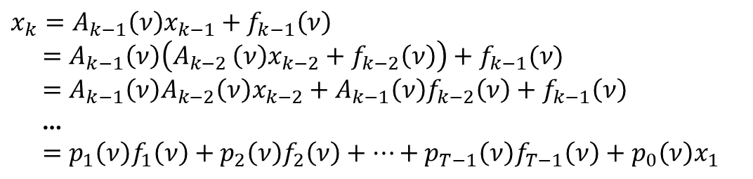
Fragmentation model
$$A_{1}(ν)$$
$$A_{2}(ν)$$
$$A_{T−1}(ν)$$
$$x_{1}$$
$$x_{2}$$
$$x_{3}$$
…
$$x_{T}$$
$$f_{1}(ν)$$
$$f_{2}(ν)$$
$$f_{T−1}(ν)$$
$$x_{k}=A_{k−1}\left(ν\right)x_{k−1}+f_{k−1}\left(ν\right)$$
$=A_{k−1}\left(ν\right)\left(A_{k−2 }\left(ν\right)x_{k−2}+f_{k−2}\left(ν\right)\right)+f_{k−1}(ν)$
$=A_{k−1}\left(ν\right)A_{k−2}\left(ν\right)x_{k−2}+A_{k−1}\left(ν\right)f_{k−2}\left(ν\right)+f_{k−1}\left(ν\right)$
…
$=p_{1}\left(ν\right)f_{1}\left(ν\right)+p_{2}\left(ν\right)f_{2}\left(ν\right)+…+p_{T−1}\left(ν\right)f_{T−1}\left(ν\right)+p_{0}\left(ν\right)x_{1}$

Slide 14
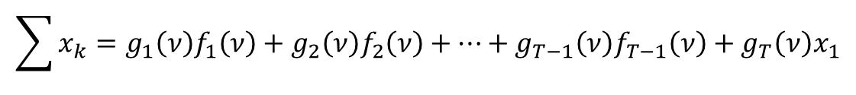
Fragmentation model
$$A_{1}(ν)$$
$$A_{2}(ν)$$
$$A_{T−1}(ν)$$
$$x_{1}$$
$$x_{2}$$
$$x_{3}$$
…
$$x_{T}$$
$$f_{1}(ν)$$
$$f_{2}(ν)$$
$$f_{T−1}(ν)$$
$$x_{k}=A_{k−1}\left(ν\right)x_{k−1}+f_{k−1}\left(ν\right)$$
$=A_{k−1}\left(ν\right)\left(A_{k−2 }\left(ν\right)x_{k−2}+f_{k−2}\left(ν\right)\right)+f_{k−1}(ν)$
$=A_{k−1}\left(ν\right)A_{k−2}\left(ν\right)x_{k−2}+A_{k−1}\left(ν\right)f_{k−2}\left(ν\right)+f_{k−1}\left(ν\right)$
…
$=p_{1}\left(ν\right)f_{1}\left(ν\right)+p_{2}\left(ν\right)f_{2}\left(ν\right)+…+p_{T−1}\left(ν\right)f_{T−1}\left(ν\right)+p_{0}\left(ν\right)x_{1}$
$$\sum{x_{k}}=g_{1}\left(ν\right)f_{1}\left(ν\right)+g_{2}\left(ν\right)f_{2}\left(ν\right)+…+g_{T−1}\left(ν\right)f_{T−1}\left(ν\right)+g_{T}\left(ν\right)x_{1}$$

Slide 15

Kernel
So we know the total infected population in the following T years would be
$f\left(ν\right)=1_{I}^{T}\sum{x_{k}}=g_{1}\left(ν\right)1_{I}^{T}f_{1}\left(ν\right)+g_{2}\left(ν\right)1_{I}^{T}f_{2}\left(ν\right)+…+g_{T−1}\left(ν\right)1_{I}^{T}f_{T−1}\left(ν\right)+g_{T}\left(ν\right)1_{I}^{T}x_{1}$

Slide 16
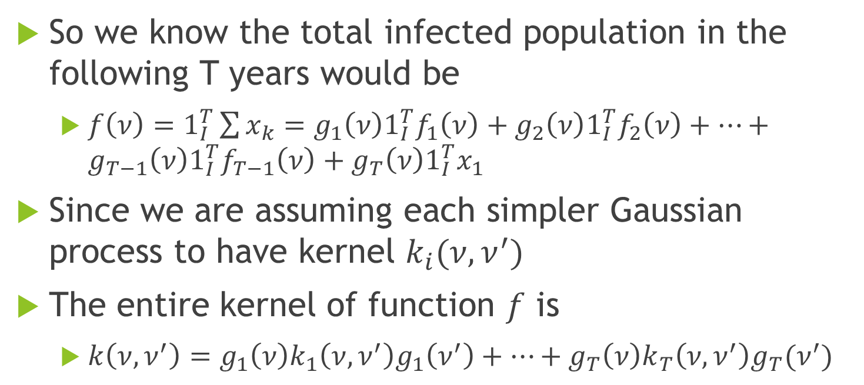
Kernel
So we know the total infected population in the following T years would be
$f\left(ν\right)=1_{I}^{T}\sum{x_{k}}=g_{1}\left(ν\right)1_{I}^{T}f_{1}\left(ν\right)+g_{2}\left(ν\right)1_{I}^{T}f_{2}\left(ν\right)+…+g_{T−1}\left(ν\right)1_{I}^{T}f_{T−1}\left(ν\right)+g_{T}\left(ν\right)1_{I}^{T}x_{1}$
Since we are assuming each simpler Gaussian process to have kernel $k_{i}(ν,ν^{′})$
The entire kernel of function $f$ is
$k\left(ν,ν^{′}\right)=g_{1}\left(ν\right)k_{1}\left(ν,ν^{′}\right)g_{1}\left(ν^{′}\right)+…+g_{T}\left(ν\right)k_{T}\left(ν,ν^{′}\right)g_{T}(ν^{′})$

Slide 17
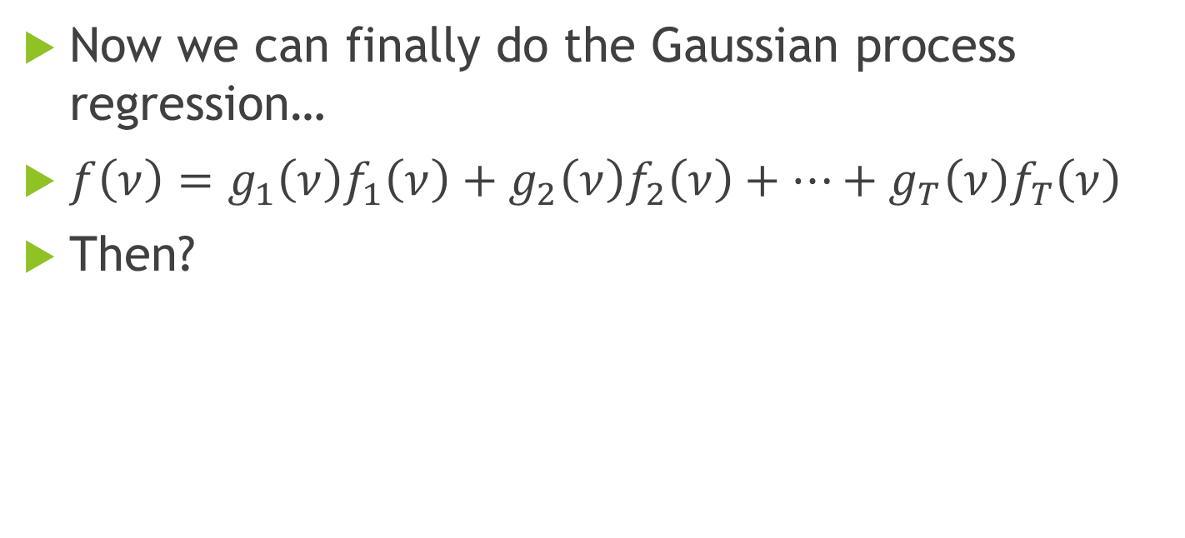
Gaussian process regression
Now we can finally do the Gaussian process regression…
$f\left(ν\right)=g_{1}\left(ν\right)f_{1}\left(ν\right)+g_{2}\left(ν\right)f_{2}\left(ν\right)+…+g_{T}\left(ν\right)f_{T}\left(ν\right)$
Then?

Slide 18
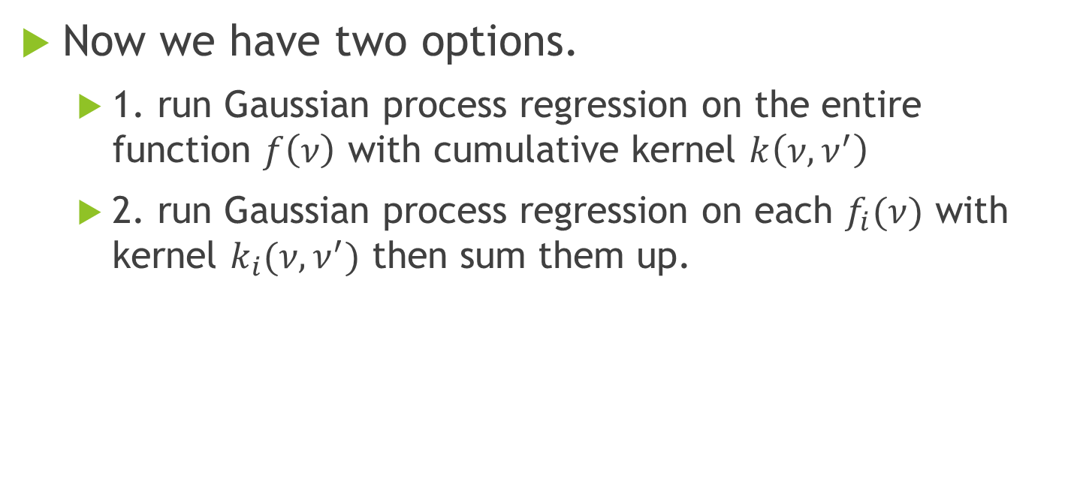
Gaussian process regression
Now we have two options.
1. run Gaussian process regression on the entire function $f\left(ν\right)$ with cumulative kernel $k\left(ν,ν^{′}\right)$
2. run Gaussian process regression on each $f_{i}(ν)$ with kernel $k_{i}(ν,ν^{′})$ then sum them up.

Slide 19
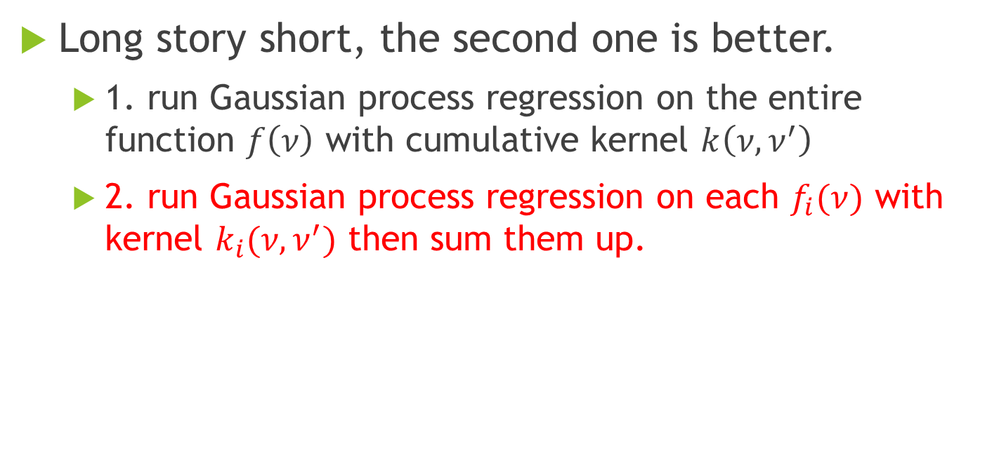
Short story
Long story short, the second one is better.
1. run Gaussian process regression on the entire function $f\left(ν\right)$ with cumulative kernel $k\left(ν,ν^{′}\right)$
2. run Gaussian process regression on each $f_{i}(ν)$ with kernel $k_{i}(ν,ν^{′})$ then sum them up.

Slide 20
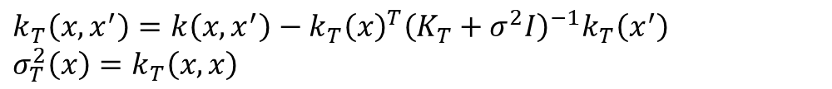
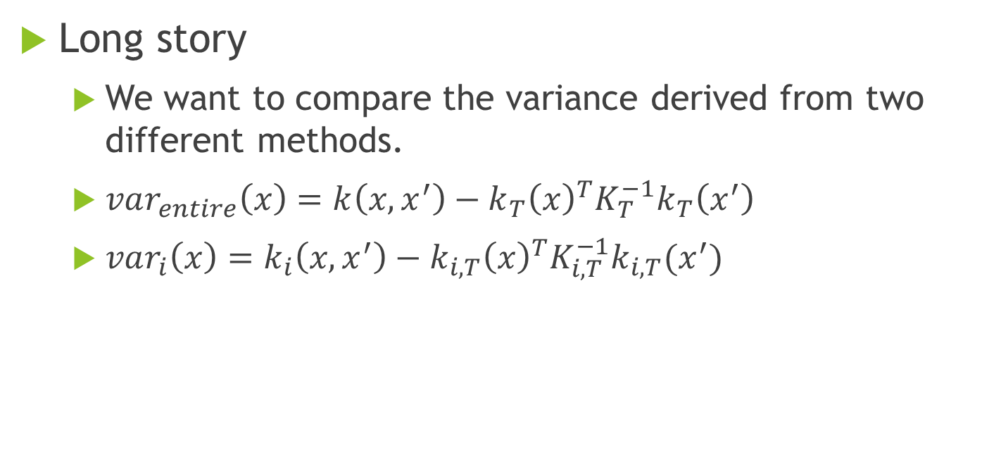
Long story…
Long story
We want to compare the variance derived from two different methods.
$var_{entire}\left(x\right)=k\left(x,x^{′}\right)−k_{T}{\left(x\right)}^{T}K_{T}^{−1}k_{T}\left(x^{′}\right)$
$var_{i}\left(x\right)=k_{i}\left(x,x^{′}\right)−k_{i,T}{\left(x\right)}^{T}K_{i,T}^{−1}k_{i,T}(x^{′})$
$k_{T}\left(x,x^{′}\right)=k\left(x,x^{′}\right)−k_{T}{\left(x\right)}^{T}{\left(K_{T}+σ^{2}I\right)}^{−1}k_{T}\left(x^{′}\right)$
$σ_{T}^{2}\left(x\right)=k_{T}\left(x,x\right)$

Slide 21
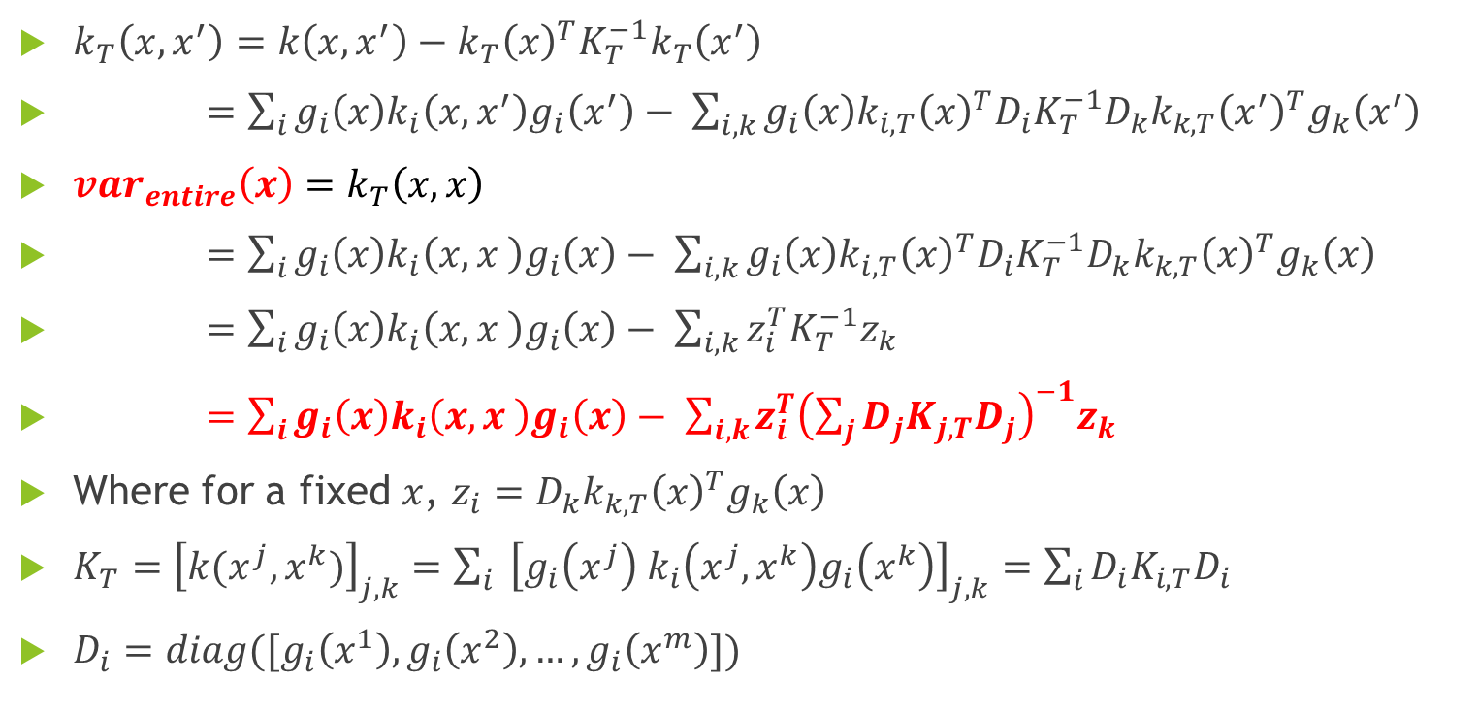
Long long story…
$k_{T}\left(x,x^{′}\right)=k\left(x,x^{′}\right)−k_{T}{\left(x\right)}^{T}K_{T}^{−1}k_{T}\left(x^{′}\right)$
$=\sum_{i}{g_{i}\left(x\right)k_{i}\left(x,x^{′}\right)g_{i}\left(x^{′}\right)}− \sum_{i,k}{g_{i}\left(x\right)k_{i,T}{\left(x\right)}^{T}D_{i}K_{T}^{−1}D_{k}k_{k,T}{\left(x^{′}\right)}^{T}g_{k}\left(x^{′}\right)}$
$var_{entire}\left(x\right)=k_{T}\left(x,x\right)$
$=\sum_{i}{g_{i}\left(x\right)k_{i}\left(x,x \right)g_{i}\left(x\right)}− \sum_{i,k}{g_{i}\left(x\right)k_{i,T}{\left(x\right)}^{T}D_{i}K_{T}^{−1}D_{k}k_{k,T}{\left(x\right)}^{T}g_{k}\left(x\right)}$
$=\sum_{i}{g_{i}\left(x\right)k_{i}\left(x,x \right)g_{i}\left(x\right)}− \sum_{i,k}{z_{i}^{T}K_{T}^{−1}z_{k}}$
$=\sum_{i}{g_{i}\left(x\right)k_{i}\left(x,x \right)g_{i}\left(x\right)}− \sum_{i,k}{z_{i}^{T}{\left(\sum_{j}{D_{j}K_{j,T}D_{j}}\right)}^{−1}z_{k}}$
Where for a fixed $x$, $z_{i}=D_{k}k_{k,T}{\left(x\right)}^{T}g_{k}\left(x\right)$
$K_{T}={\left[k(x^{j}, x^{k})\right]}_{j,k}=\sum_{i}{ {\left[g_{i}\left(x^{j}\right) k_{i}\left(x^{j},x^{k}\right)g_{i}\left(x^{k}\right)\right]}_{j,k}}=\sum_{i}{D_{i}K_{i,T}D_{i}}$
$D_{i}=diag([g_{i}\left(x^{1}\right),g_{i}\left(x^{2}\right),…,g_{i}\left(x^{m}\right)])$

Slide 22
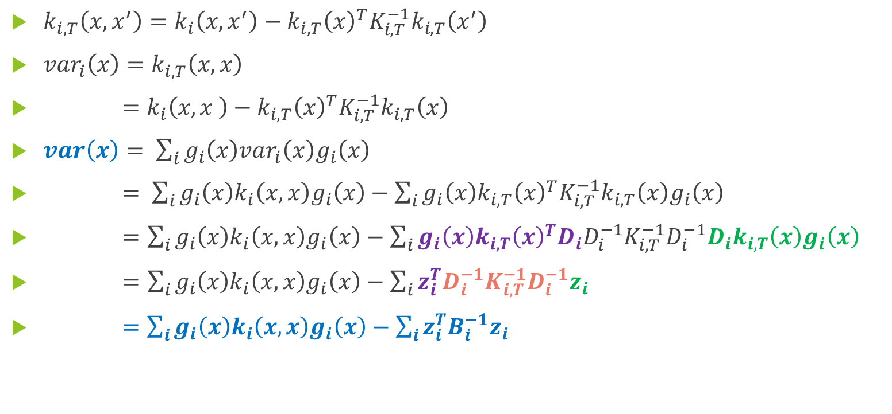
Long long long story…
$k_{i,T}\left(x,x^{′}\right)=k_{i}\left(x,x^{′}\right)−k_{i,T}{\left(x\right)}^{T}K_{i,T}^{−1}k_{i,T}\left(x^{′}\right)$
$var_{i}\left(x\right)=k_{i,T}\left(x,x\right)$
$=k_{i}\left(x,x \right)−k_{i,T}{\left(x\right)}^{T}K_{i,T}^{−1}k_{i,T}\left(x\right)$
$var\left(x\right)$ $= \sum_{i}{g_{i}\left(x\right)var_{i}\left(x\right)g_{i}\left(x\right)}$
$= \sum_{i}{g_{i}\left(x\right)k_{i}\left(x,x\right)g_{i}\left(x\right)}−\sum_{i}{g_{i}\left(x\right)k_{i,T}{\left(x\right)}^{T}K_{i,T}^{−1}k_{i,T}\left(x\right)g_{i}\left(x\right)}$
$=$ $\sum_{i}{g_{i}\left(x\right)k_{i}\left(x,x\right)g_{i}\left(x\right)}−\sum_{i}{g_{i}\left(x\right)k_{i,T}{\left(x\right)}^{T}D_{i}D_{i}^{−1}K_{i,T}^{−1}D_{i}^{−1}D_{i}k_{i,T}\left(x\right)g_{i}\left(x\right)}$
$=$ $\sum_{i}{g_{i}\left(x\right)k_{i}\left(x,x\right)g_{i}\left(x\right)}−\sum_{i}{z_{i}^{T}D_{i}^{−1}K_{i,T}^{−1}D_{i}^{−1}z_{i}}$
$=\sum_{i}{g_{i}\left(x\right)k_{i}\left(x,x\right)g_{i}\left(x\right)}−\sum_{i}{z_{i}^{T}B_{i}^{−1}z_{i}}$

Slide 23
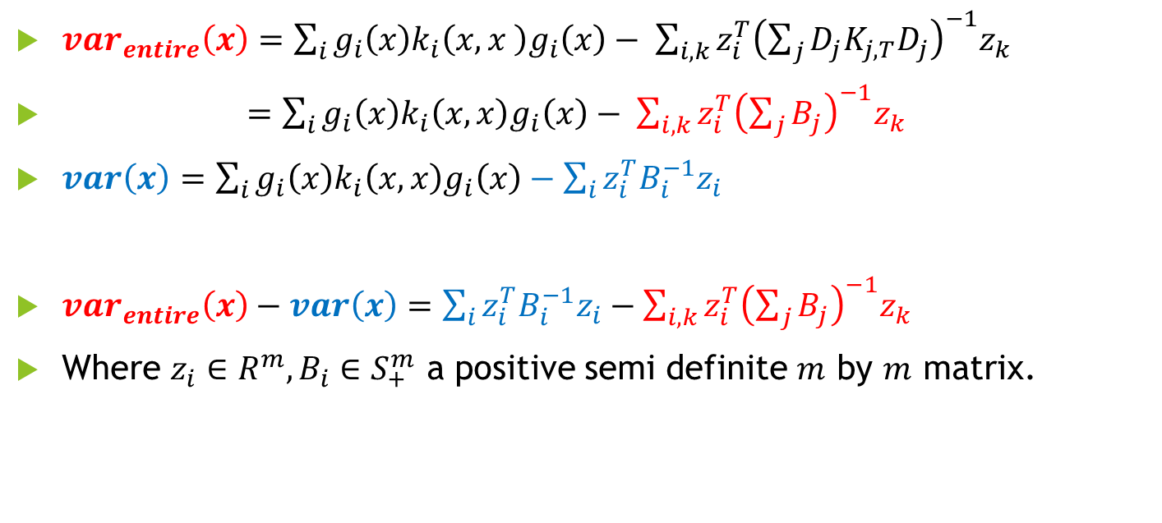
Conti.
$var_{entire}\left(x\right)=\sum_{i}{g_{i}\left(x\right)k_{i}\left(x,x \right)g_{i}\left(x\right)}− \sum_{i,k}{z_{i}^{T}{\left(\sum_{j}{D_{j}K_{j,T}D_{j}}\right)}^{−1}z_{k}}$
$=\sum_{i}{g_{i}\left(x\right)k_{i}\left(x,x\right)g_{i}\left(x\right)}− \sum_{i,k}{z_{i}^{T}{\left(\sum_{j}{B_{j}}\right)}^{−1}z_{k}}$
$var\left(x\right)=$ $\sum_{i}{g_{i}\left(x\right)k_{i}\left(x,x\right)g_{i}\left(x\right)}−\sum_{i}{z_{i}^{T}B_{i}^{−1}z_{i}}$
$var_{entire}\left(x\right)−var\left(x\right)=\sum_{i}{z_{i}^{T}B_{i}^{−1}z_{i}}−\sum_{i,k}{z_{i}^{T}{\left(\sum_{j}{B_{j}}\right)}^{−1}z_{k}}$
Where $z_{i}∈R^{m}, B_{i}∈S_{+}^{m}$ a positive semi definite $m$ by $m$ matrix.

Slide 24
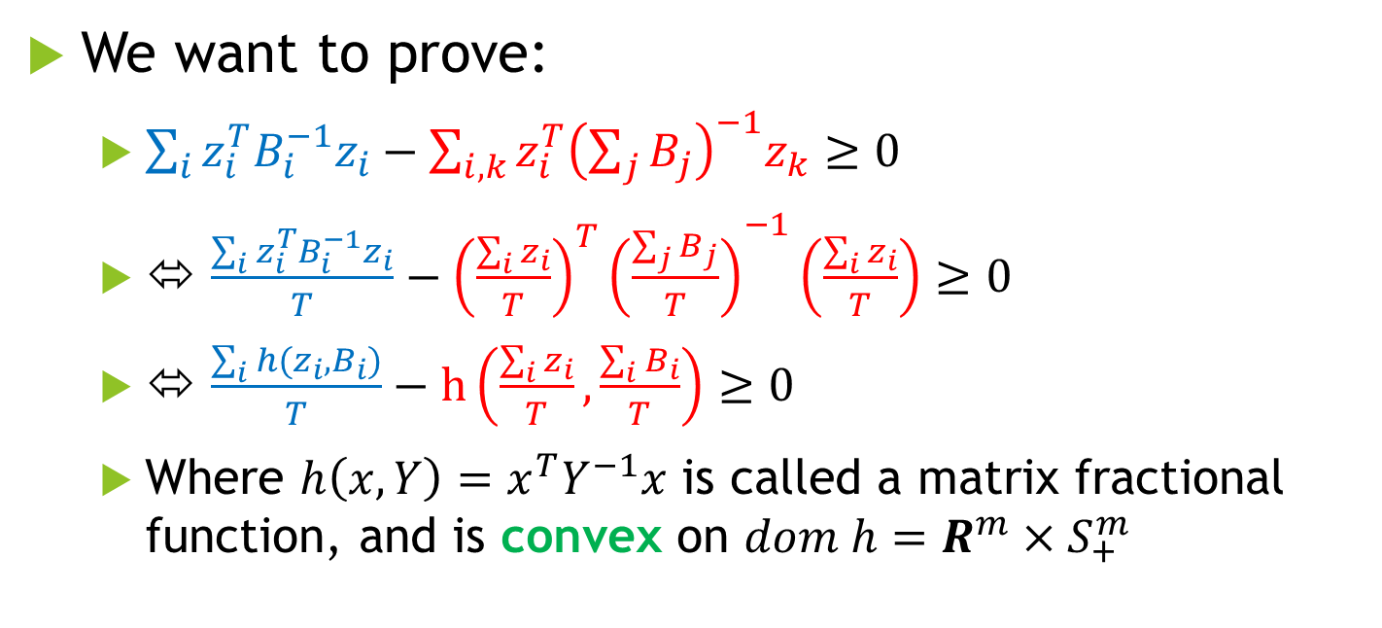
Conti.
We want to prove:
$\sum_{i}{z_{i}^{T}B_{i}^{−1}z_{i}}−\sum_{i,k}{z_{i}^{T}{\left(\sum_{j}{B_{j}}\right)}^{−1}z_{k}}≥0$
⬄ $\frac{\sum_{i}{z_{i}^{T}B_{i}^{−1}z_{i}}}{T}−{{\left(\frac{\sum_{i}{z_{i}}}{T}\right)}^{T}\left(\frac{\sum_{j}{B_{j}}}{T}\right)}^{−1}\left(\frac{\sum_{i}{z_{i}}}{T}\right)≥0$
⬄ $\frac{\sum_{i}{h(z_{i},B_{i})}}{T}−h\left(\frac{\sum_{i}{z_{i}}}{T},\frac{\sum_{i}{B_{i}}}{T}\right)≥0$
Where $h\left(x,Y\right)=x^{T}Y^{−1}x$ is called a matrix fractional function, and is convex on $dom h=R^{m}×S_{+}^{m}$

Slide 25

Conti.
Therefore, by Jenson’s inequality on convex function $h$, the inequality holds.
$\frac{\sum_{i}{h(z_{i},B_{i})}}{T}−h\left(\frac{\sum_{i}{z_{i}}}{T},\frac{\sum_{i}{B_{i}}}{T}\right)≥0$

Slide 26
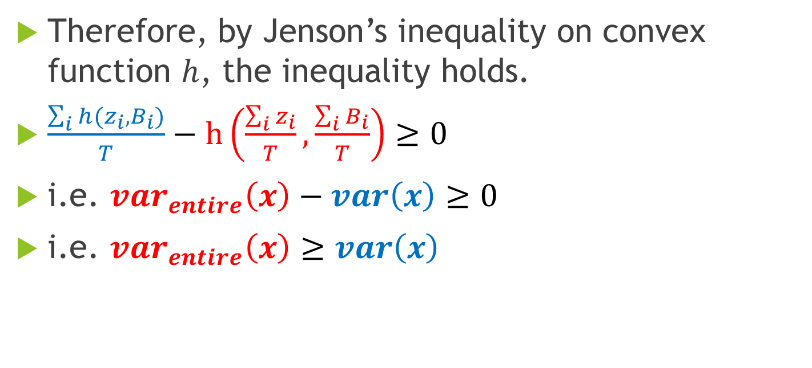
Conti.
Therefore, by Jenson’s inequality on convex function $h$, the inequality holds.
$\frac{\sum_{i}{h(z_{i},B_{i})}}{T}−h\left(\frac{\sum_{i}{z_{i}}}{T},\frac{\sum_{i}{B_{i}}}{T}\right)≥0$
i.e. $var_{entire}\left(x\right)−var\left(x\right)≥0$
i.e. $var_{entire}\left(x\right)≥var\left(x\right)$

Slide 27
Conclusion
It implies running individual Gaussian process regression helps on reducing the uncertainty.

Slide 28

Next step
Our problem is a two-stage problem:
1. Learn the linear approximation $g_{i}(ν)$
2. Approximate $f\left(x\right)= \sum_{i}{g_{i}\left(ν\right)f_{i}(ν)}$ and find the optimal solution

Slide 29

Next step
Our problem is a two-stage problem:
1. Learn the linear approximation $g_{i}(ν)$
2. Approximate $f\left(x\right)= \sum_{i}{g_{i}\left(ν\right)f_{i}(ν)}$ and find the optimal solution

Slide 30
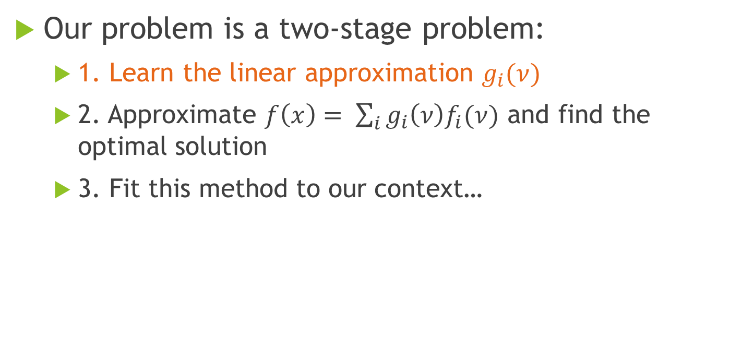
Next step
Our problem is a two-stage problem:
1. Learn the linear approximation $g_{i}(ν)$
2. Approximate $f\left(x\right)= \sum_{i}{g_{i}\left(ν\right)f_{i}(ν)}$ and find the optimal solution
3. Fit this method to our context…

