Slide 1
GP-UCB proof sketch
Gaussian Process Optimization in the Bandit Setting: No Regret and Experimental Design Niranjan Srinivas, Andreas Krause, Sham M. Kakade, Matthias Seeger

Slide 2
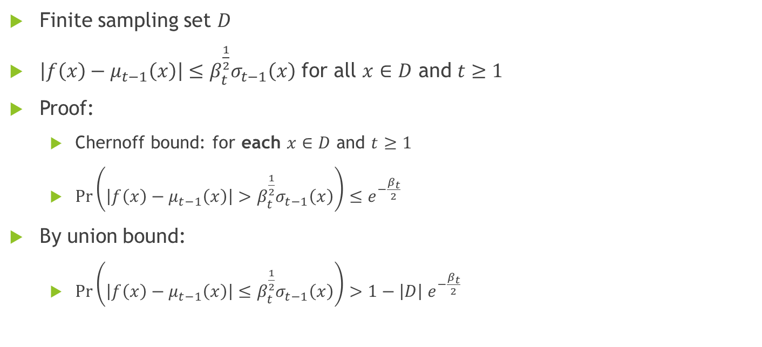
Chernoff bound and union bound
Finite sampling set $D$
$\left|f\left(x\right)−μ_{t−1}\left(x\right)\right|≤β_{t}^{\frac{1}{2}}σ_{t−1}\left(x\right)$ for all $x∈D$ and $t≥1$
Proof:
Chernoff bound: for each $x∈D$ and $t≥1$
$\operatorname{Pr}\left(\left|f\left(x\right)−μ_{t−1}\left(x\right)\right|>β_{t}^{\frac{1}{2}}σ_{t−1}\left(x\right)\right)≤e^{−\frac{β_{t}}{2}}$
By union bound:
$\operatorname{Pr}\left(\left|f\left(x\right)−μ_{t−1}\left(x\right)\right|≤β_{t}^{\frac{1}{2}}σ_{t−1}\left(x\right)\right)>1−\left|D\right| e^{−\frac{β_{t}}{2}}$

Slide 3

Chernoff bound and union bound
Choose $\left|D\right|e^{−\frac{β_{t}}{2}}=\frac{δ}{π_{t}}$ with $\sum_{t}{\frac{1}{π_{t}}}=1$
So by union bound on $t≥1$
$\operatorname{Pr}\left(\left|f\left(x\right)−μ_{t−1}\left(x\right)\right|≤β_{t}^{\frac{1}{2}}σ_{t−1}\left(x\right)\right)>1−\sum_{t}{\left|D\right|e^{−\frac{β_{t}}{2}}}=1−δ$

Slide 4
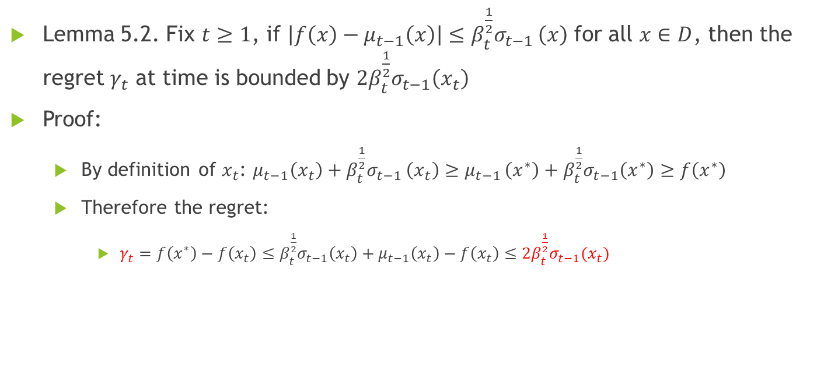
Regret
Lemma 5.2. Fix $t≥1$, if $\left|f\left(x\right)−μ_{t−1}\left(x\right)\right|≤β_{t}^{\frac{1}{2}}σ_{t−1 }\left(x\right)$ for all $x∈D$, then the regret $γ_{t}$ at time is bounded by $2β_{t}^{\frac{1}{2}}σ_{t−1}\left(x_{t}\right)$
Proof:
By definition of $x_{t}$: $μ_{t−1}\left(x_{t}\right)+β_{t}^{\frac{1}{2}}σ_{t−1 }\left(x_{t}\right)≥μ_{t−1 }\left(x^{∗}\right)+β_{t}^{\frac{1}{2}}σ_{t−1}\left(x^{∗}\right)≥f\left(x^{∗}\right)$
Therefore the regret:
$γ_{t}=f\left(x^{∗}\right)−f\left(x_{t}\right)≤β_{t}^{\frac{1}{2}}σ_{t−1}\left(x_{t}\right)+μ_{t−1}\left(x_{t}\right)−f\left(x_{t}\right)≤2β_{t}^{\frac{1}{2}}σ_{t−1}(x_{t})$

Slide 5
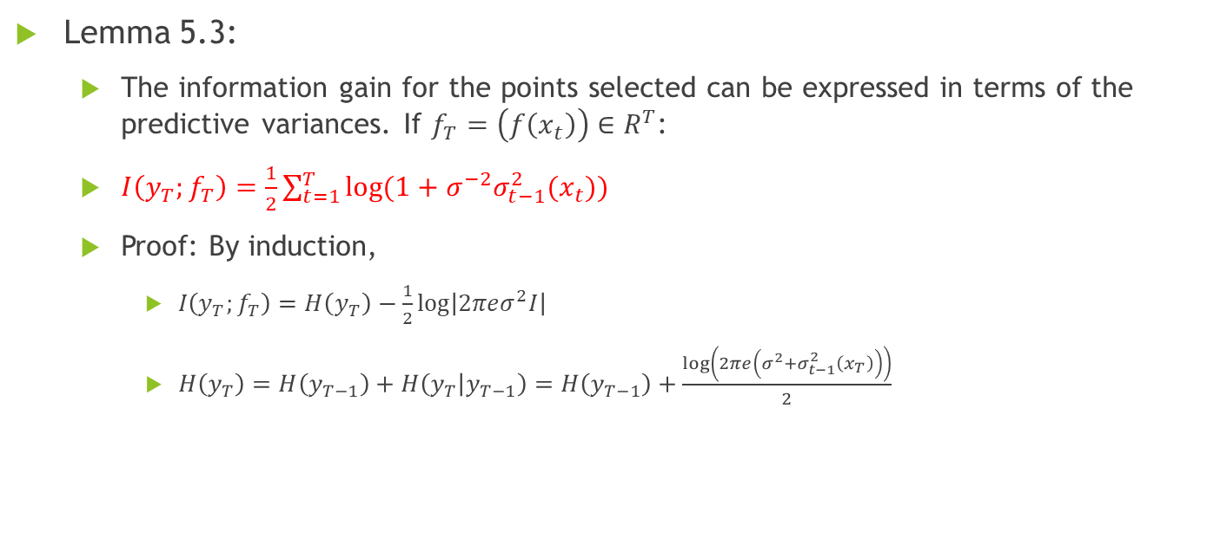
Information Gain
Lemma 5.3:
The information gain for the points selected can be expressed in terms of the predictive variances. If $f_{T}=\left(f\left(x_{t}\right)\right)∈R^{T}$:
$I\left(y_{T};f_{T}\right)=\frac{1}{2}\sum_{t=1}^{T}{\log{(1+σ^{−2}σ_{t−1}^{2}(x_{t}))}}$
Proof: By induction,
$I\left(y_{T};f_{T}\right)=H\left(y_{T}\right)−\frac{1}{2}\log\left|2πeσ^{2}I\right|$
$H\left(y_{T}\right)=H\left(y_{T−1}\right)+H\left(y_{T} | y_{T−1}\right)=H\left(y_{T−1}\right)+\frac{\log\left(2πe\left(σ^{2}+σ_{t−1}^{2}\left(x_{T}\right)\right)\right)}{2}$

Slide 6
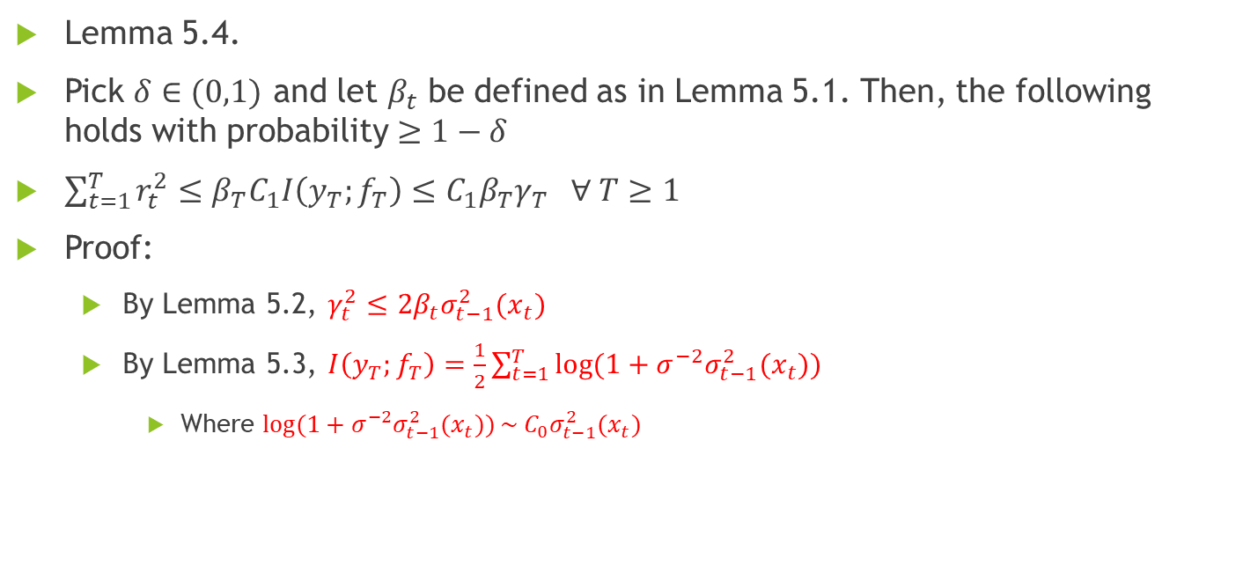
Regret Bound
Lemma 5.4.
Pick $δ∈(0,1)$ and let $β_{t}$ be defined as in Lemma 5.1. Then, the following holds with probability $≥1−δ$
$\sum_{t=1}^{T}{r_{t}^{2}}≤β_{T}C_{1}I\left(y_{T};f_{T}\right)≤C_{1}β_{T}γ_{T} ∀ T≥1$
Proof:
By Lemma 5.2, $γ_{t}^{2}≤$ $2β_{t}σ_{t−1}^{2}(x_{t})$
By Lemma 5.3, $I\left(y_{T};f_{T}\right)=\frac{1}{2}\sum_{t=1}^{T}{\log{(1+σ^{−2}σ_{t−1}^{2}(x_{t}))}}$
Where $\log{(1+σ^{−2}σ_{t−1}^{2}(x_{t}))}\sim C_{0}σ_{t−1}^{2}(x_{t})$

Slide 7
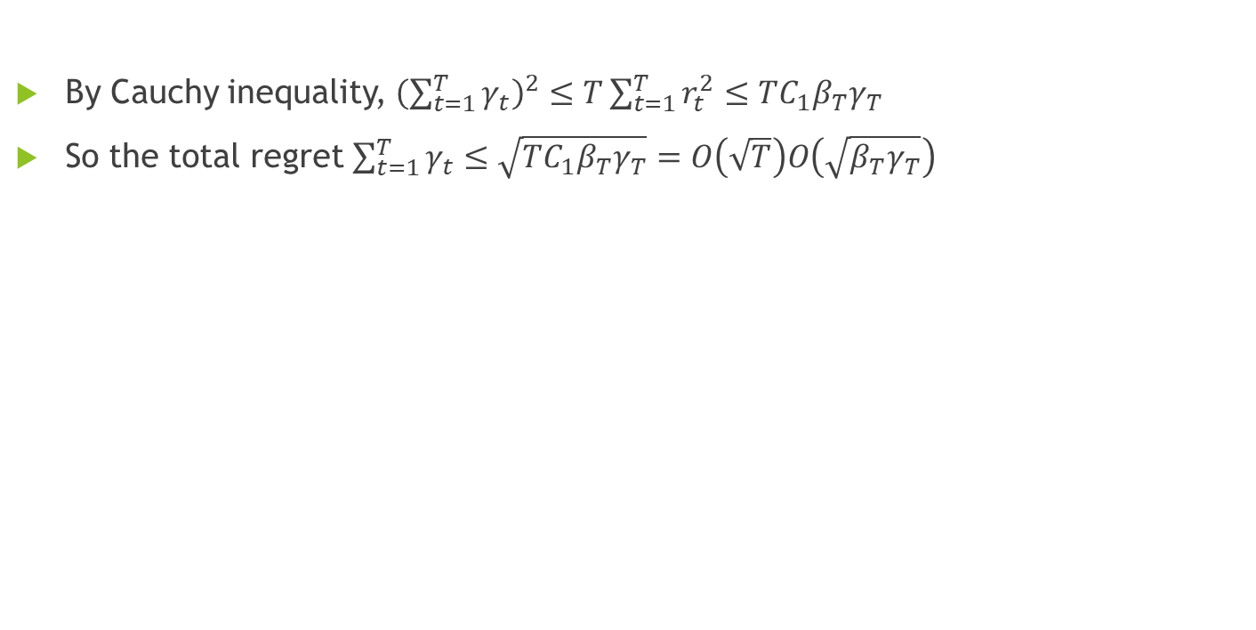
Regret Bound
By Cauchy inequality, ${\left(\sum_{t=1}^{T}{γ_{t}}\right)}^{2}≤T\sum_{t=1}^{T}{r_{t}^{2}}≤TC_{1}β_{T}γ_{T}$
So the total regret $\sum_{t=1}^{T}{γ_{t}}≤\sqrt{TC_{1}β_{T}γ_{T}}=O\left(\sqrt{T}\right)O\left(\sqrt{β_{T}γ_{T}}\right)$

Slide 8
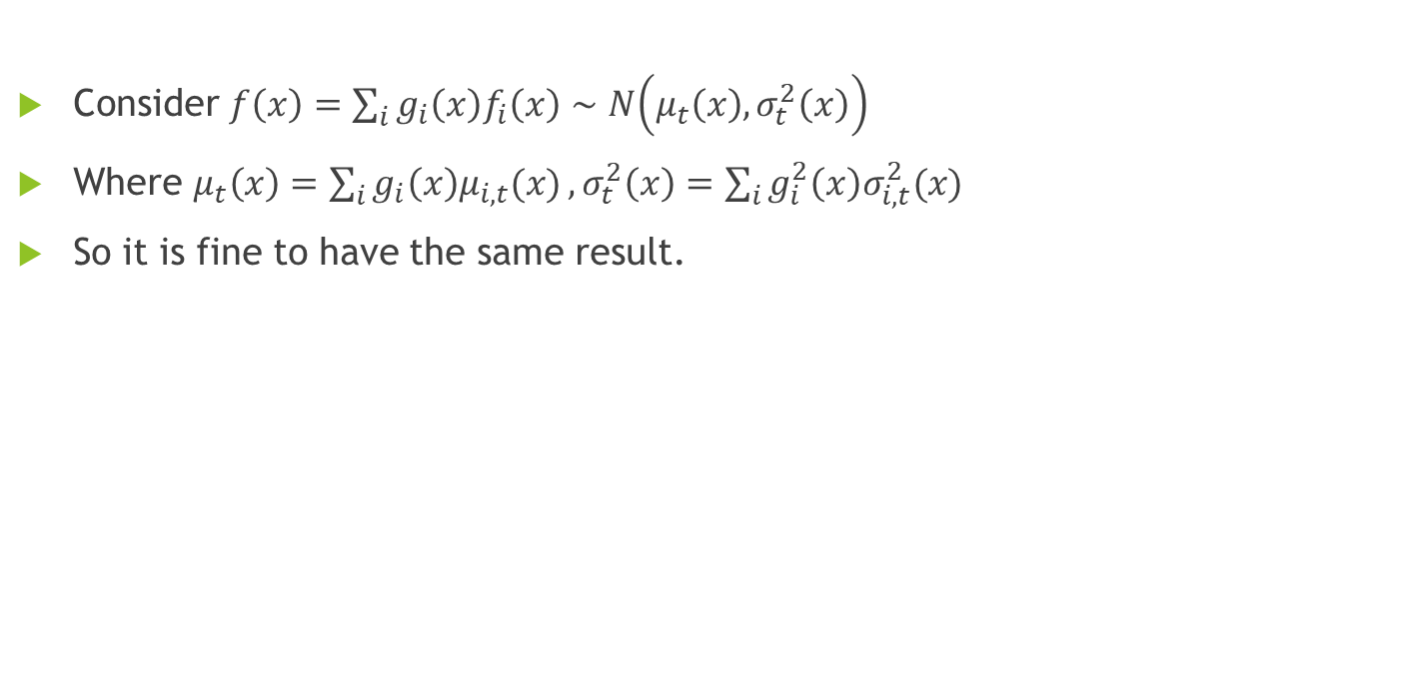
In our case: Chernoff Bound
Consider $f\left(x\right)=\sum_{i}{g_{i}\left(x\right)f_{i}\left(x\right)}∼N\left(μ_{t}\left(x\right), σ_{t}^{2}\left(x\right)\right)$
Where $μ_{t}\left(x\right)=\sum_{i}{g_{i}\left(x\right)μ_{i,t}(x)}, σ_{t}^{2}\left(x\right)=\sum_{i}{g_{i}^{2}\left(x\right)σ_{i,t}^{2}(x)}$
So it is fine to have the same result.

Slide 9

In our case: Regret
$γ_{t}=f\left(x^{∗}\right)−f\left(x_{t}\right)≤β_{t}^{\frac{1}{2}}σ_{t−1}\left(x_{t}\right)+μ_{t−1}\left(x_{t}\right)−f\left(x_{t}\right)≤2β_{t}^{\frac{1}{2}}σ_{t−1}(x_{t})$
$σ_{t−1}^{2}\left(x_{t}\right)=\sum_{i}^{I}{g_{i}^{2}(x_{t})σ_{i,t−1}^{2}(x_{t})}$

Slide 10
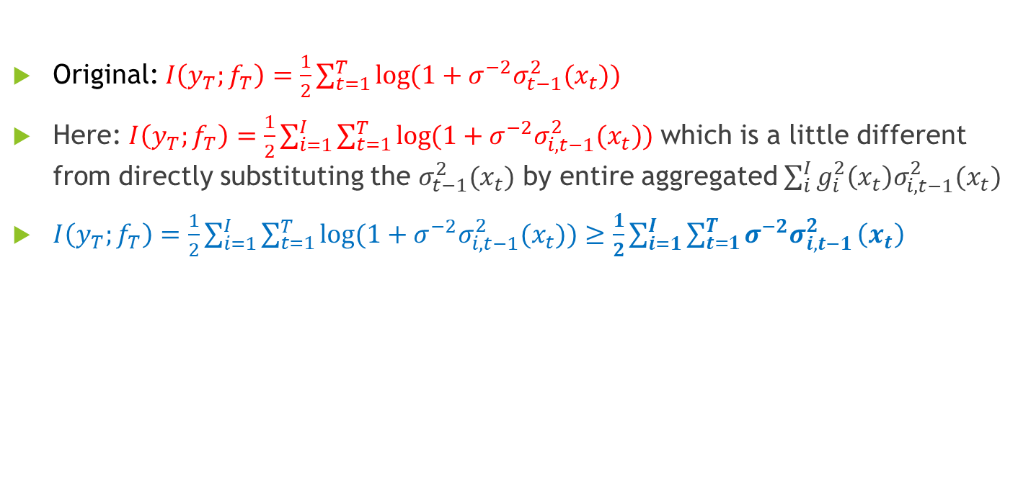
In our case: Information Gain
Original: $I\left(y_{T};f_{T}\right)=\frac{1}{2}\sum_{t=1}^{T}{\log{(1+σ^{−2}σ_{t−1}^{2}(x_{t}))}}$
Here: $I\left(y_{T};f_{T}\right)=\frac{1}{2}\sum_{i=1}^{I}{\sum_{t=1}^{T}{\log{(1+σ^{−2}σ_{i, t−1}^{2}(x_{t}))}}}$ which is a little different from directly substituting the $σ_{t−1}^{2}(x_{t})$ by entire aggregated $\sum_{i}^{I}{g_{i}^{2}\left(x_{t}\right)σ_{i,t−1}^{2}(x_{t})}$
$I\left(y_{T};f_{T}\right)=\frac{1}{2}\sum_{i=1}^{I}{\sum_{t=1}^{T}{\log{(1+σ^{−2}σ_{i, t−1}^{2}(x_{t}))}}}≥\frac{1}{2}\sum_{i=1}^{I}{\sum_{t=1}^{T}{σ^{−2}σ_{i,t−1}^{2}}\left(x_{t}\right)}$

Slide 11
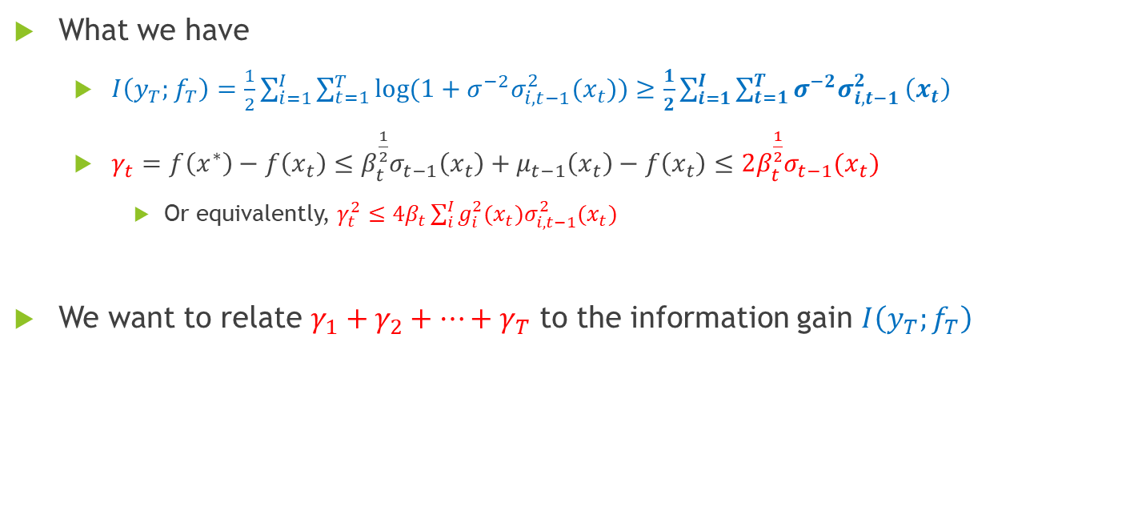
In our case: Summary
What we have
$I\left(y_{T};f_{T}\right)=\frac{1}{2}\sum_{i=1}^{I}{\sum_{t=1}^{T}{\log{(1+σ^{−2}σ_{i, t−1}^{2}(x_{t}))}}}≥\frac{1}{2}\sum_{i=1}^{I}{\sum_{t=1}^{T}{σ^{−2}σ_{i,t−1}^{2}}\left(x_{t}\right)}$
$γ_{t}=f\left(x^{∗}\right)−f\left(x_{t}\right)≤β_{t}^{\frac{1}{2}}σ_{t−1}\left(x_{t}\right)+μ_{t−1}\left(x_{t}\right)−f\left(x_{t}\right)≤2β_{t}^{\frac{1}{2}}σ_{t−1}(x_{t})$
Or equivalently, $γ_{t}^{2}≤4β_{t}\sum_{i}^{I}{g_{i}^{2}(x_{t})σ_{i,t−1}^{2}(x_{t})}$
We want to relate $γ_{1}+γ_{2}+…+γ_{T}$ to the information gain $I\left(y_{T};f_{T}\right)$

Slide 12
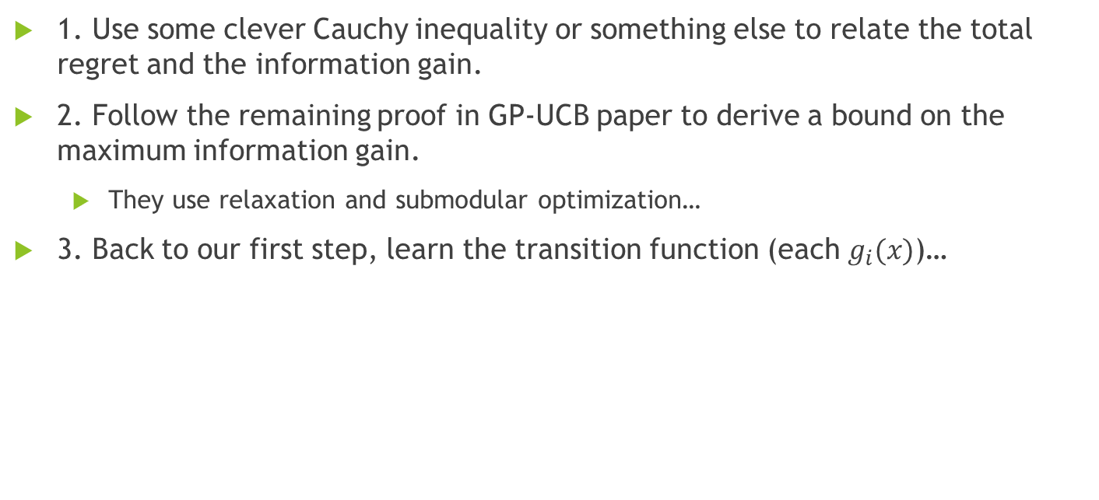
In our case: Next Step
1. Use some clever Cauchy inequality or something else to relate the total regret and the information gain.
2. Follow the remaining proof in GP-UCB paper to derive a bound on the maximum information gain.
They use relaxation and submodular optimization…
3. Back to our first step, learn the transition function (each $g_{i}(x)$)…

