Slide 1
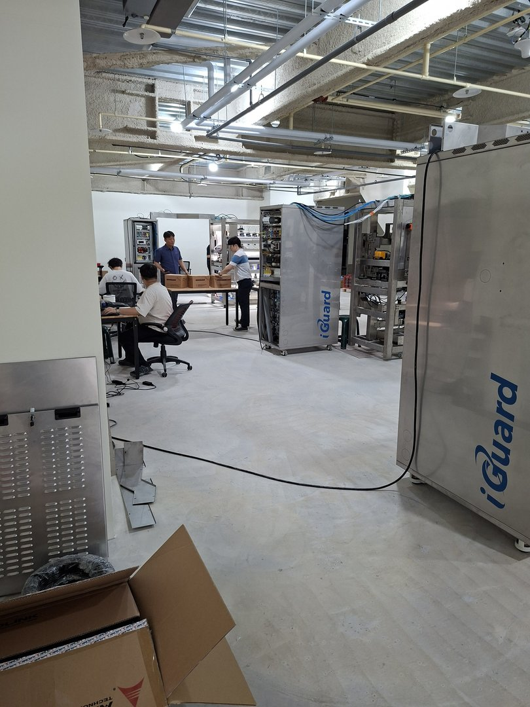
iGuard
Automated Optical Inspection System
Prepreg & CCL Material Defect Inspection
Customer Acceptance Review
Acceptance Date: 2026-06-07 | AOITEK Co., Ltd.
1 / 10

Slide 2
Acceptance Agenda
Overview of Today's Review
01
System Introduction
02
Machine Installation
Architecture, functions, and specifications of iGuard AOI
On-site installation, assembly, and setup verification
03
Test Material Confirmation
04
Material Loading & Feed
Prepreg / CCL roll sample specification review
Roll loading, tension control, and feed path verification
05
System Operation Test
06
Defect Detection Demo
Full-speed run, AOI scanning, and real-time processing
Live defect images, classification, and grading results
07
Software Interface Review
08
Customer Discussion
HMI operations, reporting, and data export functions
Customer feedback, Q&A, and engineer responses
09
Acceptance Conclusion
Passed items / Action items / Next steps
iGuard AOI System | Prepreg & CCL Acceptance Review
2 / 10

Slide 3

iGuard AOI — System Overview
Architecture & Capabilities
Inspection Target
Prepreg (glass-fiber prepreg rolls) / CCL (copper-clad laminate)
Defect Types
Foreign matter, scratch, dent, void, crease, bubble, edge defect
Scanning Method
Full-width line-scan camera with real-time row-by-row comparison
Output Functions
Live marking, defect grading, report export, AI-assisted review
System Brand
iGuard · AOITEK Co., Ltd.
iGuard AOI System | Prepreg & CCL Acceptance Review
3 / 10

Slide 4
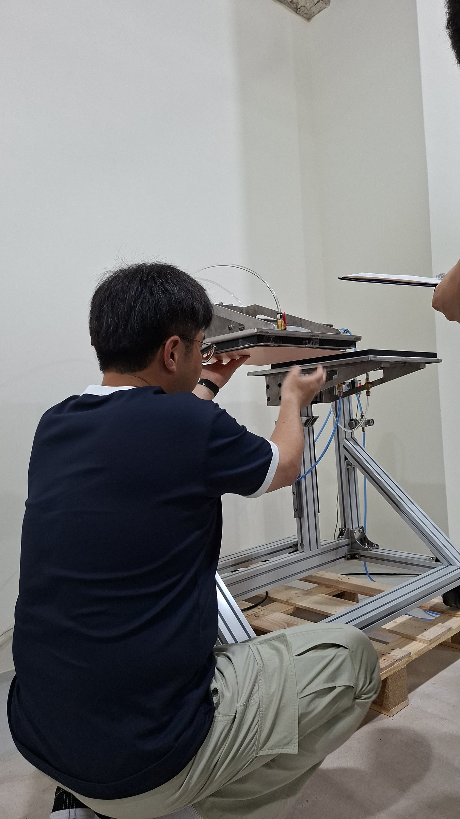
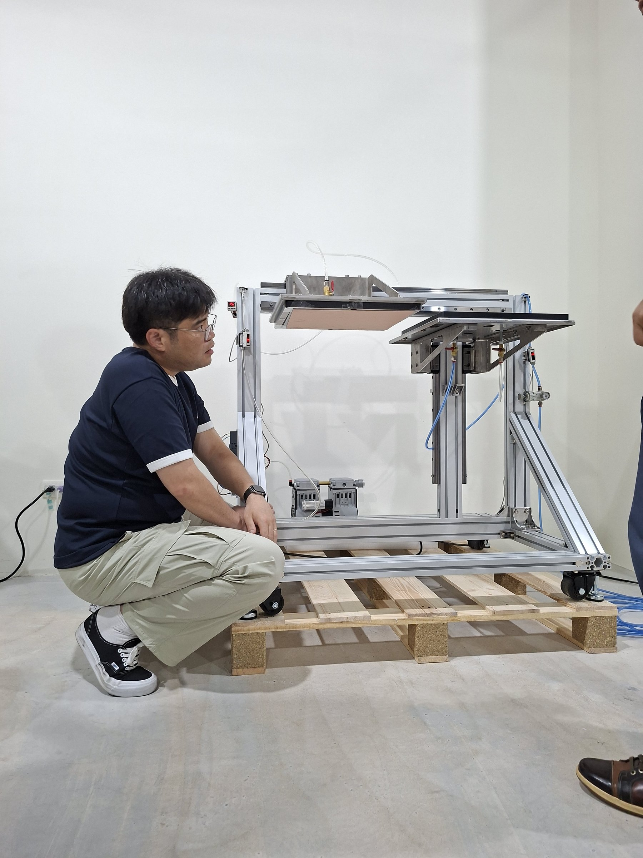
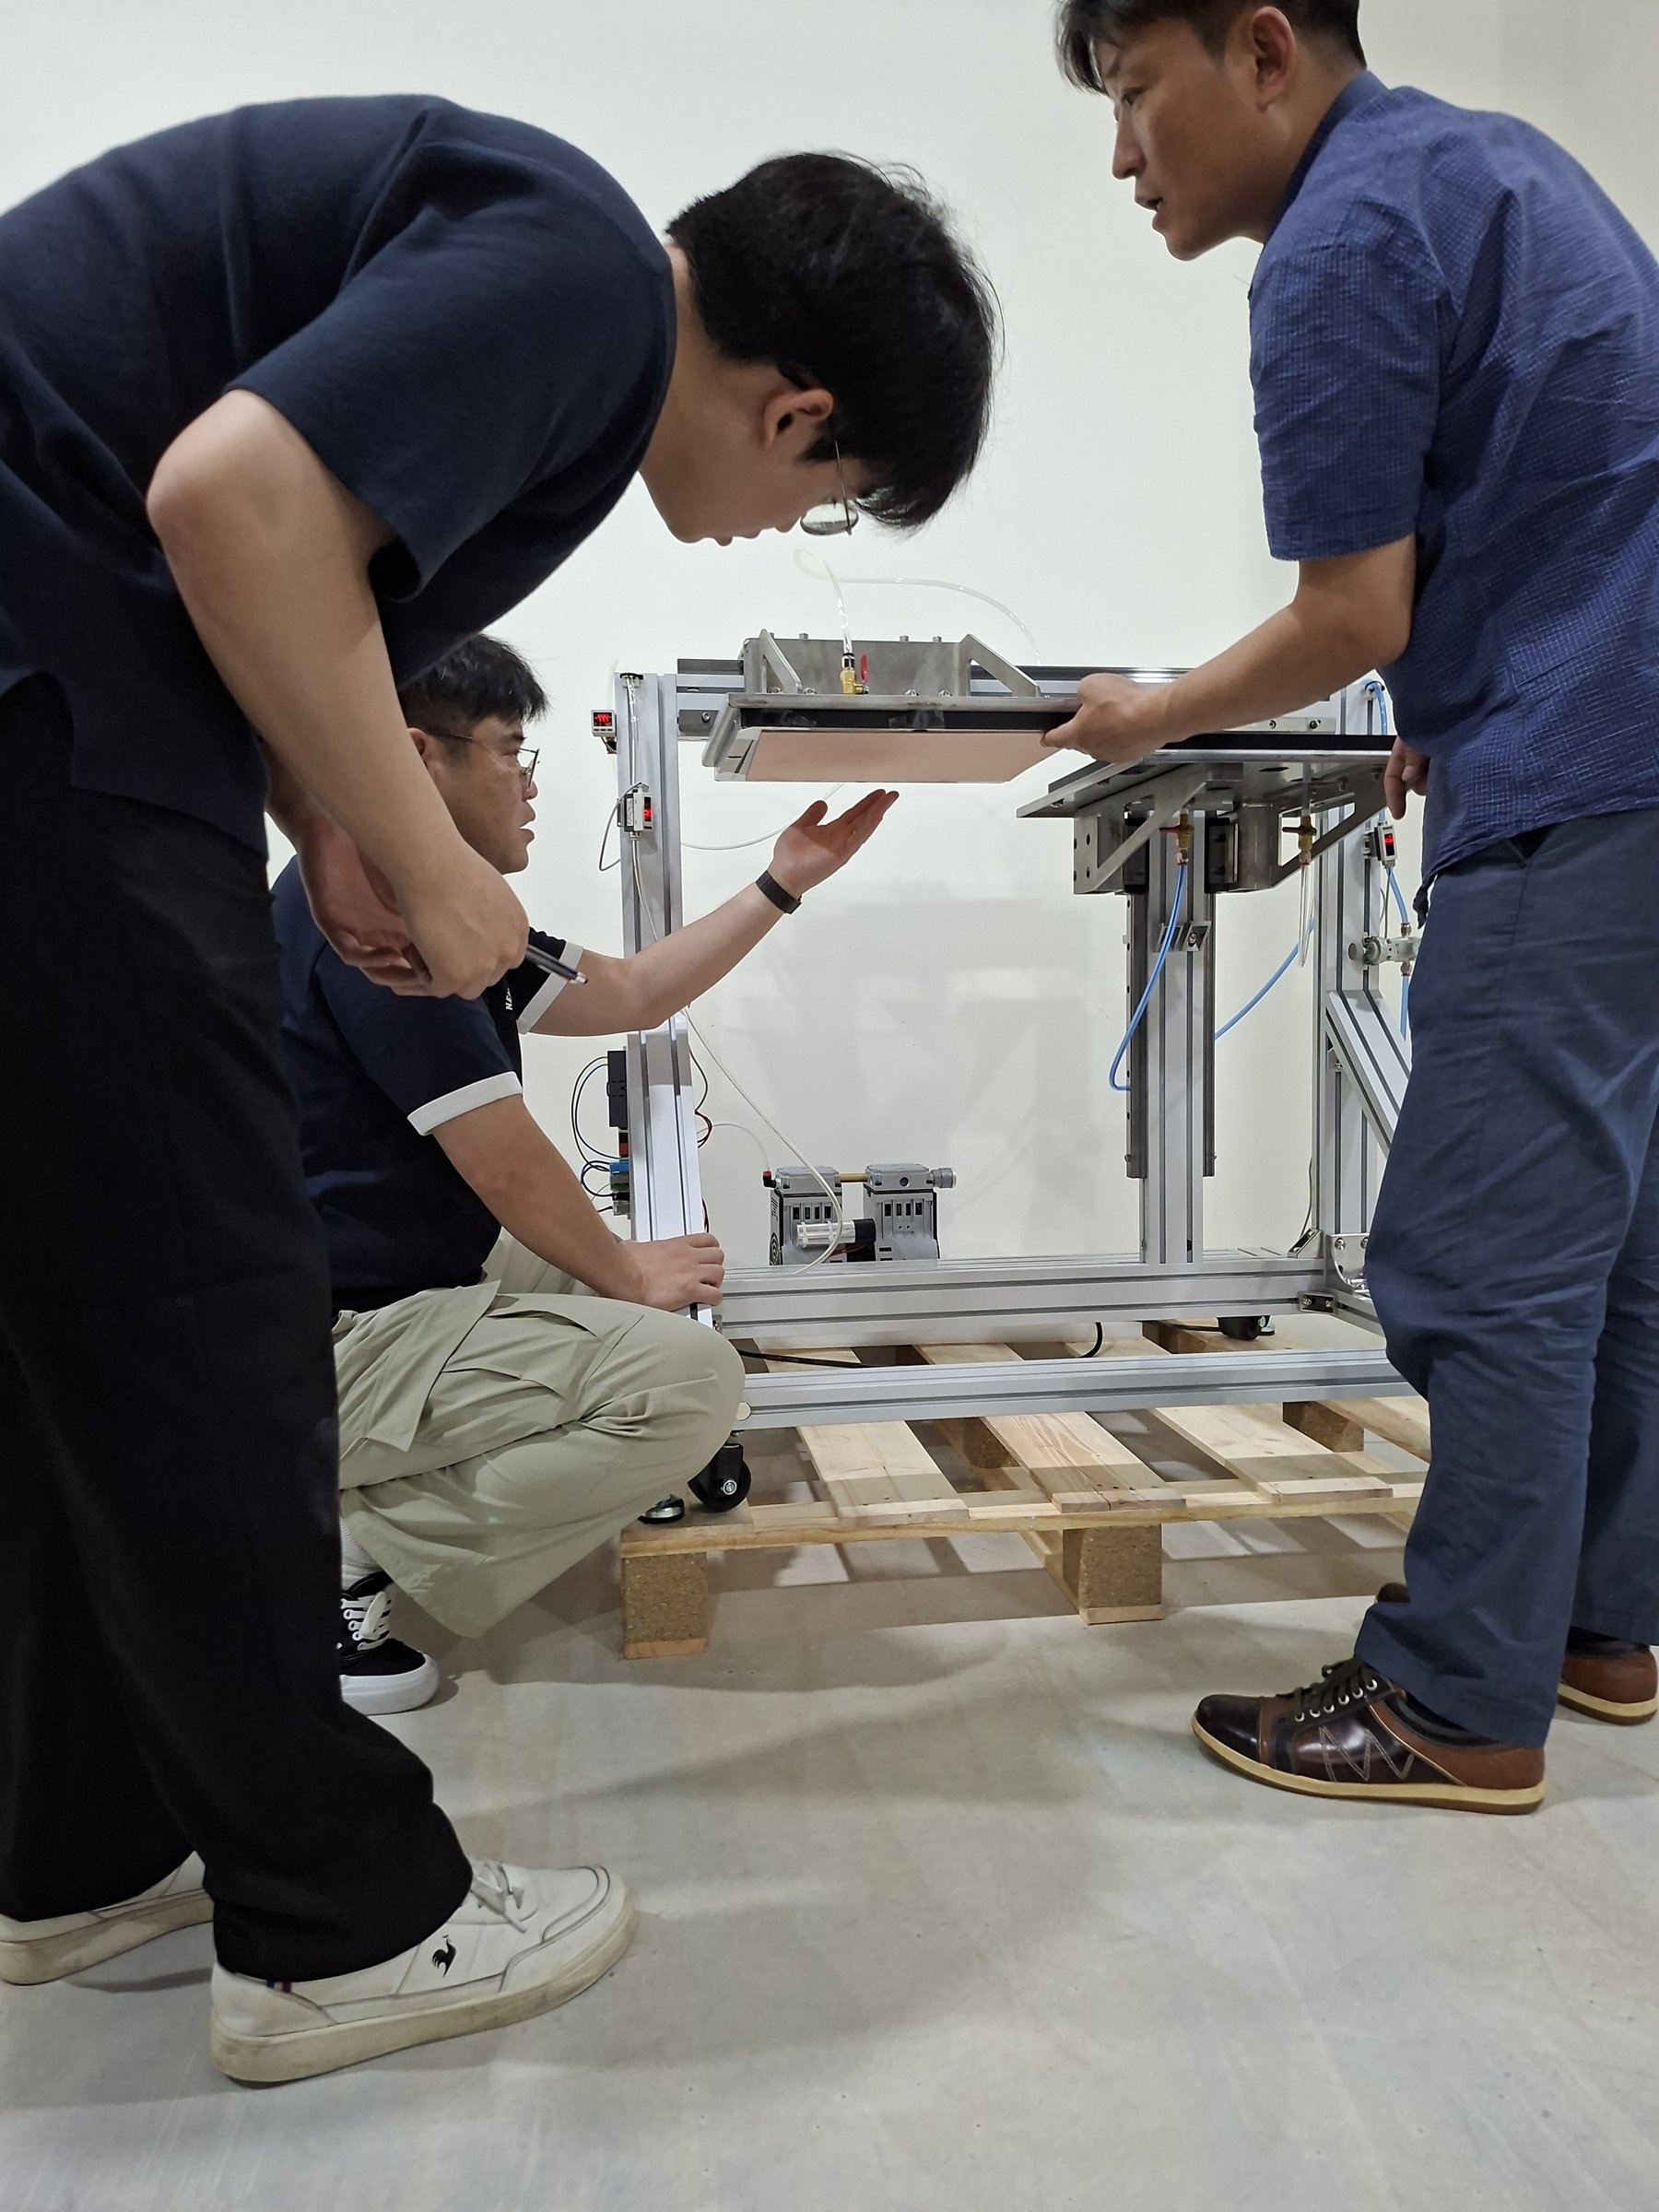
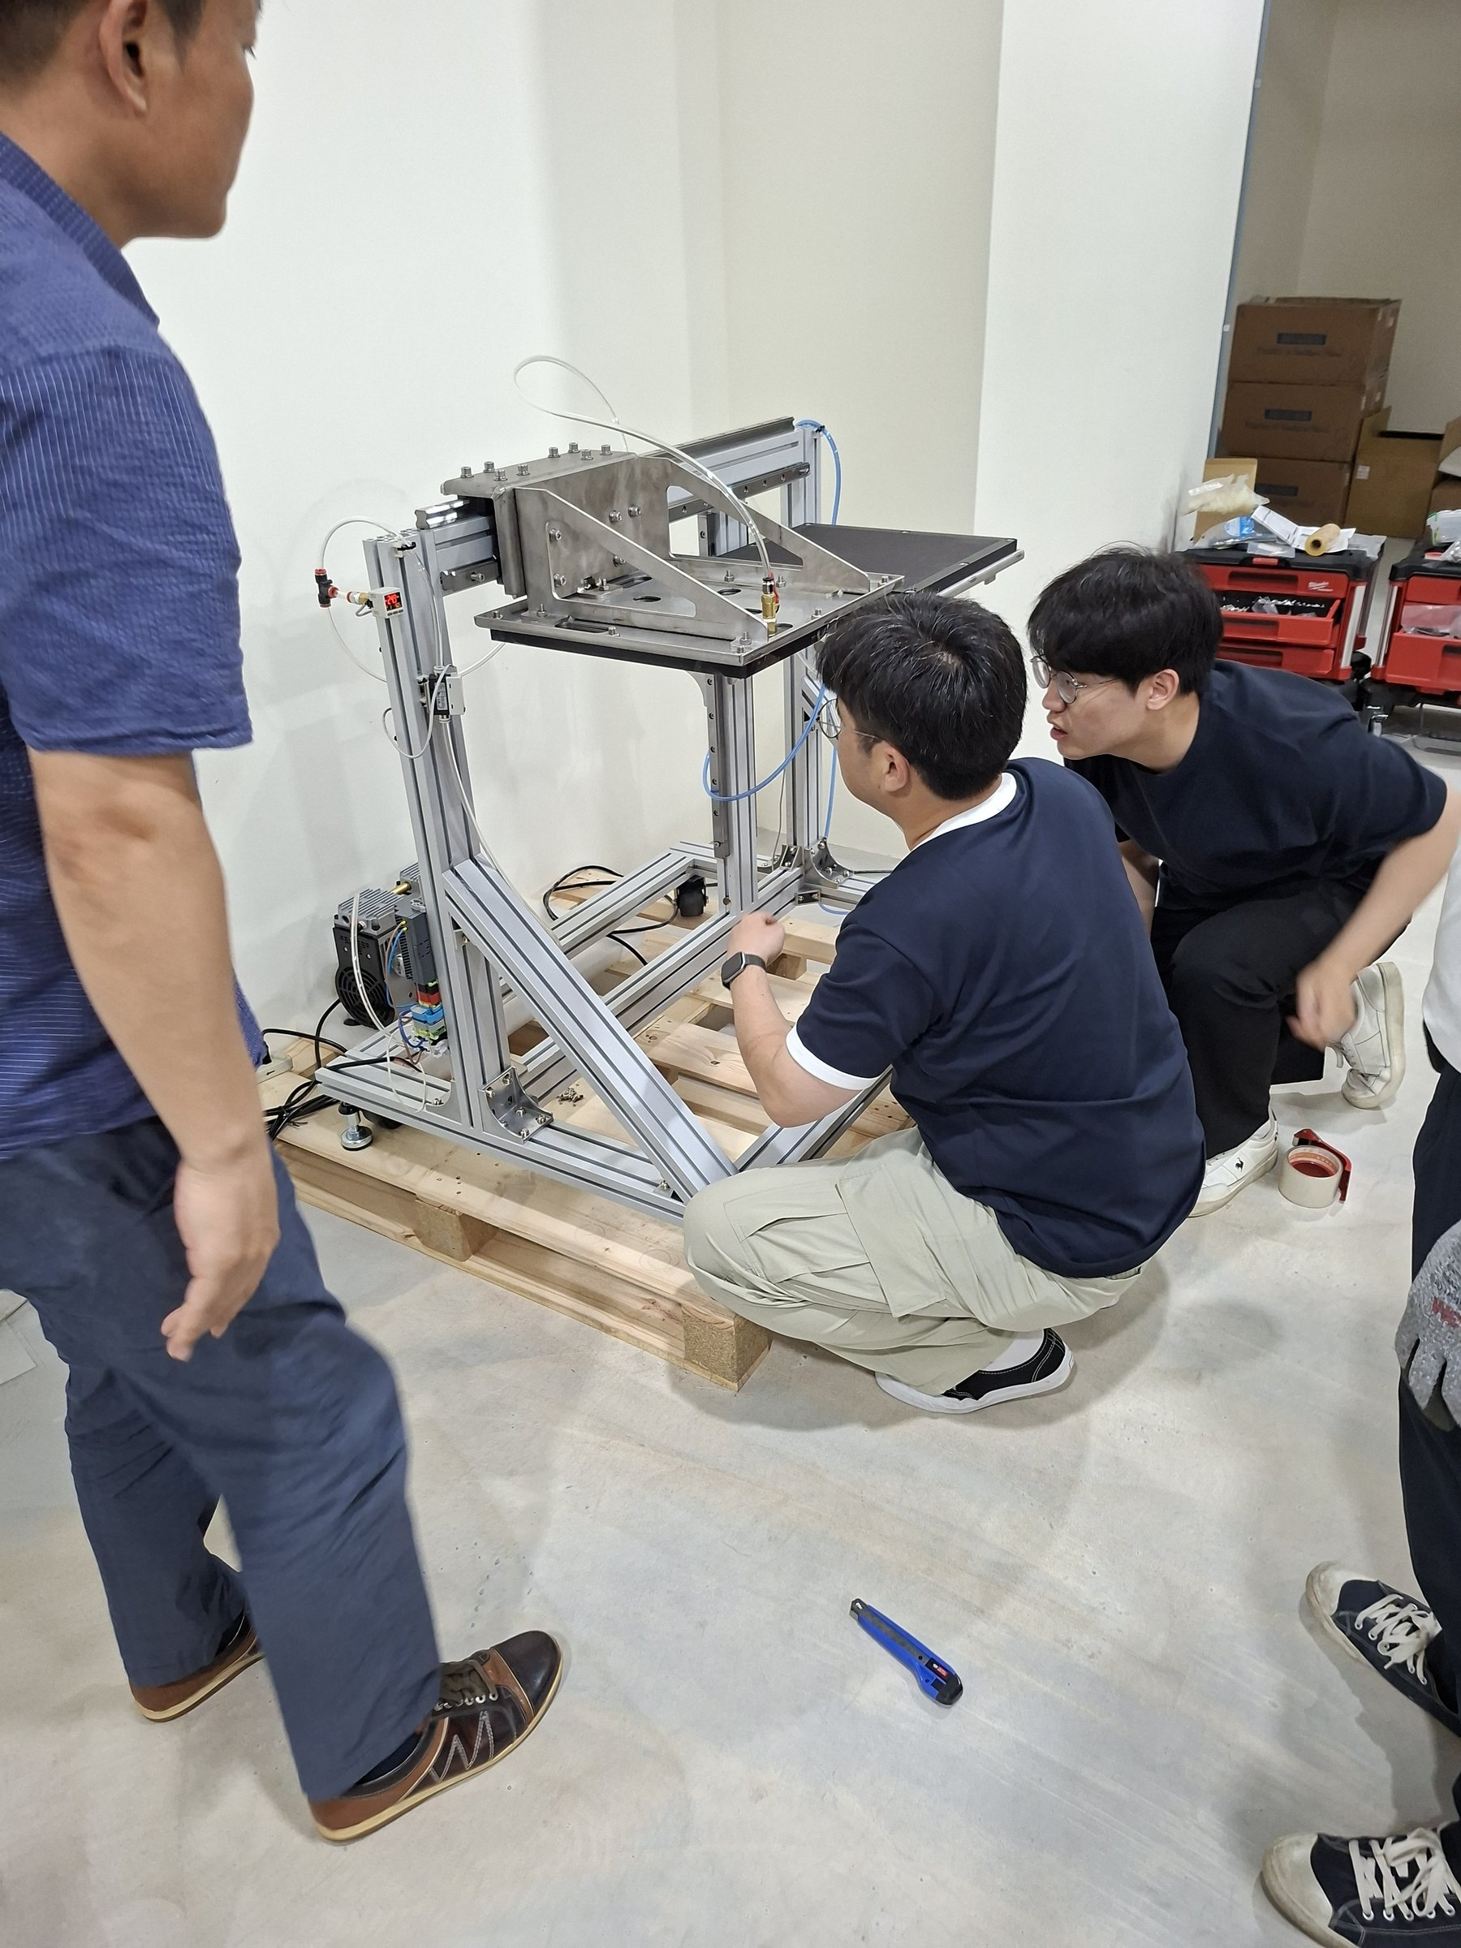
Machine Installation & Setup
Equipment Assembly Verification
Engineer inspecting machine frame structure
Machine framework visual inspection
Team collaborative assembly and calibration
Multi-person on-site assembly verification
iGuard AOI System | Prepreg & CCL Acceptance Review
4 / 10

Slide 5
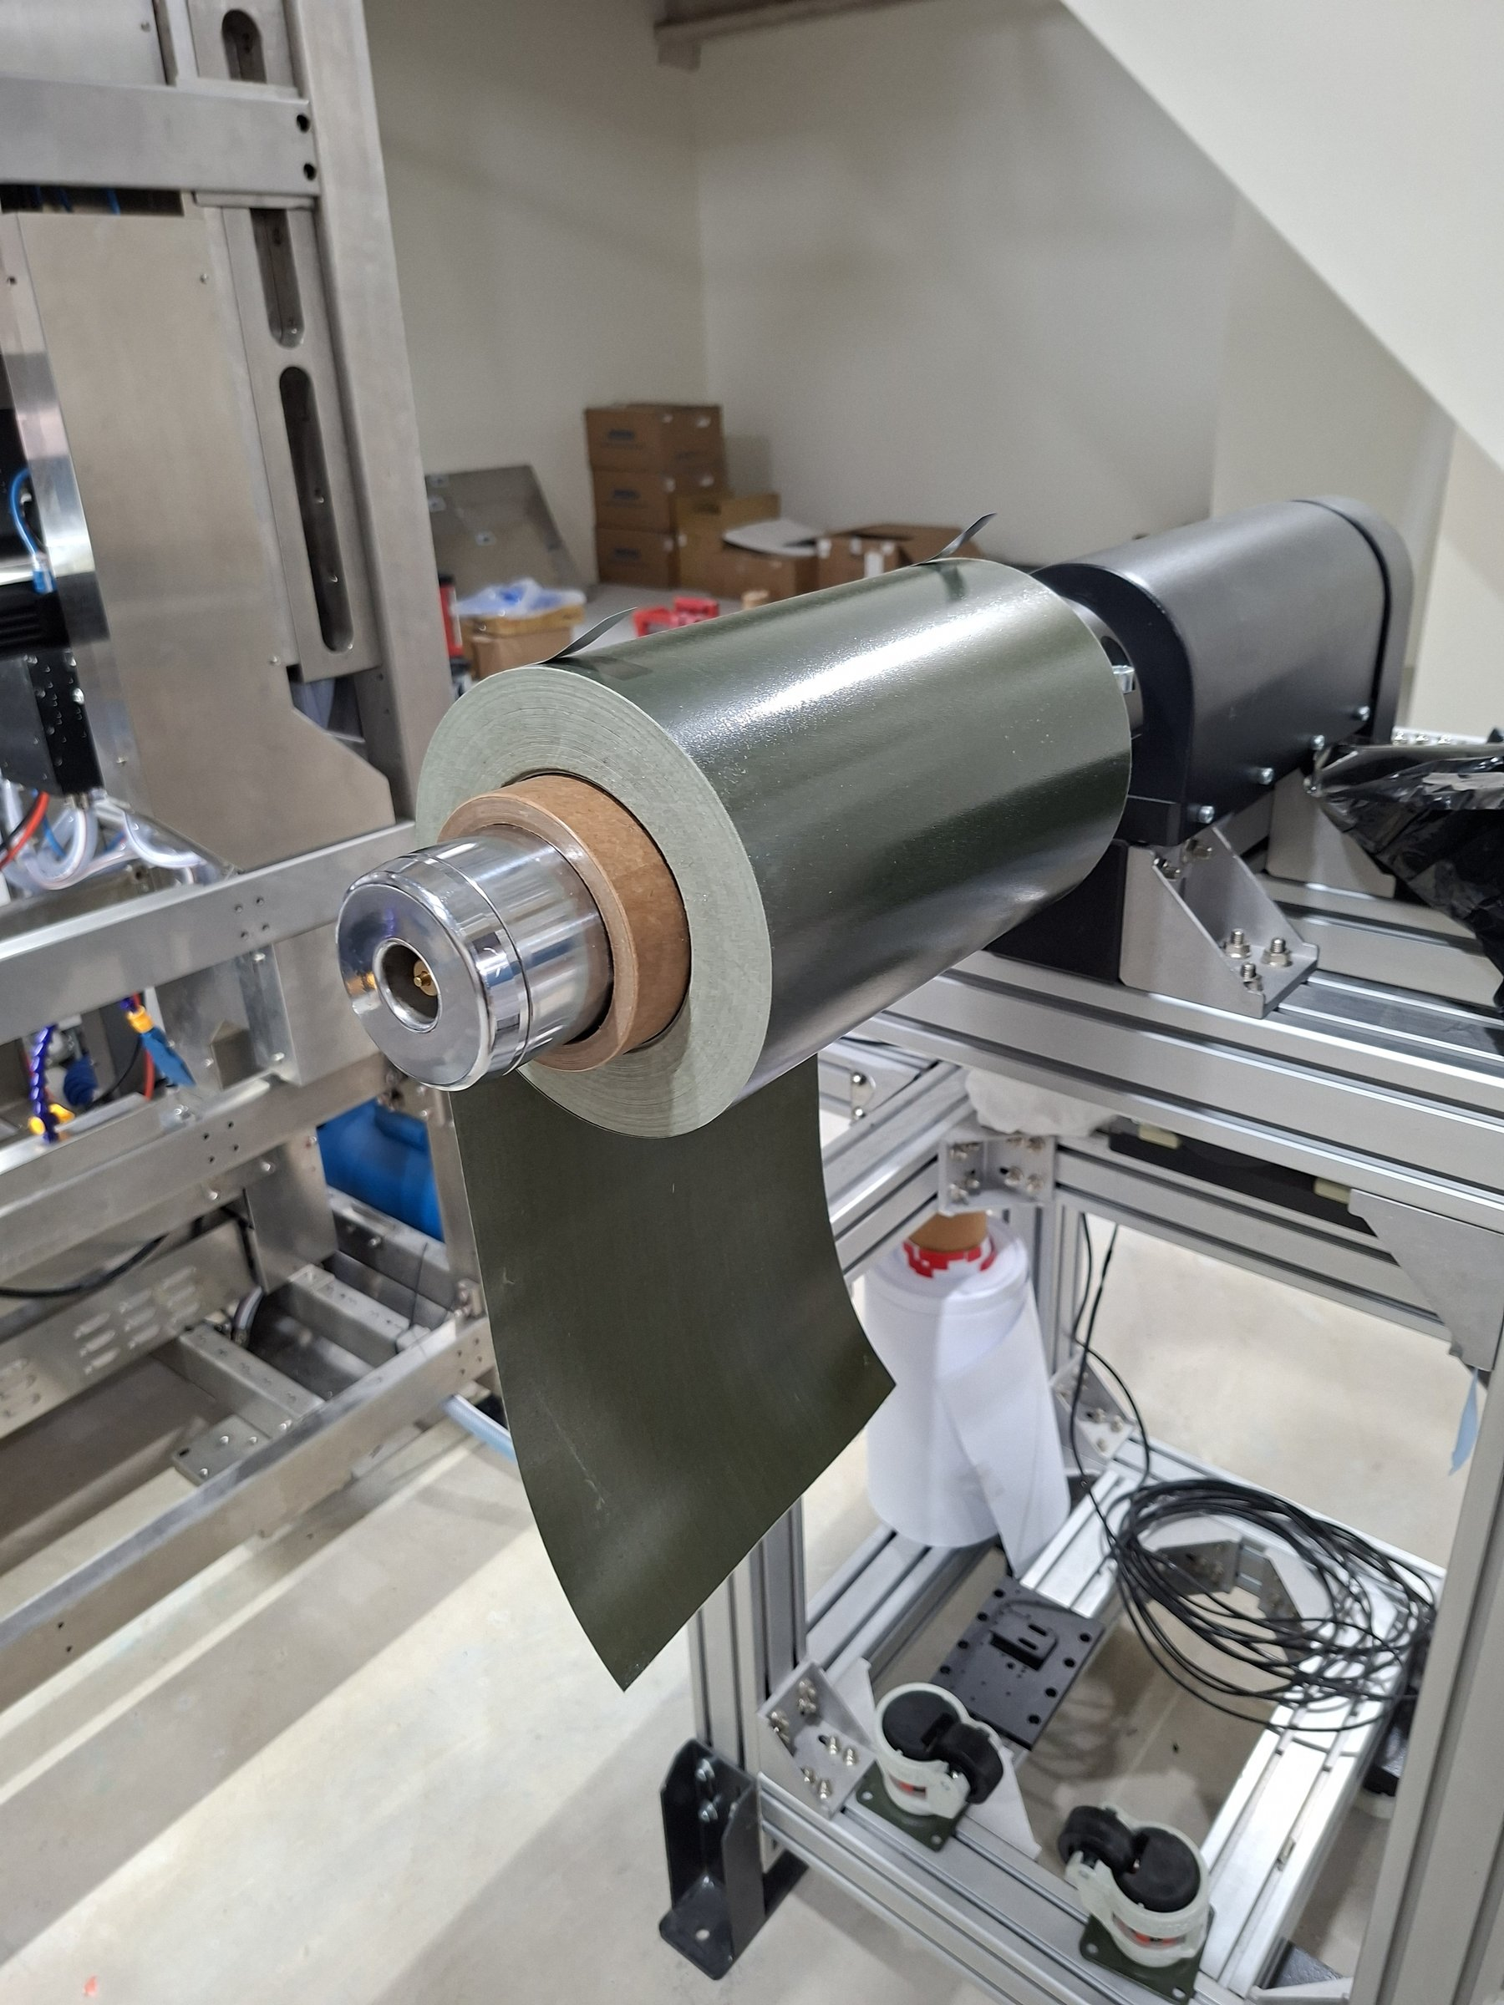
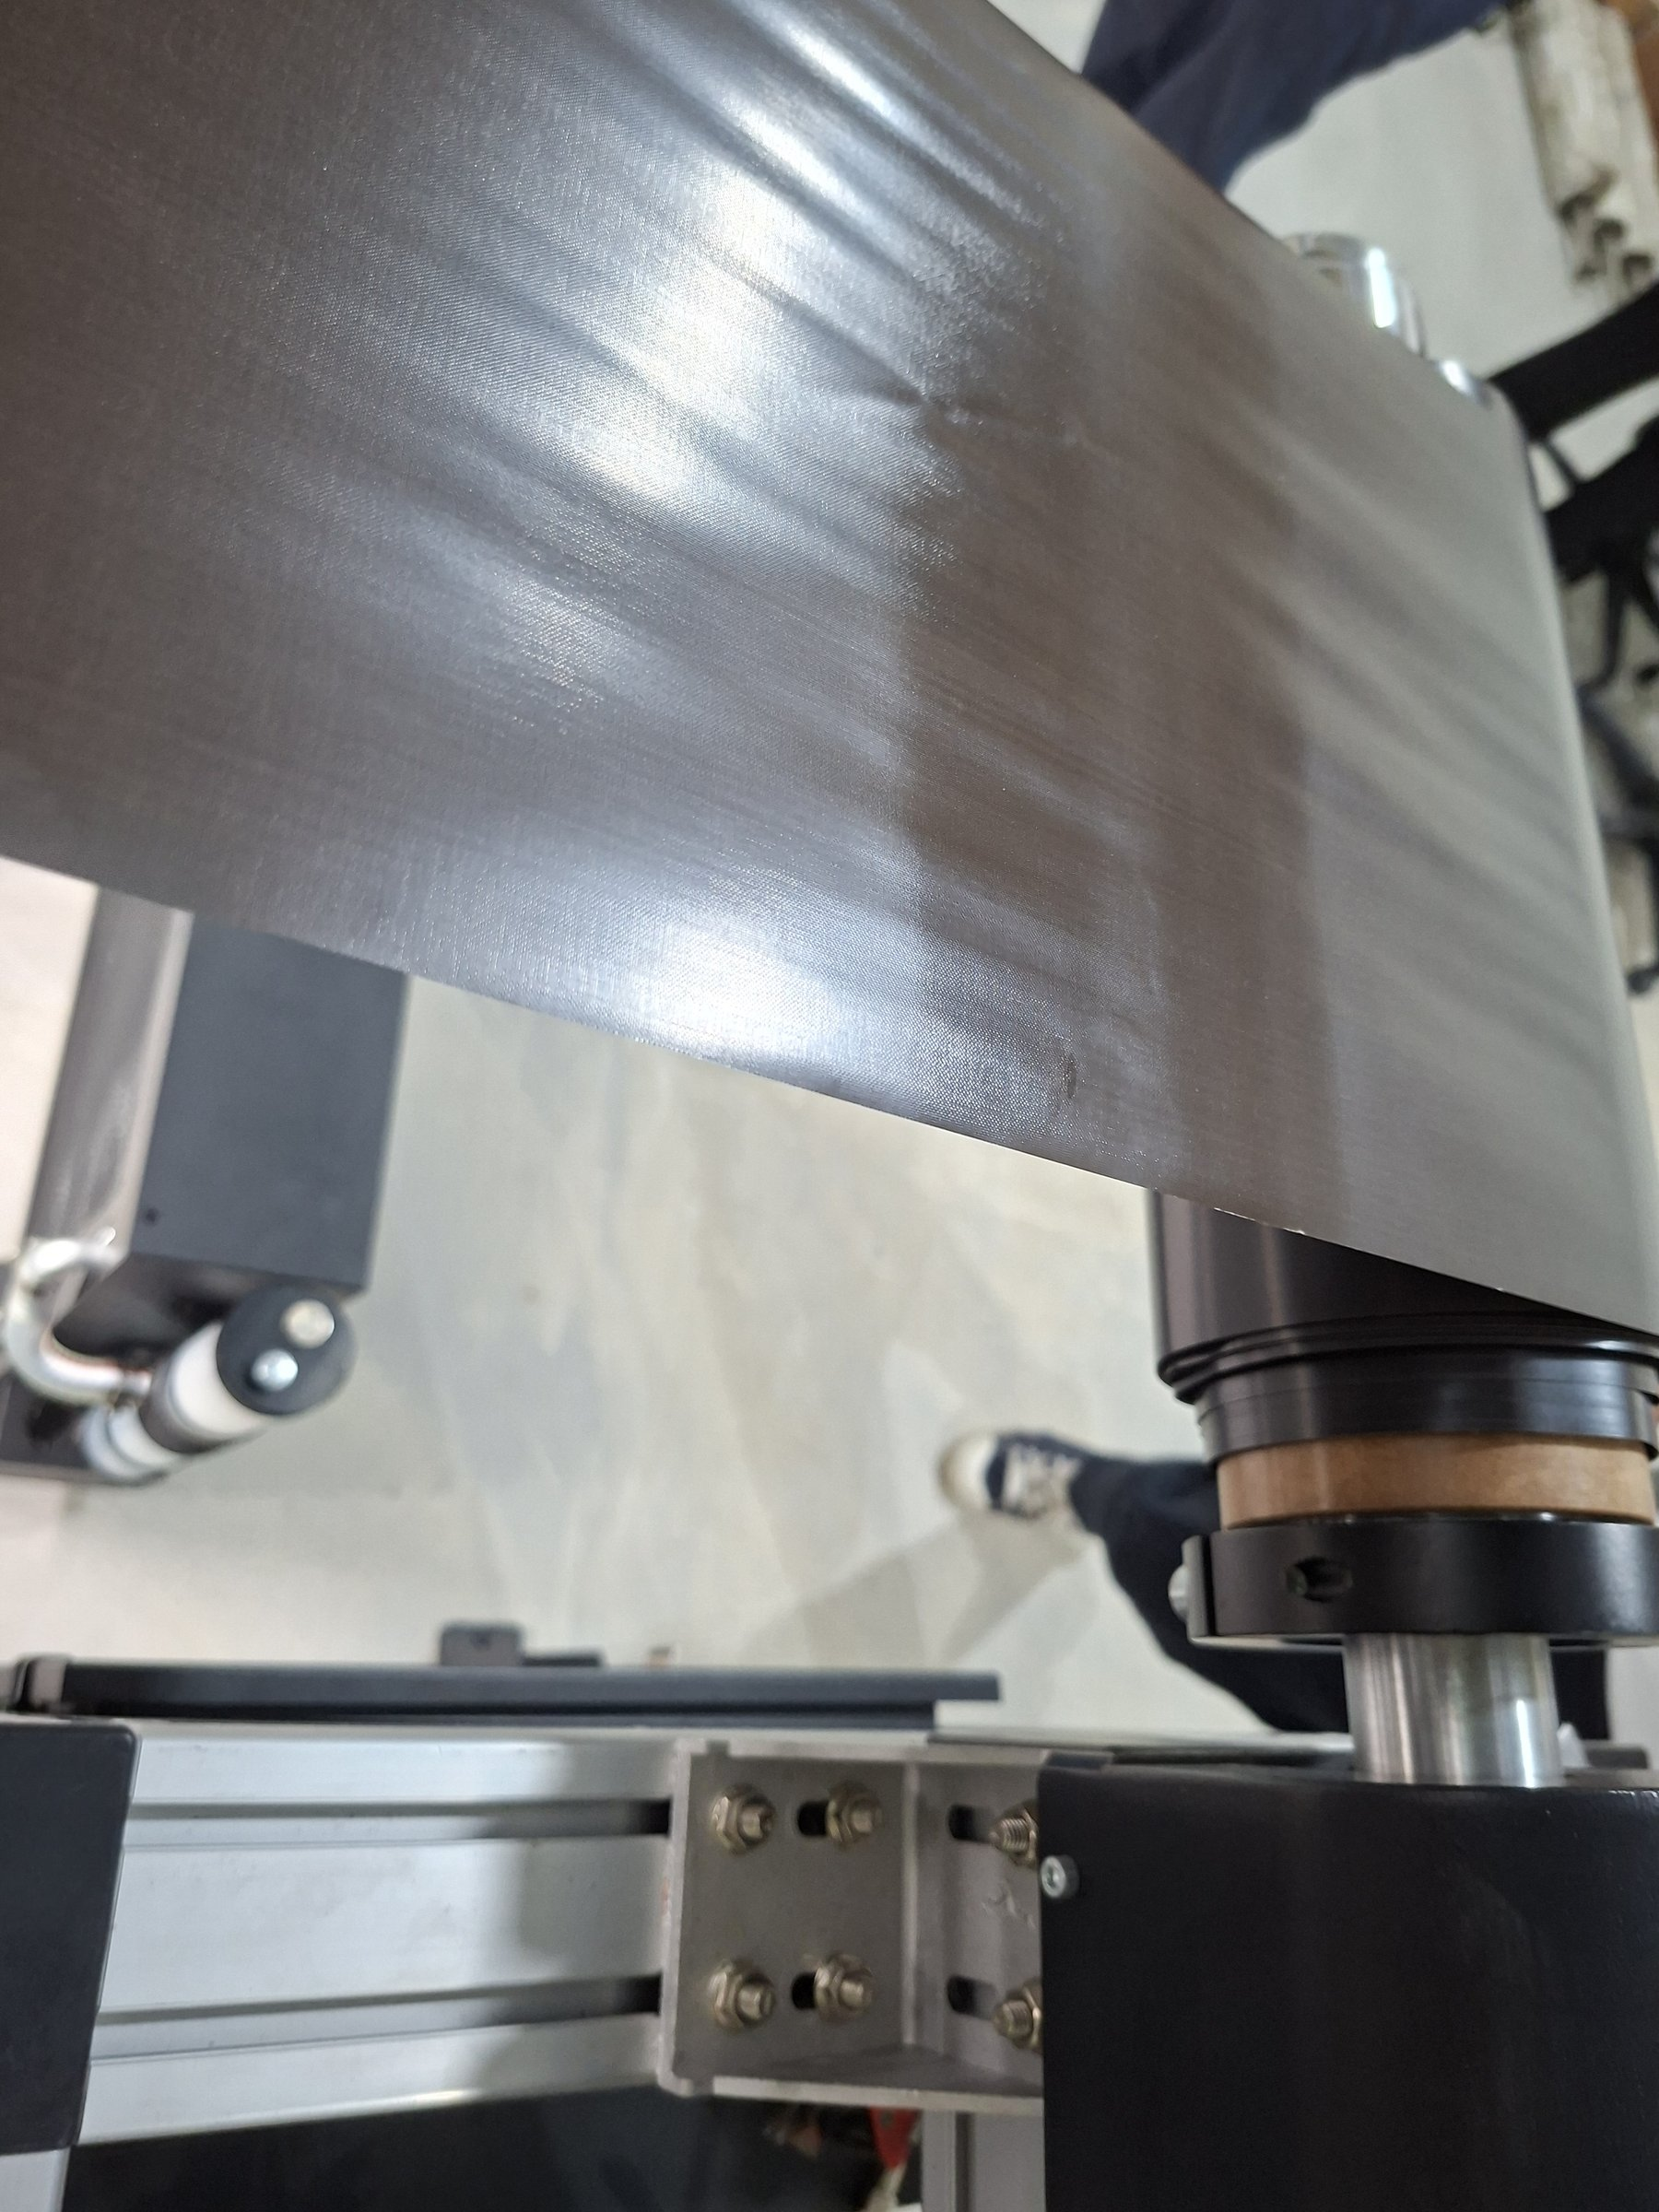
Test Material Confirmation
Prepreg / CCL Roll Sample Review
Material Specifications
Material Type
Prepreg (glass-fiber epoxy prepreg) / CCL (copper-clad laminate)
Supplier
DOOSAN Corporation
Appearance
Roll form, olive-green / brown, width approx. 600 mm
Prepreg roll (olive-green, glass-fiber epoxy prepreg)
Key Defects
Crease, surface scratch, foreign matter, dent, bubble
Roll Dimension
Per production spec (including core weight)
Loading Method
Unwind spindle with automatic tension controller
Prepreg surface detail (visible crease / minor defect)
iGuard AOI System | Prepreg & CCL Acceptance Review
5 / 10

Slide 6
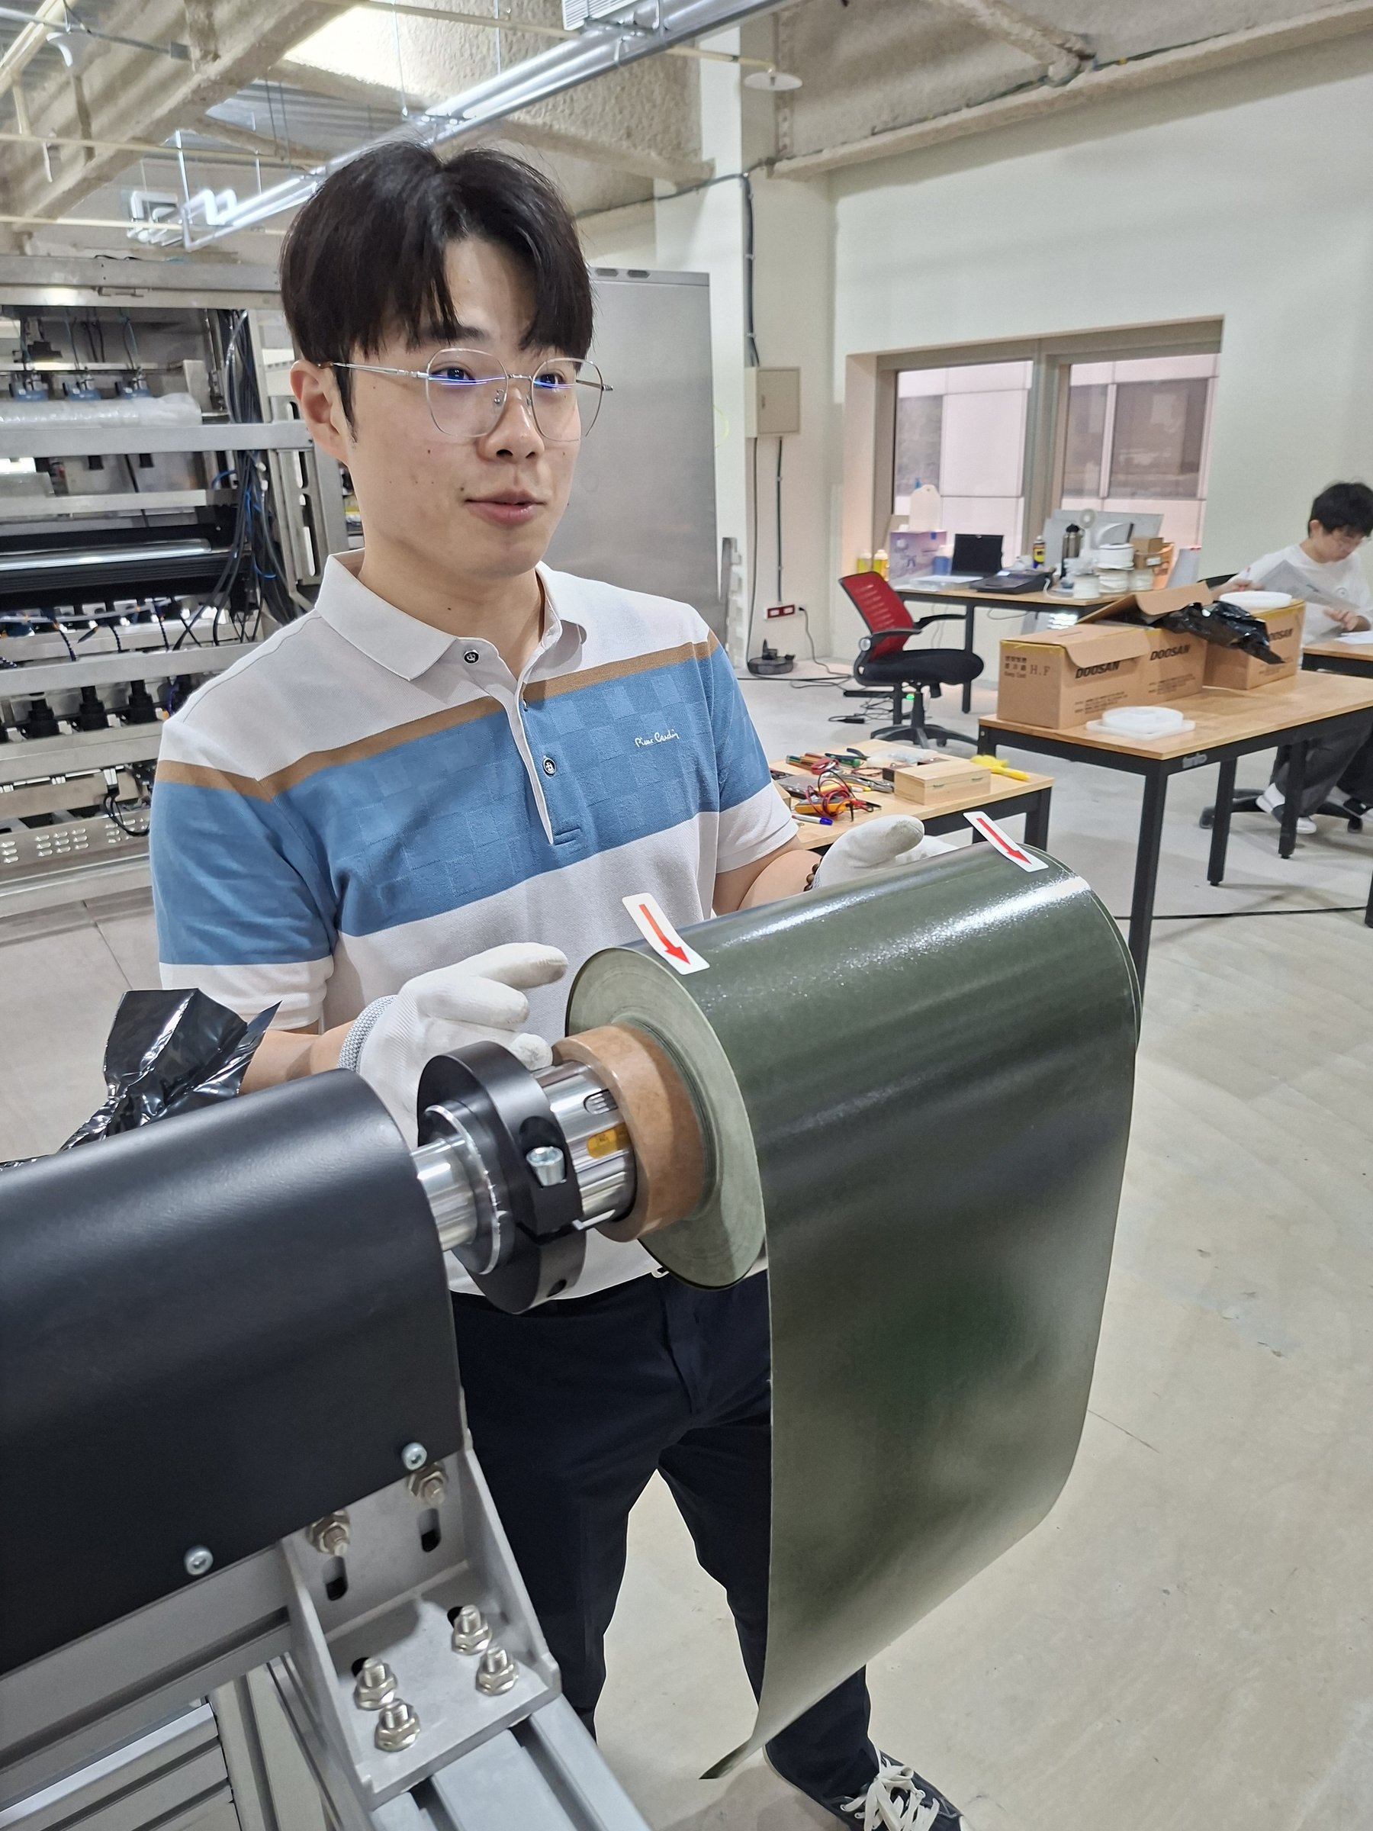
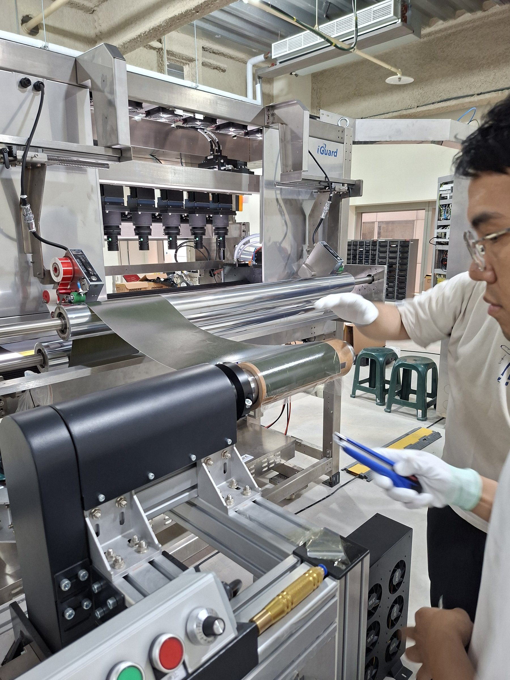
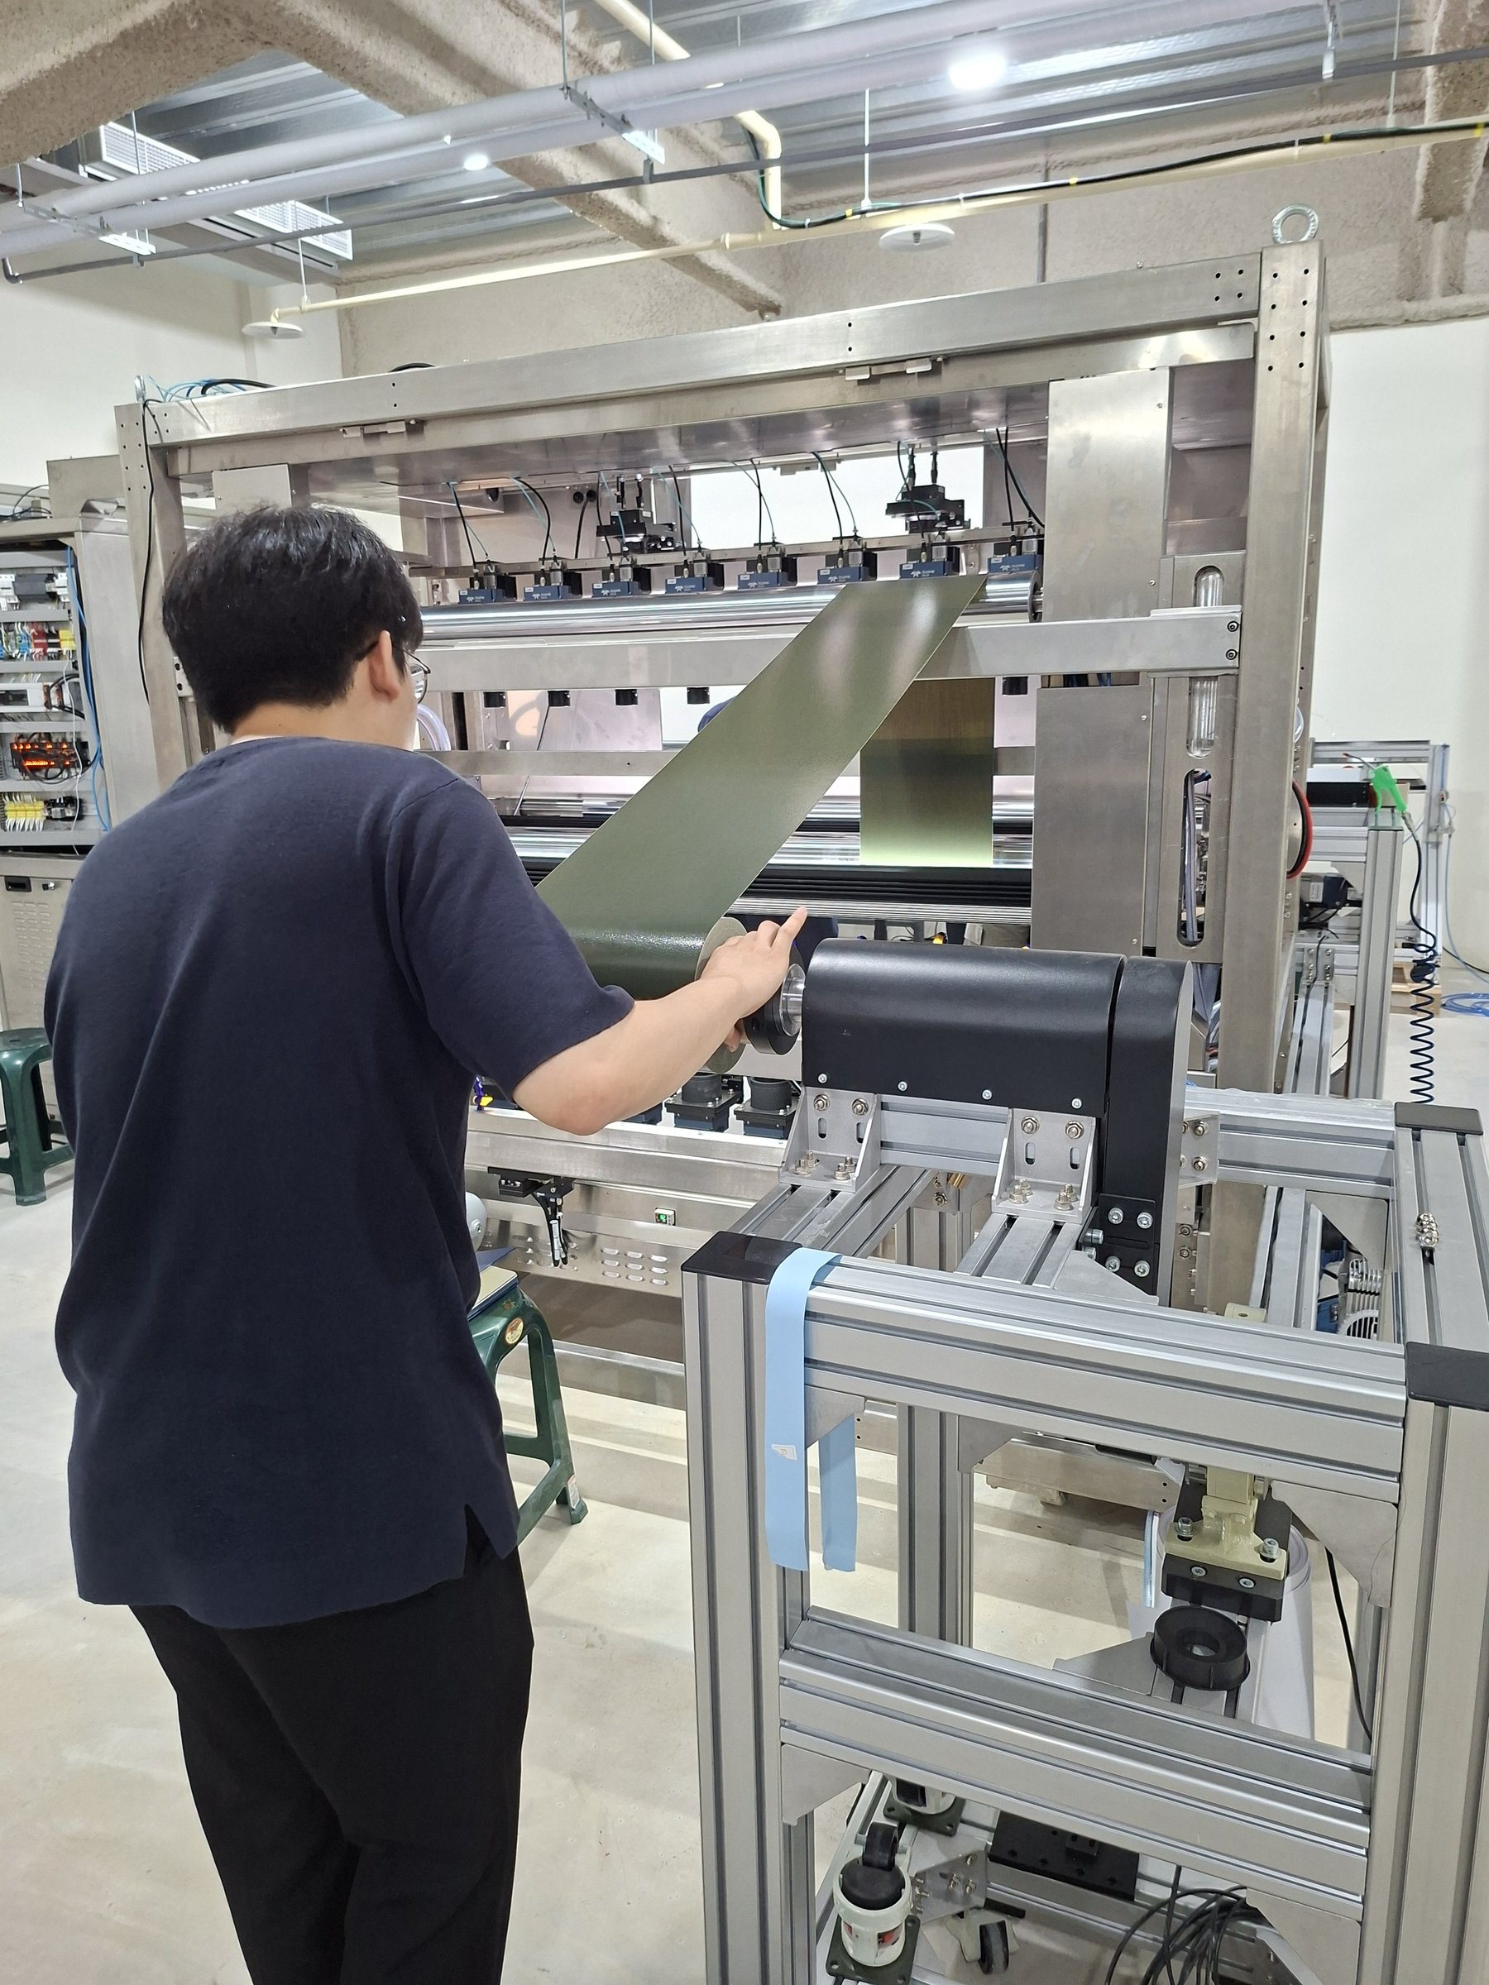
Material Loading & Feed Verification
Roll Threading and Feed Path Confirmation
Engineer manually mounting the roll
Threading material through the feed rollers
Full machine feed path confirmed
① Confirm Roll
② Mount Spindle
③ Thread Material
④ Set Tension
⑤ Trial Run
iGuard AOI System | Prepreg & CCL Acceptance Review
6 / 10

Slide 7
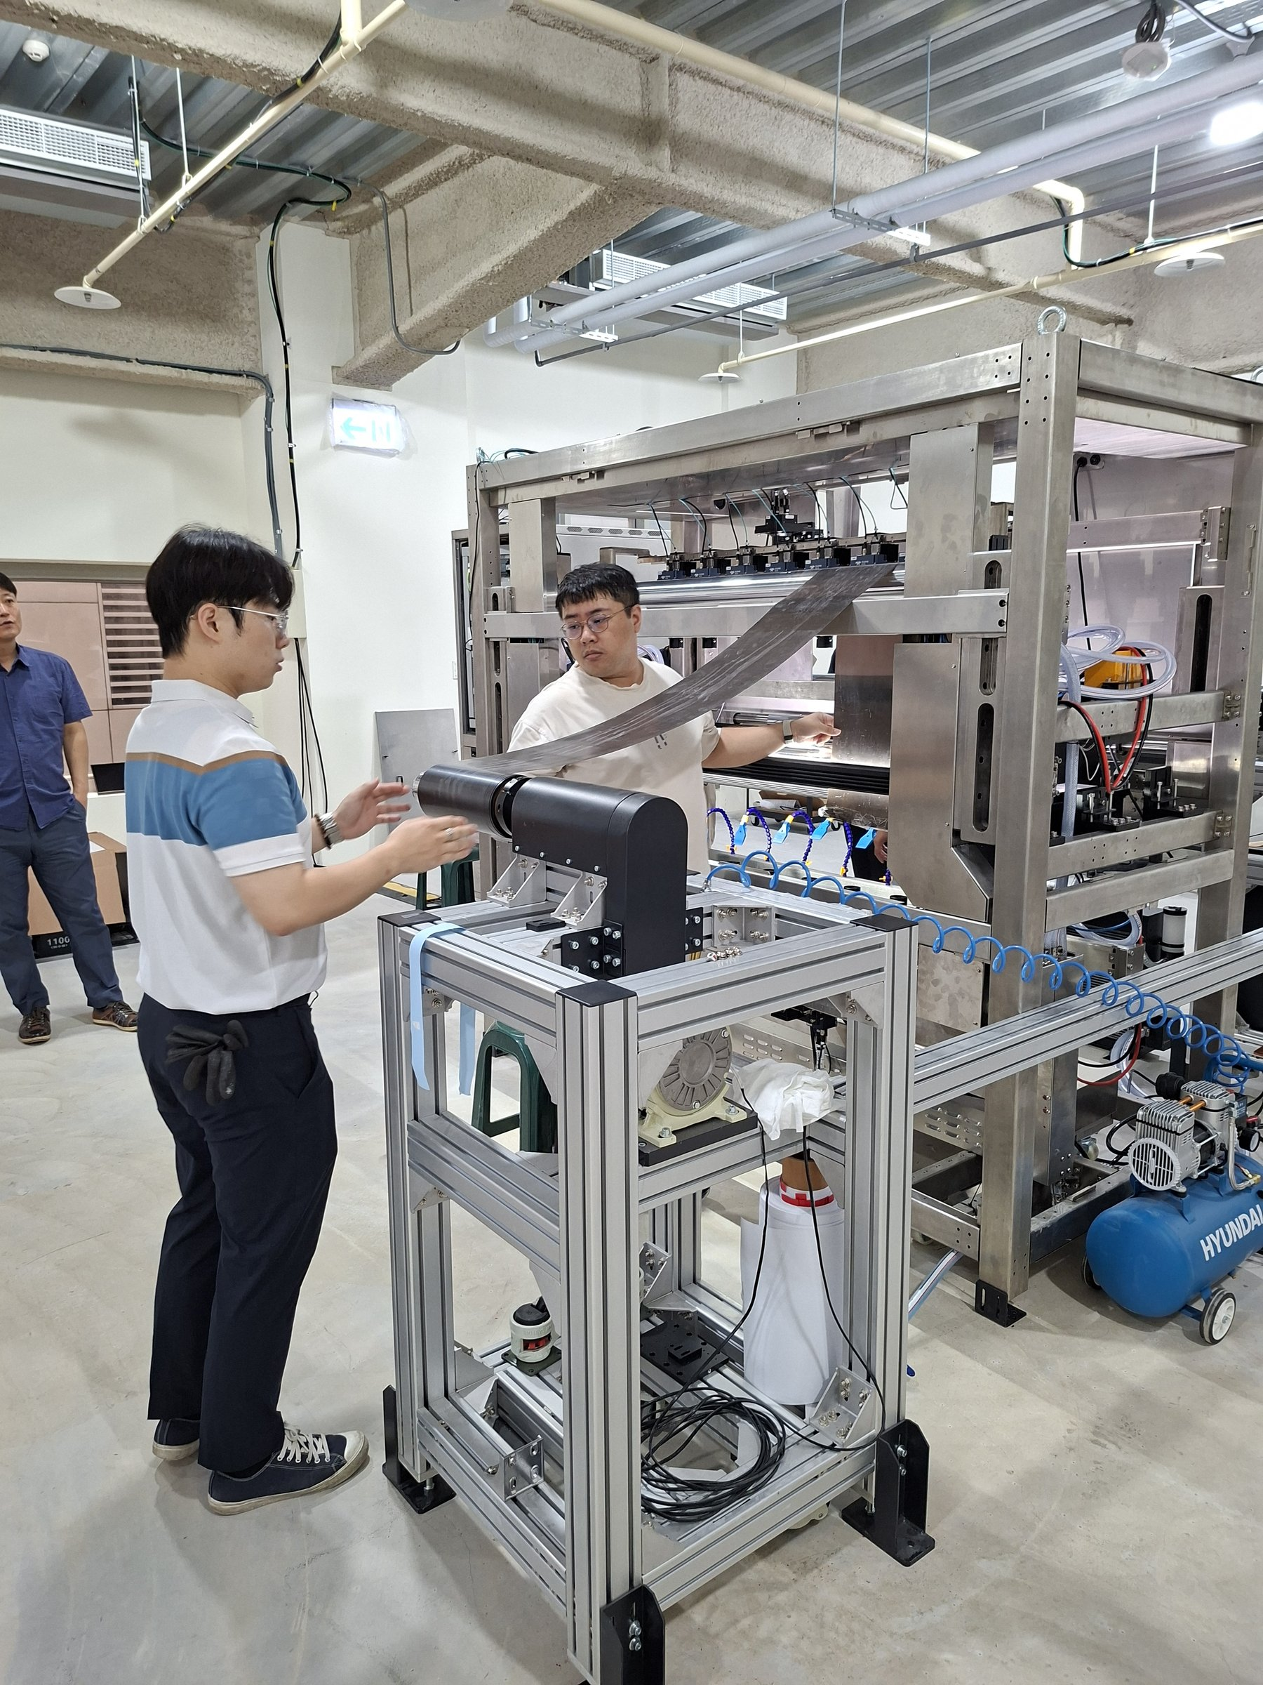
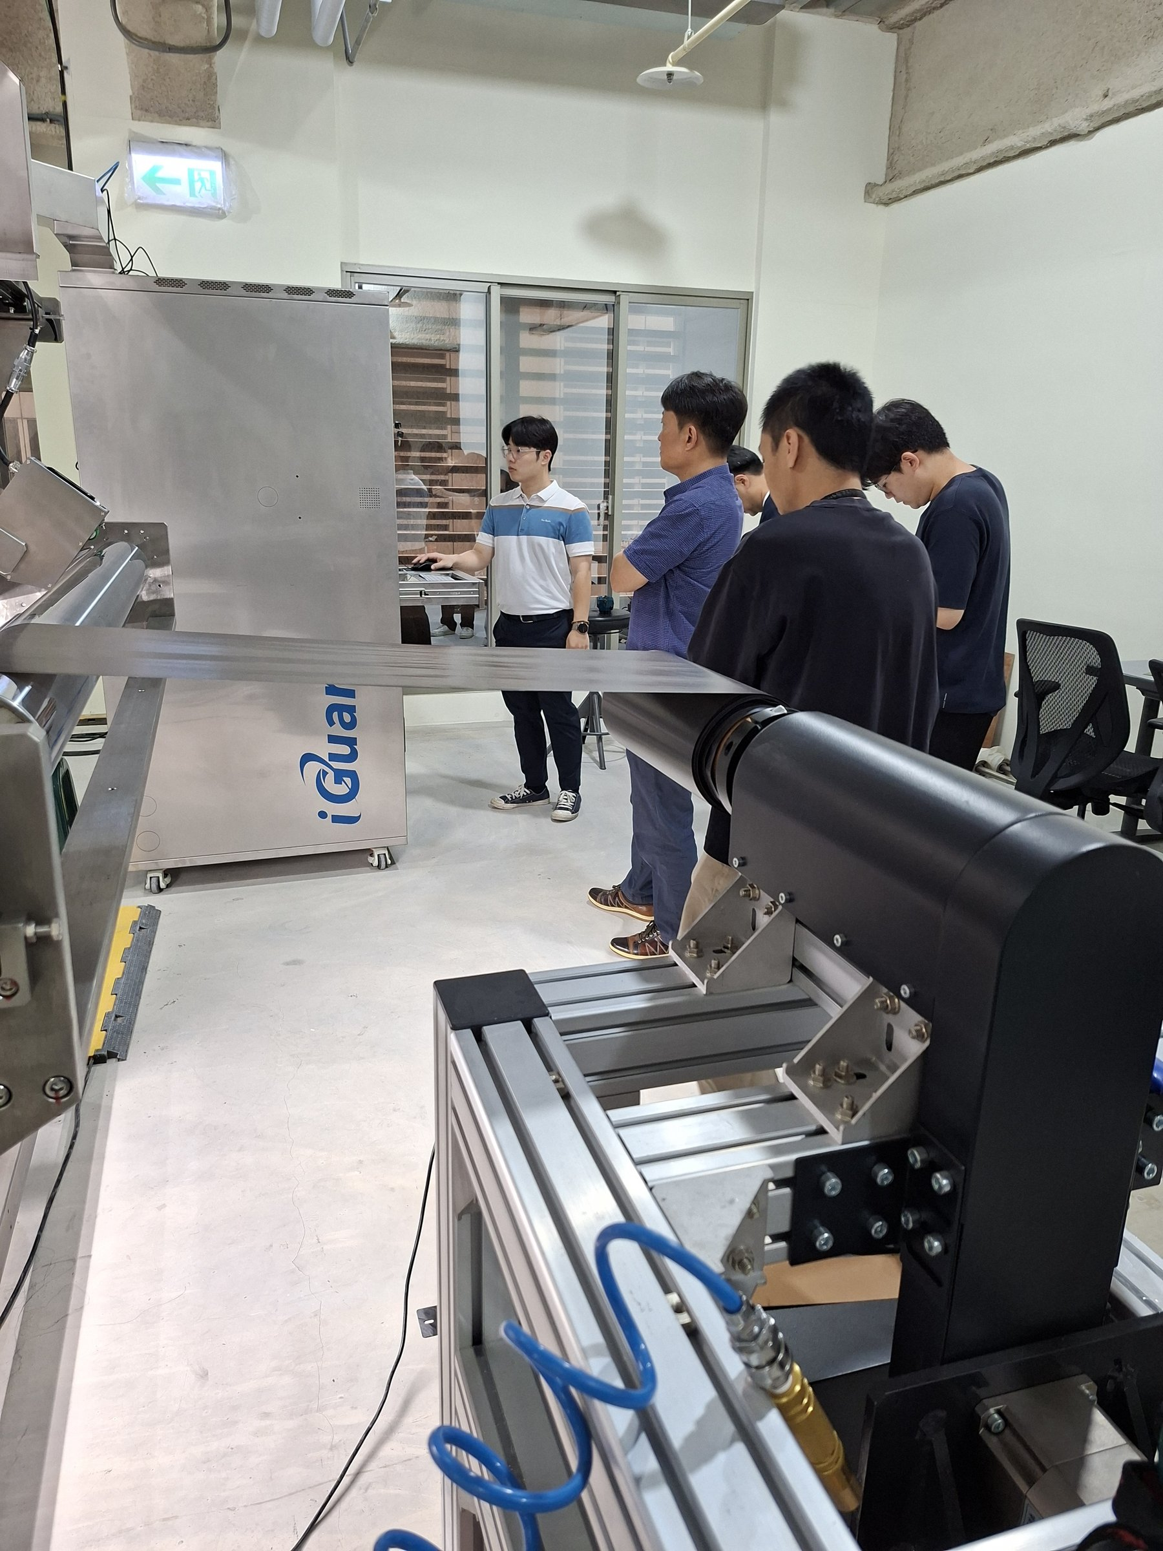
System Operation & Scanning Test
Functional Verification Checklist
Verification Checklist
✔
Machine startup normal — no fault alarms
✔
Feed speed stable — no tension fluctuation
✔
Line-scan camera imaging clear and sharp
AOI scanning unit in operation
✔
Real-time display smooth (≥ 30 fps)
✔
AOI algorithm loaded and running correctly
✔
Emergency stop (E-Stop) function verified
Engineer verifying scan status on-site
✔
Control cabinet wiring neat — no loose connections
iGuard AOI System | Prepreg & CCL Acceptance Review
7 / 10

Slide 8
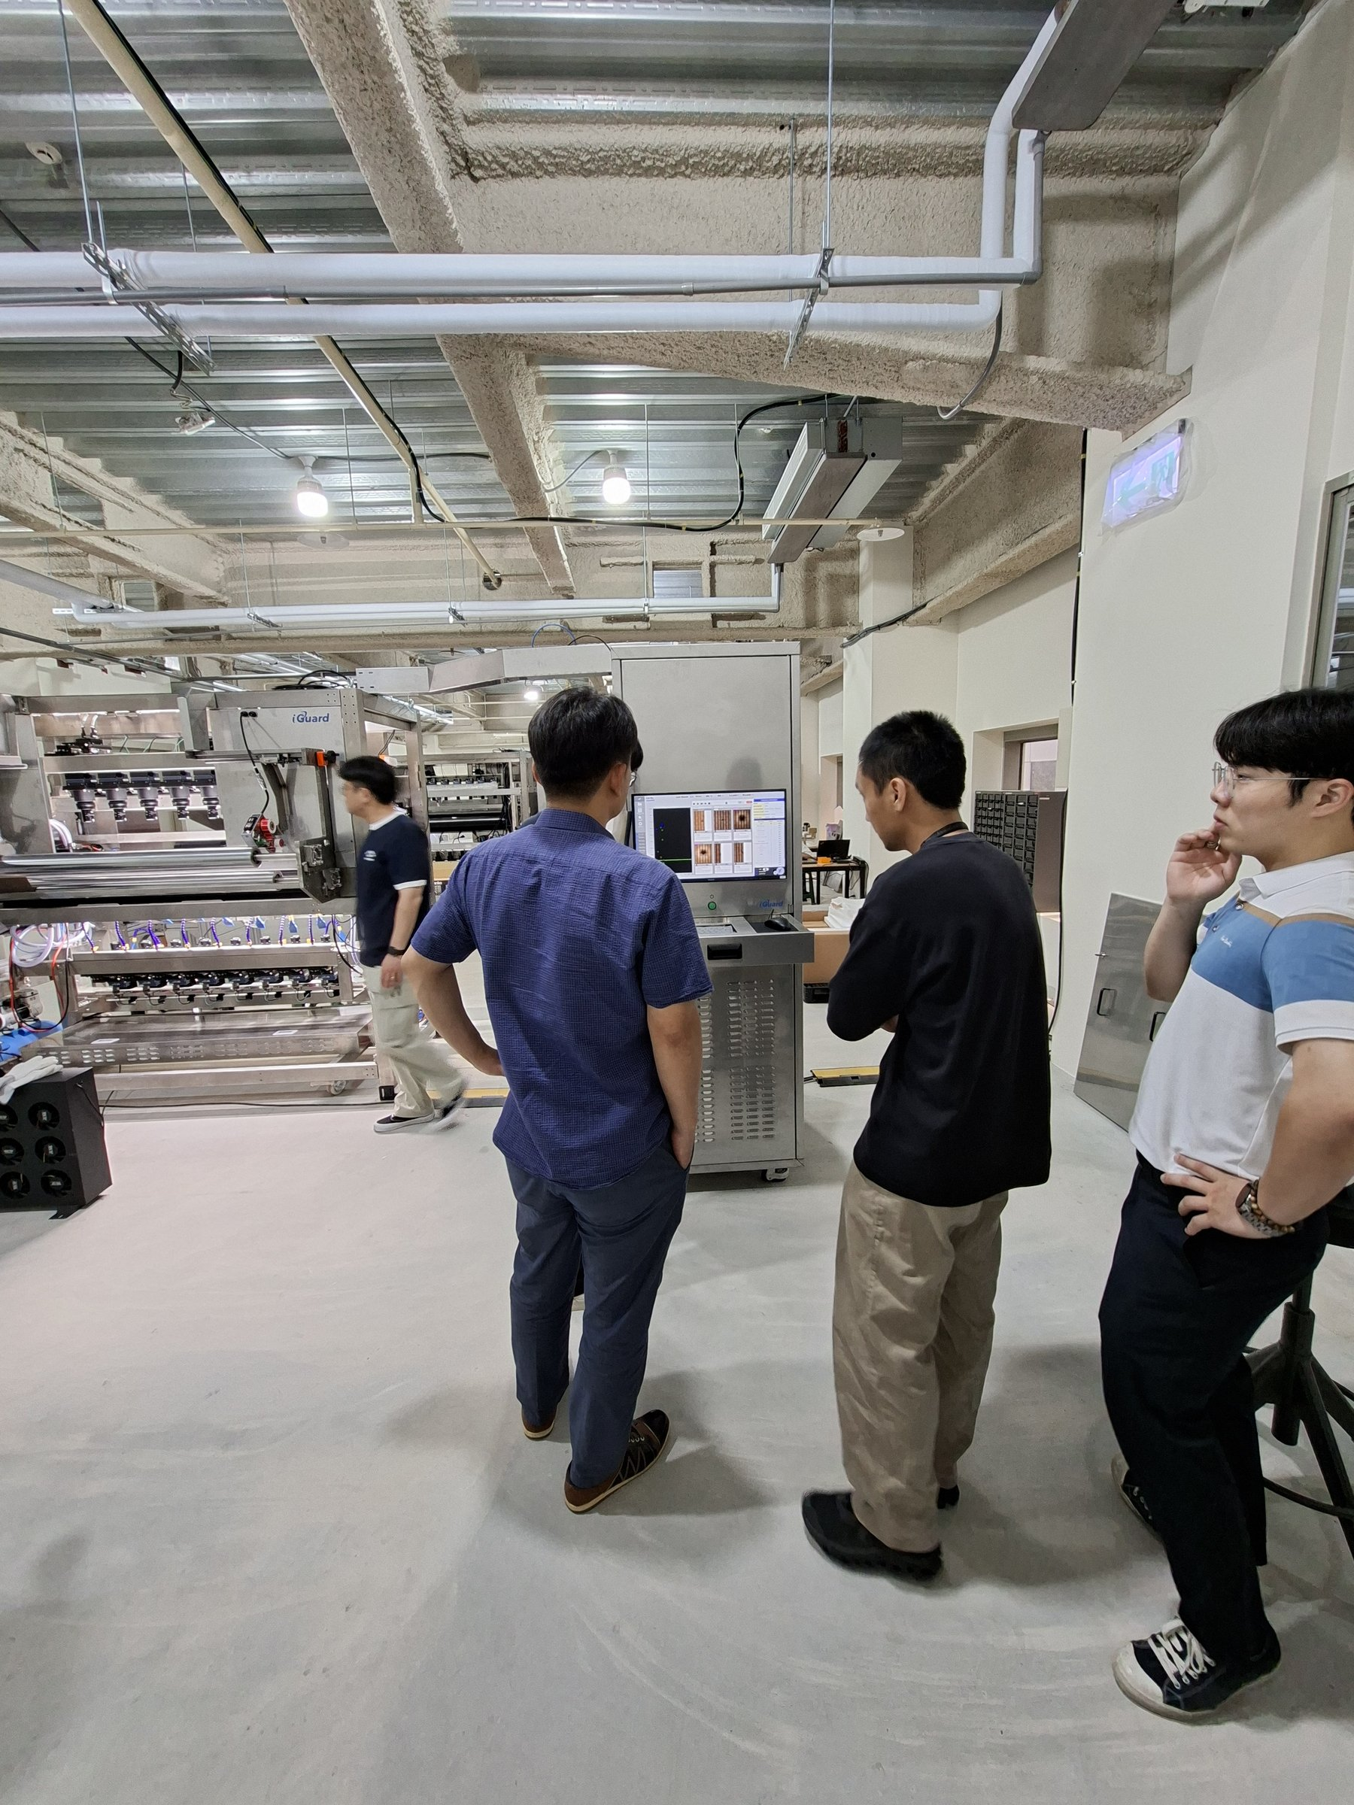
Defect Detection Results
Live AOI Output — Defect Classification & Grading
Defect Classification Results
Crease
Grade B
Detected
Surface Scratch
Grade A
Detected
Dent
Grade B
Detected
Foreign Matter
Grade A
Detected
Edge Defect
Grade C
Detected
Normal
PASS
Passed
iGuard AOI System | Prepreg & CCL Acceptance Review
8 / 10
AOI software displaying real-time CCL scan results with defect marking

Slide 9
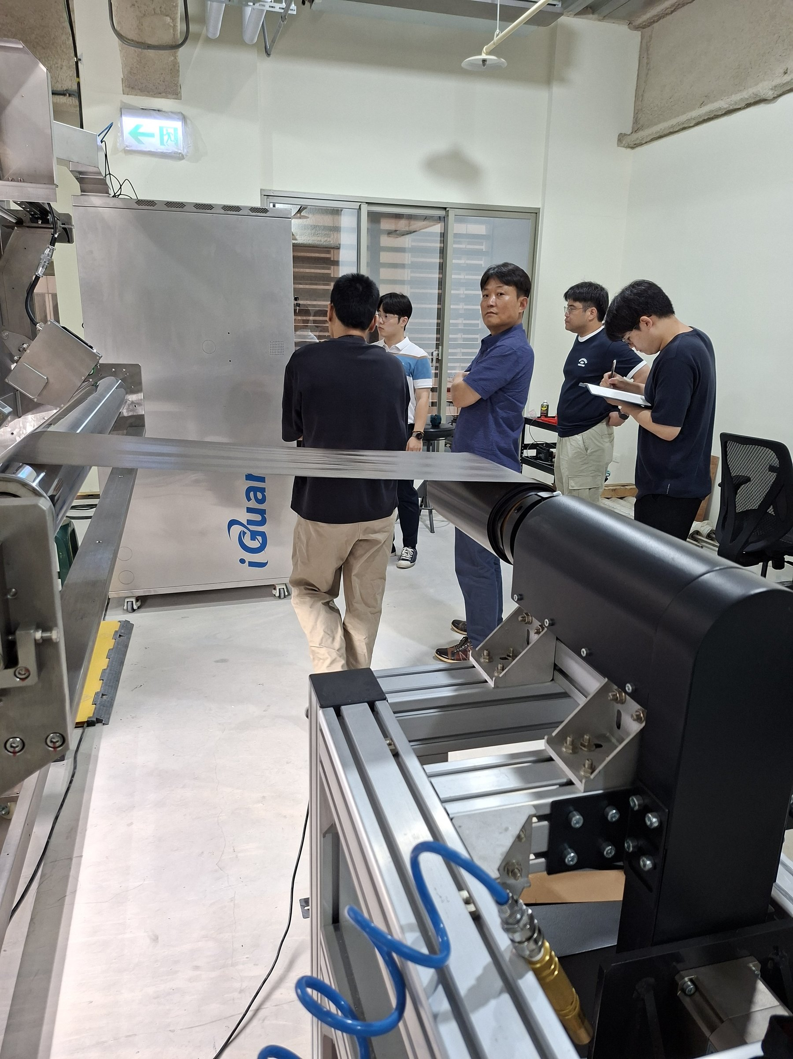
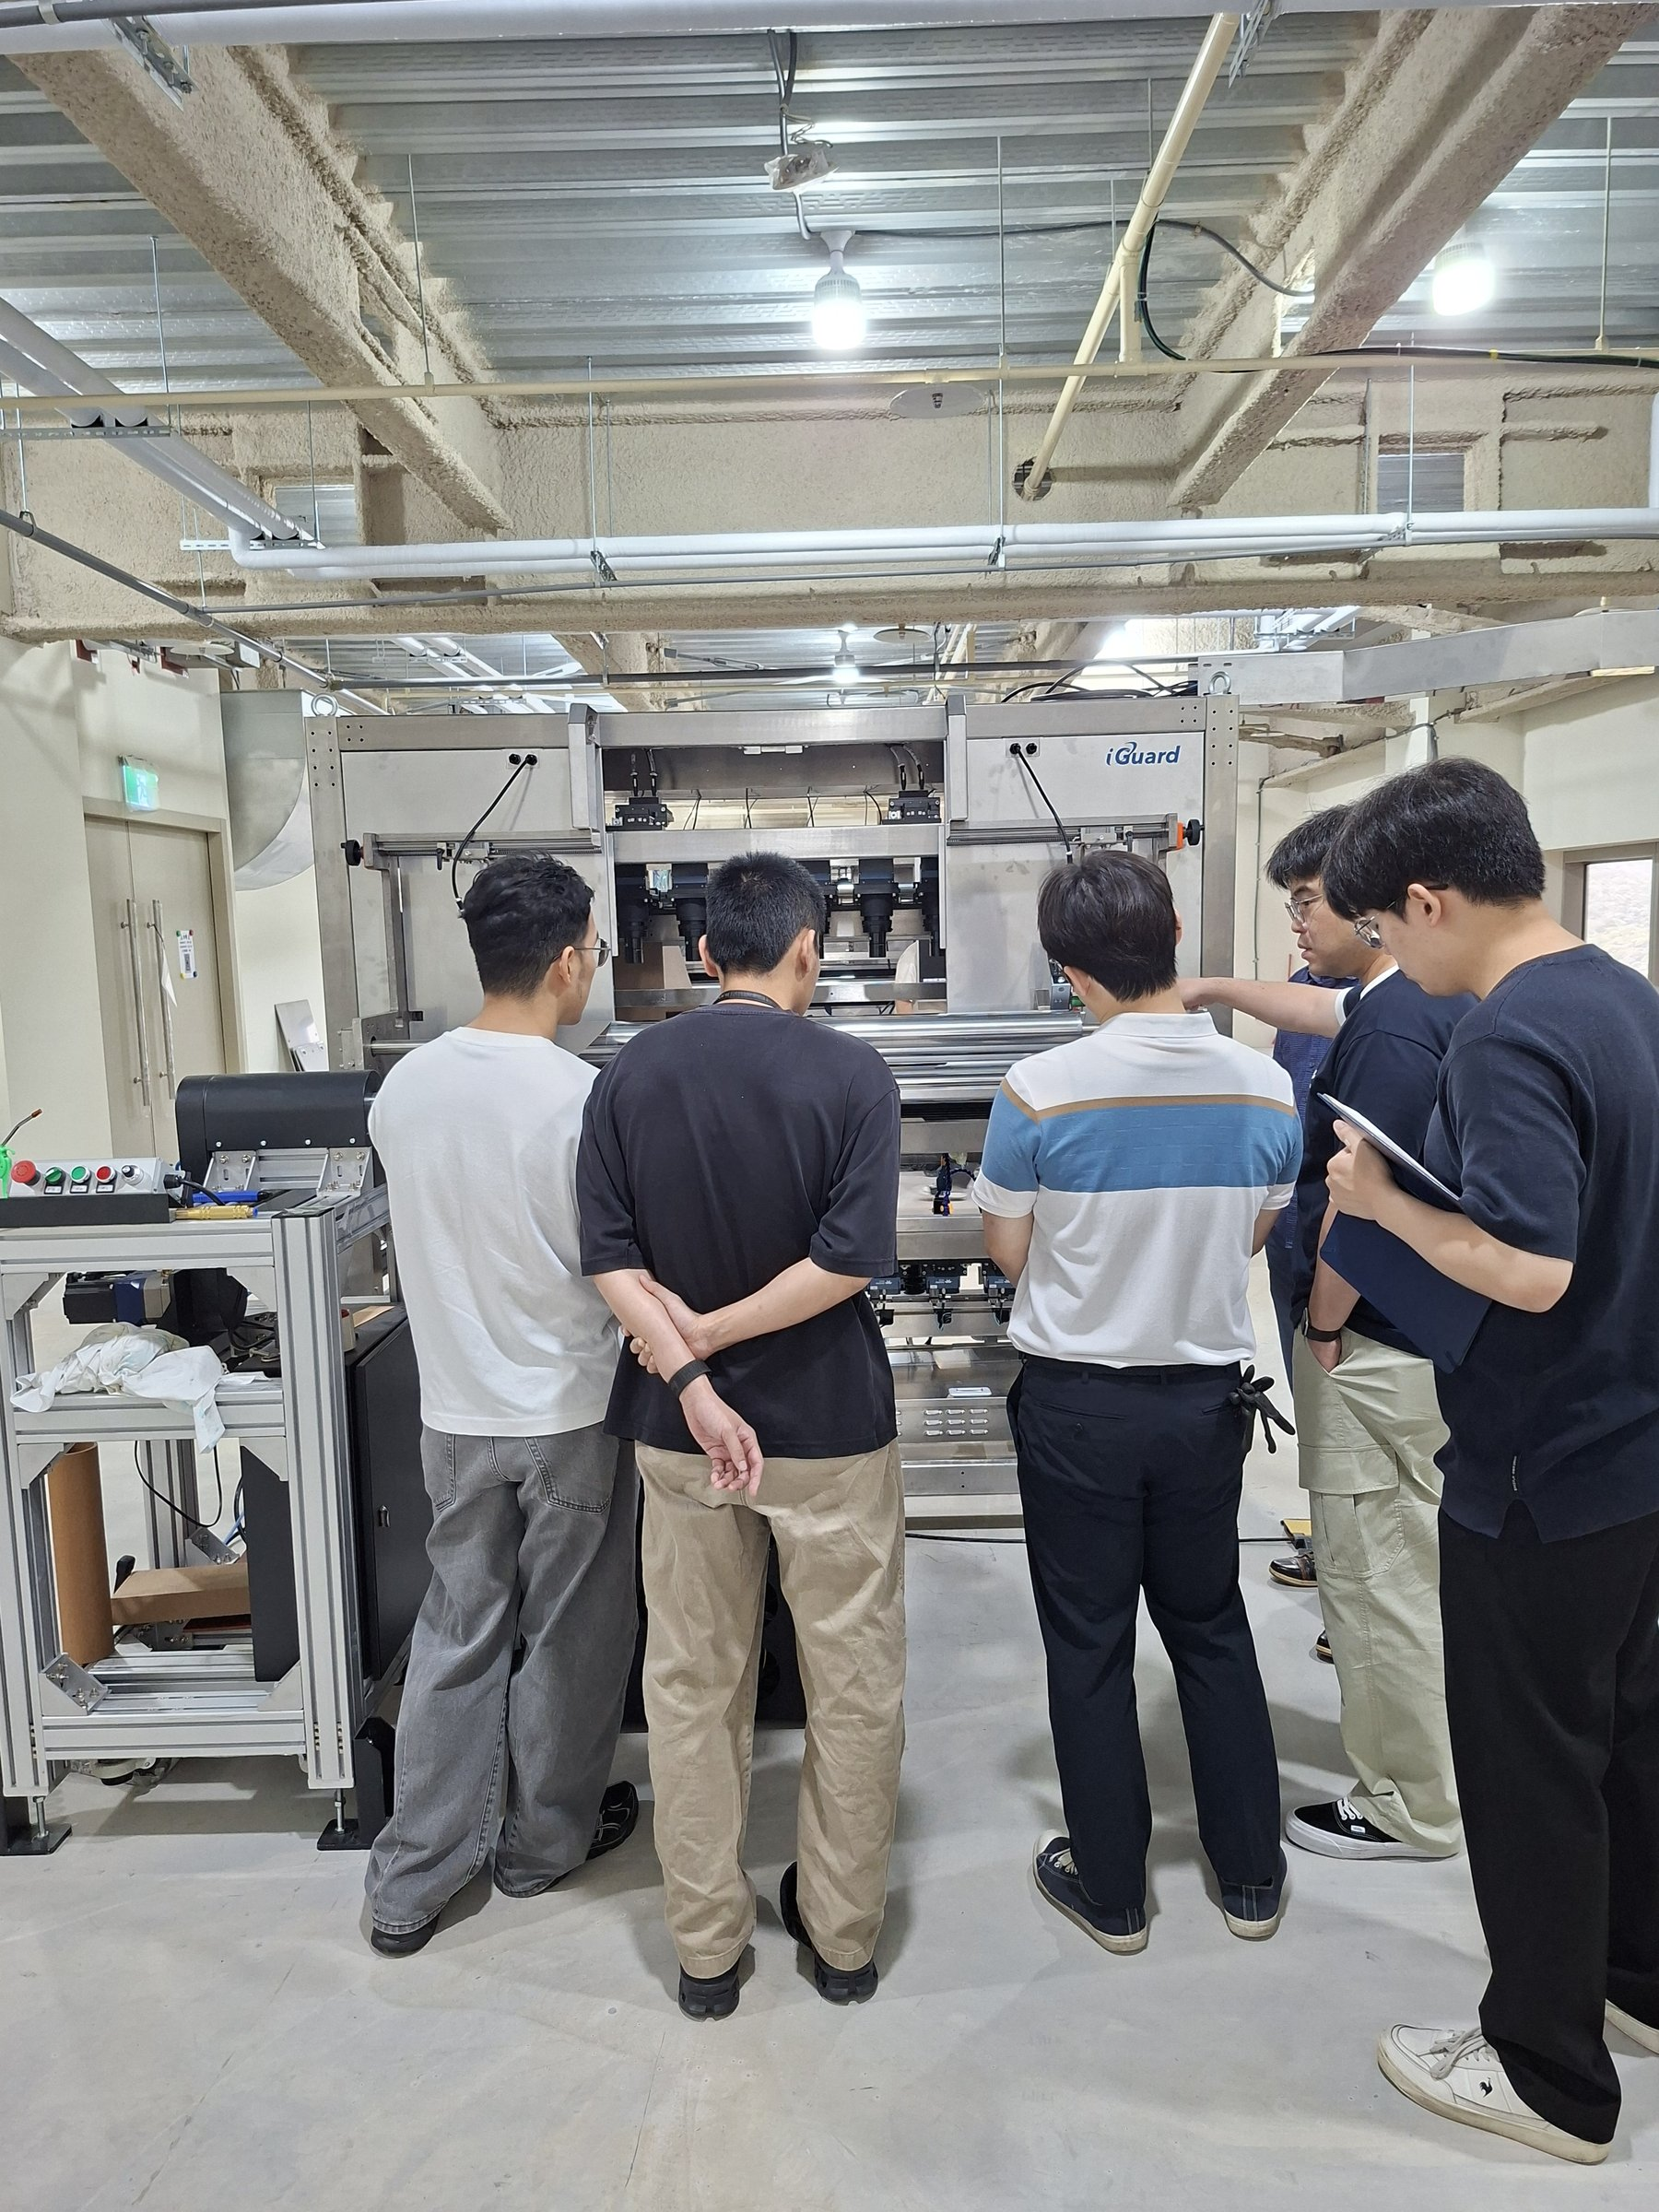
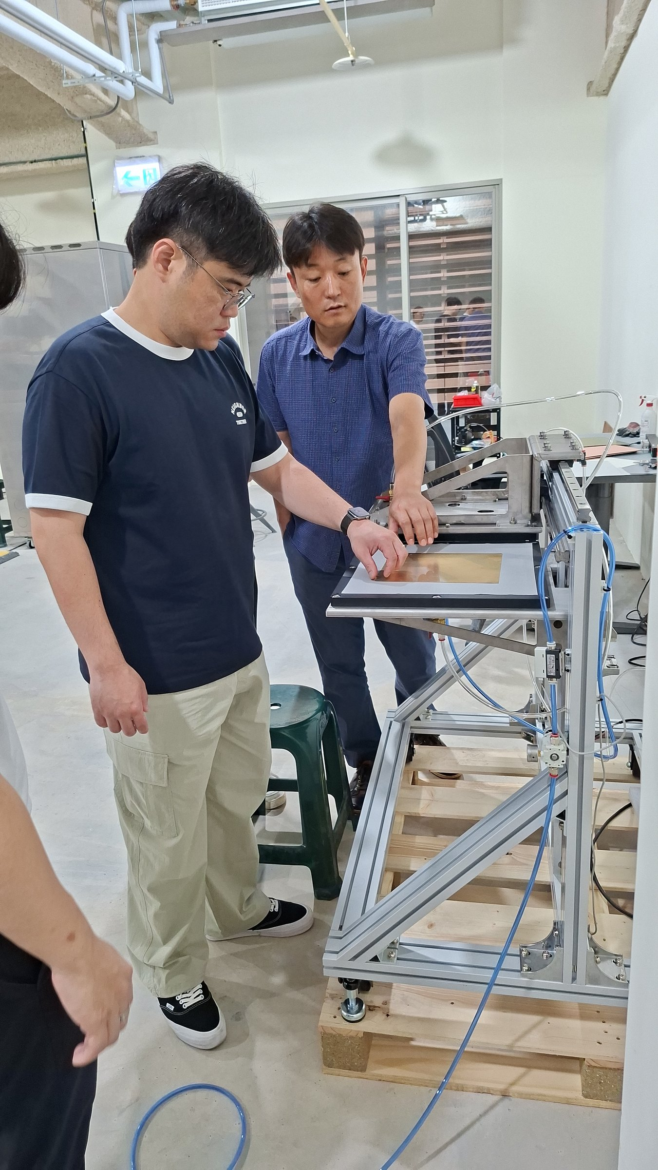
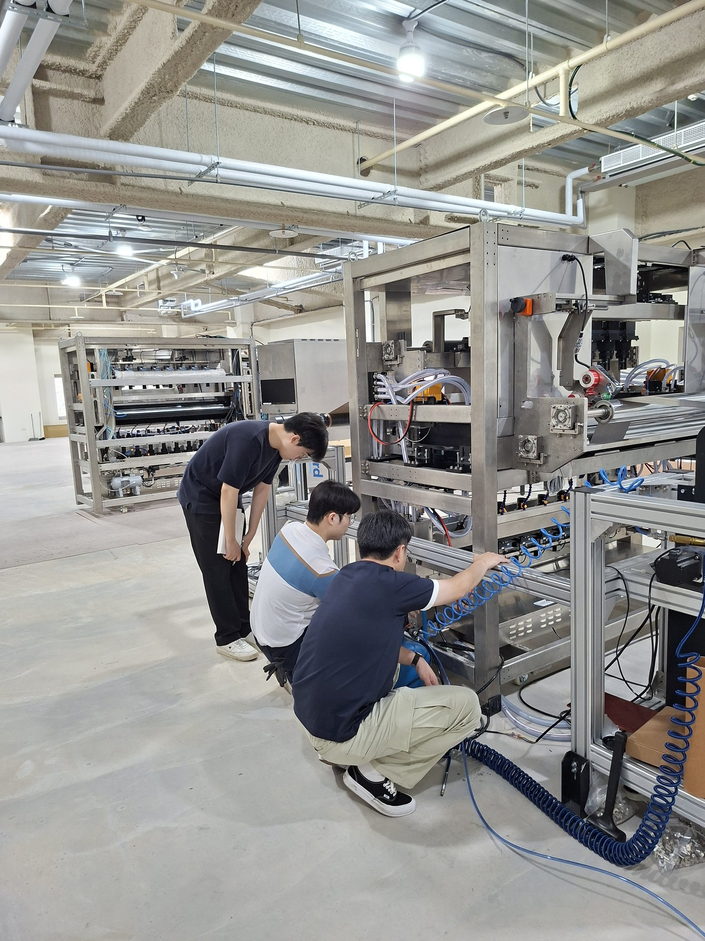
Customer Review & On-site Discussion
Joint Inspection Walkthrough
Customer and engineers conduct joint machine review
On-site discussion of machine configuration
Customer representative examines mechanical details
Sensor and electrical wiring verification
iGuard AOI System | Prepreg & CCL Acceptance Review
9 / 10

Slide 10
Acceptance Conclusion
iGuard AOI System · Prepreg & CCL Inspection · 2026-06-07
✔ Items Accepted
⚡ Action Items
● Machine structure assembled correctly, no loose parts
→ Sign and finalize the acceptance report
● Roll loading and material feed path smooth
→ Complete machine cleaning and packaging before shipment
● Line-scan camera image quality confirmed
→ Provide operation training and maintenance manual
● Real-time defect detection functioning properly
→ Confirm on-site installation schedule
● HMI software interface clear and operable
→ Finalize after-sales warranty terms in writing
● Emergency stop (E-Stop) function verified and passed
Thank you for your participation · AOITEK Co., Ltd. · 2026-06-07

