Slide 1
Wind Turbine Analysis
B03505043 陳麒友
B03505004 楊筌鈞
5/30

Slide 2
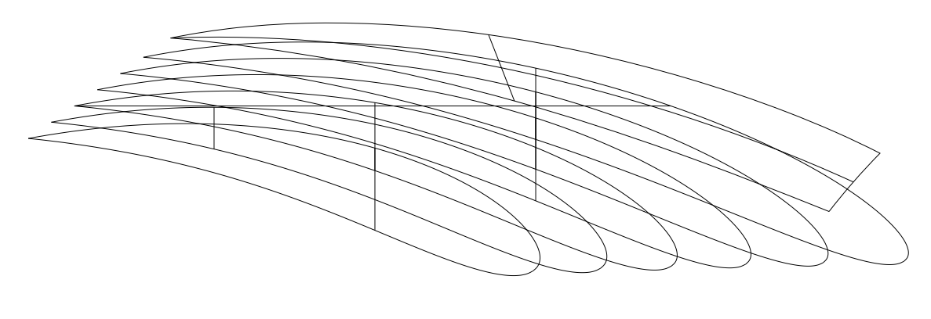
7u’s blade

Slide 3
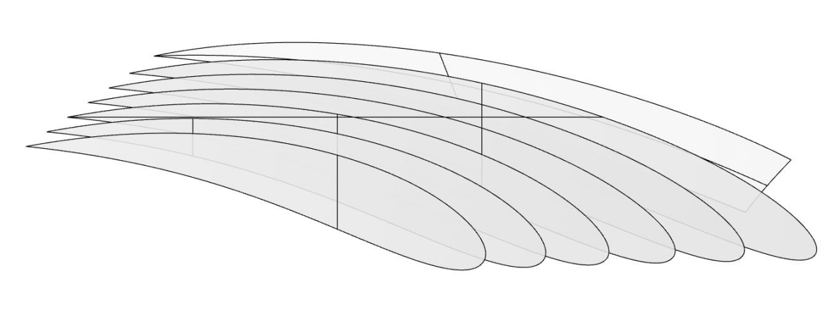
7u’s blade

Slide 4
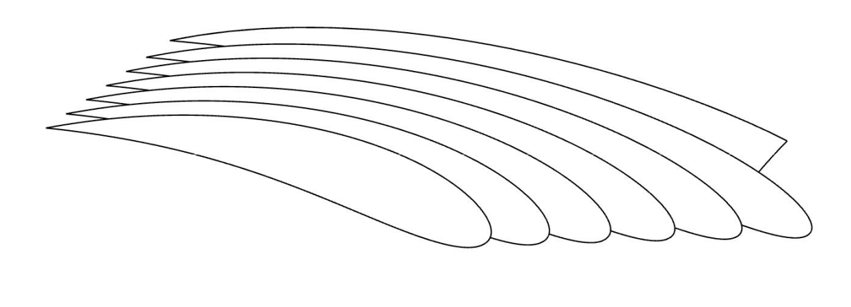
7u’s blade

Slide 5
Blade sections along radius
R(m) | Twist(°) | Chord
7 | 54.41 | 0.18
13 | 54.13 | 0.17
19 | 54.30 | 0.16
25 | 54.28 | 0.14
31 | 54.22 | 0.14
37 | 54.60 | 0.12

Slide 6
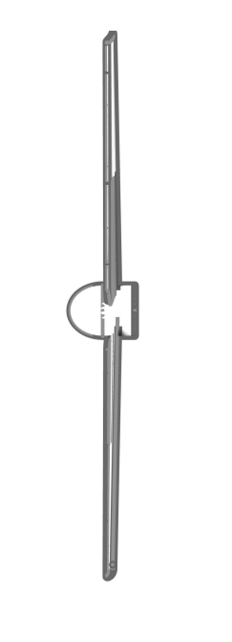
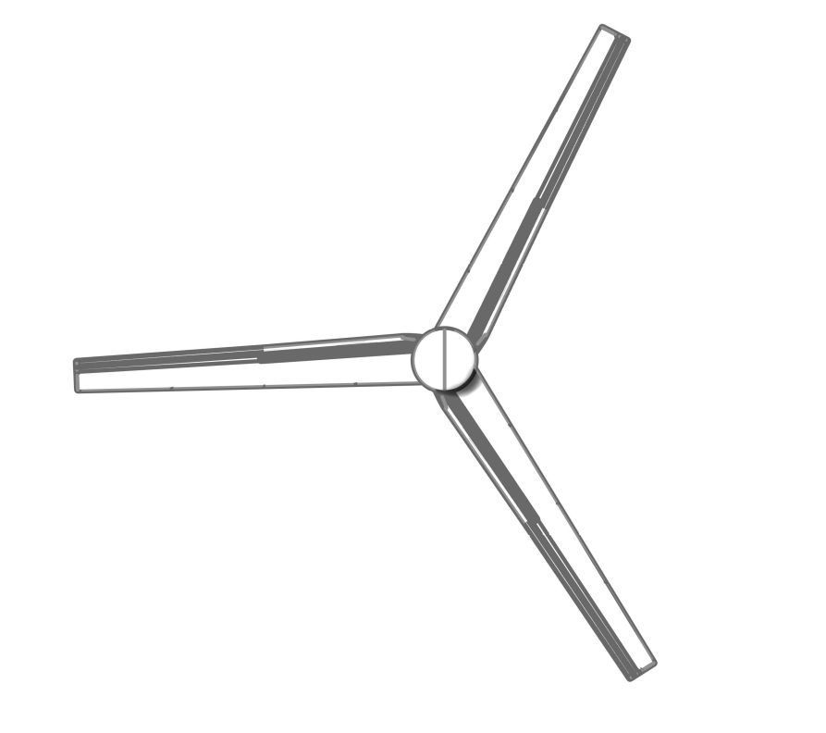

Target Wind Turbine
Rotor Diameter (𝐷) | 80 m
Hub Height (H) | 120 m (1.5D)
Tilt Angle (𝜃₎) | 0°
Rated Wind Speed | 16 m/s
Rated Rotor Speed | 16.7 rpm
Rated Power | 4.56 MW
^{𝜃})
D
H
Ground

Slide 7
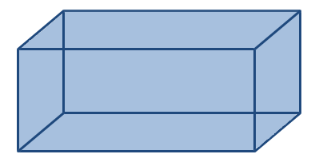
Computational Domain
3D
4D
6D
2D

Slide 8
Computational Domain
3D
Uniform wind: 16m/s
4D
6D
2D
Rotational Conditions: 16.7 rpm
Axis: (0,-1,0)

Slide 9
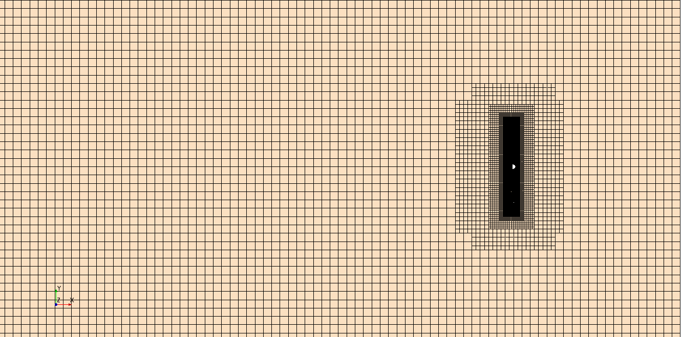
Mesh Distribution
Total mesh: 2,884,571

Slide 10
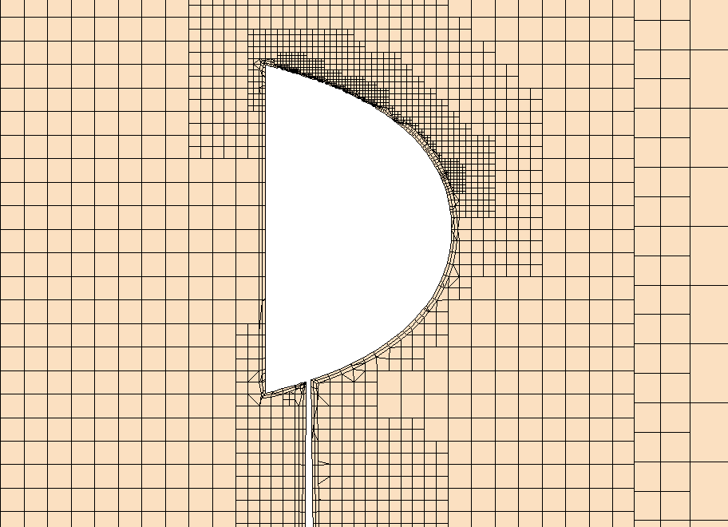
Mesh Distribution
Total mesh: 2,884,571

Slide 11
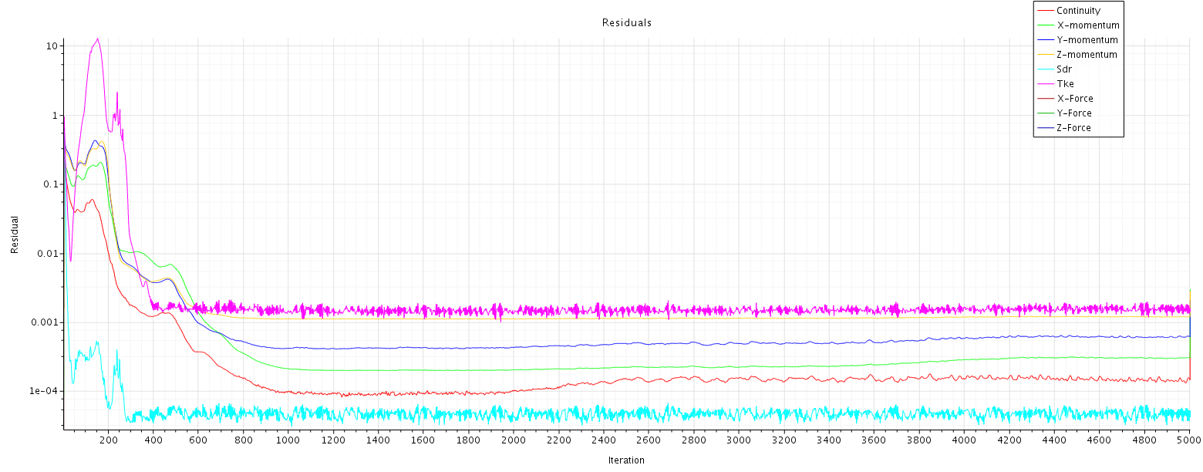
Convergence Condition

Slide 12
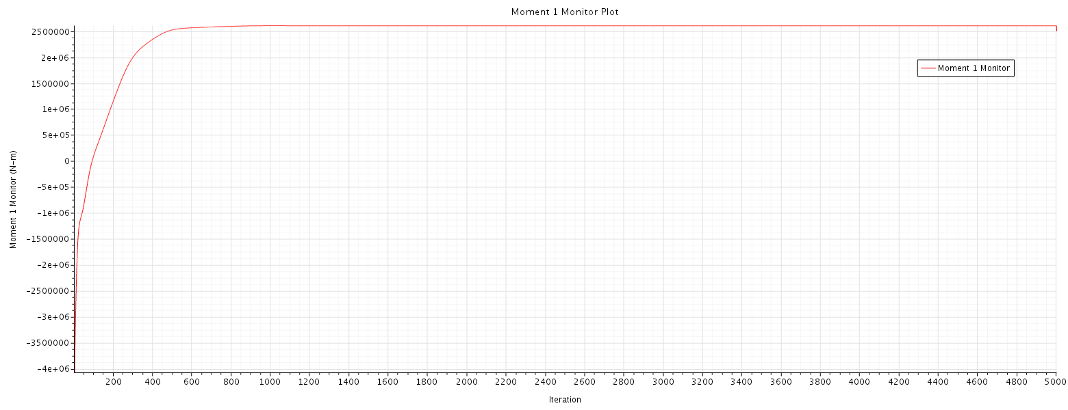
Convergence Condition

Slide 13
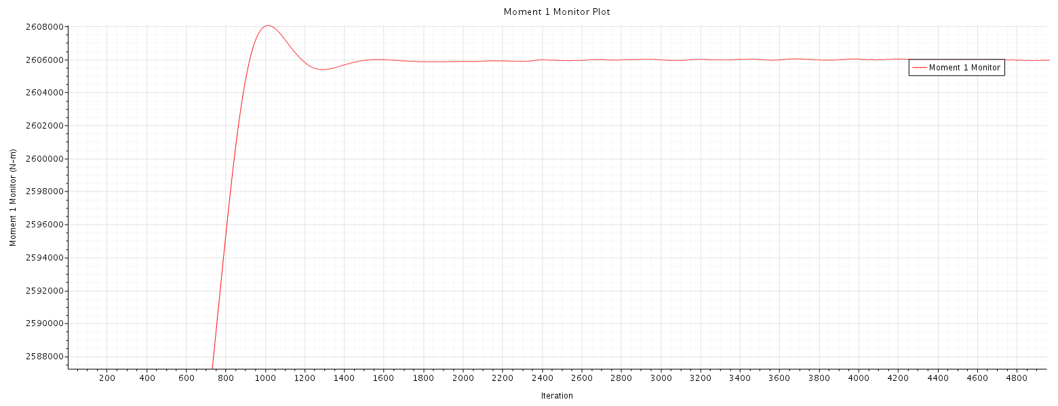
Convergence Condition
2,606,000
Rated power: 4.56MW

Slide 14
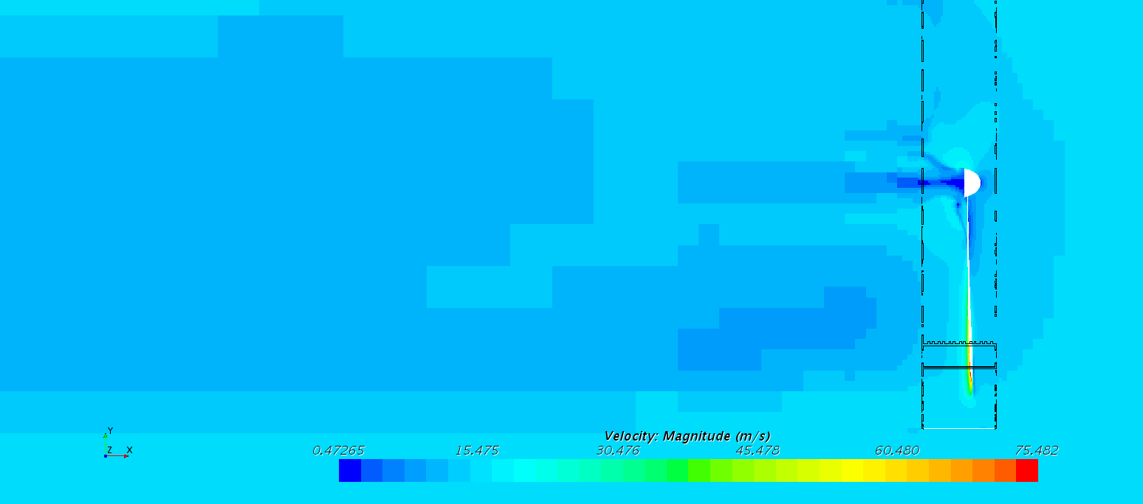
Flow Field

Slide 15
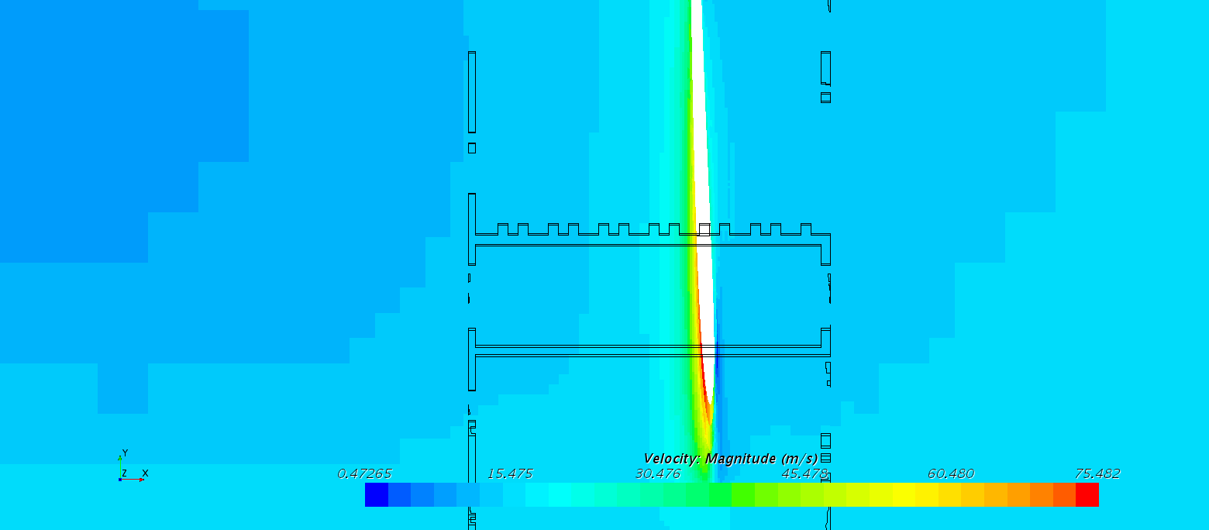
Flow Field

Slide 16
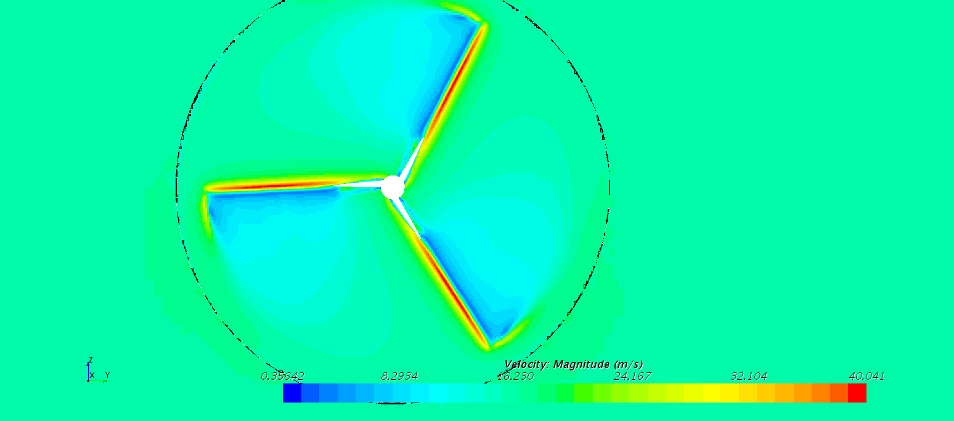
Flow Field

Slide 17
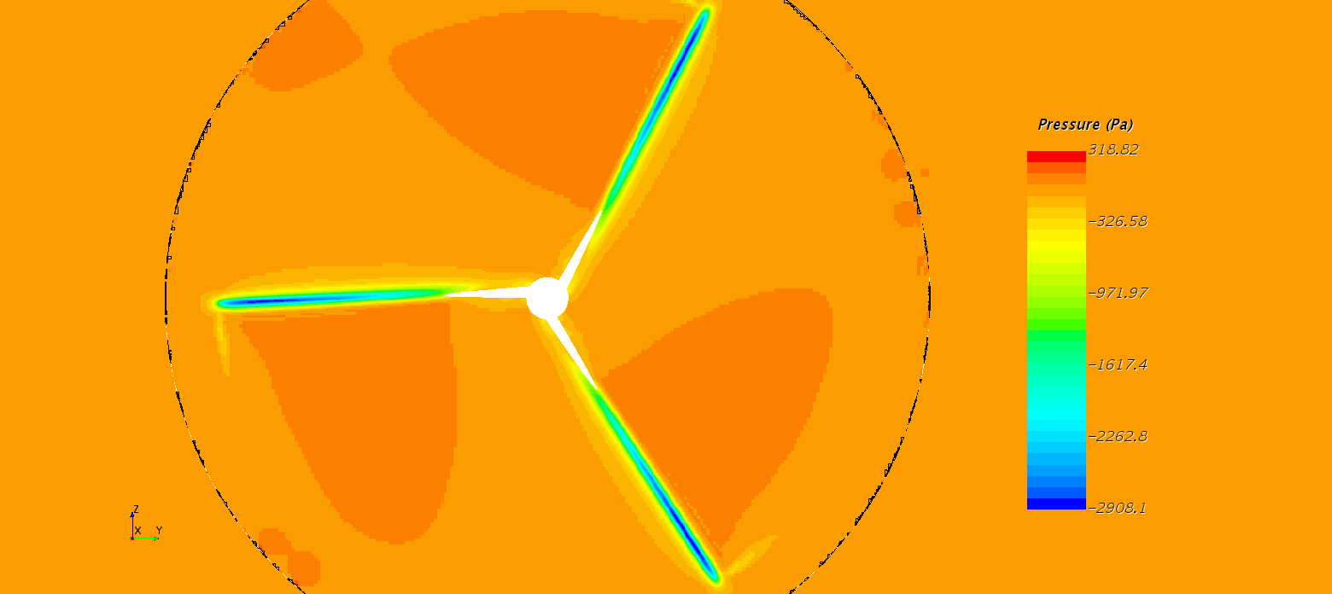
Flow Field

Slide 18
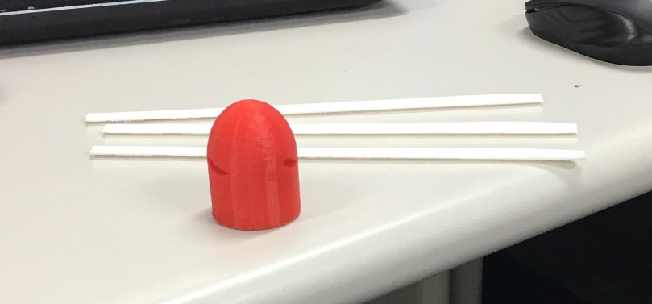
3D-printing
Before assembling

Slide 19
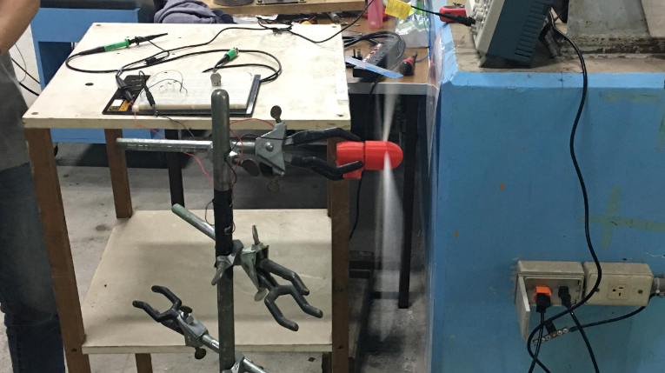
3D-printing
In action

Slide 20
Power Measurement
距離(m) | 風扇強度 | 風速(m/s) | 轉速(RPM) | Mean Voltage (V) | Peak to peak voltage (V) | 平均風速(m/s) | 平均轉速(RPM) | 平均Mean Voltage (V) | 平均 Peak to peak voltage (V) | 平均功率 (W)
1.00 | 弱 | 5.6 | 339.00 | 1.36 | 0.50 | 5.73 | 333.11 | 1.36 | 0.52 | 0.17
 |  | 5.7 | 329.33 | 1.37 | 0.56
 |  | 5.9 | 331.00 | 1.34 | 0.50
 | 中 | 6.4 | 389.33 | 1.54 | 0.76 | 6.57 | 388.44 | 1.53 | 0.71 | 0.21
 |  | 6.5 | 387.33 | 1.53 | 0.72
 |  | 6.8 | 388.67 | 1.53 | 0.66
 | 強 | 7.1 | 433.00 | 1.65 | 0.82 | 7.07 | 428.00 | 1.65 | 0.81 | 0.25
 |  | 7.2 | 427.67 | 1.66 | 0.72
 |  | 6.9 | 423.33 | 1.64 | 0.88
2.00 | 弱 | 4.5 | 276.00 | 1.05 | 0.30 | 4.33 | 273.67 | 1.00 | 0.35 | 0.09
 |  | 4.2 | 263.33 | 1.04 | 0.34
 |  | 4.3 | 281.67 | 0.91 | 0.40
 | 中 | 4.8 | 316.67 | 1.15 | 0.52 | 4.80 | 311.11 | 1.18 | 0.53 | 0.13
 |  | 4.7 | 313.00 | 1.20 | 0.58
 |  | 4.9 | 303.67 | 1.19 | 0.48
 | 強 | 5.0 | 338.67 | 1.24 | 0.56 | 5.17 | 332.89 | 1.28 | 0.59 | 0.15
 |  | 5.2 | 325.33 | 1.36 | 0.58
 |  | 5.3 | 334.67 | 1.23 | 0.62

Slide 21
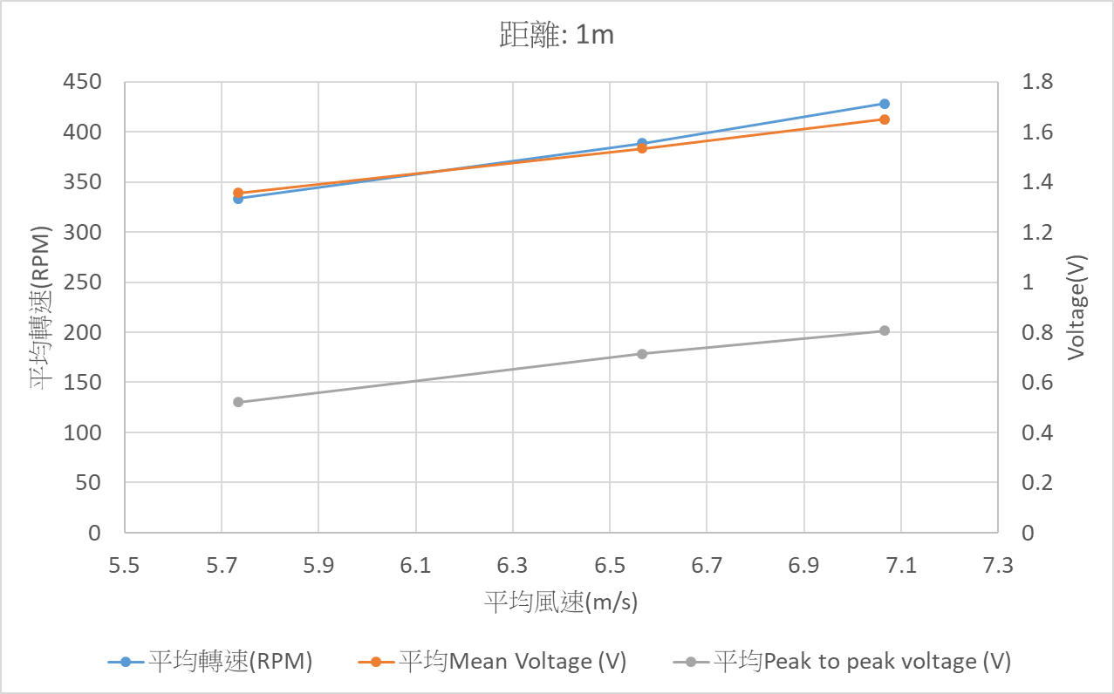
Power Measurement

Slide 22
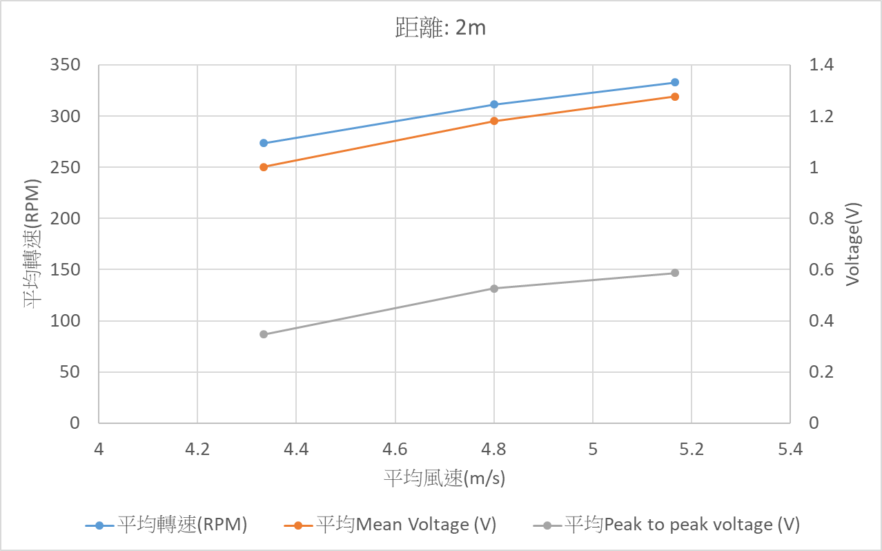
Power Measurement

Slide 23
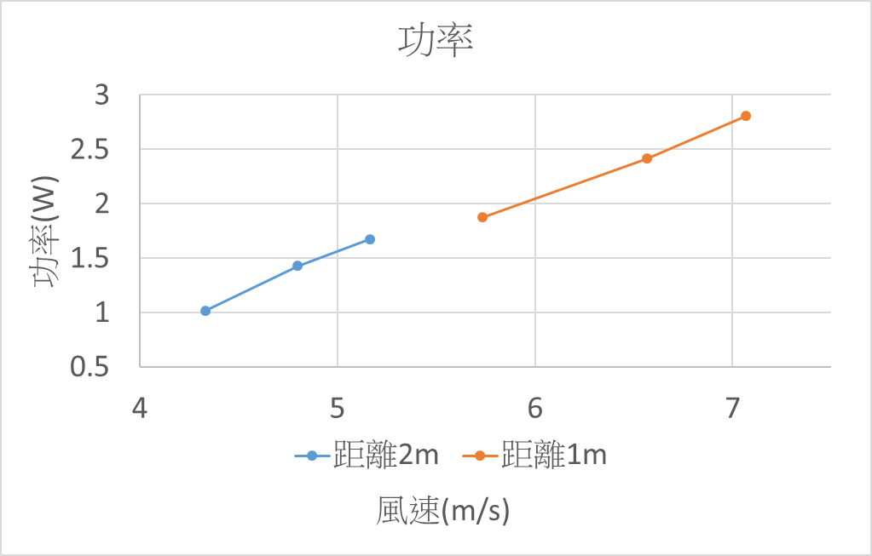
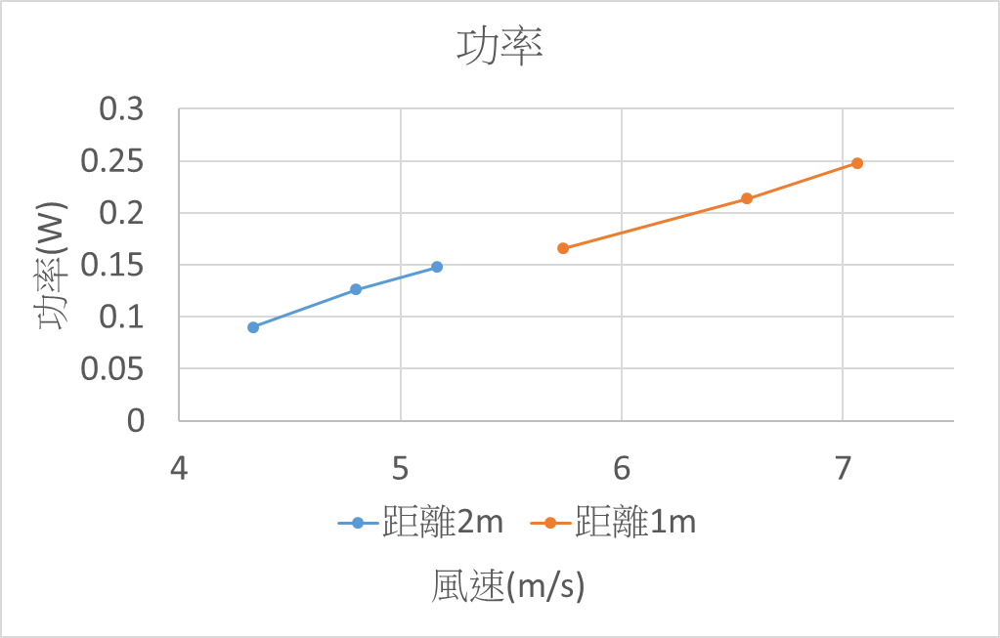
Power Measurement

