Slide 1
RIFFA 2.2.2 for dummy
2018/04/09 v1.0 Sheng Jui Huang
2019/07/17 v2.0 Shih Wei Hsieh

Slide 2
Outline
What is RIFFA
Practice #1
Practice #2
Appendix

Slide 3
What is RIFFA
RIFFA:
Reusable Integration Framework for FPGA Accelerators
Requires a PCIe enabled workstation and a FPGA board with a PCIe connector
Pros:
Both the software and hardware interfaces have been greatly simplified
Ease of programming: details of the PCIe protocol, device driver, DMA operation, and all hardware addressing are hidden from both the software and hardware.
Support for Linux and Windows, software bindings for C/C++, Python, Matlab, and Java
Cons:
Takes up resource: If no high speed data I/O communication is needed, then its better to not use it
Loss of flexibility

Slide 4
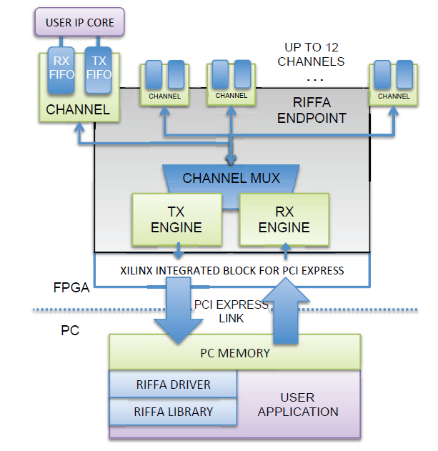
What is RIFFA
User cores interface with RIFFA 2.0 via a Channel core
The Channel core has FIFOs for receiving and sending data respectively.
The RX Engine core is responsible for extracting and demultiplexing received PCIe payload data.
The TX Engine core is responsible for formatting payload data into PCIe packets and multiplexing access to the PCIe link
The PCIe link configuration determines the width of the data bus. This width can be 32, 64, or 128 bits wide (RIFFA does not support 256 bits interface)
All PCIe Gen 1 and Gen 2 configurations up to x8 lanes are supported.
Where you need to plug your design

Slide 5
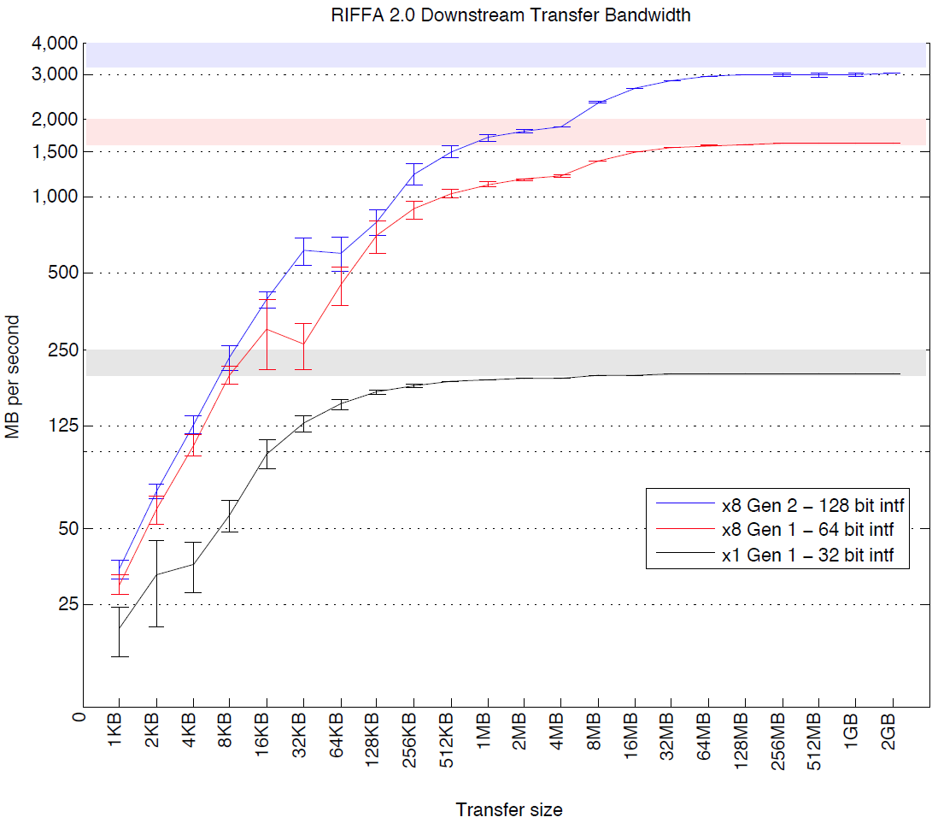
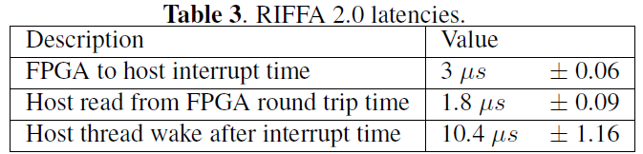
What is RIFFA
Sending data in smaller transfer sizes reduces effective throughput
Making a copy of a large buffer of data in software before sending it to the FPGA takes time and can severely impact throughput
Less transmission improves throughput

Slide 6
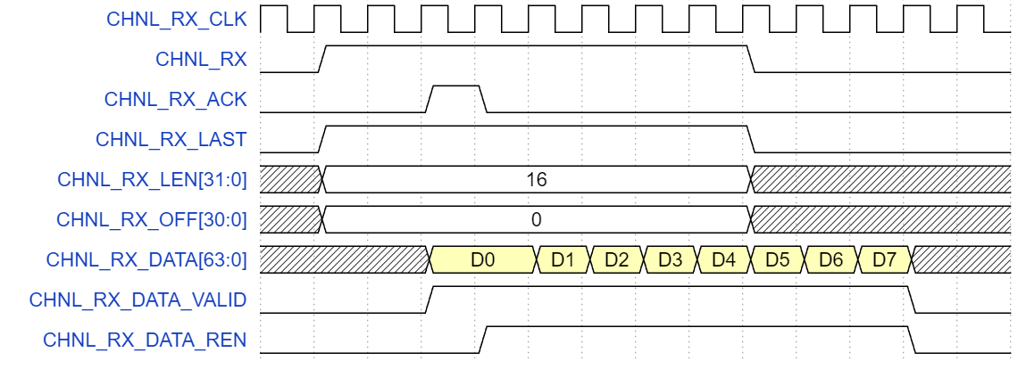
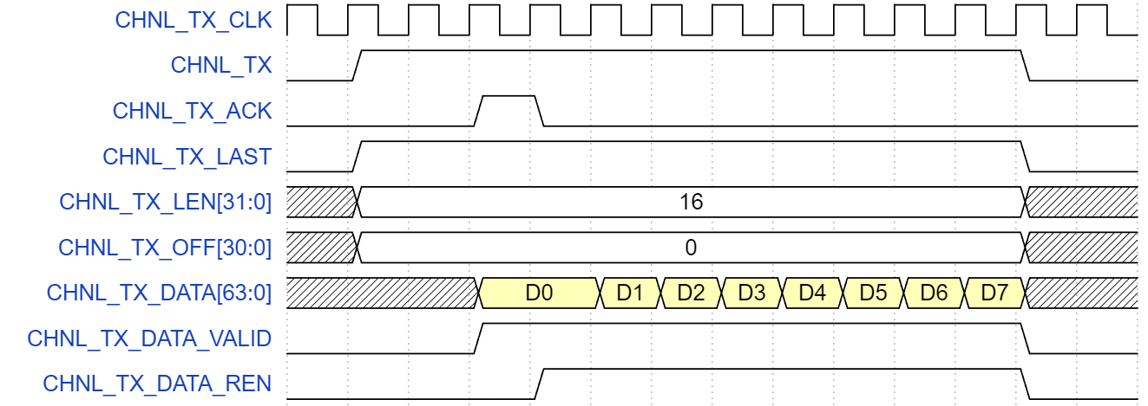
Hardware Interface
RX/ TX protocol:
Read: https://sites.google.com/a/eng.ucsd.edu/matt-jacobsen/riffa/riffa_2_0/hw-interface
Learn from example: our sample code

Slide 7
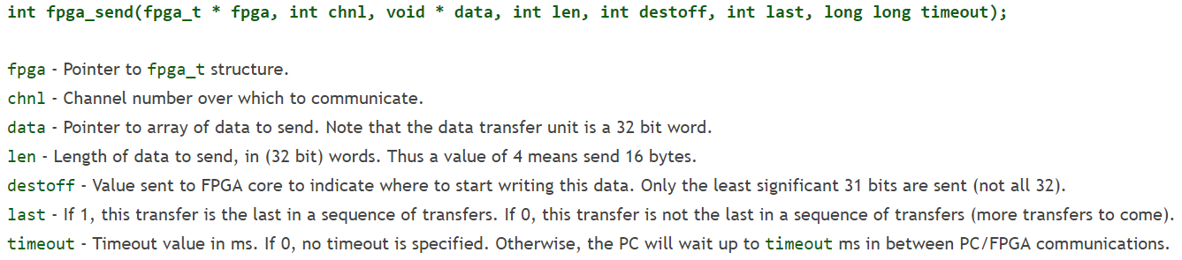
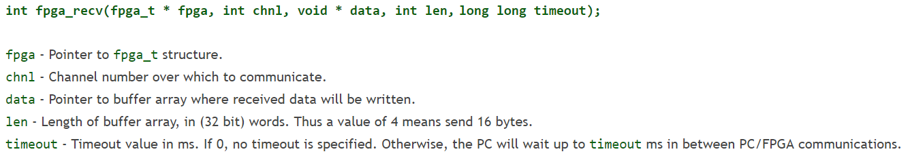
Software Interface
RX/ TX protocol:
Read: https://sites.google.com/a/eng.ucsd.edu/matt-jacobsen/riffa/riffa_2_0/c-interface
Learn from example: our sample code

Slide 8
Recommended design tips
It is recommended that you separate your design from the RIFFA transmission part
Pros:
Easier to maintain your code
You can test your code using ncverilog simulation before programming it on FPGA
Easier to debug your code
Saves your time (Quartus compilation is time-consuming)
RIFFA Channel
Your design
RIFFA software interface
FPGA flow
pattern generator
Testbench
ASIC flow

Slide 9
Practice time
More info (website/ paper/ github):
https://sites.google.com/a/eng.ucsd.edu/matt-jacobsen/riffa/riffa_2_0
http://kastner.ucsd.edu/wp-content/uploads/2014/04/admin/fpl-riffa2.pdf
https://github.com/KastnerRG/riffa
DE4 workstation:
IP: 140.112.48.159
Port: 42020
Download:
https://github.com/b03901165Shih/2019-FPGA-training-course
cp –r /mnt/ds1515/fpga/riffa_2.2.2/ ./
Use this to copy riffa from our workstation

Slide 10

Practice time
Practice #1: Block RAM
Input $→$ Store in BRAM $→$ Read from BRAM (reverse order) $→$ Output
Data input
Block RAM
Data output

Slide 11
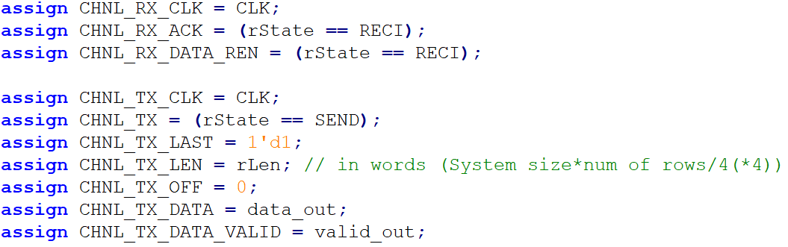
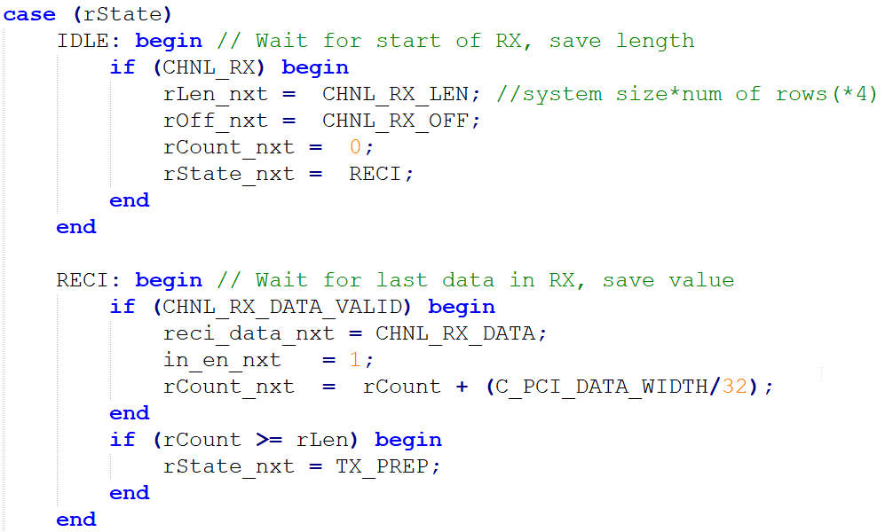
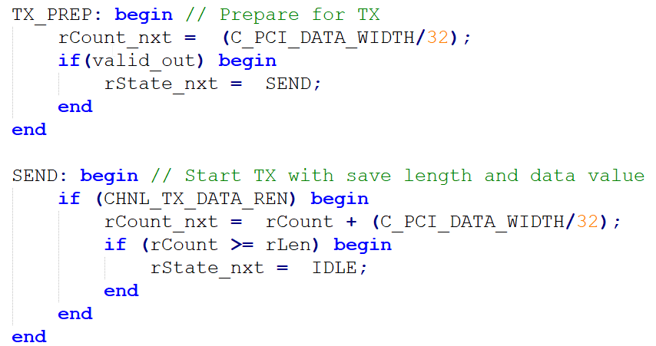
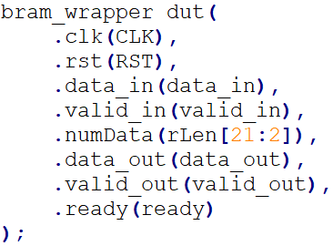
Practice time
Channel tester:
Plugged design

Slide 12
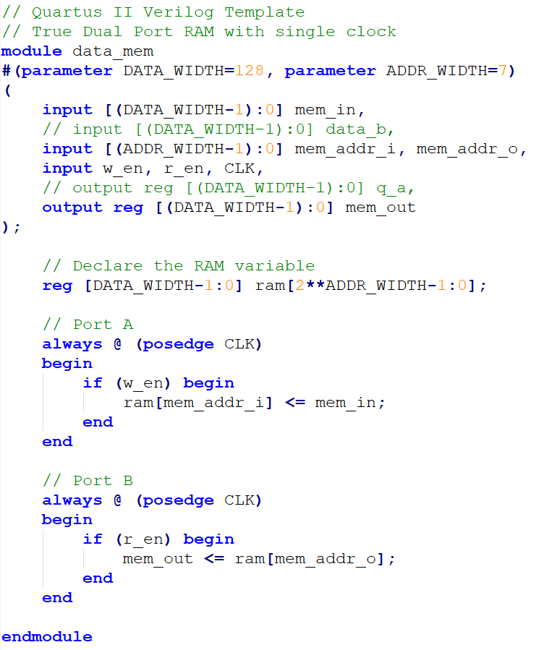
Practice time
Inferred dual port Block RAM:

Slide 13
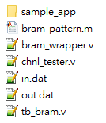

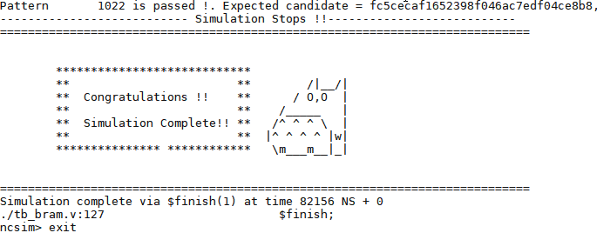
Step-by-step guide
Download sample code:
https://github.com/b03901165Shih/2019-FPGA-training-course
Generate pattern from bram_wrapper.m (done)
Simulate with ncverilog
IC design workstation: 140.112.48.159 port 41140
Source file: source /cad/source.cshrc
Simulate: ncverilog tb_bram.v bram_wrapper.v +access+r
Practice 1

Slide 14
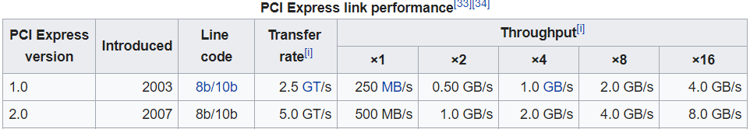
Step-by-step guide
Open Quartus II (License file: 25000@140.112.33.164)
Quartus 15.0 (for DE4 projects):
/mnt/ds1515/opt/intelFPGA/15.0/quartus/bin/quartus &
Quartus 17.0:
/mnt/ds1515/opt/intelFPGA/17.0/quartus/bin/quartus &
Copy RIFFA from workstation
cp –r /mnt/ds1515/fpga/riffa_2.2.2/ ./
Open Project
Located at:
<your path>/riffa_2.2.2/source/fpga/altera/de#/DE#Gen#x#If###/prj/DE#Gen#x#lf###.qpf
de#: de4/ de5
DE#Gen#x#If###: DE4Gen2x8If128
FPGA: DE4
PCIe Spec: generation 2; 8 lanes; 128 bits width (250 MHz)
Gen2x8 | 250 MHz/ 128 bits
Gen2x4 | 125 MHz/ 128 bits

Slide 15
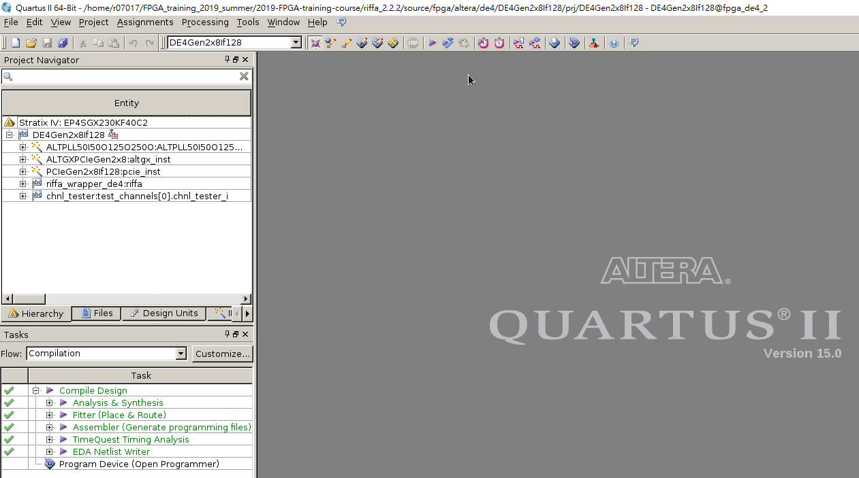
Step-by-step guide
Replace files in RIFFA directory:
Compile:
(may take some time)
(Delete original sample_app)
<your path>/riffa_2.2.2/source/c_c++/linux/x64/
<your path>/riffa_2.2.2/source/fpga/riffa_hdl/
Press

Slide 16
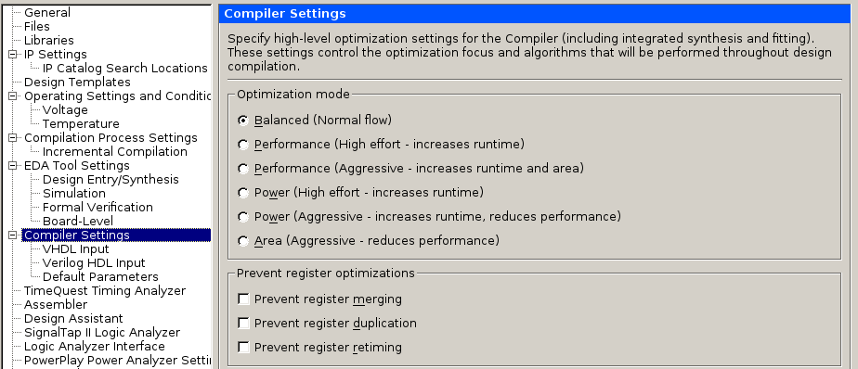
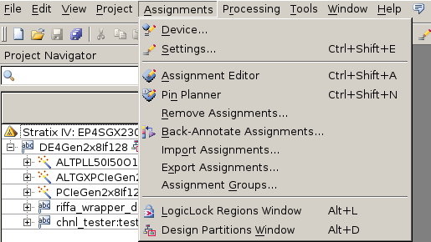
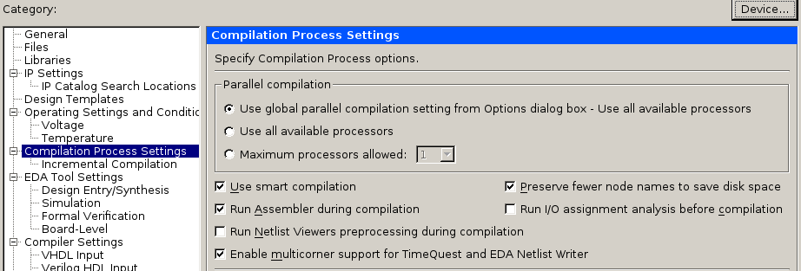
Step-by-step guide
Additional settings

Slide 17
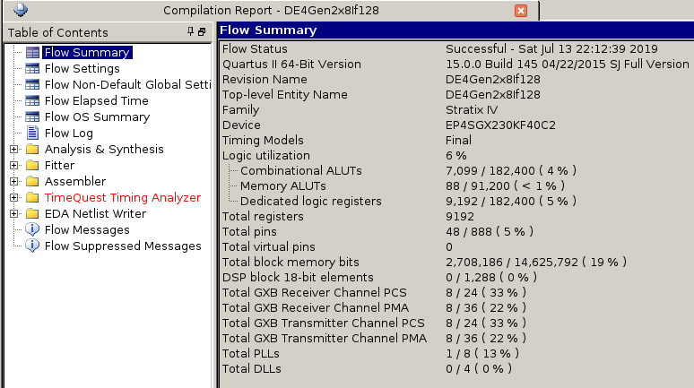
Step-by-step guide
Compilation report
Pay attention to these

Slide 18
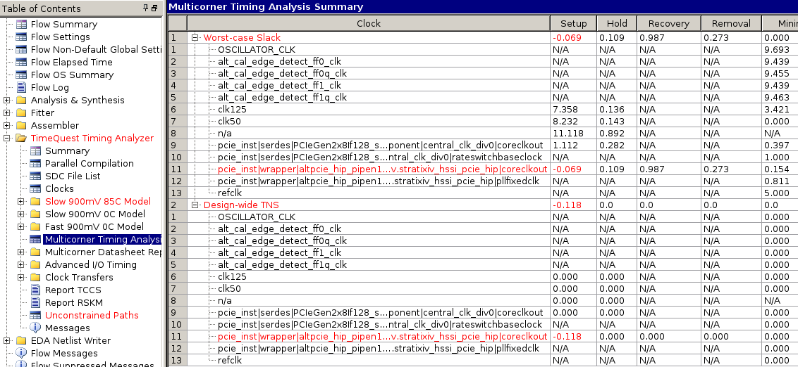
Step-by-step guide
Timing analyzer
WNS should be positive for all corners
Not ok, but we’ll skip for now

Slide 19
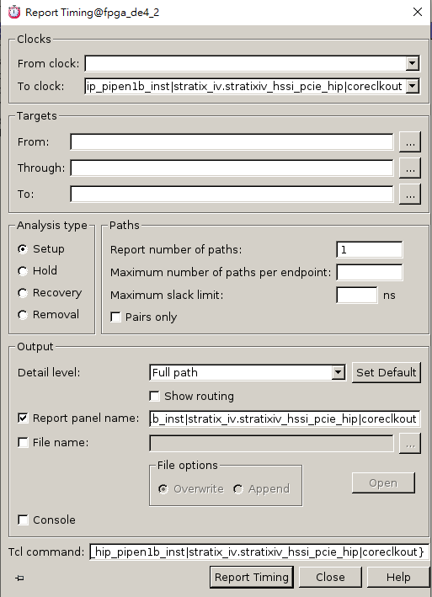
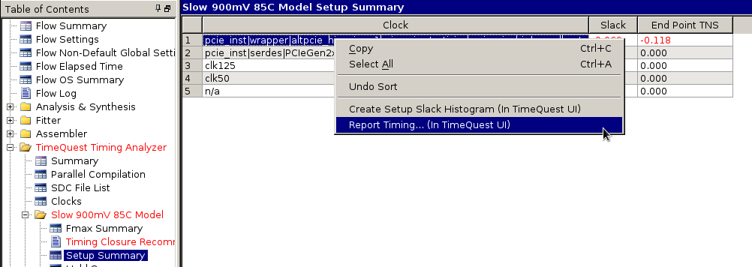
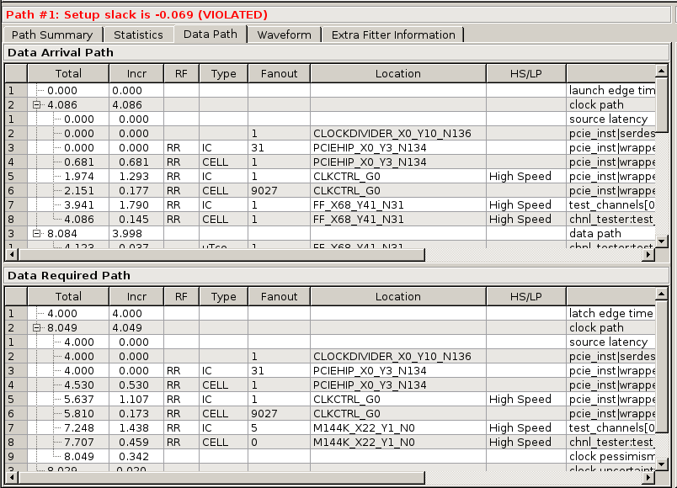
Step-by-step guide
Timequest timing analyzer
Critical path

Slide 20
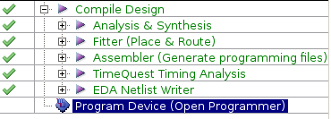
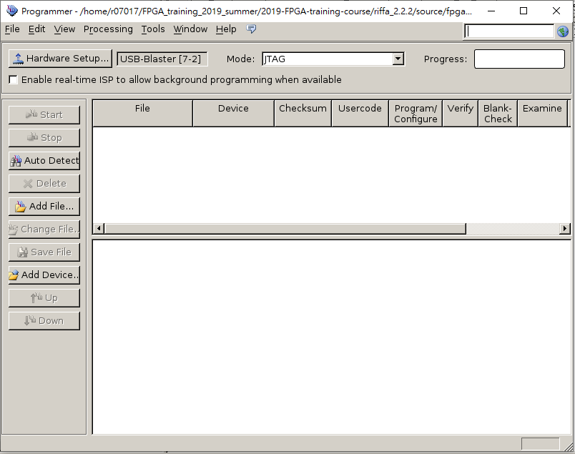
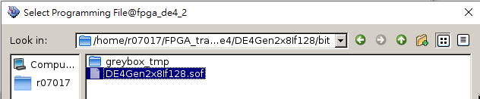
Step-by-step guide
If “No hardware”:
sudo killall jtagd
sudo /mnt/ds1515/opt/intelFPGA/15.0/quartus/bin/jtagconfig
Programmer
5. close
1.
4.
2.
3.

Slide 21
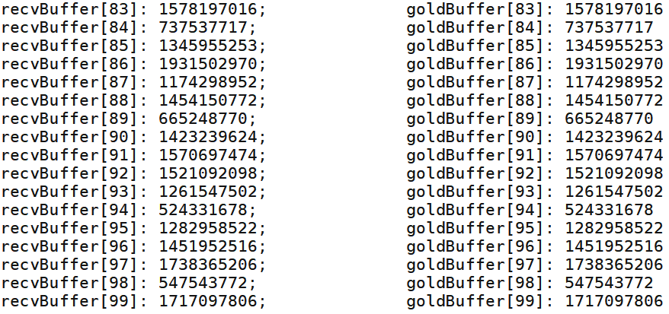
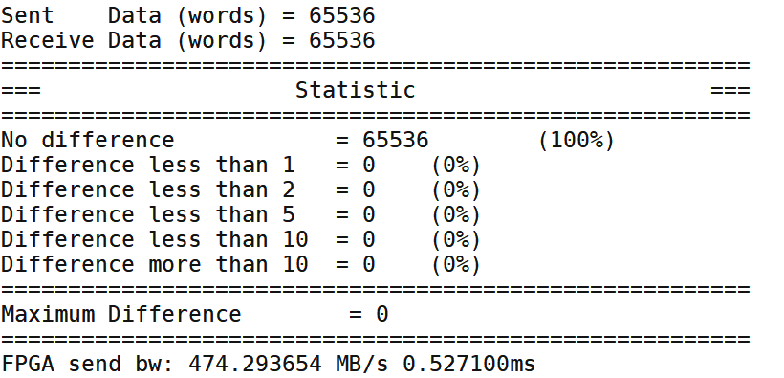
Step-by-step guide
Reboot
sudo reboot
Run
cd <your path>/riffa_2.2.2/source/c_c++/linux/x64/sample_app
make
./testutil 0 //List FPGA info
./testutil 1 0 //Reset FPGA 0
./testutil 2 <numofdata> //numofdata: multiples of 4 (up to 65536)
Congratulations !

Slide 22

Practice time
Practice #2: Floating Point Unit
Input $→$ Addition $→$Store in BRAM $→$ Read from BRAM $→$ Output
Data input
Block RAM
Data output
(a, b, c, d)
(0, 0, 0, a+b+c+d)

Slide 23
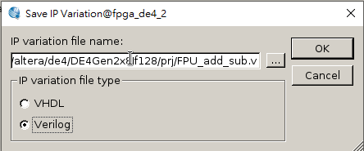
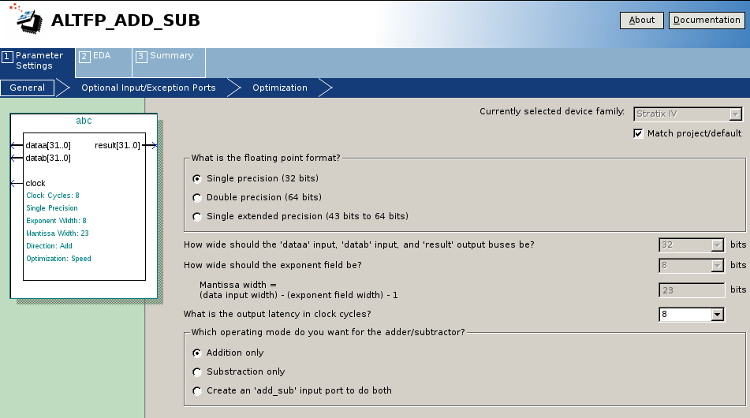
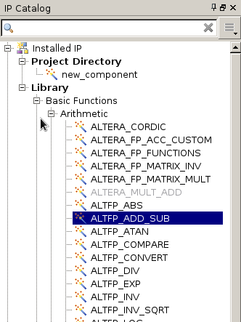
FPU IP
Library > Basic Functions > Arithmetic > ALTFP_ADD_SUB
File name: FPU_add_sub.v
Choose 8 stages pipeline

Slide 24
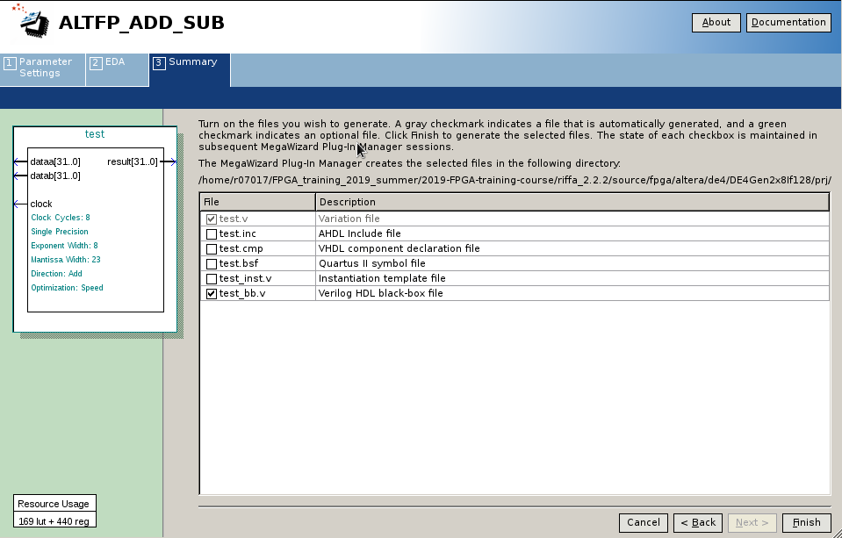
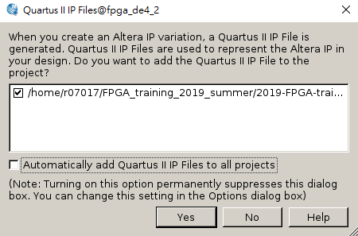

FPU IP
Library > Basic Functions > Arithmetic > ALTFP_ADD_SUB
Next $→$ Next$→$ Next…$→$ Finish $→$ Yes

Slide 25
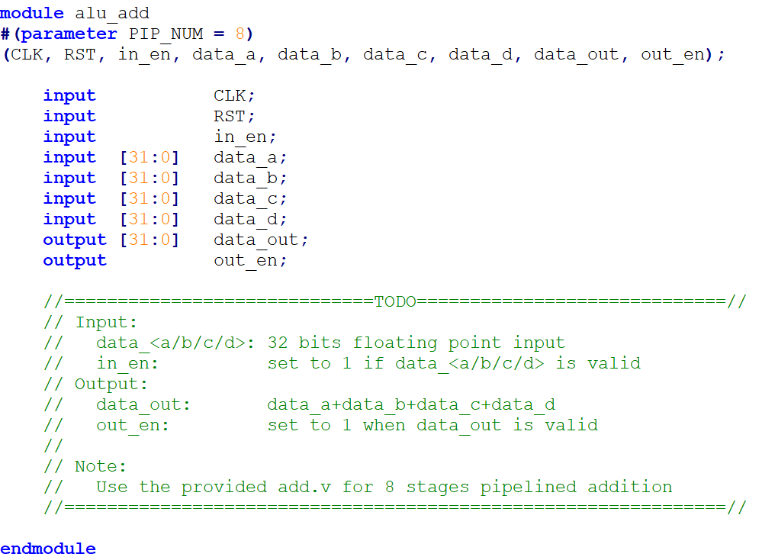
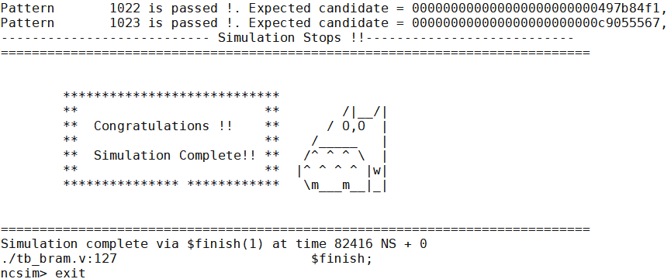

TODOs
Finish alu_add in bram_wrapper.v at line 139
Simulation:
ncverilog tb_bram.v bram_wrapper.v add.v +access+r
Pass $→$ Next step

Slide 26
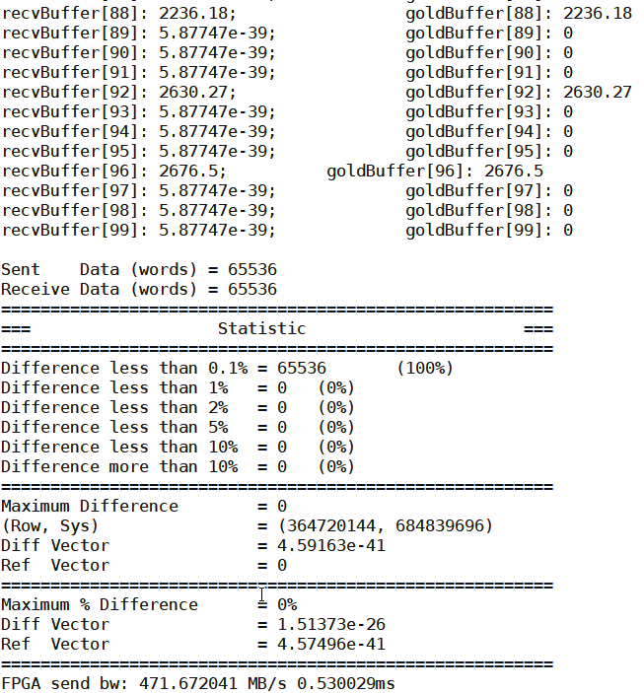
TODOs
Follow the step-by-step guide to finish the FPGA part
Run:
./testutil 2 65536
If you see this, you passed the FPGA test
End of tutorial!

Slide 27
Appendix: Modifying PCIe

Slide 28
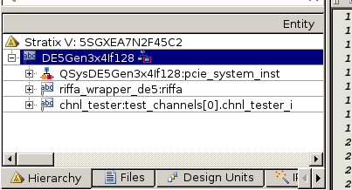
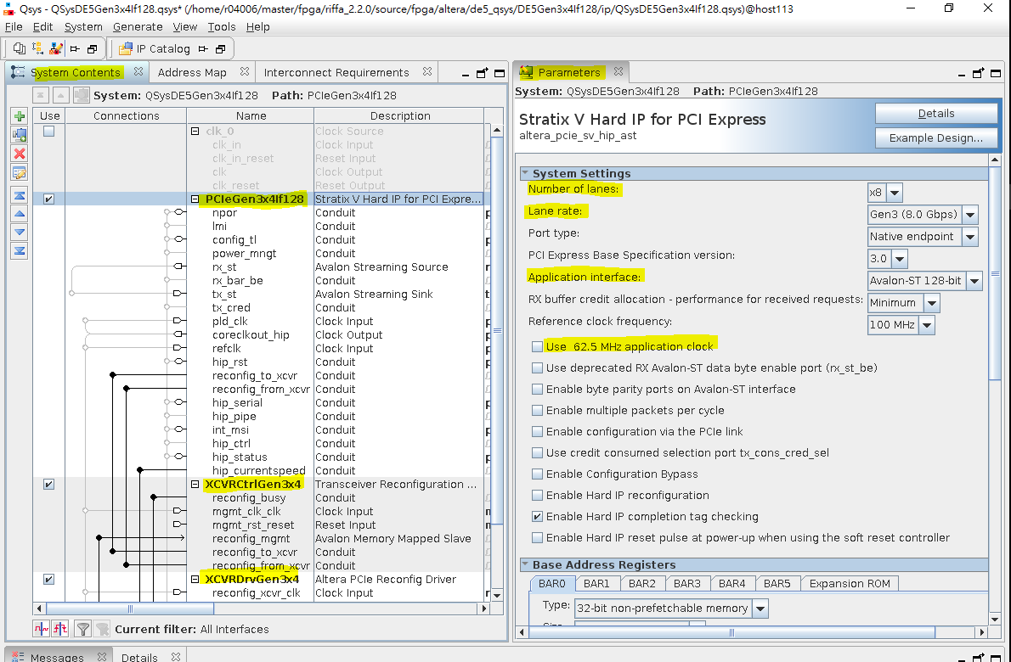
Modifying the PCIe on the Qsys
Double click on
QSysDE#Gen#x#lf###:pcie_system_inst
Areas to be edited are highlighted
Edit settings in PCIeDE#Gen#x#lf### first
Then for XCVRCtrlGen#x#, and XDRVCtrlGen#x#
Edit Number of reconfiguration interfaces accordingly

Slide 29
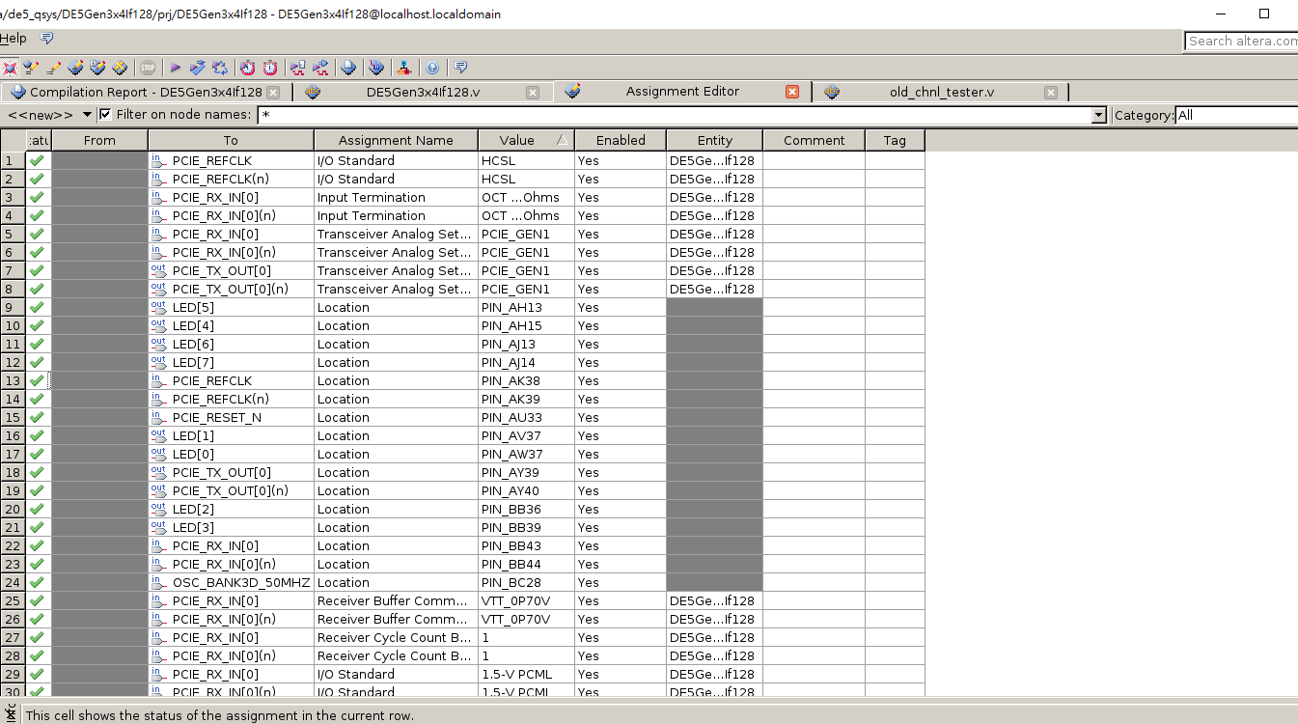
Changing PCIe generation
Go to assignment editor
Change Values accordingly
PCIE_GEN1
PCIE_GEN2
PCIE_GEN3

Slide 30
Changing width
Go to DE#Gen#x#lf###.v
Change parameter C_PCI_DATA_WIDTH to width
For IP QSysDE#Gen#x#If### pcie_system_inst
.rx_st_data (rx_st_data[C_PCI_DATA_WIDTH-1:0]),
.tx_st_data (tx_st_data[C_PCI_DATA_WIDTH-1:0]),

Slide 31
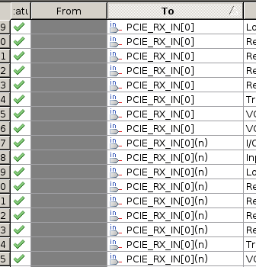
Changing number of lanes
Go to DE#Gen#x#lf###.v
Change parameter C_NUM_LANES to number of lanes
For IP QSysDE#Gen#x#If### pcie_system_inst
.pcieserial_tx_out0 (PCIE_TX_OUT[0]),
.pcieserial_tx_out1 (PCIE_TX_OUT[1]),
...
.pcieserial_tx_out# (PCIE_TX_OUT[#]),
AND
.pcieserial_rx_in0 (PCIE_RX_IN[0]),
.pcieserial_rx_in1 (PCIE_RX_IN[1]),
...
.pcieserial_rx_in# (PCIE_RX_IN[#]),
# = C_NUM_LANES - 1
Go to assignment editor
Add PCIE_RX_IN[#], PCIE_RX_IN[#](n), PCIE_TX_OUT[#], PCIE_TX_OUT[#](n),

Slide 32
Changing number of lanes
Go to DE#Gen#x#lf###.v
Change parameter C_NUM_LANES to number of lanes
For IP QSysDE#Gen#x#If### pcie_system_inst
.pcieserial_tx_out0 (PCIE_TX_OUT[0]),
.pcieserial_tx_out1 (PCIE_TX_OUT[1]),
...
.pcieserial_tx_out# (PCIE_TX_OUT[#]),
AND
.pcieserial_rx_in0 (PCIE_RX_IN[0]),
.pcieserial_rx_in1 (PCIE_RX_IN[1]),
...
.pcieserial_rx_in# (PCIE_RX_IN[#]),
# = C_NUM_LANES - 1
Go to assignment editor
Add PCIE_RX_IN[#], PCIE_RX_IN[#](n), PCIE_TX_OUT[#], PCIE_TX_OUT[#](n),

