Slide 1
h(x) = +1
h(x) = -1
h(x) = -1
h(x) = -1
positive interval
h(x) = -1
h(x) = +1
h(x) = +1
h(x) = +1
negative interval

Slide 2
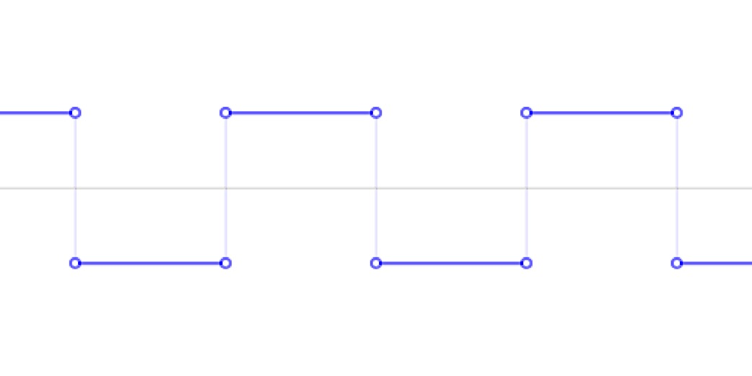






$h_{α}(x)$ = +1
$$\frac{2}{α}$$
$$\frac{2}{α}$$
$$\frac{2}{α}$$
$$\frac{2}{α}$$
$h_{α}(x)$ = -1

