Slide 1
Gaming Strategy
CSIE B04902009 蕭千惠
CSIE B04902077 江緯璿
Notes:
我是神射手

Slide 2
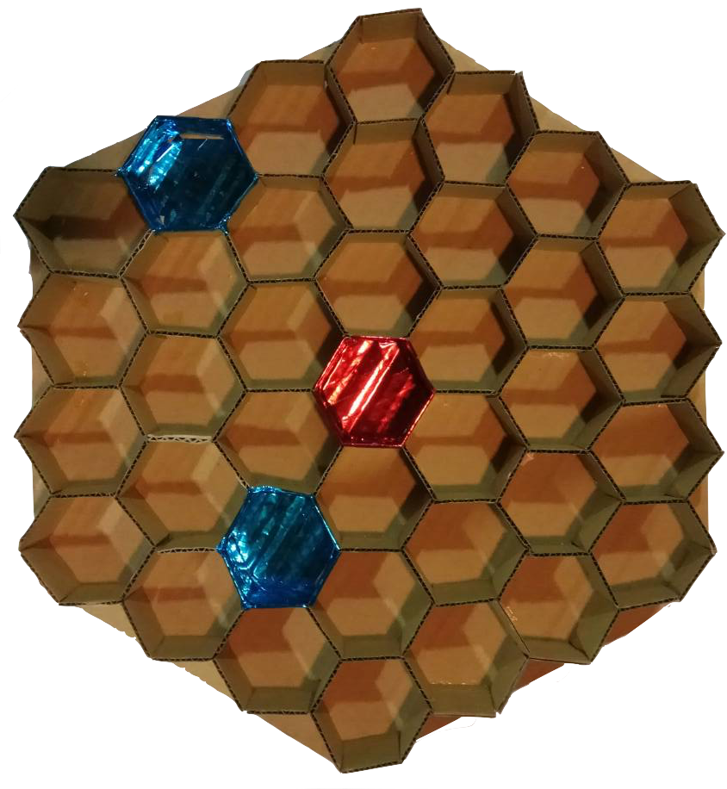
Board
Game Design Credit: OT B04 蔡心瑜

Slide 3
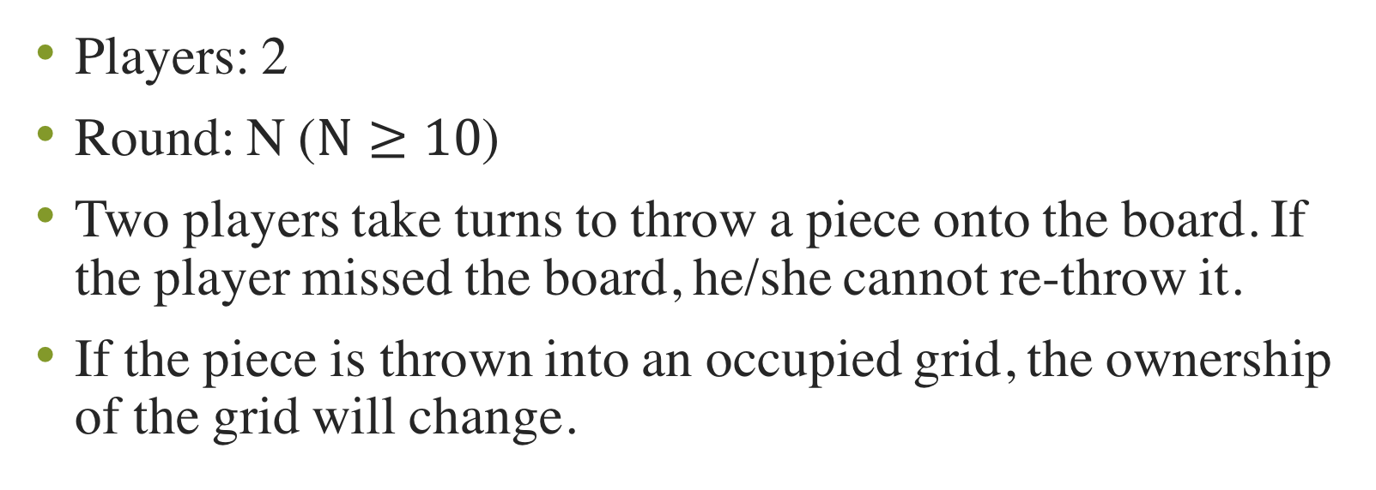
Game Introduction
Players: 2
Round: N ($N≥10$)
Two players take turns to throw a piece onto the board. If the player missed the board, he/she cannot re-throw it.
If the piece is thrown into an occupied grid, the ownership of the grid will change.
Game Design Credit: OT B04 蔡心瑜

Slide 4
Winning Condition
Each grid has a weighted score, after N rounds, the player with higher total score wins.
After N rounds, the player with highest number of pieces in a same vertical or diagonal row wins.

Slide 5
Winning Condition
Each grid has a weighted score, after N rounds, the player with higher total score wins.
After N rounds, the player with highest number of pieces in a same vertical or diagonal row wins.

Slide 6
Vertical row Diagonal row

Slide 7
Coordinates
Polar coordinates
Oblique coordinate
Cartesian coordinates

Slide 8
Coordinates
Polar coordinates
Oblique coordinates
Cartesian coordinates

Slide 9
Coordinates
Polar coordinates
Oblique coordinates
Cartesian coordinates
3,0
1,2
2,0
2,1
1,1
0,3
1,0
0,2
0,1
0,0
0,-1
0,-2
-1,0
0,-3
-1,-1
-1,-2
-2,0
-2,-1
-3,0

Slide 10
Coordinates
Polar coordinates
Oblique coordinates
Cartesian coordinates
0,6
-1,5
1,5
-2,4
0,4
2,4
-3,3
-1,3
1,3
3,3
-2,2
0,2
2,2
-3,1
-1,1
1,1
3,1
-2,0
0,0
2,0
-3,-1
-1,-1
1,-1
3,-1
-2,-2
0,-2
2,-2
-3,-3
-1,-3
1,-3
3,-3
-2,-4
0,-4
2,-4
-1,-5
1,-5
0,-6

Slide 11
Take (0,0) as the center.
Definition of d(x, y): the minimal number of grids from the grid (x, y) to the center grid (0,0)
0,6
-1,5
1,5
-2,4
0,4
2,4
-3,3
-1,3
1,3
3,3
-2,2
0,2
2,2
-3,1
-1,1
1,1
3,1
-2,0
0,0
2,0
-3,-1
-1,-1
1,-1
3,-1
-2,-2
0,-2
2,-2
-3,-3
-1,-3
1,-3
3,-3
d = 6 | d = 5 | d = 4 | d = 3 | d = 2 | d = 1 | d = 0
-2,-4
0,-4
2,-4
-1,-5
1,-5
0,-6

Slide 12
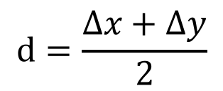


(x, y)
(Δ x, Δy)
 | d = 0
 | d = 1
 | d = 2
 | d = 3
 | d = 4
 | d = 5
 | d = 6
0,6
0,12
$$d=\frac{∆x+∆y}{2}$$
-1,5
1,5
1,11
-2,4
0,4
2,4
0,10
2,10
-3,3
-1,3
1,3
3,3
1,9
3,9
-2,2
0,2
2,2
0,8
2,8
4,8
-3,1
-1,1
1,1
3,1
1,7
3,7
5,7
$$m=1$$
-2,0
0,0
2,0
0,6
2,6
4,6
6,6
-3,-1
-1,-1
1,-1
3,-1
1,5
3,5
5,5
-2,-2
0,-2
2,-2
0,4
2,4
4,4
6,4
-3,-3
-1,-3
1,-3
3,-3
1,3
3,3
5,3
-2,-4
0,-4
2,-4
0,2
2,2
4,2
6,2
-1,-5
1,-5
1,1
3,1
5,1
$$d=∆x$$
0,-6
0,0
2,0
4,0
6,0

Slide 13
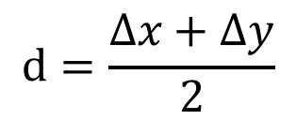
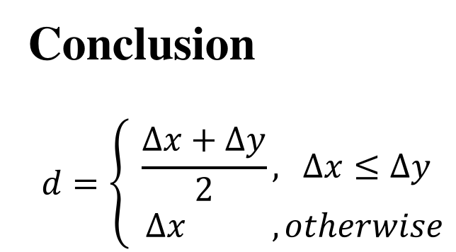

 | d = 0
 | d = 1
 | d = 2
 | d = 3
 | d = 4
 | d = 5
 | d = 6
Conclusion
$$d=\left\{\begin{aligned}\frac{∆x+∆y}{2}\text{,} ∆x≤∆y \\ ∆x , otherwise\end{aligned}\right.$$
0,12
$$d=\frac{∆x+∆y}{2}$$
1,11
0,10
2,10
1,9
3,9
0,8
2,8
4,8
1,7
3,7
5,7
0,6
2,6
4,6
6,6
$$m=1$$
1,5
3,5
5,5
Next?
Test for N.D.
Adopt Strategies
0,4
2,4
4,4
6,4
1,3
3,3
5,3
0,2
2,2
4,2
6,2
1,1
3,1
5,1
0,0
2,0
4,0
6,0
$$d=∆x$$

Slide 14

Test the Model for Normal Distribution
$$α=0.1$$
$${χ^{2}}_{0.1}\left(8\right)=13.36$$

Slide 15
d | Class | Mid | Frequency (Y) | f*mid | f*(mid-mean)²
-4 | [-31.5,-24.5) | -28 | 0 | 0 | 0
-3 | [-24.5,-17.5) | -21 | 1 | -21 | 441
-2 | [-17.5,-10.5) | -14 | 7 | -98 | 1372
-1 | [-10.5,-3.5) | -7 | 11 | -77 | 539
0 | [-3.5,3.5) | 0 | 7 | 0 | 0
1 | [3.5,10.5) | 7 | 11 | 77 | 539
2 | [10.5,17.5) | 14 | 7 | 98 | 1372
3 | [17.5,24.5) | 21 | 1 | 21 | 441
4 | [24.5,31.5) | 28 | 0 | 0 | 0
 |  | sum | 45 | 0 | 2352
 |  | mean | 0
 |  | variance | 53.45454545
 |  | stdev | 7.31126155

Slide 16
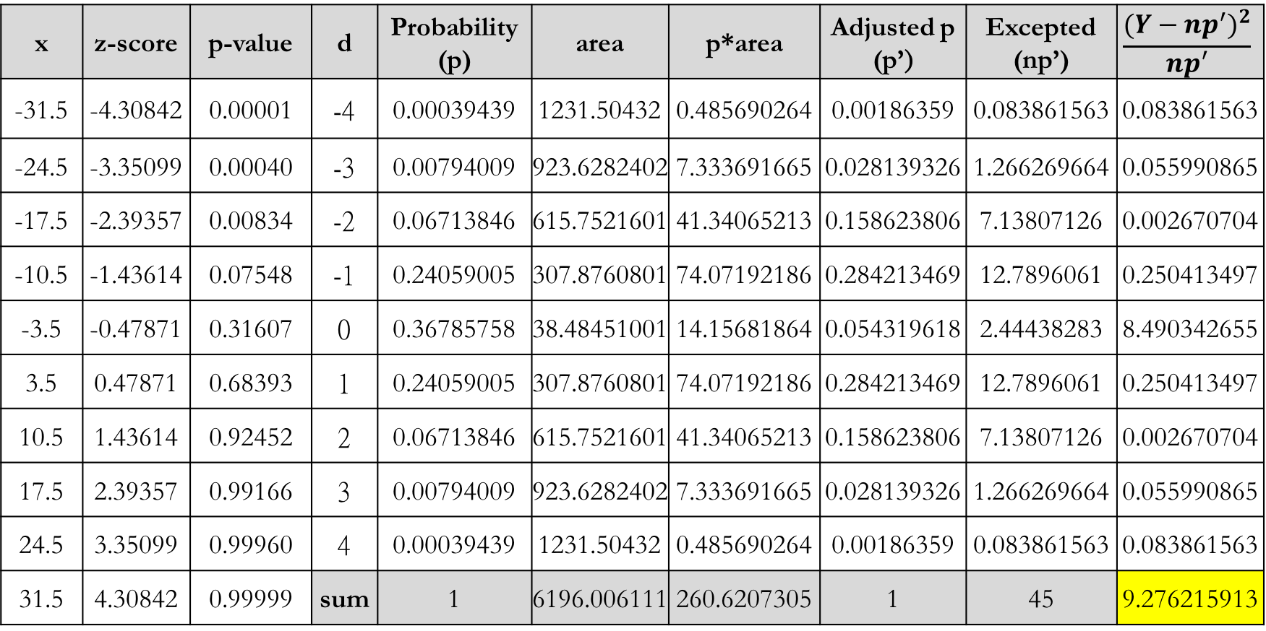
x | z-score | p-value | d | Probability (p) | area | p*area | Adjusted p (p’) | Excepted (np’) | $$\frac{{(Y−np^{′})}^{2}}{np′}$$
-31.5 | -4.30842 | 0.00001 | -4 | 0.00039439 | 1231.50432 | 0.485690264 | 0.00186359 | 0.083861563 | 0.083861563
-24.5 | -3.35099 | 0.00040 | -3 | 0.00794009 | 923.6282402 | 7.333691665 | 0.028139326 | 1.266269664 | 0.055990865
-17.5 | -2.39357 | 0.00834 | -2 | 0.06713846 | 615.7521601 | 41.34065213 | 0.158623806 | 7.13807126 | 0.002670704
-10.5 | -1.43614 | 0.07548 | -1 | 0.24059005 | 307.8760801 | 74.07192186 | 0.284213469 | 12.7896061 | 0.250413497
-3.5 | -0.47871 | 0.31607 | 0 | 0.36785758 | 38.48451001 | 14.15681864 | 0.054319618 | 2.44438283 | 8.490342655
3.5 | 0.47871 | 0.68393 | 1 | 0.24059005 | 307.8760801 | 74.07192186 | 0.284213469 | 12.7896061 | 0.250413497
10.5 | 1.43614 | 0.92452 | 2 | 0.06713846 | 615.7521601 | 41.34065213 | 0.158623806 | 7.13807126 | 0.002670704
17.5 | 2.39357 | 0.99166 | 3 | 0.00794009 | 923.6282402 | 7.333691665 | 0.028139326 | 1.266269664 | 0.055990865
24.5 | 3.35099 | 0.99960 | 4 | 0.00039439 | 1231.50432 | 0.485690264 | 0.00186359 | 0.083861563 | 0.083861563
31.5 | 4.30842 | 0.99999 | sum | 1 | 6196.006111 | 260.6207305 | 1 | 45 | 9.276215913

Slide 17
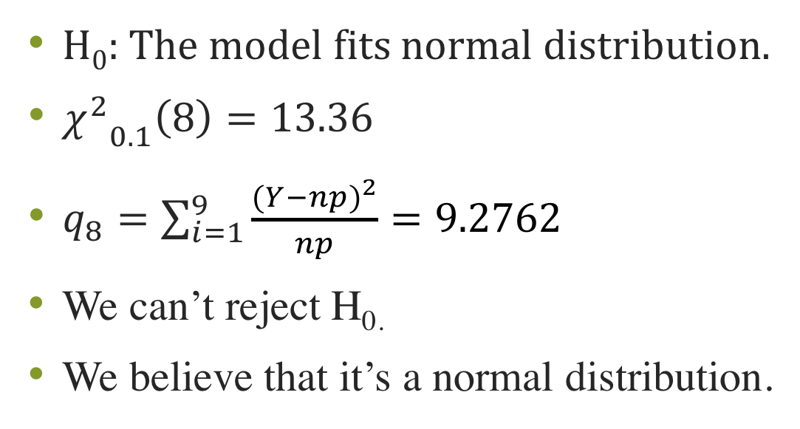
Test the Model for Normal Distribution
H₀: The model fits normal distribution.
${χ^{2}}_{0.1}\left(8\right)=13.36$
$q_{8}=\sum_{i=1}^{9}{\frac{{(Y−np)}^{2}}{np}}=9.2762$
We can’t reject H_{0.}
We believe that it’s a normal distribution.

Slide 18
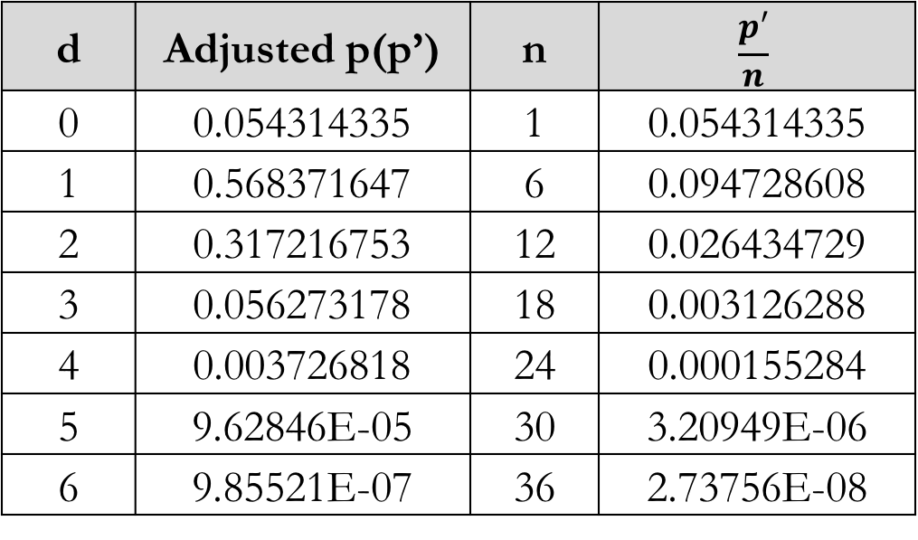
Probability of grids with different d
d | Adjusted p(p’) | n | $$\frac{p′}{n}$$
0 | 0.054314335 | 1 | 0.054314335
1 | 0.568371647 | 6 | 0.094728608
2 | 0.317216753 | 12 | 0.026434729
3 | 0.056273178 | 18 | 0.003126288
4 | 0.003726818 | 24 | 0.000155284
5 | 9.62846E-05 | 30 | 3.20949E-06
6 | 9.85521E-07 | 36 | 2.73756E-08

Slide 19
Strategies
Given a certain board, the optimal strategy is to
optimize player’s score.
optimize score difference between player and opponent.
considering future conditions (consider opponent’s target grid.)
without consideration of future conditions

Slide 20
 | Player |  | Opponent
 | Consider future | Optimization | Consider future | Optimization
1 | Yes | Difference | No | Own score
2 | Yes | Difference | No | Difference
3 | No | Own score | X | X
4 | No | Difference | X | X

Slide 22
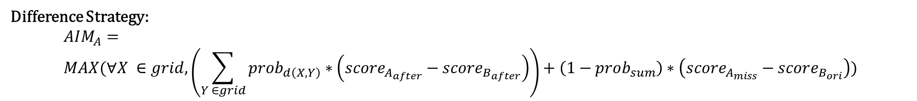
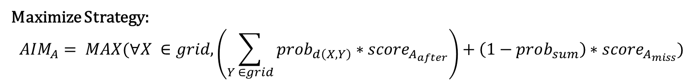
Maximize Strategy:
$$AIM_{A}= MAX(∀X ∈grid, \left(\sum_{Y ∈grid}{{prob}_{d\left(X,Y\right)}∗score_{A_{after}}}\right)+\left(1−prob_{sum}\right)∗score_{A_{miss}})$$
Difference Strategy:
$$AIM_{A}= \\ MAX(∀X ∈grid, \left(\sum_{Y ∈grid}{{prob}_{d\left(X,Y\right)}∗\left(score_{A_{after}}−score_{B_{after}}\right)}\right)+\left(1−prob_{sum}\right)∗\left(score_{A_{miss}}−score_{B_{ori}}\right))$$

Slide 24
0.494
-.503
0.615
0.615
-.382
-.382
0.615
0.837
0.615
-.382
-.137
-.382
0.494
0.887
0.887
0.494
-.503
-.087
-.087
-.503
0.837
0.975
0.837
-.137
0.070
-.137
0.615
0.975
0.975
0.615
-.382
0.070
0.070
-.382
0.887
0.996
0.887
-.087
0.050
-.087
0.615
0.975
0.975
0.615
-.382
0.070
0.070
-.382
0.837
0.975
0.837
-.137
0.070
-.137
0.494
0.887
0.887
0.494
-.503
-.087
-.087
-.503
0.615
0.837
0.615
-.382
-.137
-.382
0.615
0.615
-.382
-.382
0.494
-.503

Slide 25
Simulation Result
Only Partial Data are shown in the slides
Full source code, data and records please check: ___________________

Slide 26
Simulation Parameters
Test_Time = 10000 (Default)
Round = 10
Prob = {0.054314335,0.094728608,0.026434729,0.003126288,0.000155284,3.20949e-6,2.73756e-8}
Player 1 Goes First

Slide 27
1策略 |  |  | 2策略
Future | Self Max | Opp Max | Future | Self Max | Opp Max | 1 AVG | 2 AVG | 2-1AVG | 1 WON | 1 WON% | 1 WON% No Draw | 2 WON | 2 WON% | 2 WON% No Draw | DRAW | DRAW% | N
0 | 0 | 0 | 0 | 0 | 0 | 2.3126 | 2.4303 | 0.1177 | 2372 | 23.72% | 42.35% | 3229 | 32.29% | 57.65% | 4399 | 43.99% | 10000
0 | 0 | 0 | 0 | 1 | 0 | 2.4357 | 2.4777 | 0.042 | 2747 | 27.47% | 47.72% | 3010 | 30.10% | 52.28% | 4243 | 42.43% | 10000
0 | 0 | 0 | 1 | 0 | 1 | 2.2826 | 2.3981 | 0.1155 | 2333 | 23.33% | 42.14% | 3203 | 32.03% | 57.86% | 4464 | 44.64% | 10000
0 | 1 | 0 | 0 | 0 | 0 | 2.3485 | 2.5046 | 0.1561 | 2320 | 23.20% | 39.84% | 3503 | 35.03% | 60.16% | 4177 | 41.77% | 10000
0 | 1 | 0 | 0 | 1 | 0 | 2.4744 | 2.5588 | 0.0844 | 2599 | 25.99% | 44.85% | 3196 | 31.96% | 55.15% | 4205 | 42.05% | 10000
0 | 1 | 0 | 1 | 0 | 1 | 2.3106 | 2.4588 | 0.1482 | 2324 | 23.24% | 40.37% | 3433 | 34.33% | 59.63% | 4243 | 42.43% | 10000
1 | 0 | 1 | 0 | 0 | 0 | 2.2839 | 2.4068 | 0.1229 | 2308 | 23.08% | 42.06% | 3180 | 31.80% | 57.94% | 4512 | 45.12% | 10000
1 | 0 | 1 | 0 | 1 | 0 | 2.3948 | 2.4444 | 0.0496 | 2689 | 26.89% | 47.41% | 2983 | 29.83% | 52.59% | 4328 | 43.28% | 10000
0 | 0 | 0 | 1 | 0 | 0 | 2.33736 | 2.44064 | 0.1033 | 1851 | 24.83% | 43.39% | 2415 | 32.39% | 56.61% | 3189 | 42.78% | 7455
0 | 1 | 0 | 1 | 0 | 0 | 2.35266 | 2.5198 | 0.1671 | 1711 | 22.97% | 39.25% | 2648 | 35.55% | 60.75% | 3090 | 41.48% | 7449
1 | 0 | 0 | 0 | 0 | 0 | 2.35382 | 2.45105 | 0.0972 | 1876 | 25.23% | 43.54% | 2433 | 32.72% | 56.46% | 3127 | 42.05% | 7436
1 | 0 | 0 | 0 | 1 | 0 | 2.46951 | 2.49844 | 0.0289 | 2080 | 28.25% | 48.67% | 2194 | 29.80% | 51.33% | 3089 | 41.95% | 7363
1 | 0 | 0 | 1 | 0 | 0 | 2.37567 | 2.47195 | 0.0963 | 908 | 24.49% | 43.30% | 1189 | 32.07% | 56.70% | 1611 | 43.45% | 3708
1 | 0 | 0 | 1 | 0 | 1 | 2.32429 | 2.41424 | 0.09 | 1206 | 24.60% | 43.63% | 1558 | 31.78% | 56.37% | 2139 | 43.63% | 4903
1 | 0 | 1 | 1 | 0 | 0 | 2.29965 | 2.41894 | 0.1193 | 1162 | 23.82% | 41.93% | 1609 | 32.98% | 58.07% | 2108 | 43.21% | 4879
1 | 0 | 1 | 1 | 0 | 1 | 2.24735 | 2.36953 | 0.1222 | 1665 | 22.63% | 41.02% | 2394 | 32.54% | 58.98% | 3299 | 44.84% | 7358

Slide 28
Claims:
The second player has advantage in this game.
“Difference Strategy” is better than “Maximize Strategy”
Both players tend to adopt “Difference Strategy” (w/o future)
“Consider Future” is often better than “Not Consider Future” when player assume opponent adopts “Difference Strategy”

Slide 29
1策略 |  |  | 2策略
Future | Self Max | Opp Max | Future | Self Max | Opp Max | 1 AVG | 2 AVG | 2-1AVG | 1 WON | 1 WON% | 1 WON% No Draw | 2 WON | 2 WON% | 2 WON% No Draw | DRAW | DRAW% | N
0 | 0 | 0 | 0 | 0 | 0 | 2.3126 | 2.4303 | 0.1177 | 2372 | 23.72% | 42.35% | 3229 | 32.29% | 57.65% | 4399 | 43.99% | 10000
0 | 0 | 0 | 0 | 1 | 0 | 2.4357 | 2.4777 | 0.042 | 2747 | 27.47% | 47.72% | 3010 | 30.10% | 52.28% | 4243 | 42.43% | 10000
0 | 0 | 0 | 1 | 0 | 1 | 2.2826 | 2.3981 | 0.1155 | 2333 | 23.33% | 42.14% | 3203 | 32.03% | 57.86% | 4464 | 44.64% | 10000
0 | 1 | 0 | 0 | 0 | 0 | 2.3485 | 2.5046 | 0.1561 | 2320 | 23.20% | 39.84% | 3503 | 35.03% | 60.16% | 4177 | 41.77% | 10000
0 | 1 | 0 | 0 | 1 | 0 | 2.4744 | 2.5588 | 0.0844 | 2599 | 25.99% | 44.85% | 3196 | 31.96% | 55.15% | 4205 | 42.05% | 10000
0 | 1 | 0 | 1 | 0 | 1 | 2.3106 | 2.4588 | 0.1482 | 2324 | 23.24% | 40.37% | 3433 | 34.33% | 59.63% | 4243 | 42.43% | 10000
1 | 0 | 1 | 0 | 0 | 0 | 2.2839 | 2.4068 | 0.1229 | 2308 | 23.08% | 42.06% | 3180 | 31.80% | 57.94% | 4512 | 45.12% | 10000
1 | 0 | 1 | 0 | 1 | 0 | 2.3948 | 2.4444 | 0.0496 | 2689 | 26.89% | 47.41% | 2983 | 29.83% | 52.59% | 4328 | 43.28% | 10000
0 | 0 | 0 | 1 | 0 | 0 | 2.33736 | 2.44064 | 0.1033 | 1851 | 24.83% | 43.39% | 2415 | 32.39% | 56.61% | 3189 | 42.78% | 7455
0 | 1 | 0 | 1 | 0 | 0 | 2.35266 | 2.5198 | 0.1671 | 1711 | 22.97% | 39.25% | 2648 | 35.55% | 60.75% | 3090 | 41.48% | 7449
1 | 0 | 0 | 0 | 0 | 0 | 2.35382 | 2.45105 | 0.0972 | 1876 | 25.23% | 43.54% | 2433 | 32.72% | 56.46% | 3127 | 42.05% | 7436
1 | 0 | 0 | 0 | 1 | 0 | 2.46951 | 2.49844 | 0.0289 | 2080 | 28.25% | 48.67% | 2194 | 29.80% | 51.33% | 3089 | 41.95% | 7363
1 | 0 | 0 | 1 | 0 | 0 | 2.37567 | 2.47195 | 0.0963 | 908 | 24.49% | 43.30% | 1189 | 32.07% | 56.70% | 1611 | 43.45% | 3708
1 | 0 | 0 | 1 | 0 | 1 | 2.32429 | 2.41424 | 0.09 | 1206 | 24.60% | 43.63% | 1558 | 31.78% | 56.37% | 2139 | 43.63% | 4903
1 | 0 | 1 | 1 | 0 | 0 | 2.29965 | 2.41894 | 0.1193 | 1162 | 23.82% | 41.93% | 1609 | 32.98% | 58.07% | 2108 | 43.21% | 4879
1 | 0 | 1 | 1 | 0 | 1 | 2.24735 | 2.36953 | 0.1222 | 1665 | 22.63% | 41.02% | 2394 | 32.54% | 58.98% | 3299 | 44.84% | 7358

Slide 30
Claim 1
The second player has advantage in this game.

Slide 31
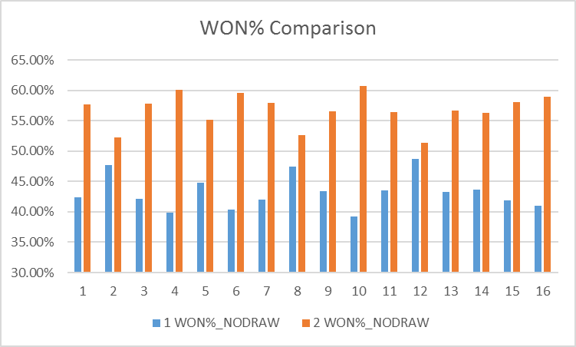

Slide 32
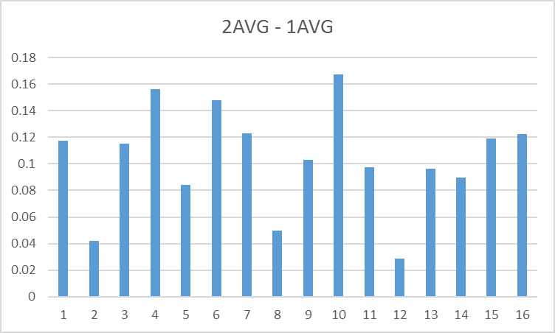

Slide 33
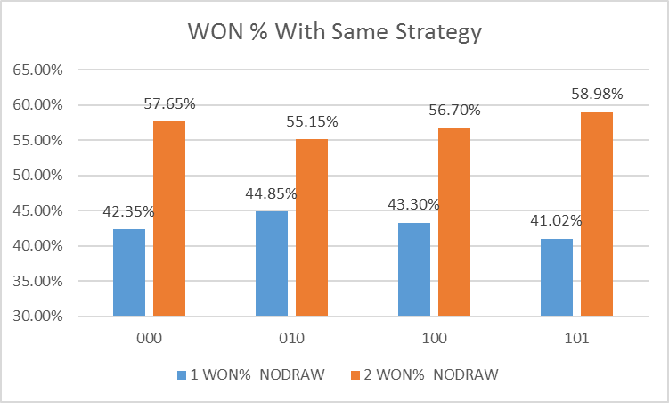

Slide 34
Claim 2
“Difference Strategy” is better than “Maximize Strategy”

Slide 35
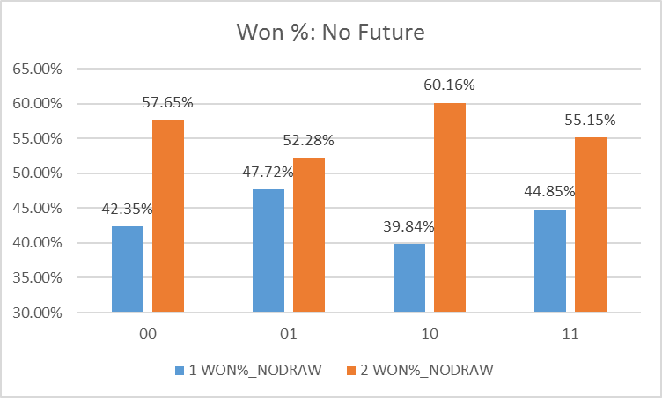

Slide 36
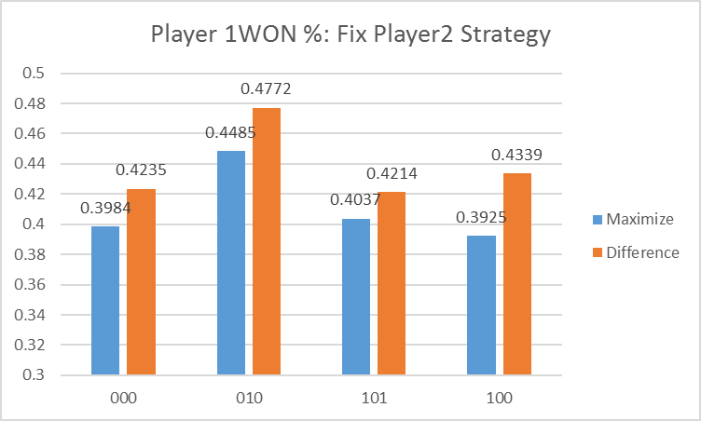
Notes:
Vice Versa

Slide 37
Claim 3
Both players tend to adopt “Difference Strategy” (w/o future)

Slide 38
Nash Equilibrium

Slide 39
Claim 4
“Consider Future” is often better than “Not Consider Future” when player assume opponent adopts “Difference Strategy”

Slide 40
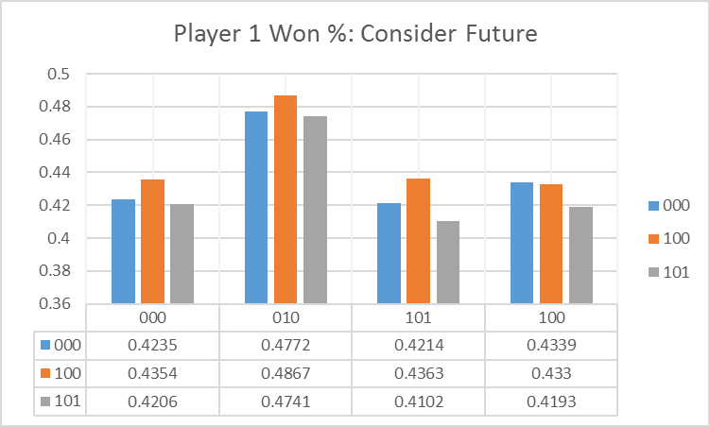

Slide 41
Conclusions
Throwing the pieces satisfies a normal distribution (There’s no enough evidence to show that it is not N.D.)
This game is not fair: Player 2 has advantage
Adopting a better strategy can result in higher winning rate
This game has a Nash equivalent strategy (w/o future)

Slide 42
Future Work
Research on different winning conditions and rules
Parallelize the simulating process
How to solve the imbalance between Player 1 and 2 ?

