Slide 1
VFX final
Realtime Image cloning tools
B05902062王子銘 B05902066蔡翔陞

Slide 2
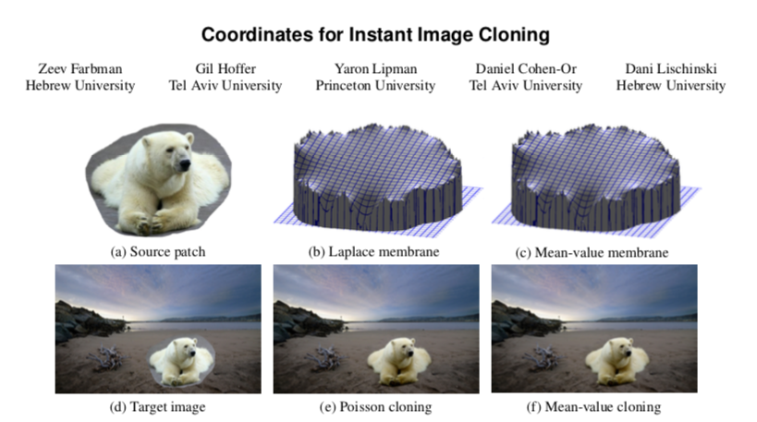

Slide 3
Idea
Human are not sensitive to the difference of lightness
Slow luminance change would be ignore
Use Mean-Value Coordinates(MVC) to define the coordinate in polygon
Use Submesh and Boundary Sampling to speed up

Slide 4
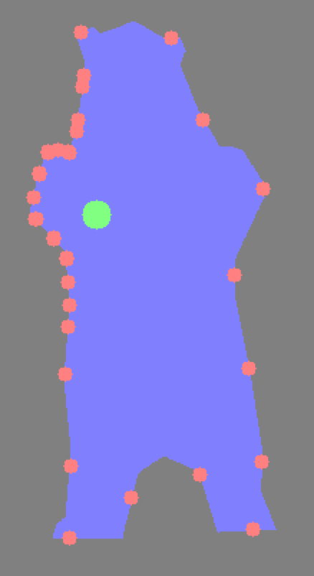
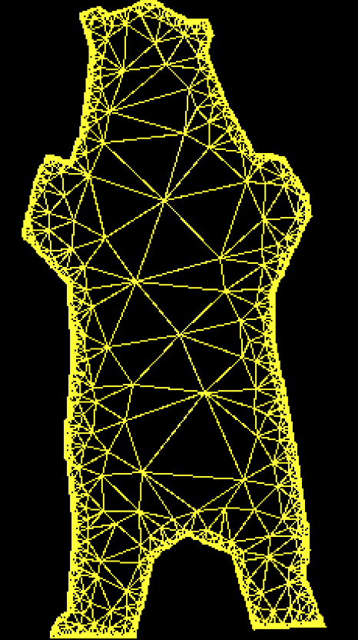
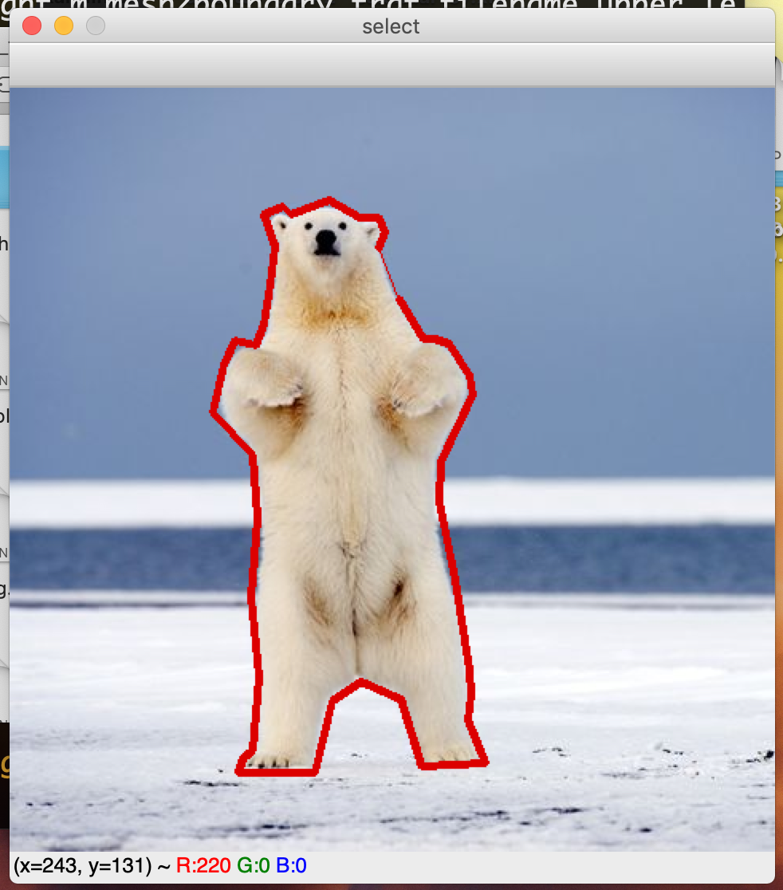
How to

Slide 5
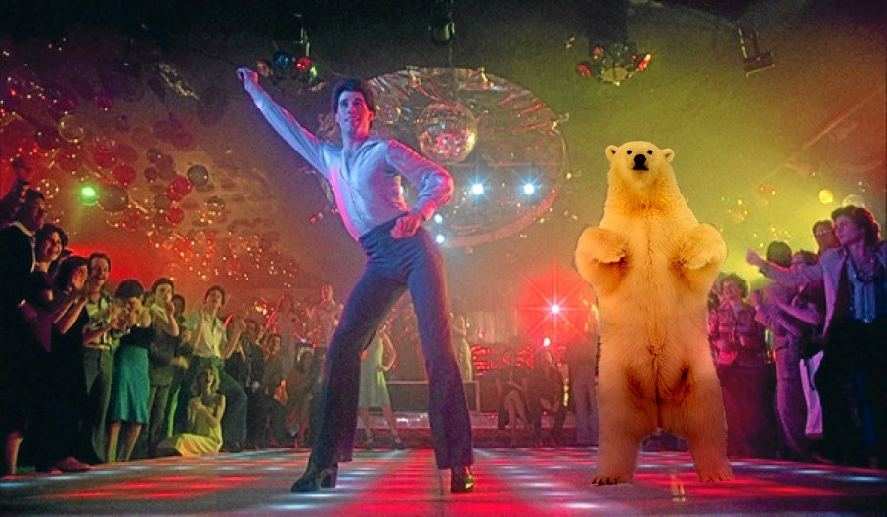
Result

Slide 6
DMEO
IN different environment
With same boundary texture
Apply on human face

