Slide 1
3D Viewing and Clipping
Ming Ouhyoung
歐陽明 Professor
Dept. of CSIE and GINM
NTU

Slide 2
3D Viewing Process
Clip against view volume
Project onto projection plane
Transform into viewport in 2D device coordinates for display
3D world-coordinate output primitives
Clipped world coordinates
2D device coordinates

Slide 3
Perspective Projection (Pinhole Camera, eye at origin )
Projection
plane
x
P(x, y, z)
x_{p}
z
d
View along y axis
View along x axis
d
z
y_{p}
Projection
plane
P(x, y, z)
y

Slide 4
Perspective Division
However W ≠ 1, so we must divide by W to return from homogeneous coordinates

Slide 5
Specification of an Arbitrary 3D View
v
View plane
VUP
VRP
VPN
u
n
VRP: view reference point
VPN: view-plane normal
VUP: view-up vector

Slide 6
Truncated View Volume for an Perspective Projection (how to do 3D clipping?), PRP: projection reference point, DOP: direction of projection
Back
Clipping
plane
View
plane
Front
Clipping
plane
VRP
VPN
F
B

Slide 7
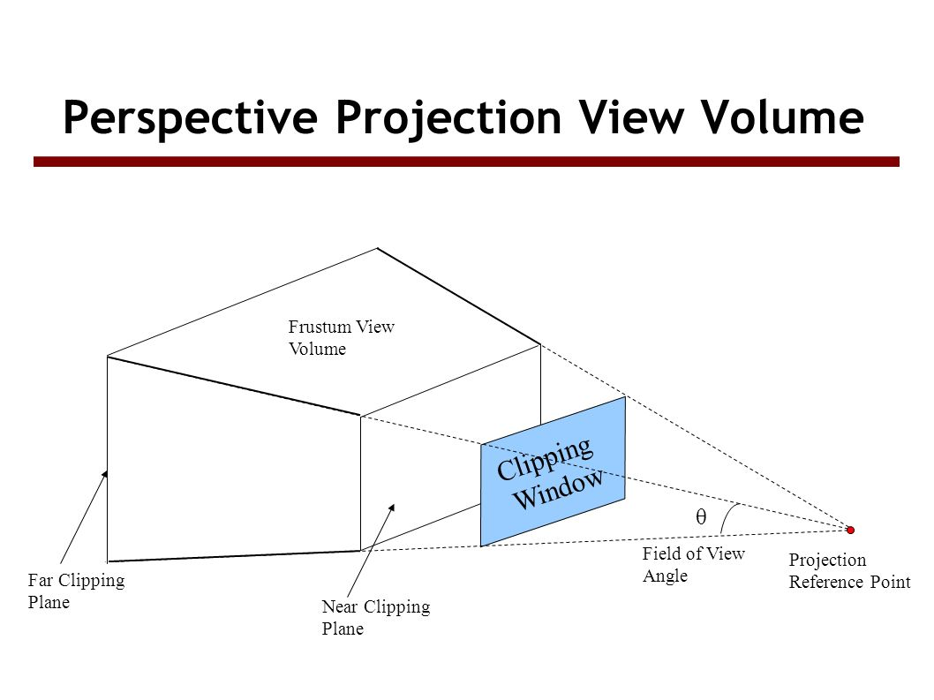
PRP: Projection reference point

Slide 8
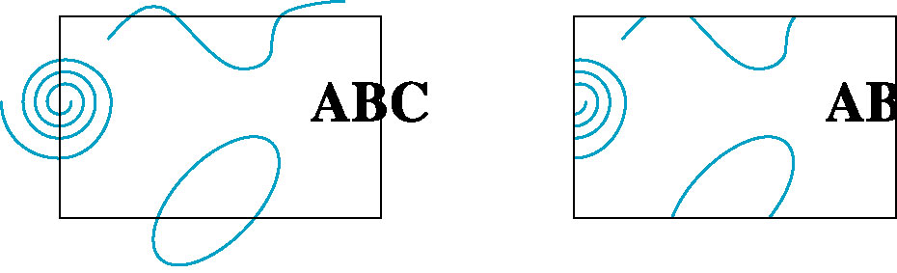
Clipping: 2D & 3D
2D against clipping window
3D against clipping volume
Easy for line segments polygons
Hard for curves and text
Convert to lines and polygons first

Slide 9
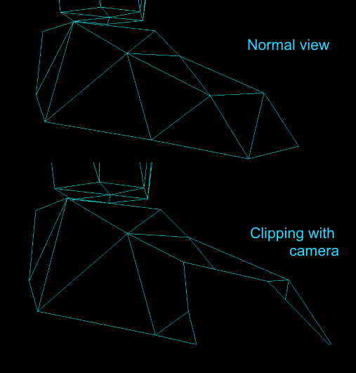
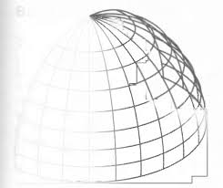
Clipping: wireframe

Slide 10
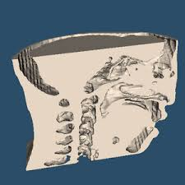
Clipping: surface

Slide 11
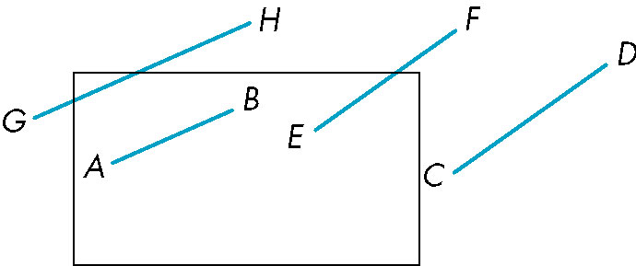
Clipping 2D Line Segments
Brute force approach: compute intersections with all sides of clipping window
Inefficient: one division per intersection

Slide 12
Cohen-Sutherland Algorithm
Idea: eliminate as many cases as possible without computing intersections
Start with four lines that determine the sides of the clipping window
y = y_{max}
x = x_{min}
x = x_{max}
y = y_{min}

Slide 13
The Cases
Case 1: both endpoints of line segment inside all four lines
Draw (accept) line segment as is
Case 2: both endpoints outside all lines and on same side of a line
Discard (reject) the line segment
y = y_{max}
x = x_{min}
x = x_{max}
y = y_{min}

Slide 14
The Cases
Case 3: One endpoint inside, one outside
Must do at least one intersection
Case 4: Both outside
May have part inside
Must do at least one intersection
y = y_{max}
x = x_{min}
x = x_{max}

Slide 15
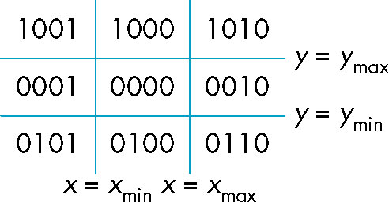
Defining Outcodes
For each endpoint, define an outcode
Outcodes divide space into 9 regions
Computation of outcode requires at most 4 subtractions
b₀b₁b₂b₃
b₀ = 1 if y > y_{max}, 0 otherwise
b₁ = 1 if y < y_{min}, 0 otherwise
b₂ = 1 if x > x_{max}, 0 otherwise
b₃ = 1 if x < x_{min}, 0 otherwise

Slide 16
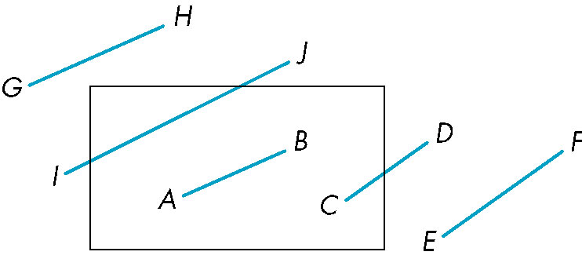
Using Outcodes
Consider the 5 cases below
AB: outcode(A) = outcode(B) = 0
Accept line segment

Slide 17
Using Outcodes
CD: outcode (C) = 0, outcode(D) ≠ 0
Compute intersection
Location of 1 in outcode(D) determines which edge to intersect with
Note if there were a segment from A to a point in a region with 2 ones in outcode, we might have to do two interesections

Slide 18
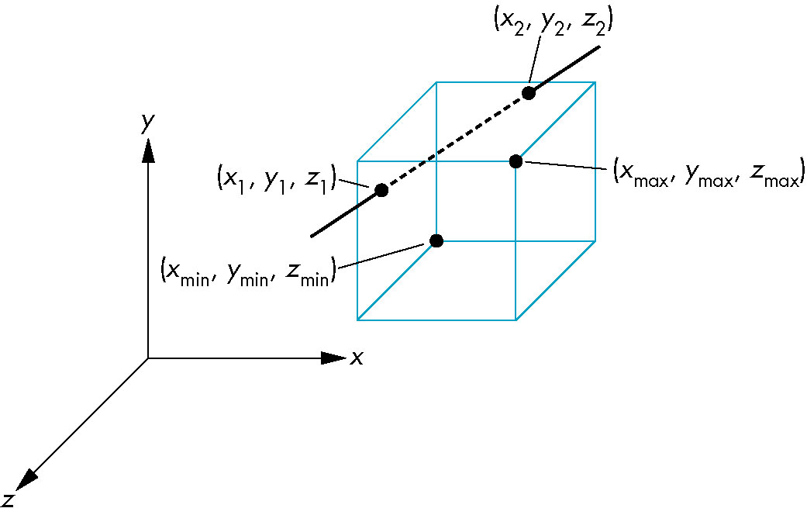
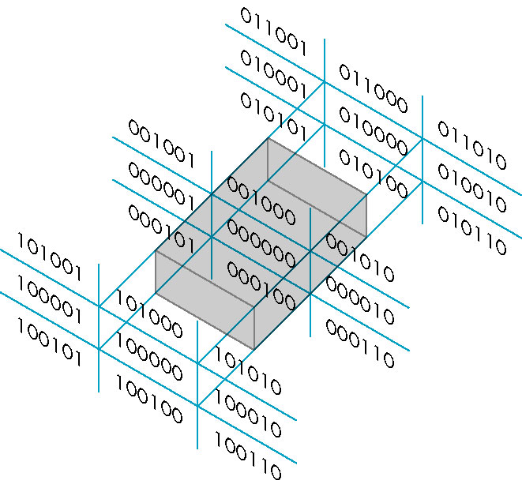
Cohen Sutherland in 3D
Use 6-bit outcodes
When needed, clip line segment against planes

Slide 19
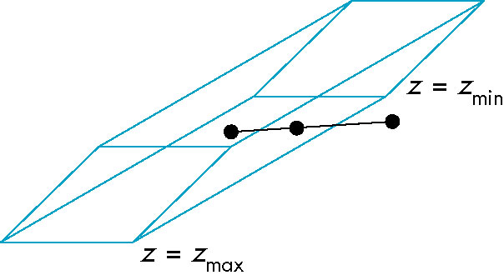
Clipping and Normalization
General clipping in 3D requires intersection of line segments against arbitrary plane
Example: oblique view

Slide 20
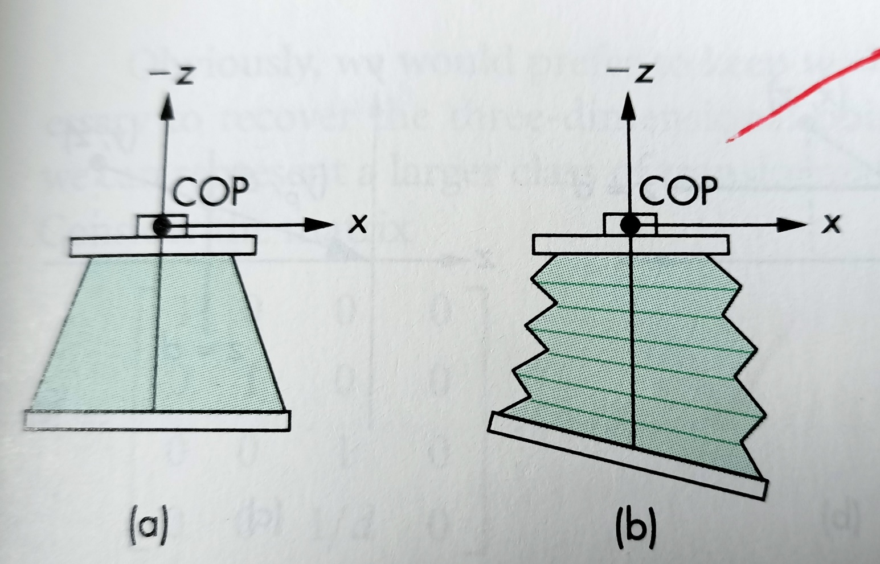
Two cameras: (b) back not parallel to the front

Slide 21
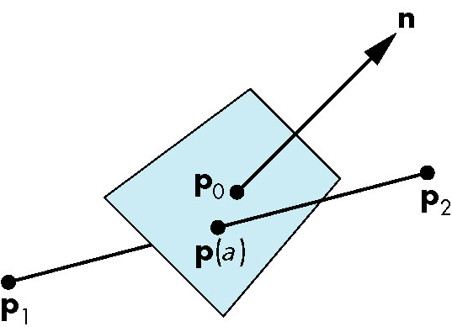
Plane-Line Intersections
Line p₁p₂ =
p₁ + t*(p₂-p₁)
where 0<= t<=1
when t = α
The intersection
point

Slide 22
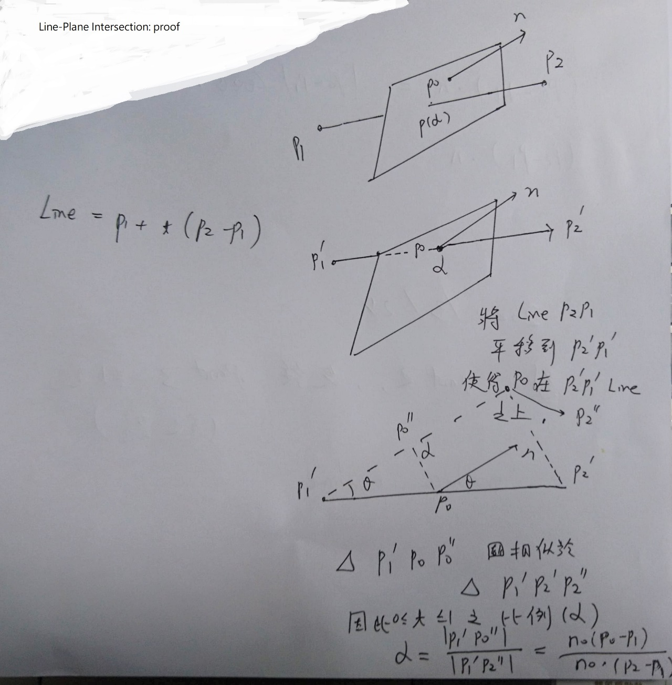
Plane-Line Intersections: II

Slide 23
Canonical View Volume for Perspective Projection: 3D clipping is easier this way!
x or y
Back
plane
1
Front
plane
-z
-1
-1
x = z, y = z, z = -z_{min}
x = -z, y = -z, z = -1

Slide 24
The Extension of the Cohen-Sutherland Algorithm
bit 1 – point is above view volume y > -z
bit 2 – point is below view volume y < z
bit 3 – point is right of view volume x > -z
bit 4 – point is left of view volume x < z
bit 5 – point is behind view volume z < -1
bit 6 – point is in front of view volume z > -z_{min}

Slide 25
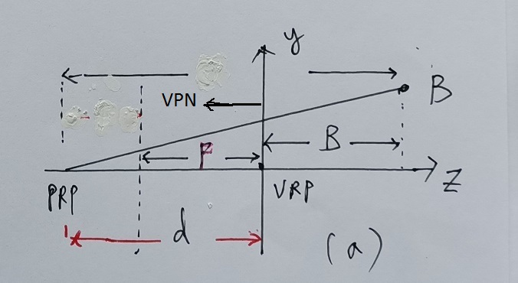
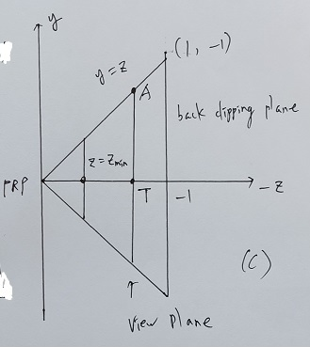
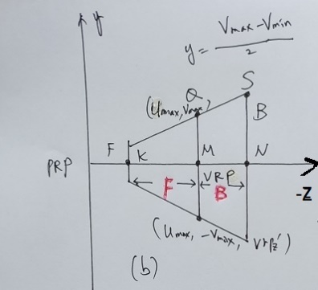
The Steps of Implementation of Perspective Projection
Translate the VRP to the origin
Rotate VRC such that the VPN becomes the z axis
Translate such that the PRP is at the origin
Shear such that the DOP becomes parallel to the z axis
Scale such that the view volume becomes the canonical perspective view volume

Slide 26
N_{per} = S_{per} * SH_{per} * T(-PRP) * R * T(-VRP) T(-VRP) =T(0,0,0) where no oblique proj.
T(-PRP) = T((0,0,d))
SH_{per}=1, R=R_{y}(180º)= [ -1 0 0 0 ]
[ 0 1 0 0 ]
[ 0 0 -1 0 ]
[ 0 0 0 1 ]

Slide 27
S_{per}(scaling)=
Assuming back clipping plane = (U_{max}, V_{max}, B )
Front clipping plane = (U_{min}, V_{min}, Z_{min} = F)
For example, let U_{max} = 5 = V_{max}, B=10, F=-d+2 U_{min} = -5 = V_{min}, vrp_{z}‘ = d, where d=8

Slide 28
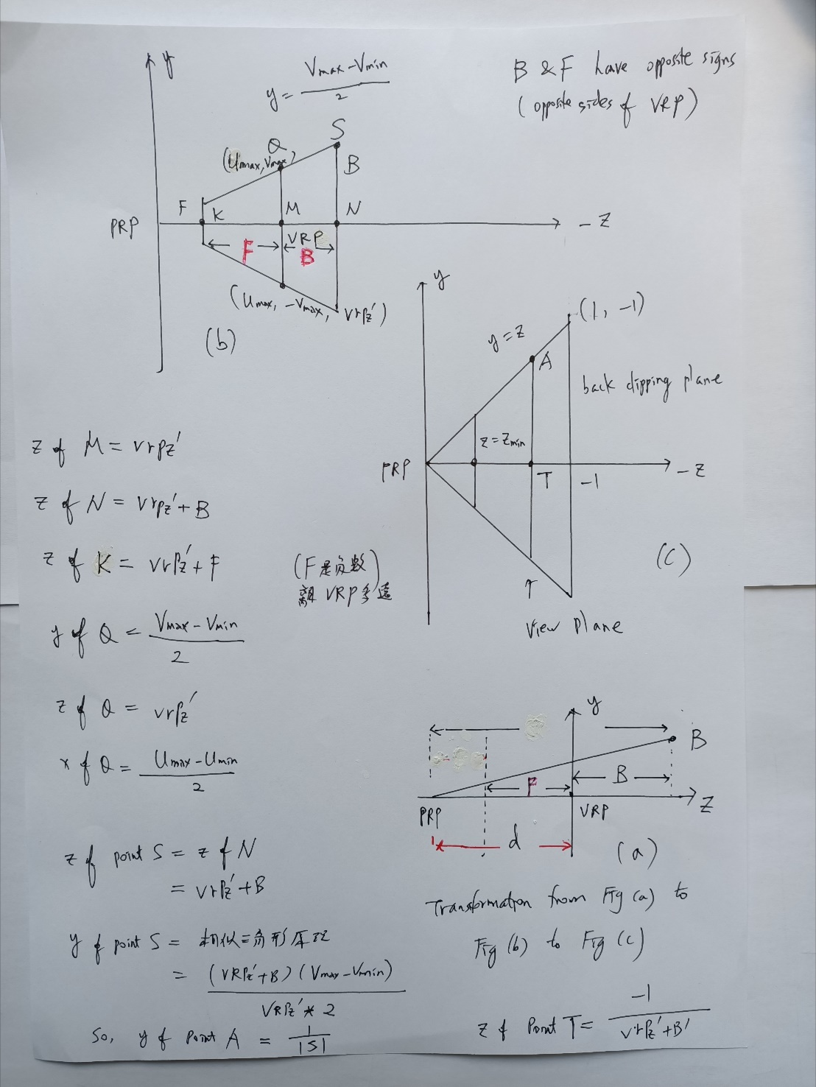
Detailed derivation: step by step

Slide 29
Vanishing Points
Parallel lines (not parallel to the projection plan) on the object converge at a single point in the projection (the vanishing point)
Drawing simple perspectives by hand uses these vanishing point(s)
vanishing point

Slide 30
Advantages and Disadvantages
Objects further from viewer are projected smaller than the same sized objects closer to the viewer (diminuition)
Looks realistic
Equal distances along a line are not projected into equal distances (nonuniform foreshortening)
Angles preserved only in planes parallel to the projection plane
More difficult to construct by hand than parallel projections (but not more difficult by computer)

Slide 31
Canonical View Volume for Orthographic Parallel Projection
x or y
Back
plane
1
Front
plane
-z
-1
-1
x = -1, y = -1, z = 0
x = 1, y = 1, z = -1

Slide 32
The Extension of the Cohen-Sutherland Algorithm
bit 1 – point is above view volume y > 1
bit 2 – point is below view volume y < -1
bit 3 – point is right of view volume x > 1
bit 4 – point is left of view volume x < -1
bit 5 – point is behind view volume z < -1
bit 6 – point is in front of view volume z > 0

Slide 33
Intersection of a 3D Line
A line from to can be represented as
So when y = 1

Slide 34
Intersection of a 3D Line
So when y = z

Slide 35
Clipping in Homogeneous Coordinates
Why clip in homogeneous coordinates ?
it is possible to transform the perspective-projection canonical view volume into the parallel-projection canonical view volume

Slide 36
Clipping in Homogeneous Coordinates
The corresponding plane equations are
X = -W
X = W
Y = -W
Y = W
Z = -W
Z = 0

Slide 37
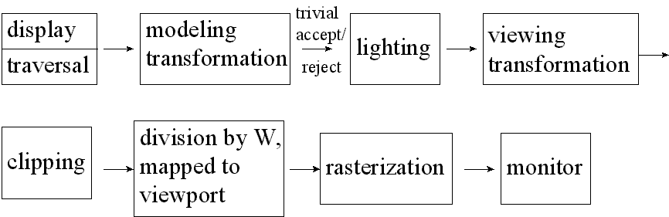
Standard Graphics Pipeline

