Slide 1

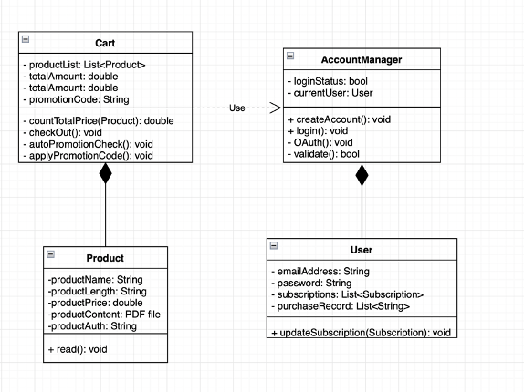
Fast Pass: Online Textbook
Chia-Yuan Chang, Eric Yeh, Kai-Chih Huang, Li-Yuan Hsu, Po-Han Hou, Xian-Ji Chen
Dept. of Computer Science and Engineering, Texas A&M University
Introduction
Main customer need
Maintain a Calculus and finance textbooks website.
Provide users to purchase online textbooks and to read it.
Developed and maintained based on TypeScript, React, and NestJS, Docker
Let readers read the textbook and manage their subscription status
To distinguish who can get access to the textbook. There are 3 categories of people who can read the book:
People who paid for the book
Students of Texas A&M and University of South Carolina
People who receive a promo code from the book owner
Let customers buy textbooks on the MyMath website. Customers should be able to checkout using PayPal or a promotion code.
Let potential customers browse sample chapters of the finance textbook
Book owner can give promo codes to anyone he wants.
Legacy Project
Lack information from previous owner.
This is a dysfunctional legacy code.
It has incorrect development instructions in README file.
The layout of front-end is not as same as the website working now.
Out of date dependencies
Unconnectable database
Incompatible version of package
Backend server is not functional
Wrong datatype of variable
Original version is lacking of user account system
User Stories
Purchase online textbooks:
Create cart function
Create cart page
Connect to payment API
Change the subscription option to 5 months and 24 months
Change the pages in calculus for not preview should be showed “Purchase to show the page” and redirect to purchase page
View info page of finance textbooks
Create the layout of the finance textbook page
Build the information of the finance textbooks
Show the sample chapters of the finance textbooks
Google login system:
Connect to database
Fetch the data sent from google
Store into database
Design Diagram
Refactoring
Upgrade all the deprecated dependencies including:
NestJS/typeorm
TypeORM
Upgrade to v0.3.10
Modify the template of DataSource
Update the environment variables for deploying to server including:
React app server domain
Google Oauth 2.0 client id & callback
Mailgun related variables
Database related variables
Future Work
Still need to work on the third party payment i.e. Paypal
Missing subscription status page for customers to view and manage their subscription.
Need to finish the promotion code function including the customer side and admin side.

