Slide 1


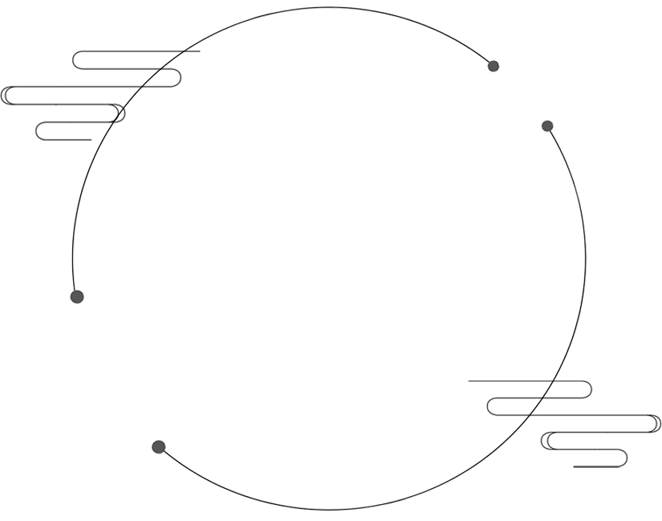
統
計
A Statistic Final Report
報告
與台灣犯罪率相關數據之調查

Slide 2
目錄
Contents
1
研究動機
Research Inspiration
3
結論
Conclusion
統計分析 – 迴歸
Statistic Analyzation – Regression Analysis
2

Slide 3
研究動機
Research Inspiration

Slide 4
研究動機 – 與台灣犯罪率相關之調查
廟宇密度
1
都說什麼混八加九的人都比較會作亂
究竟是真的嗎
人口密度
2
數大必有枯枝，人多必有白痴
人口密度高的地方犯罪率也會跟著增加嗎
直轄市與否
3
直轄市的居民似乎享有著較多的社會資源
這會讓整體犯罪率降低嗎
氣溫
4
天氣熱讓人火氣好大
氣溫高的地方會有比較高的犯罪率嗎

Slide 5
統計分析
Statistic Analyzation – Regression Analysis

Slide 6
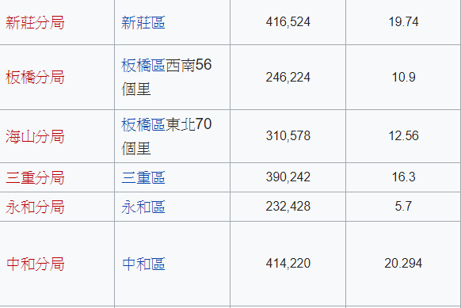
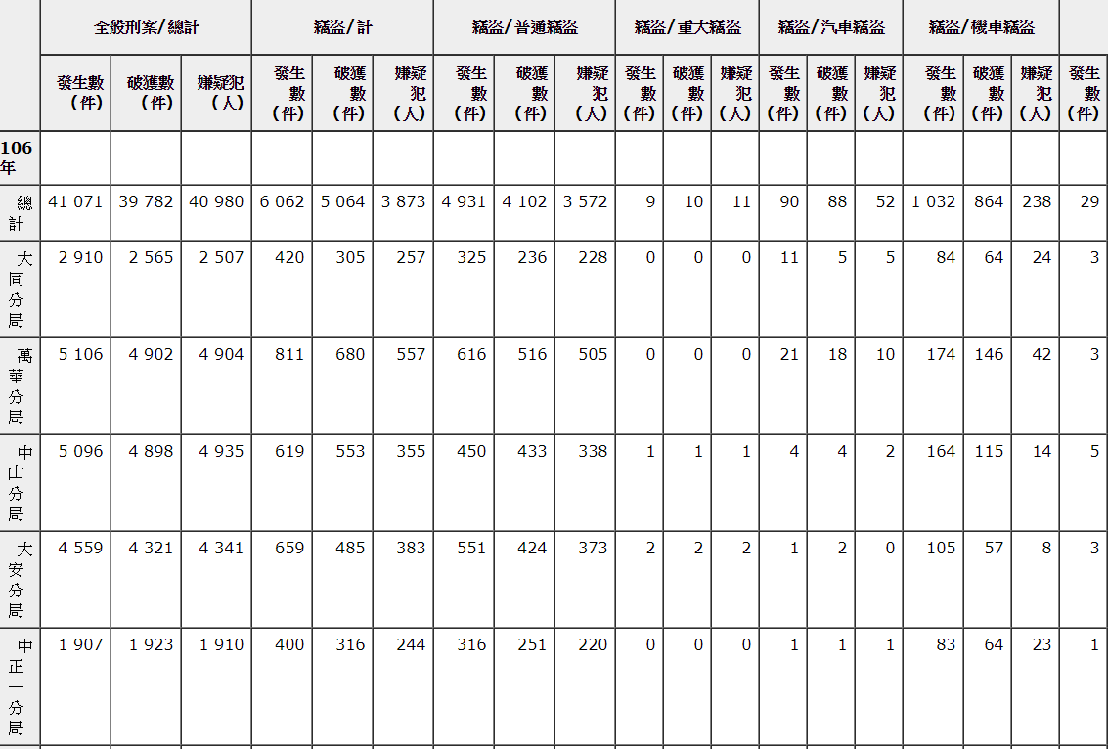
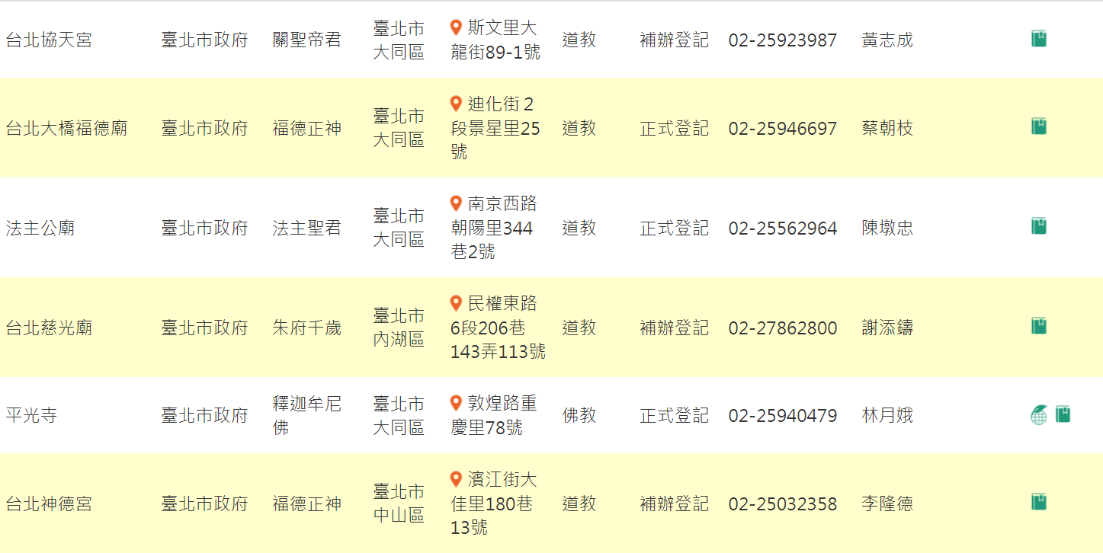
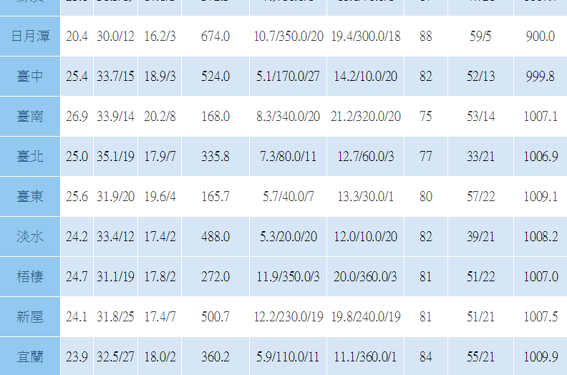
統計分析 – 資料蒐集
透過搜尋引擎
查詢各地區警察局轄區人數與面積
透過宗教資訊網
查詢各轄區廟宇數量
透過警察局網路公開資訊
查詢各轄區犯罪案件數量
透過氣象局網站
查詢各轄區平均溫度

Slide 7
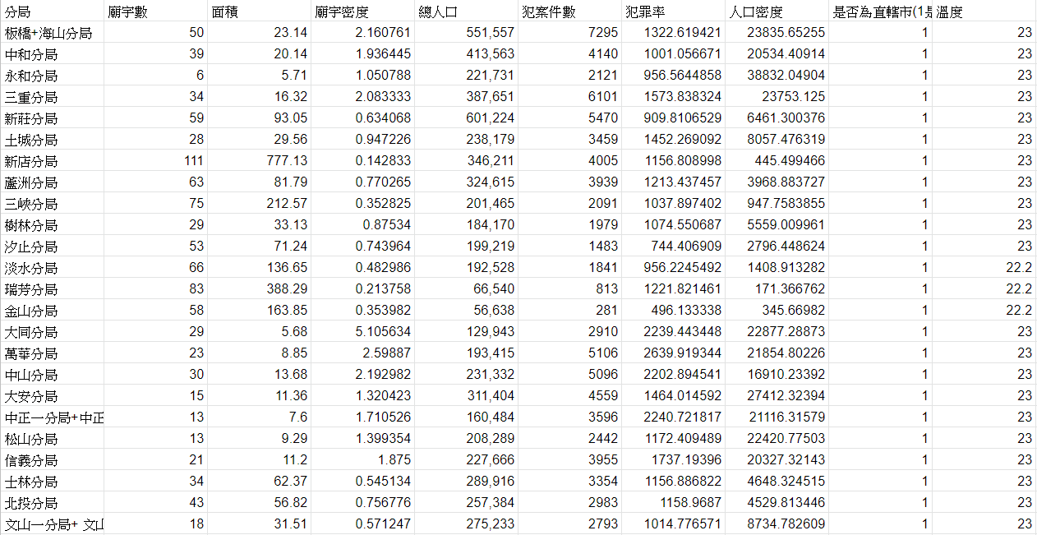
統計分析 – 資料處理
將資料進行處理製作表格
將人口數除以面積
得到人口密度
將犯罪數除以轄區人口
再乘以100000
得到每十萬人之犯罪率
將資料蒐集成為一個表格
点击此处更换文本编辑字点击此处更换文本编辑文字点击此处更换文本编辑文字点击此处更换文本编辑文字

Slide 8
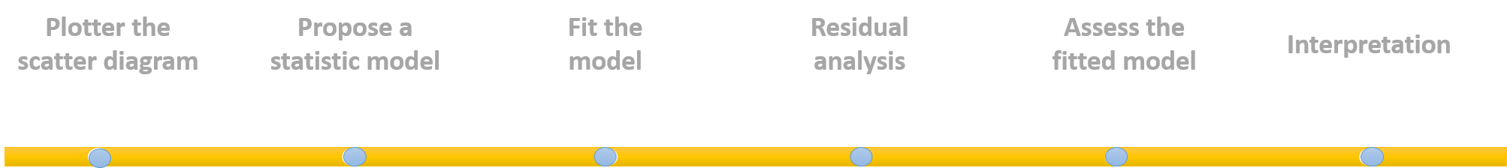
Regression Analysis
Plotter the scatter diagram

Slide 9
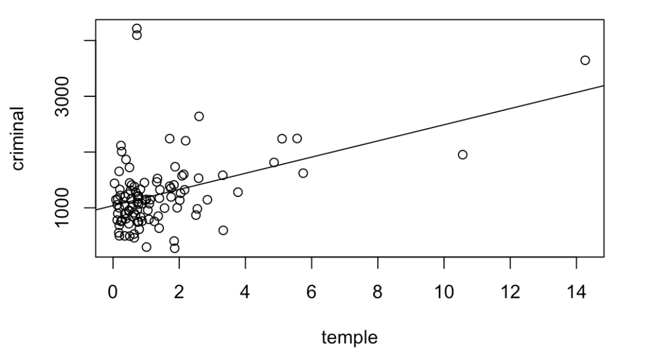
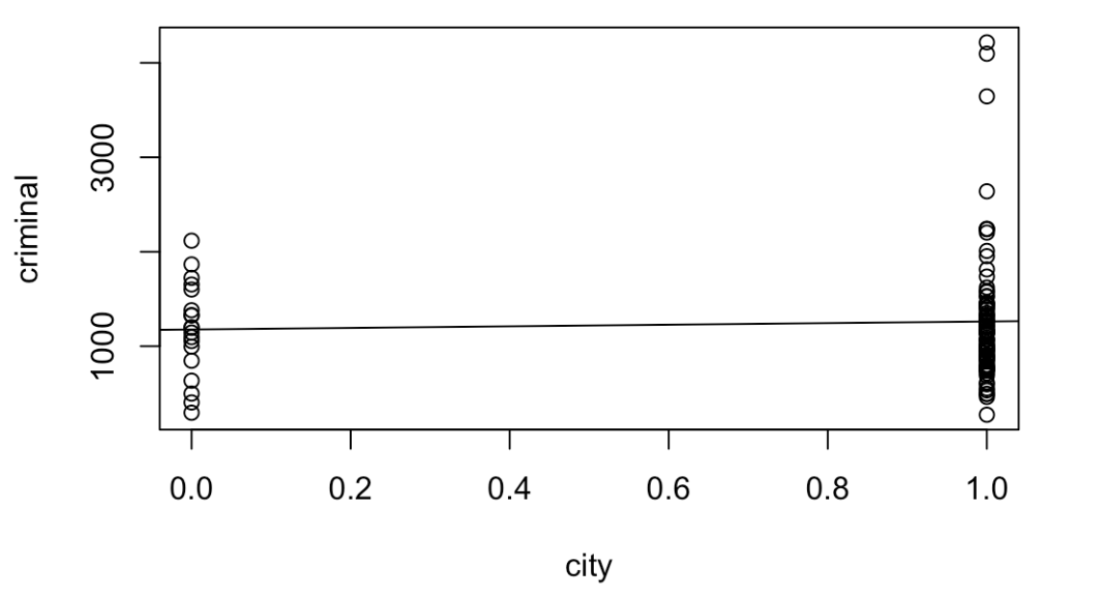
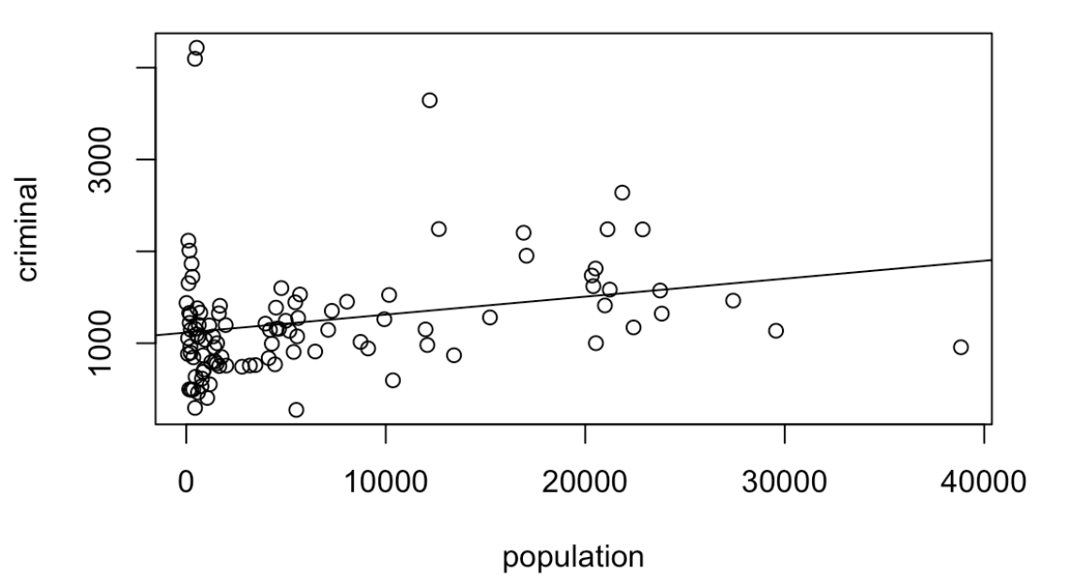
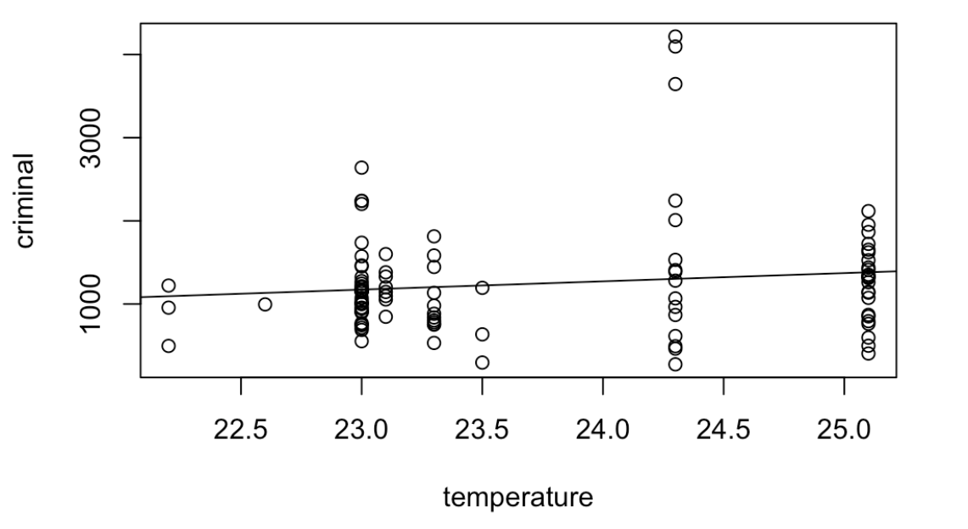
統計分析 – 迴歸線
犯罪率與廟宇密度的關係
犯罪率與是否為直轄市的關係
犯罪率與人口密度的關係
犯罪率與溫度之關係

Slide 10
Regression Analysis
Plotter the scatter diagram
Propose a statistic model

Slide 11
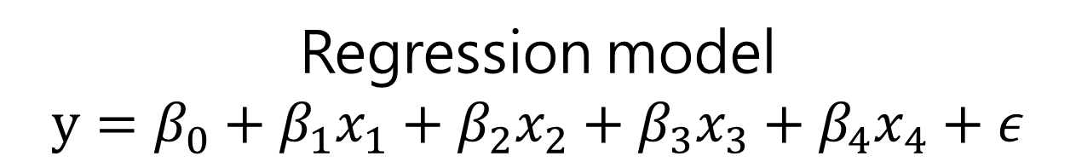
統計分析 – 迴歸模型與迴歸分析
Regression model
$$y=β_{0}+β_{1}x_{1}+β_{2}x_{2}+β_{3}x_{3}+β_{4}x_{4}+ε$$

Slide 12
Regression Analysis
Plotter the scatter diagram
Propose a statistic model
Fit the model

Slide 13
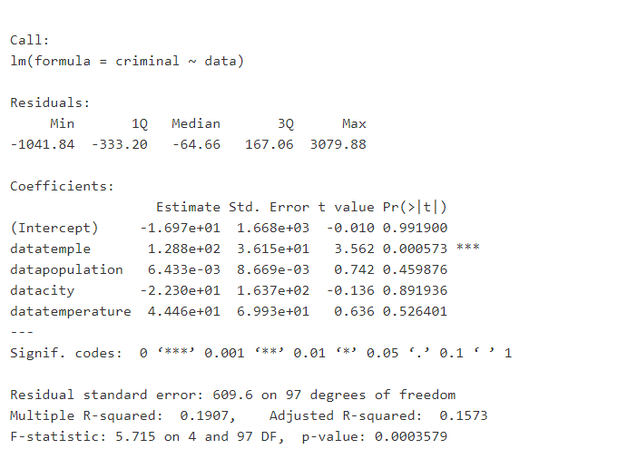
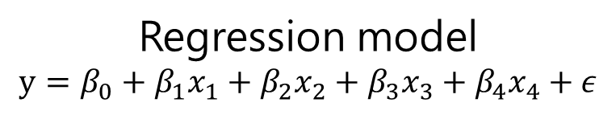
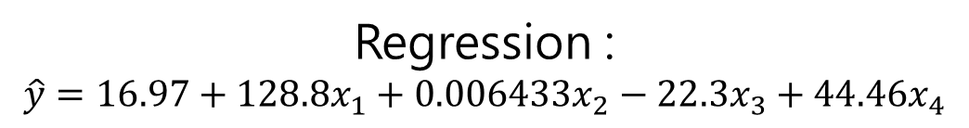
統計分析 – 迴歸模型與迴歸分析
Regression model
$$y=β_{0}+β_{1}x_{1}+β_{2}x_{2}+β_{3}x_{3}+β_{4}x_{4}+ε$$
result
Regression :
$$\hat{y}=16.97+128.8x_{1}+0.006433x_{2}−22.3x_{3}+44.46x_{4}$$

Slide 14
Regression Analysis
Regression Diagnostics
Plotter the scatter diagram
Propose a statistic model
Fit the model

Slide 15
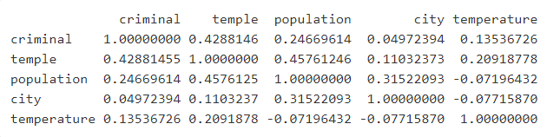
統計分析 – 迴歸模型與迴歸分析
Check if exists multicollinearity
Regression result
Multicollinearity
Take “city” out of the data

Slide 16
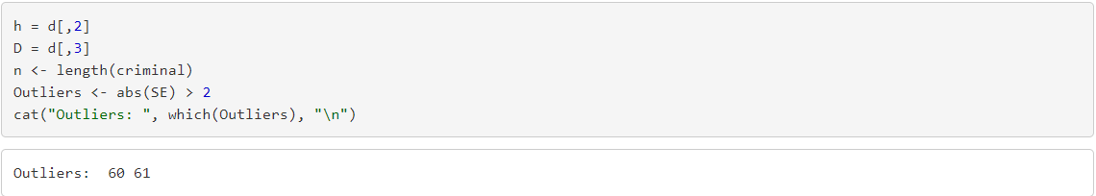
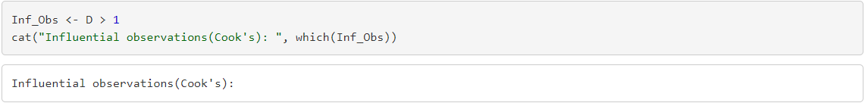
統計分析 – 迴歸模型與迴歸分析
Check the outliers and influential observations
Take out the outliers too.

Slide 17
Regression Analysis
Plotter the scatter diagram
Propose a statistic model

Slide 18
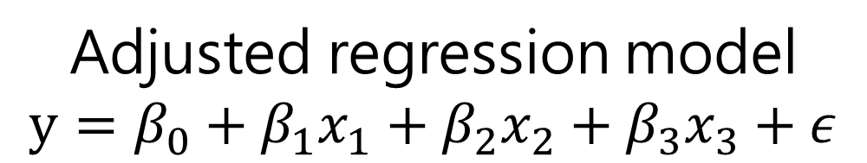
統計分析 – 迴歸模型與迴歸分析
Adjusted regression model
$$y=β_{0}+β_{1}x_{1}+β_{2}x_{2}+β_{3}x_{3}+ε$$

Slide 19
Regression Analysis
Plotter the scatter diagram
Propose a statistic model
Fit the model

Slide 20
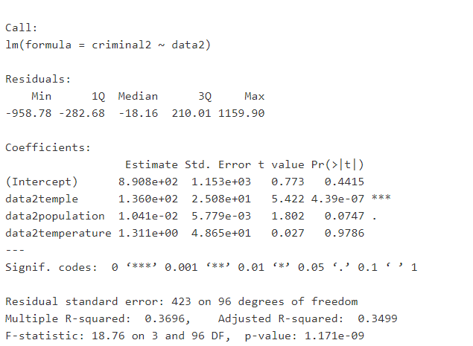

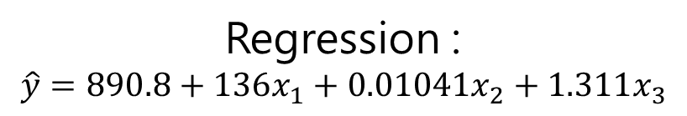
統計分析 – 迴歸模型與迴歸分析
Adjusted regression model
$$y=β_{0}+β_{1}x_{1}+β_{2}x_{2}+β_{3}x_{3}+ε$$
result
Regression :
$$\hat{y}=890.8+136x_{1}+0.01041x_{2}+1.311x_{3}$$

Slide 21
Regression Analysis
Regression Diagnostics
Plotter the scatter diagram
Propose a statistic model
Fit the model

Slide 22
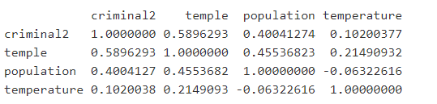
統計分析 – 迴歸模型與迴歸分析
Check if exists multicollinearity
Regression result

Slide 23
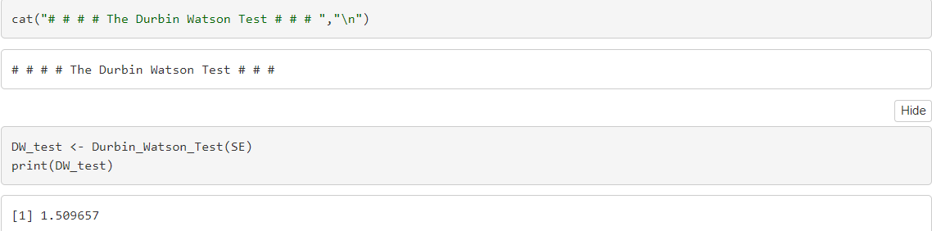
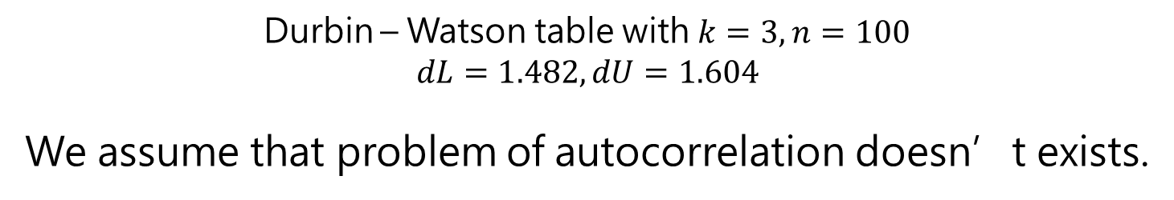
統計分析 – 迴歸模型與迴歸分析
Check if exists autocorrelation
Durbin – Watson table with $k=3, n=100$
$$dL=1.482, dU=1.604$$
We assume that problem of autocorrelation doesn’t exists.

Slide 24
Regression Analysis
Plotter the scatter diagram
Propose a statistic model
Fit the model
Residual analysis

Slide 25
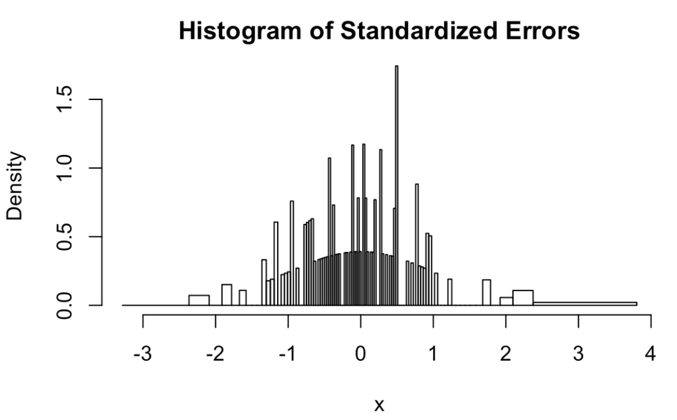
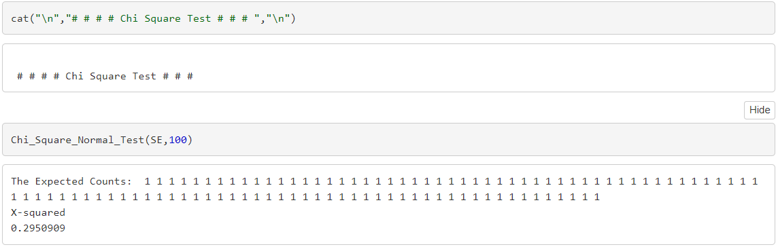
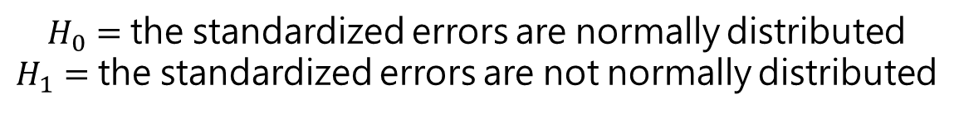
統計分析 – 迴歸模型與迴歸分析
Check if is normally distributed
$H_{0}=$ the standardized errors are normally distributed
$H_{1}=$ the standardized errors are not normally distributed
Do not reject $H_{0}$, we assume that the standardized errors are normally distributed

Slide 26
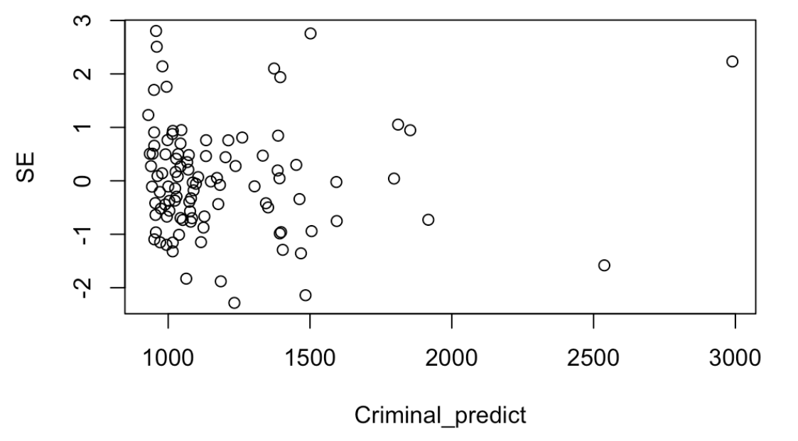
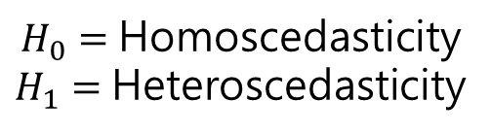
統計分析 – 迴歸模型與迴歸分析
Check if Heteroscedasticity is a problem
$H_{0}=$ Homoscedasticity
$H_{1}=$ Heteroscedasticity
Do not reject $H_{0}$, we can assume that the variation is constant and the mean is around 0.

Slide 27
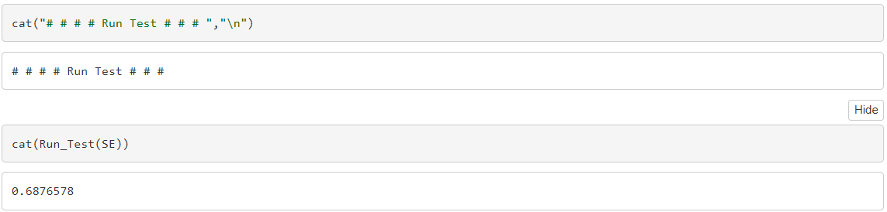
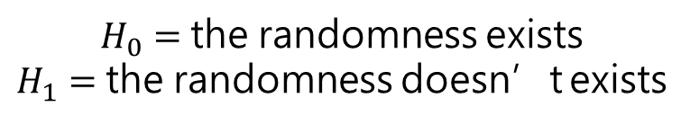
統計分析 – 迴歸模型與迴歸分析
Check if randomness exists
$H_{0}=$ the randomness exists
$H_{1}=$ the randomness doesn’t exists
Don’t reject $H_{0}$, we assume that randomness exists.

Slide 28
Regression Analysis
Plotter the scatter diagram
Propose a statistic model
Fit the model
Residual analysis
Assess the fitted model

Slide 29
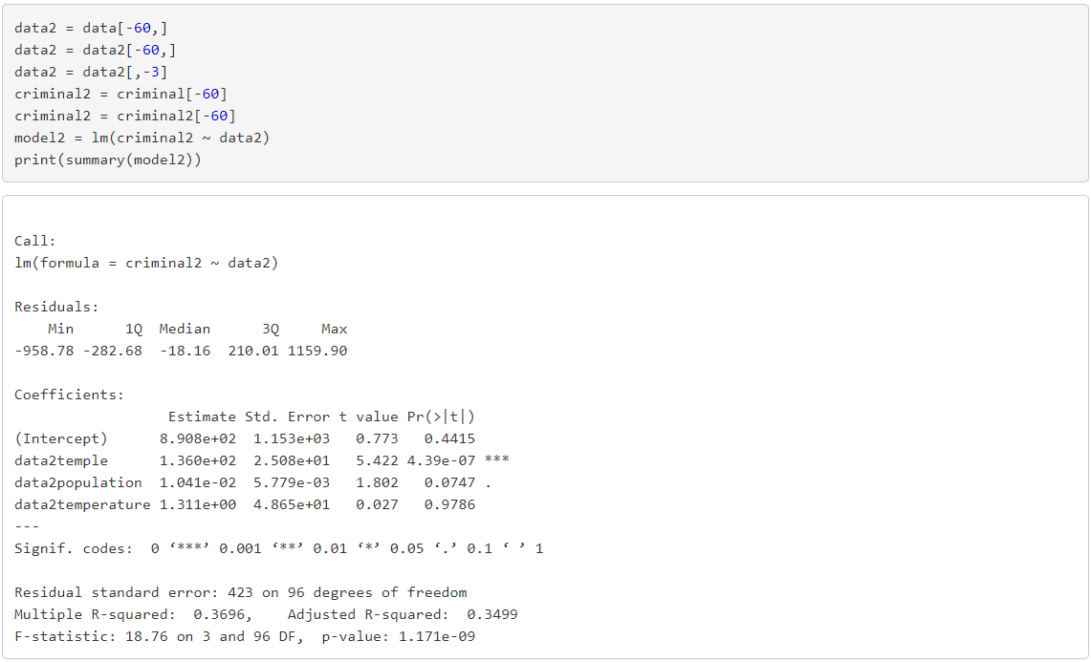

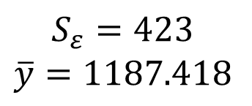
統計分析 – 迴歸模型與迴歸分析
$$S_{ε}=423$$
$$\overline{y}=1187.418$$
It seems that $S_{ε}$ is small comparing to $\overline{y}$, so we assume this model fits well

Slide 30

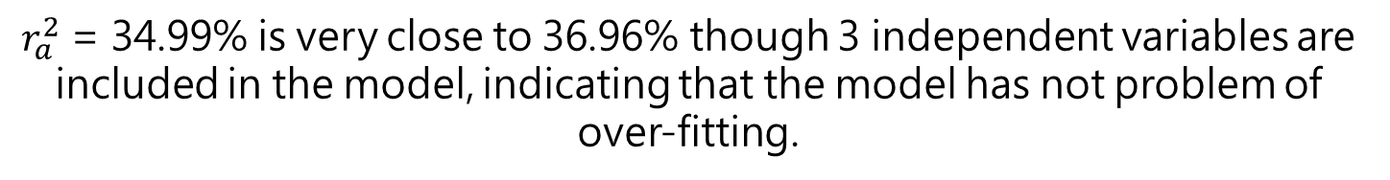
統計分析 – 迴歸模型與迴歸分析
$$r^{2}=36.96\%$$
$$r_{a}^{2}=34.99\%$$
36.96% of the variation in criminal rate is explained by this regression line of the three independent variables.
$r_{a}^{2}$ = 34.99% is very close to 36.96% though 3 independent variables are included in the model, indicating that the model has not problem of over-fitting.

Slide 31
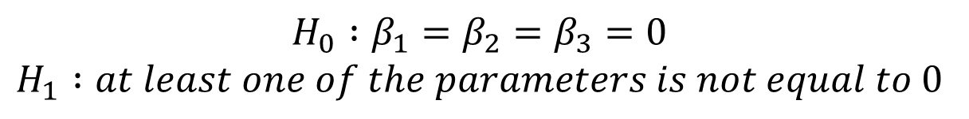
統計分析 – 迴歸模型與迴歸分析
$$H_{0} :β_{1}=β_{2}=β_{3}=0$$
$$H_{1} :at least one of the parameters is not equal to 0$$
The p-value is 1.171e-09, so we reject the null hypothesis, the model is valid.

Slide 32
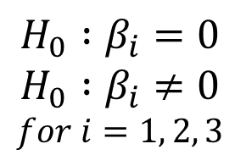
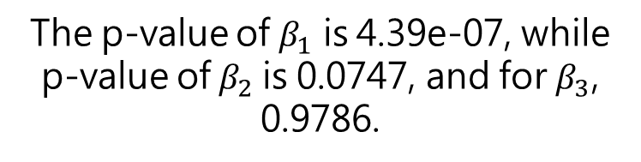
統計分析 – 迴歸模型與迴歸分析
$$H_{0} :β_{i}=0$$
$$H_{0} :β_{i}≠0$$
$$for i=1, 2, 3$$
The p-value of $β_{1}$ is 4.39e-07, while
p-value of $β_{2}$is 0.0747, and for $β_{3}$, 0.9786.
The density of temple is linearly related to the criminal rate by 5% significance level.
The population density is also quite related to the criminal rate as it’s p-value is 0.0747, which is relatively small.
The temperature has a little to do with the criminal rate.

Slide 33
Regression Analysis
Plotter the scatter diagram
Propose a statistic model
Fit the model
Residual analysis
Assess the fitted model
Interpretation

Slide 34

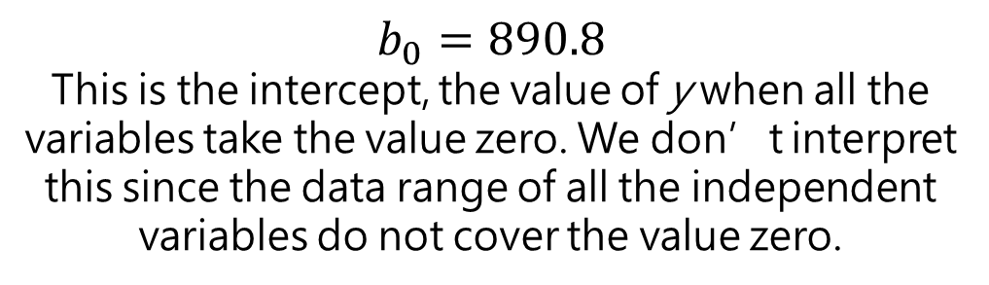
統計分析 – 迴歸模型與迴歸分析
Regression result
$$b_{0}=890.8$$
This is the intercept, the value of y when all the variables take the value zero. We don’t interpret this since the data range of all the independent variables do not cover the value zero.
$$b_{1}=136$$
In this model, for each additional density of temple, the criminal rate increases on the average by 136.

Slide 35
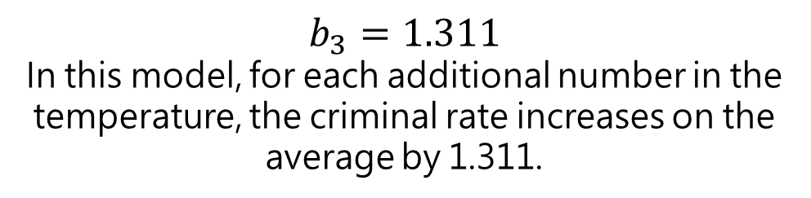
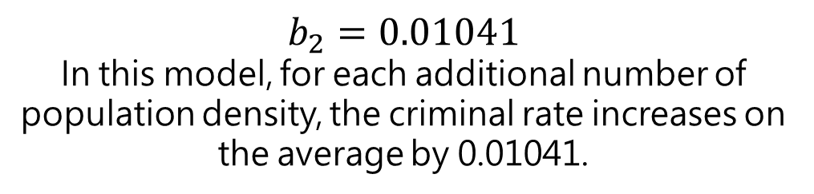
統計分析 – 迴歸模型與迴歸分析
Regression result
$$b_{2}=0.01041$$
In this model, for each additional number of population density, the criminal rate increases on the average by 0.01041.
$$b_{3}=1.311$$
In this model, for each additional number in the temperature, the criminal rate increases on the average by 1.311.

Slide 36
結論
Conclusion

Slide 37
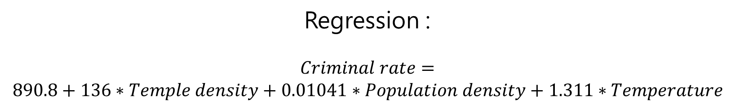
結論
Regression :
$$Criminal rate=$$
$$890.8+136∗Temple density+0.01041∗Population density+1.311∗Temperature$$
Due to our result, we found out that temple density of a region is linearly relative to the criminal rate in Taiwan, and with a high coefficient it implies that these temples are indeed causing social problems.
On the other hand, we also found out a higher population density results in a higher criminal rate, which didn’t surprise us. After all, if the percentage of people violating the law remains the same in every populations, it should lead to this result.
Comparing to the two result above, the number of temperature did much less to the criminal rate.

Slide 38
Thanks for listening
謝謝聆聽
ご清聴ありがとうございました
들어주셔서 감사합니다
Gracias por su atención
Vielen Dank für Ihre Aufmerksamkeit
Merci de votre attention
Grazie per l'attenzione
Спасибо, что выслушали

