Slide 1
Bandwidth-Efficient Inferencing at the Edge -- An Experimental
Approach to Analyze the Effect of VSR on Compressed Video
Yu-Chien Tsai 蔡予謙
Network and Systems Laboratory
Graduate Institute of Electrical Engineering
National Taiwan University
Jun 11th, 2024
‹#›
Notes:
Can Super-resolution help bandwidth efficiency in object detection
Bandwidth/accuracy trade-offs for object detectors using super-resolution
Balancing Performance and Bandwidth: Video Super-Resolution and Compression for Object Detection
Impact of Video Super-Resolution and Compression on Object Detection
‹#›

Slide 2
Outline
Introduction
Related Work
Methodology
Results

Slide 3
Outline
Introduction
Related Work
Methodology
Results

Slide 4
Motivation
Edge-assisted inferencing solutions
Strain on limited upload bandwidth
Reducing quality saves bandwidth but impacts performance.
The role of super-resolution
Prior works highlights the impact of image/video quality on object detection
Super-resolution can enhance the user experience in live-streaming.
Can Super-resolution also enhance object detection accuracy?

Slide 5
Outline
Introduction
Related Work
Methodology
Results

Slide 6
Super-resolution (SR)
Convert low-resolution images into high-resolution images.
Number of input images
Single Image Super Resolution (SISR)
Video Super Resolution (VSR)
Leverages both intra-frame and inter-frame information.

Slide 7
Video Codec
H.264/AVC^{[4][5]}
Although H.264 has been around for many years and newer codecs like HEVC and AV1 continue to emerge, H.264 still dominate and compatible with most of the devices nowadays.
Similar to previous standards, H.264 divide input images input macroblocks. These macroblocks are further coded in Intra or Inter mode.

Slide 8
Video Codec (Compression)
Quantization parameter (QP)
QP defines how much information to give up in a given block of pixels.
Higher QP, lower quality.
Notes:
https://www.coconut.co/articles/mastering-crf-dive-into-vbr-encoding

Slide 9
Video Codec (Compression)
Two modes to utilize QP
Constant quantization parameter (CQP)
Same QP for each frame.
Higher CQP, lower quality.
Constant rate factor (CRF)
QP is adjusted for each frame to provide maximum compression efficiency.
Higher CRF, lower quality.
Notes:
https://www.coconut.co/articles/mastering-crf-dive-into-vbr-encoding

Slide 10
Object detection
Yolo^{[3]}
There are many CNN-based object detectors today, e.g. R-CNN, YOLO, SSD, RetinaNet, EfficientNet.
YOLO is a single-stage detector that view detection problems as regression problems. YOLO is extremely fast and good in learning generalizable representation of objects.
Pre-trained Yolov5x6 model
strongest/largest yolov5 model

Slide 11
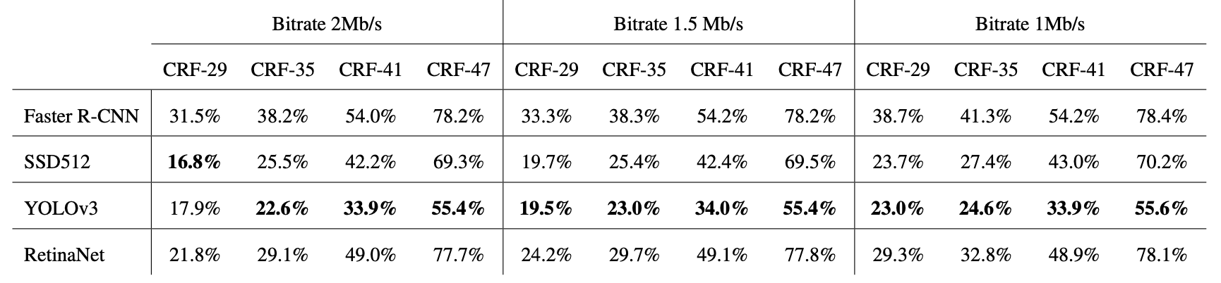
Related Work^{[1][2]}
How video/image quality affect object detection
Without any video/image enhancement
Resolution is not the focus

Slide 12
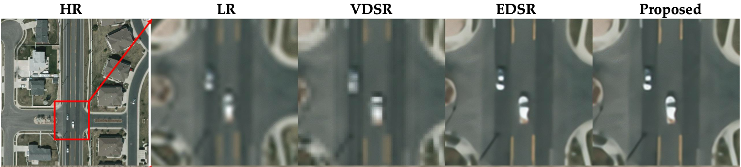
Related Work^{[7][8]}
Task-driven super resolution
Train SR models for specific tasks
More specific targets like satellite images or surveillance cameras

Slide 13
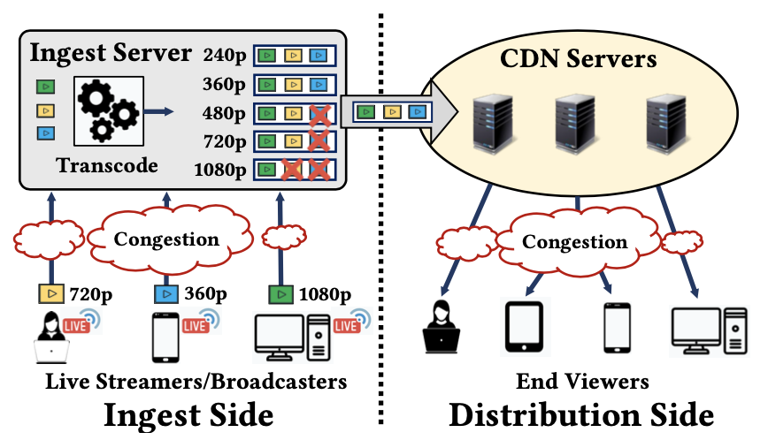
Related Work^{[9][10][11]}
SR-enhanced live streaming
Consider only resolution but no quality degradation
Consider only quality gain without any downstream task like object detection performance

Slide 14
Thesis Statement
General super-resolution on low-quality videos can be helpful for object detection accuracy.
But still ineffective in saving bandwidth and time.

Slide 15
Contribution
Present tradeoffs between video average bitrate and object detection performance across different video qualities and resolutions.
Present the (in)effectiveness of applying general super-resolution methods on lower-quality videos.

Slide 16
Outline
Introduction
Related Work
Methodology
Results

Slide 17
Video Data
Inter4K:
60fps
5 second
high resolution (4K)
videos taken by mobile devices

Slide 18
Data Pre-processing
Transcode with FFmpeg
Resolution pairs (4x)
360p & 1440p
270p & 1080p
Compression
CRF/CQP
0/2/5/7/10/15/20/25/30/35/40
Preset
medium
Codec
H.264
Notes:
The main reason to use this dataset is because the dataset provides standardized video resolutions at ultra-high definition (UHD/4K) which suit the need for tasks like super-resolution or frame interpolation.
Fixing bitrate
ffmpeg -i UHD/1.mp4 -c:v libx264 -vf scale=1280:720 -b:v 2M -pass 1 -f null dev/null && ffmpeg -i UHD/1.mp4 -c:v libx264 -vf scale=1280:720 -b:v 2M -pass 2 _1.mp4
dv
(default) -preset medium
other options
-crf (default) 23
-q

Slide 19
Structure Overview - case 1
original video
FFmpeg
Transcode
1440p
frames
(uncompress)
YOLO
Set as GT
Calculate
mAP
Super Resolution
1440p
frames
YOLO
SR results
360p
CRF=0
1. No SR (Linear scaling)
2. Interpolation (Bicubic interpolation)
3. Single Image Super Resolution (FSRCNN)
4. Video Super Resolution (BasciVSR++)
360p
CRF=2
360p
CRF=5

Slide 20
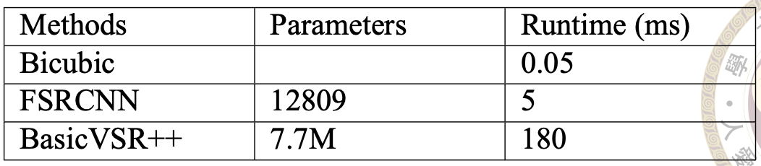
Video Enhancement
No Super Resolution
scale (multiply) the bounding box coordinates
Bicubic Interpolation (BI)
OpenCV resize function
Single Image Super Resolution (SISR)
FSRCNN model
pre-trained on T91 dataset
Video Super Resolution (VSR)
BasicVSR++ model
pre-trained on REDS4 dataset

Slide 21
Structure Overview - case 2
original video
FFmpeg
Transcode
1440p
frames
(uncompress)
YOLO
Set as GT
Calculate
mAP
YOLO
SR results
1440p
CRF=2
1440p
CRF=5
1440p
CRF=7

Slide 22
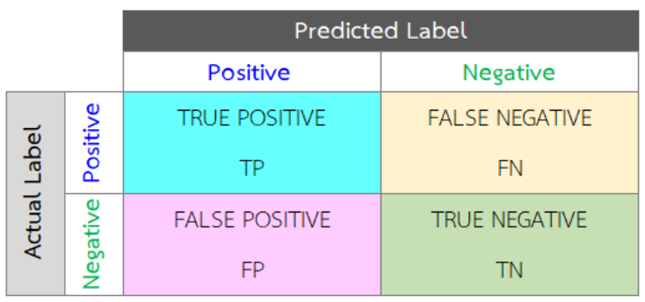
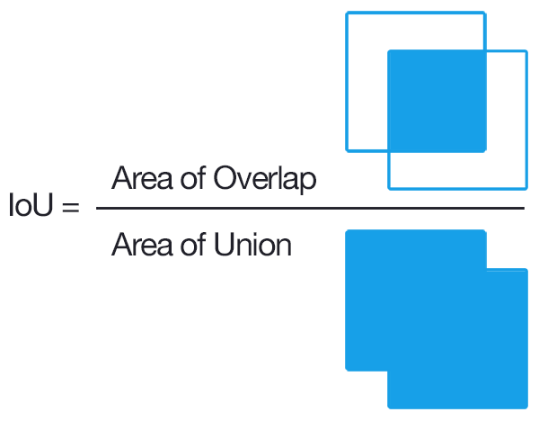
Metrics
mAP (mean average precision)
AP (average precision)
PRC (Precision-Recall Curve)
Confusion matrix
Recall = TP / ( TP + FN )
Precision = TP / ( TP + FP )
IOU (Intersection Over Union) > 50%
determine whether a boundbox is a correct prediction.
figure reference: https://pyimagesearch.com/2016/11/07/intersection-over-union-iou-for-object-detection/ https://www.researchgate.net/publication/329526806_A_novel_heuristic_method_for_misclassification_cost_tuning_in_imbalanced_data

Slide 23
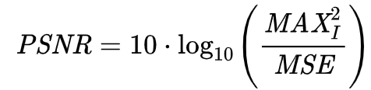
Metrics
PSNR (peak signal-to-noise ratio)
MAX: 255

Slide 24
Outline
Introduction
Related Work
Methodology
Results

Slide 25
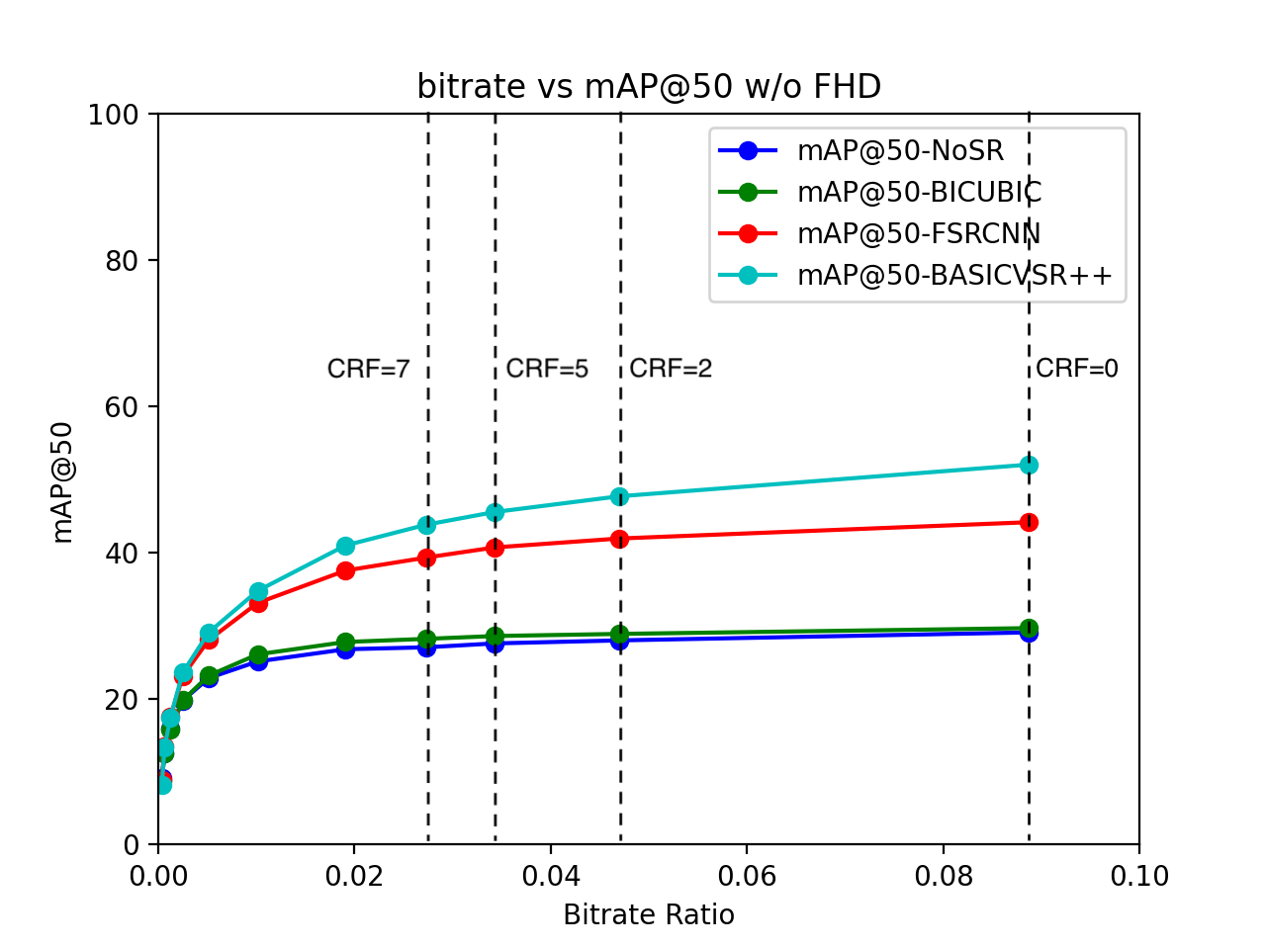
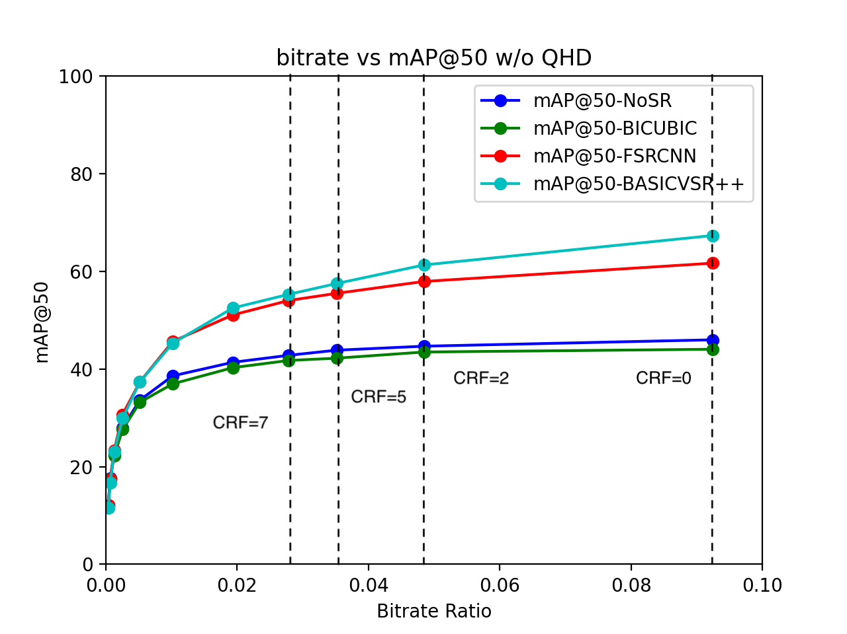
Compressed LR + SR (case 1)
No SR: baseline
Bicubic: ~0%
FSRCNN: 7%~15%
BasicVSR++: 7%~20%
1080p
1440p
compression level increases

Slide 26
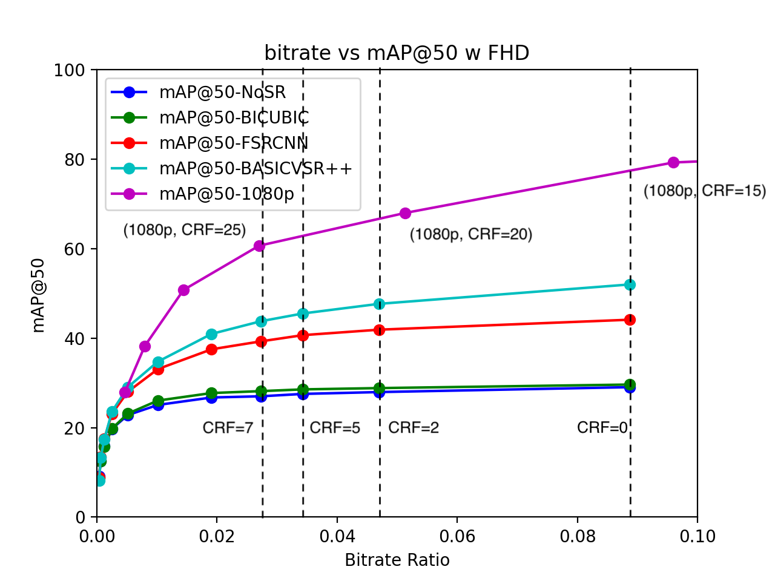
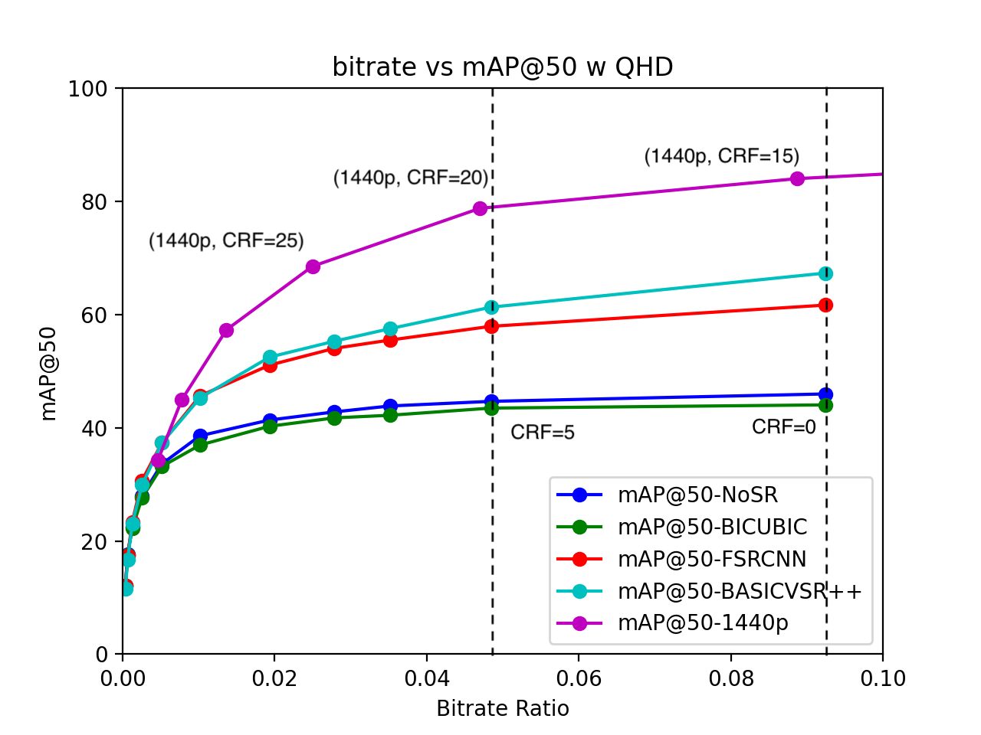
Compressed HR (case 1+2)
mAP of compressed high resolution video
Bitrates: (1080p, CRF=25) close to (270p, CRF=7)
mAP: (1080p, CRF=25) better than (270p, CRF=7)
Reduce the resolution to save bandwidth might not be the greatest idea!
1080p
1440p

Slide 27
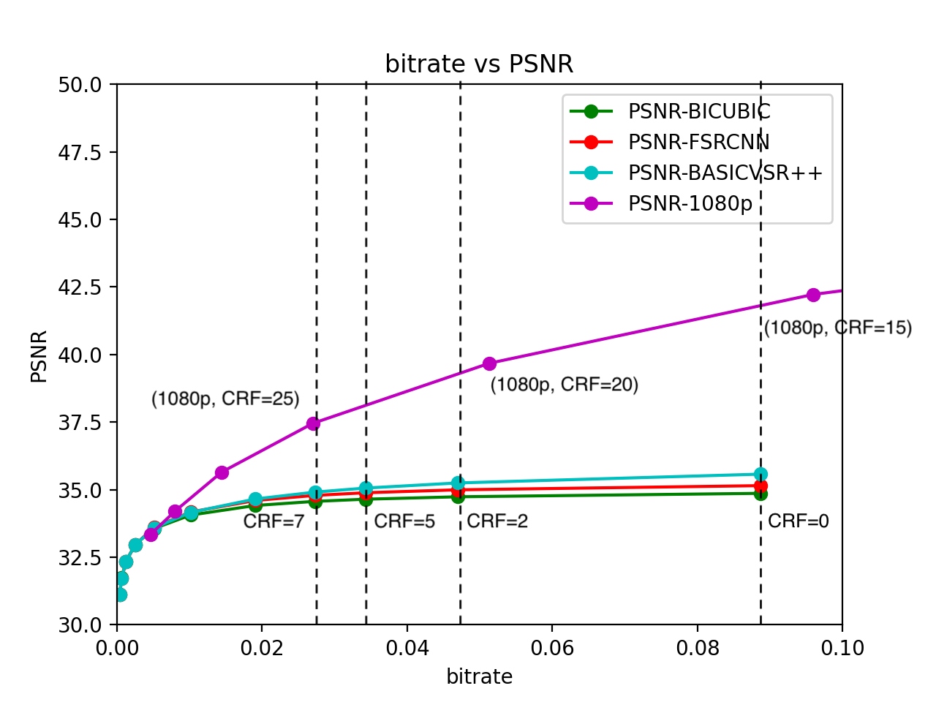
PSNR
SISR and VSR have little difference with Bicubic
SR can be are helpful for object detection
1080p PSNR
1080p mAP@50

Slide 28
Conclusions
Directly scales videos with interpolation have no benefit for mAP and PSNR.
SISR and VSR methods attain maximum 15~20% of mAP improvement.
Adjusting CRF (CQP) alone could be more effective than adjusting both CRF (CQP) and resolution, even with the help of general SR methods, in terms of both time and bandwidth.

Slide 29
Implications
Mobile-AR or Live Streaming
Bandwidth
Consider both resolution and CRF (or other rate control mode) when encoding videos.
Optimize SR without directly fitting specific datasets.

Slide 30
Q&A
‹#›

Slide 31
References
[1] Borel-Donohue, Christoph, and S. Susan Young. "Image quality and super resolution effects on object recognition using deep neural networks."
[2] Aqqa, Miloud, Pranav Mantini, and Shishir K. Shah. "Understanding How Video Quality Affects Object Detection Algorithms."
[3] Redmon, Joseph, et al. "You only look once: Unified, real-time object detection."
[4] Ostermann, Jörn, et al. "Video coding with H. 264/AVC: tools, performance, and complexity."
[5] Chen, Jian-Wen, Chao-Yang Kao, and Youn-Long Lin. "Introduction to H. 264 advanced video coding."
[6] H. S. Malvar, A. Hallapuro, M. Karczewicz and L. Kerofsky, "Low-complexity transform and quantization in H.264/AVC."

Slide 32
References
[7] Haris, Muhammad, Greg Shakhnarovich, and Norimichi Ukita. "Task-driven super resolution: Object detection in low-resolution images."
[8] Wang, Yi, et al. "Remote sensing image super-resolution and object detection: Benchmark and state of the art."
[9] Chen, Ying, et al. "Higher quality live streaming under lower uplink bandwidth: an approach of super-resolution based video coding."
[10] Wang, Zelong, et al. "Revisiting super-resolution for internet video streaming."
[11] Kim, Jaehong, et al. "Neural-enhanced live streaming: Improving live video ingest via online learning."

Slide 33
Thank you for listening

Slide 34
Backup slides

Slide 35
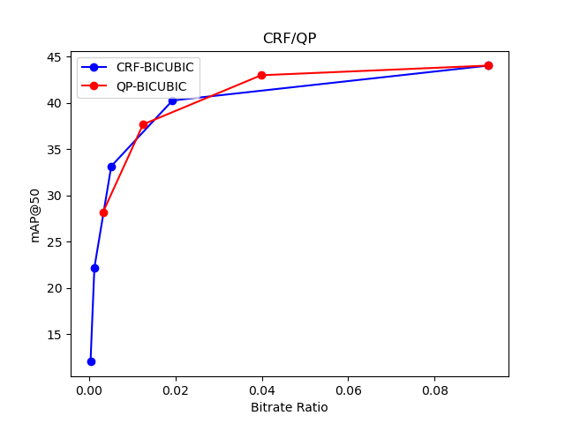
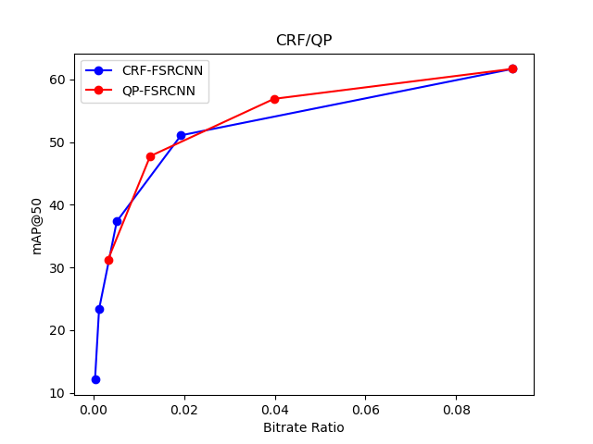
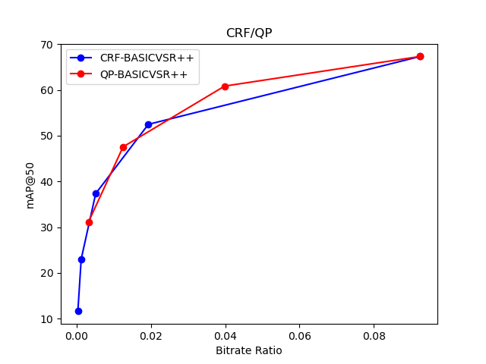
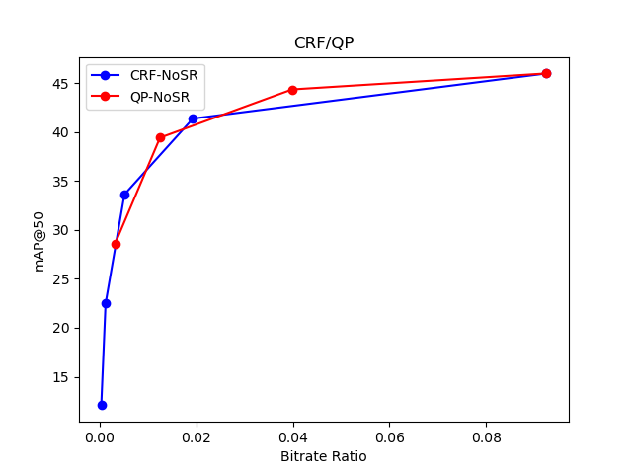
Results
CRF vs CQP

Slide 36
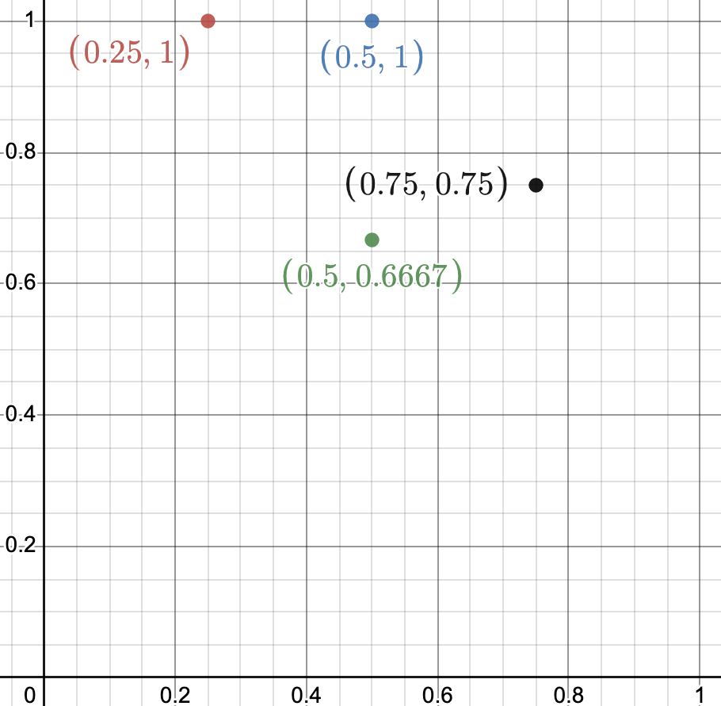
Metrics
mAP (mean average precision)
mAP@50: IOU > 0.5
Precision = TP / (TP+FP) = 1/1
Recall = TP / total GT = 1/4
Precision = TP / (TP+FP) = 2/2
Recall = TP / total GT = 2/4
GT | BB | IoU | Confidence | Is TP
GT1 | BB1 | 0.7 | 0.9 | Yes
GT2 | BB2 | 0.9 | 0.8 | Yes
GT2 | BB7 | 0.6 | 0.7 | No
GT3 | BB3 | 0.6 | 0.6 | Yes
GT4 | BB4 | 0.4 | 0.6 | No
Precision = TP / (TP+FP) = 2/3
Recall = TP / total GT = 2/4
Precision = TP / (TP+FP) = 3/4
Recall = TP / total GT = 3/4
Precision = TP / (TP+FP) = 3/5
Recall = TP / total GT = 3/4
Precision: Y-axis
Recall: X-axis
(0.75, 0.6)

Slide 37
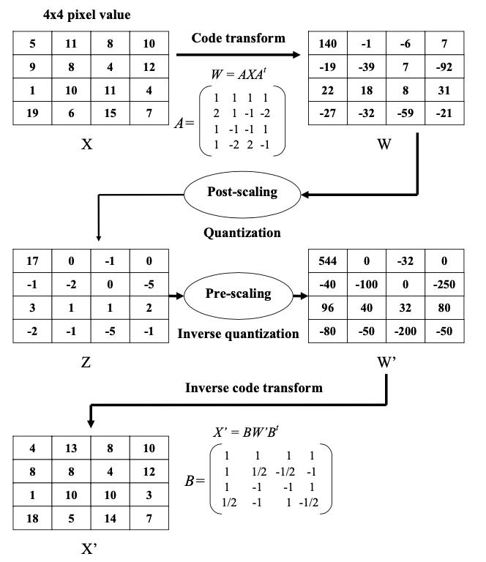
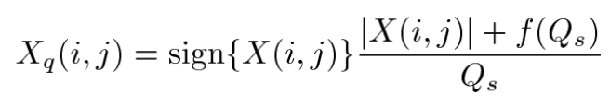

Quantization parameter
H.264, H.265,...
I/B/P-type frames
residual encoding using DCT or Integer transform
encode^{[6]}:
decode^{[6]}:
Notes:
QP is widely adopted by H.264, H.265 and many subsequent codecs.
In I-type frames, all macroblocks are encoded in Intra mode. In P-type frames, all macroblocks are predicted using a motion compensated prediction with one reference frame and in B-type frames with two reference frames.

