Slide 1
Preparation for OWASP Bay Area Workshop

Slide 2
Install MobSF
https://github.com/MobSF/Mobile-Security-Framework-MobSF
Easiest is using docker:
$ docker pull opensecurity/mobile-security-framework-mobsf
$ docker run -it -p 8000:8000 opensecurity/mobile-security-framework-mobsf:latest
Open 127.0.0.1:8000 in your browser.

Slide 3
Download Burp Suite
Please make sure you have JRE installed!
Download the community edition
https://portswigger.net/burp/communitydownload

Slide 4
Install Android Studio
https://developer.android.com/studio/install

Slide 5
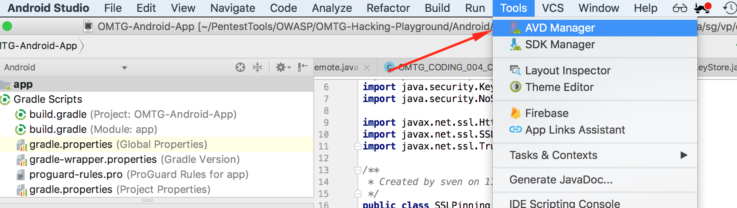
Open AVD Manager

Slide 6
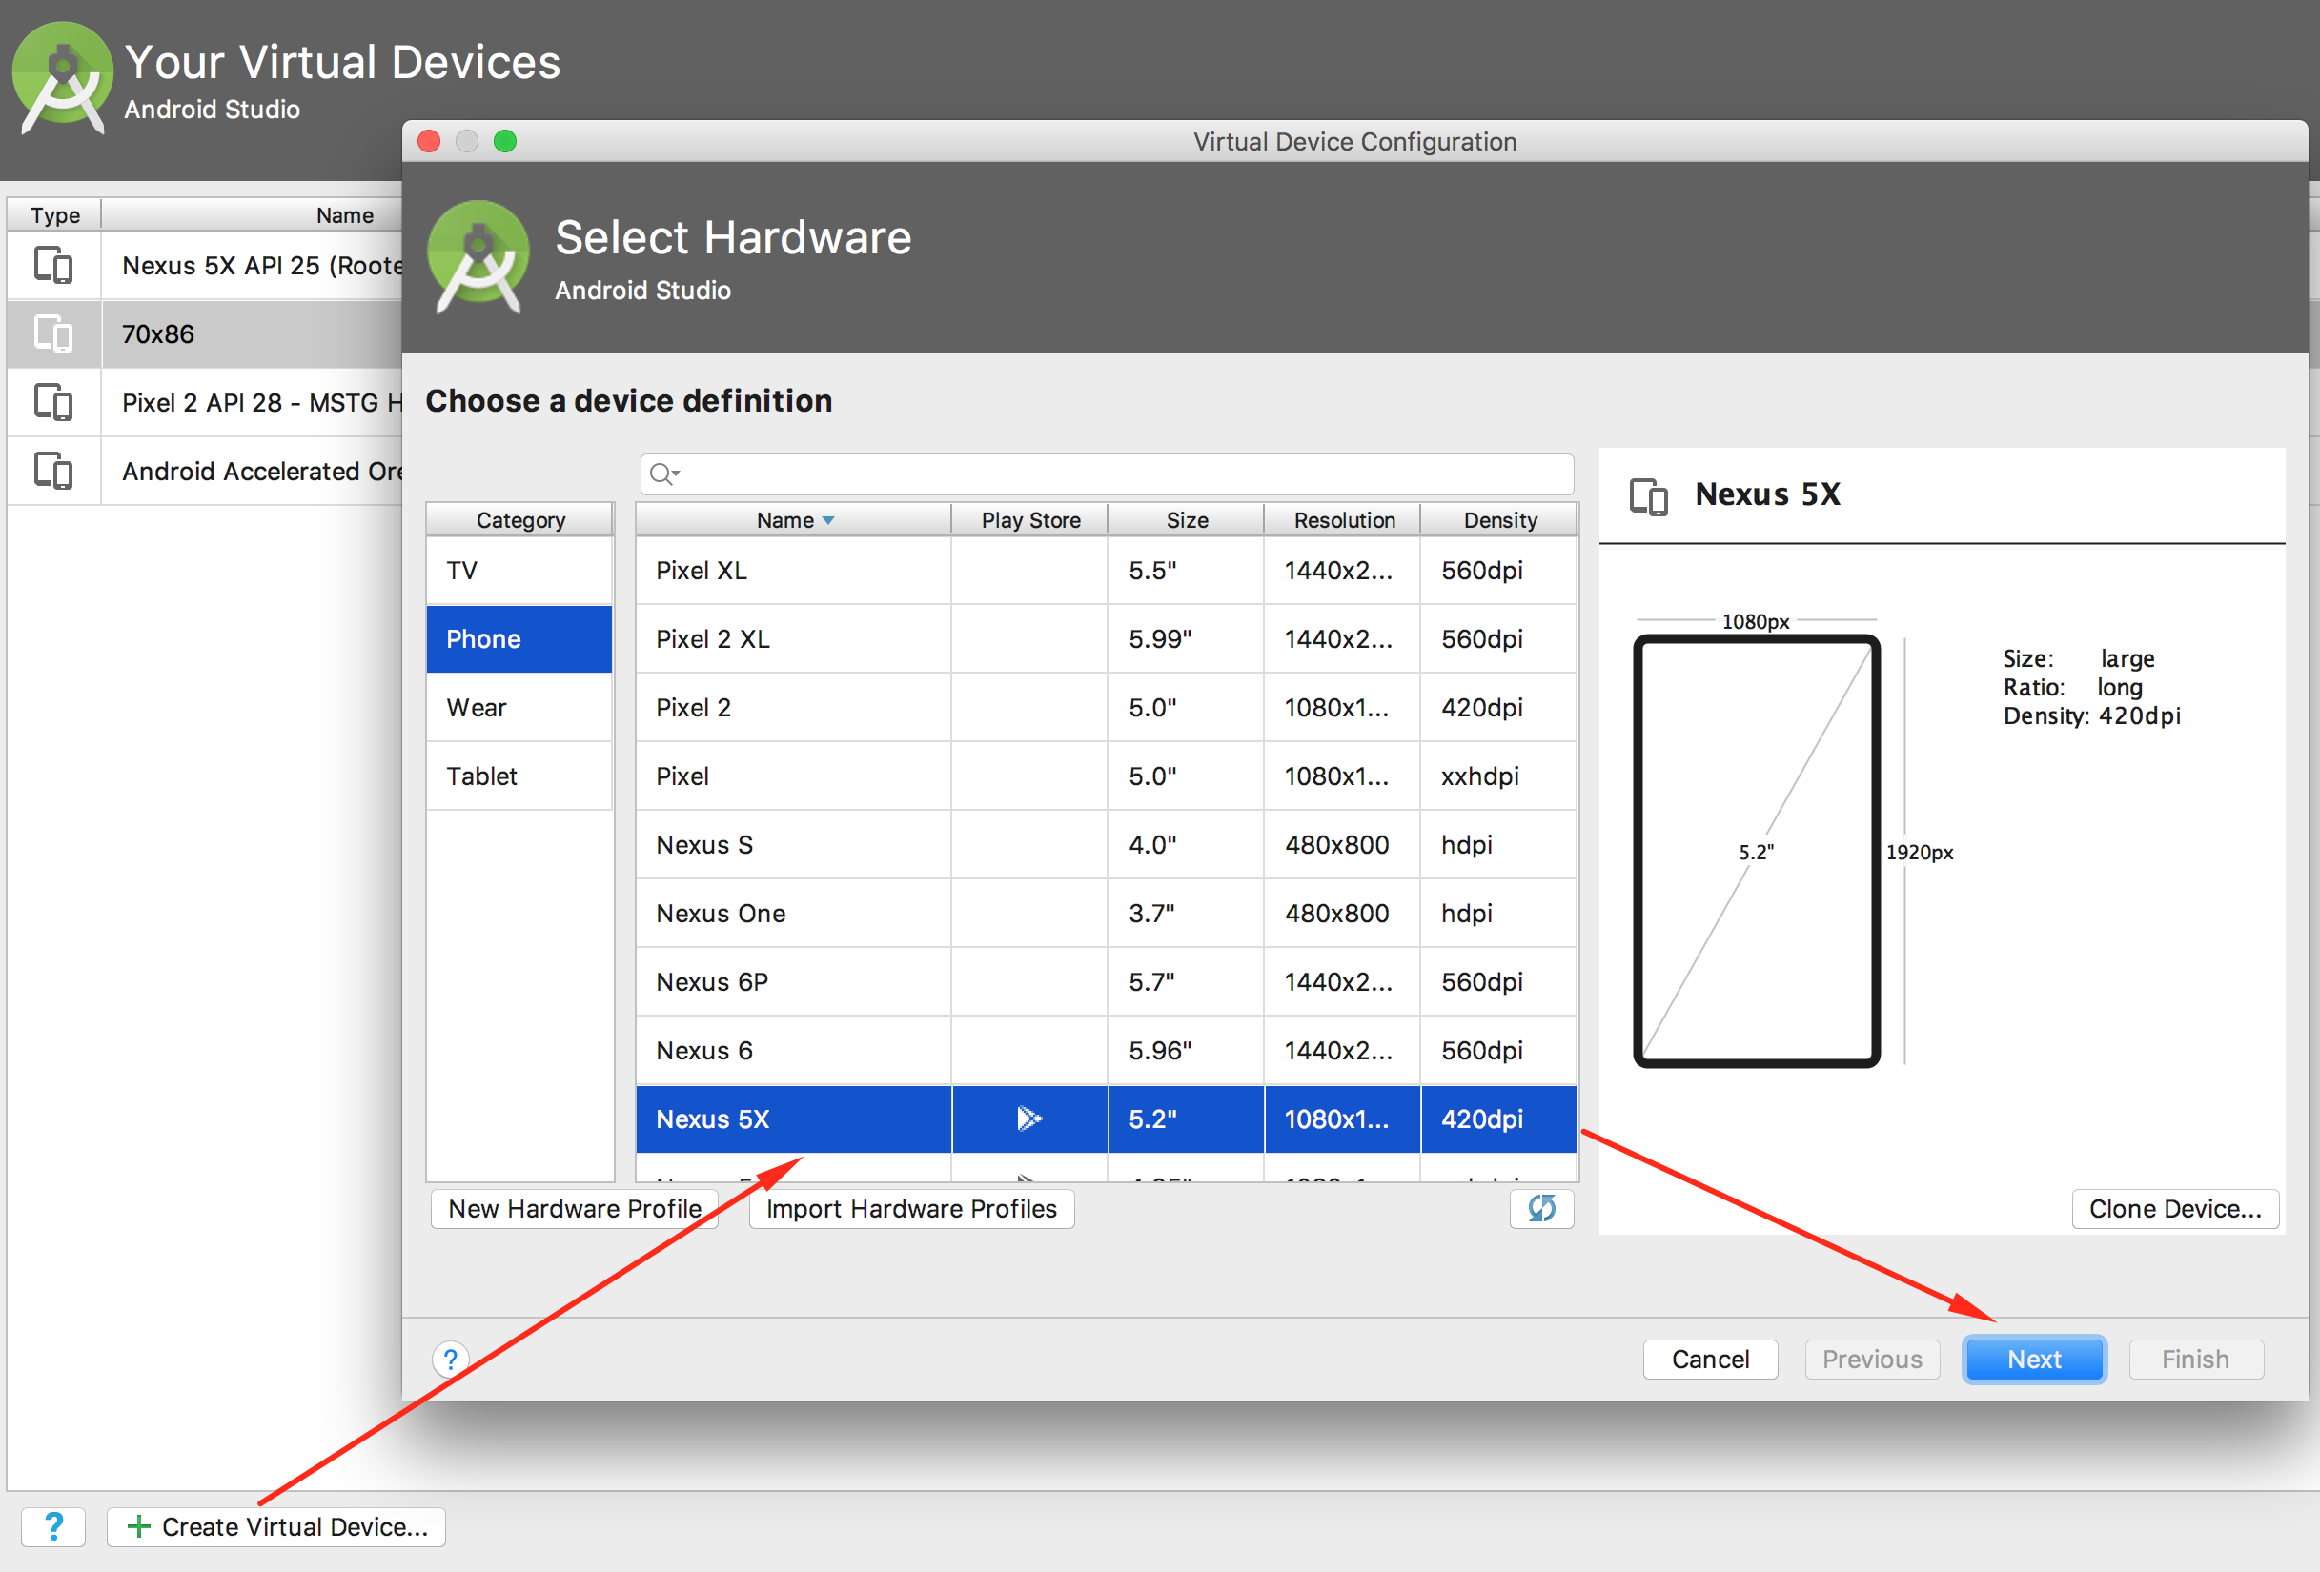
Select Nexus 5X

Slide 7
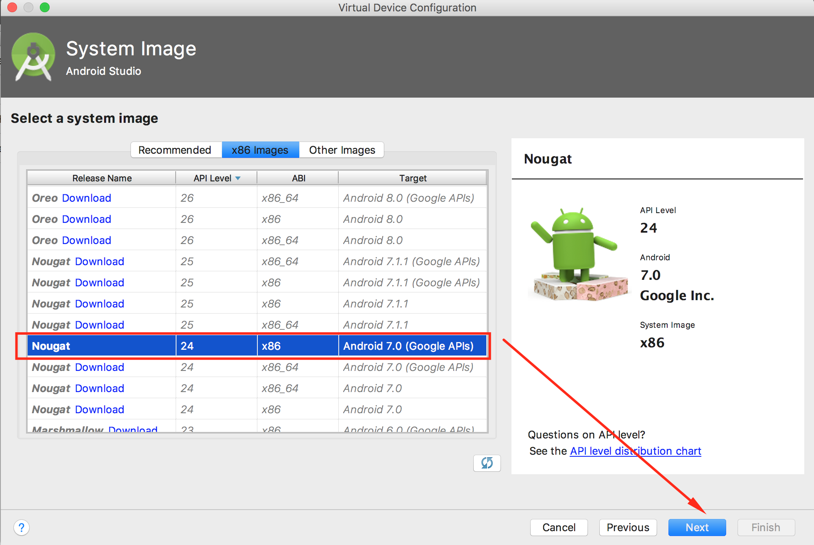
Download Nougat

Slide 8
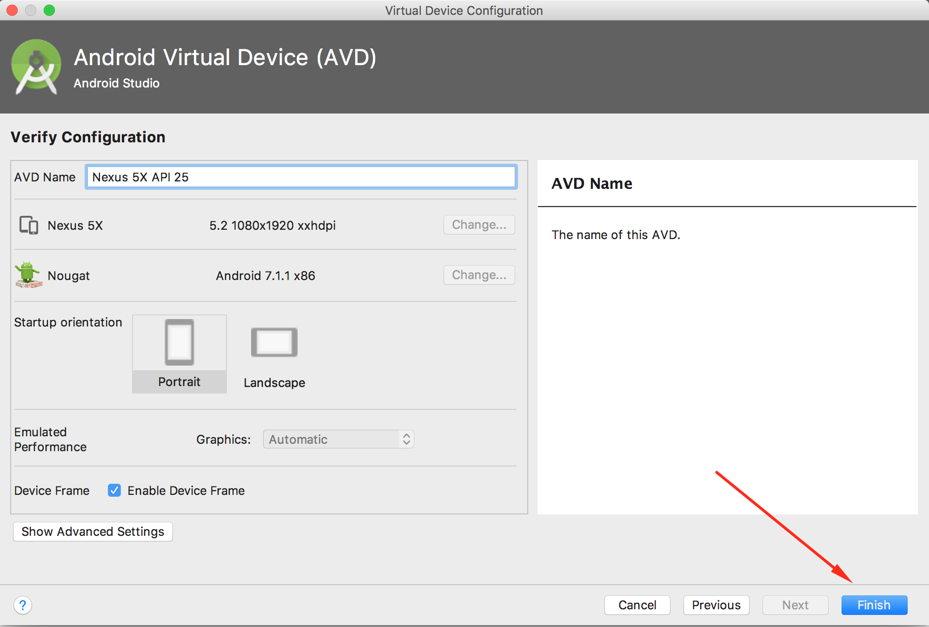
Finish

Slide 9
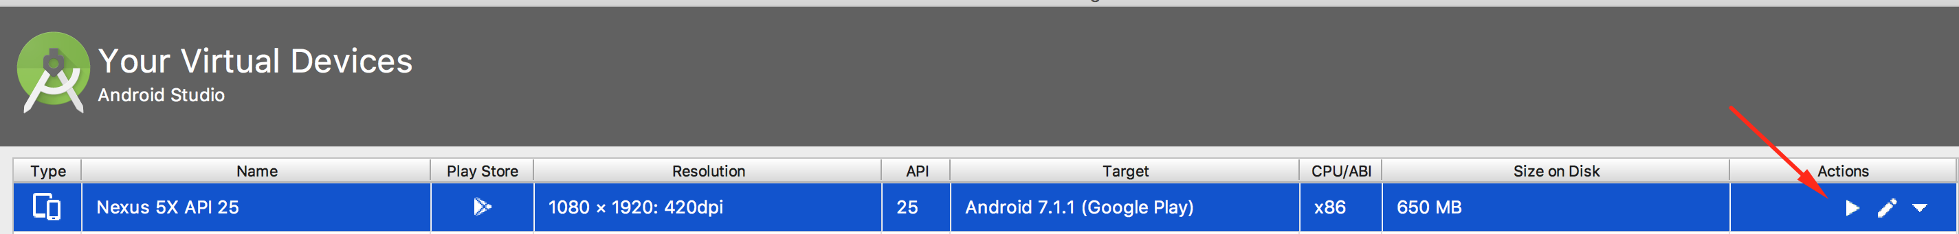
Start the new AVD (Might take a few minutes)

Slide 10
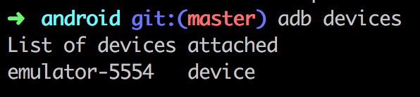
Check if adb is installed and if the emulator can be found
Otherwise install ADB now for your platform:
https://www.xda-developers.com/install-adb-windows-macos-linux/

Slide 11
Checkout the Github repo for OWASP Bay Area Workshop
$ git clone https://github.com/sushi2k/OWASP-Bay-Area/
$ cd OWASP-Bay-Area/android

Slide 12
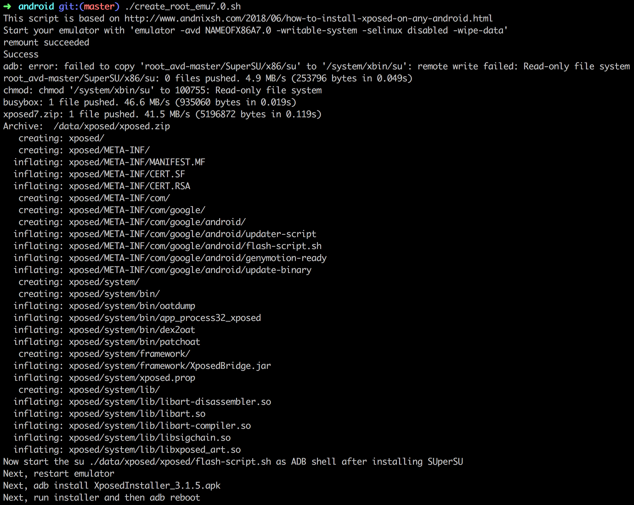
Execute the shell script create_root_emu7.0.sh

Slide 13
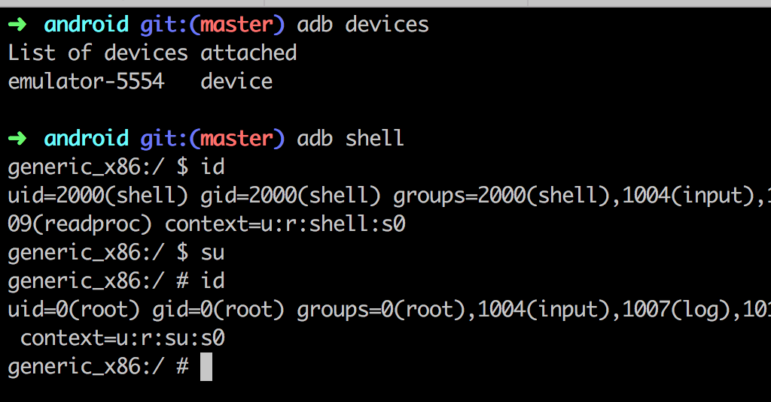
Close the Android Emulator and start it again. You have now root access when connecting via adb

Slide 14
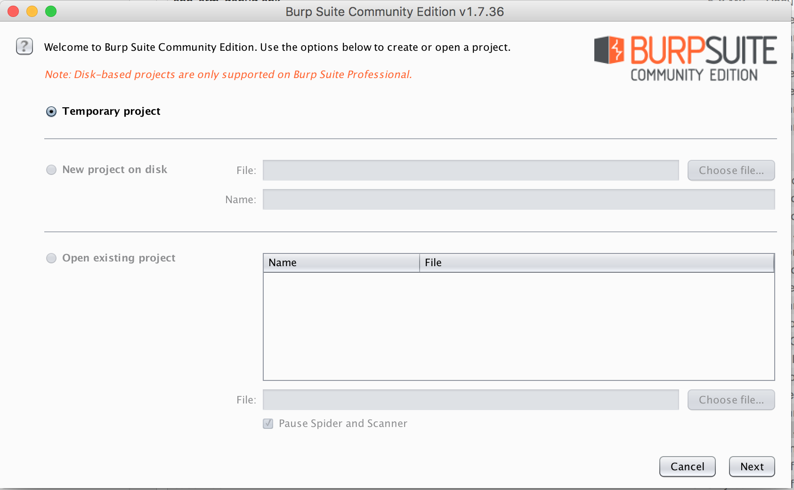
Start Burp Suite and create a temporary project

Slide 15
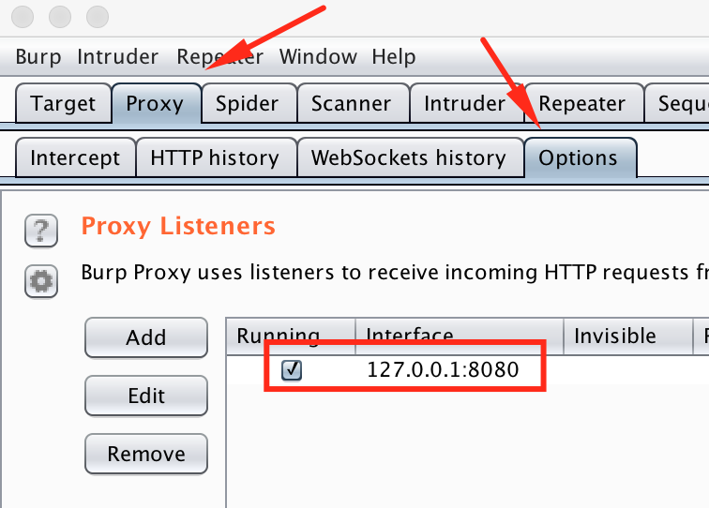
Check if the Proxy Server from Burp is running on port 8080

Slide 16
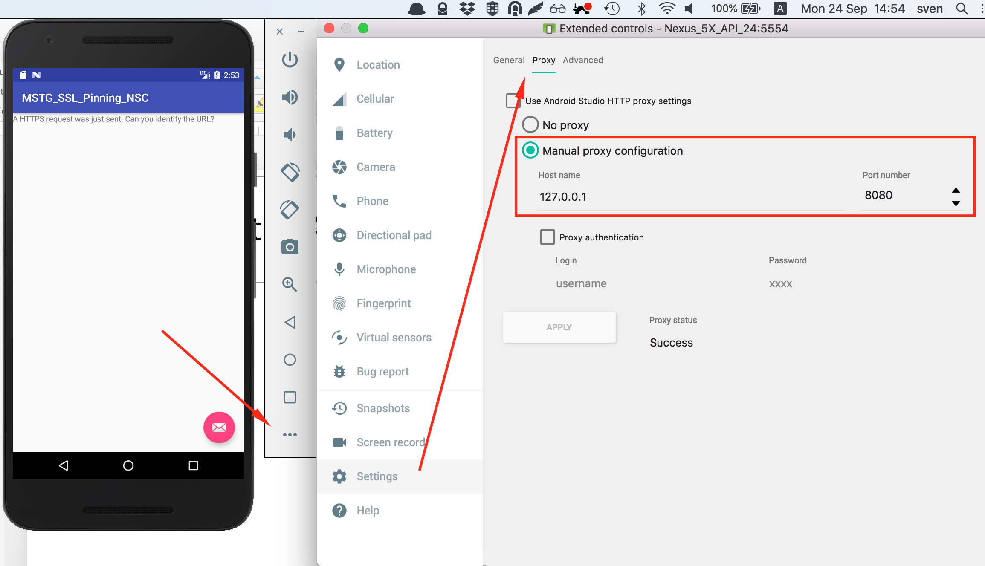
Configure the AVD to use Burp as Proxy

