Slide 1
Preparation for OWASP Bay Area Workshop

Slide 2
Checkout our Github Repo
https://github.com/sushi2k/OWASP-Bay-Area/
Please note: It’s around 5 GB!

Slide 3
Install MobSF
https://github.com/MobSF/Mobile-Security-Framework-MobSF
Easiest is using docker:
$ docker pull opensecurity/mobile-security-framework-mobsf
$ docker run -it -p 8000:8000 opensecurity/mobile-security-framework-mobsf:latest
Open 127.0.0.1:8000 in your browser, you should be able to see now MobSF

Slide 4
Download Burp Suite
Please make sure you have JRE (java 8!) installed!
Download the community edition
https://portswigger.net/burp/communitydownload

Slide 5
Install Objection
Please install objection
https://github.com/sensepost/objection/wiki/Installation
Please check the prerequisites
https://github.com/sensepost/objection/wiki/Installation#prerequisites
Install objection in a virtual environment, then your local installation of Python and Pip is not changed
https://github.com/sensepost/objection/wiki/Installation#virtual-installation

Slide 6
Install Android Studio
https://developer.android.com/studio/install
Next, use the sdkmanager to download the SDK and AVD for Android 7 (API level 24) for Android 8 (api lvl 26), using an x86 image. (NOT X86-64!)

Slide 7
Create AVD (Android Virtual Device)
Go into the Github repo:
$ cd OWASP-Bay-Area/android/
Copy the android8.zip to your AVD folder and unzip it (macOS)
$ cp anroid8.zip /Users/<your username>/.android/avd
$ unzip android8.zip
On Windows the folder will be:
C:\Documents and Settings{your windowslogin}\.android\avd\

Slide 8
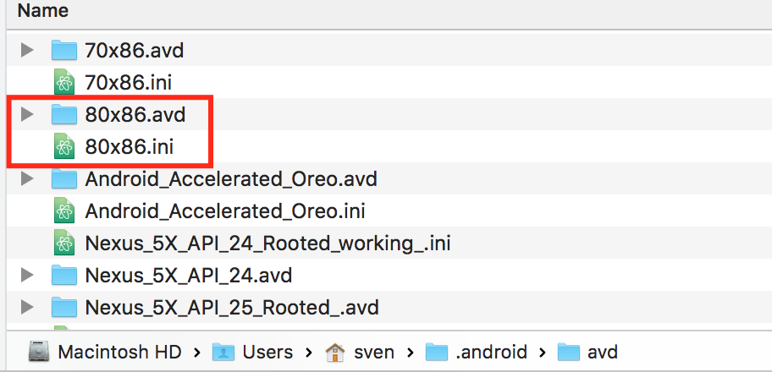
Create AVD (Android Virtual Device)
It should look now like this:

Slide 9
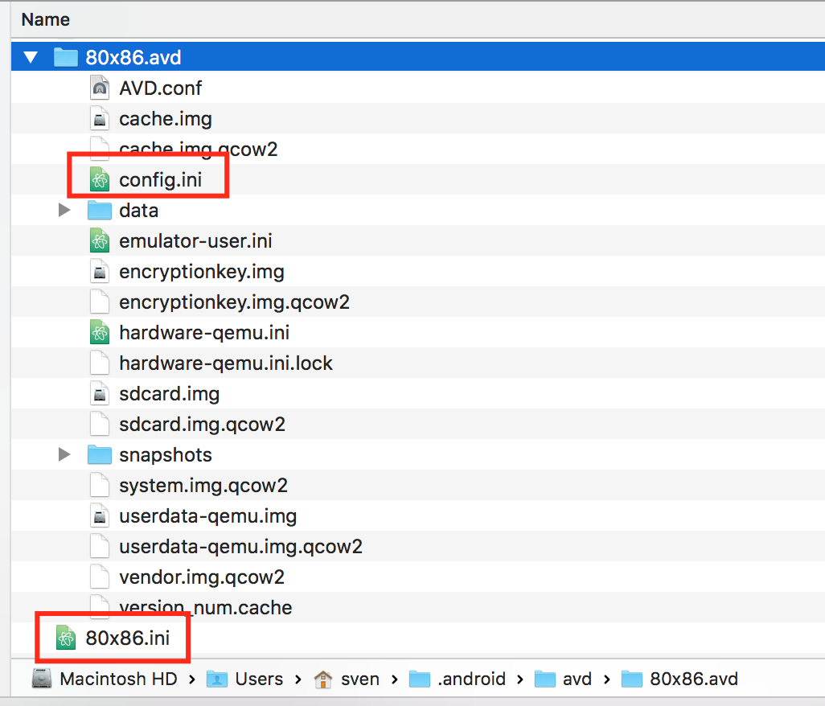
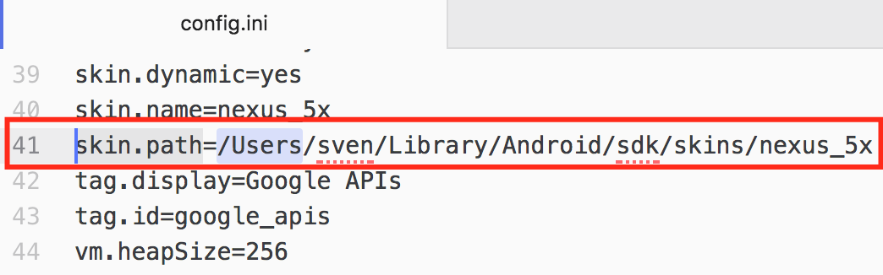
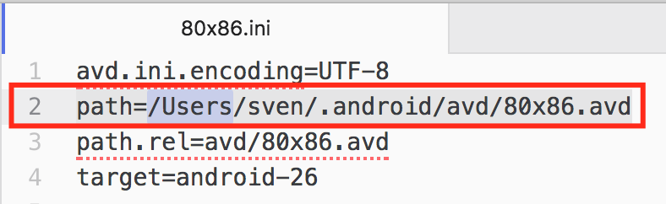
Create AVD (Android Virtual Device)
Now you need to change the path in config.ini and 80x86.ini
Change the path to your actual path on your machine:
Change the path to your actual path on your machine:

Slide 10
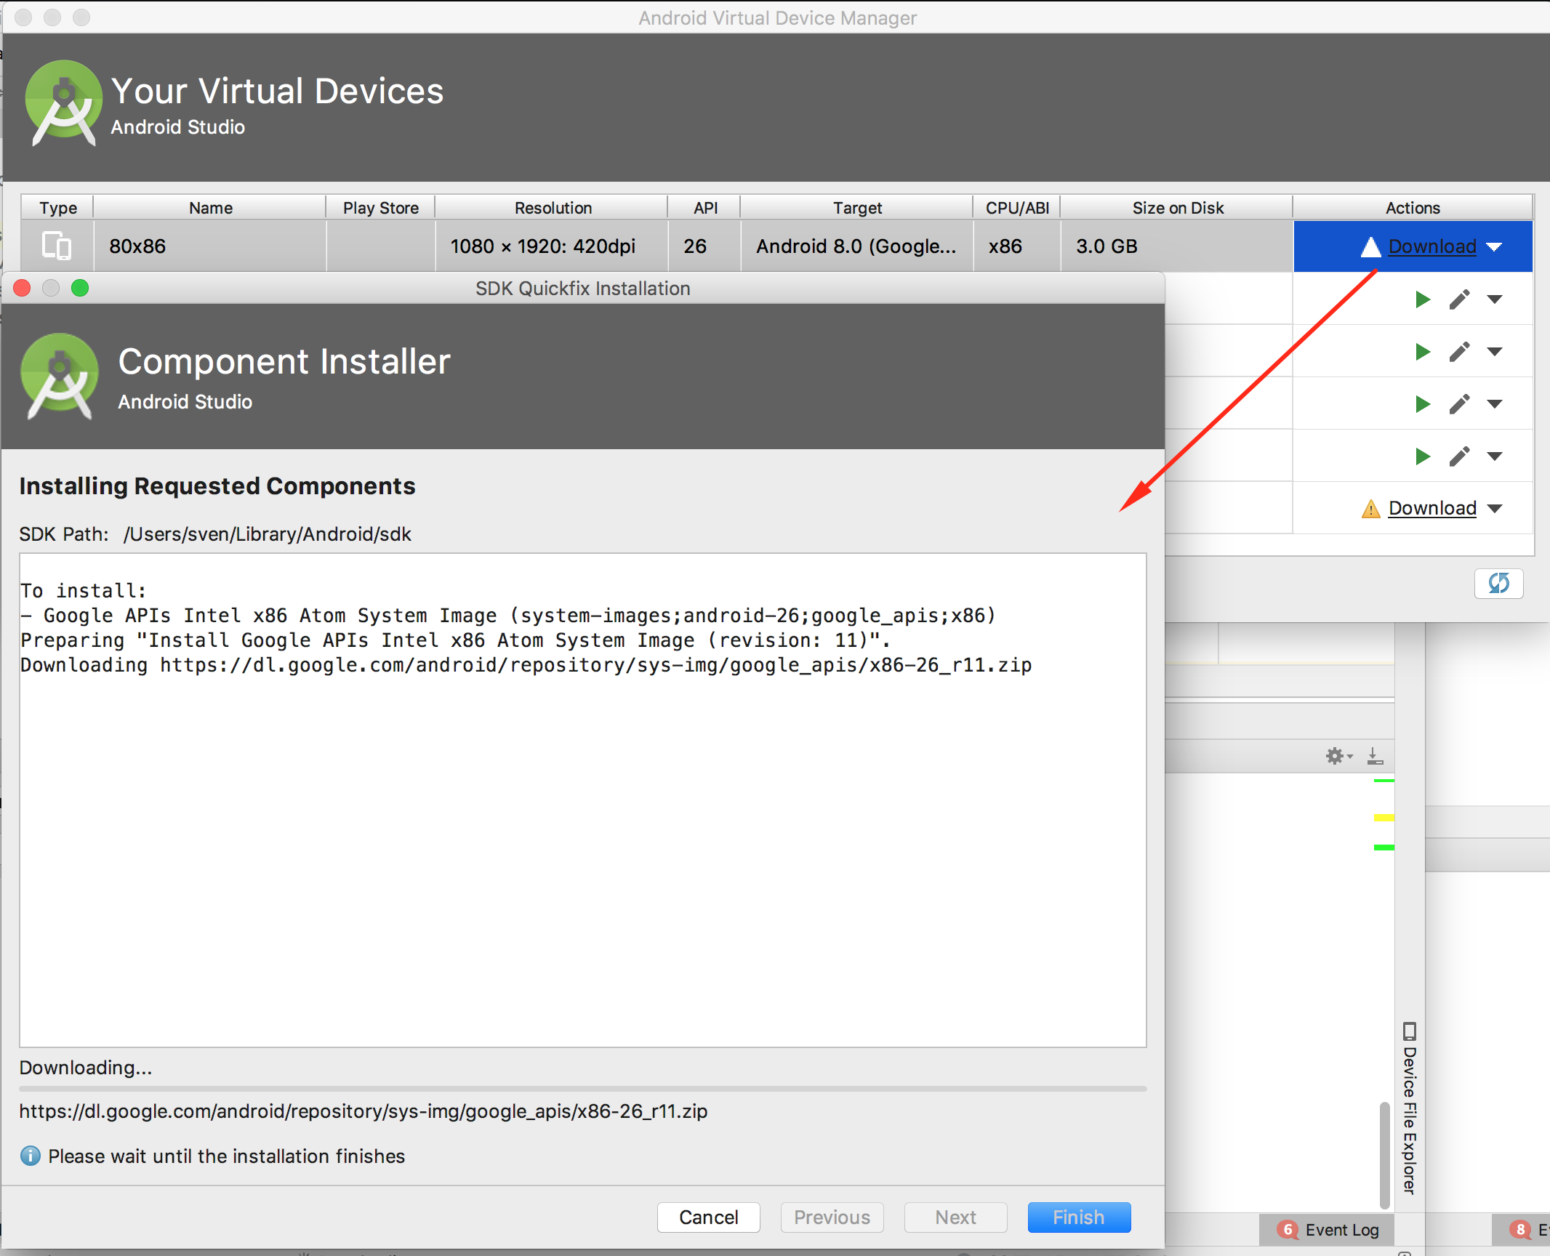
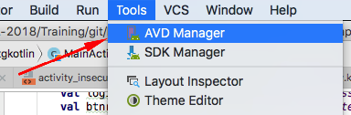
Create AVD (Android Virtual Device)
Please make sure that the image for the AVD is downloaded.
Go to Android Studio
Go to Tools / AVD Manager
Select 80x86 and click on Download
The system image used by this AVD will now be downloaded, if it wasn’t downloaded before

Slide 11
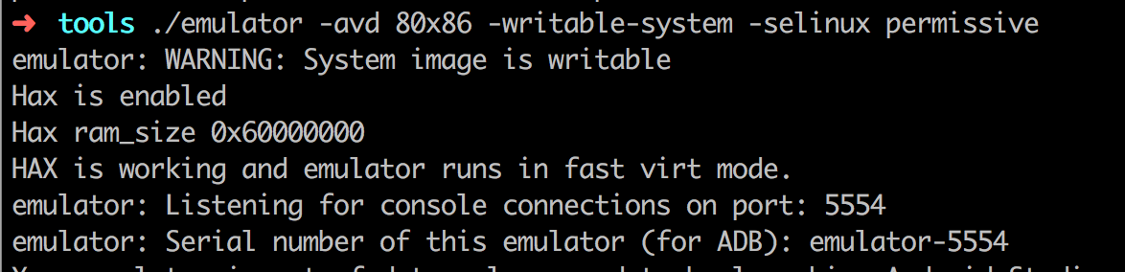
Create AVD (Android Virtual Device)
Next we start our AVD
Go to the Android SDK directory and go tools. There you will find the ‘emulator’ command. It’s located in: /Users/sven/Library/Android/sdk/tools (macOS)
Let’s start our emulator with two custom flags
In case you get an error like this, set the ANDROID_SDK_ROOT
Let’s start the AVD
export ANDROID_SDK_ROOT=/Users/<Username>/Library/Android/sdk
$ emulator -avd 80x86 -writable-system -selinux permissive
We need to start it with both flags!

Slide 12
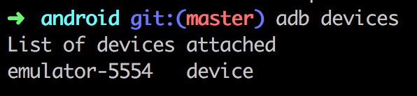
Check if adb is installed and if the emulator can be found
Note: you can find adb in your $ANDROID_HOME/tools (e.g. on Mac OS X that can be /Users/<username>/Library/Android/sdk/tools). Add it to your PATH to make it reachable everywhere.
Still in trouble? Follow the instructions here:
https://www.xda-developers.com/install-adb-windows-macos-linux/

Slide 13
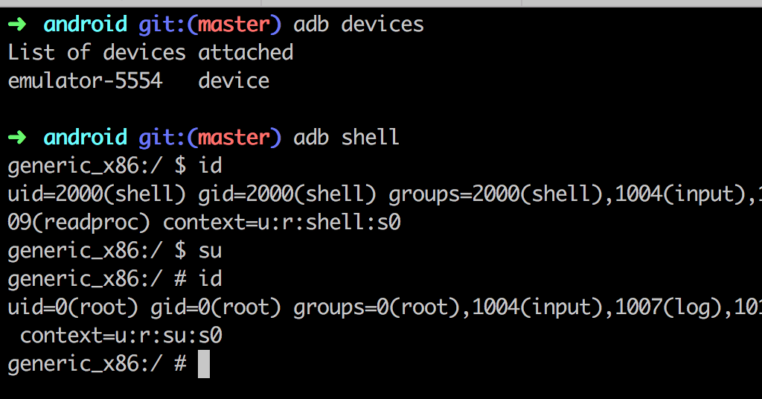
Check the root access on the emulator

Slide 14
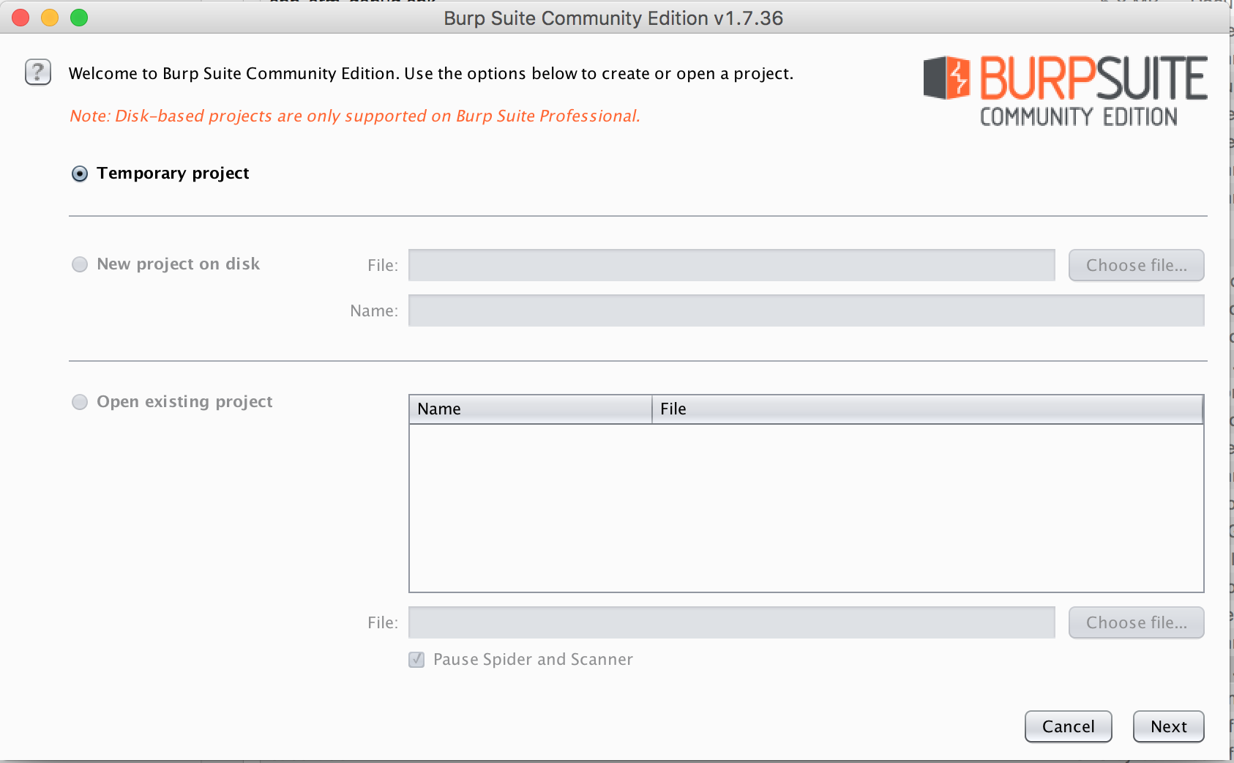
Start Burp Suite and create a temporary project

Slide 15
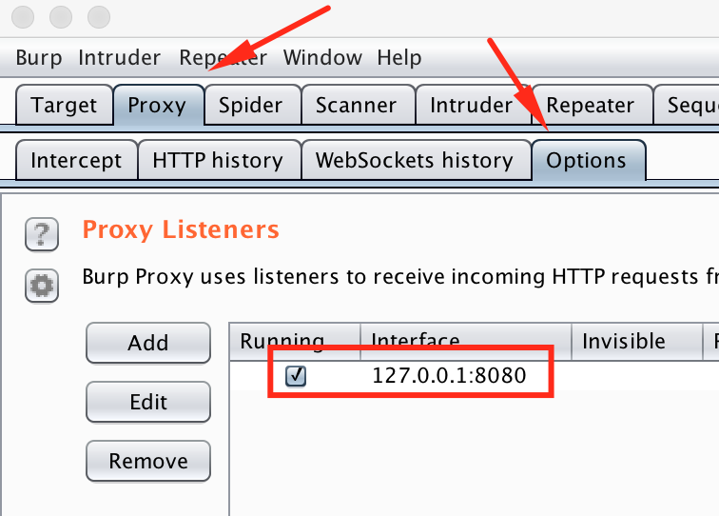
Check if the Proxy Server from Burp is running on port 8080

Slide 16
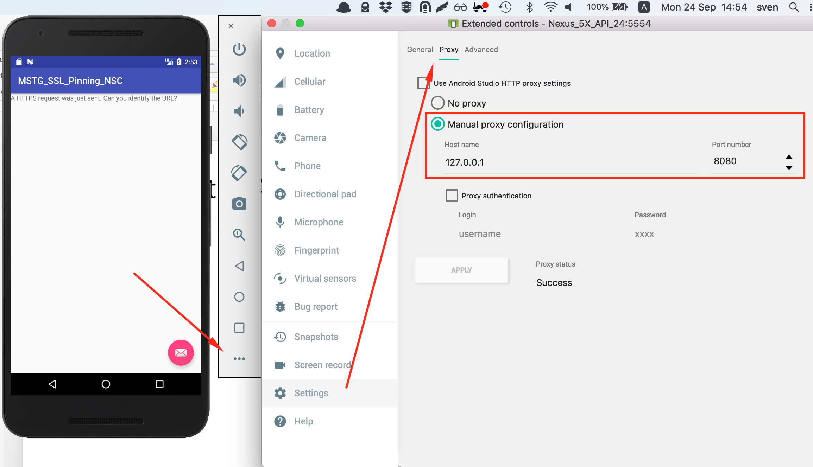
Configure the AVD to use Burp as Proxy

Slide 17
Install apktool & dex2jar
Apktool: https://ibotpeaches.github.io/Apktool/install/
Dex2jar: https://github.com/pxb1988/dex2jar
Jadx: https://github.com/skylot/jadx
apkx: https://github.com/b-mueller/apkx

Slide 18
OPTIONAL PART
This is not needed for the workshop but should be done if you want to explore HTTPS traffic with Burp!

Slide 19
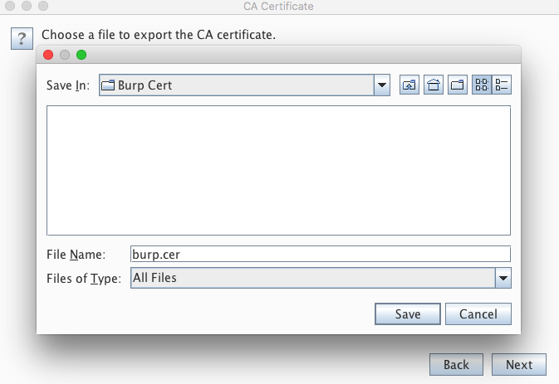
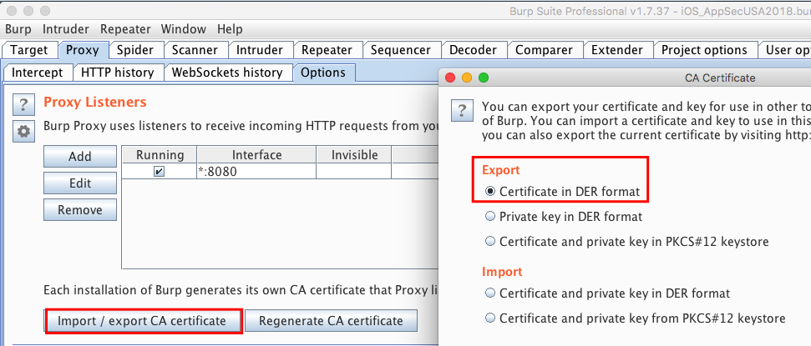
Prepare the CA Certificate of Burp
Open ”Proxy/Options” and click on Import/Export CA Certificate” and export it in der format.
Save the file as “burp.cer” (NOT DER!)
Next push this certificate to the Emulator

Slide 20
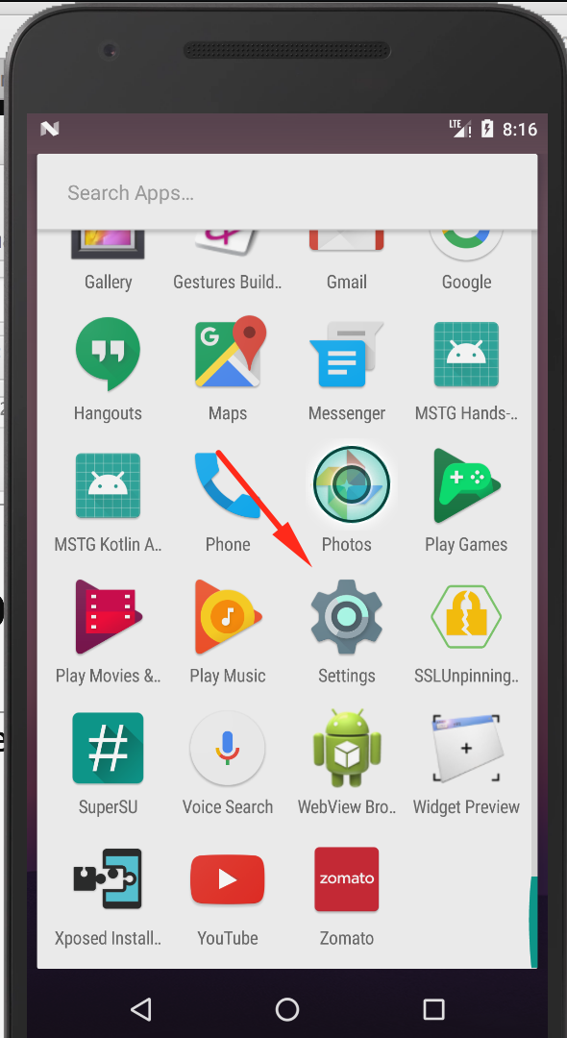
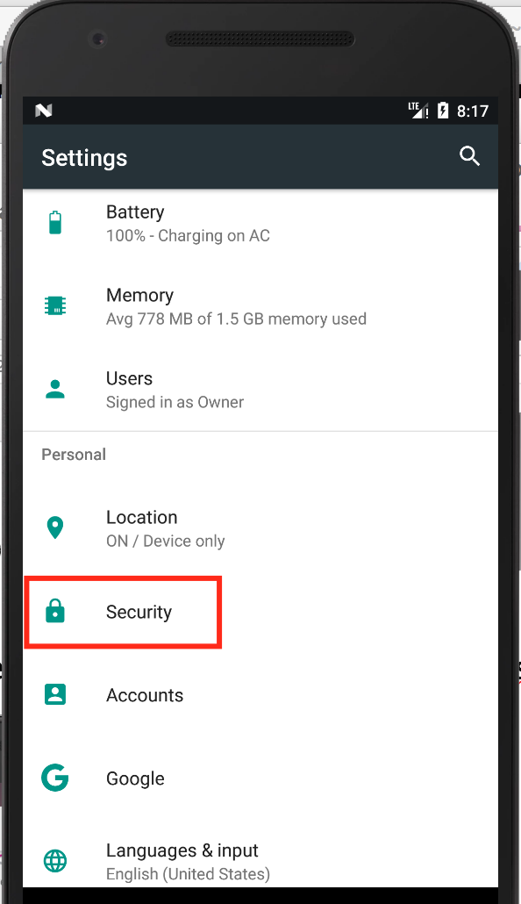
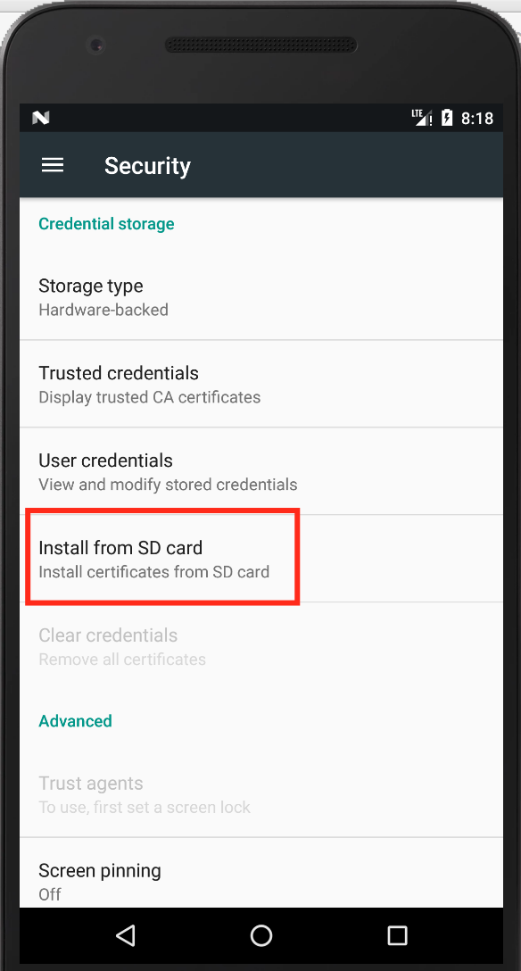
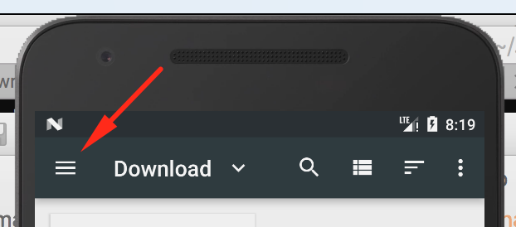
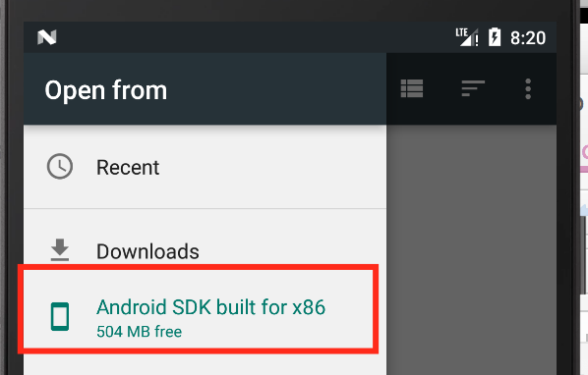
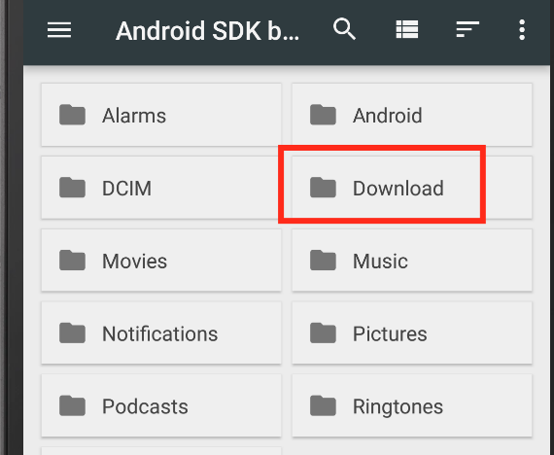
Prepare the CA Certificate of Burp
Next we need to import the CA into our trustore on the emulator:

Slide 21
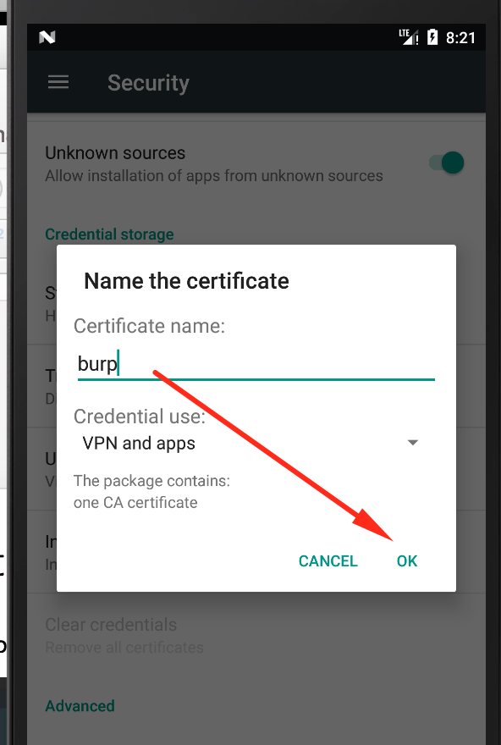
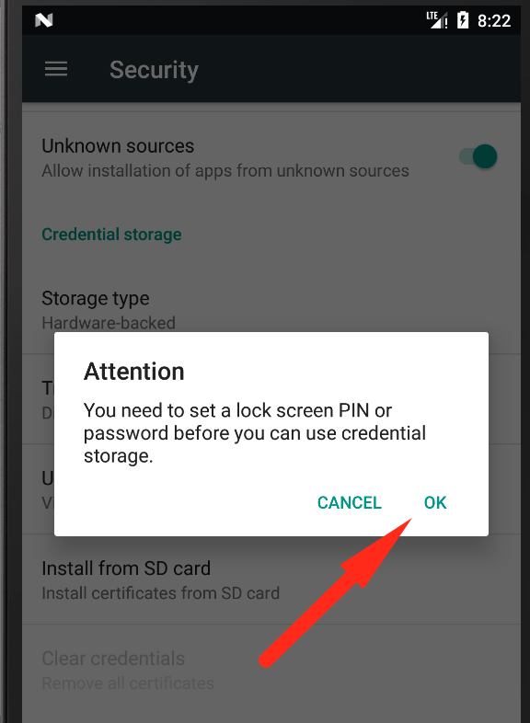
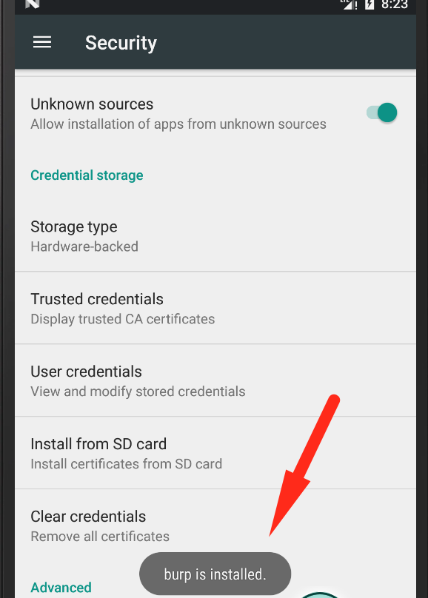
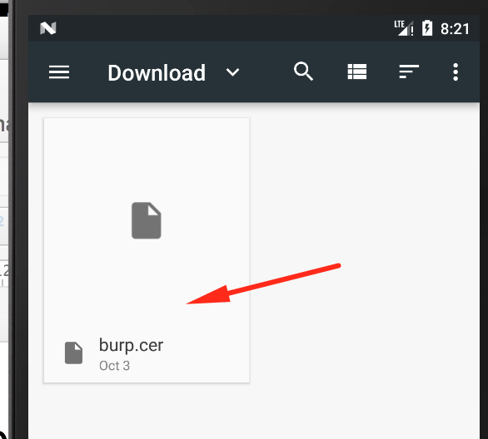
Prepare the CA Certificate of Burp
Next we need to import the CA into our trustore on the emulator:
Now you are able to also intercept HTTPS traffic in Burp!

