Slide 1
Autonomous/user drone control with augmented reality implementation
Bogdan Stanciu
City University London

Slide 2
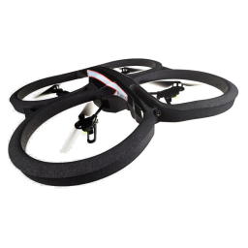
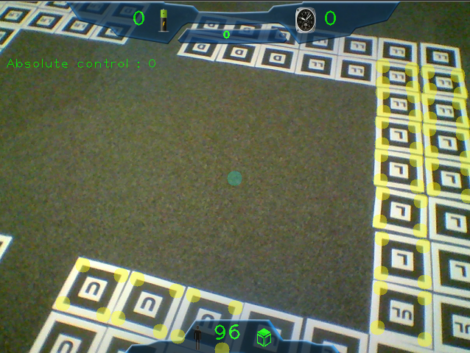
Project Structure
1. Systems integration (drone)
2. Game implementation

Slide 3
System integration (drone)
Initial aim:
Hex-Copter drones – still in development
Achieved:
User drone control – cvDrone library
Boundaries – OpenCV, ARma library
Autonomous drone control

Slide 4
System integration (drone)
Limitations:
Drone
Low res camera
Low Lightning conditions
FPS – network speed
Room and drone size – turbulences
Skips frames
Inability to recognise patterns
3rd party dependencies

Slide 5
Systems integration (drone) demo

Slide 6
Game implementation
Initial aim:
Hex-Copter drones interactions – Augmented Reality game
Achieved:
Augmented reality interaction
Pattern recognition
OpenCV drawing
Game logic
Sea rescue inspired game

Slide 7
Game implementation
Limitations:
Inability to use both cameras simultaneously
Low res vertical camera
OpenCV basic drawing
Time constraints
Resources
Room dimensions
Financial constraints

Slide 8
Game implementation demo

Slide 9
Further development
Smoother drone controls
Better pattern recognition
More advanced game
Project beneficieries
Open source
Parrot AR.Drone 2.0 owners

Slide 10
Questions?

