Slide 1
Autonomous/user drone control with augmented reality implementation
Bogdan Stanciu
City University London

Slide 2
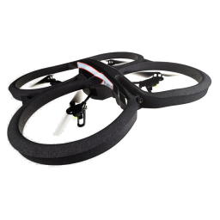
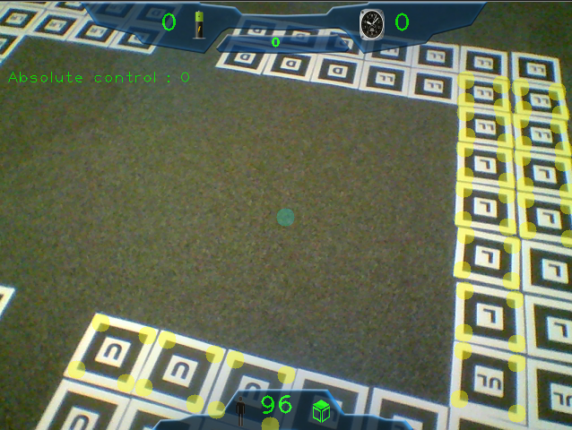
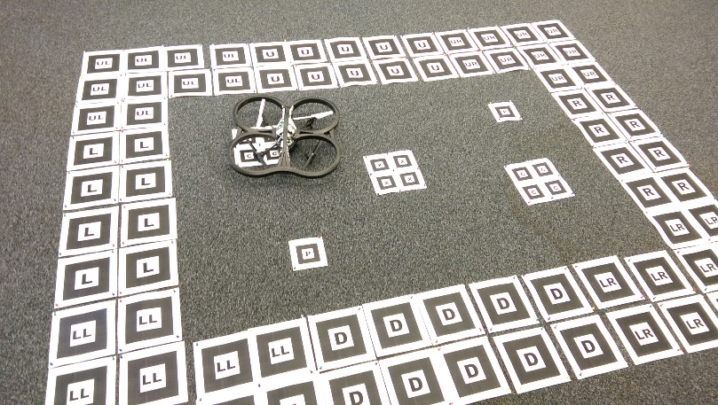
Project Structure
1. Systems integration (drone)
2. Game implementation

Slide 3

Development
Planning
Testing
GitHub

Slide 4
System integration (drone)
Initial aim:
Hex-Copter drones – still in development
Achieved:
User drone control – cvDrone library
Boundaries – OpenCV, ARma library
Autonomous drone control

Slide 5
System integration (drone)
Limitations:
Drone
Low res camera
Low Lightning conditions
FPS – network speed
Room and drone size – turbulences
Skips frames
Inability to recognise patterns
3rd party dependencies

Slide 6
Systems integration (drone) demo

Slide 7
Game implementation
Initial aim:
Hex-Copter drones interactions – Augmented Reality game
Achieved:
Augmented reality interaction
Pattern recognition
OpenCV drawing
Game logic
Sea rescue inspired game

Slide 8
Game implementation demo

Slide 9
Game implementation
Limitations:
Inability to use both cameras simultaneously
Low res vertical camera
OpenCV basic drawing
Time constraints
Resources
Room dimensions
Financial constraints

Slide 10
Further development
Smoother drone controls
Better pattern recognition
More advanced game
Project beneficieries
Open source
Parrot AR.Drone 2.0 owners

Slide 11
Questions?

