Slide 1
Compiler
Team Anacondas

Slide 2
About compiler and team members
Compiler: From JavaCode to PythonCode
Team members:
Rustam Boranov
Shokubassov Amir
Elnur Tazhimbetov
Pan Danil
Abylkairov Marat

Slide 3
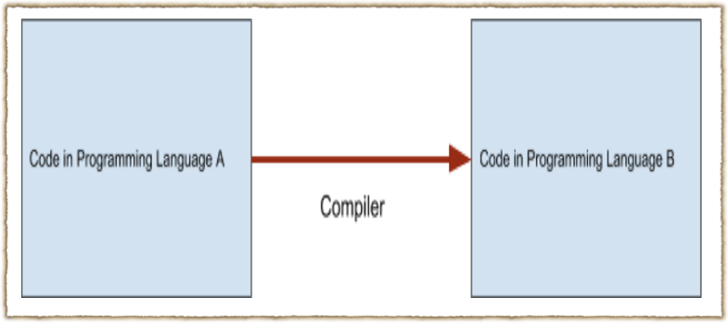
Visualization
Java
Python

Slide 4
Architecture
Our compiler consist of 3 steps:
1) Tokenizer - divide our code into tokens, that have type and value. F.e token «+», type ‘arithmetic’, value ‘+’
2) Parser - creation of AST
3) Code generator - generate code from AST to Python code

Slide 5
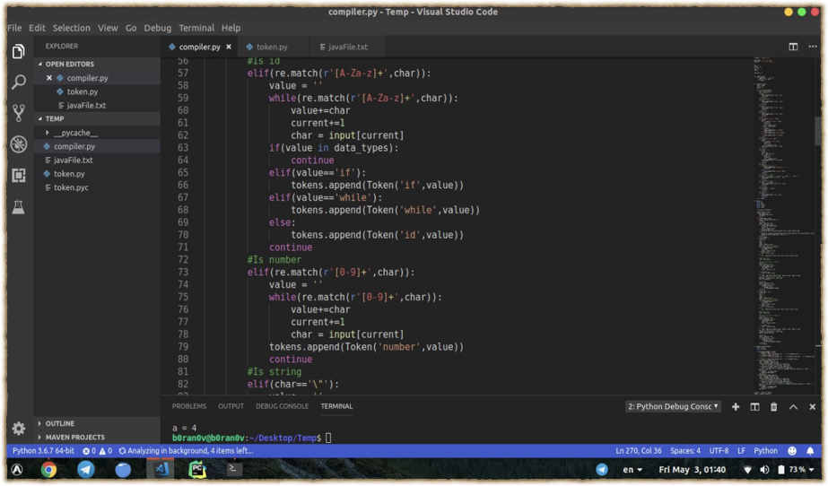
Tokenize

Slide 6

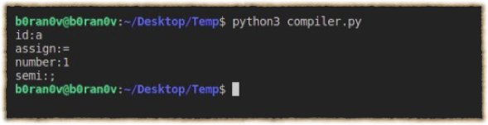
Output
Input
Output

Slide 7
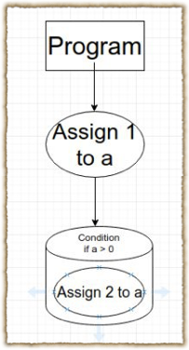
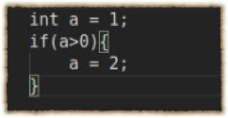
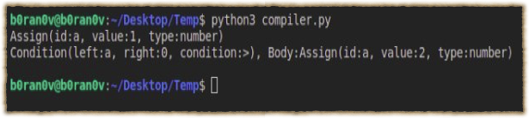
Parsing
Input
AST

Slide 8
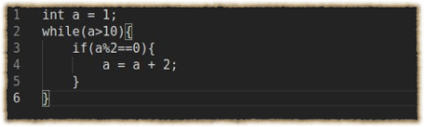
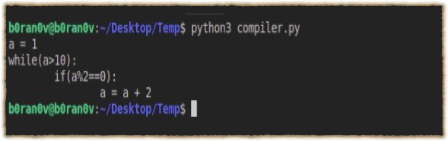
Code Generation
Java
Python

Slide 9
Thank for you attention!

