Slide 1

GabAI
A safety companion
for Marinduque
Preparedness that stays close, even offline
GabAI
01
Notes:
0:40 | Imagine needing guidance during an emergency when the internet is unreliable. GabAI is a safety companion designed for Marinduque. It brings preparedness guidance, local emergency contacts and an assistant into one mobile app. Our goal is to make useful information easier to reach before a crisis and during the first moments of one.

Slide 2

The problem
In an emergency, finding the next step should be simple
Information is scattered
People may need to search across messages, websites and contact lists while under pressure.
Connectivity can be uncertain
A useful safety tool must still provide core guidance when a connection is unavailable.
GabAI
02
Notes:
0:50 | Emergencies create a difficult information problem. People need to know what to do, whom to call and what information to share, often while stressed. That information may be scattered among websites, social media posts and personal contact lists. Connectivity can also be uncertain. Our design challenge is to make essential guidance accessible in a single place, including when the network is unavailable.

Slide 3
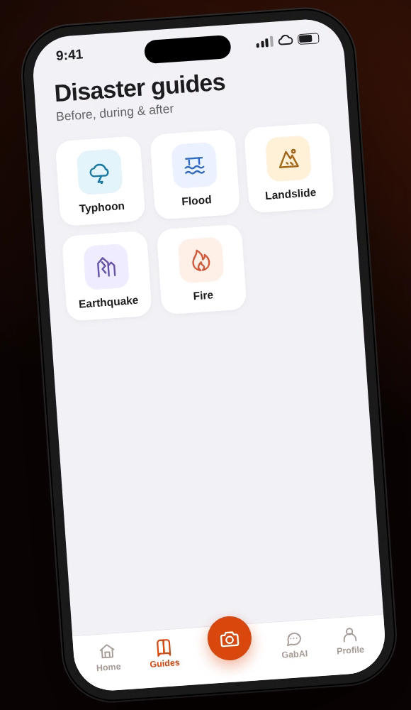
The solution
An offline-first companion built around local needs
Guidance at hand
Bundled disaster and first-aid guides remain available offline.
Local help within reach
Emergency contacts are organized by location, with a manual fallback.
Guide content and hotline numbers require authority review before release.
GabAI
03
Notes:
0:55 | GabAI brings the core safety journey into one app. Bundled guides cover hazards and first aid, so the guidance can be opened offline. The emergency directory organizes contacts around the user’s location and provides a manual fallback. The screen shown is a product preview. The guide content and hotline directory are drafts and must be reviewed by the appropriate medical and disaster-risk authorities before release.

Slide 4
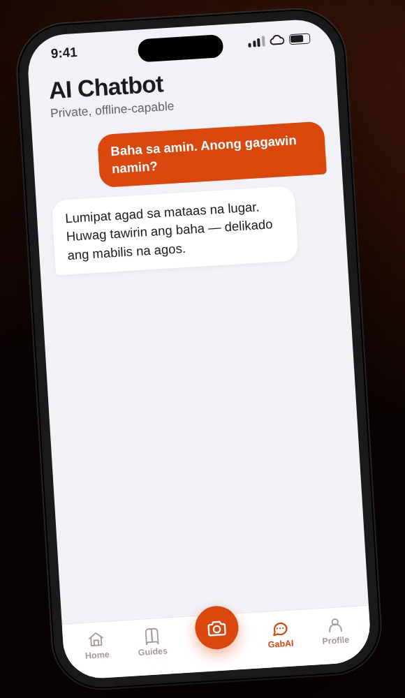
A companion that
can answer questions
Ask in natural language
The assistant can use cloud AI, an optional on-device model, or bundled guide retrieval.
Built for continuity
When a preferred service fails, GabAI can fall back and tell the user which source answered.
GabAI
04
Notes:
0:55 | The assistant adds a conversational way to access information. Users can choose cloud AI, a custom backend or an optional model downloaded to a supported device. If the preferred service is unavailable, the app can fall back to an on-device model or bundled guide retrieval, and explains the source of the answer. This is support for navigating information, not a substitute for emergency responders or professional medical care.

Slide 5
Who GabAI serves
Start in Marinduque, with community partners
Residents and families
A single place to prepare, find guidance and locate emergency contacts.
Local institutions
LGUs, schools and community organizations can support outreach and local validation.
GabAI
05
Notes:
0:50 | Our first users are residents and families in Marinduque who want useful safety information close at hand. Local governments, schools and community organizations are potential partners because they already help communities prepare. A focused local pilot gives us a practical way to validate the content, test usability and understand whether people can find the right information quickly. Expansion beyond the pilot would depend on those results.

Slide 6
Proposed business model
Keep essential access free for residents
Residents
Institutional partners
Sustainability
Free access to core safety guides and emergency contacts
LGUs or organizations fund deployment, outreach and local content maintenance
Pilot grants or sponsorships support review, updates and support
This model is a proposal to validate with partners. Pricing and contracts are not yet established.
GabAI
06
Notes:
0:55 | We propose keeping essential safety information free to residents. The potential paying customer is an institution such as a local government or community organization that wants to support deployment, outreach and the upkeep of local content. Pilot grants or sponsorships could help fund the initial work. This is a proposed model rather than an existing revenue claim. We would validate willingness to pay, operating costs and procurement requirements with partners before setting a price.

Slide 7
Target impact
Measure whether people can use GabAI when it matters
Access
Readiness
Trust
Can users open essential guides without a network?
Can users find the relevant guide and emergency contact?
Do users understand the source and limits of an answer?
Pilot measures: task completion, time to find information and user feedback
These are proposed measures, not results.
GabAI
07
Notes:
0:55 | Our intended impact is better access to useful safety information and stronger preparedness. We would evaluate the pilot with observed tasks rather than assume that downloads equal impact. Can someone open a guide offline? Can they find an appropriate contact? Do they understand where an answer came from? We would record completion, time to find information and user feedback, then use the findings to improve the product. These are proposed measures, not results already achieved.

Slide 8
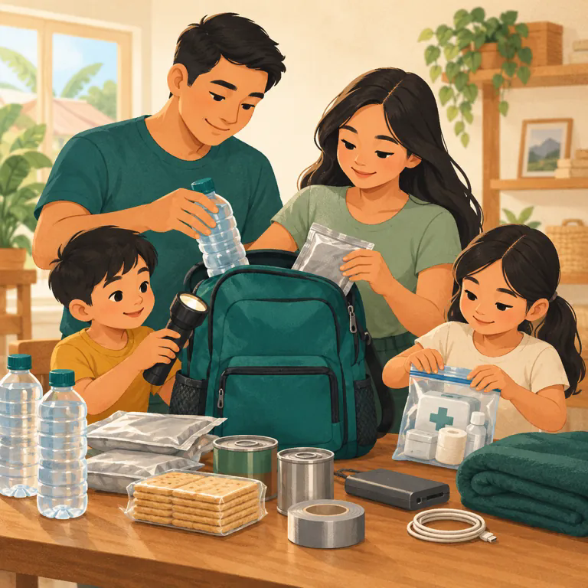
Let’s pilot GabAI
in Marinduque
We are seeking partners for:
Content and hotline verification
Community testing and outreach
Pilot funding and feedback
Together, we can put practical safety information closer to the people who need it.
GabAI
08
Notes:
0:50 | GabAI has a working foundation, and our next step is a responsible pilot in Marinduque. We are looking for partners who can review the safety content and contact directory, help us test with residents, and support a pilot. The immediate outcome we seek is evidence: whether the app is usable, trusted and helpful in local conditions. We invite you to help us validate GabAI with the community and build the path to a responsible release.

