Slide 1

CHAPTER THREE
Ebusiness:
Electronic Business Value
Notes:
CLASSROOM OPENER
GREAT BUSINESS DECISIONS – Edwin Land Develops the Polaroid Camera
In 1937, Edwin Land started a company that made a polarizing plastic and named it Polaroid. The business boomed. Land was taking family pictures on his vacation in 1943 when his three-year-old daughter asked why they had to wait so long to see the developed photographs. Land was struck with the idea of combining the polarization technology with developing films. By 1950, Land had a camera that produced black-and-white images and by 1963, he released a camera that produced color pictures. The Polaroid camera took off and by the late 1960s, it was estimated that 50 percent of American households owned one.
If Polaroid executives had used Porter’s Five Forces analysis would they have discovered the threat of substitute products of the digital camera?
What could they have done to combat this threat?

Slide 2
Chapter Three little case
1937年，Edwin Land創立了一家製造偏光塑料的公司，並將其命名為Polaroid。 生意興隆。 1943年，Land在度假期間為全家福拍照，當時他三歲的女兒問為什麼他們必須等這麼長時間才能看到顯影的照片。震驚了Land將Polaroid技術與膠卷顯影相結合的想法。 到1950年，Land擁有一台可產生黑白圖像的相機，到1963年，他發布了一款可產生彩色圖像的相機。 Polaroid相機開始騰飛，到1960年代後期，據估計有50％的美國家庭擁有一個。
如果Polaroid管理人使用了波特的五力分析，他們是否會發現數位相機替代產品的威脅？
他們可以做些什麼來應對這種威脅？

Slide 3
Chapter Three little case
一小時的膠卷底片沖洗和數位相機都是Polaroid的滅亡原因。 Polaroid是一家堅實的公司，擁有創新的技術和強大的客戶群。 Polaroid所面臨的難題是大多數組織所面臨的難題–組織用於為其當前制定企業決策的標準可能會給未來企業帶來問題。 從本質上講，最適合當前企業的業務從長遠來看可能會毀掉它。
在過去的幾年中，電子商務似乎已經滲透到日常生活的方方面面。 在短時間內，個人和組織都已採用Internet技術來提高生產力，最大化便利性，並改善全球通信。 本章重點介紹突破性技術，互聯網和電子商務流程，這些流程正在改變買賣雙方關係的本質、資訊科術的角色、組織結構、和任務。 本章還討論了發展電子商務所帶來的機會和優勢。 在本章中，突破性技術與電子商務之間建立了明確的關係。

Slide 4
Chapter Three Overview
SECTION 3.1 – Web 1.0 – Ebusiness
Web 1.0: Disruptive Technology
The Four Ebusiness Models
Ebusiness Tools for Connecting and Communicating
The Challenges of Ebusiness
SECTION 3.2 – Web 2.0 – Business 2.0
Web 2.0: Advantages of Business 2.0
Networking Communities with Business 2.0
Business 2.0 Tools for Collaborating
The Challenges of Business 2.0
Web 3.0: Defining the Next Generation of Online Business Opportunities

Slide 5
Section 3.1
WEB 1.0 – EBUSINESS
Notes:
One-hour film processing and digital cameras both contributed to the demise of Polaroid, a solid company that had an innovative technology and a captive customer base. The dilemma that faced Polaroid is a dilemma that most organizations face – the criteria an organization uses to make business decisions for its present business could possibly create issues for its future business. Essentially, what is best for the current business could ruin it in the long term.
In the past few years, ebusiness seems to have permeated every aspect of daily life. In just a short time, both individuals and organizations have embraced Internet technologies to enhance productivity, maximize convenience, and improve com­munications globally. This chapter focuses on the disruptive technology, the Internet, and ebusiness processes that are changing the nature of the buyer-seller relationship, the role of information technology (IT), and organizational structures and tasks. The chapter also discusses the opportunities and advantages found with developing ebusinesses. Specific relationships have been developed in the chapter between disruptive technologies and ebusinesses.

Slide 6
Learning Outcomes 1 of 2
3.1 Compare disruptive and sustaining technologies and explain how the Internet and WWW caused business disruption.
3.2 Describe ebusiness and its associated advantages.
3.3 Compare the four ebusiness models.
3.4 Describe the six ebusiness tools for connecting and communicating.
3.5 Identify the four challenges associated with ebusiness.

Slide 7
Disruptive Technology
Digital Darwinism – Implies that organizations that cannot adapt to the new demands placed on them for surviving in the information age are doomed to extinction絕大多數企業，將成為歷史化石. 主題是關於下一階段的電子商務，會是什麼？
How can a company like Polaroid go bankrupt?
拍立得公司由美國物理學家艾爾文·蘭德於1937年成立，1944年研發出即時攝影技術。
1948年11月26日在市場推出世界上第一個即時成像相機Polaroid 95，當時的售價是每台89.75美元。
1972年，拍立得推出SX－70袖珍型即時成像相機，隨即風靡世界，到70年代中期時共售出了600萬台。SX-70開創了自動吐片的革命。這款相機具有自動、電機驅動、可摺疊、單鏡頭反光等特點，拍攝的膠片能夠自顯影和自控時間。美國《生活》雜誌更以「Magic Camera」來形容它。
2001年，拍立得宣告破產。2005年，公司被明尼蘇達州企業派特斯全球集團買下。

Slide 8
Disruptive Versus Sustaining Technology 1 of 2
What do steamboats, transistor radios, and Intel’s 8088 processor all have in common?
Disruptive technology – A new way of doing things that initially does not meet the needs of existing customers
Sustaining technology – Produces an improved product customers are eager to buy
第一款民用電晶體收音機TR-1，由美國印第安納州的印第安納波利斯市工業發展工程師協會Regency部研製，於1954年11月投入市場。當時價格49.95美元。美國市場上，電晶體收音機直到1960年代早期才降到20美元以下； 後來「香港製造」大量湧入美國，進一步把價格降到10美元以下。
電晶體收音機的放大單元使用電晶體代替了電子管，因而比電子管收音機更小巧，更省電。電晶體收音機是現存的眾多通訊設備中最簡單的。據估算世界上至少現存70億台
steamboat汽船

Slide 9
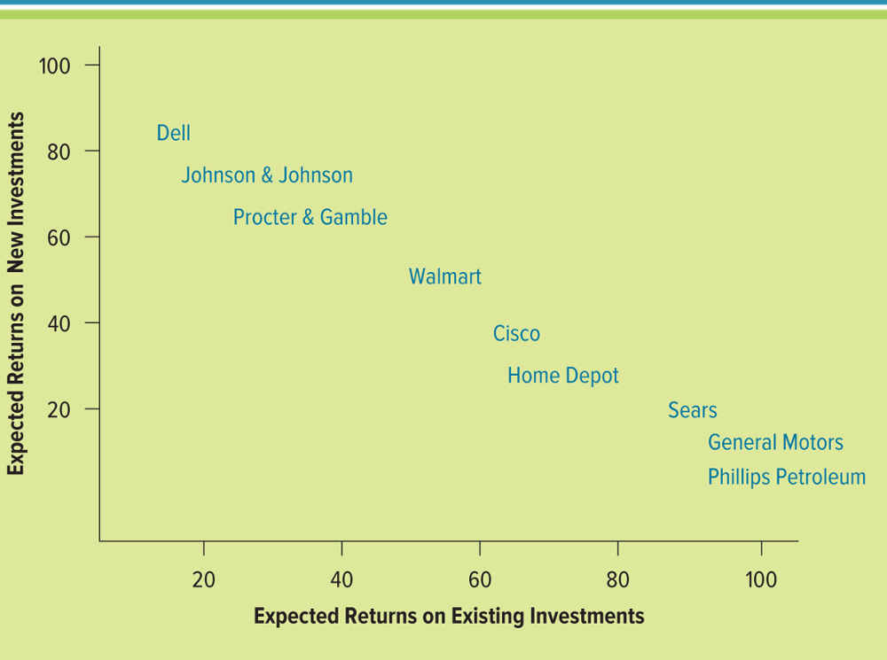
Figure 3.1 Disruptive and Sustaining Technologies
Sears 1886年創建了西爾斯郵購公司. 不敵電子商務競爭，2018年10月15日，該公司向美國法院申請破產保護
Phillps美國第二大煉油廠, 2017年3月以133億美元出售加拿大
Notes:
The above figure only displays the top four and bottom four companies. To review the entire figure please refer students to the text.
This figure displays companies that are expecting future growth to occur from new investments (disruptive technologies) and companies that are expecting future growth to occur from existing investment (sustaining technologies)
Ask your students to list additional companies, not mentioned in the figure, that depend mostly on new investments (disruptive technologies) for profits
Ask your students to list additional companies, not mentioned in the figure, that depend mostly on existing investments (sustaining technologies) for profits

Slide 10
Disruptive Versus Sustaining Technology 2 of 2
Innovator’s Dilemma discusses how established companies can take advantage of disruptive technologies without hindering existing relationships with customers, partners, and stakeholders

Slide 11
The Internet and World Wide Web – The Ultimate Business Disruptors 1 of 4
One of the biggest forces changing business is the Internet – A massive network that connects computers all over the world and allows them to communicate with one another
Organizations must be able to transform as markets, economic environments, and technologies change
Focusing on the unexpected allows an organization to capitalize on the opportunity for new business growth from a disruptive technology
Notes:
Do your students agree that the Internet is an example of a disruptive technology?
When it was first introduced would they consider it a form of disruptive technology?
CLASSROOM EXERCISE
Finding Innovation
Innovation, new ideas, and new technology are exciting. It is currently estimated that everything we know technically will represent 1 percent of all technology in 2050. Break your students into groups and ask them to search the Internet for the most exciting form of innovation that is going to hit our market and change our lives over the next ten years. Have your students present their findings to the class and offer a small prize to the winner.
A few examples include:
Computers that offer smells, click on a perfume and the scent permeates from your computer, movie theatres will offer smells that correspond to the movie
Electronic toilets – analyze output and let you know if you getting sick days before the cold actually hits. Great for rest homes and hospitals
Planes the size of small ships that offer shopping and restaurants
Ships the size of small cities where you can purchase an apartment
What's For Dinner? Just Call Your Refrigerator – google smart appliances to show your students what’s new in the kitchen!

Slide 12
The Internet and World Wide Web – The Ultimate Business Disruptors 2 of 4
The Internet began as an emergency military communications system operated by the Department of Defense
Gradually the Internet moved from a military pipeline to a communication tool for scientists to businesses

Slide 13
The Internet and World Wide Web – The Ultimate Business Disruptors 3 of 4
World Wide Web (WWW) – Provides access to Internet information through documents including text, graphics, audio, and video files that use a special formatting language called HTML – hypertext markup language
Web browser – Allows users to access the WWW
Hypertext Transport Protocol – The Internet protocol Web browsers use to request and display Web pages using URL – universal resource locator統一資源定位器,網頁地址

Slide 14
The Internet and World Wide Web – The Ultimate Business Disruptors 4 of 4
Reasons for growth of the WWW
Microcomputer revolution
Advancements in networking
Easy browser software
Speed, convenience, and low cost of email
Web pages easy to create and flexible

Slide 15
Web 1.0 – The Catalyst for Ebusiness 1 of 2
The Internet has had an impact on almost every industry including
Travel
Entertainment
Electronics
Financial services
Retail
Automobiles
Education and training
catalyst促进因素

Slide 16
Web 1.0 – The Catalyst for Ebusiness 2 of 2
Web 1.0 – A term to refer to the WWW during its first few years of operation between 1991 and 2003
Ecommerce – Buying and selling of goods and services over the Internet
Ebusiness – Includes ecommerce along with all activities related to internal and external business operations

Slide 17
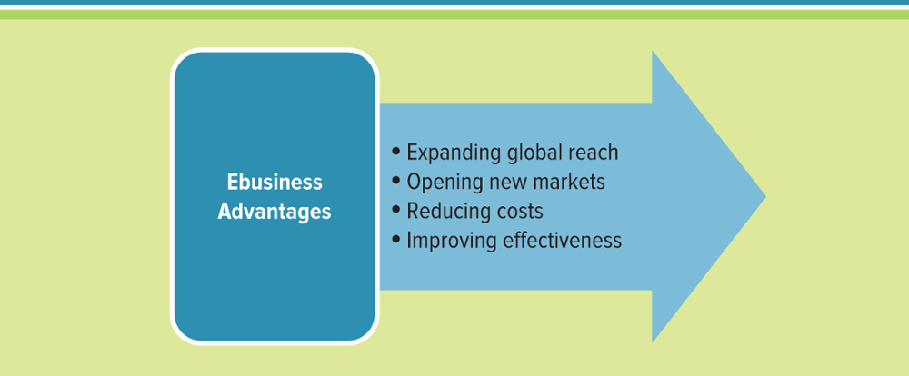
Figure 3.5 Ebusiness Advantages
Notes:
Both individuals and organizations have embraced ebusiness to enhance productivity, maximize convenience, and improve communications

Slide 18
Expanding Global Reach
The Internet’s impact on information
Easy to compile
Increased richness
Increased reach
Improved content
Easy to compile: Searching for information on products, prices, customers, suppliers, and partners is faster and easier when using the Internet.
Increased richness: refers to the depth and breadth of information transferred between customers and business.
Increased reach: refers to the number of people a business can communicate with, on a global basis.
Improved content: A key element of the Internet is its ability to provide dynamic relevant content.
Notes:
What is the difference between information richness and information reach?
Information richness refers to the depth and breath of information transferred between customers and business
Instead of a company catalog with a simple text box and perhaps a small photo, the Web allows companies to post 3-dimensional photos, video, customer reviews, newspaper and magazine articles, product comparisons including price, etc.
Information reach refers to the number of people a business can communicate with, on a global basis
Companies can now reach customers around the world, not just customers who can physically travel to their store
Internet’s Impact on Information
Easy to compile: Searching for information on products, prices, customers, suppliers, and partners is faster and easier when using the Internet.
Increased richness: refers to the depth and breadth of information transferred between customers and business. Businesses and
customers can collect and track more detailed information when using the Internet.
Increased reach: refers to the number of people a business can communicate with, on a global basis. Businesses can share information with numerous customers all over the world.
Improved content: A key element of the Internet is its ability to provide dynamic relevant content. Buyers need good content descriptions to make informed purchases, and sellers use content to properly market and differentiate themselves from the competition. Content and product description establish the common understanding between both parties to the transaction. As a result, the reach and richness of that content directly affects the transaction.

Slide 19
Opening New Markets
Mass customization – The ability of an organization to tailor its products or services to the customers’ specifications such as BMW Mini Cooper 三門/五門/敞篷車型, Nike shoes, M&Ms
Personalization – Occurs when a company knows enough about a customer’s likes and dislikes that it can fashion offers more likely to appeal to that person
Notes:
Mass customization: The ability of an organization to tailor its products or services to the customers’ specifications
Personalization occurs when a website can know enough about a person’s likes and dislikes that it can fashion offers that are more likely to appeal to that person. Personalization involves tailoring a presentation of an ebusiness website to individuals or groups of customers based on profile information, demographics, or prior transactions. Amazon uses personalization to create a unique portal for each of its customers.
Ask your students to create a list of companies or products that are using mass customization
Mini Cooper
Nike shoes
M&Ms
Ask your students to create a list of products that feature personalization
Amazon is the best example
Netflix

Slide 20
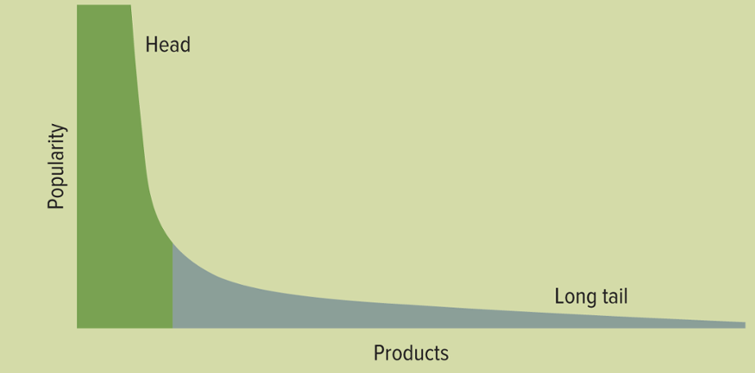
Figure 3.6 The Long Tail
The Long Tail – Refers to the tail of a typical sales curve
獨立搖滾指的是由獨立廠牌製作的低成本搖滾樂，通常音樂人自己動手製作，因此能夠探索不同於主流品味的聲音、情感和題材
Notes:
Ask your students to list products they would include in the head of the sales curve
Top 40 music
Top 40 videos
Brand name apparel
Top selling books
Regular sized shoes and clothes
Ask your students to list products they would include in the long tail of the sales curve
Indie bands
Irregular sized shoes and clothes
Books on specific topics

Slide 21
Reducing Costs
Intermediary中间人– Agents, software, or businesses that provide a trading infrastructure to bring buyers and sellers together
Disintermediation
Reintermediation
Cybermediation
Disintermediation: Occurs when a business sells directly to the customer online and cuts out the intermediary
Reintermediation: Steps are added to the value chain as new players find ways to add value to the business process
Cybermediation: Refers to the creation of new kinds of intermediaries that simply could not have existed before the advent of ebusiness
Notes:
Disintermediation: Occurs when a business sells directly to the customer online and cuts out the intermediary
Reintermediation: Steps are added to the value chain as new players find ways to add value to the business process
Cybermediation: Refers to the creation of new kinds of intermediaries that simply could not have existed before the advent of ebusiness

Slide 22
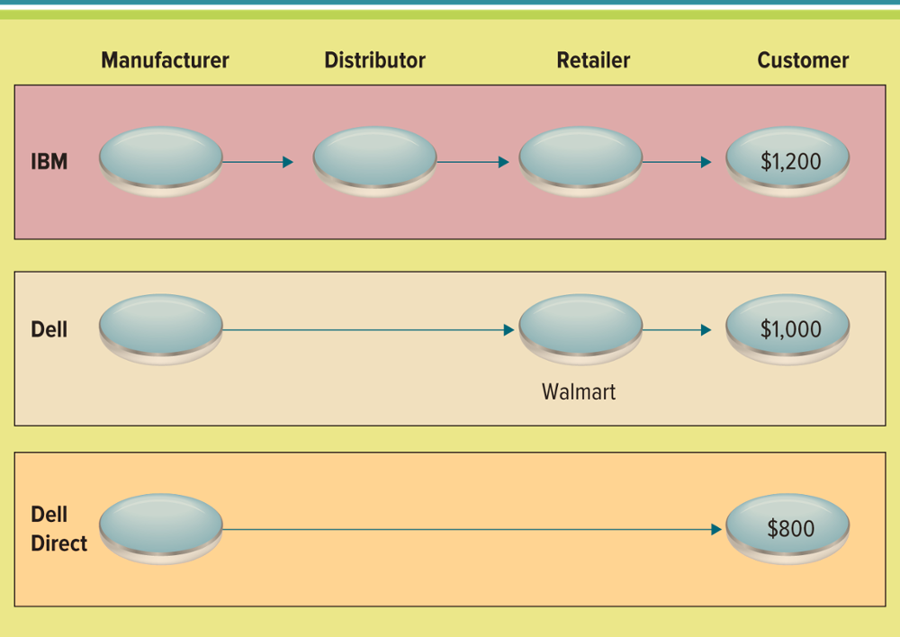
Figure 3.7 Business Value of Disintermediation
Jump to long image description
Notes:
For the reasons discussed in the previous slide, information reach and information richness, companies want to be able to post audio, video, graphic and text files to help run their businesses
CLASSROOM EXERCISE
Formatting the Web
Ask your students their majors: accounting, finance, marketing, management, human resources, information technology, etc.
List the different majors on the board and ask them how each one can use the different file formats to improve the way they achieve tasks
Accounting: video and audio files for audits
Marketing: all formats for website sales and marketing campaigns
Finance: video and audio files for training on new tax laws or training new employees how to use the systems
Human Resources: video and audio files for training and demonstration of sexual harassment or unethical behavior that is not tolerated by the company

Slide 23
Improving Effectiveness 1 of 4
Interactivity - Measures advertising effectiveness by counting visitor interactions with the target ad, including time spent viewing the ad, number of pages viewed, and number of repeat visits to the advertisement.
Heat map - A two-dimensional representation of data in which values are represented by colors.
Heat maps will tell the company where the majority of traffic lands, where they leave, the videos they are watching, the products they are looking at, heat maps can tell the company the hot spots for the website!
Notes:
Ask your students why a company would want to review a heat map of their website?
Heat maps will tell the company where the majority of traffic lands, where they leave, the videos they are watching, the products they are looking at, heat maps can tell the company the hot spots for the website!

Slide 24
Improving Effectiveness 2 of 4
Clickstream data tracks the exact pattern of a consumer’s navigation through a website
Clickstream data can reveal
Number of page views
Pattern of websites visited
Length of stay on a website
Date and time visited
Number of customers with shopping carts
Number of abandoned shopping carts
Notes:
Clickstream data can reveal a number of basic data points on how consumers interact with websites
Ask your students what an organization can learn from understanding clickstream data
For example, what does number of abandoned shopping carts tell an organization?

Slide 25
Improving Effectiveness 3 of 4
Generating marketing revenue on the Internet
Associate program (affiliate program) - Businesses generate commissions or royalties
Banner ad - Box running across a web page that contains advertisements
Pop-up ad - A small web page containing an advertisement
Viral marketing - A technique that induces websites or users to pass on a marketing message
橫幅式廣告通常橫向出現在網頁中，最常見的尺寸是468×60和468×80，目前還有728x90大尺寸型。是網絡廣告比較早出現的一種廣告形式。以往以jpg或者gif格式為主，伴隨網際網路的發展，swf格式的旗幟廣告也比較常見了
彈出式廣告意圖透過廣告來增加網站流量或取得電郵地址。它透過用戶在進入網頁時，自動開啟一個新的瀏覽器視窗，以吸引讀者直接到相關網址瀏覽，
Notes:
CLASSROOM EXERCISE
Viral Marketing Video Clip
From Spam to Viral Marketing from John Cleese
One B2B marketer used a lot of silliness to increase its web traffic tenfold and generate thousands of sales leads starting a viral phenomenon which went from a wacky idea to revenue-generating success. Great John Cleese video on the backup trauma institute. I like to use this video when introducing IT Architectures. This is also one of the first examples of a successful viral marketing campaign. https://www.youtube.com/watch?v=MgxgYL5P4z4
A Banner ad is a box running across a web page that is often used to contain advertisements. The banner generally contains a link to the advertiser’s website. Web-based advertising services can track the number of times users click the banner, generating statistics that enable advertisers to judge whether the advertising fees are worth paying. Banner ads are like living, breathing classified ads.
A pop-up ad is a small web page containing an advertisement that appears on the web page outside of the current website loaded in the web browser. A pop-under ad is a form of a pop-up ad that users do not see until they close the current web browser screen.
Associate programs (affiliate programs) allow businesses to generate commissions or royalties from an Internet site. For example, a business can sign up as an associate of a major commercial site such as Amazon. The business then sends potential buyers to the Amazon site using a code or banner ad. The business receives a commission when the referred customer makes a purchase on Amazon.
Viral marketing is a technique that induces websites or users to pass on a marketing message to other websites or users, creating exponential growth in the message’s visibility and effect. One example of successful viral marketing is Hotmail, which promotes its service and its own advertisers’ messages in every user’s email notes. Viral marketing encourages users of a product or service supplied by an ebusiness to encourage friends to join. Viral marketing is a word-of-mouth type advertising program.

Slide 26
Improving Effectiveness 4 of 4
Clickstream analytics - The process of collecting, analyzing and reporting aggregate data about which pages a website visitor visits—and in what order.
Website traffic analytics - Uses clickstream data to determine the efficiency of the site for the users and operates at the server level.
Website ebusiness analytics - Uses clickstream data to determine the effectiveness of the site as a channel-to-market.
病毒式行銷通常以網路化社群和各種媒體管道發布不尋常的訊息來吸引大眾對品牌、產品或活動的關注。其中目前最流行的病毒式內容形式是網路爆紅短片
病毒式行銷當中最好的例子就是電子郵件行銷。電子郵件行銷除了成本低廉的優點之外，更大的好處其實是能夠發揮病毒式行銷的威力，利用網友「好康道相報」的心理，輕輕鬆鬆按個轉寄鍵就化身為廣告主的行銷助理，一傳十、十傳百，甚至能夠接觸到原本公司企業行銷範圍之外的潛在消費者，不少嚐過病毒式行銷甜頭的公司也因而津津樂道。
Notes:
Ask your students to differentiate between Website traffic analytics and Website ebusiness analytics
Website traffic analytics will help a company understand ease of use of the website, or the efficiency
Website ebusiness analytics will help a company understand buying patterns and if the right customers are finding the right products to purchase

Slide 27
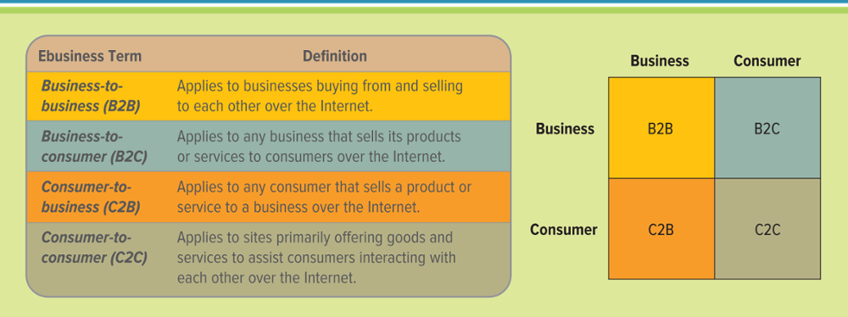
Figure 3.9 Ebusiness Models 1 of 2
Ebusiness model – A plan that details how a company creates, delivers, and generates revenues on the Internet
Jump to long image description
Notes:
Can a business operate with more than one ebusiness model?
Yes, eBay and Amazon are prime examples. eBay and Amazon’s ebusiness models change depending on who is posting the goods for sale and who is buying the goods for sale?’
CLASSROOM EXERCISE
ebusiness Business
Ask your students to list the types of companies they want to work for when they graduate
List the companies on the board and categorize them by industry
Assign each industry to a group, or assign the industry to each individual depending on the company they want to work for, and have the students research how the different industries are using ebusiness
Manufacturing and Retail: RFID, online payments and orders, sales via the Internet, customer service via the Internet
Financial: online banking, online mortgages, online loans
Telecommunications: Voice over the Internet (VoIP)
Healthcare: digital hospitals, pharmacy orders via the Internet
Travel: online reservations, Travelocity, Expedia

Slide 28
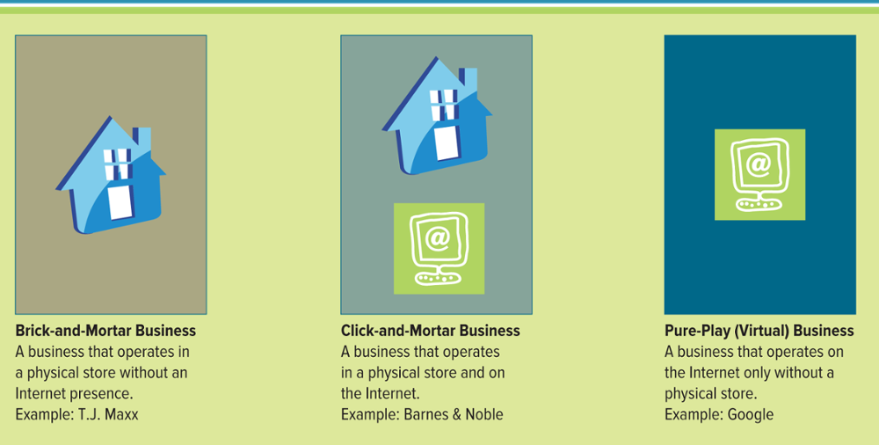
Figure 3.10 Forms of Business-To-Consumer Operations
Jump to long image description
Notes:
Business Types:
Brick-and-mortar business: operates in a physical store without an Internet presence.
Pure-play (virtual) business: a business that operates on the Internet only without a physical store. Examples include Amazon.com and Expedia.com.
Click-and-mortar business: a business that operates in a physical store and on the Internet. Examples include REI and Barnes and Noble.
Can you name a company that operates in each of the different business types?
Brick-and-mortar business: local book store, college book store (there are not many today)
Pure-play business: Amazon.com, eBay
Click-and-mortar business: Barnes and Noble

Slide 29
Ebusiness Forms and Revenue-Generating Strategies 1 of 3
Common ebusiness forms
Content providers
Infomediaries
Online marketplaces
Portals
Service providers
Transaction brokers
Notes:
Discuss the Figure from the text which highlights the different types of intermediaries
Explain the relationship between intermediaries and reintermediation
Reintermediation occurred because of intermediaries
CLASSROOM EXERCISE
Trip to a trip
Have your students create a trip itinerary for a 7 day trip to Paris with a nice hotel and rental car on Priceline or Kayak
Which site did they like best?
Which site had the best website?
Which site will they continue to use?

Slide 30
Ebusiness Forms and Revenue-Generating Strategies 2 of 3
Search engine – Website software that finds other pages based on keyword matching similar to Google
Search engine ranking – Evaluates variables that search engines use to determine where a URL appears on the list of search results
Search engine optimization – Combines art along with science to determine how to make URLs more attractive to search engines resulting in higher search engine ranking透過了解搜尋引擎的運作規則來調整網站，以及提高目的網站在有關搜尋引擎內排名的方式。由於不少研究發現，搜尋引擎的用戶往往只會留意搜尋結果最前面的幾個條目，所以不少網站都希望透過各種形式來影響搜尋引擎的排序，讓自己的網站可以有優秀的搜尋排名。當中尤以各種依靠廣告維生的網站為甚。
Notes:
Discuss the Figure from the text which highlights the different forms of searching
Ask your students how frequently they search and the different types of search they use
Ask your students if they ran a business which type of search would be most effective?
Which type of search would be least effective?
Ask your students to categorize the different types of search according to business models
retail store
movie theater
book store
grocery store
coffee shop
auto dealer

Slide 31
Ebusiness Forms and Revenue-Generating Strategies 3 of 3
Ebusiness revenue models
Advertising fees
License fees
Subscription fees
Transaction fees
Value-added service fees
Pay-per-click
Pay-per-call
Pay-per-conversion
Notes:
eBay is the Internet’s most successful C2C site and is now ranked in the top 15 retailers in the United States
Which type of revenue models would the following industries use?
Car
Boat
Vacation
Bicycle
Coat
DVDs
Pet grooming service
Dog walking service
Wedding catering
CLASSROOM EXERCISE
“The Competitive Nature of Websites”
Have students team up with two or three classmates to select and compare websites of two retailers that are in the same business (as an example jcrew.com vs. abercrombie.com, or Amazon.com vs. bn.com). Have students use the list of "do's and don'ts" from a Google search and compare the two sites, along with other criteria you might like to add. Have students review the range of information resources and services used in the sites and the ways in which they are organized, designed, and presented.
The basic question the groups should attempt to answer is how well the sites support the conduct of ebusiness. After analyzing the sites, have students compare the strengths and weak­nesses of the two sites. Students should be able to draw a conclusion as to which one they think does the best job of attracting customers to the website and retaining them once they get there. Also, have students comment on how well they think each site:
Offers a fast and convenient shopping experience
Provides access to help or additional information
Selects desirable products and displays them and describes them in an attractive and easy-to­ understand manner
Describes its method for getting purchases to customers promptly
Uses online ads, affiliate programs, viral marketing, and email marketing

Slide 32
Ebusiness Fraud
Affiliate program联盟计划 - Allows a business to generate commissions or referral fees when a customer visiting its website clicks a link to another merchant’s website.
Click fraud - The practice of artificially inflating traffic statistics for online advertisements.
Hitbots - Create the illusion that a large number of potential customers are clicking the advertiser's links, when in fact there is no likelihood that any of the clicks will lead to profit for the advertiser.
Notes:
Ask your students why a company would engage in click fraud to hurt a rival or competitor?
Ask your students why a company might use hitbots on its own website?

Slide 33
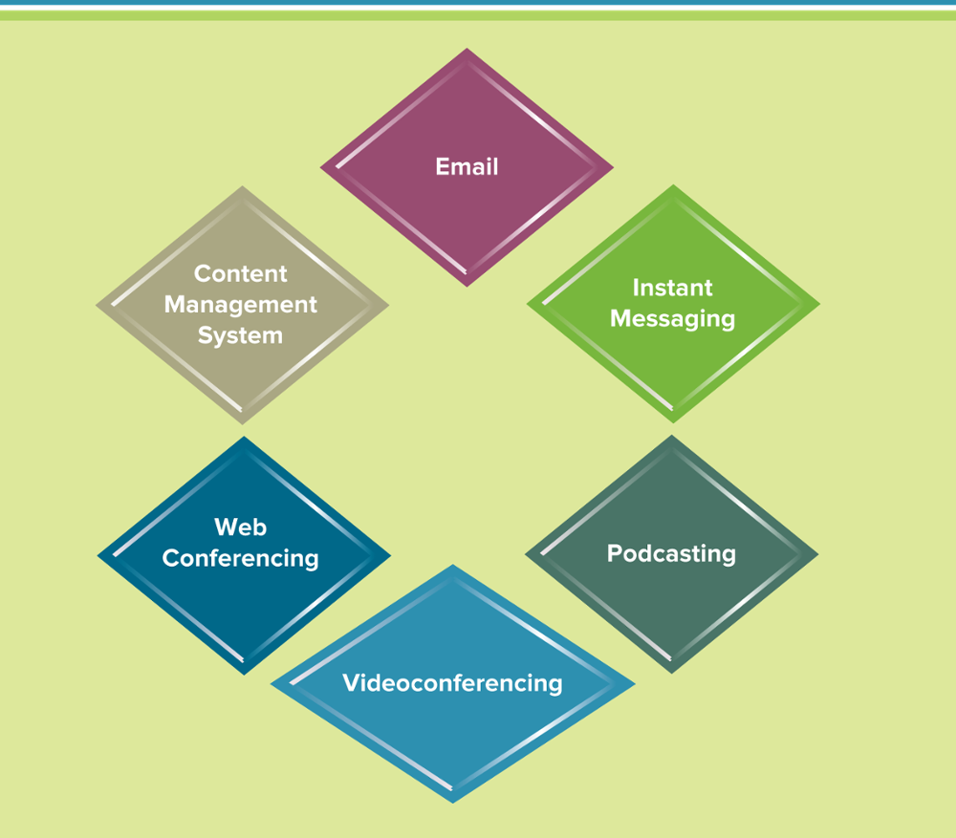
Figure 3.13 Ebusiness Tools
由iPod（蘋果MP3播放器）和broadcast（廣播）組合而成。它是一種新的技術;是Rss技術與MP3播放器結合的產物;簡單地說;就是把預先錄製的MP3音頻文件發佈在blog上
Notes:
As firms began to move online, more MIS tools were created to support ebusiness processes and requirements
Videoconferencing is a set of interactive telecommunication technologies that allow two or more locations to interact via two-way video and audio transmissions simultaneously. It has also been called visual collaboration and is a type of groupware. Videoconferencing uses telecommunications of audio and video to bring people at different sites together for a meeting. This can be as simple as a conversation between two people in private offices (point-to-point) or involve several sites (multi-point) with more than one person in large rooms at different sites. Besides the audio and visual transmission of people, videoconferencing can be used to share documents, computer-displayed information, and whiteboards
Ask your students what are the business advantages of videoconferencing?
What industries are at risk because of videoconference?
Airlines, hotels, rental cars (all businesses used in business travel which becomes nonexistent with the use of videoconferencing)
Web conferencing blends audio, video, and document-sharing technologies to create virtual meeting rooms where people “gather” at a password-protected Web site. There, they can chat in conference calls or use real-time text messages. They can mark up a shared document as if it were a blackboard, and even watch live software demos or video clips.
Perhaps the biggest surprise about Web conferencing is its simplicity. Users only need to set up an account and download a few small software files. The best part about a Web conference is that attendees do not have to have the same hardware or software. Every participant can see what is on anyone else’s screen, regardless of the application being used
Ask your students what are the business advantages of videoconferencing?
What industries are at risk because of videoconferencing?
Airlines, hotels, rental cars (all businesses used in business travel which becomes nonexistent with the use of videoconferencing)

Slide 34
Ebusiness Tools for Connecting and Communicating
Email
Instant messaging
Podcasting: converts an audio broadcast to a digital music player
Videoconferencing
Web conferencing
Content management system
Notes:
Email: short for electronic mail, is the exchange of digital messages over the Internet
Email is typically delivered through an Internet service provider – a company that provides access to the Internet for a monthly fee such as AOL and Comcast
Instant messaging: a service that enables instant or real-time communication between people
Instant messaging occurs in real-time, when a system updates information at the same rate it receives it
Podcasting: converts an audio broadcast to a digital music player
Videoconferencing: allows people at two or more locations to interact via two-way video and audio transmissions simultaneously
Web conferencing blends videoconferencing with document sharing and allows the user to deliver a presentation over the Web to a group of geographically dispersed participants
Content management system: helps companies manage the creation, storage, editing, and publication of their website content
Taxonomy: the scientific classification of organisms into groups based on similarities of structure of origin
Information architecture: the set of ideas about how all information in a given context should be organized

Slide 35
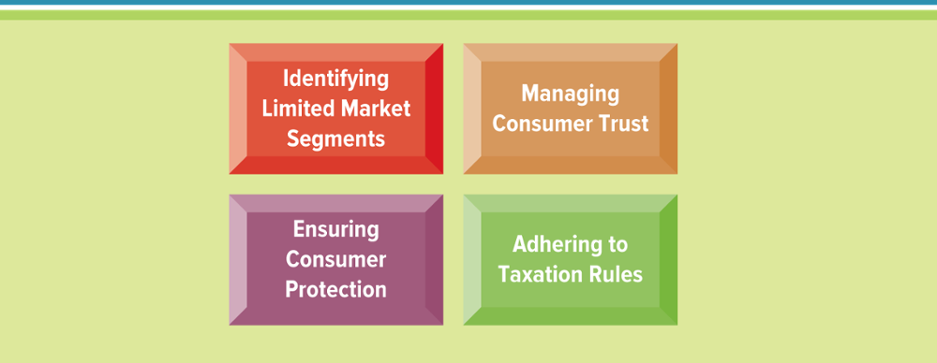
Figure 3.14 Challenges Facing Ebusiness
Notes:
Identity theft is already so common that there are entire units within law enforcement that deal with this issue every day
There are toll-free numbers, websites and documents that clearly define incident response procedures
Which challenge would you pick if asked to identify the most difficult ebusiness challenge?
Would it change depending on the industry?
Would it change depending on the company?
Would it change depending on the customer?
CLASSROOM EXERCISE
Protecting Customers
Identity theft is rising and there are great examples on the Internet
Ask your students to compile a listing of identity theft and phising scams by researching the Internet to find examples
Discuss all of the examples to help spread awareness to your students
What can a company do to help prevent identity theft and phising scams?

Slide 36
Section 3.2
WEB 2.0 – BUSINESS 2.0
Notes:
CLASSROOM OPENER
GREAT BUSINESS DECISIONS – Jeff Bezos Decides to Sell Books over the Internet
Jeff Bezos owns 41 percent of Amazon and is estimated to be worth over $900 million. Bezos graduated from Princeton and was the youngest Vice President at Banker’s Trust in New York. Bezos had to make a decision to stay and receive his 1994 Wall Street bonus or leave and start a business on the Internet. “I tried to imagine being eighty years old, looking back on my life. I knew that I would hardly regret having missed the 1994 Wall Street bonus. But having missed being part of the Internet boom – that would have really hurt,” stated Bezos. The first books ordered through Amazon were dispatched in the fall of 1994 (personally packaged by Bezos and his wife). Amazon.com is now the biggest bookstore on the planet. It is the exemplar of electronic business.

Slide 37
Learning Outcomes 2 of 2
3.6 Explain Web 2.0 and identify its four characteristics.
3.7 Explain how Business 2.0 is helping communities network and collaborate.
3.8 Describe the three Business 2.0 tools for collaborating.
3.9 Explain the three challenges associated with Business 2.0.
3.10 Describe Web 3.0 and the next generation of online business.

Slide 38
Web 2.0: Advantages of Business 2.0
Web 2.0 – The next generation of Internet use – a more mature, distinctive communications platform characterized by three qualities
Collaboration
Sharing
Free
Notes:
Web 2.0 is a set of economic, social, and technology trends that collectively form the basis for the next generation of the Internet—a more mature, distinctive medium characterized by user participation, openness, and network effects. Although the term suggests a new version of the World Wide Web, it does not refer to an update to Web technical specifications; instead, it refers to changes in the ways software developers and end-users use the Web as a platform. According to Tim O’Reilly, “Web 2.0 is the business revolution in the computer industry caused by the move to the Internet as platform, and an attempt to understand the rules for success on that new platform.” The text figures display the move from Web 1.0 to Web 2.0, and the timeline of Web 1.0 and Web 2.0.
More than just the latest technology buzzword, Web 2.0 is a transformative force that is propelling companies across all industries toward a new way of doing business. Those who act on the Web 2.0 opportunity stand to gain an early-mover advantage in their markets. What is causing this change? Consider the following raw demographic and technological drivers:
One billion people around the globe now have access to the Internet.
Mobile devices outnumber desktop computers by a factor of two.
Nearly 50 percent of all U.S. Internet access is now via always-on broadband connections.
CLASSROOM EXERCISE
The Web’s Most Useful Sites
You have lots of stuff to get done. And these next-generation services can help with everything from wrangling passwords to throwing a party. Google the most useful websites for a current listing of what is hot on the net
Will these sites be useful in Web 2.0?
How will these sites be different in Web 2.0?

Slide 39
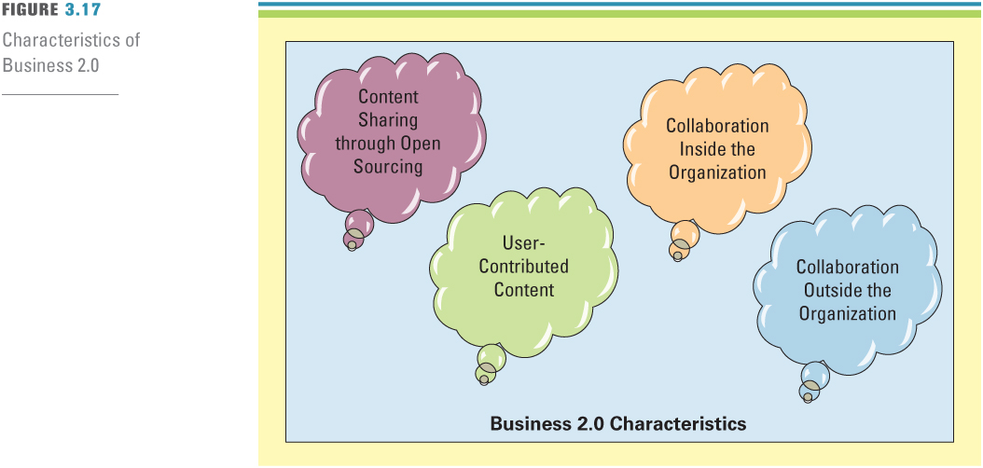
Figure 3.15 Four Characteristics of Web 2.0
Jump to long image description
Notes:
It is getting harder and harder for any one individual to perform organizational activities in isolation
Ask your students to list types of organizational activities that are performed by individuals
Ans: For the most part, almost all organizational activities are performed in teams. For example, a customer service representative usually needs to talk with many coworkers to discover customer issues and problem resolution
A marketing executive will need to work with sales representatives to determine what is “hot” in the market, what is selling, and what issues/complaints customers have before launching a new product
The majority of work today is performed in groups and teams
These teams can be departmental, interdepartmental, cross-functional, internal, and external

Slide 40
Content Sharing Through Open Sourcing
Open system – Nonproprietary hardware and software based on publicly known standards that allows third parties to create add-on products to plug into or interoperate with the system
Source code
Open source
Closed source
Source code: contains instructions written by a programmer specifying the actions to be performed by computer software
Open source: any software whose source code is made available free for any third party to review and modify
Closed source: 專有軟體，又稱非自由軟體、專屬軟體、私有軟體、封閉性軟體等，是指在使用、修改上有限制的軟體
Notes:
Source code: contains instructions written by a programmer specifying the actions to be performed by computer software
Open source: any software whose source code is made available free for any third party to review and modify
Collaboration systems, such as groupware, enable, support, and facilitate internal and external team collaboration
This is a good time to mention the importance of people skills, or soft skills, in additional to business knowledge. Your students should anticipate working with many coworkers from different areas of the business when solving issues or finding opportunities. Building soft skills is just as important as building analytical skills. Successful people rarely work in isolation.
Collaboration solves specific business tasks such as telecommuting, online meetings, deploying applications, and remote project and sales management
Collaboration allows people, teams, and organizations to leverage and build upon the ideas and talents of staff, suppliers, customers, and business partners
It involves a unique set of business challenges that:
Include complex interactions between people who may be in different locations and desire to work across function and discipline areas
Require flexibility in work process and the ability to involve others quickly and easily
Create and share information rapidly and effortlessly within a team
Increasingly, organizations are extending their focus from internal operations like planning and scheduling, enterprise resource planning and sales force automation, toward operations beyond their own four walls with external customers and suppliers
This chapter focuses on the need for collaboration, the technology that supports collaboration, and collaboration trends

Slide 41
User-Contributed Content
User-contributed content – Created and updated by many users for many users
Reputation system
Native advertising
信譽系統是一種通過一些實體相互給出看法和評價，來試圖確定這些實體的等級和類別的合作性篩選算法。這很類似於一種推薦系統, 但是和其他對實體的推薦不同（比如書籍、電影，或者是音樂），信譽系統是實體間的互相推薦.
原生廣告是網路廣告的一種，藉由產生有價值的內容，期望在消費者的體驗中獲得關注，通常執行者可能會試圖編輯一份包含圖文報導的訊息或文章，讓消費者覺得有價值的內容，並且讓消費者願意進一步閱讀或接收訊息。
例如在Facebook 就以「動態贊助」 或「建議貼文」的方式經營原生廣告平台，而品牌廣告主也可以在Facebook上面藉由經營「粉絲專頁」或製作「應用程式」的方式發布原生廣告。但原生廣告的平台不僅限於Facebook，包括Twitter、Plurk、YouTube、Pinterest、Instagram、Quora等社群訊息平台，都有可能作為原生廣告發布的媒體。
Notes:
Ask your students to identify websites that operate using user-contributed content
YouTube
Wikipedia
Yelp
Rate My Professor

Slide 42
Collaboration Inside the Organization 1 of 2
Collaboration system – Tools that support the work of teams or groups by facilitating the sharing and flow of information
Collective intelligence – Collaborating and tapping into the core knowledge of all employees, partners, and customers
Knowledge management - Involves capturing, classifying, evaluating, retrieving, and sharing information assets in a way that provides context for effective decisions and actions
Tap into充分利用或挖掘
Notes:
Collaboration system: set of tools that supports the work of teams or groups by facilitating the sharing and flow of information
Collective intelligence: Collaborating and tapping into the core knowledge of all employees, partners, and customers.
Knowledge management: Involves capturing, classifying, evaluating, retrieving, and sharing information assets in a way that provides context for effective decisions and actions.
Knowledge management system: Supports the capturing, organization, and dissemination of knowledge (i.e., know-how) throughout an organization
Why is knowledge one of the real competitive advantages?
It is difficult to duplicate knowledge
It can take years to acquire
It is a personal asset
What if an organization could capture all of a persons knowledge using technology?
You would no longer need that person in the organization

Slide 43
Collaboration Inside the Organization 2 of 2
Knowledge-based assets fall into two categories
Explicit knowledge – Consists of anything that can be documented, achieved, and codified, often with the help of IT
Tacit knowledge – Knowledge contained in people’s heads
Notes:
Identify two types of explicit knowledge and tacit knowledge
Explicit knowledge: payroll information, customer address, student grades, faculty courses taught
Tacit knowledge: how to perform a process, how to perform an activity, how you feel about something

Slide 44
Collaboration Outside the Organization
Crowdsourcing – the wisdom of the crowd
Asynchronous communication
Synchronous communication
Notes:
Asynchronous communication such as email in which the message and the response do not occur at the same time.
Synchronous communications that occur at the same time such as IM or chat.

Slide 45
Networking Communities With Business 2.0
Social media – Websites that rely on user participation and user-contributed content
Social network – An application that connects people by matching profile information
Social networking – The practice of expanding your business and/or social contacts by a personal network
Notes:
Social networking analysis: Maps group contacts identifying who knows each other and who works together.
KM is not a purely technology-based concept
Organizations that implement a centralized database system, electronic message board, Web portal, or any other collaborative tool in the hope that they have established a KMS are wasting both their time and money
What types of knowledge management programs could your college pursue to help new students adapt to the college?
Effective study habits
Writing rules
Research database
Course evaluations

Slide 46
Social Tagging
Tags – Specific keywords or phrases incorporated into website content for means of classification or taxonomy
Social tagging
Folksonomy
Website bookmark
Social bookmarking
Social tagging: Describes the collaborative activity of marking shared online content with keywords or tags as a way to organize it for future navigation, filtering, or search.
Folksonomy: Similar to taxonomy except that crowdsourcing determines the tags or keyword-based classification system.
Website bookmark: A locally stored URL or the address of a file or Internet page saved as a shortcut.
Social bookmarking: Allows users to share, organize, search, and manage bookmarks.
Notes:
Social tagging: Describes the collaborative activity of marking shared online content with keywords or tags as a way to organize it for future navigation, filtering, or search.
Folksonomy: Similar to taxonomy except that crowdsourcing determines the tags or keyword-based classification system.
Website bookmark: A locally stored URL or the address of a file or Internet page saved as a shortcut.
Social bookmarking: Allows users to share, organize, search, and manage bookmarks.
Ask your students to research the Internet to determine how tagging can impact an organization

Slide 47
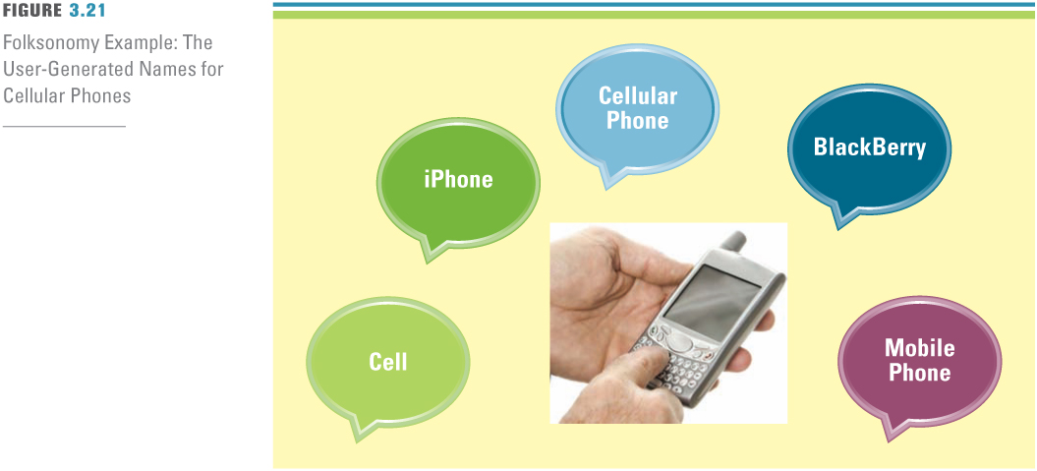
Figure 3.19 Folksonomy Example: The User-Generated Names for Cellular Phones
Notes:
Social tagging: Describes the collaborative activity of marking shared online content with keywords or tags as a way to organize it for future navigation, filtering, or search.
Folksonomy: Similar to taxonomy except that crowdsourcing determines the tags or keyword-based classification system.
Website bookmark: A locally stored URL or the address of a file or Internet page saved as a shortcut.
Social bookmarking: Allows users to share, organize, search, and manage bookmarks.

Slide 48
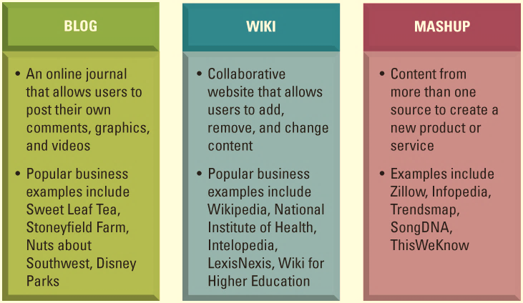
Figure 3.20 Business 2.0 Communication and Collaboration Tools
mashup混搭
Notes:
Blog: An online journal that allows users to post their own comments, graphics, and video.
Wiki: A type of collaborative Web page that allows users to add, remove, and change content, which can be easily organized and reorganized as required.
Mashup: A website or Web application that uses content from more than one source to create a completely new product or service.
Mashup editor: WYSIWYGs or What You See Is What You Get tools
CLASSROOM EXERCISE
Process of Collaboration
Collaboration is always operating through certain group processes: processes of communication, coordination, cooperation, but also information sharing. Split students up into four groups, each representing the processes above. Have each group make a list of the collaborative technologies differentiated by the collaboration processes they support.
These processes do not work independently of one another but are usually intermingled and determined by each other. True collaboration tools will try to provide help for all those collaboration processes, but their main focus is mostly on one of these areas.

Slide 49
Blogs
Blog – Online journal that allows users to post their own comments, graphics, and video
Microblogging
Real simple syndication
Microblogging: The practice of sending brief posts (140 to 200 characters) to a personal blog, either publicly or to a private group of subscribers who can read the posts as IMs or as text
Real simple syndication: A Web format used to publish frequently updated works, such as blogs, news headlines, audio, and video in a standardized format.
Notes:
Blog: Online journal that allows users to post their own comments, graphics, and video
Microblogging: The practice of sending brief posts (140 to 200 characters) to a personal blog, either publicly or to a private group of subscribers who can read the posts as IMs or as text
Real simple syndication: A Web format used to publish frequently updated works, such as blogs, news headlines, audio, and video in a standardized format.

Slide 50
Wikis
Wiki – Collaborative Web page that allows users to add, remove, and change content, which can be easily organization and reorganized as required
Network effect
Network effect: Describes how products in a network increase in value to users as the number of users increases
Notes:
Wikis are Web-based tools that make it easy for users to add, remove, and change online content
Network effect: Describes how products in a network increase in value to users as the number of users increases
Business wikis are collaborative Web pages that allow users to edit documents, share ideas, or monitor the status of a project. Most people are familiar with Wikipedia, one of the largest online collaboration Web sites. Employees also use wikis to collaborate; for example, companies such as Intel, Motorola, IBM, and Sony use them for a host of tasks, from setting internal meeting agendas to posting documents related to new products. Many companies rely on wikis to engage customers in ongoing discussions about products. Wikis for Motorola and T-Mobile handsets serve as continually updated user guides. TV networks including ABC and CBS are creating fan wikis that let viewers interact with each other as they unravel mysteries from such shows as Lost and CSI: Crime Scene Investigation

Slide 51
Mashups
Mashup – Website or Web application that uses content from more than one source to create a completely new product or service
Application programming interface
Mashup editor
Mashup editors are WSYIWYGs (What You See Is What You Get) for mashups. They provide a visual interface to build a mashup, often allowing the user to drag and drop data points into a Web application
Notes:
A Web mashup is a website or web application that uses content from more than one source to create a completely new service. The term is typically used in the context of music; putting Jay-Z lyrics over a Radiohead song makes something old become new. The Web version of a mashup allows users to mix map data, photos, video, news feeds, blog entries and so on. Content used in mashups is typically sourced from an application programming interface (API), which is a set of routines, protocols, and tools for building software applications.
Mashup editors are WSYIWYGs (What You See Is What You Get) for mashups. They provide a visual interface to build a mashup, often allowing the user to drag and drop data points into a Web application
Example mash-ups:
1001 Secret Fishing Holes: Over a thousand fishing spots in national parks, wildlife refuges, lakes, campgrounds, historic trails etc. (Google Maps API).
25 Best Companies to Work For: Map of the 100 best U.S. companies to work for as rated by Fortune magazine. (Google Maps API).
Album Covers: Uses the Amazon API and an Ajax-style user interface to retrieve CD/DVD covers from the Amazon catalog (Amazon eCommerce API).
Gawker: A handy mashup for keeping up with celebrity sightings in New York City. Readers are encouraged to e-mail as soon as the celeb is spotted (Google Maps API).
The Hype Machine: Combines blog posts from a set of curated music blogs with Amazon sales data and upcoming events. The Hype Machine tracks songs and discussion posted on the best blogs about music. It integrates with iTunes to take customers right from the Web page to the track they are interested in. If the customer prefers buying through Amazon, The Hype Machine figures out what CD page to display.

Slide 52
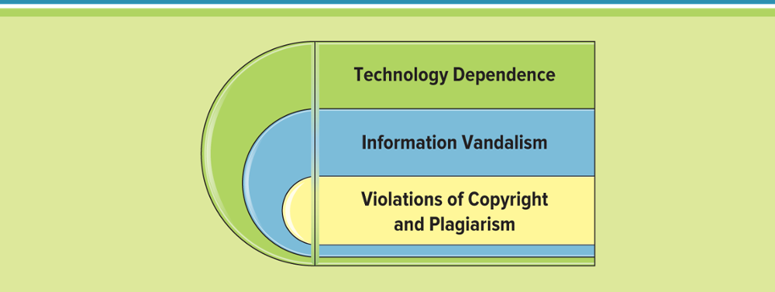
Figure 3.21 Challenges of Business 2.0
vandalism故意破坏
Notes:
Ebusiness challenges include:
Protecting consumers
Leveraging existing systems
Increasing liability
Providing security
Adhering to taxation rules
Which type of ebusiness security would you recommend a business implement? Why?
Ebusiness Security
Encryption: scrambles information into an alternative form that requires a key or password to decrypt. Encryption is achieved by scrambling letters, replacing letters, replacing letters with numbers, and other ways.
Secure socket layer (SSL): 1 creates a secure and private connection between a client and server computer, 2 encrypts the information, and 3 sends the information over the Internet. SSL is identified by a website address that includes an “s” at the end—https.
Secure electronic transaction (SET): a transmission security method that ensures transactions are secure and legitimate. Similar to SSL, SET encrypts information before sending it over the Internet. However, SET also enables customer authentication for credit card transaction. SETs are endorsed by major ecommerce players including MasterCard, American Express, Visa, Netscape, and Microsoft.

Slide 53
Web 3.0 1 of 2
Deep web - The large part of the Internet that is inaccessible to conventional search engines.
Dark web - The portion of the Internet that is intentionally hidden from search engines, uses masked IP addresses, and is accessible only with a special web browser
The deep web, sometimes called the invisible web, is the large part of the Internet that is inaccessible to conventional search engines. Deep web content includes email messages, chat messages, private content on social media sites, electronic bank statements, electronic health records, and other content that is accessible over the Internet but is not crawled and indexed by search engines such as Google, Yahoo, or Bing.
Notes:
The deep web, sometimes called the invisible web, is the large part of the Internet that is inaccessible to conventional search engines. Deep web content includes email messages, chat messages, private content on social media sites, electronic bank statements, electronic health records, and other content that is accessible over the Internet but is not crawled and indexed by search engines such as Google, Yahoo, or Bing.
The term deep web was coined by BrightPlanet in a 2001 white paper entitled "The Deep Web: Surfacing Hidden Value" and is often confused in the media with the term dark web. The dark web is the portion of the Internet that is intentionally hidden from search engines, uses masked IP addresses, and is accessible only with a special web browser. The key takeaway here is that the dark web is part of the deep web.

Slide 54
Web 3.0 2 of 2
Web 3.0 – Based on “intelligent” Web applications using natural language processing, machine-based learning and reasoning, and intelligence applications
Semantic Web – A component of Web 2.0 that describes things in a way that computers can understand
Notes:
Transforming the Web into a Database
The first step toward a Web 3.0 is the emergence of the data-driven Web as structured data records are published to the Web in formats that are reusable and able to be queried remotely. Because of the recent growth of standardized query language for searching across distributed databases on the Web, the data-driven Web enables a new level of data integration and application interoperability, making data as openly accessible and linkable as Web pages. The data-driven Web is the first step on the path toward the full semantic Web. In the data-driven Web phase, the focus is on making structured data available using databases. The full semantic Web stage will widen the scope such that both structured data and even what is traditionally thought of as unstructured or semistructured content (such as Web pages, documents, email, etc.) will be widely available in common formats.
An Evolutionary Path to Artificial Intelligence
Web 3.0 has also been used to describe an evolutionary path for the Web that leads to artificial intelligence that can reason about the Web in a quasi-human fashion. Some skeptics regard this as an unobtainable vision. However, companies such as IBM and Google are implementing new technologies that are yielding surprising information, such as predicting hit songs by mining information on college music Web sites. There is also debate over whether the driving force behind Web 3.0 will be intelligent systems, or whether intelligence will emerge in a more organic fashion, from systems of intelligent people, such as via collaborative filtering services like del.icio.us, Flickr, and Digg that extract meaning and order from the existing Web and how people interact with it.
The Realization of the Semantic Web and SOA
Related to the artificial intelligence direction, Web 3.0 could be the realization of a possible convergence of the semantic Web and service-oriented architecture (SOA). Companies have longed to integrate existing systems in order to implement information technology support for
business processes that cover the entire business value chain. The main drivers for SOA adoption are that it links computational resources and promotes their reuse. Enterprise architects believe that SOA can help businesses respond more quickly and cost-effectively to changing market conditions. This style of architecture can simplify interconnection to, and usage of, existing IT (legacy) assets.
Evolution Toward 3D
Another possible path for Web 3.0 is toward the three-dimensional vision championed by the Web3D Consortium. This would involve the Web transforming into a series of 3D spaces, taking the concept realized by Second Life further. This could open up new ways to connect and collaborate using 3D shared spaces.

Slide 55
Egovernment: The Government Moves Online
Egovernment - Involves the use of strategies and technologies to transform government(s) by improving the delivery of services and enhancing the quality of interaction between the citizen-consumer within all branches of government
Notes:
The chapter discussed many ways that businesses are growing and increasing profits through ebusiness
How can egovernment use some of the trends discussed throughout the chapter to help reduce costs and increase revenue?

Slide 56
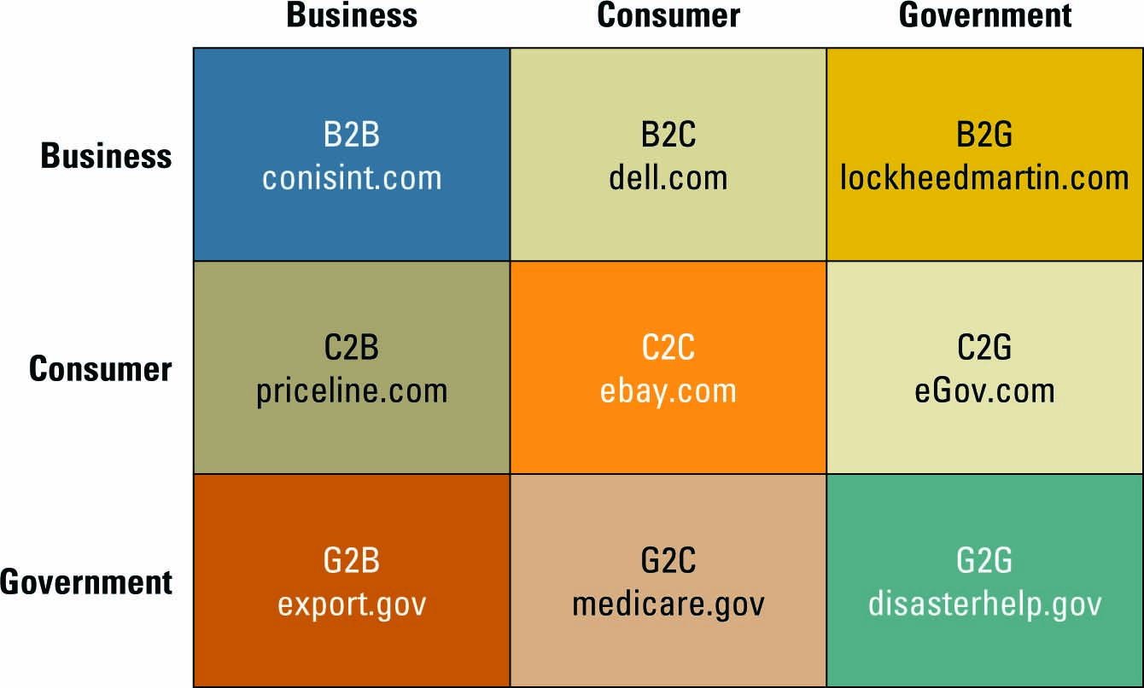
Figure 3.22 Extended Ebusiness
Jump to long image description
Notes:
Review the website http://firstgov.gov/:the official U.S. gateway to all government information
This website is a catalyst for a growing electronic government
Ask your students to review the following websites to further understand the progress being made in egovernment
C2G: eGov.com
B2G: lockheedmartin.com
G2B: export.gov
G2C: medicare.gov
G2G: disasterhelp.gov

Slide 57
Learning Outcome Review
Now that you have finished the chapter please review the learning outcomes in your text.

Slide 58
Appendix of Image Long Descriptions

Slide 59
Appendix 1 Figure 3.1 Disruptive and Sustaining Technologies
On a scale of 0 to 100, Dell expects over 80 returns on new investments and less than 20 on existing investments.
At the other end, General Motors and Phillips Petroleum are shown together as expecting less than 20 returns on new investments and nearly 100 on existing investments.
Walmart is shown near the middle, with about 50 expected returns on both new and existing investments.
Other companies fall near a line connecting these three data points, with decreasing returns on new and increasing returns on existing investments.
The full list in order is: Dell, Johnson and Johnson, Proctor and Gamble, Walmart, Cisco, Home Depot, Sears, and General Motors and Phillips Petroleum shown together.
Return to original slide

Slide 60
Appendix 2 Figure 3.6 The Long Tail
When products are first introduced, popularity is high. As products hit a certain age, popularity drops sharply. This interval is labeled Head.
As products continue to age, popularity tapers slowly down to a very low level. The interval of slow tapering is labeled Long tail
Return to original slide

Slide 61
Appendix 3 Figure 3.7 Business Value of Disintermediation
I B M products flow from manufacturer, to distributor, to retailer, and then the customer. Resulting price is $1,200.
Dell products flow from manufacturer, to Walmart as a specific retailer, and then the customer. Resulting price is $1,000.
Dell Direct flows from manufacturer right to the customer with resulting price of $800.
Return to original slide

Slide 62
Appendix 4 Figure 3.9 Ebusiness Models 1 of 2
Models include:
business to business (or B 2 B). Applies to businesses buying from and selling to each other over the Internet.
business to consumer (or B 2 C). Applies to any business that sells its products or services to consumers over the Internet.
consumer to business (or C 2 B). Applies to any consumer that sells a product or service to a business over the Internet.
consumer to consumer (or C 2 C). Applies to sites primarily offering goods and services to assist consumers interacting with each other over the Internet.
Return to original slide

Slide 63
Appendix 5 Figure 3.15 Four Characteristics of Web 2.0
Characteristics include:
Content sharing through open sourcing
User-contributed content
Collaboration inside the organization
Collaboration outside the organization
Return to original slide

Slide 64
Appendix 7 Figure 3.20 Business 2.0 Communication and Collaboration Tools
Blog
An online journal that allows users to post their own comments, graphics, and videos
Popular business examples include Sweet Leaf Tea, Stoneyfield Farm, Nuts about Southwest, Disney Parks
Wiki
Collaborative website that allows users to add, remove, and change content
Popular business examples include Wikipedia, National Institute of Health, Intelopedia, LexisNexis, Wiki for Higher Education
Mashup
Content from more than one source to create a new product or service
Examples include Zillow, Infopedia, Trends map, Song D N A, This We Know
Return to original slide

Slide 65
Appendix 7 Figure 3.22 Extended Ebusiness
Combinations with example Web sites include:
business to business (or B 2 B), c o n i s int dot com
business to consumer (or B 2 C), dell dot com
business to government (or B 2 G), lockheed martin dot com
consumer to business (or C 2 B), price line dot com
consumer to consumer (or C 2 C), ebay dot com
consumer to government (or C 2 G), e Gov dot com
government to business (or G 2 B), export dot gov
government to consumer (or G 2 C), medicare dot gov
government to government (or G 2 G), disaster help dot gov
Return to original slide

