Slide 1
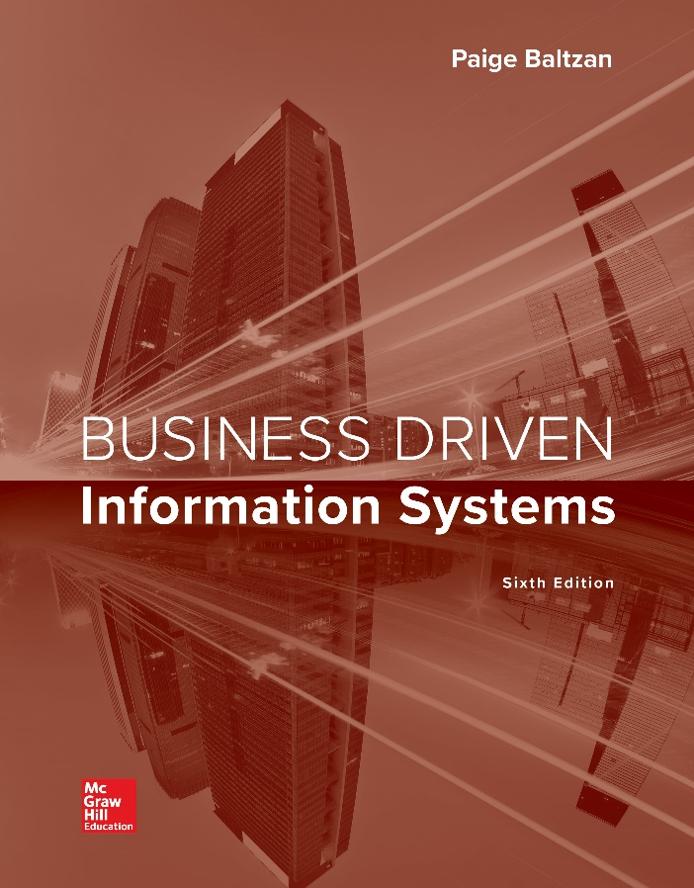
CHAPTER SEVEN
Networks:
Mobile Business
網絡和電信是為了通信而在一定距離上傳輸信號。 在現代，這個過程幾乎總是涉及電子發射器發送電磁波，但在早些年它可能涉及使用煙霧信號，鼓或信号灯旗语。
今天，網絡和電信普及，並且在世界許多地方普遍使用such as 電視，無線電和電話等設備。
還有大量網絡連接這些設備，包括計算機網絡，公共電話網絡，無線電網絡和電視網絡。 互聯網上的計算機通信，例如電子郵件和即時消息，只是電信的許多例子之一。
Notes:
Networks and telecommunications are the transmission of signals over a distance for the purpose of communication. In modern times, this process almost always involves the sending of electromagnetic waves by electronic transmitters but in earlier years it may have involved the use of smoke signals, drums or semaphore.
Today, network and telecommunication is widespread and devices that assist the process such as the television, radio, and telephone are common in many parts of the world.
There is also a vast array of networks that connect these devices, including computer networks, public telephone networks, radio networks, and television networks. Computer communication across the Internet, such as email and instant messaging, is just one of many examples of telecommunication.

Slide 2
Chapter Seven Overview
SECTION 7.1 – Connectivity: The Business Value of a Networked World
Overview of a Connected World
Benefits of a Connected World
Challenges of a Connected World
SECTION 7.2 – Mobility: The Business Value of a Wireless World
Wireless Network Categories
Business Applications of Wireless Networks
Benefits of Business Mobility
Challenges of Business Mobility

Slide 3
Section 7.1
CONNECTIVITY
Notes:
CLASSROOM OPENER
Start the class by asking students who understands how the Internet works? How does email go from the University of Denver to Boston University? Or how does a web page go from client to server back to client?
Go to http://computer.howstuffworks.com/internet-infrastructure.htm for an overview of how the Internet infrastructure works. There are some great diagrams and easy to understand explanations.

Slide 4
Learning Outcomes 1 of 2
7.1 Explain the five networking elements creating a connected world.
7.2 Identify the benefits and challenges of a connected world.
計算機網絡在全球持續運營，支持我們全天候和始終保持聯繫的生活方式。
你現在可能正在使用幾個不同的網絡，甚至沒有意識到它。
您可能正在使用學校的網絡與教師進行通信，使用電話網絡與朋友進行通信，使用有線網絡觀看電視或收聽廣播。
網絡電信或信息交換（語音，文本，數據，音頻，視頻）。
電信業已經從政府監管的壟斷轉變為放鬆管制的市場，許多供應商都在激烈競爭。

Slide 5
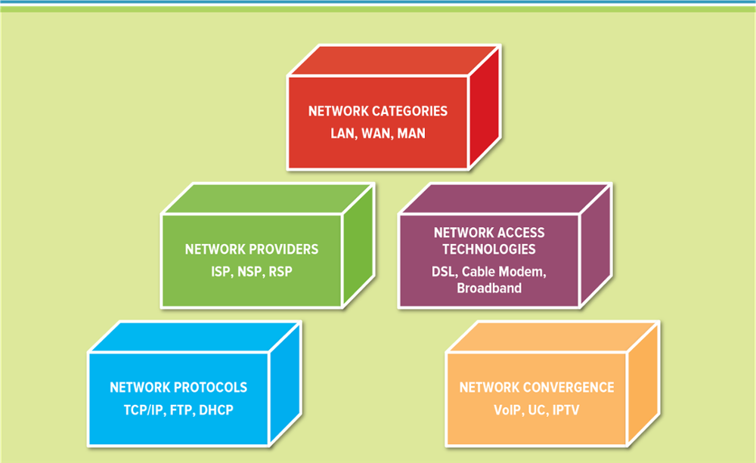
Figure 7.1 Networking Elements Creating a Connected World
Jump to long image description
Notes:
Computer networks are continuously operating all over the globe supporting our 24/7/365 always on and always connected lifestyles.
You are probably using several different networks right now without even realizing it.
You might be using a school’s network to communicate with teachers, a phone network to communicate with friends, and a cable network to watch TV or listen to the radio.
Networks enable telecommunications or the exchange of information (voice, text, data, audio, video).
The telecommunication industry has morphed from a government-regulated monopoly to a deregulated market where many suppliers ferociously compete.

Slide 6
Network Categories
Local area network (LAN) – Connects a group of computers in close proximity接近, such as in an office building, school, or home
Wide area network (WAN) – Spans a large geographic area such as a state, province, or country
Metropolitan area network (MAN) – A large computer network usually spanning a city
Notes:
The SABRE airline reservation system is a classic example of a strategic information system that depends upon communication provided through a network.
SABRE Airline Solutions pioneered technological advances for the industry in areas such as revenue management, pricing, flight scheduling, cargo, flight operations, and crew scheduling.
In addition, not only did SABRE help invent e-commerce (now referred to as ebusiness) for the travel industry, the company holds claim to progressive solutions that defined, and continue to revolutionize, the travel and transportation marketplace.
It is very important, for example, for managers to be able to retrieve overall corporate sales forecasts from corporate databases to use in developing spreadsheets (or any other program used for business analysis) to project future activity.
In order to satisfy customers, automobile dealers need to be able to locate particular vehicle models and colors with specific equipment installed.
Managers at various points in a supply chain need to have accurate, up-to-date data on inventory levels and locations.
Accountants at corporate headquarters need to be able to retrieve summary data on sales and expenses from each of the company's divisional computer centers.
The chief executive officer, using an executive information system, needs to be able to access up-to-the-minute data on business trends from the corporate network.
An organization has to be concerned about proper identification of users and authorization of network access, the control of access, and the protection of data integrity. Almost all networks require some kind of logon, including user name and password. Many people are casual with their passwords, making them easy to guess. A good password has both letters and numbers along with a few punctuation marks for added security. Most corporate security goes far beyond passwords such as using a "firewall," a computer that sits between an internal network and the Internet. The firewall allows access to internal data from specified incoming sites but tries to detect unauthorized access attempts and prevent them from occurring.

Slide 7
Network Providers
National service providers (NSPs) – Private companies that own and maintain the worldwide backbone that supports the Internet國家級服務供商
Network access points (NAPs) – Traffic exchange points in the routing hierarchy of the Internet that connects NSPs網路進出點
Regional service providers (RSPs) – Offer Internet service by connecting to NSPs, but they also can connect directly to each other

Slide 8
Network Access Technologies 1 of 2
Bandwidth – The maximum amount of data that can pass from one point to another in a unit of time
Bit
Bit rate
Modem
Bit是Binary digit（二進位數位）的縮寫，資訊的最小單位, 由數學家John Wilder Tukey提出（可能是1946年提出)
Bit Rate: The number of bits transferred or received per unit of time.
Modem: A device that enables a computer to transmit and receive data.
Notes:
T1 line: A type of data connection able to transmit a digital signal at 1.544 Mpbs.
Bit Rate: The number of bits transferred or received per unit of time.
Modem: A device that enables a computer to transmit and receive data.
To transmit one page of text over a 128,000 bps (128 kbps) DSL line would take only four-tenths of a second. Graphics require approximately one million bits for one page. This would require about 8 seconds over a 128 kbps DSL line. Full-motion video transmission requires the enormous bandwidth of 12 million bps, and thus data compres­sion techniques must be employed to be able to send video over the existing telephone network. The bandwidth determines what types of communication (voice, data, graphics, full-motion video) can reasonably be transmitted over a particular medium.

Slide 9
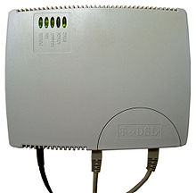
Network Access Technologies 2 of 2
Broadband – A high-speed Internet connection that is always connected
Digital subscriber lineInternet cable connection
High speed Internet cable connections
Cable modem
Telecommuting遠程辦公
Broadband over power line電力線寬頻，是一種允許在公共電力線上進行高速率資料傳輸的電力線通訊技術。
Digital subscriber line (DSL) Allows high-speed digital data transmission over standard telephone lines.數位用戶迴路
通過銅線或者本地電話網提供數位連接的一種技術。它的歷史要追溯到1988年
Notes:
Digital subscriber line (DSL) Allows high-speed digital data transmission over standard telephone lines.
Internet cable connection Provides Internet access using a cable television company’s infrastructure and a special cable modem.
T1 line A type of data connection able to transmit a digital signal at 1.544 Mpbs.

Slide 10
Network Protocols 1 of 2
Protocol – A standard that specifies the format of data as well as the rules to be followed during transmission
Transmission control protocol/Internet protocol (TCP/IP) – Provides the technical foundation for the public Internet as well as for large numbers of private networks
Domain name system – Converts IP addresses into domains
協定:包括對資料格式，同步方式，傳送速度，傳送步驟，檢糾錯方式以及控制字元定義等問題做出統一規定，通信雙方必須共同遵守
誰來定技術標準呢？IAB (Internet Activities Board) 提供網際網路的發展方向和訂定技術標準。IAB 下設有兩個單位：Internet Engineering Task Force (IETF) 和 Internet Research Task Force (IRTF)。Internet Engineering Task Force (IETF) 專責於技術標準之制定；Internet Research Task Force (IRTF) 則努力於研究 Internet 上的未來方向。
Notes:
Protocol: A standard that specifies the format of data as well as the rules to be followed during transmission
Transmission control protocol/Internet protocol (TCP/IP): Provides the technical foundation for the public Internet as well as for large numbers of private networks
Domain name system: Converts IP addresses into domains
Computers using the same protocol can communicate easily, providing accessibility, scalability, and connectability between networks.
One of the primary reasons for developing TCP/IP was to allow diverse or differing networks to connect and communicate with each other, essentially allowing LANs, WANs, and MANs to grow with each new connection.

Slide 11
DNS
全世界最上源的dns伺服器叫root name server 。他負責解析全世界所有的域名，所有的計算機想找其他域名的設備都需先問它。那麼隨著計算機越來越多，根域名伺服器很累。於是老美又給它創造了12個兄弟，分散世界各地，其中美洲最多，有9個，歐洲有2個，亞洲有1個，可是還不夠用。後來其他國的運營商分分創建DNS伺服器去學習它們(與他們同步解析數據)，以保證他們的用戶能快速解析域名。 A root name server is a “name server” for the root zone of the Domain Name System (DNS) of the Internet.
Making money = USA=US $
美國人把全世界的各各地區的域名規劃好後，開始全球賣域名，於是就有了新網萬網等域名代理商。隨著域名需求量越來越大，好多人有喜歡加錢買公司行號域名再去高價賣。

Slide 12
Network Protocols 2 of 2
Packet is a single unit of binary data routed(sent) through a network
Standard packet format include a packet header, packet body containing the original message, and packet footer
Packet header lists the destination (IP address) along with the length of the message data
Packet footer represents the end of the packet or transmission end
Traceroute utility application that monitors the network path of packet data sent to a remote computer
Proxy: A proxy is software that prevents direct communication between sending and receiving computer and is used to monitor packets for security reasons代理伺服器
Notes:
A packet is a single unit of binary data routed through a network.
Packets directly impact network performance and reliability by subdividing an electronic message into smaller more manageable packets.
Standard packet formats include a packet header, packet body containing the original message, and packet footer.
The packet header lists the destination (for example in IP packets the destination is the IP address) along with the length of the message data.
The packet footer represents the end of the packet or transmission end.
The packet header and packet footer contain error-checking information to ensure the entire message is sent and received. The receiving device reassembles the individual packets into the original by stripping off the headers and footers and then piecing together the packets in the correct sequence.
Traceroute is a utility application that monitors the network path of packet data sent to a remote computer.
Traceroute programs send a series of test messages over the network (using the name or IP address) until the last message finally reaches its destination.
When finished, traceroute displays the path from the initial computer to the destination computer.
A proxy is software that prevents direct communication between asending and receiving computer and is used to monitor packets for security reasons.

Slide 13
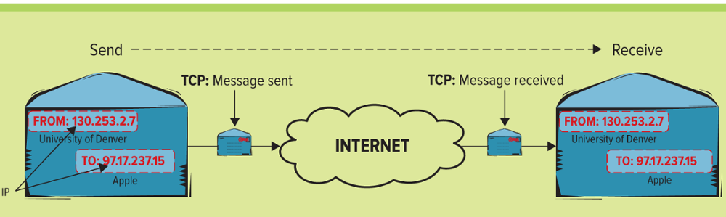
Figure 7.6 Example of TCP/IP
Network access technologies use a standard Internet protocol called transmission control protocol/Internet protocol (TCP/IP), which provides the technical foundation for the public Internet as well as for large numbers of private networks
Jump to long image description
Notes:
Network access technologies use a standard Internet protocol called transmission control protocol/Internet protocol (TCP/IP), which provides the technical foundation for the public Internet as well as for large numbers of private networks.
One of the primary reasons for developing TCP/IP was to allow diverse or differing networks to connect and communicate with each other, essentially allowing LANs, WANs, and MANs to grow with each new connection.
An IP address is a unique number that identifies where computers are located on the network. IP addresses appear in the form of xxx.xxx.xxx.xxx, though each grouping can be as short as a single digit.

Slide 14
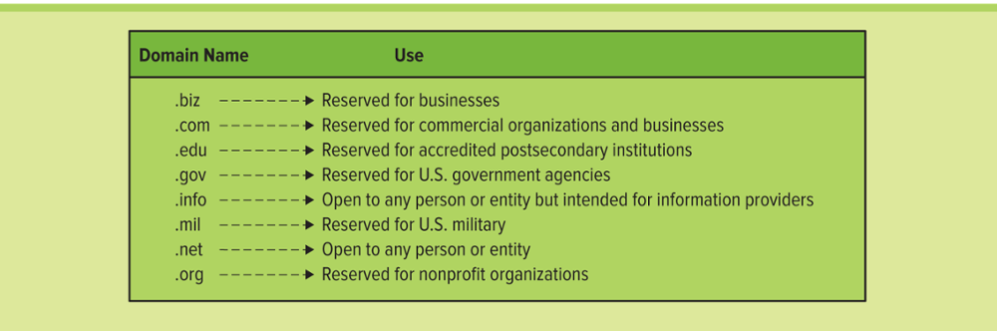
Figure 7.7 Internet Domains
If there is one flaw in TCP/IP, it is the complexity of IP addresses.
This is why we use a domain name system (DNS) to convert IP addresses into domains, or identifying labels that use a variety of recognizable naming conventions. Therefore, instead of trying to remember 97.17.237.15, users can simply specify a domain name to access a computer or website, such as www.apple.com
Jump to long image description
Notes:
If there is one flaw in TCP/IP, it is the complexity of IP addresses.
This is why we use a domain name system (DNS) to convert IP addresses into domains, or identifying labels that use a variety of recognizable naming conventions. Therefore, instead of trying to remember 97.17.237.15, users can simply specify a domain name to access a computer or website, such as www.apple.com

Slide 15
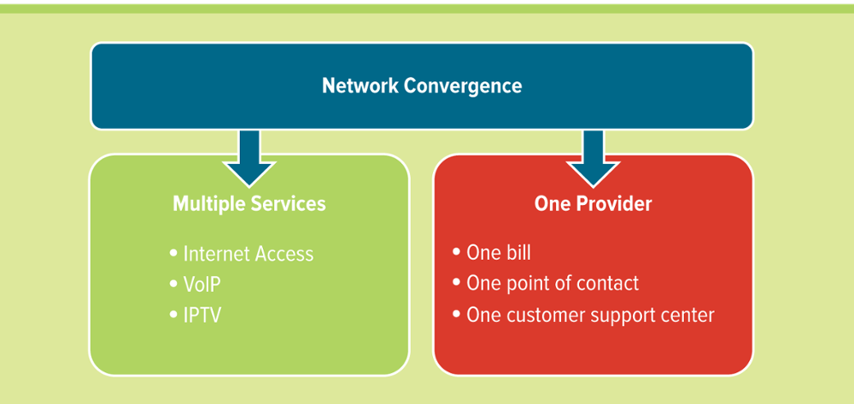
Figure 7.8 Benefits of Network Convergence
Network convergence – The efficient coexistence of telephone, video, and data communication within a single network, offering convenience and flexibility not possible with separate infrastructures
Jump to long image description
Notes:
In part due to the explosive use of the Internet and connectivity of TCP/IP, there is a convergence of network devices, applications, and services.
Consumers, companies, educational institutions, and government agencies extensively engage in texting, Web surfing, videoconference applications, online gaming, and ebusiness.

Slide 16
Network Convergence
Unified communication (UC) – The integration of communication channels into a single service
Peer-to-peer (P2P) – A computer network that relies on the computing power and bandwidth of the participants in the network rather than a centralized server
The benefits of network convergence allow for multiple services, multiple devices, but one network, one vendor, and one bill.
Notes:
Unified communications (UC):The integration of communication channels into a single service
Voice over IP (VoIP): Uses IP technology to transmit telephone calls.
Almost any type of information can be converted into digital form and exchanged over a network.
Network convergence then allows the weaving together of voice, data, and video.
The benefits of network convergence allow for multiple services, multiple devices, but one network, one vendor, and one bill.

Slide 17
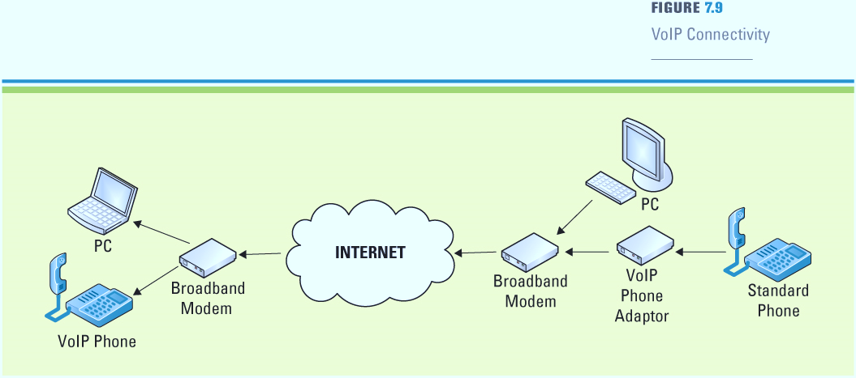
Figure 7.9 VoIP Connectivity
Voice over IP (VoIP) – Uses IP technology to transmit telephone calls
Internet Protocol TV (IPTV) – Distributes digital video content using IP across the Internet and private IP networks
遺憾的是，VoIP通過網絡流量使用的相同路徑路，因此它受到Internet威脅。 VoIP流量與數據非常相似可以攔截，捕獲或修改。 任何可能會使服務速度變慢或降級的威脅都會破壞業務。 因此，必須保護VoIP流量
Jump to long image description
Notes:
Numerous vendors offer VoIP services; however, the service works differently depending on the vendor’s IT infrastructure
The start-up Skype pairs P2P (peer-to-peer) technology with a PC’s sound card to create a voice service, which the user can use to call other Skype users
Vonage lets the user place calls to any person who has a mobile or landline (regular telephone) number
Vonage sends the call over a cable via a digital-to-analog converter
A few providers even offer an adapter for a traditional handset that plugs into a broadband modem
All of these vendors are providing VoIP, but the service and its features can vary significantly
Unfortunately, VoIP routes calls through the same paths used by network and Internet traffic, therefore it has the same vulnerabilities and is subject to the same Internet threats. Much like data, VoIP traffic can be intercepted, captured or modified. Any threat that slows down or degrades service even slightly will disrupt business. As a result, VoIP traffic must be secured.

Slide 18
Benefits of a Connected World
Networks offer many advantages for a business including:
Sharing resources
Providing opportunities
Reducing travel移動
在網絡之前，在計算機之間傳輸數據既費時又費力。人們不得不使用磁碟將數據從一台機器複製到另一台機器。
網絡是誘人的惡作劇和欺詐目標
Notes:
Before networks, transferring data between computers was time-consuming and labor intensive.
People had to physically copy data from machine to machine using a disk.
Networks offer many advantages for a business including:
Sharing resources
Providing opportunities
Reducing travel
There have been many network security problems, networks are a tempting target for mischief and fraud
An organization has to be concerned about:
Proper identification of users and authorization of network access
The control of access, and the protection of data integrity

Slide 19
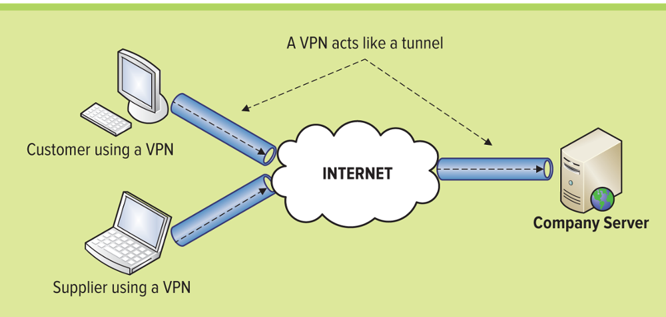
Figure 7.12 Using a VPN
The primary resources for sharing include:
Intranet
Extranet
Virtual private network
Why would a VPN be important to a business?
With security on the rise, keeping electronic records safe is an area of concern for many businesses
Notes:
Intranet: A restricted network that relies on Internet technologies to provide an Internet-like environment within the company for information sharing, communications, collaboration, web publishing, and the support of business process.
Extranet: An extension of an intranet that is only available to authorized outsiders, such as customers, partners, and suppliers.
Virtual private network (VPN): Companies can establish direct private network links among themselves or create private, secure Internet access, in effect a “private tunnel” within the Internet.
Why would a VPN be important to a business?
With security on the rise, keeping electronic records safe is an area of concern for many businesses

Slide 20
Challenges of a Connected World
Networks create a diverse, globally-connected world eliminating time and distance, which makes it possible to communicate in ways not previously imaginable
Even though networks provide many business advantages, they also create increased challenges in security, social, ethical, and political issues
聯邦通信委員會（FCC）禁止在飛機上使用手機，因為它們可能會對地面上的手機系統造成嚴重破壞。當您在地面上附近使用時，手機發出的信號只能到達您附近的幾個手機節點，而獲得最強信號的節點會連結您的電話。然而，從空中，你的手機信號可以達到英里，同時連結到許多節點，所有節點都具有相同的強度。另外，你的速度是每小時幾百英里。手機系統並未設計解決這個問題。
美國聯邦航空管理局支持FCC禁令。他們擔心手機可能會干擾導航和其他飛機系統。
航空公司機組人員提報的事故報告也證明了潛在的​​麻煩。其副標題是“乘客表現不佳”，其中包含一些涉及乘客的事件的報告，這些乘客的“個人電子設備”似乎在飛機的電子系統中造成干擾。
Notes:
Ask your students what types of issues they see with a connected world?
CLASSROOM EXERCISE
Cell Phones and Airplanes
Break your students into groups and ask them to research the Internet to find the reasons why people are required to turn off their cell phones when they are on an airplane. There are two reasons why cell phones are not allowed on an airplane:
The Federal Communication Commission (FCC) bans the use of cell phones on airplanes because they could wreak havoc with cell phone systems on the ground. Signals from your cell phone, when you use it on or near the ground, reach just a few cell phone nodes near you and the node that is getting the strongest signal picks up your call. If you move, while driving your car or walking, the next node picks up the call. From the air, however, your phone's signal could reach miles, hitting many nodes at once, all with equal strength. Plus, you are moving at several hundred miles an hour. Cell phone systems were not designed to handle that.
The Federal Aviation Administration, for its part, supports the FCC ban for its own reasons. They fear cell phones may interfere with navigation and other aircraft systems.
Incident reports submitted by airline crews also demonstrate the potential for trouble. NASA's Aviation Safety Reporting System's "Passenger Electronic Devises Database Report Set“, which could be subtitled "passengers behaving badly“, contains several reports of incidents involving passengers whose "personal electronic devices" seemed to create disturbances in aircrafts' electronic systems.

Slide 21
Security
SSL Certificate – An electronic document that confirms the identity of a website or server and verifies that a public key belongs to a trustworthy individual or company
Secure hypertext transfer protocol (SHTTP or HTTPS) –A combination of HTTP and SSL to provide encryption and secure identification of an Internet server
公司首先必須確保正確識別使用者身份和網絡存取權限。例如，外部供應商可能被允許通過公司的外聯網存取生產計劃，但他們無法查看其他信息，如財務記錄。
公司還應保持其資料的完整性; 只允許有資格的用戶更改和更新資料，並且只保留正確的資料。
互聯網上的安全問題愈演愈烈，公司需要防範欺詐，無效購買和信用卡信息的盜用。
Notes:
SSL Certificate: An electronic document that confirms the identity of a website or server and verifies that a public key belongs to a trustworthy individual or company.
Secure hypertext transfer protocol (SHTTP or HTTPS): A combination of HTTP and SSL to provide encryption and secure identification of an Internet server.
Networks are a tempting target for mischief and fraud. A company first has to ensure proper identification of users and authorization of network access.
Outside suppliers might be allowed to access production plans via the company’s extranet, for example, but they must not be able to see other information such as financial records.
The company should also preserve the integrity of its data; only qualified users should be allowed to change and update data, and only well-specified data.
Security problems intensify on the Internet where companies need to guard against fraud, invalid purchases, and misappropriation of credit card information.

Slide 22
Social, Ethical, and Political Issues
Digital divide – A worldwide gap giving advantage to those with access to technology
數位落差是指社會上不同性別、種族、經濟、居住環境、階級背景的人，接近使用數位產品（如電腦或是網路）的機會與能力上的差異。
優缺
Social, Ethical, and Political
Notes:
Only a small fraction of the world’s population has access to the Internet, and some people who have had access in the past have lost it due to changes in their circumstances such as unemployment or poverty.
Providing network access to those who want or need it helps to level the playing field and removes the digital divide, a worldwide gap giving advantage to those with access to technology.
Some organizations are trying to bridge the divide such as the Boston Digital Bridge Foundation, which concentrates on local schoolchildren and their parents, helping to make them knowledgeable about computers, programs, and the Internet.
Other organizations provide inexpensive laptops and Internet access in low-income areas in developing countries

Slide 23
Section 7.2
MOBILITY
Notes:
CLASSROOM OPENER
HowStuffWorks
Start the class by asking students who understands how the Internet works? How does email go from the University of Denver to Boston University? Or how does a web page go from client to server back to client?
Go to http://computer.howstuffworks.com/internet-infrastructure.htm for an overview of how the Internet infrastructure works. There are some great diagrams and easy to understand explanations.

Slide 24
Learning Outcomes 2 of 2
7.3 Explain the different wireless network categories.
7.4 Explain the different wireless network business applications.

Slide 25
Wireless Network Categories
Wireless networks
Personal area networks (PAN) – Provide communication over a short distance that is intended for use with devices that are owned and operated by a single user
Wireless LAN (WLAN) – A local area network that uses radio signals to transmit and receive data over distances of a few hundred feet無線電波，有時也稱無線電、射頻等，是一種電磁波
Wireless MAN (WMAN) – A metropolitan area network that uses radio signals to transmit and receive data
Wireless WAN (WWAN) – A wide area network that uses radio signals to transmit and receive data
Notes:
Personal area networks (PAN): Provide communication over a short distance that is intended for use with devices that are owned and operated by a single user.
Wireless LAN (WLAN): A local area network that uses radio signals to transmit and receive data over distances of a few hundred feet.
Wireless MAN (WMAN): A metropolitan area network that uses radio signals to transmit and receive data.
Wireless WAN (WWAN): A wide area network that uses radio signals to transmit and receive data.
Companies worldwide are going wireless to increase productivity, speed delivery to market, and reduce operating costs
Wireless transmissions rely on radio waves, microwaves, and satellites to send data across high frequency radio ranges that later connect to wired media
Untethered connectivity, anytime, anywhere, has fueled a major market and technology disruption, which has permeated almost every consumer market worldwide. The domino effect of the success of wireless technology has resulted in a unique opportunity for innovation and creativity in technology, marketing, and business strategy.

Slide 26
Personal Area Network
Personal area networks (PAN) – Provide communication over a short distance that is intended for use with devices that are owned and operated by a single user
Bluetooth – Wireless PAN technology that transmits signals over short distances between cell phones, computers, and other devices
一種無線通訊技術標準，用來讓固定與行動裝置，在短距離間交換資料，以形成個人區域網路
Notes:
Since Bluetooth’s development in 1994 by the Swedish telecommunications company Ericsson, more than 1,800 companies worldwide have signed on to build products to the wireless specifications
Bluetooth is named to honor a 10th century Viking Kind, Harold Bluetooth, who is credited with uniting Denmark and bringing order to the country

Slide 27
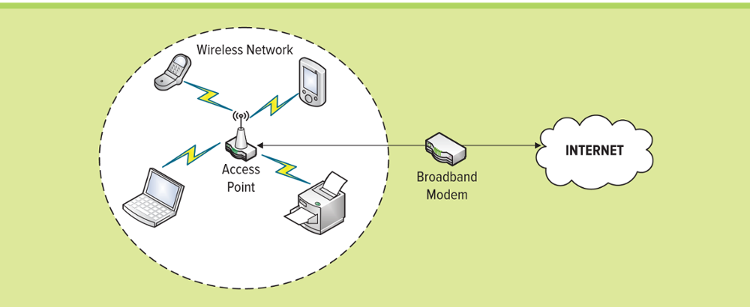
Figure 7.14 Wi-Fi Networks
Wireless LAN (WLAN) – A local area network that uses radio signals to transmit and receive data over distances of a few hundred feet
Wireless fidelity (Wi-Fi) – A means by which portable devices can connect wirelessly to a local area network, using access points that send and receive data via radio waves IEEE 802.11
Notes:
Wireless fidelity (Wi-Fi): A means by which portable devices can connect wirelessly to a local area network, using access points that send and receive data via radio waves.
802.11: A set of standards carrying out wireless local area network communication.
Wireless LAN (WLAN): A local area network that uses radio signals to transmit and receive data over distances of a few hundred feet.
The terms mobile and wireless are often used synonymously, but actually denote two different technologies
Mobile means the technology can travel with the user, but it is not necessarily in real-time
Wireless gives users a live (Internet) connection via satellite or radio transmitters
Wireless technologies are transforming how we live, work, and play
Handheld devices are continuing to offer additional functionality, and cellular networks are advancing rapidly in their increased speed and throughput abilities
These enabling technologies are fueling widespread adoption and creation of new and innovative ways to perform business
Ask your students how many of them are currently using these types of wireless devices
Ask your students to discuss additional types of wireless devices that they are currently using
Ask your students to define additional types of wireless devices that they are not currently using

Slide 28
Wireless LAN
Access point – The computer or network device that serves as an interface between devices and the network
Wireless access point – Enables devices to connect to a wireless network to communicate with each other
Multiple-in/multiple-out technology – Multiple transmitters and receivers allowing them to send and receive greater amounts of data than traditional networking devices

Slide 29
Wireless MAN
Wireless MAN (WMAN) – A metropolitan area network that uses radio signals to transmit and receive data
WiMAX技術最早提出時，WiMAX定位是取代WiFi的一種新的無線傳輸方式，但後來發現WiMAX定位比較像3.5G一樣
WiMAX全面撤台:
繼大同電信撤出WiMAX市場，全球一動也因基地台設定不夠，計畫書附加三項條件未達之由被NCC停發證照，雖其曾行使行政訴訟訴願成功，但NCC仍堅持原則。對此全球一動董事長表示，原本支援政府政策投資，結果Intel臨時收手，根本沒有誠信可言。而威達電通則痛斥LTE業者做大，政府卻不允許WiMAX業者換照。
Notes:
Wireless MAN (WMAN) A metropolitan area network that uses radio signals to transmit and receive data.
Worldwide Interoperability for Microwave Access (WiMAX) A communications technology aimed at providing high-speed wireless data over metropolitan area networks.
Ask your students how many wireless devices they use to perform their jobs
How many wireless devices do they think they will need in the future to perform their jobs?
Ans: Hopefully, just one
Can you name any additional technologies?
Online description and diagram on how WiMAX works
http://computer.howstuffworks.com/wimax1.htm

Slide 30
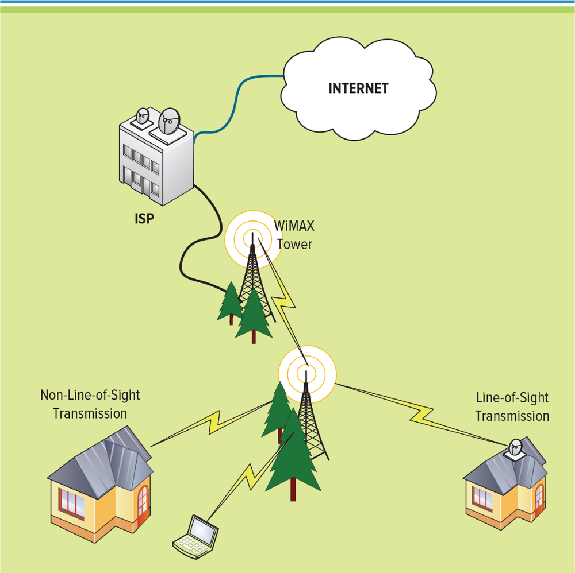
Figure 7.16 WiMAX Infrastructure
Worldwide Interoperability for Microwave Access (WiMAX) – A communications technology aimed at providing high-speed wireless data over metropolitan area networks
WiMAX塔站可以使用高寬頻有線連接（如，T3線路）直接連接到Internet。 它還可以使用視距微波連接到另一個WiMAX塔。 這種與第二個塔（通常稱為回程）的連接，以及單個塔覆蓋多達3,000平方英里的能力，使WiMAX能夠為偏遠的農村地區提供覆蓋。
Jump to long image description
Notes:
Wireless MAN (WMAN): A metropolitan area network that uses radio signals to transmit and receive data.
Worldwide Interoperability for Microwave Access (WiMAX): A communications technology aimed at providing high-speed wireless data over metropolitan area networks.
The latest trends in cell phones reflect a convergence of voice, video and data communications
By blending information with entertainment, cell phones are center-stage in the evolving trend of mobile infotainment
A WiMAX tower station can connect directly to the Internet using a high-bandwidth, wired connection (for example, a T3 line). It can also connect to another WiMAX tower using a line-of-sight, microwave link. This connection to a second tower (often referred to as a backhaul), along with the ability of a single tower to cover up to 3,000 square miles, is what allows WiMAX to provide coverage to remote rural areas.

Slide 31
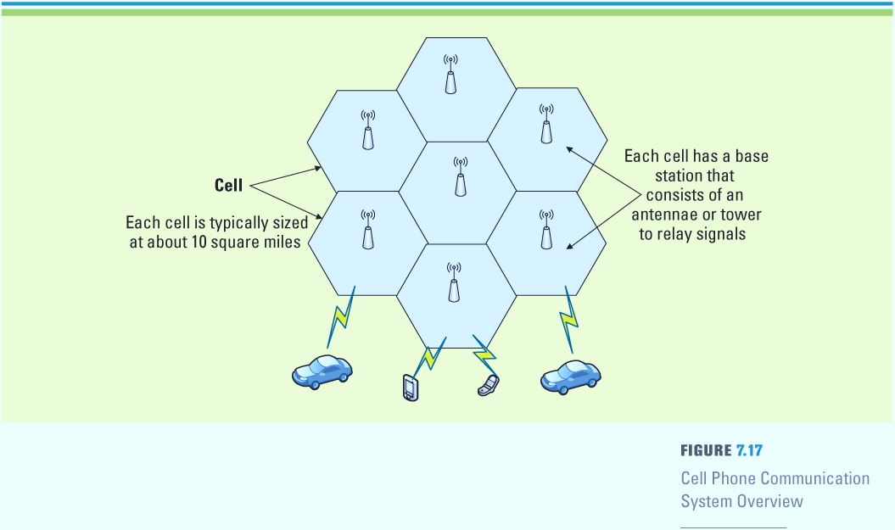
Figure 7.17 Cell Phone Communication System
Wireless WAN (WWAN) – A wide area network that uses radio signals to transmit and receive data
Jump to long image description
Notes:
Cellular telephones (cell phones) work by using radio waves to communicate with radio antennas (or towers) placed within adjacent geographic areas called cells
A telephone message is transmitted to the local cell by the cellular telephone and then is passed from antenna to antenna, or cell to cell
In less than twenty years, the mobile telephone has gone from being rare, expensive equipment of the business elite to a pervasive, low-cost personal item. Several countries, including the UK, now have more mobile phones than people. There are over five hundred million active mobile phone accounts in China. Luxembourg has the highest mobile phone penetration rate in the world, at 164%. The total number of mobile phone subscribers in the world was estimated at 3.3 billion at the end of 2007, thus reaching an equivalent of over half the planet's population. At present, Africa has the largest growth rate of cellular subscribers in the world, its markets expanding nearly twice as fast as Asian markets. The availability of prepaid or 'pay-as-you-go' services, where the subscriber is not committed to a long-term contract, has helped fuel this growth in Africa as well as in other continents.

Slide 32
Wireless WAN - Cellular
Smart phone – Offer more advanced computing ability and connectivity than basic cell phones
3G – A service that brings wireless broadband to mobile phones
Streaming – A method of sending audio and video files over the Internet
第一代成功的PDA是Palm Pilots。 它們主要用作電子記事本，支持地址簿，日曆，電子郵件，筆記等.PDA僅偶爾需要連接到PC以進行“同步”。 例如，PDA可以通過USB與PC連接日曆和電子郵件收件箱同步。 較新的PDA型號還可以通過藍牙無線連接到PC，或通過無線連接到Internet。
Notes:
The first generation of successful PDAs were Palm Pilots. They primarily functioned as electronic organizers with support for address books, calendars, email, notes, etc. The PDA only occasionally needs to connect to a companion PC for "synchronization." For instance, a PDA can be synchronized with a PC address book, calendar, and email inbox, via a USB cable. Newer PDA models can also connect to PCs wirelessly via Bluetooth (which we describe in the next section), or connect to the Internet via wireless.
Personal digital assistants (PDA) are small, handheld computers capable of entirely digital communications transmission

Slide 33
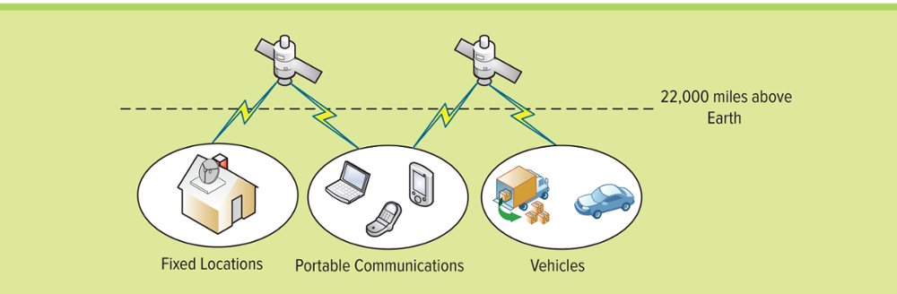
Figure 7.19 Satellite Communication System
Satellite – A space station that orbits the Earth3繞行盘旋receiving and transmitting signals from Earth-based stations over a wide area
Jump to long image description
Notes:
General Motors is serious about satellite radio, and the amount of nameplates that offer standard XM is growing all the time. Previously, GM made XM standard on all Cadillacs, and now the subscription radio service will also be available for all new Buick, HUMMER, and Saab models as well. The move enlarges XM's customer base while also giving new-car drivers a chance to test the technology for three months free of charge.

Slide 34
Protecting Wireless Connections
Wired equivalent privacy (WEP) – An encryption algorithm designed to protect wireless transmission data又稱無線加密協議
War chalking – The practice of tagging pavement with codes displaying where Wi-Fi access is available
將已發現的基地台留下記號方便其他人找尋叫做 "War Chalking"
War driving – Deliberately searching for Wi-Fi signals有意 while driving by in a vehicle捧著電腦到處找尋可用的基地台叫 "War driving"
Notes:
Wired equivalent privacy (WEP) is an encryption algorithm designed to protect wireless transmission data.
If using a Wi-Fi connection, WEP encrypts the data using a key converting the data into a non-human readable form.
The purpose of WEP was to provide wireless networks with the equivalent level of security as wired networks.
Unfortunately, the underlying technology behind WEP has been demonstrated to be relatively insecure compared to newer protocols such as WPA. WLANs that use Wi-Fi have a built-in security mechanism called
Wi-Fi Protected Access (WPA): a wireless security protocol to protect Wi-Fi networks.
It is an improvement on the original Wi-Fi security standard, Wired Equivalent Privacy (WEP), and provides more sophisticated data encryption and user authentication.
Anyone who wants to use an access point must know the WPA encryption key to access the Wi-Fi connection.
War chalking is the practice of tagging pavement with codes displaying where Wi-Fi access is available.
The codes for war chalking tell other users the kind of access available, the speed of the network, and if the network is secured.
War driving is deliberately searching for Wi-Fi signals while driving by in a vehicle.
Many individuals who participate in war driving simply map where Wi-Fi networks are available

Slide 35
Managing Mobile Devices
IT consumerization
Mobile device management (MDM)
Mobile application management (MAM)
IT個人化原因：工作場合的移動性，使用自己的設備，社交網路，設備同步問題。現在IT個人化可行的Solution有：虛擬化、雲端，及虛擬化與雲端的混合方案。
行動裝置管理主要提供企業針對行動裝置(例如：smart phone、Pad.....)進行管理的一個服務，使企業能在不干擾使用者情況下，透過無線方式快速管理行動裝置，其功能包括：• 安全管理 • 政策管理 • 軟體部署 • 資產管理
行動應用管理 (Mobile Application Management, MAM) 負責組態和控制對公司提供的自攜裝置(BYOD)，如智慧型手機或平板電腦的軟體設定中，使用內部開發和商業的行動應用的軟體和服務。
行動應用管理在應用程式層級提供精細控制，使管理員能夠管理和保護應用程式資料。行動應用管理(MAM)不同於行動裝置管理（MDM），其重點是控制整個裝置，並要求用戶註冊他們的裝置並安裝服務代理。
Notes:
Ask your students how much IT consumerization matters to them. Many students today expect seamless integration among their devices.
Ask your students how they see MDM and MAM being applied to a company
How are your students currently managing their mobile devices to sync email, text messages, etc.?

Slide 36
Business Applications of Wireless Networks
Areas experiencing tremendous growth using wireless technologies include:
Radio-frequency identification (RFID)
Global positioning systems (GPS)
Geographic information systems (GIS)
Notes:
MasterCard now provides cardholders with a mobile, location-based search and directory service, so they can request the location of the nearest ATM be sent to their mobile phone via SMS (Short Message Service, aka “text message”). The service, which works with all major mobile operators in the United States, is provided by MasterCard to cardholders free of charge (although operator text message rates may apply).
The most popular location based service used today is Global Positioning System (GPS)
The GPS is owned and operated by the U.S. Department of Defense but is available for general use around the world. In 1993, the Defense Department made this global positioning technology available for commercial use to anyone who has a GPS device. GPS devices have special microprocessors that analyze satellite signals.

Slide 37
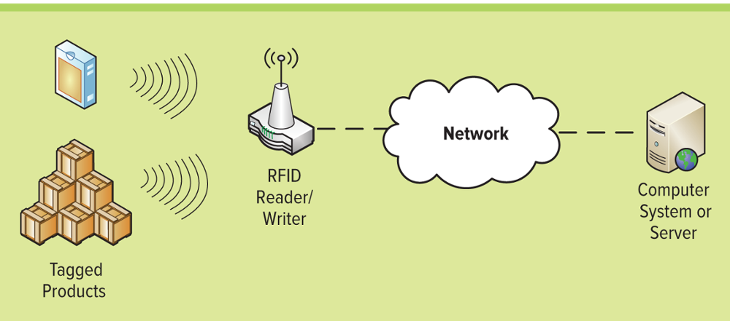
Figure 7.21 Elements of an RFID system
Radio frequency identification (RFID) – Uses electronic tags and labels to identify objects wirelessly over short distances
Notes:
Describe RFID and how it can be used to help make a supply chain more effective?
Integrating RFID in the supply chain will change the way a companies operate from managing maintenance, combating theft, to augmenting Sarbanes-Oxley initiatives
RFID tag: contains a microchip and an antenna, and typically work by transmitting a serial number via radio waves to an electronic reader, which confirms the identity of a person or object bearing the tag
Walk through each of the three components to an RFID system
CLASSROOM EXERCISE
RFID
Have your students find examples of RFID tags on the Internet
How big are the tags?
How are the tags being used?
What are the business ramifications of plastic RFID tags?
Washable
Weather resistant (can be used outside)
RFID tags will be added to every product and shipping box
At every step of an item’s journey, a reader scans one of the tags and updates the information on the server
Manufacturers and retailers can observe sales patterns in real-time and make swift decisions about production, ordering, and pricing

Slide 38
Radio Frequency Identification (RFID) 1 of 2
RFID tag – An electronic identification device that is made up of a chip and antenna
RFID reader (RFID interrogator) – A transmitter/receiver that reads the contents of RFID tags in the area
Passive RFID tag – Does not have a power source
Active RFID tag – Contains a transmitter and a power source (typically a battery)
Notes:
An RFID tag is an electronic identification device that is made up of a chip and antenna.
An RFID reader (RFID interrogator) is a transmitter/receiver that reads the contents of RFID tags in the area
Passive RFID tags do not have a power source, whereas active RFID tags have their own transmitter and a power source (typically a battery).
The power source runs the microchip’s circuitry and broadcasts a signal to the reader (similar to the way a cell phone transmits signals to a base station).
Passive RFID tags draw power from the RFID reader, which sends out electromagnetic waves that induce a current in the tag’s antenna.

Slide 39
Radio Frequency Identification (RFID) 2 of 2
Semipassive RFID tag – Uses a battery to run the microchip’s circuitry, but communicates by drawing power from the RFID reader
Asset tracking – Occurs when a company places active or semi-passive RFID tags on expensive products or assets to gather data on the items’ locations with little or no manual intervention
RFID accelerometer – A device that measures the acceleration (the rate of change of velocity) of an item and is used to track truck speeds or taxi cab speeds加速度計量器
Chipless RFID tag – Uses plastic or conductive polymers instead of silicon-based microchips, allowing them to be washed or exposed to water without damaging the chip
Notes:
Semipassive RFID tags use a battery to run the microchip’s circuitry, but communicate by drawing power from the RFID reader.
Asset tracking occurs when a company places active or semi-passive RFID tags on expensive products or assets to gather data on the items’ location with little or no manual intervention. Asset tracking allows a company to focus on its supply chain, reduce theft, identify the last known user of assets, and automate maintenance routines.
Active and semi-passive tags are useful for tracking high value goods that need to be scanned over long ranges, such as railway cars on a track.
The cost of active and semi-passive RFID tags is significant hence low-cost items typically use passive RFID tags.
RFID accelerometer is a device that measures the acceleration (the rate of change of velocity) of an item and is used to track truck speeds or taxi cab speeds.
Chipless RFID tags use plastic or conductive polymers instead of silicon-based microchips, allowing them to be washed or exposed to water without damaging the chip.

Slide 40
Global Positioning System 1 of 2
Global positioning system (GPS) – A satellite-based navigation system providing extremely accurate position, time, and speed information
Automatic vehicle location (AVL) – Uses GPS tracking to track vehicles
Latitude – Represents a north/south measurement of position
Longitude – Represents an east/west measurement of position
Notes:
A GIS is useful for mobile applications, but it offers benefits that go well beyond what is required in a mobile environment. For example, using a GIS, users can decide what information is and is not relevant to them, and formulate their queries based on their personal criteria. Unlike a paper map, a GIS allows for in-depth analysis and problem solving that can make marketing, sales, and planning much more successful.
Latitude represents a north/south measurement of position.
Longitude represents an east/west measurement of position.

Slide 41
Global Positioning System 2 of 2
Geocache – A GPS technology adventure game that posts the longitude and latitude location for an item on the Internet for users to find 寶可夢，地理藏寶
Geocoin – A round coin-sized object uniquely numbered and hidden in geocache
Estimated time of arrival (ETA) – The time of day of an expected arrival at a certain destination, typically used for navigation applications
Estimated time enroute (ETE) – The time remaining before reaching a destination using the present speed, typically used for navigation applications途中
Notes:
Geocache is a GPS technology adventure game that posts the longitude and latitude location for an item on the Internet for users to find.
GPS users find the geocache and typically sign a guest book or take an item and leave an item for the next adventure players to find.
Caches are often placed in locations that are interesting or challenging for people to discover.
A geocoin, a round coin-sized object, is uniquely numbered and hidden in geocache. Geocoins can also be shaped to match a theme such as the state of Colorado or a birthday party hat.
Geocoins are often decorative or commemorative, making them collectible and highly valuable for technology adventures.
GPS applications are in every kind of company vehicle these days, from police cars to bulldozers, from dump trucks to mayoral limousines. Emergency response systems use GPS to track each of their vehicles and so dispatch those closest to the scene of an accident.
If a vehicle is missing, its GPS locator can help locate it.
Estimated time of arrival (ETA) is the time of day of an expected arrival at a certain destination and is typically used for navigation applications.
Estimated time enroute (ETE) is the time remaining before reaching a destination using the present speed and is typically used for navigation applications.

Slide 42
Geographic Information System (GIS) 1 of 4
Geographic information system (GIS) – Consists of hardware, software, and data that provide location information for display on a multidimensional map
Google map商家資訊
Notes:
Automobiles have GPSs linked to maps that display in a screen on the dashboard driving directions and exact location of the vehicle. GM offers the OnStar system, which sends a continuous stream of information to the OnStar center about the car’s exact location. The OnStar Vehicle Diagnostics automatically performs hundreds of diagnostic checks on four key operating systems (the engine/transmission, antilock brakes, air bags, and OnStar systems) in GM vehicles. The vehicle is programmed to send the results via email to the owner each month. The unique email report also provides maintenance reminders based on the current odometer reading, remaining engine oil life, and other relevant ownership information.

Slide 43
Geographic Information System
GIS是一門綜合性學科，結合地理學與地圖學，已經廣泛的應用在不同的領域，可以分為以下五部分：
人員：是GIS中最重要的組成部分。開發人員必須定義GIS中被執行的各種任務，開發處理程式。熟練的操作人員通常可以克服GIS軟體功能的不足。
資料：精確可用的資料可以影響到查詢和分析的結果。
硬體：硬體的效能影響到處理速度，使用是否方便及可能的輸出方式。
軟體：不僅包含GIS軟體，還包括各種資料庫，繪圖、統計、影像處理及其它程式。
流程：GIS要求明確定義，一致的方法來生成正確的可驗證的結果。

Slide 44
Geographic Information System (GIS) 2 of 4
Cartography – The science and art of making an illustrated map or chart地圖學
Edge matching (warping, rubber sheeting) – Occurs when paper maps are laid edge to edge and items that run across maps but do not match are reconfigured to match邊緣匹配（變形，橡皮布）
GIS map automation – Links business assets to a centralized system where they can be tracked and monitored over time
Notes:
Cartography is the science and art of making an illustrated map or chart.
GIS allows users to interpret, analyze, and visualize data in different ways that reveal patterns and trends in the form of reports, charts, and maps.
Edge matching (warping, rubber sheeting) occurs when paper maps are laid edge to edge and items that run across maps but do not match are reconfigured to match.
Edge matching is a critical component of creating a GIS database because map misalignments occur frequently for many reasons, including survey error and cartographic errors.
GIS map automation links business assets to a centralized system where they can be tracked and monitored over time.

Slide 45
Geographic Information System (GIS) 3 of 4
Spatial data (geospatial data or geographic information) – Identifies the geographic location of features and boundaries on Earth, such as natural or constructed features, oceans, and more
Geocoding – A spatial databases coding process that assigns a digital map feature an attribute that serves as a unique ID or classification
Notes:
Spatial data (geospatial data or geographic information) identifies the geographic location of features and boundaries on Earth, such as natural or constructed features, oceans, and more.
Spatial data can be mapped and is stored as coordinates and topology.
A GIS accesses, manipulates, and analyzes spatial data.
Geocoding in spatial databases is a coding process that assigns a digital map feature an attribute that serves as a unique ID (tract number, node number) or classification (soil type, zoning category).
GIS professionals are certified in geocoding practices to ensure industry standards are met when classifying spatial data.

Slide 46
Geographic Information System (GIS) 4 of 4
Location based services (LBS) – Applications that use location information to provide a service
Notes:
Social Networking Gets Mobilized. Mobility is added to existing Internet business models, services and behaviors, driving traffic for wireless operators. Teens and twenties accustomed to constant connectivity and habit-forming websites, such as MySpace and Facebook, lead a wave of membership in mobile social networks. Location social networking including friend and event finder services are gaining popularity, even in the professional and over-50 segments. Google, Yahoo!, and Skype are more compelling for users than wireless brands, which are hard-pressed to compete. Social networking applications initially are preloaded on many mobile devices sold and later become downloadable.
Mobile TV — Now Showing for Early Adopters. In the short term, wireless users are unlikely to plunk down $5.99 to 9.99 per month for mobile TV service. Instead, look for per-view or per-minute pricing for “sneaking,” a consumer tendency to watch key minutes of a sports event or drama while engaged in another activity. Sneaking leads to more regular viewing, and within 3 to 5 years, mobile TV will become an indispensable service. Broadcast TV is the primary driver of revenues and consumer adoption, but peer-to-peer video is gaining interest, too. Operators are squaring off with content providers over control of the subscriber relationship and user experience.
Multi-Function Devices Become Cheaper and More Versatile. Intense competition and margin pressure will continue in the handset market, forcing prices of third-generation (3G) handsets below $90 and making them affordable for a wide range of users. Seeking to replicate the success of camera phones, device manufacturers will produce more multi-function units with music-playing, location, video and other capabilities. Twenty percent of all handsets sold in North America are application specific, built for a usage proposition, such as music or video consumption or business productivity.
Location-Based Services: And the Winner Is ... GPS! Yes, GPS is the location technology of choice for the wireless industry. Handset manufacturers will continue to push GPS-enabled handsets as the technology evolves from popular in-car satellite navigation systems like TomTom to a broadly accepted feature in wireless phones. With Nokia having launched its first GPS-enabled handsets in early 2007 and bandwidth available to support new multimedia services, location-based service providers are building critical mass. Since there are 10 to 20 times more mobile phones sold than any other consumer electronics device, wireless is a huge driver for GPS adoption.
Mobile Advertising Breaks Loose. Major brands are shifting from basic SMS marketing to more sophisticated multimedia advertising. RBC Capital Markets expects mobile marketing revenues to balloon from $45 million in 2005 to $1.5 billion by 2010. With the technological ability to target and measure the effectiveness of mobile advertising, brands are more strategic in their approach. Rich 3G content and video services and accuracy advancements in GPS-based location services deliver further value to brands targeting existing and potential customers in innovative ways.
Wireless Providers Move into Home Entertainment. Mobile makes headway against fixed broadband operators, who have dominated Internet and cheaper voice service provision in the home. Wi-Fi will remains the primary wireless access technology. The fixed operators may be strengthened by Wi-Fi capabilities in consumer electronics devices (set-top boxes, game consoles and MP3 players) that enable cost-effective content downloads.
Wireless Security Moves to the Forefront. There is a monumental need to put strong security measures in place. This could be the year that hackers really start paying attention to millions of wireless devices, the growth in mobile data usage and vulnerable points between mobile and fixed networks. CIOs consistently cite security as their number one concern in extending network access to wireless devices. Attacks, viruses and data security now exceed device loss or theft as concerns. Emerging services, such as VoIP and mobile payments, provide additional challenges. Vulnerabilities directly affect the bottom line, corporate image, regulatory compliance and competitive advantage.
Enterprise Mobility — It’s for Real Now. Enterprises can’t resist the convenient, reliable, attractively priced, bundled mobile solutions entering the market. Corporations switch from phones to mobile computers for transactions, data collection and messaging for a wide variety of employees. Many voice communications processes, such as order placement and delivery notifications, dispatch operations and remote asset monitoring, continue to shift to wireless data to increase information access and field transaction volume across organizations. Many corporations will completely replace their cellular handsets with a combined voice/data device or a data-only device.

Slide 47
Benefits of Business Mobility
Enhances mobility
Provides immediate data access
Increases location and monitoring capability
Improves work flow
Provides mobile business opportunities
Provides alternative to wiring
Notes:
THE POWER OF MOBILITY, by Russell McGuire
Over eighty percent of Americans above the age of five own a cell phone, most with digital cameras built in, and bundled with an e-mail service specifically designed for sending those captured moments to friends and family. These consumer applications are just simple examples of mobility being built into everyday products to create tremendous new value. From a business perspective, a new technology can introduce radical changes, changes so dramatic that they fundamentally change the nature of the business, the nature of the product, and the reasons why customers buy the product. When this happens, the rules of competition change. It is happening now. The Age of Mobility is upon us. How will it impact you and your business in the months and years to come?
The Power of Mobility shows you how to look forward, envision the Power of Mobility in your business, and implement the steps required to turn vision into reality.?Russell McGuire, one of the telecom industry's leading strategists, details the specific actions you must take to deliver the tremendous value that mobility adds, and win customers' hearts and wallets. He presents a powerful framework for capturing the Power of Mobility: the Seven Steps. If you can Digitize, Connect, Evaluate, Limit, Position, Protect, and Learn, you will capture the Power of Mobility in your products, your services, and your processes. He further clarifies the power of the Seven Steps with illustrative case studies of seven companies that have successfully implemented this framework and redefined the rules of competition in their industries.
The Mobility Age represents a great opportunity for businesses large and small to capture the Power of Mobility in order to create competitive differentiation and to take market share. Stories of businesses that have been crushed by the competition because they have denied the changes brought by technologies in the past will likely be repeated. You have a choice. You can wait for a competitor to lead and define the rules to his benefit and your demise. Or you can lead and set the rules, if you capture The Power of Mobility now.

Slide 48
Challenges of Business Mobility
Protecting against theft防止盜竊
Protecting wireless connections
Preventing viruses on a mobile device
Addressing privacy concerns with RFID and LBS行動定位服務(Location-based Service)
Notes:
INTO THE UNKNOWN, by Jack Uldrich
Great book to discuss in class
Latching onto the idea that everything old is new again, Uldrich, a former naval officer and author of The Next Big Thing Is Really Small, puts forth Lewis and Clark as two shining examples of all that is right with leadership and management. Spotlighting the pair's many strong points, from people skills and future-thinking capabilities to optimism and an ability to see the forest as well as the trees, Uldrich (drawing on what has obviously been years of extensive research) points to modern-day companies like Coca-Cola, General Electric, and DaimlerChrysler as entities that could all learn something from Lewis and Clark.
Whether the "project" is a westward expedition or a hostile corporate takeover, Uldrich makes the case that the past is not so different from the present, or from the future, especially when concerning new technologies. The parallels between these men and today's leaders are intriguing and well thought out. For corporate types looking for tips, there is certainly plenty to digest. The overriding messages are clear: mentor and be mentored; find a way to balance the task at hand with the overall future vision; and maintain a confident and optimistic approach from the beginning.

Slide 49
Learning Outcome Review
Now that you have finished the chapter please review the learning outcomes in your text.

Slide 50
Appendix of Image Long Descriptions

Slide 51
Appendix 1 Figure 7.1 Networking Elements Creating a Connected World
Network protocols
T C P / I P, F T P, D H C P
Network providers
I S P, N S P, R S P
Network categories
LAN, WAN, MAN
Network access technologies
D S L, cable modem, broadband
Network convergence
V o I P, U C, I P T V
Return to original slide

Slide 52
Appendix 2 Figure 7.6 Example of TCP/IP
A message contains a "from" I P number assigned to the University of Denver and a "to" I P number assigned to Apple.
The message is sent via T C P to the Internet and received via T C P from the Internet.
Return to original slide

Slide 53
Appendix 3 Figure 7.7 Internet Domains
Dot biz – reserved for businesses
Dot com – reserved for commercial organizations and businesses
Dot e d u – reserved for accredited postsecondary institutions
Dot gov – reserved for U S government agencies
Dot info – open to any person or entity but intended for information providers
Dot mil – reserved for U S military
Dot net – open to any person or entity
Dot org – reserved for nonprofit organizations
Return to original slide

Slide 54
Appendix 4 Figure 7.8 Benefits of Network Convergence
Multiple services provide:
Internet access
V o I P
I P T V
V o D
One provider provides:
One Bill
One Point of contact
One Customer support center
Return to original slide

Slide 55
Appendix 5 Figure 7.9 VoIP Connectivity
A standard phone connects to a V o I P phone adaptor.
The adaptor and a P C each connect to a broadband modem which transmits to the Internet.
The Internet then transmits to a second broadband modem which connects to a P C and V o I P phone.
Return to original slide

Slide 56
Appendix 6 Figure 7.16 WiMAX Infrastructure
A house connects via line-of-sight transmission to a W i MAX tower.
Another house and a laptop each connect via non-line-of-sight transmission to the same tower.
The tower connects to another W i MAX tower which is linked to an I S P, which then connects to the Internet.
Return to original slide

Slide 57
Appendix 7 Figure 7.17 Cell Phone Communication System
A honeycomb structure contains multiple cells, each with a base station that consists of an antenna or tower to relay signals.
Each cell is typically sized at about 10 square miles.
Images of cars and cell phones are shown connected to various cells via a signal.
Return to original slide

Slide 58
Appendix 8 Figure 7.19 Satellite Communication System
Two satellites are shown 22,000 miles above Earth.
Three groups exchange signals with the satellites:
Fixed locations – a house
Portable communications – a laptop, cell phone, and tablet
Vehicles – a car and delivery truck
Return to original slide

