Slide 1

C H A P T E R T W O
Frequency Distributions and Graphs

Slide 2
Frequency Distributions and Graphs
CHAPTER
2
1.1
Outline
Descriptive and Inferential Statistics
2-1 | Organizing Data
2-2 | Histograms, Frequency Polygons, and Ogives
2-3 | Other Types of Graphs
Copyright © 2012 The McGraw-Hill Companies, Inc.
Slide 2

Slide 3
Learning Objectives
1.1
1 | Organize data using a frequency distribution.
2 | Represent data in frequency distributions graphically using histograms, frequency polygons, and ogives.
3 | Represent data using bar graphs, Pareto charts, time series graphs, pie graphs, and dotplots.
4 | Draw and interpret a stem and leaf plot.
Descriptive and inferential statistics

Slide 4
2-1 Organizing Data
Data collected in original form is called raw data.
A frequency distribution is the organization of raw data in table form, using classes and frequencies.
Nominal- or ordinal-level data that can be placed in categories is organized in categorical frequency distributions.

Slide 5
Chapter 2 Frequency Distributions and Graphs
Section 2-1
Example 2-1
Page #43

Slide 6
Categorical Frequency Distribution
Twenty-five army inductees were given a blood test to determine their blood type.
Raw Data: A,B,B,AB,O O,O,B,AB,B B,B,O,A,O A,O,O,O,AB AB,A,O,B,A
Construct a frequency distribution for the data.

Slide 7
Categorical Frequency Distribution
Twenty-five army inductees were given a blood test to determine their blood type.
Raw Data: A,B,B,AB,O O,O,B,AB,B B,B,O,A,O A,O,O,O,AB AB,A,O,B,A
Class | Tally | Frequency | Percent
A B O AB
IIII
IIII II
IIII IIII
IIII
5
7
9
4
20
28
36
16

Slide 8
Grouped Frequency Distribution
Grouped frequency distributions are used when the range of the data is large.
The smallest and largest possible data values in a class are the lower and upper class limits. Class boundaries separate the classes.
To find a class boundary, average the upper class limit of one class and the lower class limit of the next class.

Slide 9
Grouped Frequency Distribution
The class width can be calculated by subtracting
successive lower class limits (or boundaries)
successive upper class limits (or boundaries)
upper and lower class boundaries
The class midpoint X_{m} can be calculated by averaging
upper and lower class limits (or boundaries)

Slide 10
Rules for Classes in Grouped Frequency Distributions
There should be 5-20 classes.
The class width should be an odd number.
The classes must be mutually exclusive.
The classes must be continuous.
The classes must be exhaustive.
The classes must be equal in width (except in open-ended distributions).

Slide 11
Chapter 2 Frequency Distributions and Graphs
Section 2-1
Example 2-2
Page #47

Slide 12
Constructing a Grouped Frequency Distribution
The following data represent the record high temperatures for each of the 50 states. Construct a grouped frequency distribution for the data using 7 classes.
112 100 127 120 134 118 105 110 109 112
110 118 117 116 118 122 114 114 105 109
107 112 114 115 118 117 118 122 106 110
116 108 110 121 113 120 119 111 104 111
120 113 120 117 105 110 118 112 114 114

Slide 13
Constructing a Grouped Frequency Distribution
STEP 1 Determine the classes.
Find the class width by dividing the range by the number of classes 7.
Range = High – Low
= 134 – 100 = 34
Width = Range/7 = 34/7 = 5
Rounding Rule: Always round up if a remainder.

Slide 14
Constructing a Grouped Frequency Distribution
For convenience sake, we will choose the lowest data value, 100, for the first lower class limit.
The subsequent lower class limits are found by adding the width to the previous lower class limits.
Class Limits
100 -
105 -
110 -
115 -
120 -
125 -
130 -
The first upper class limit is one less than the next lower class limit.
The subsequent upper class limits are found by adding the width to the previous upper class limits.
104
109
114
119
124
129
134

Slide 15
Constructing a Grouped Frequency Distribution
The class boundary is midway between an upper class limit and a subsequent lower class limit. 104,104.5,105
Class Limits | Class Boundaries | Frequency | Cumulative Frequency
100 - 104 105 - 109 110 - 114 115 - 119 120 - 124 125 - 129 130 - 134
99.5 - 104.5
104.5 - 109.5
109.5 - 114.5
114.5 - 119.5
119.5 - 124.5
124.5 - 129.5
129.5 - 134.5

Slide 16
Constructing a Grouped Frequency Distribution
STEP 2 Tally the data.
STEP 3 Find the frequencies.
Class Limits | Class Boundaries | Frequency | Cumulative Frequency
100 - 104 105 - 109 110 - 114 115 - 119 120 - 124 125 - 129 130 - 134
99.5 - 104.5
104.5 - 109.5
109.5 - 114.5
114.5 - 119.5
119.5 - 124.5
124.5 - 129.5
129.5 - 134.5
2
8
18
13
7
1
1

Slide 17
Constructing a Grouped Frequency Distribution
STEP 4 Find the cumulative frequencies by keeping a running total of the frequencies.
Class Limits | Class Boundaries | Frequency | Cumulative Frequency
100 - 104 105 - 109 110 - 114 115 - 119 120 - 124 125 - 129 130 - 134
99.5 - 104.5
104.5 - 109.5
109.5 - 114.5
114.5 - 119.5
119.5 - 124.5
124.5 - 129.5
129.5 - 134.5
2
8
18
13
7
1
1
2
10
28
41
48
49
50

Slide 18
2-2 Histograms, Frequency Polygons, and Ogives
3 Most Common Graphs in Research
Histogram
Frequency Polygon
Cumulative Frequency Polygon (Ogive)

Slide 19
2-2 Histograms, Frequency Polygons, and Ogives
The histogram is a graph that displays the data by using vertical bars of various heights to represent the frequencies of the classes.
The class boundaries are represented on the horizontal axis.

Slide 20
Chapter 2 Frequency Distributions and Graphs
Section 2-2
Example 2-4
Page #57

Slide 21
Histograms
Construct a histogram to represent the data for the record high temperatures for each of the 50 states (see Example 2–2 for the data).

Slide 22
Histograms
Histograms use class boundaries and frequencies of the classes.
Class Limits | Class Boundaries | Frequency
100 - 104 105 - 109 110 - 114 115 - 119 120 - 124 125 - 129 130 - 134
99.5 - 104.5
104.5 - 109.5
109.5 - 114.5
114.5 - 119.5
119.5 - 124.5
124.5 - 129.5
129.5 - 134.5
2
8
18
13
7
1
1

Slide 23
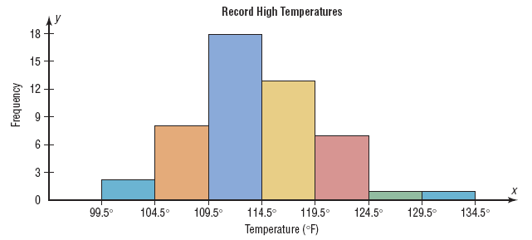
Histograms
Histograms use class boundaries and frequencies of the classes.

Slide 24
2.2 Histograms, Frequency Polygons, and Ogives
The frequency polygon is a graph that displays the data by using lines that connect points plotted for the frequencies at the class midpoints. The frequencies are represented by the heights of the points.
The class midpoints are represented on the horizontal axis.

Slide 25
Chapter 2 Frequency Distributions and Graphs
Section 2-2
Example 2-5
Page #58

Slide 26
Frequency Polygons
Construct a frequency polygon to represent the data for the record high temperatures for each of the 50 states (see Example 2–2 for the data).

Slide 27
Frequency Polygons
Frequency polygons use class midpoints and frequencies of the classes.
Class Limits | Class Midpoints | Frequency
100 - 104 105 - 109 110 - 114 115 - 119 120 - 124 125 - 129 130 - 134
102
107
112
117
122
127
132
2
8
18
13
7
1
1

Slide 28
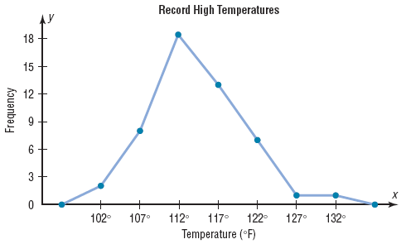
Frequency Polygons
Frequency polygons use class midpoints and frequencies of the classes.
A frequency polygon
is anchored on the
x-axis before the first
class and after the
last class.

Slide 29
2.2 Histograms, Frequency Polygons, and Ogives
The Ogive is a graph that represents the cumulative frequencies for the classes in a frequency distribution.
The upper class boundaries are represented on the horizontal axis.

Slide 30
Chapter 2 Frequency Distributions and Graphs
Section 2-2
Example 2-6
Page #59

Slide 31
Ogives
Construct an ogive to represent the data for the record high temperatures for each of the 50 states (see Example 2–2 for the data).

Slide 32
Ogives
Ogives use upper class boundaries and cumulative frequencies of the classes.
Class Limits | Class Boundaries | Frequency | Cumulative Frequency
100 - 104 105 - 109 110 - 114 115 - 119 120 - 124 125 - 129 130 - 134
99.5 - 104.5
104.5 - 109.5
109.5 - 114.5
114.5 - 119.5
119.5 - 124.5
124.5 - 129.5
129.5 - 134.5
2
8
18
13
7
1
1
2
10
28
41
48
49
50

Slide 33
Ogives
Ogives use upper class boundaries and cumulative frequencies of the classes.
Class Boundaries | Cumulative Frequency
Less than 104.5
Less than 109.5
Less than 114.5
Less than 119.5
Less than 124.5
Less than 129.5
Less than 134.5
2
10
28
41
48
49
50

Slide 34
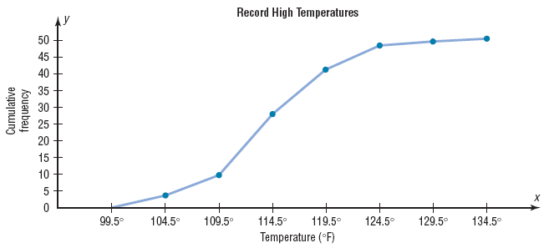
Ogives
Ogives use upper class boundaries and cumulative frequencies of the classes.

Slide 35
2.2
Histograms, Frequency Polygons, and Ogives
Constructing Statistical Graphs
Step 1 Draw and label the x and y axes.
Step 2 Choose a suitable scale for the frequencies or cumulative frequencies, and label it on the y axis. (Do not label the y axis with numbers in the cumulative frequency)
Step 3 Represent the class boundaries for the histogram or ogive, or the midpoint for the frequency polygon, on the x axis.
Step 4 Plot the points and then draw the bars or lines.

Slide 36
2.2 Histograms, Frequency Polygons, and Ogives
If proportions are used instead of frequencies, the graphs are called relative frequency graphs.
Relative frequency graphs are used when the proportion of data values that fall into a given class is more important than the actual number of data values that fall into that class.

Slide 37
Chapter 2 Frequency Distributions and Graphs
Section 2-2
Example 2-7
Page #61

Slide 38
Construct a histogram, frequency polygon, and ogive using relative frequencies for the
distribution (shown here) of the miles that 20 randomly selected runners ran during a
given week.
Class Boundaries | Frequency
5.5 - 10.5 10.5 - 15.5 15.5 - 20.5 20.5 - 25.5 25.5 - 30.5 30.5 - 35.5 35.5 - 40.5
1
2
3
5
4
3
2

Slide 39
Histograms
The following is a frequency distribution of miles run per week by 20 selected runners.
Class Boundaries | Frequency | Relative Frequency
5.5 - 10.5 10.5 - 15.5 15.5 - 20.5 20.5 - 25.5 25.5 - 30.5 30.5 - 35.5 35.5 - 40.5
Divide each frequency by the total frequency to get the relative frequency.
1
2
3
5
4
3
2
1/20 =
2/20 =
3/20 =
5/20 =
4/20 =
3/20 =
2/20 =
0.05
0.10
0.15
0.25
0.20
0.15
0.10
Σf = 20
Σrf = 1.00

Slide 40
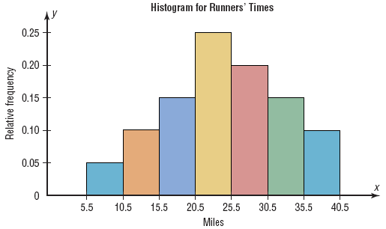
Histograms
Use the class boundaries and the relative frequencies of the classes.

Slide 41
Frequency Polygons
The following is a frequency distribution of miles run per week by 20 selected runners.
Class Boundaries | Class Midpoints | Relative Frequency
5.5 - 10.5 10.5 - 15.5 15.5 - 20.5 20.5 - 25.5 25.5 - 30.5 30.5 - 35.5 35.5 - 40.5
8
13
18
23
28
33
38
0.05
0.10
0.15
0.25
0.20
0.15
0.10

Slide 42
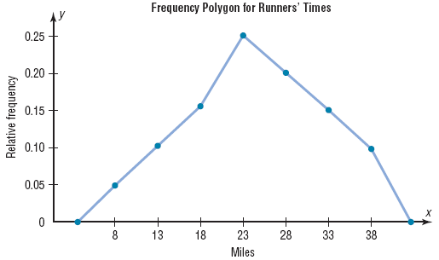
Frequency Polygons
Use the class midpoints and the relative frequencies of the classes.

Slide 43
Ogives
The following is a frequency distribution of miles run per week by 20 selected runners.
Class Boundaries | Frequency | Cumulative Frequency | Cum. Rel. Frequency
5.5 - 10.5 10.5 - 15.5 15.5 - 20.5 20.5 - 25.5 25.5 - 30.5 30.5 - 35.5 35.5 - 40.5
1
2
3
5
4
3
2
1
3
6
11
15
18
20
1/20 =
3/20 =
6/20 =
11/20 =
15/20 =
18/20 =
20/20 =
0.05
0.15
0.30
0.55
0.75
0.90
1.00
Σf = 20

Slide 44
Ogives
Ogives use upper class boundaries and cumulative frequencies of the classes.
Class Boundaries | Cum. Rel. Frequency
Less than 10.5
Less than 15.5
Less than 20.5
Less than 25.5
Less than 30.5
Less than 35.5
Less than 40.5
0.05
0.15
0.30
0.55
0.75
0.90
1.00

Slide 45
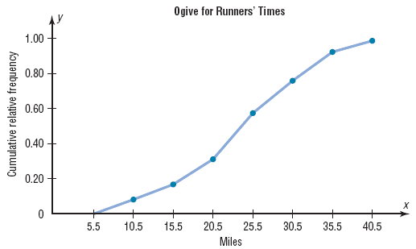
Ogives
Use the upper class boundaries and the cumulative relative frequencies.

Slide 46
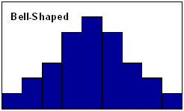
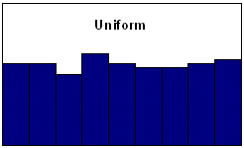
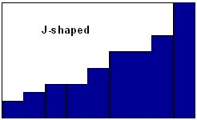
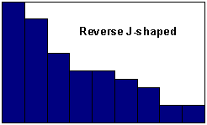
Shapes of Distributions

Slide 47
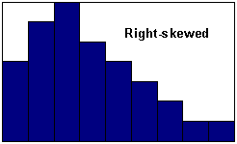
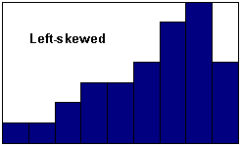
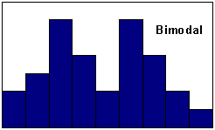
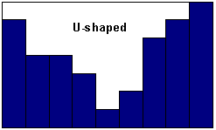
Shapes of Distributions

Slide 48
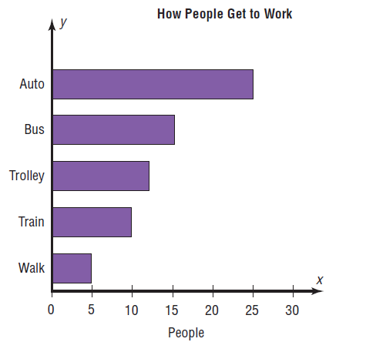
2.3 Other Types of Graphs Bar Graphs

Slide 49
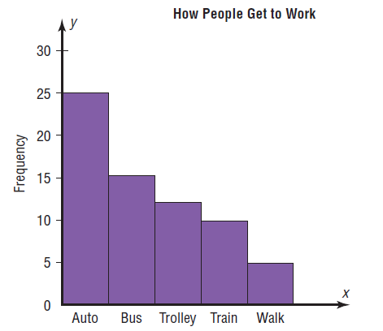
2.3 Other Types of Graphs Pareto Charts

Slide 50
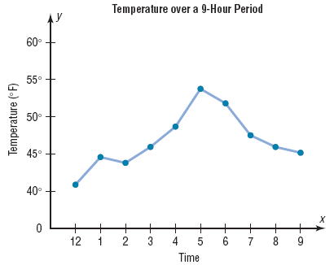
2.3 Other Types of Graphs Time Series Graphs

Slide 51
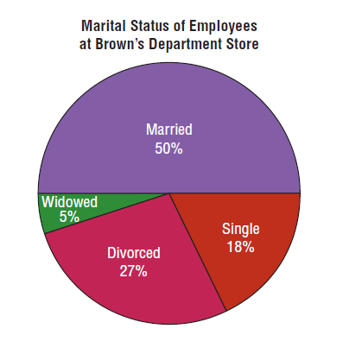
2.3 Other Types of Graphs Pie Graphs

Slide 52
2.3 Other Types of Graphs Dotplot
A dotplot is a statistical graph in which each data value is plotted as a point (dot) above the horizontal axis.
Dotplots are useful for showing how values are distributed, and for finding extremely high or low data values.

Slide 53
Chapter 2 Frequency Distributions and Graphs
Section 2-3
Example 2-13
Page #83

Slide 54
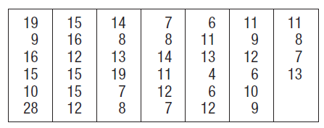
Example 2-13: Named Storms
Construct and analyze a dotplot from the data.

Slide 55
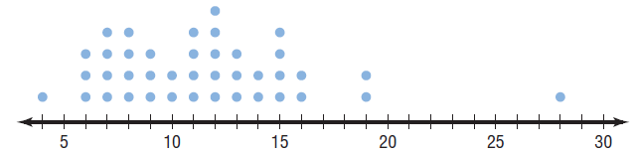
Example 2-13: Named Storms

Slide 56
2.3 Other Types of Graphs Stem and Leaf Plots
A stem and leaf plot is a data plot that uses part of a data value as the stem and part of the data value as the leaf to form groups or classes.
It has the advantage over grouped frequency distribution of retaining the actual data while showing them in graphic form.

Slide 57
Chapter 2 Frequency Distributions and Graphs
Section 2-3
Example 2-14
Page #84

Slide 58
At an outpatient testing center, the number of cardiograms performed each day for 20 days is shown. Construct a stem and leaf plot for the data.
25 31 20 32 13
14 43 02 57 23
36 32 33 32 44
32 52 44 51 45

Slide 59
25 31 20 32 13
14 43 2 57 23
36 32 33 32 44
32 52 44 51 45
Unordered Stem Plot
Ordered Stem Plot
0
2
0 | 2
1 | 3 | 4
2 | 0 | 3 | 5
3 | 1 | 2 | 2 | 2 | 2 | 3 | 6
4 | 3 | 4 | 4 | 5
5 | 1 | 2 | 7
1
3
4
2
5
0
3
3
1
2
6
2
3
2
2
4
3
4
4
5
5
7
2
1

