Slide 1

C H A P T E R T H R E E
DATA DESCRIPTION

Slide 2
Data Description
CHAPTER
3
1.1
Outline
Descriptive and Inferential Statistics
3-1 | Measures of Central Tendency
3-2 | Measures of Variation
3-3 | Measures of Position
3-4 | Exploratory Data Analysis
Copyright © 2012 The McGraw-Hill Companies, Inc.
Slide 2

Slide 3
Learning Objectives
1 | Summarize data, using measures of central tendency, such as the mean, median, mode, and midrange.
2 | Describe data, using measures of variation, such as the range, variance, and standard deviation.
3 | Identify the position of a data value in a data set, using various measures of position, such as percentiles, deciles, and quartiles.
4 | Use the techniques of exploratory data analysis, including boxplots and five-number summaries, to discover various aspects of data.
1.1
Descriptive and Inferential Statistics
Copyright © 2015 The McGraw-Hill Companies, Inc. Permission required for reproduction or display.
Slide 3

Slide 4
Introduction
Traditional Statistics
Average
Variation
Position

Slide 5
Measures of Central Tendency
What Do We Mean By Average?
Mean
Median
Mode
Midrange
Weighted Mean

Slide 6
3.1 Measures of Central Tendency
A statistic is a characteristic or measure obtained by using the data values from a sample.
A parameter is a characteristic or measure obtained by using all the data values for a specific population.

Slide 7
Measures of Central Tendency
General Rounding Rule
The basic rounding rule is that rounding should not be done until the final answer is calculated. Use of parentheses on calculators or use of spreadsheets help to avoid early rounding error.

Slide 8
Measures of Central Tendency: Mean
The mean is the quotient of the sum of the values and the total number of values.
The symbol is used for sample mean.
For a population, the Greek letter μ (mu) is used for the mean.

Slide 9
Rounding Rule: Mean
The mean should be rounded to one more decimal place than occurs in the raw data.
The mean, in most cases, is not an actual data value.

Slide 10
Chapter 3 Data Description
Section 3-1
Example 3-1
Page #112

Slide 11
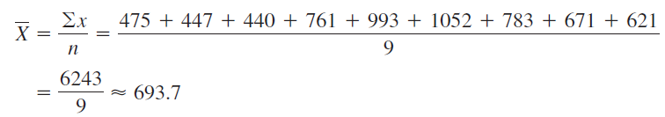
Example 3-1: Police Incidents
The number of calls that a local police department responded to for a sample of9 months is shown. Find the mean.
475, 447, 440, 761, 993, 1052, 783, 671, 621
The mean number of incidents is 693.7

Slide 12

Finding the Mean for Grouped Data
Step 1 Make a table as shown
Step 2 Find the midpoints of each class and place them in column C.
Step 3 multiply the frequency by the midpoint for each class, and place the product in column D.
Bluman chapter 3

Slide 13
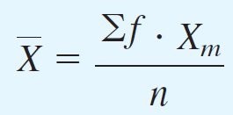
Finding the mean for Grouped Data
Step 4 Find the sum of column D.
Step 5 Divide the sum obtained in column D by the sum of frequencies obtained in column B.
The formula for the mean is
Bluman chapeter 3

Slide 14
Chapter 3 Data Description
Section 3-1
Example 3-3
Page #113

Slide 15
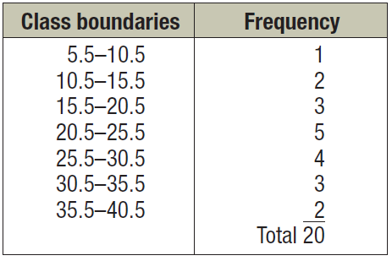
Example 3-3: Miles Run
Below is a frequency distribution of miles run per week. Find the mean.

Slide 16
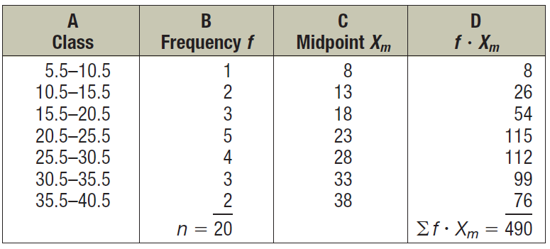
Example 3-3: Miles Run

Slide 17
Measures of Central Tendency: Median
The median is the midpoint of the data array. The symbol for the median is MD.

Slide 18
Finding the median
Step 1 Arrange the data values in ascending order.
Step 2 determine the number of values in the data set.
Step 3
If n is odd, select the middle data value as the median.
If n is even, find the mean of the two middle values. That is, add them and divide the sum by 2.
Bluman chapter 3

Slide 19
Chapter 3 Data Description
Section 3-1
Example 3-4
Page #115

Slide 20
Example 3-4: Police Officers Killed
The number of police officers killed in the line of duty over the last 11 years is shown. Find the median.
177 153 122 141 189 155 162 165 149 157 240
sort in ascending order
122, 141, 149, 153, 155, 157, 162, 165, 177, 189, 240
Select the middle value.
MD = 157
The median is 157 rooms.

Slide 21
Chapter 3 Data Description
Section 3-1
Example 3-5
Page #115

Slide 22
Example 3-5: Tornadoes in the U.S.
The number of tornadoes that have occurred in the United States over an 8-year period follows. Find the median.
684, 764, 656, 702, 856, 1133, 1132, 1303
Find the average of the two middle values.
656, 684, 702, 764, 856, 1132, 1133, 1303
The median number of tornadoes is 810.

Slide 23
Measures of Central Tendency: Mode
The mode is the value that occurs most often in a data set.
It is sometimes said to be the most typical case.
There may be no mode, one mode (unimodal), two modes (bimodal), or many modes (multimodal).

Slide 24
Chapter 3 Data Description
Section 3-1
Example 3-6
Page #116

Slide 25
Example 3-6: NFL Signing Bonuses
Find the mode of the signing bonuses of eight NFL players for a specific year. The bonuses in millions of dollars are
18.0, 14.0, 34.5, 10, 11.3, 10, 12.4, 10
You may find it easier to sort first.
10, 10, 10, 11.3, 12.4, 14.0, 18.0, 34.5
Select the value that occurs the most.
The mode is 10 million dollars.

Slide 26
Chapter 3 Data Description
Section 3-1
Example 3-7
Page #117

Slide 27
Example 3-7: Licensed Nuclear Reactors
The data show the number of licensed nuclear reactors in the United States for a recent 15-year period. Find the mode.
104 and 109 both occur the most. The data set is said to be bimodal.
104 104 104 104 104 107 109 109 109 110
109 111 112 111 109
The modes are 104 and 109.

Slide 28
Chapter 3 Data Description
Section 3-1
Example 3-9
Page #117

Slide 29
Example 3-9: Miles Run per Week
Find the modal class for the frequency distribution of miles that 20 runners ran in one week.
Class | Frequency
5.5 – 10.5 | 1
10.5 – 15.5 | 2
15.5 – 20.5 | 3
20.5 – 25.5 | 5
25.5 – 30.5 | 4
30.5 – 35.5 | 3
35.5 – 40.5 | 2
The modal class is
20.5 – 25.5.
The mode, the midpoint
of the modal class, is
23 miles per week.

Slide 30
Chapter 3 Data Description
Section 3-1
Example 3-10
Page #118

Slide 31
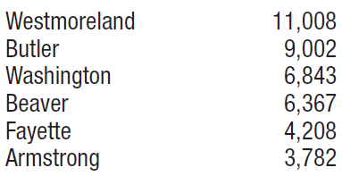
Example 3-10: Area Boat Registrations
The data show the number of boats registered for six counties in southwestern Pennsylvania. Find the mode.
Since the category with the highest frequency is Westmoreland, the most typical case is Westmoreland. Hence, the mode is Westmoreland.

Slide 32
Measures of Central Tendency: Midrange
The midrange is the average of the lowest and highest values in a data set.

Slide 33
Chapter 3 Data Description
Section 3-1
Example 3-12
Page #119

Slide 34
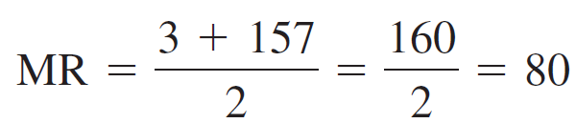
Example 3-12: Bank failures
The number of bank failures for a recent five-year period is shown. Find the midrange.
3, 30, 148, 157, 71
The midrange is 80.

Slide 35
Measures of Central Tendency: Weighted Mean
Find the weighted mean of a variable by multiplying each value by its corresponding weight and dividing the sum of the products by the sum of the weights.

Slide 36
Chapter 3 Data Description
Section 3-1
Example 3-14
Page #120

Slide 37
Example 3-17: Grade Point Average
A student received the following grades. Find the corresponding GPA.
Course | Credits, w | Grade, X
English Composition | 3 | A (4 points)
Introduction to Psychology | 3 | C (2 points)
Biology | 4 | B (3 points)
Physical Education | 2 | D (1 point)
The grade point average is 2.7.

Slide 38
Properties of the Mean
Found by using all the values of data.
Varies less than the median or mode
Used in computing other statistics, such as the variance
Unique, usually not one of the data values
Cannot be used with open-ended classes
Affected by extremely high or low values, called outliers

Slide 39
Properties of the Median
Gives the midpoint
Used when it is necessary to find out whether the data values fall into the upper half or lower half of the distribution.
Can be used for an open-ended distribution.
Affected less than the mean by extremely high or extremely low values.

Slide 40
Properties of the Mode
Used when the most typical case is desired
Easiest average to compute
Can be used with nominal data
Not always unique or may not exist

Slide 41
Properties of the Midrange
Easy to compute.
Gives the midpoint.
Affected by extremely high or low values in a data set

Slide 42
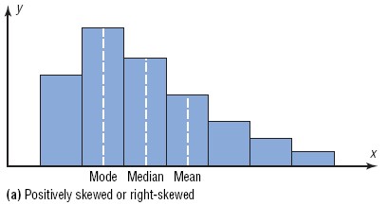
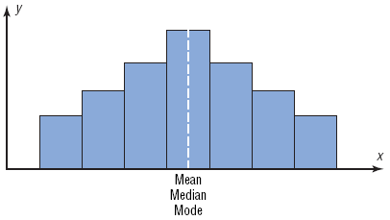
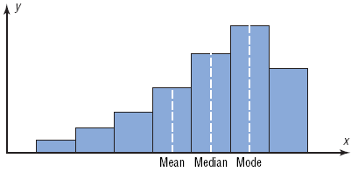
Distributions

Slide 43
Measures of Variation: Range
The range is the difference between the highest and lowest values in a data set.

Slide 44
Chapter 3 Data Description
Section 3-2
Example 3-18/19
Page #123

Slide 45
Example 3-15: Outdoor Paint
Two experimental brands of outdoor paint are tested to see how long each will last before fading. Six cans of each brand constitute a small population. The results (in months) are shown. Find the mean and range of each group.
Brand A | Brand B
10 | 35
60 | 45
50 | 30
30 | 35
40 | 40
20 | 25

Slide 46
Example 3-15: Outdoor Paint
Brand A | Brand B
10 | 35
60 | 45
50 | 30
30 | 35
40 | 40
20 | 25
The average for both brands is the same, but the range
for Brand A is much greater than the range for Brand B.
Which brand would you buy?

Slide 47
Measures of Variation: Variance & Standard Deviation
The population variance is the average of the squares of the distance each value is from the mean.
The standard deviation is the square root of the variance.

Slide 48
Uses of the Variance and Standard Deviation
To determine the spread of the data.
To determine the consistency of a variable.
To determine the number of data values that fall within a specified interval in a distribution (Chebyshev’s Theorem).
Used in inferential statistics.

Slide 49
Measures of Variation: Variance & Standard Deviation (Population Theoretical Model)
The population variance is
The population standard deviation is

Slide 50
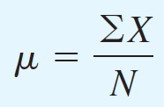



Finding the Population Variance and Population Standard Deviation
Step 1 Find the mean for the data.
Step 2 Find the Deviation for each data value.
Step 3 Square each of the deviations.
Step 4 Find the sum of the squares.
Bluman chapter 3
50

Slide 51
Chapter 3 Data Description
Section 3-2
Example 3-18
Page #131

Slide 52
Example 3-18: Outdoor Paint
Find the variance and standard deviation for the data set for Brand A paint. 10, 60, 50, 30, 40, 20
Months, X | µ | X – µ | (X – µ)²
10 60 50 30 40 20
35
35
35
35
35
35
–25
25
15
–5
5
–15
625
625
225
25
25
225
1750

Slide 53
Measures of Variation: Variance & Standard Deviation (Sample Theoretical Model)
The sample variance is
The sample standard deviation is

Slide 54
Measures of Variation: Variance & Standard Deviation (Sample Computational Model)
Is mathematically equivalent to the theoretical formula.
Saves time when calculating by hand
Does not use the mean
Is more accurate when the mean has been rounded.

Slide 55
Measures of Variation: Variance & Standard Deviation (Sample Computational Model)
The sample variance is
The sample standard deviation is

Slide 56
Measures of Variation: Coefficient of Variation
The coefficient of variation is the standard deviation divided by the mean, expressed as a percentage.
Use CVAR to compare standard deviations when the units are different.

Slide 57
Chapter 3 Data Description
Section 3-2
Example 3-23
Page #138

Slide 58
Example 3-23: Sales of Automobiles
The mean of the number of sales of cars over a 3-month period is 87, and the standard deviation is 5. The mean of the commissions is $5225, and the standard deviation is $773. Compare the variations of the two.
Commissions are more variable than sales.

Slide 59
Chapter 3 Data Description
Section 3-2
Example 3-24
Page #139

Slide 60
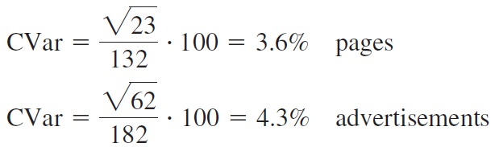
Example 3-24: Pages in Magazines
The mean for the number of pages of a sample of women’s fitness magazines is 132, with a variance of 23; the mean for the number of advertisements of a sample of women’s fitness magazines is 182, with a variance of 62. Compare the variations.
The Number of advertisements is more variable than the number of pages.

Slide 61
Measures of Variation: Range Rule of Thumb
The Range Rule of Thumb approximates the standard deviation as
when the distribution is unimodal and approximately symmetric.

Slide 62
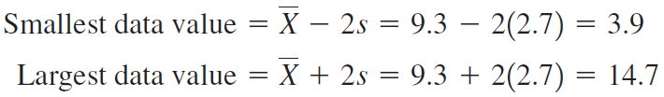
Measures of Variation: Range Rule of Thumb

Slide 63
Measures of Variation: Chebyshev’s Theorem
The proportion of values from any data set that fall within k standard deviations of the mean will be at least 1 – 1/k², where k is a number greater than 1 (k is not necessarily an integer).
# of standard deviations, k | Minimum Proportion within k standard deviations | Minimum Percentage within k standard deviations
2 | 1 – 1/4 = 3/4 | 75%
3 | 1 – 1/9 = 8/9 | 88.89%
4 | 1 – 1/16 = 15/16 | 93.75%

Slide 64
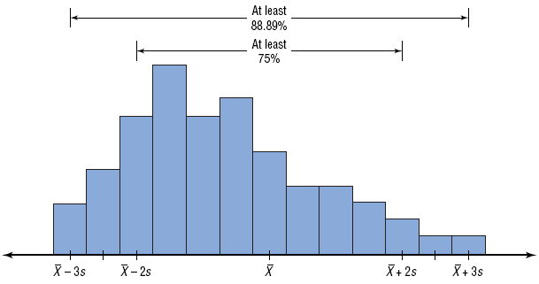
Measures of Variation: Chebyshev’s Theorem

Slide 65
Chapter 3 Data Description
Section 3-2
Example 3-25
Page #141

Slide 66
Example 3-25: Prices of Homes
The mean price of houses in a certain neighborhood is $50,000, and the standard
deviation is $10,000. Find the price range for which at least 75% of the houses will sell.
Chebyshev’s Theorem states that at least 75% of a data set will fall within 2 standard deviations of the mean.
50,000 – 2(10,000) = 30,000
50,000 + 2(10,000) = 70,000
At least 75% of all homes sold in the area will have a
price range from $30,000 and $70,000.

Slide 67
Chapter 3 Data Description
Section 3-2
Example 3-26
Page #141

Slide 68
Example 3-26: Travel Allowances
A survey of local companies found that the mean amount of travel allowance for executives was $0.25 per mile. The standard deviation was 0.02. Using Chebyshev’s theorem, find the minimum percentage of the data values that will fall between $0.20 and $0.30.
At least 84% of the data values will fall between
$0.20 and $0.30.

Slide 69
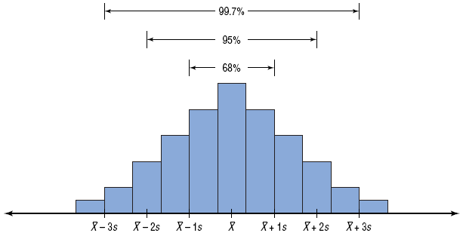
Measures of Variation: Empirical Rule (Normal)

Slide 70
Measures of Variation: Empirical Rule (Normal)
The percentage of values from a data set that fall within k standard deviations of the mean in a normal (bell-shaped) distribution is listed below.
# of standard deviations, k | Proportion within k standard deviations
1 | 68%
2 | 95%
3 | 99.7%

Slide 71
3-3 Measures of Position
Standard scores
Percentiles
Deciles
Quartiles

Slide 72
Measures of Position: z-score
A z-score or standard score for a value is obtained by subtracting the mean from the value and dividing the result by the standard deviation.
A z-score represents the number of standard deviations a value is above or below the mean.

Slide 73
Chapter 3 Data Description
Section 3-3
Example 3-27
Page #148

Slide 74
Example 3-27: Test Scores
A student scored 65 on a calculus test that had a mean of 50 and a standard deviation of 10; she scored 30 on a history test with a mean of 25 and a standard deviation of 5. Compare her relative positions on the two tests.
She has a higher relative position in the Calculus class.

Slide 75
Measures of Position: Percentiles
Percentiles separate the data set into 100 equal groups.
A percentile rank for a datum represents the percentage of data values below the datum.

Slide 76
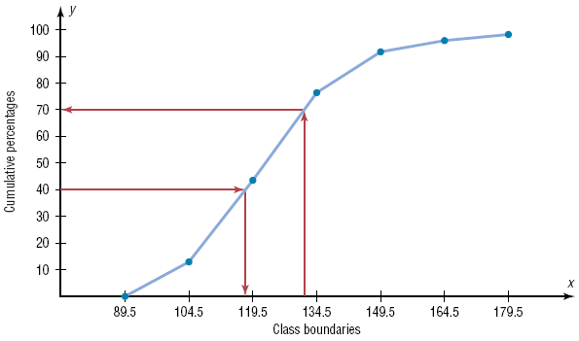

Measures of Position: Example of a Percentile Graph

Slide 77
Chapter 3 Data Description
Section 3-3
Example 3-30
Page #153

Slide 78
Example 3-30: Test Scores
A teacher gives a 20-point test to 10 students. Find the percentile rank of a score of 12.
18, 15, 12, 6, 8, 2, 3, 5, 20, 10
Sort in ascending order.
2, 3, 5, 6, 8, 10, 12, 15, 18, 20
6 values
A student whose score was 12 did better than 65% of the class.

Slide 79
Chapter 3 Data Description
Section 3-3
Example 3-32
Page #154

Slide 80
Example 3-32: Test Scores
A teacher gives a 20-point test to 10 students. Find the value corresponding to the 25th percentile.
18, 15, 12, 6, 8, 2, 3, 5, 20, 10
Sort in ascending order.
2, 3, 5, 6, 8, 10, 12, 15, 18, 20
The value 5 corresponds to the 25th percentile.

Slide 81
Measures of Position: Quartiles and Deciles
Deciles separate the data set into 10 equal groups. D₁=P₁₀, D₄=P₄₀
Quartiles separate the data set into 4 equal groups. Q₁=P₂₅, Q₂=MD, Q₃=P₇₅
The Interquartile Range, IQR = Q₃ – Q₁.

Slide 82
3.3
Measures of Position
Finding Data Values Corresponding to Q₁, Q₂, and Q₃
Step 1 Arrange the data in order from lowest to highest.
Step 2 Find the median of the data values. This is the value for Q₂.
Step 3 Find the median of the data values that fall below Q₂. This is the value for Q₁.
Step 4 Find the median of the data values that fall above Q₂. This is the value for Q₃.

Slide 83
Chapter 3 Data Description
Section 3-3
Example 3-34
Page #156

Slide 84
Example 3-34: Quartiles
Find Q₁, Q₂, and Q₃ for the data set.
15, 13, 6, 5, 12, 50, 22, 18
Sort in ascending order.
5, 6, 12, 13, 15, 18, 22, 50

Slide 85
Measures of Position: Outliers
An outlier is an extremely high or low data value when compared with the rest of the data values.
A data value less than Q₁ – 1.5(IQR) or greater than Q₃ + 1.5(IQR) can be considered an outlier.

Slide 86
3.4 Exploratory Data Analysis
The Five-Number Summary is composed of the following numbers: Low, Q₁, MD, Q₃, High
The Five-Number Summary can be graphically represented using a Boxplot.

Slide 87
Constructing Boxplots
Find the five-number summary.
Draw a horizontal axis with a scale that includes the maximum and minimum data values.
Draw a box with vertical sides through Q₁ and Q₃, and draw a vertical line though the median.
Draw a line from the minimum data value to the left side of the box and a line from the maximum data value to the right side of the box.

Slide 88
Chapter 3 Data Description
Section 3-4
Example 3-37
Page #169

Slide 89
Example 3-37: Meteorites
The number of meteorites found in 10 U.S. states is shown. Construct a boxplot for the data.
89, 47, 164, 296, 30, 215, 138, 78, 48, 39
30, 39, 47, 48, 78, 89, 138, 164, 215, 296
Five-Number Summary: 30-47-83.5-164-296
Low
Q₁
MD
Q₃
High
47
83.5
164
30
296

