Slide 1

C H A P T E R F O U R
Probability and Counting Rules

Slide 2
Probability and
Counting Rules
CHAPTER
4
1.1
Descriptive and Inferential Statistics
Outline
4-1 | Sample Spaces and Probability
4-2 | The Addition Rules for Probability
4-3 | The Multiplication Rules and Conditional Probability
4-4 | Counting Rules
4-5 | Probability and Counting Rules
Copyright © 2012 The McGraw-Hill Companies, Inc.
2
Bluman Chapter 4

Slide 3
Learning Objectives
1.1
1 | Determine sample spaces and find the probability of an event, using classical probability or empirical probability.
2 | Find the probability of compound events, using the addition rules.
3 | Find the probability of compound events, using the multiplication rules.
4 | Find the conditional probability of an event.
Descriptive and Inferential Statistics
Bluman Chapter 4
3

Slide 4
Learning Objectives
1.1
5 | Find the total number of outcomes in a sequence of events, using the fundamental counting rule.
6 | Find the number of ways that r objects can be selected from n objects, using the permutation rule.
7 | Find the number of ways that r objects can be selected from n objects without regard to order, using the combination rule.
8 | Find the probability of an event, using the counting rules.
Descriptive and Inferential Statistics
Bluman Chapter 4
4

Slide 5
Probability
Probability can be defined as the chance of an event occurring. It can be used to quantify what the “odds” are that a specific event will occur. Some examples of how probability is used everyday would be weather forecasting, “75% chance of snow” or for setting insurance rates.

Slide 6
4-1 Sample Spaces and Probability
A probability experiment is a chance process that leads to well-defined results called outcomes.
An outcome is the result of a single trial of a probability experiment.
A sample space is the set of all possible outcomes of a probability experiment.
An event consists of outcomes.

Slide 7
Sample Spaces
Experiment
Sample Space
Toss a coin
Head,
Tail
Roll a die
1, 2, 3, 4, 5, 6
Answer a true/false
True, False
question
Toss two coins
HH,
HT, TH, TT

Slide 8
Chapter 4 Probability and Counting Rules
Section 4-1
Example 4-1
Page #187

Slide 9
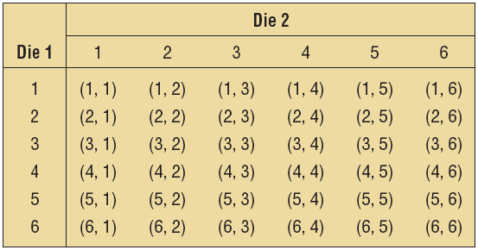
Example 4-1: Rolling Dice
Find the sample space for rolling two dice.

Slide 10
Chapter 4 Probability and Counting Rules
Section 4-1
Example 4-3
Page #187

Slide 11
Example 4-3: Gender of Children
Find the sample space for the gender of the children if a family has three children. Use B for boy and G for girl.
BBB BBG BGB GBB GGG GGB GBG BGG

Slide 12
Chapter 4 Probability and Counting Rules
Section 4-1
Example 4-4
Page #188

Slide 13
Example 4-4: Gender of Children
Use a tree diagram to find the sample space for the gender of three children in a family.
B
BBB
BBG
BGB
BGG
GBB
GBG GGB GGG
B
G
B
B
G
G
B
B
G
G
B
G
G

Slide 14
Sample Spaces and Probability
There are three basic interpretations of probability:
Classical probability
Empirical probability
Subjective probability

Slide 15
Sample Spaces and Probability
Classical probability uses sample spaces to determine the numerical probability that an event will happen and assumes that all outcomes in the sample space are equally likely to occur.

Slide 16
Sample Spaces and Probability
Rounding Rule for Probabilities
Probabilities should be expressed as reduced fractions or rounded to two or three decimal places. When the probability of an event is an extremely small decimal, it is permissible to round the decimal to the first nonzero digit after the decimal point.

Slide 17
Chapter 4 Probability and Counting Rules
Section 4-1
Example 4-6
Page #190

Slide 18
Example 4-6: Gender of Children
If a family has three children, find the probability that exactly two of the three children are girls.
Sample Space:
BBB, BBG BGB GBB GGG GGB GBG BGG
Three outcomes (BGG, GBG, GGB) have two girls.
The probability of having two of three children being girls is 3/8.

Slide 19

4.1
Sample Spaces and Probability
Probability Rule 1
The probability of any event E is a number (either a fraction or decimal) between and including 0 and 1.
This is denoted by 0 ≤ P(E) ≤ 1.
19

Slide 20
4.1
Sample Spaces and Probability
Probability Rule 2
The sum of the probabilities of all the outcomes in the sample space is 1.
20

Slide 21
4.1
Sample Spaces and Probability
Probability Rule 3
If an event E cannot occur (i.e., the event contains no members in the sample space), its probability is 0.
21

Slide 22
4.1
Sample Spaces and Probability
Probability Rule 4
If an event E is certain, then the probability of E is 1.
Bluman Chapter 4
22

Slide 23
Chapter 4 Probability and Counting Rules
Section 4-1
Example 4-9
Page #192

Slide 24

Exercise 4-9: Rolling a Die
When a single die is rolled, what is the probability of getting a number less than 7?
Since all outcomes—1, 2, 3, 4, 5, and 6—are less than 7, the probability is
The event of getting a number less than 7 is certain.

Slide 25
Complementary Events

Slide 26
Chapter 4 Probability and Counting Rules
Section 4-1
Example 4-10
Page #192

Slide 27
Example 4-10: Finding Complements
Find the complement of each event.
Event
Complement
of the Event
Rolling a die and getting a 4
Getting a 1, 2, 3, 5, or 6
Selecting a letter of the alphabet
Getting a consonant (assume y is a
and getting a vowel
consonant)
Selecting a month and getting a
Getting February, March, April, May,
month that begins with a J
August, September, October,
November, or December
Selecting a day of the week and
Getting Saturday or Sunday
getting a weekday

Slide 28
Chapter 4 Probability and Counting Rules
Section 4-1
Example 4-11
Page #193

Slide 29
Example 4-11: Favorite Ice Cream Flavors
In a study, it was found that 23% of the people surveyed said that vanilla was their favorite flavor of ice cream. If a person is selected at random, find the probability that the person’s favorite flavor of ice cream is not vanilla.
P(not vanilla) = 1 - P(vanilla)
= 1 - 0.23 = 0.77 = 77%

Slide 30
Sample Spaces and Probability
There are three basic interpretations of probability:
Classical probability
Empirical probability
Subjective probability

Slide 31
Sample Spaces and Probability
Empirical probability relies on actual experience to determine the likelihood of outcomes.

Slide 32
Chapter 4 Probability and Counting Rules
Section 4-1
Example 4-13
Page #194

Slide 33
Example 4-13: Blood Types
In a sample of 50 people, 21 had type O blood, 22 had type A blood, 5 had type B blood, and 2 had type AB blood. Set up a frequency distribution and find the following probabilities.
a. A person has type O blood.
Type | Frequency
A | 22
B | 5
AB | 2
O | 21
Total 50

Slide 34
Example 4-13: Blood Types
In a sample of 50 people, 21 had type O blood, 22 had type A blood, 5 had type B blood, and 2 had type AB blood. Set up a frequency distribution and find the following probabilities.
b. A person has type A or type B blood.
Type | Frequency
A | 22
B | 5
AB | 2
O | 21
Total 50

Slide 35
Example 4-13: Blood Types
In a sample of 50 people, 21 had type O blood, 22 had type A blood, 5 had type B blood, and 2 had type AB blood. Set up a frequency distribution and find the following probabilities.
c. A person has neither type A nor type O blood.
Type | Frequency
A | 22
B | 5
AB | 2
O | 21
Total 50

Slide 36
Example 4-13: Blood Types
In a sample of 50 people, 21 had type O blood, 22 had type A blood, 5 had type B blood, and 2 had type AB blood. Set up a frequency distribution and find the following probabilities.
d. A person does not have type AB blood.
Type | Frequency
A | 22
B | 5
AB | 2
O | 21
Total 50

Slide 37
Sample Spaces and Probability
There are three basic interpretations of probability:
Classical probability
Empirical probability
Subjective probability

Slide 38
Sample Spaces and Probability
Subjective probability uses a probability value based on an educated guess or estimate, employing opinions and inexact information.
Examples: weather forecasting, predicting outcomes of sporting events

Slide 39
4.2 Addition Rules for Probability
Two events are mutually exclusive events if they cannot occur at the same time (i.e., they have no outcomes in common)

Slide 40
Chapter 4 Probability and Counting Rules
Section 4-2
Example 4-15
Page #202

Slide 41
Example 4-15: Determining Mutually Exclusive Events
Determine which events are mutually exclusive. Explain your answer.
a. Randomly selecting a female student
Randomly selecting a student who is a junior
These events are not mutually exclusive since a student can be both female and a junior.

Slide 42
Example 4-15: Determining Mutually Exclusive Events
Determine which events are mutually exclusive.
b. Randomly selecting a person with type A blood
Randomly selecting a person with type O blood
These events are mutually exclusive since a person cannot have type A blood and type O blood at the same time.

Slide 43
Example 4-15: Determining Mutually Exclusive Events
Determine which events are mutually exclusive.
c. Rolling a die and getting an odd number
Rolling a die and getting a number less than 3
These events are not mutually exclusive since the number 1 is both an odd
number and a number less than 3.

Slide 44
Example 4-15: Determining Mutually Exclusive Events
Determine which events are mutually exclusive.
d. Randomly selecting a person who is under 21 years of age
Randomly selecting a person who is over 30 years of age
These events are mutually exclusive since a person cannot be both under 21 and
over 30 years of age at the same time.

Slide 45
Chapter 4 Probability and Counting Rules
Section 4-2
Example 4-18
Page #203

Slide 46
Example 4-18: R&D Employees
The corporate research and development centers for three local companies have the following number of employees:
U.S. Steel 110
Alcoa 750
Bayer Material Science 250
If a research employee is selected at random, find the probability that the employee is employed by U.S. Steel or Alcoa.

Slide 47
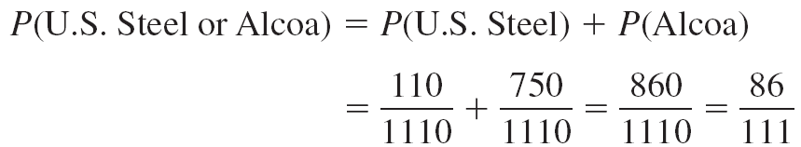
Example 4-18: R&D Employees

Slide 48
Chapter 4 Probability and Counting Rules
Section 4-2
Example 4-21
Page #204

Slide 49
Example 4-21: Medical Staff
In a hospital unit there are 8 nurses and 5 physicians; 7 nurses and 3 physicians are females.
If a staff person is selected, find the probability that the subject is a nurse or a male.
Staff
Females
Males
Total
Nurses
7
1
8
Physicians
3
2
5
Total
10
3
13

Slide 50
Chapter 4.3 The Multiplication Rules and Conditional Probability
Two events A and B are independent events if the fact that A occurs does not affect the probability of B occurring.

Slide 51
Chapter 4 Probability and Counting Rules
Section 4-3
Example 4-23
Page #213

Slide 52
Example 4-23: Tossing a Coin
A coin is flipped and a die is rolled. Find the probability of getting a head on the coin and a 4 on the die.
This problem could be solved using sample space.
H1, H2, H3, H4, H5, H6, T1, T2, T3, T4, T5, T6

Slide 53
Chapter 4 Probability and Counting Rules
Section 4-3
Example 4-26
Page #214

Slide 54
Example 4-26: Survey on Stress
A Harris poll found that 46% of Americans say they suffer great stress at least once a week. If three people are selected at random, find the probability that all three will say that they suffer great stress at least once a week.

Slide 55
Chapter 4 Probability and Counting Rules
Section 4-3
Example 4-28
Page #216

Slide 56
Example 4-28: Overqualified Workers
In a recent survey, 33% of the respondents said that they feel that they are overqualified (O) for their present job. Of these, 24% said that they were looking for a new job (J). If a person is selected at random, find the probability that the person feels that he or she is overqualified and is also looking for a new job.
P(O and J) = P(O) • P(JO) = (0.33)(0.24) ≈ 0.079

Slide 57
4.3 Conditional Probability
Conditional probability is the probability that the second event B occurs given that the first event A has occurred.

Slide 58
Chapter 4 Probability and Counting Rules
Section 4-3
Example 4-33
Page #219

Slide 59
Example 4-33: Parking Tickets
The probability that Sam parks in a no-parking zone and gets a parking ticket is 0.06, and the probability that Sam cannot find a legal parking space and has to park in the no-parking zone is 0.20. On Tuesday, Sam arrives at school and has to park in a no-parking zone. Find the probability that he will get a parking ticket.
N = parking in a no-parking zone
T = getting a ticket

Slide 60
Chapter 4 Probability and Counting Rules
Section 4-3
Example 4-34
Page #219

Slide 61
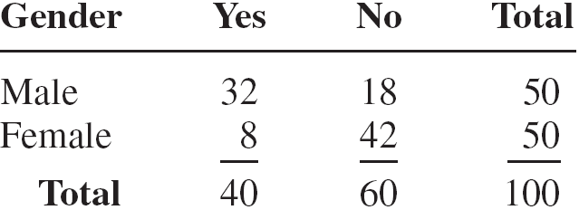
Example 4-34: Women in the Military
A recent survey asked 100 people if they thought women in the armed forces should be permitted to participate in combat. The results of the survey are shown.

Slide 62
Example 4-34: Women in the Military
a. Find the probability that the respondent answered yes (Y), given that the respondent was a female (F).

Slide 63
Example 4-34: Women in the Military
b. Find the probability that the respondent was a male (M), given that the respondent answered no (N).

Slide 64
Chapter 4 Probability and Counting Rules
Section 4-3
Example 4-37
Page #221

Slide 65
Example 4-37: Ties
The Neckware Association of America reported that 3% of ties sold in the United States are bow ties (B). If 4 customers who purchased a tie are randomly selected, find the probability that at least 1 purchased a bow tie.

Slide 66
4.4 Counting Rules
The fundamental counting rule is also called the multiplication of choices.
In a sequence of n events in which the first one has k₁ possibilities and the second event has k₂ and the third has k₃, and so forth, the total number of possibilities of the sequence will be
k₁ · k₂ · k₃ · · · k_{n}

Slide 67
Chapter 4 Probability and Counting Rules
Section 4-4
Example 4-39
Page #227

Slide 68
Example 4-39: Types of Paint
A paint manufacturer wishes to manufacture several different paints. The categories include
Color: red, blue, white, black, green, brown, yellow
Type: latex, oil
Texture: flat, semigloss, high gloss
Use: outdoor, indoor
How many different kinds of paint can be made if you can select one color, one type, one texture, and one use?

Slide 69
Counting Rules
Factorial is the product of all the positive numbers from 1 to a number.
Permutation is an arrangement of objects in a specific order. Order matters.

Slide 70
Counting Rules
Combination is a grouping of objects. Order does not matter.

Slide 71
Chapter 4 Probability and Counting Rules
Section 4-4
Example 4-42/4-43
Page #229 - 230

Slide 72
Example 4-42: Business Location
Suppose a business owner has a choice of 5 locations in which to establish her business. She decides to rank each location according to certain criteria, such as price of the store and parking facilities. How many different ways can she rank the 5 locations?
Using factorials, 5! = 120.
Using permutations, ₅P₅ = 120.

Slide 73
Example 4-43: Business Location
Suppose the business owner in Example 4–42 wishes to rank only the top 3 of the 5 locations. How many different ways can she rank them?
Using permutations, ₅P₃ = 60.

Slide 74
Chapter 4 Probability and Counting Rules
Section 4-4
Example 4-44
Page #231

Slide 75

Example 4-44: Radio Show Guests
A radio talk show host can select 3 of 6 special guests for her program.
The order of appearance of the guests is important. How many different ways can this be done?
Since the order of appearance on the show is important, there are ₆P₃ ways to select the guests.
Hence, there can be 120 different ways to select 3 guests and present them on the program in a specific order.

Slide 76
Chapter 4 Probability and Counting Rules
Section 4-4
Example 4-45
Page #231

Slide 77

Example 4-45: School Musical Plays
A school musical director can select 2 musical plays to present next year. One will be presented in the fall, and one will be presented in the spring. If she has 9 to pick from, how many different possibilities are there?
Order matters, so we will use permutations.

Slide 78
Chapter 4 Probability and Counting Rules
Section 4-4
Example 4-48
Page #233

Slide 79

Example 4-48: Flier Types
An advertising executive must select 3 different photographs for an advertising flier.
If she has 10 different photographs that can be used, how many ways can she select 3 of them?

Slide 80
Chapter 4 Probability and Counting Rules
Section 4-4
Example 4-49
Page #234

Slide 81
Example 4-49: Committee Selection
In a club there are 7 women and 5 men. A committee of 3 women and 2 men is to be chosen. How many different possibilities are there?
There are not separate roles listed for each committee member, so order does not matter. We will use combinations.
There are 35·10 = 350 different possibilities.

Slide 82
4.5 Probability and Counting Rules
The counting rules can be combined with the probability rules in this chapter to solve
many types of probability problems.
By using the fundamental counting rule, the permutation rules, and the combination rule, you can compute the probability of outcomes of many experiments, such as getting a full house when 5 cards are dealt or selecting a committee of 3 women and 2 men from a club consisting of 10 women and 10 men.

Slide 83
Chapter 4 Probability and Counting Rules
Section 4-5
Example 4-52
Page #243

Slide 84
Example 4-52: Magazines
A store has 6 TV Graphic magazines and 8 Newstime magazines on the counter. If two customers purchased a magazine, find the probability that one of each magazine was purchased.
TV Graphic: One magazine of the 6 magazines
Newstime: One magazine of the 8 magazines
Total: Two magazines of the 14 magazines

Slide 85
Chapter 4 Probability and Counting Rules
Section 4-5
Example 4-53
Page #243

Slide 86
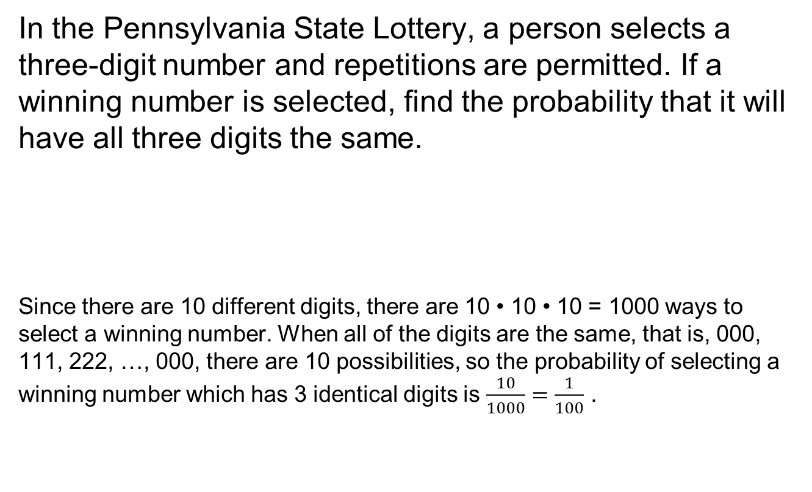
Example 4-53: State Lottery Number
In the Pennsylvania State Lottery, a person selects a three-digit number and repetitions are permitted. If a winning number is selected, find the probability that it will have all three digits the same.
Since there are 10 different digits, there are 10 • 10 • 10 = 1000 ways to select a winning number. When all of the digits are the same, that is, 000, 111, 222, …, 000, there are 10 possibilities, so the probability of selecting a winning number which has 3 identical digits is $\frac{10}{1000}=\frac{1}{100}$ .

