Slide 1

C H A P T E R F I V E
Discrete Probability Distributions

Slide 2
Discrete Probability Distributions
CHAPTER
5
1.1
Descriptive and Inferential Statistics
Outline
5-1 | Probability Distributions
5-2 | Mean, Variance, Standard Deviation, and Expectation
5-3 | The Binomial Distribution
5-4 | Other Types of Distributions Summary
Copyright © 2012 The McGraw-Hill Companies, Inc.
Slide 2

Slide 3
Learning Objectives
1.1
1 | Construct a probability distribution for a random variable.
2 | Find the mean, variance, standard deviation, and expected value for a discrete random variable.
3 | Find the exact probability for X successes in n trials of a binomial experiment.
4 | Find the mean, variance, and standard deviation for the variable of a binomial distribution.
5 | Find probabilities for outcomes of variables, using the Poisson, hypergeometric, and multinomial distributions.
Descriptive and inferential statistics

Slide 4
5.1 Probability Distributions
A random variable is a variable whose values are determined by chance.
A discrete probability distribution consists of the values a random variable can assume and the corresponding probabilities of the values.
The sum of the probabilities of all events in a sample space add up to 1. Each probability is between 0 and 1, inclusively.

Slide 5
Chapter 5 Discrete Probability Distributions
Section 5-1
Example 5-1
Page #259

Slide 6

Example 5-1: Rolling a Die
Construct a probability distribution for rolling a single die.

Slide 7
Chapter 5 Discrete Probability Distributions
Section 5-1
Example 5-2
Page #260

Slide 8
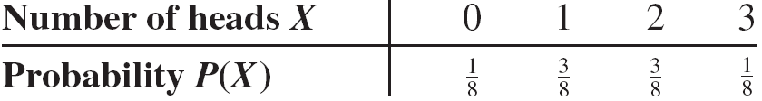
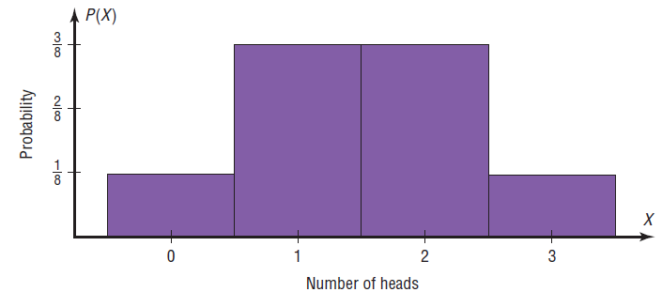
Example 5-2: Tossing Coins
Represent graphically the probability distribution for the sample space for tossing three coins.
.

Slide 9
5-2 Mean, Variance, Standard Deviation, and Expectation

Slide 10
Mean, Variance, Standard Deviation, and Expectation
Rounding Rule
The mean, variance, and standard deviation should be rounded to one more decimal place than the outcome X.
When fractions are used, they should be reduced to lowest terms.

Slide 11
Chapter 5 Discrete Probability Distributions
Section 5-2
Example 5-5
Page #266

Slide 12
Example 5-5: Rolling a Die
Find the mean of the number of spots that appear when a die is tossed.
.

Slide 13
Chapter 5 Discrete Probability Distributions
Section 5-2
Example 5-8
Page #267

Slide 14
Example 5-8: Trips of 5 Nights or More
The probability distribution shown represents the number of trips of five nights or more that American adults take per year. (That is, 6% do not take any trips lasting five nights or more, 70% take one trip lasting five nights or more per year, etc.) Find the mean.
.

Slide 15
Example 5-8: Trips of 5 Nights or More

Slide 16
Chapter 5 Discrete Probability Distributions
Section 5-2
Example 5-9
Page #268

Slide 17
Example 5-9: Rolling a Die
Compute the variance and standard deviation for the probability distribution in Example 5–5.
.

Slide 18
Chapter 5 Discrete Probability Distributions
Section 5-2
Example 5-11
Page #263

Slide 19

Example 5-11: On Hold for Talk Radio
A talk radio station has four telephone lines. If the host is unable to talk (i.e., during a commercial) or is talking to a person, the other callers are placed on hold. When all lines are in use, others who are trying to call in get a busy signal. The probability that 0, 1, 2, 3, or 4 people will get through is shown in the distribution. Find the variance and standard deviation for the distribution.

Slide 20
Example 5-11: On Hold for Talk Radio

Slide 21
Example 5-11: On Hold for Talk Radio
A talk radio station has four telephone lines. If the host is unable to talk (i.e., during a commercial) or is talking to a person, the other callers are placed on hold. When all lines are in use, others who are trying to call in get a busy signal.
Should the station have considered getting more phone lines installed?

Slide 22
Example 5-11: On Hold for Talk Radio
No, the four phone lines should be sufficient.
The mean number of people calling at any one time is 1.6.
Since the standard deviation is 1.1, most callers would be accommodated by having four phone lines because µ + 2σ would be
1.6 + 2(1.1) = 1.6 + 2.2 = 3.8.
Very few callers would get a busy signal since at least 75% of the callers would either get through or be put on hold. (See Chebyshev’s theorem in Section 3–2.)

Slide 23
Expectation
The expected value, or expectation, of a discrete random variable of a probability distribution is the theoretical average of the variable.
The expected value is, by definition, the mean of the probability distribution.

Slide 24
Chapter 5 Discrete Probability Distributions
Section 5-2
Example 5-13
Page #270

Slide 25
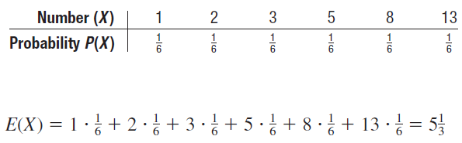
Example 5-13: Selecting Balls
You have six balls numbered 1-8 and 13 are placed in a box. A ball is selected at random , and its number is recorded and it is replaced
Find the expected value of the number that will occur

Slide 26
5-3 The Binomial Distribution
Many types of probability problems have only two possible outcomes or they can be reduced to two outcomes.
Examples include: when a coin is tossed it can land on heads or tails, when a baby is born it is either a boy or girl, etc.

Slide 27
The Binomial Distribution
The binomial experiment is a probability experiment that satisfies these requirements:
There must be a fixed number of trials.
Each trial can have only two outcomes
The outcomes of each trial must be independent of each other.
The probability of success must remain the same for each trial.

Slide 28
Notation for the Binomial Distribution
P(S)
P(F)
p
q
P(S) = p
n
X
Note that X = 0, 1, 2, 3, ... , n
The symbol for the probability of success
The symbol for the probability of failure
The numerical probability of success
The numerical probability of failure
and P(F) = 1 – p = q
The number of trials
The number of successes in n trials

Slide 29
The Binomial Distribution
In a binomial experiment, the probability of exactly X successes in n trials is

Slide 30
Chapter 5 Discrete Probability Distributions
Section 5-3
Example 5-17
Page #279

Slide 31
Example 5-17: Survey on Doctor Visits
A survey found that one out of five Americans say he or she has visited a doctor in any given month. If 10 people are selected at random, find the probability that exactly 3 will have visited a doctor last month.

Slide 32
Chapter 5 Discrete Probability Distributions
Section 5-3
Example 5-18
Page #279

Slide 33
Example 5-18: Survey on Employment
A survey from Teenage Research Unlimited (Northbrook, Illinois) found that 30% of teenage consumers receive their spending money from part-time jobs. If 5 teenagers are selected at random, find the probability that at least 3 of them will have part-time jobs.

Slide 34
Chapter 5 Discrete Probability Distributions
Section 5-3
Example 5-19
Page #279

Slide 35
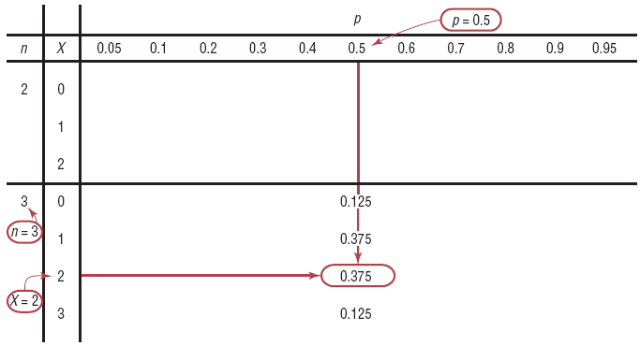
Example 5-19: Tossing Coins
A coin is tossed 3 times. Find the probability of getting exactly two heads, using Table B.

Slide 36
The Binomial Distribution
The mean, variance, and standard deviation of a variable that has the binomial distribution can be found by using the following formulas.

Slide 37
Chapter 5 Discrete Probability Distributions
Section 5-3
Example 5-23
Page #282

Slide 38
Example 5-23: Likelihood of Twins
The Statistical Bulletin published by Metropolitan Life Insurance Co. reported that 2% of all American births result in twins. If a random sample of 8000 births is taken, find the mean, variance, and standard deviation of the number of births that would result in twins.

Slide 39
5-4 Other Types of Distributions
The multinomial distribution is similar to the binomial distribution but has the advantage of allowing one to compute probabilities when there are more than two outcomes.
The binomial distribution is a special case of the multinomial distribution.

Slide 40
Chapter 5 Discrete Probability Distributions
Section 5-4
Example 5-25
Page #290

Slide 41
Example 5-25: Leisure Activities
In a large city, 50% of the people choose a movie, 30% choose dinner and a play, and 20% choose shopping as a leisure activity. If a sample of 5 people is randomly selected, find the probability that 3 are planning to go to a movie, 1 to a play, and 1 to a shopping mall.

Slide 42
Other Types of Distributions
The Poisson distribution is a distribution useful when n is large and p is small and when the independent variables occur over a period of time.
The Poisson distribution can also be used when a density of items is distributed over a given area or volume, such as the number of plants growing per acre or the number of defects in a given length of videotape.

Slide 43
Other Types of Distributions
Poisson Distribution
The probability of X occurrences in an interval of time, volume, area, etc., for a variable, where λ (Greek letter lambda) is the mean number of occurrences per unit (time, volume, area, etc.), is
The letter e is a constant approximately equal to 2.7183.

Slide 44
Chapter 5 Discrete Probability Distributions
Section 5-4
Example 5-28
Page #292

Slide 45
Example 5-27: Typographical Errors
If there are 200 typographical errors randomly distributed in a 500-page manuscript, find the probability that a given page contains exactly 3 errors.
First, find the mean number of errors. With 200 errors distributed over 500 pages, each page has an average of
errors per page.
Thus, there is less than 1% chance that any given page will contain exactly 3 errors.

Slide 46
Other Types of Distributions
The hypergeometric distribution is a distribution of a variable that has two outcomes when sampling is done without replacement.

Slide 47
Other Types of Distributions
Hypergeometric Distribution
Given a population with only two types of objects (females and males, defective and nondefective, successes and failures, etc.), such that there are a items of one kind and b items of another kind and a + b equals the total population, the probability P(X) of selecting without replacement a sample of size n with X items of type a and n – X items of type b is
The letter e is a constant approximately equal to 2.7183.

Slide 48
Chapter 5 Discrete Probability Distributions
Section 5-4
Example 5-32
Page #295

Slide 49
Example 5-32: House Insurance
A recent study found that 2 out of every 10 houses in a neighborhood have no insurance. If 5 houses are selected from 10 houses, find the probability that exactly 1 will be uninsured.

Slide 50
Other Types of Distributions
Geometric Distribution
This distribution can be used when we have an experiment that has two outcomes and is repeated until a successful outcome is obtained.

Slide 51

Other Types of Distributions
Geometric Distribution
If p is the probability of a success on each trial of a binomial experiment and n is the number of the trial at which the first success occurs, then the probability of getting the first success on the nth trial is:
Where n is 1, 2, 3…

Slide 52
Chapter 5 Discrete Probability Distributions
Section 5-4
Example 5-35
Page #296

Slide 53
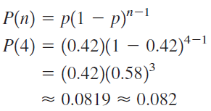
Example 5-35: Blood Types
In the US, approximately 42%of people have type A blood. If 4 people are selected at random find the probability that the fourth person is the first one selected with type A blood
Let p = 0.42 and n = 4.

