Slide 1

C H A P T E R S I X
The Normal Distribution
Copyright © 2015 The McGraw-Hill Companies, Inc. Permission required for reproduction or display.

Slide 2
CHAPTER
6
The Normal Distribution
1.1
Outline
Descriptive and Inferential Statistics
6-1 | Normal Distributions
6-2 | Applications of the Normal Distribution
6-3 | The Central Limit Theorem
6-4 | The Normal Approximation to the Binomial Distribution
Copyright © 2012 The McGraw-Hill Companies, Inc.
Slide 2

Slide 3
Learning Objectives
1.1
1 | Identify the properties of a normal distribution.
2 | Identify distributions as symmetric or skewed
3 | Find the area under the standard normal distribution, given various z values.
4 | Find probabilities for a normally distributed variable by transforming it into a standard normal variable.
5 | Find specific data values for given percentages, using the standard normal distribution.
Descriptive and inferential statistics

Slide 4
Learning Objectives
1.1
6 | Use the central limit theorem to solve problems involving sample means for large samples.
7 | Use the normal approximation to compute probabilities for a binomial variable.
Descriptive and inferential statistics

Slide 5
6.1 Normal Distributions
Many continuous variables have distributions that are bell-shaped and are called approximately normally distributed variables.
The theoretical curve, called the bell curve or the Gaussian distribution, can be used to study many variables that are not normally distributed but are approximately normal.

Slide 6
Normal Distributions
The mathematical equation for the normal distribution is:

Slide 7
Normal Distributions
The shape and position of the normal distribution curve depend on two parameters, the mean and the standard deviation.
Each normally distributed variable has its own normal distribution curve, which depends on the values of the variable’s mean and standard deviation.

Slide 8
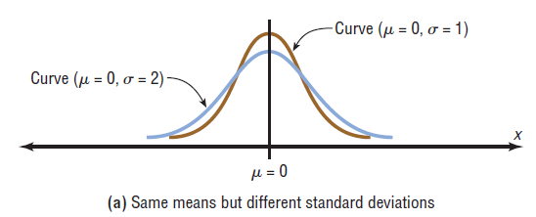
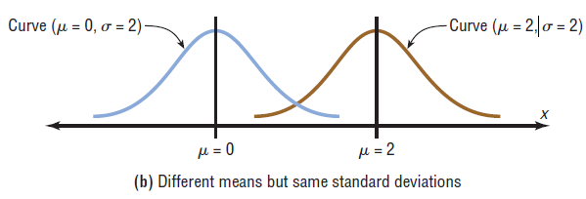
Normal Distributions

Slide 9
Normal Distribution Properties
The normal distribution curve is bell-shaped.
The mean, median, and mode are equal and located at the center of the distribution.
The normal distribution curve is unimodal (i.e., it has only one mode).
The curve is symmetrical about the mean, which is equivalent to saying that its shape is the same on both sides of a vertical line passing through the center.

Slide 10
Normal Distribution Properties
The curve is continuous—i.e., there are no gaps or holes. For each value of X, there is a corresponding value of Y.
The curve never touches the x-axis. Theoretically, no matter how far in either direction the curve extends, it never meets the x-axis—but it gets increasingly close.

Slide 11
Normal Distribution Properties
The total area under the normal distribution curve is equal to 1.00 or 100%.
The area under the normal curve that lies within
one standard deviation of the mean is approximately 0.68 (68%).
two standard deviations of the mean is approximately 0.95 (95%).
three standard deviations of the mean is approximately 0.997 ( 99.7%).

Slide 12
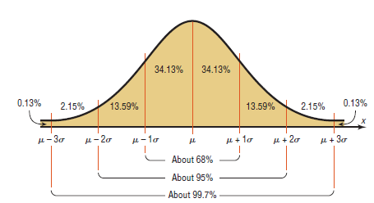
Normal Distribution Properties

Slide 13
Standard Normal Distribution
Since each normally distributed variable has its own mean and standard deviation, the shape and location of these curves will vary. In practical applications, one would have to have a table of areas under the curve for each variable. To simplify this, statisticians use the standard normal distribution.
The standard normal distribution is a normal distribution with a mean of 0 and a standard deviation of 1.

Slide 14
z value (Standard Value)
The z value is the number of standard deviations that a particular X value is away from the mean. The formula for finding the z value is:

Slide 15
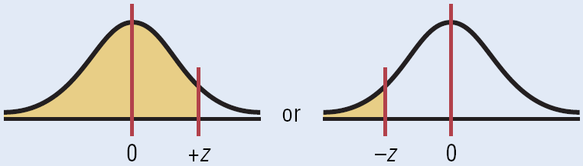
Area under the Standard Normal Distribution Curve
1. To the left of any z value:
Look up the z value in the table and use the area given.

Slide 16
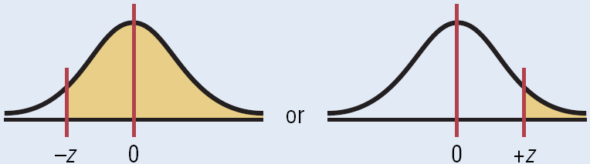
Area under the Standard Normal Distribution Curve
2. To the right of any z value:
Look up the z value and subtract the area from 1.

Slide 17
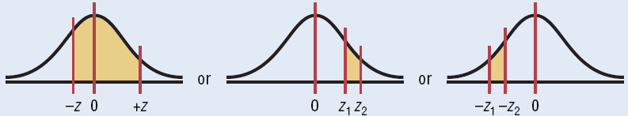
Area under the Standard Normal Distribution Curve
3. Between two z values:
Look up both z values and subtract the corresponding areas.

Slide 18
Chapter 6 Normal Distributions
Section 6-1
Example 6-1
Page #317

Slide 19
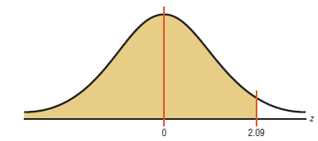
Example 6-1: Area under the Curve
Find the area to the left of z = 2.09.
From the table the area is 0.9817, so 98.17% of the area is left of z = 2.09

Slide 20
Chapter 6 Normal Distributions
Section 6-1
Example 6-2
Page #318

Slide 21
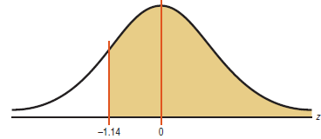
Example 6-2: Area under the Curve
Find the area to the right of z = –1.14.
Find the area from the table; 0.1271 subtract it form 1.0000 = .8729 or 87.29% of the area to the right of z

Slide 22
Chapter 6 Normal Distributions
Section 6-1
Example 6-3
Page #318

Slide 23
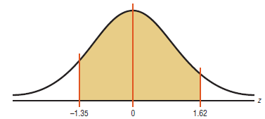
Example 6-3: Area under the Curve
Find the area between z = 1.62 and z = -135.
The values for z = 1.62 is 0.9474 and for
z = –1.35 is 0.0885. The area is 0.9535 – 0.0853 = 0.8589, or 85.89%

Slide 24
Chapter 6 Normal Distributions
Section 6-1
Example 6-4
Page #319

Slide 25
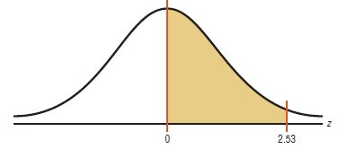
Example 6-4: Probability
Find the probability:
a. P(0 < z < 2.53) b. P(z<1.73) c. P(z>1.98)
a.
The value of 2.53 is 0.9943 and 0 is .5000. 0.9943 - 0.5000 = 0.4943 or 49.43

Slide 26
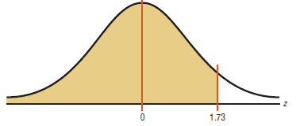
Example 6-4: Probability b.
From the table the value for 1.73 is 0.9582 or 95.82

Slide 27
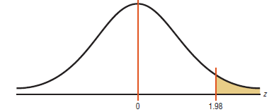
Example 6-4: Probability c.
The area corresponding to 1.98 is 0.9761 subtracting it from 1.0000 = 0.0239 or 2.39

Slide 28
Chapter 6 Normal Distributions
Section 6-1
Example 6-5
Page #320

Slide 29
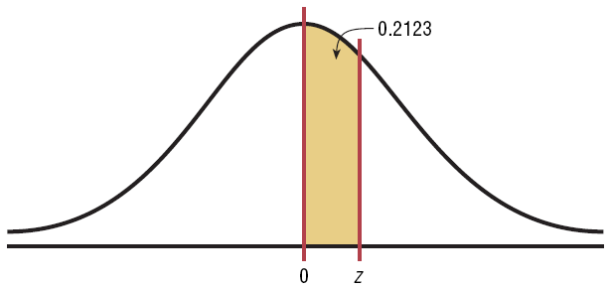
Example 6-5: Probability
Find the z value such that the area under the standard normal distribution curve between 0 and the z value is 0.2123.
Add 0.5000 to 0.2123 to get the cumulative area of 0.7123. Then look for that value inside Table E.

Slide 30
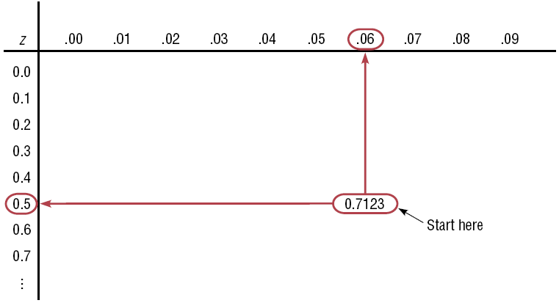
Example 6-5: Probability
Add .5000 to .2123 to get the cumulative area of .7123. Then look for that value inside Table E.
The z value is 0.56.

Slide 31
6.2 Applications of the Normal Distributions
The standard normal distribution curve can be used to solve a wide variety of practical problems. The only requirement is that the variable be normally or approximately normally distributed.
For all the problems presented in this chapter, you can assume that the variable is normally or approximately normally distributed.

Slide 32

Applications of the Normal Distributions
To solve problems by using the standard normal distribution, transform the originalvariable to a standard normal distribution variable by using the formula.

Slide 33
Chapter 6 Normal Distributions
Section 6-2
Example 6-6
Page #329

Slide 34
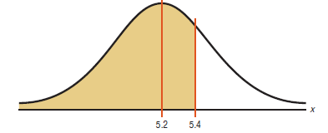

Example 6-6: Liters of Blood
An adult has on average 5.2 liters of blood. Assume the variable is normally distributed and has a standard deviation of 0.3. Find the percentage of people who have less than5.4 liters of blood in their system.

Slide 35
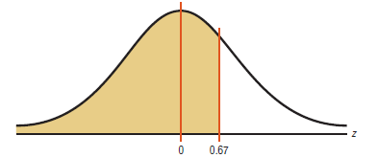
Example 6-6: Summer Spending
Find the area for 0.67 which is 0.7486 or 74.87%

Slide 36
Chapter 6 Normal Distributions
Section 6-2
Example 6-7a
Page #330

Slide 37
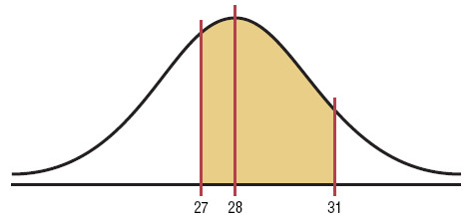
Example 6-7a: Newspaper Recycling
Each month, an American household generates an average of 28 pounds of newspaper for garbage or recycling. Assume the variable is approximately normally distributed and the standard deviation is 2 pounds. If a household is selected at random, find the probability of its generating.
Between 27 and 31 pounds per month
More than 30.2 pounds per month

Slide 38
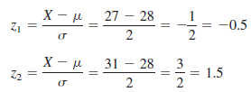
Example 6-7a: Newspaper Recycling
Step 2: Find the two z values
Table E gives us an area of 0.9332 – 0.3085 = 0.6247. The probability is 62%.

Slide 39
Chapter 6 Normal Distributions
Section 6-2
Example 6-8
Page #331

Slide 40
Example 6-8: Amount of Electricity Used by a PC
A desktop PC used 120 watts of electricity per hour based on 4 hours of use per day the variable is approximately normally distributed and the standard deviation is 6. If 500 PCs are selected, approximately how many will use less than 106 watts of power

Slide 41
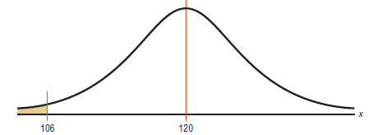

Example 6-8: Amount of Electricity Used by a PC
Find the z value

Slide 42
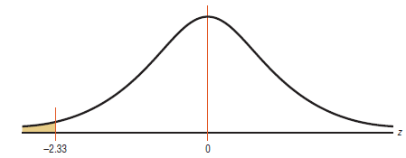
Example 6-8: Amount of Electricity Used by a PC
Multiply 500 X 0.0099 = 5 hence, approximately 5 PCs use less than 106 watts

Slide 43
Chapter 6 Normal Distributions
Section 6-2
Example 6-9
Page #333

Slide 44
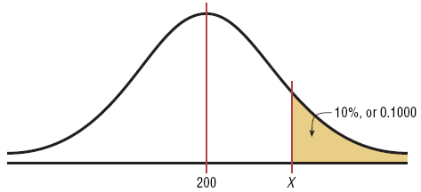
Example 6-9: Police Academy
To qualify for a police academy, candidates must score in the top 10% on a general abilities test. The test has a mean of 200 and a standard deviation of 20. Find the lowest possible score to qualify. Assume the test scores are normally distributed.
Step 1: Draw the normal distribution curve.

Slide 45
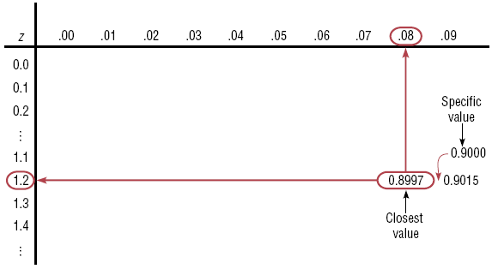
Example 6-8: Police Academy
Step 2: Subtract 1 – 0.1000 to find area to the left, 0.9000. Look for the closest value to that in Table E.
Step 3: Find X.
The cutoff, the lowest possible score to qualify, is 226.

Slide 46
Chapter 6 Normal Distributions
Section 6-2
Example 6-10
Page #334

Slide 47
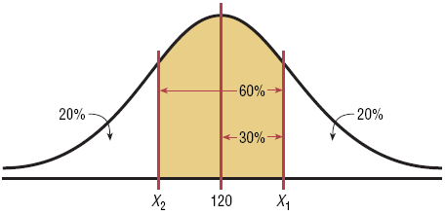
Example 6-10: Systolic Blood Pressure
For a medical study, a researcher wishes to select people in the middle 60% of the population based on blood pressure. If the mean systolic blood pressure is 120 and the standard deviation is 8, find the upper and lower readings that would qualify people to participate in the study.
Step 1: Draw the normal distribution curve.

Slide 48
Example 6-10: Systolic Blood Pressure
Area to the left of the positive z: 0.5000 + 0.3000 = 0.8000.
Using Table E, z ≈ 0.84.
Area to the left of the negative z: 0.5000 – 0.3000 = 0.2000.
Using Table E, z ≈ –0.84.
The middle 60% of readings are between 113 and 127.
X = 120 + 0.84(8) = 126.72
X = 120 – 0.84(8) = 113.28

Slide 49
Normal Distributions
A normally shaped or bell-shaped distribution is only one of many shapes that a distribution can assume; however, it is very important since many statistical methods require that the distribution of values (shown in subsequent chapters) be normally or approximately normally shaped.
There are a number of ways statisticians check for normality. We will focus on three of them.

Slide 50
Checking for Normality
Histogram
Pearson’s Index PI of Skewness
Outliers

Slide 51
Chapter 6 Normal Distributions
Section 6-2
Example 6-11
Page #335

Slide 52
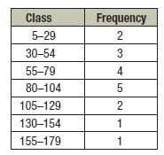
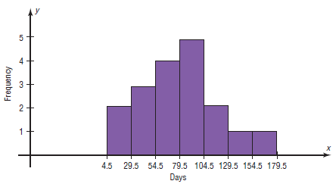
Example 6-11: Technology Inventories
A survey of 18 high-technology firms showed the number of days’ inventory they had on hand. Determine if the data are approximately normally distributed.
5 29 34 44 45 63 68 74 74
81 88 91 97 98 113 118 151 158
Method 1: Construct a Histogram.
The histogram is approximately bell-shaped.

Slide 53
Example 6-11: Technology Inventories
Method 2: Check for Skewness.
The PI is not greater than 1 or less than –1, so it can be concluded that the distribution is not significantly skewed.
Method 3: Check for Outliers.
Five-Number Summary: 5 - 45 - 77.5 - 98 - 158
Q1 – 1.5(IQR) = 45 – 1.5(53) = –34.5
Q3 + 1.5(IQR) = 98 + 1.5(53) = 177.5
No data below –34.5 or above 177.5, so no outliers.

Slide 54
Example 6-11: Technology Inventories
A survey of 18 high-technology firms showed the number of days’ inventory they had on hand. Determine if the data are approximately normally distributed.
5 29 34 44 45 63 68 74 74
81 88 91 97 98 113 118 151 158
Conclusion:
The histogram is approximately bell-shaped.
The data are not significantly skewed.
There are no outliers.
Thus, it can be concluded that the distribution is approximately normally distributed.

Slide 55
6.3 The Central Limit Theorem
In addition to knowing how individual data values vary about the mean for a population, statisticians are interested in knowing how the means of samples of the same size taken from the same population vary about the population mean.

Slide 56
Distribution of Sample Means
A sampling distribution of sample means is a distribution obtained by using the means computed from random samples of a specific size taken from a population.
Sampling error is the difference between the sample measure and the corresponding population measure due to the fact that the sample is not a perfect representation of the population.

Slide 57
Properties of the Distribution of Sample Means
The mean of the sample means will be the same as the population mean.
The standard deviation of the sample means will be smaller than the standard deviation of the population, and will be equal to the population standard deviation divided by the square root of the sample size.

Slide 58


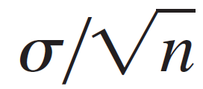
The Central Limit Theorem
As the sample size n increases, the shape of the As the sample size n increases without limit, the shape of the distribution of the sample means taken with replacement from a population with mean and standard deviation will approach a normal distribution. As previously shown, this distribution will have a mean m and
a standard deviation .

Slide 59
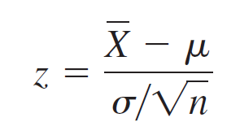
The Central Limit Theorem
The central limit theorem can be used to answer questions about sample means in the same manner that the normal distribution can be used to answer questions about individual values.
A new formula must be used for the z values:

Slide 60
Chapter 6 Normal Distributions
Section 6-3
Example 6-13
Page #347

Slide 61
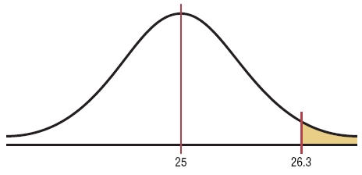
Example 6-13: Hours of Television
A. C. Neilsen reported that children between the ages of 2 and 5 watch an average of 25 hours of television per week. Assume the variable is normally distributed and the standard deviation is 3 hours. If 20 children between the ages of 2 and 5 are randomly selected, find the probability that the mean of the number of hours they watch television will be greater than 26.3 hours.

Slide 62
Example 6-13: Hours of Television
Since we are calculating probability for a sample mean, we need the Central Limit Theorem formula
The area is 1.0000 – 0.9738 = 0.0262. The probability of obtaining a sample mean larger than 26.3 hours is 2.62%.

Slide 63
Chapter 6 Normal Distributions
Section 6-3
Example 6-14
Page #348

Slide 64
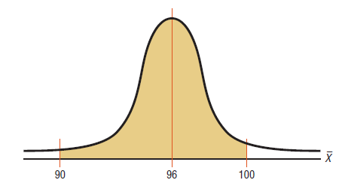
Example 6-14: Vehicle Age
The average age of a vehicle registered in the United States is 8 years, or 96 months. Assume the standard deviation is 16 months. If a random sample of 36 vehicles is selected, find the probability that the mean of their age is between 90 and 100 months.
Since the sample is 30 or larger, the normality assumption is not necessary.

Slide 65
Example 6-14: Vehicle Age
Table E gives us areas 0.9332 and 0.0122, respectively.
The desired area is 0.9332 – 0.0122 = 0.9210.
The probability of obtaining a sample mean between 90 and 100 months is 92.1%.

Slide 66
Chapter 6 Normal Distributions
Section 6-3
Example 6-15
Page #349

Slide 67
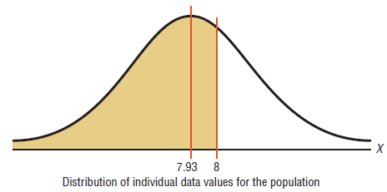
Example 6-15: Working Weekends
The average time spent by construction workers on weekends is 7.93 hours (over 2 days). Assume the distribution is approximately normal with a standard deviation of 0.8 hours.
a. Find the probability an individual who works that trade works fewer than 8 hours on the weekend

Slide 68

Example 6-15: Working Weekends
The area to the left of z = 0.09 is 0.5359 or 53.59%

Slide 69
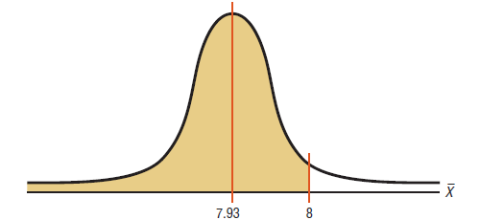
Example 6-15: Working Weekends
a. If a sample of 40 workers is randomly selected, find the probability the mean of the sample will be less than 8 hours

Slide 70
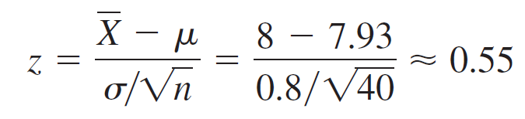
Example 6-15: Meat Consumption
The area to the left of z = 0.55 is 0.7088 meaning the probability of getting a sample mean less than 8 hours with sample size 40 is 70.88.

Slide 71
Finite Population Correction Factor
The formula for standard error of the mean is accurate when the samples are drawn with replacement or are drawn without replacement from a very large or infinite population.
A correction factor is necessary for computing the standard error of the mean for samples drawn without replacement from a finite population.

Slide 72
Finite Population Correction Factor
The correction factor is computed using the following formula:
where N is the population size and n is the sample size.
The standard error of the mean must be multiplied by the correction factor to adjust it for large samples taken from a small population.

Slide 73
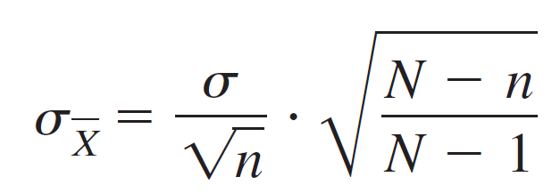
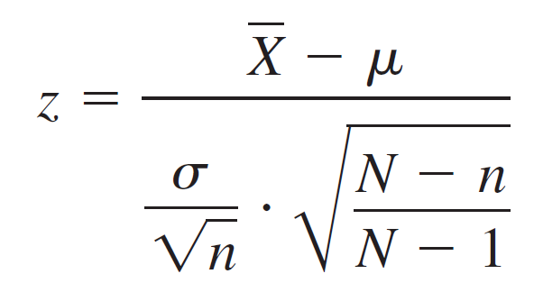
Finite Population Correction Factor
The standard error for the mean must be adjusted when it is included in the formula for calculating the z values.

Slide 74
6.4 The Normal Approximation to the Binomial Distribution
A normal distribution is often used to solve problems that involve the binomial distribution since when n is large (say, 100), the calculations are too difficult to do by hand using the binomial distribution.

Slide 75
The Normal Approximation to the Binomial Distribution
The normal approximation to the binomial is appropriate when np > 5 and nq > 5 .
In addition, a correction for continuity may be used in the normal approximation to the binomial.
The continuity correction means that for any specific value of X, say 8, the boundaries of X in the binomial distribution (in this case, 7.5 to 8.5) must be used.

Slide 76
The Normal Approximation to the Binomial Distribution
Binomial
When finding:
P(X = a)
P(X ≥ a)
P(X > a)
P(X ≤ a)
P(X < a)
Normal
Use:
P(a – 0.5 < X < a + 0.5)
P(X > a – 0.5)
P(X > a + 0.5)
P(X < a + 0.5)
P(X < a – 0.5)

Slide 77
6.4
The Normal Approximation to the Binomial
Distribution
Procedure for the Normal Approximation to the Binomial Distribution
Step 1 Check to see whether the normal approximation can be used.
Step 2 Find the mean μ and the standard deviation σ.
Step 3 Write the problem in probability notation, using X.
Step 4 Rewrite the problem by using the continuity correction factor, and show the corresponding area under the normal distribution.

Slide 78
6.4
The Normal Approximation to the Binomial
Distribution
Procedure for the Normal Approximation to the Binomial Distribution
Step 5 Find the corresponding z values.
Step 6 Find the solution.

Slide 79
Chapter 6 Normal Distributions
Section 6-4
Example 6-16
Page #356

Slide 80
Example 6-16: Reading While Driving
A magazine reported that 6% of American drivers read the newspaper while driving. If 300 drivers are selected at random, find the probability that exactly 25 say they read the newspaper while driving.
Here, p = 0.06, q = 0.94, and n = 300.
Step 1: Check to see whether a normal approximation can be used.
np = (300)(0.06) = 18 and nq = (300)(0.94) = 282
Since np ≥ 5 and nq ≥ 5, we can use the normal distribution.
Step 2: Find the mean and standard deviation.
µ = np = (300)(0.06) = 18

Slide 81
Example 6-16: Reading While Driving
Step 3: Write in probability notation.
Step 4: Rewrite using the continuity correction factor.
P(24.5 < X < 25.5)
Step 5: Find the corresponding z values.
Step 6: Find the solution
The area between the two z values is 0.9656 – 0.9429 = 0.0227, or 2.27%.
Hence, the probability that exactly 25 people read the newspaper while driving is 2.27%.
P(X = 25)

Slide 82
Chapter 6 Normal Distributions
Section 6-4
Example 6-17
Page #357

Slide 83
Example 6-17: Ragweed Allergies
Ten percent of Americans are allergic to ragweed. If a random sample of 200 people is selected find the probability that 10 or more will be allergic to ragweed.
Step 1: Check to see whether a normal approximation can be used. Here p = 0.10, q = 0.90, and n = 200
np = (200)(0.10) = 20 and nq = (200)(0.90) = 180
Since np ≥ 5 and nq ≥ 5, we can use the normal distribution.
Step 2: Find the mean and standard deviation.
µ = np = (200)(0.10) = 20

Slide 84
Example 6-17: Widowed Bowlers
Step 3: Write in probability notation.
Step 4: Rewrite using the continuity correction factor.
P(X > 9.5)
Step 5: Find the corresponding z values.
Step 6: Find the solution
The area to the right of the z value is 1.0000 – 0.0066 = 0.9934, or 99.34%.
The probability of 10 or more widowed people in a random sample of 200 bowling league members is 99.34%.
P(X ≥ 10)

