Slide 1
Chapter 4: Business Process and Functional Modeling

Slide 2
Objectives
Understand the process used to identify business processes and use cases.
Understand the process used to create use-case diagrams
Understand the process used to model business processes with activity diagrams.
Understand the rules and style guidelines for activity diagrams.
Understand the process used to create use case descriptions.
Understand the rules and style guidelines for use case descriptions.
Be able to create functional models of business processes using use-case diagrams, activity diagrams, and use case descriptions.

Slide 3
Introduction
Now begin the process of turning the requirements into functional models
Models are logical; i.e., independent of how they are implemented (manual or computerized)
Develop use-cases from the requirements
Use-case: how a business system interacts with its environment
Includes a diagram and a description to depict the discrete activities that the users perform
Develop activity diagrams from the use-cases
These model the business processes or how a business operates
Used to illustrate the movement of objects (data) between activities

Slide 4
Generation of a class diagram from flow of events
Flow of events:
Customer
store
buy
The customer enters the store to buy a toy. It has to be a toy that his daughter likes and it must cost less than 50 Euro. He tries a videogame, which uses a data glove and a head-mounted display. He likes it.
customer
enters
toy
?
enter()
daughter
store
enter()
less than 50 Euro
videogame
daughter
daughter
age
suitable
An assistant helps him. The suitability of the game depends on the age of the child. His daughter is only 3 years old. The assistant recommends another type of toy, namely a boardgame. The customer buy the game and leaves the store
depends
age
*
toy
price
buy()
like()
toy
buy()
toy
type of toy
boardgame
videogame
boardgame

Slide 5
"Purchase Ticket" use case description Flows of Event Example

Slide 6




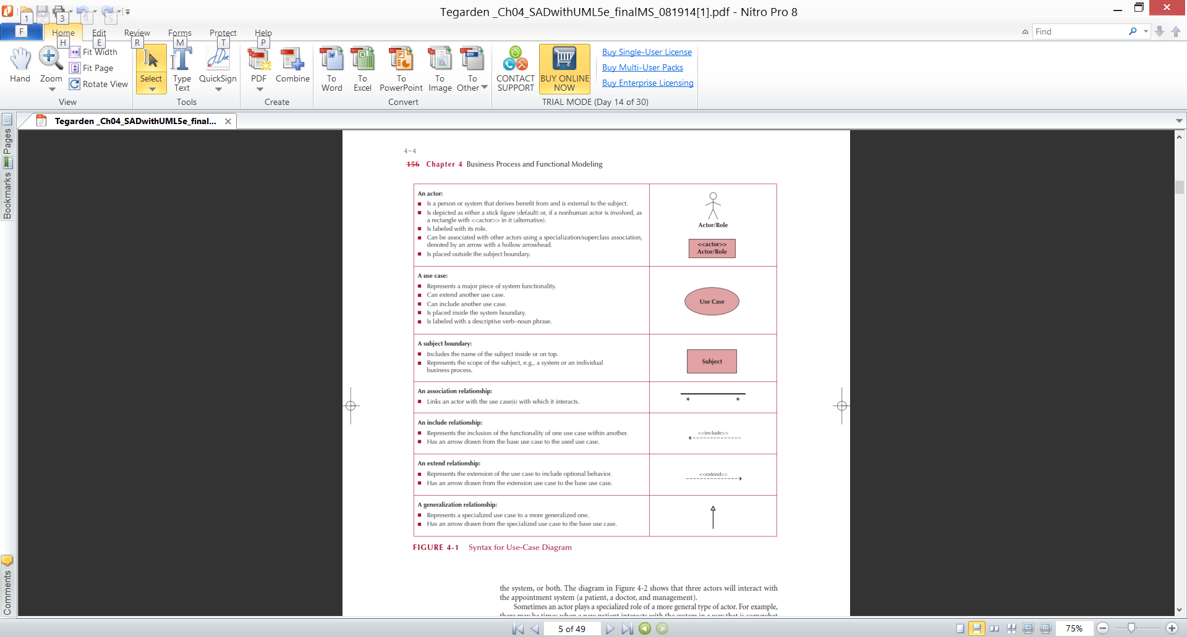
Business Process Identification With Use-Cases
Elements of Use-Case Diagrams
Actors: users or other interacting systems
Associations: lines to connect actors and use-cases
Interactions, inclusions, extensions or generalizations
Use-case: a major process in the system that gives a benefit to the users
Subject boundary: a named box that depicts the scope of the system
An association relationship: links an actor with the use case(s) with which it interacts

Slide 7
Business Process Identification With Use-Cases(Cont.)
Elements of Use-Case Diagrams
An include relationship: Represents the inclusion of the functionality of one use case within another一定要做
An extend relationship: Represents the extension of the use case to include optional behavior.選擇性
A generalization relationship: Represents a specialized use case to a more generalized one.

Slide 8
Identifying Major Use-Cases
Review the requirements definition
Identify the subject’s boundaries
Identify the primary actors and their goals
Identify the business processes and major use-cases
Carefully review the current set of use-cases
Split or combine some to create the right size
Identify additional use-cases

Slide 9
Create a Use-Case Diagram
Place & draw the use-cases
Place & draw the actors
Draw the subject boundary
Add the associations

Slide 10
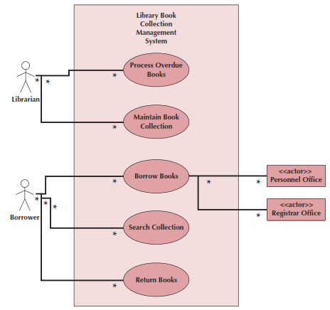
Example Use-Case
Library Book Collection
Management System
Use Case Diagram

Slide 11
Use Cases
The primary driver for all UML diagramming techniques
Depicts activities performed by the users
Describe basic functions of the system:
What the user can do
How the system responds
Use cases are building blocks for continued design activities
Each use-case describes 1 and only 1 function

Slide 12
Types of Use Cases
Purpose | Amount of information
 |  | Overview | Detail
 | Essential | High-level overview of issues essential to understanding required functionality | Detailed description of issues essential to understanding required functionality
 | Real | High-level overview of a specific set of steps performed on the real system once implemented | Detailed description of a specific set of steps performed on the real system once implemented

Slide 13
Elements of a Use Case Description
Overview:
Name, ID Number, Type, Primary Actor, Brief Description, Importance Level, Stakeholder(s), Trigger(s)
Relationships:
Association: Communication between the use case and the actors
Extend: Extends the functionality of a use case
Include: Includes another use case
Generalization: Allows use cases to support inheritance
Flow of events
Normal flow: the usual set of activities
Sub-flows: decomposed normal flows to simplify the use-case
Alternate or exceptional flows: those not considered the norm
Optional characteristics (complexity, time, etc.)

Slide 14
Use Case Writing Guidelines
Write in the form of subject-verb-direct object
Make sure it is clear who the initiator of the step is
Write from independent observer’s perspective
Write at about the same level of abstraction
Ensure the use case has a sensible set of steps
Apply the KISS principle liberally.
Write repeating instructions after the set of steps to be repeated

Slide 15
Creating Use-Case Descriptions
Pick a high priority use-case and create an overview:
List the primary actor
Determine its type (overview or detail; essential or real)
List all stakeholders and their interests
Determine the level of importance of the use-case
Briefly describe the use-case
List what triggers the use-case
List its relationship to other use-cases
Fill in the steps of the normal flow of events required to complete the use-case

Slide 16
Creating Use-Case Descriptions (cont.)
Ensure that the steps listed are not too complicated or long and are consistent in size with other steps
Identify and write the alternate or exceptional flows
Carefully review the use-case description and confirm that it is correct
Iterate over the entire set of steps again

Slide 17
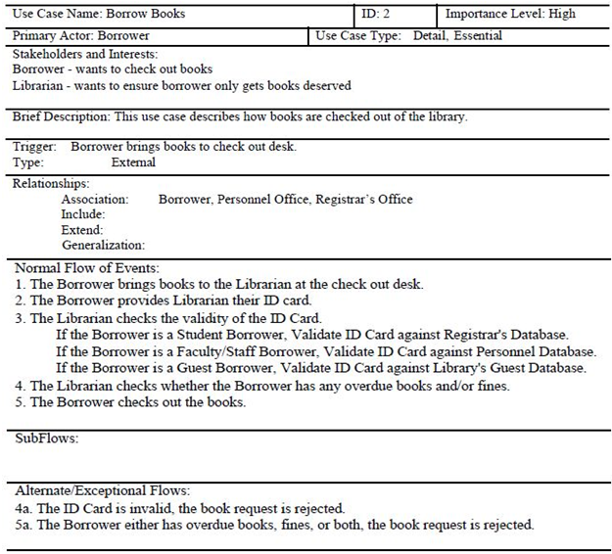
Example Use-Case Description

Slide 18
Verifying & Validating a Use-Case
Use-cases must be verified and validated before beginning structural and behavioral modeling
Utilize a walkthrough:
Perform a review of the models and diagrams created so far
Performed by individuals from the development team and the client (very interactive)
Facilitator: schedule and set up the meeting
Presenter: the one who is responsible for the specific representation being reviewed
Recorder (scribe) to take notes and especially to document errors

Slide 19
BPM With Activity Diagrams
Business processes consist of a number of activities
Activity diagrams depict the sequence of these activities
Diagrams are abstract and describe processes in general
They model behavior independent of objects
Can be used for any type of process

Slide 20
Activity Diagram Syntax
Action or Activity
Represents action or set of actions
Control Flow
Shows sequence of execution
Initial Node
The beginning of a set of actions
Final Node
Stops all flows in an activity
Decision Node
Represents a test condition

Slide 21
Elements of an Activity Diagram
Actions & Activities
Something performed for some specific business reason
Named with a verb and a noun (e.g., Get Patient Information)
Activities can be further sub-divided; actions cannot
Object Nodes: represent the flow of information from one activity to another
Control Flows: model execution paths
Object Flows: model the flow of objects
Control Nodes: 7 types

Slide 22
Control Nodes
Initial node: the beginning of the set of actions/activities
Final-activity node: stops all actions/activities
Final-flow node: stops one execution path but allows others to continue
Decision node: represents a test to determine which path to use to continue (based on a guard condition)
Merge node: rejoins mutually exclusive execution paths
Fork node: separates a single execution path into one or more parallel paths
Join node: rejoins parallel execution paths

Slide 23
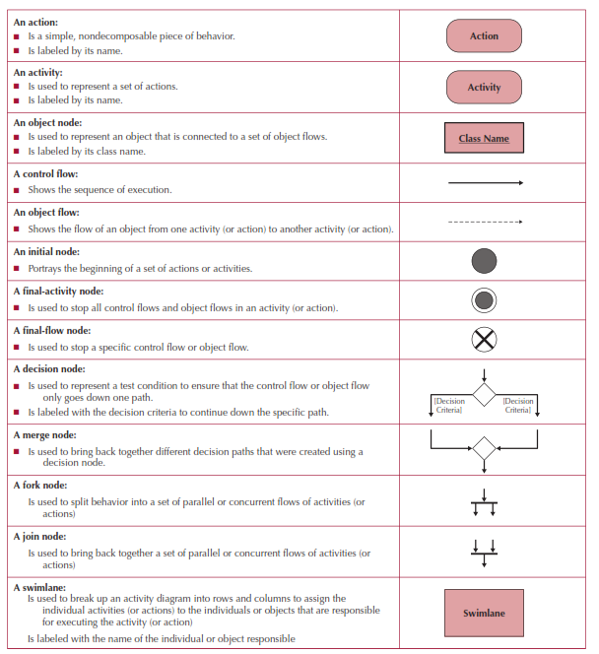
Activity Diagram Symbols

Slide 24
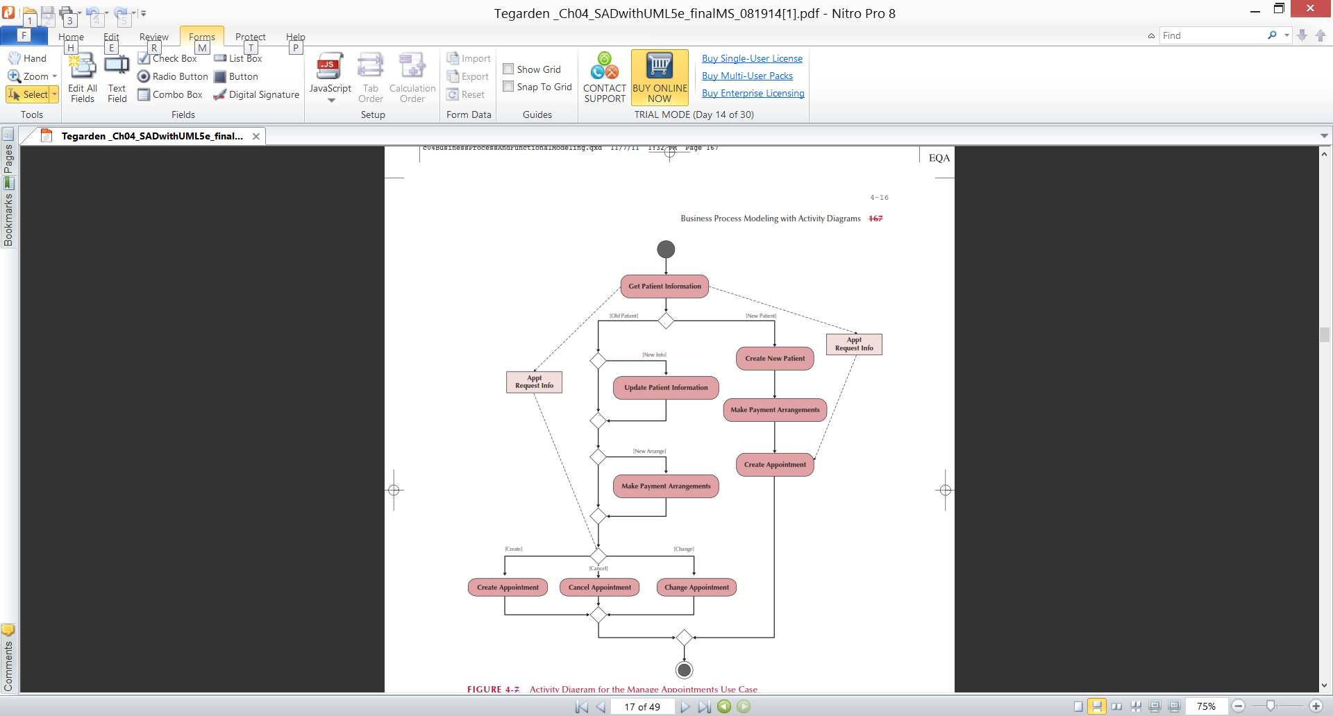
Sample Activity Diagram

Slide 25
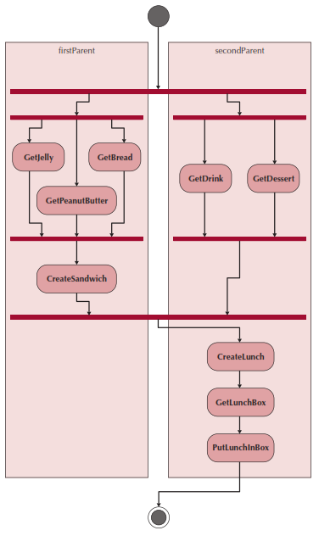
Swim lanes
Used to assign responsibility to objects or individuals who actually perform the activity
Represents a separation of roles among objects
Can be drawn horizontally or vertically

Slide 26
Guidelines for Activity Diagrams
Set the scope of the activity being modeled
Identify the activities; connect them with flows
Identify any decisions that must be made
Identify potential parallelism in the process
Draw the activity diagram

Slide 27
Creating an Activity Diagram
Choose a business process identified previously
Review the requirements definition and use-case diagram
Review other documentation collected thus far
Identify the set of activities used in the business process
Identify control flows and nodes
Identify the object flows and nodes
Lay out & draw the diagram (minimize crossing lines)

Slide 28
Rules for Verification & Validation
Ensure one recorded event in the flows of the use-case description for each action/activity on the activity diagram
All objects in an activity diagram must be mentioned in an event of the use-case description
The sequence of the use-case description should match the sequence in the activity diagram
One and only one description for each use-case

Slide 29
Rules for Verification & Validation
All actors listed in a use-case description must be shown on the use-case diagram
Stakeholders listed in the use-case description may be shown on the use-case diagram (check local policy)
All relationships in the use-case description must be depicted on the use-case diagram
All diagram-specific rules must be enforced

Slide 30
"Purchase Ticket" Diagrams

Slide 31
Summary
Presented in this chapter:
The identification of business processes using use-case diagrams and descriptions
Modeling business processes with activity diagrams
How to create the documentation of use-cases and use-case descriptions
How to verify and validate the business processes and functional models

