Slide 1
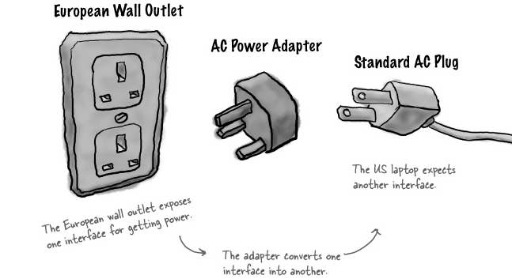

Design Pattern –
Adapter
SELAB

Slide 2


More examples in our lives
USB TO hdmi
HDMI to VGA

Slide 3
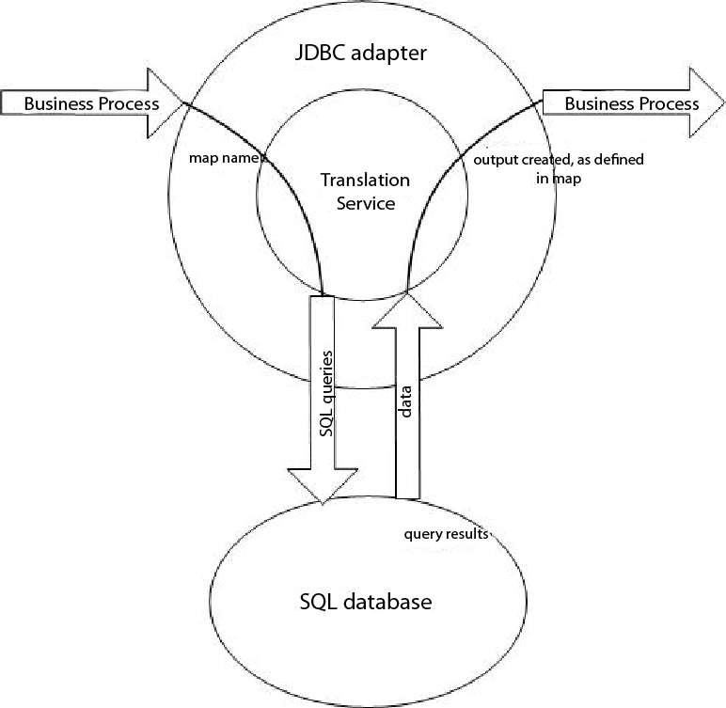
Java Data Base Connectivity (JDBC) Adaptor
Write code in Java using the methods of the JDBC Adaptor
The Adaptor creates SQL commands for you
Picture from IBM

Slide 4
Problem
You want convert one interface to another.
You have outsourced some of your work and there is a new library that needs to be added to the existing software.
Adapter

Slide 5
Creational
Structural
Behavioral
01
07
01
01
06
Chain of responsibility
Abstract factory
Adapter
Flyweight
Observer
02
02
07
02
08
Bridge
Proxy
Command
State
Builder
03
03
03
09
Factory method
Composite
Interpreter
Strategy
04
04
04
10
Prototype
Decorator
Iterator
Template method
05
05
05
11
Singleton
Facade
Mediator
Visitor
06
Memento

Slide 6
Gang of Four state the intent of Adapter is to
Convert the interface of a class into another interface clients expect.
Adapter lets classes work together that couldn't otherwise because of incompatible interfaces.

Slide 7
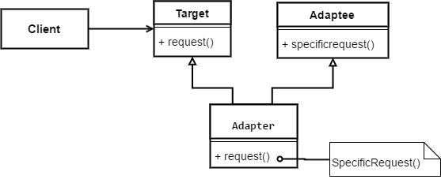
Class Adapter Structure - multiple inheritance

Slide 8
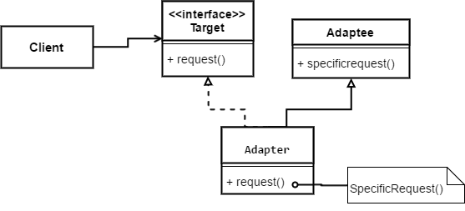
Class Adapter Structure - not multiple inheritance

Slide 9
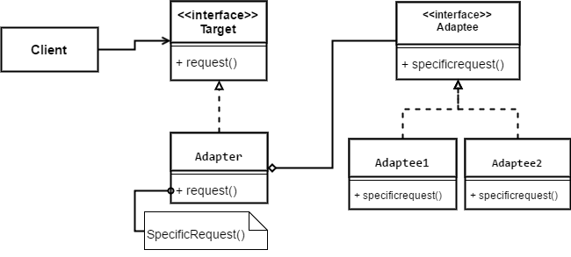
Object Adapter Structure

Slide 10
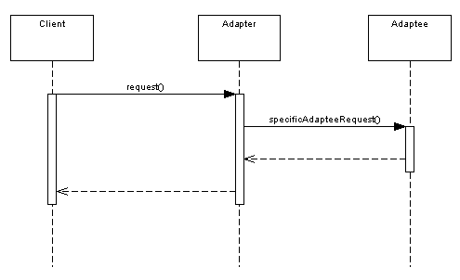
Collaboration

Slide 11
Object Adapter VS Class Adapter
Class Adapter | Object Adapter
Inheritance | Object composition
Static binding- Runtime behavior easy to understand. | Dynamic binding- Runtime behavior not easy to understand
Just adapt one class- Can not change adaptee | Adapt one or more class Can change adaptee

Slide 12
Example

Slide 13
Consequences
Class adapter
Concrete Adapter class
Unknown Adaptee subclasses might cause problem
Overloads Adaptee behavior
Introduces only one object
Object adapter
Adapter can service many different Adaptees
May require the creation of Adaptee subclasses and referencing those objects

Slide 14
Implementation
Adapter should be subtype of Target
Pluggable adapters should use the narrowest definition
Abstract operations to minimize exposed interface
Delegated objects to localize behavior
Parameterized processing avoids subclasses of adaptee

Slide 15
Q&A

