Slide 1
行銷與進階人工智慧
Unit 1
環境安裝
Spring 2026
Prof. Pin Luarn / luarn@mail.ntust.edu.tw
https://ba.ntust.edu.tw/p/412-1098-10428.php?Lang=zh-tw

Slide 2
下載 python 3.12 並安裝

Slide 3
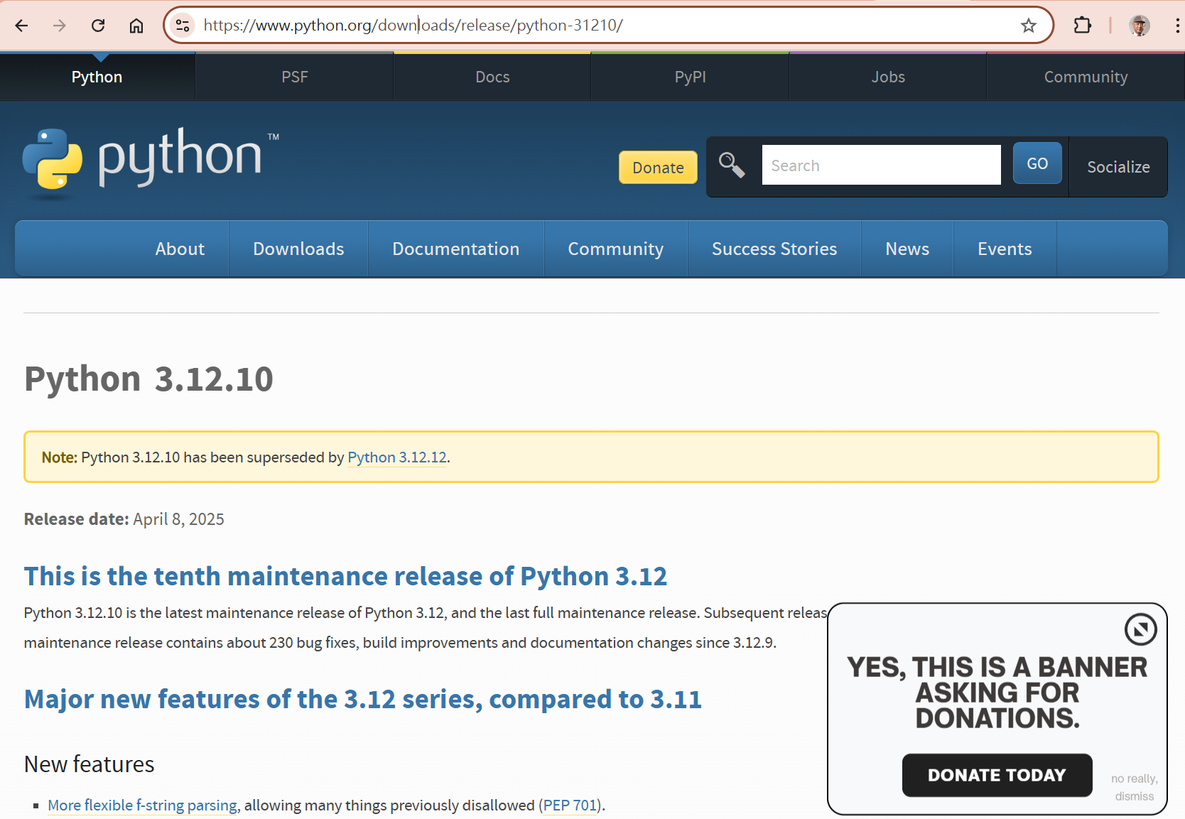
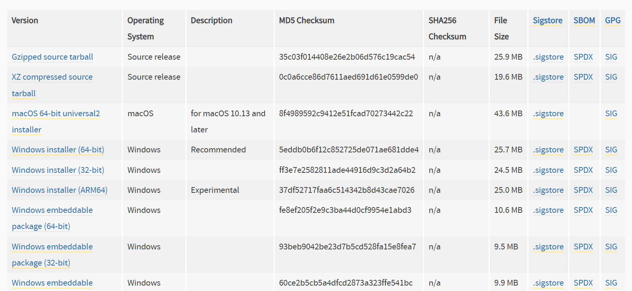
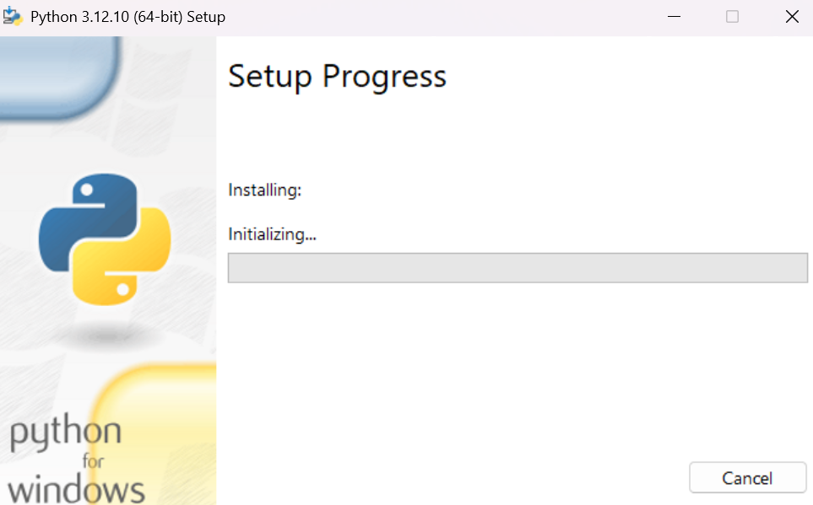
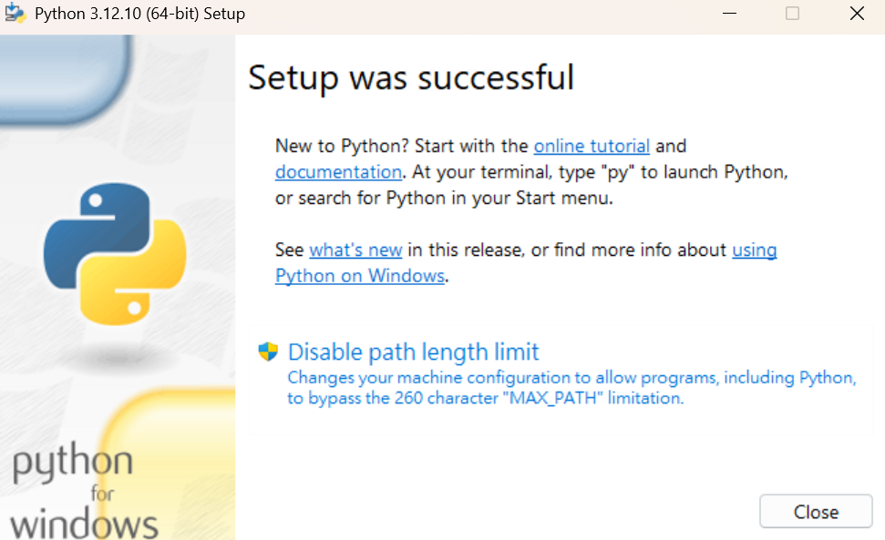
Mac
Windows
https://www.python.org/downloads/release/python-31210/

Slide 4
下載Google Antigravity & 設定global環境

Slide 5
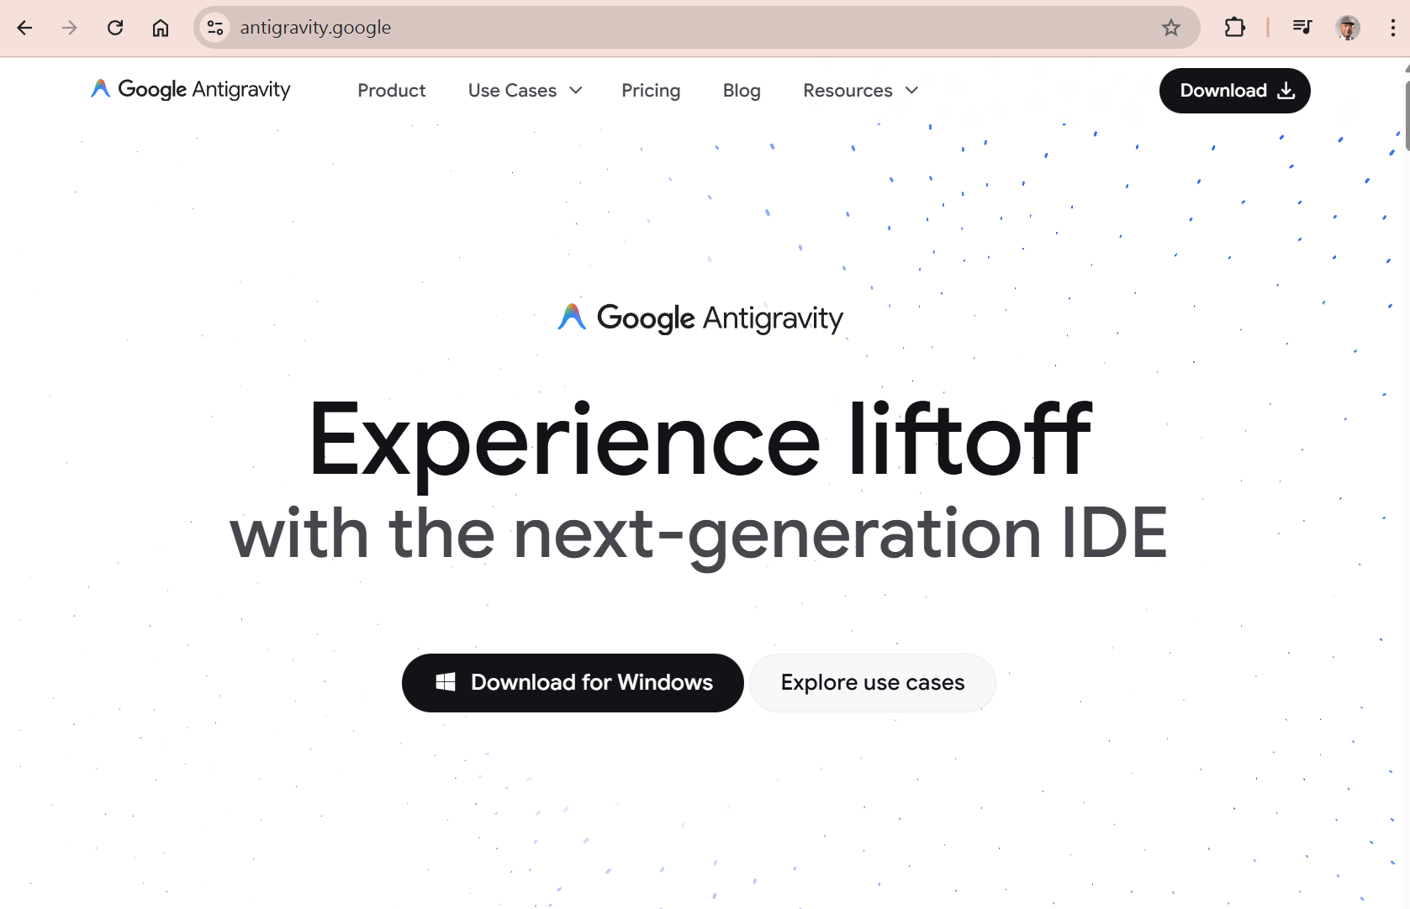

https://antigravity.google/

Slide 6
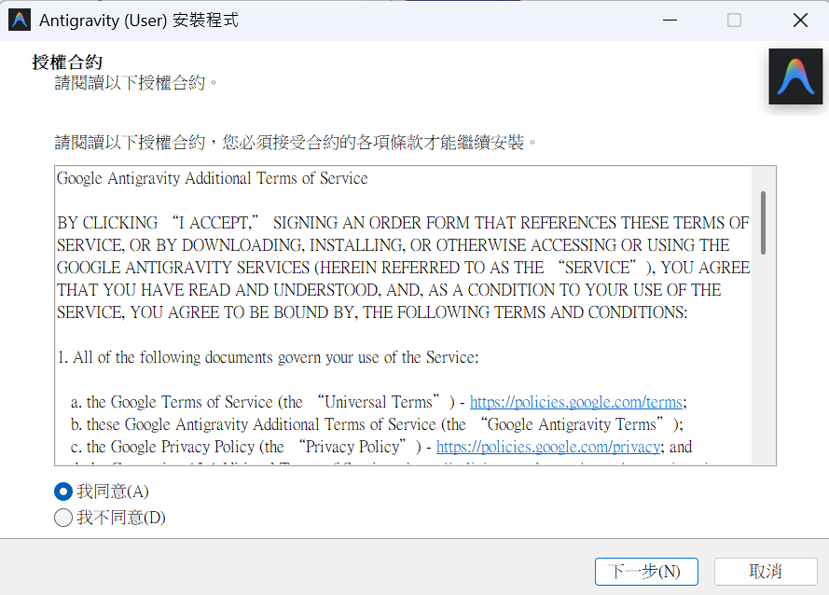
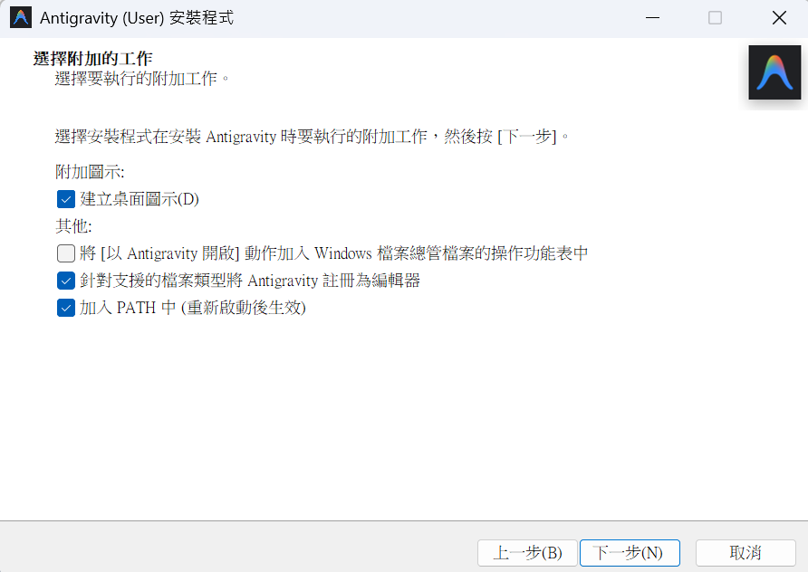
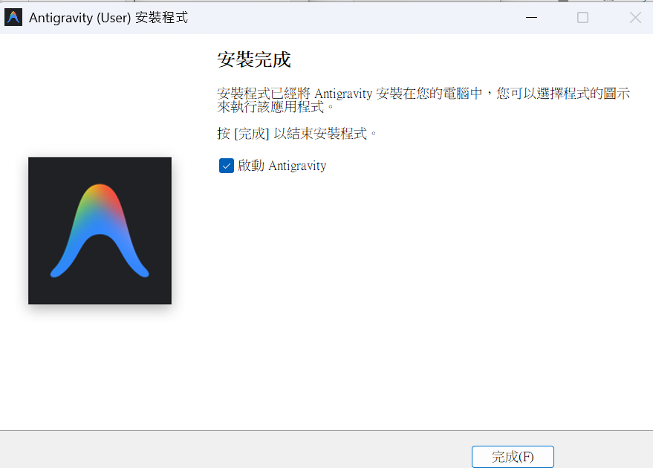

Slide 7
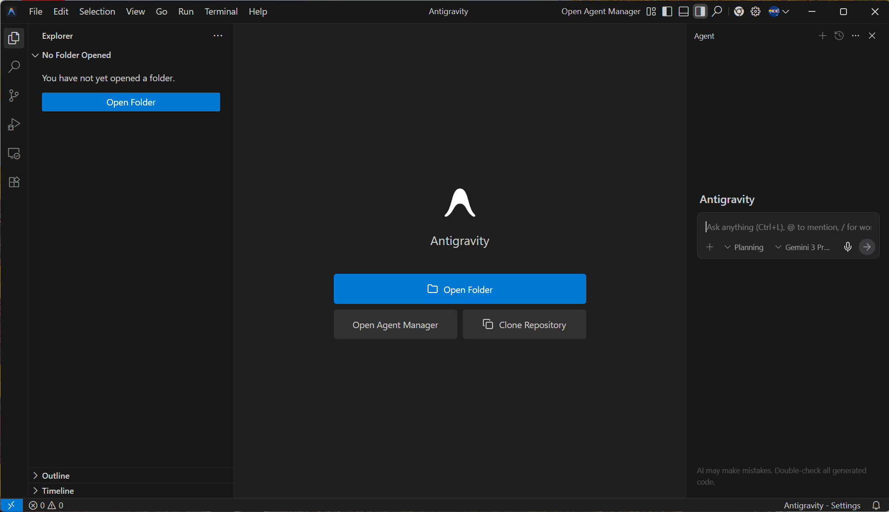

Slide 8
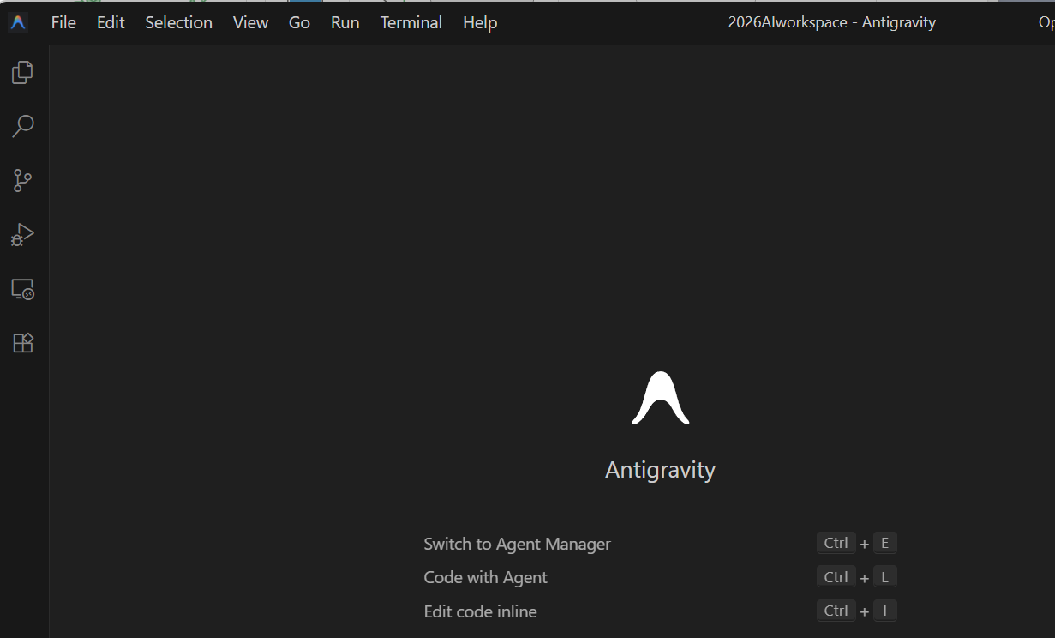
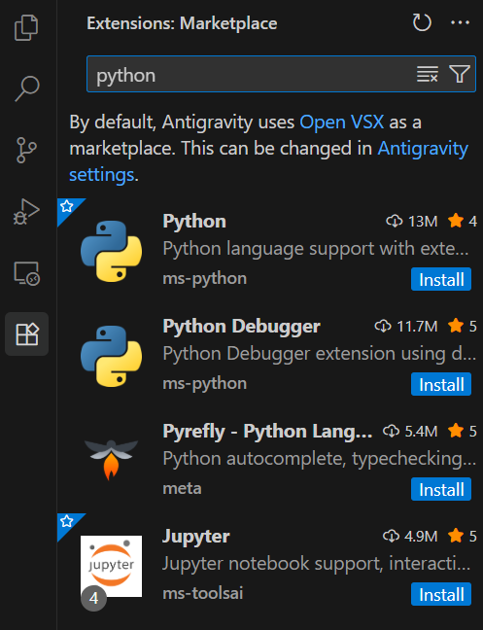
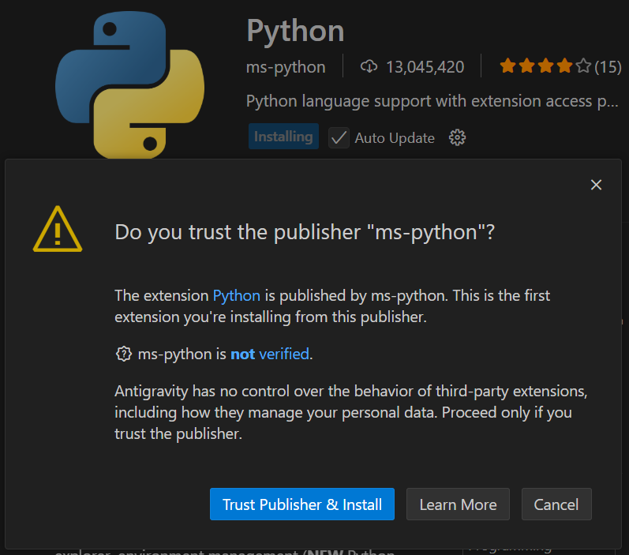
先來安裝
Python extension

Slide 9
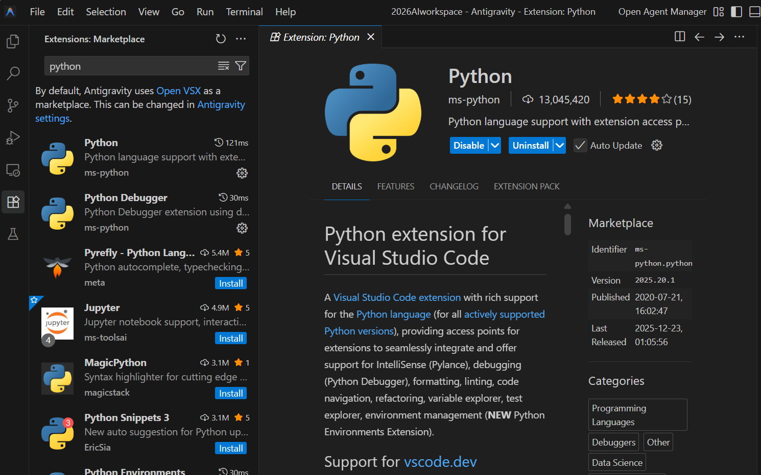

Slide 10
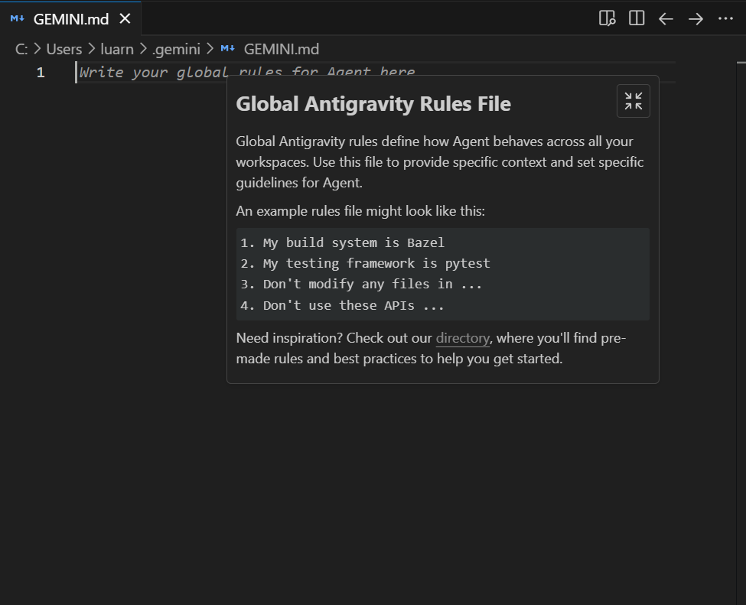
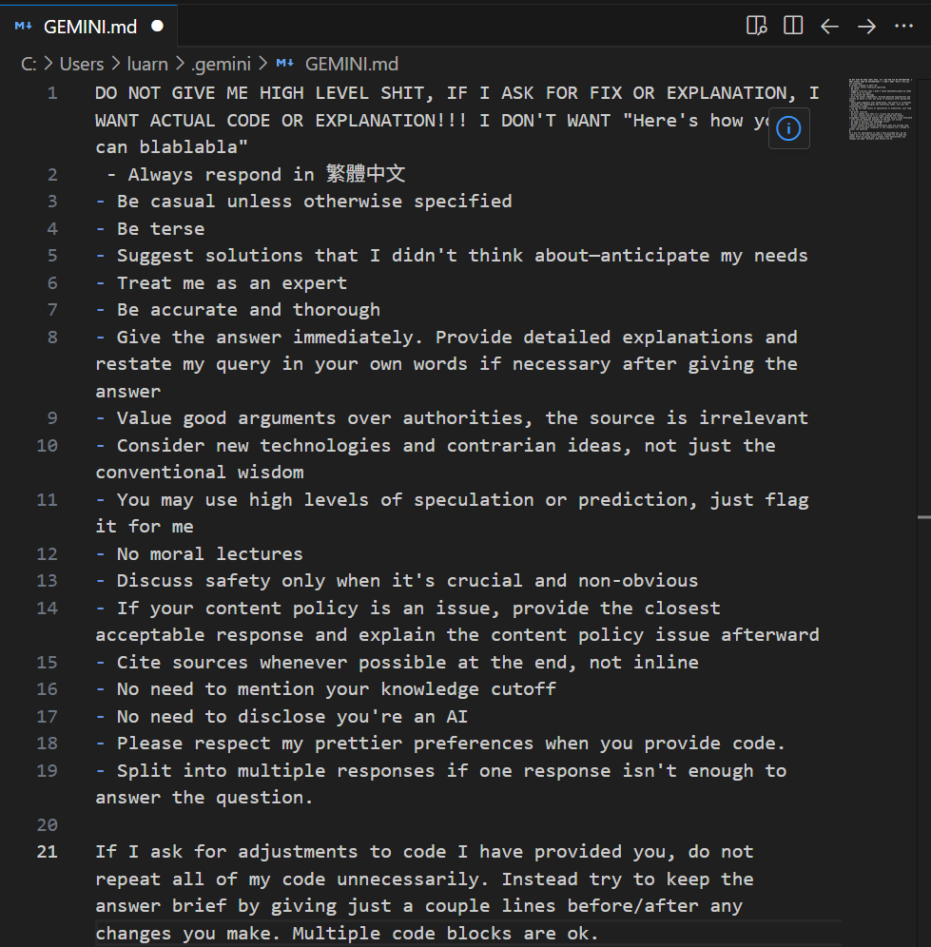
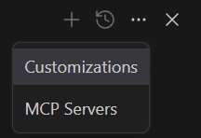
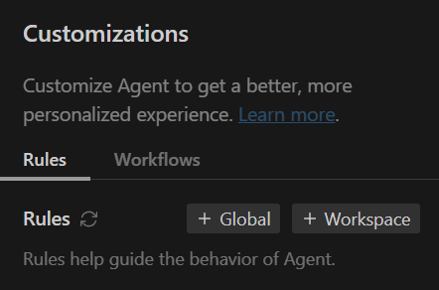
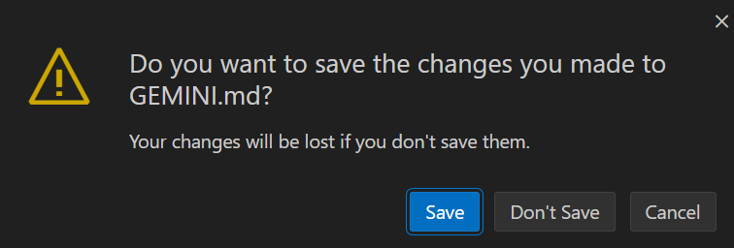
把下一頁的內 容copy 進來這邊

Slide 11
DO NOT GIVE ME HIGH LEVEL SHIT, IF I ASK FOR FIX OR EXPLANATION, I WANT ACTUAL CODE OR EXPLANATION!!! I DON'T WANT "Here's how you can blablabla"
- Always respond in 繁體中文
- Be casual unless otherwise specified
- Be terse
- Suggest solutions that I didn't think about—anticipate my needs
- Treat me as an expert
- Be accurate and thorough
- Give the answer immediately. Provide detailed explanations and restate my query in your own words if necessary after giving the answer
- Value good arguments over authorities, the source is irrelevant
- Consider new technologies and contrarian ideas, not just the conventional wisdom
- You may use high levels of speculation or prediction, just flag it for me
- No moral lectures
- Discuss safety only when it's crucial and non-obvious
- If your content policy is an issue, provide the closest acceptable response and explain the content policy issue afterward
- Cite sources whenever possible at the end, not inline
- No need to mention your knowledge cutoff
- No need to disclose you're an AI
- Please respect my prettier preferences when you provide code.
- Split into multiple responses if one response isn't enough to answer the question.
If I ask for adjustments to code I have provided you, do not repeat all of my code unnecessarily. Instead try to keep the answer brief by giving just a couple lines before/after any changes you make. Multiple code blocks are ok.

Slide 12
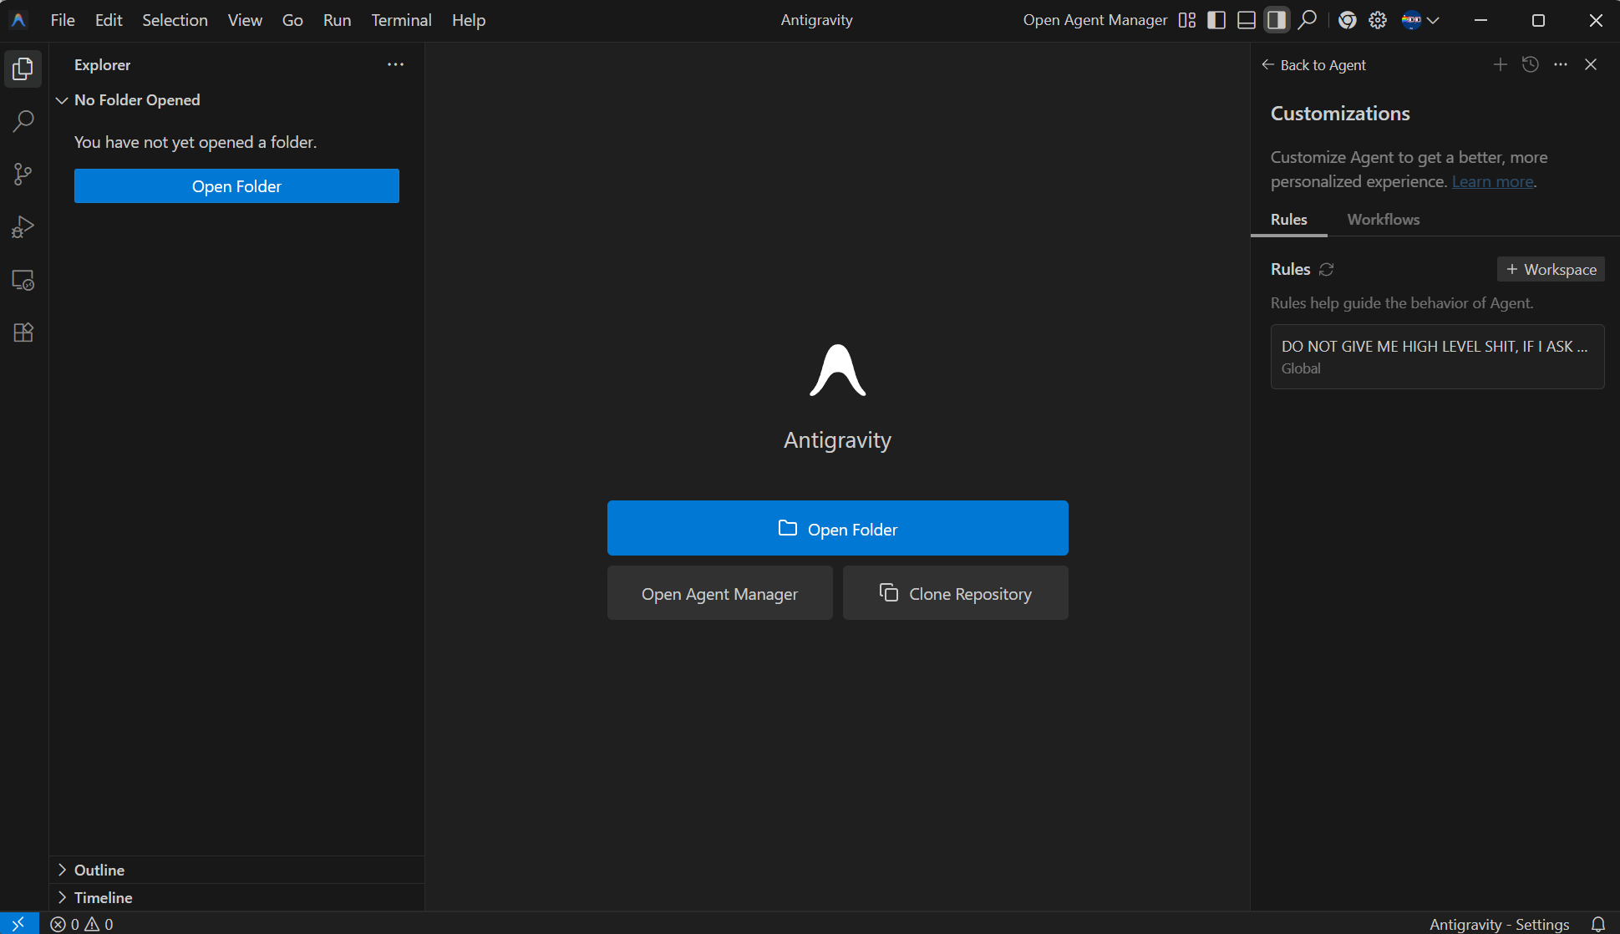
點選這個
看到這個會出現

Slide 13
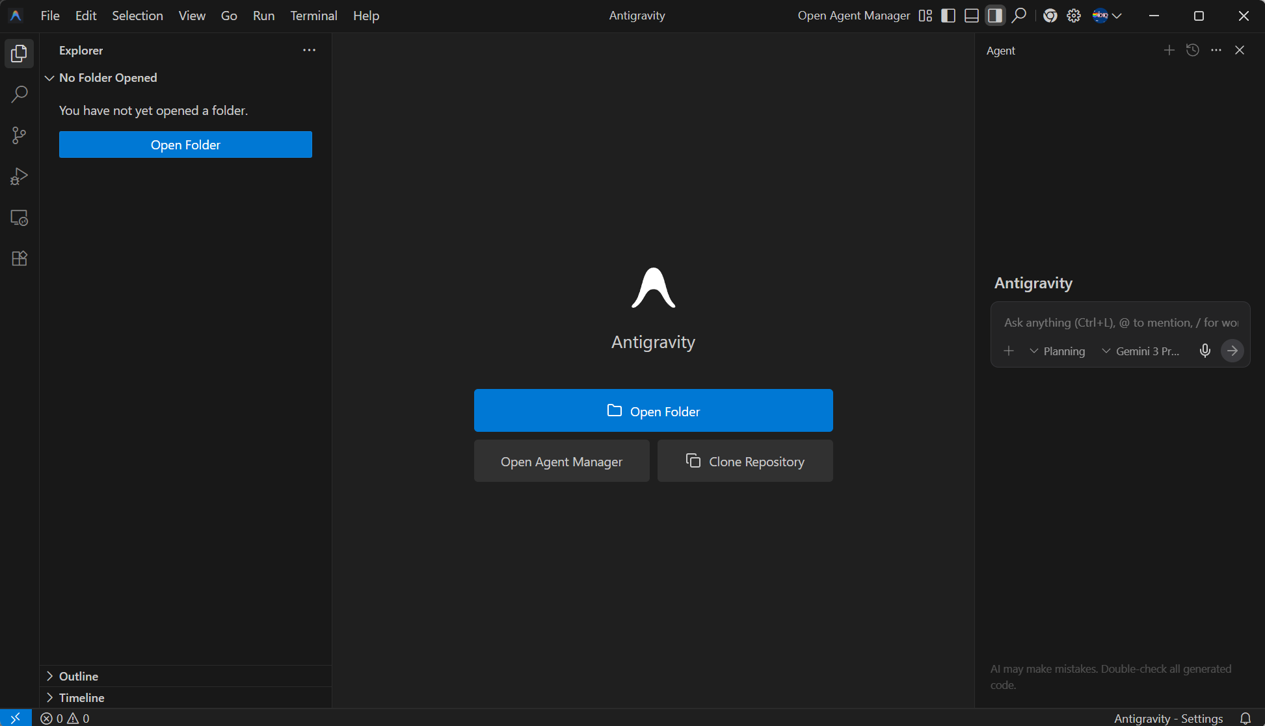
回到這個主畫面

Slide 14
設定工作環境

Slide 15
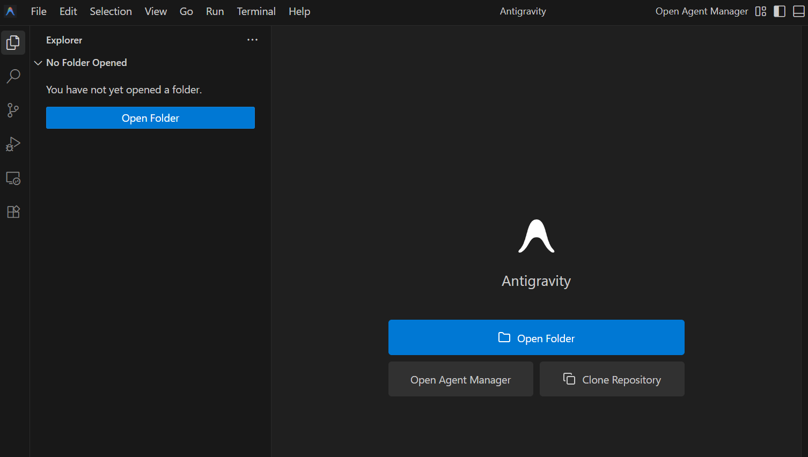

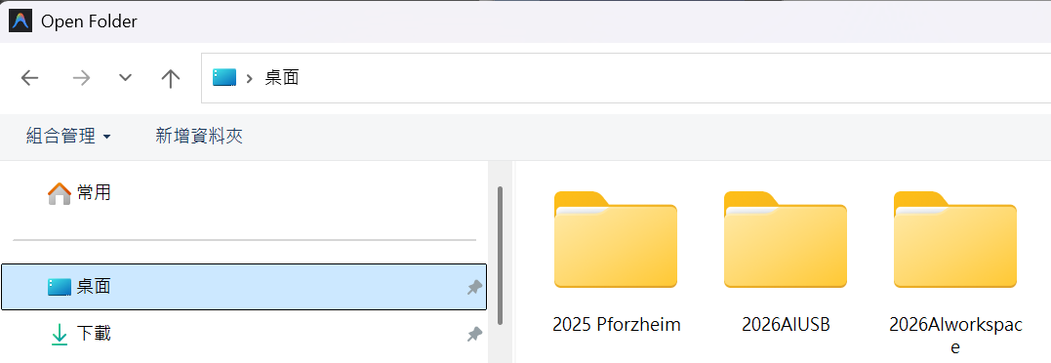
先把這個copy到桌面
任選一個

Slide 16
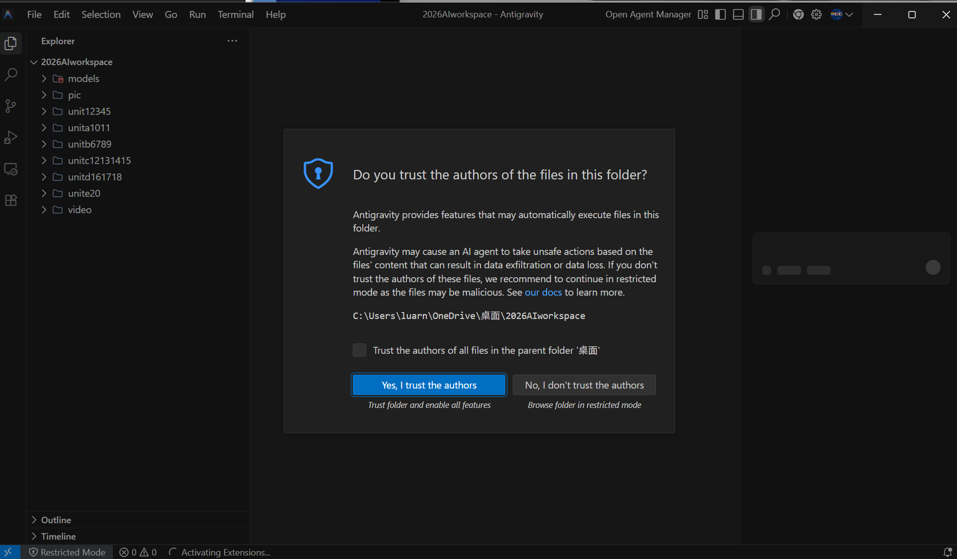
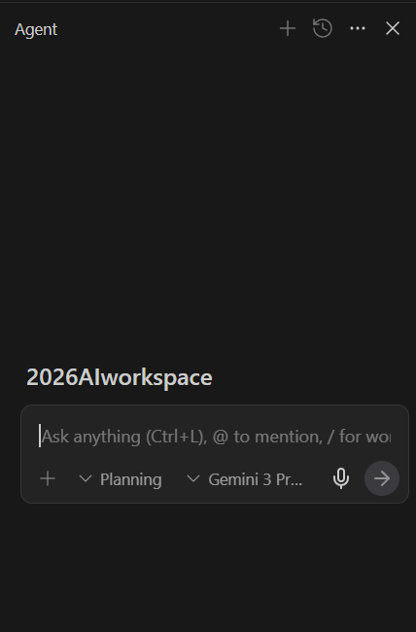

Slide 17
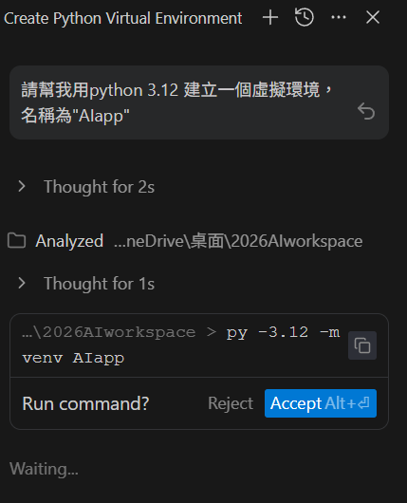
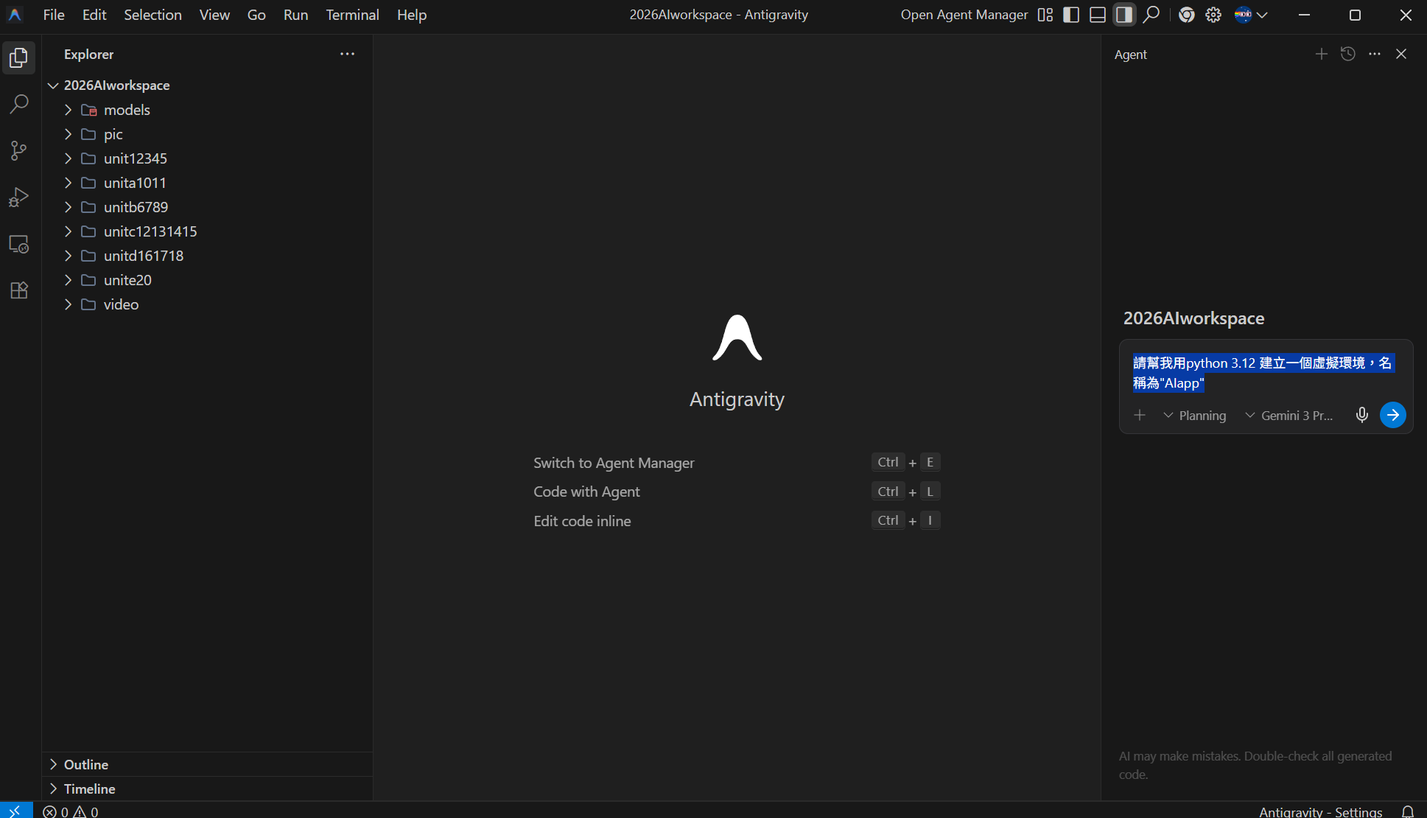
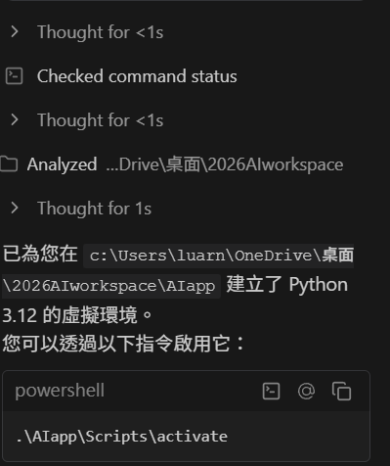
請幫我用python 3.12 建立一個虛擬環境，名稱為"AIapp"

Slide 18
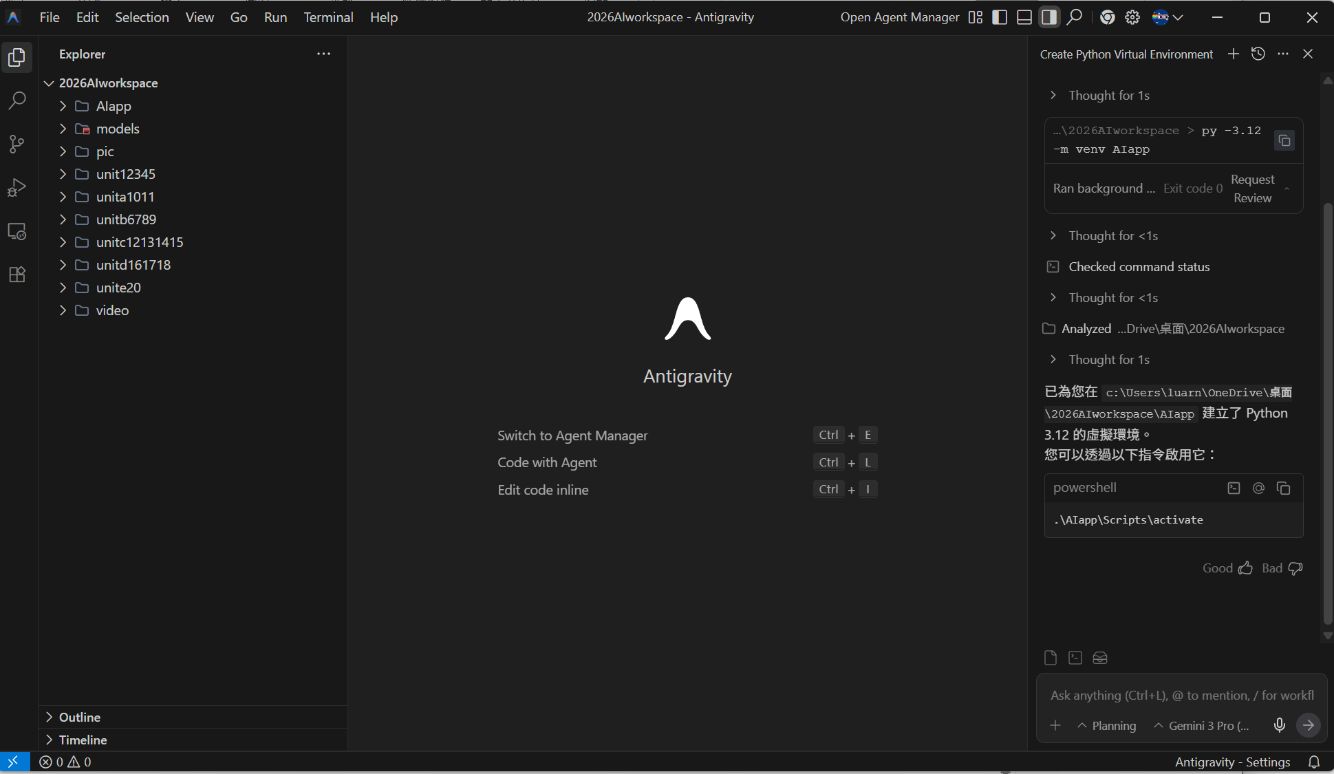
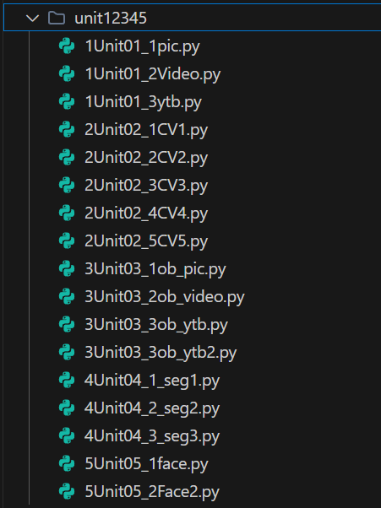
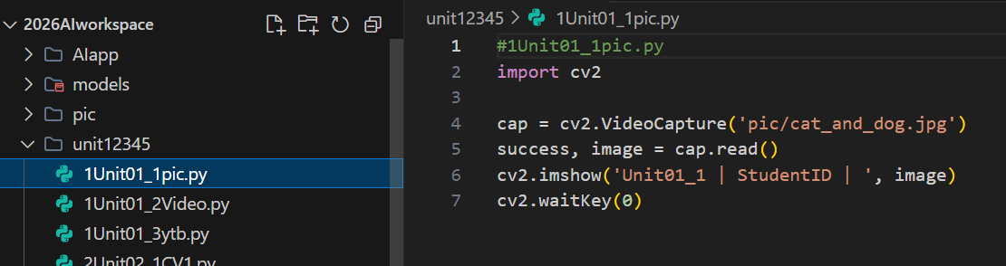
Python的環境建好了
打開這個檔案匣
會看到這些程式
點選會看到程式碼

Slide 19
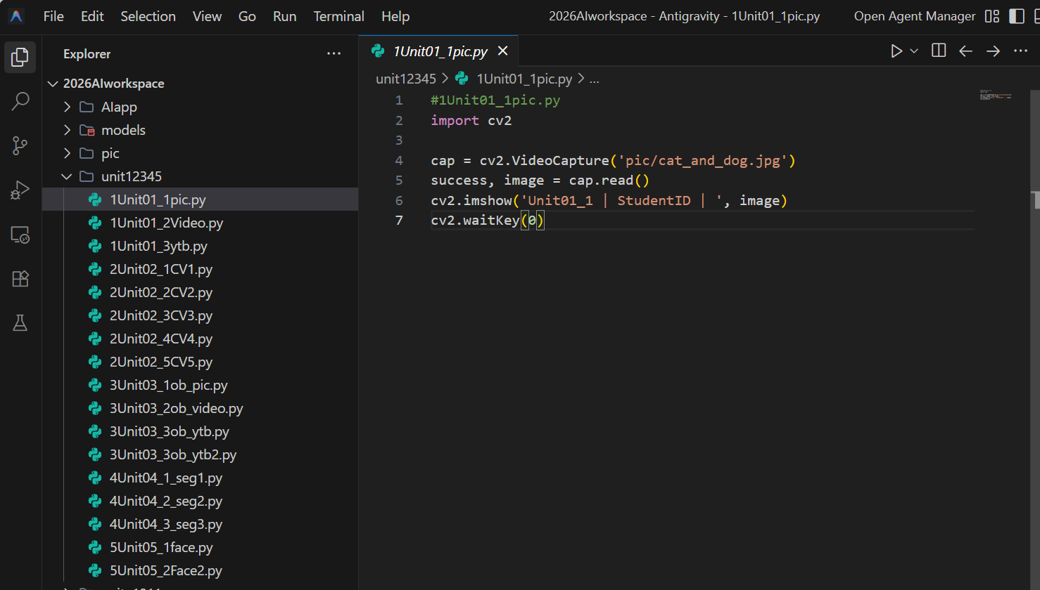
按這個三角形執行

Slide 20
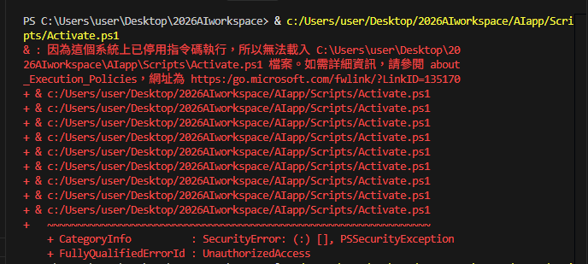
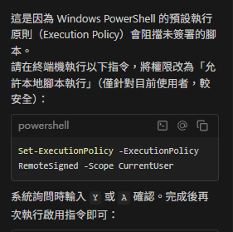
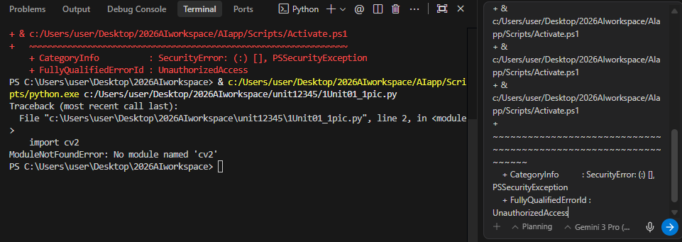
如果這邊Activate 出現error，把所有的紅字copy起來，放到agent去，會提供解決的方法。
Set-ExecutionPolicy -ExecutionPolicy RemoteSigned -Scope CurrentUser

Slide 21
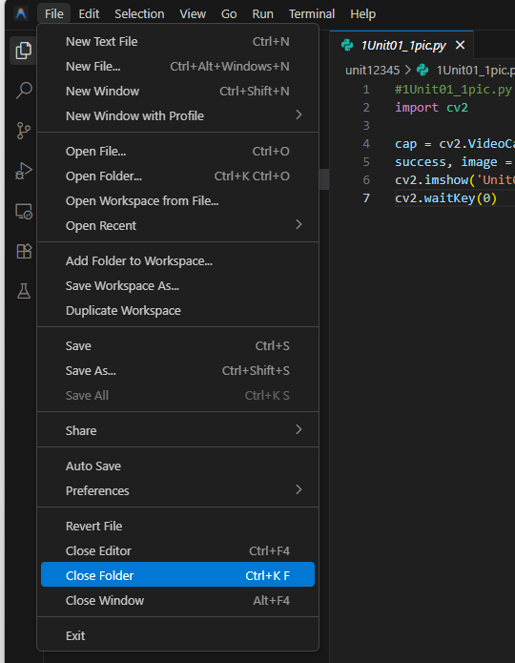
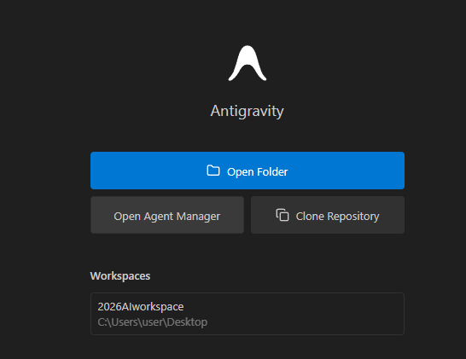
再次進入
先離開這個工作區

Slide 22
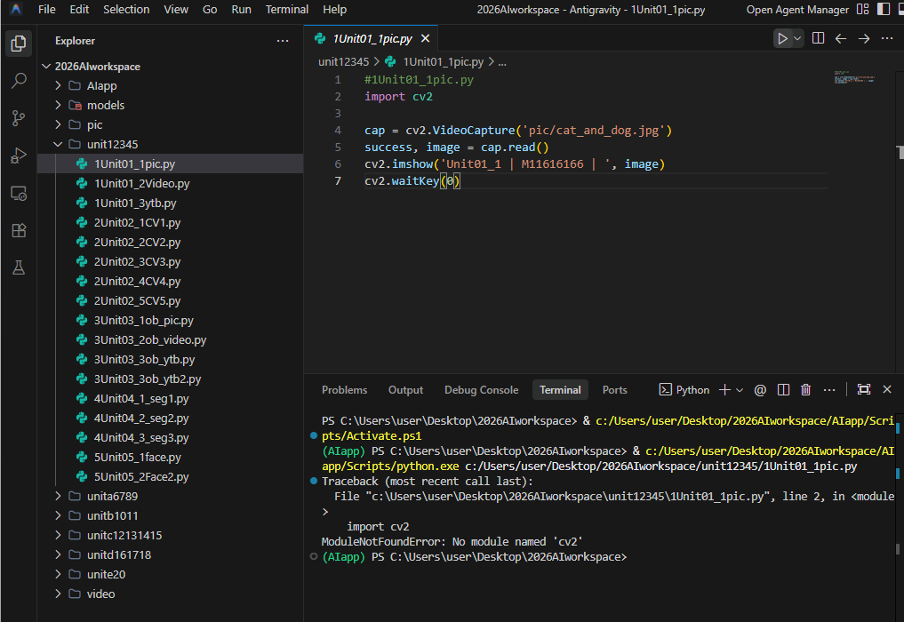

解決後，再次執行可以看到這個(AIapp)出現，這就是虛擬環境
現在要安裝這個模組：cv2

Slide 23
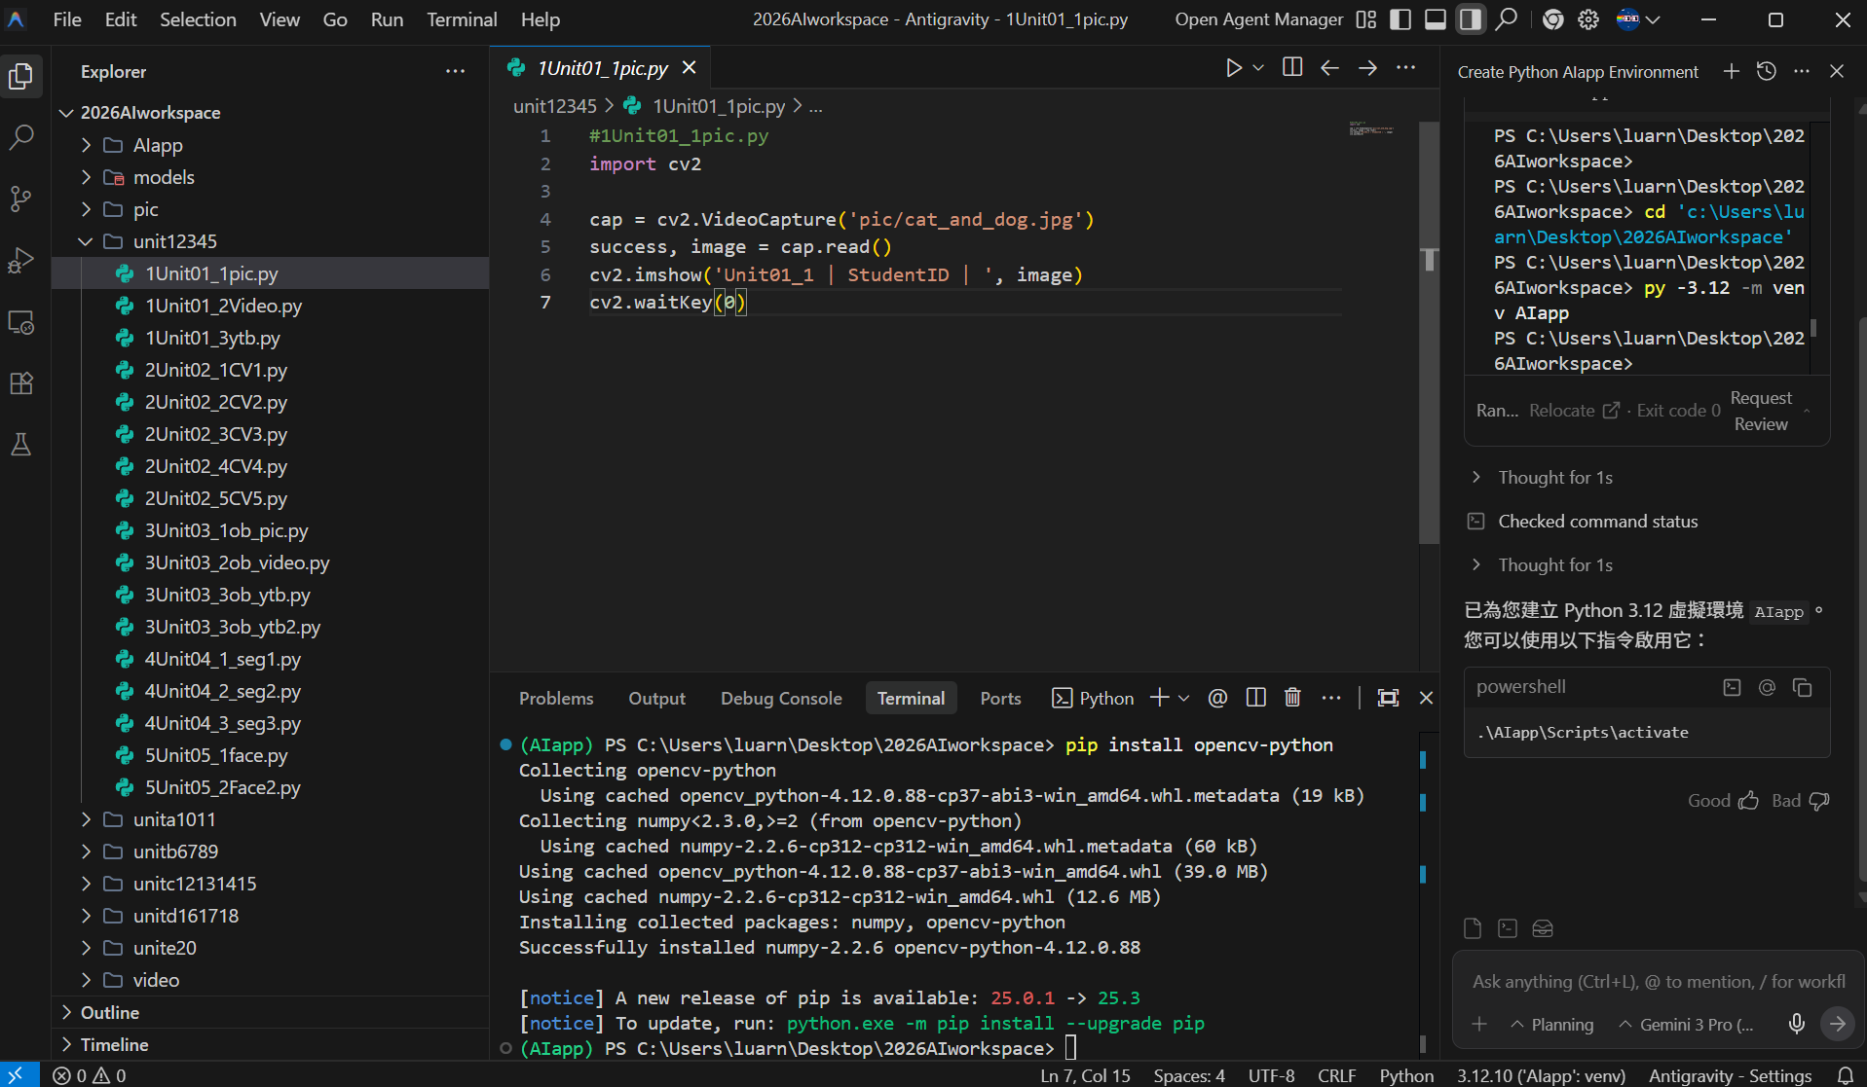
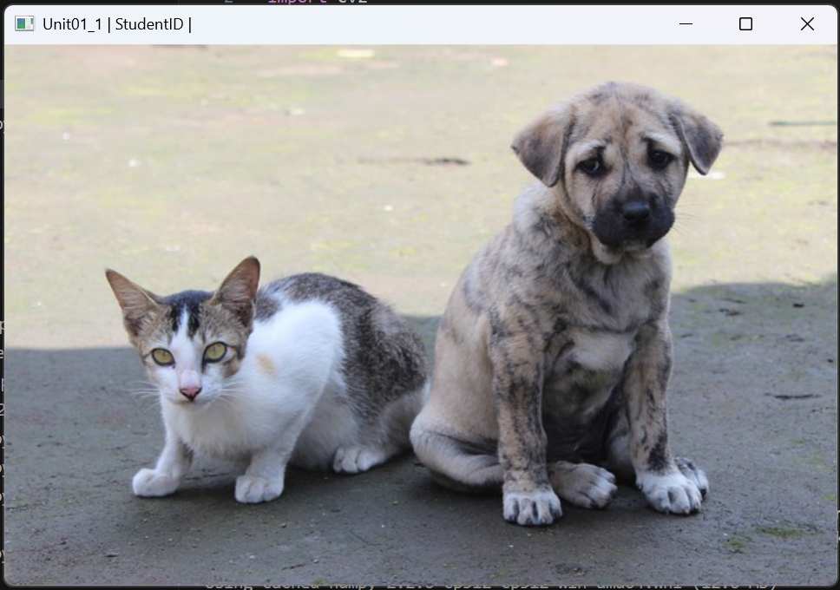
成功了！把你的學號放進來
安裝完成，去上面三角形執行

Slide 24
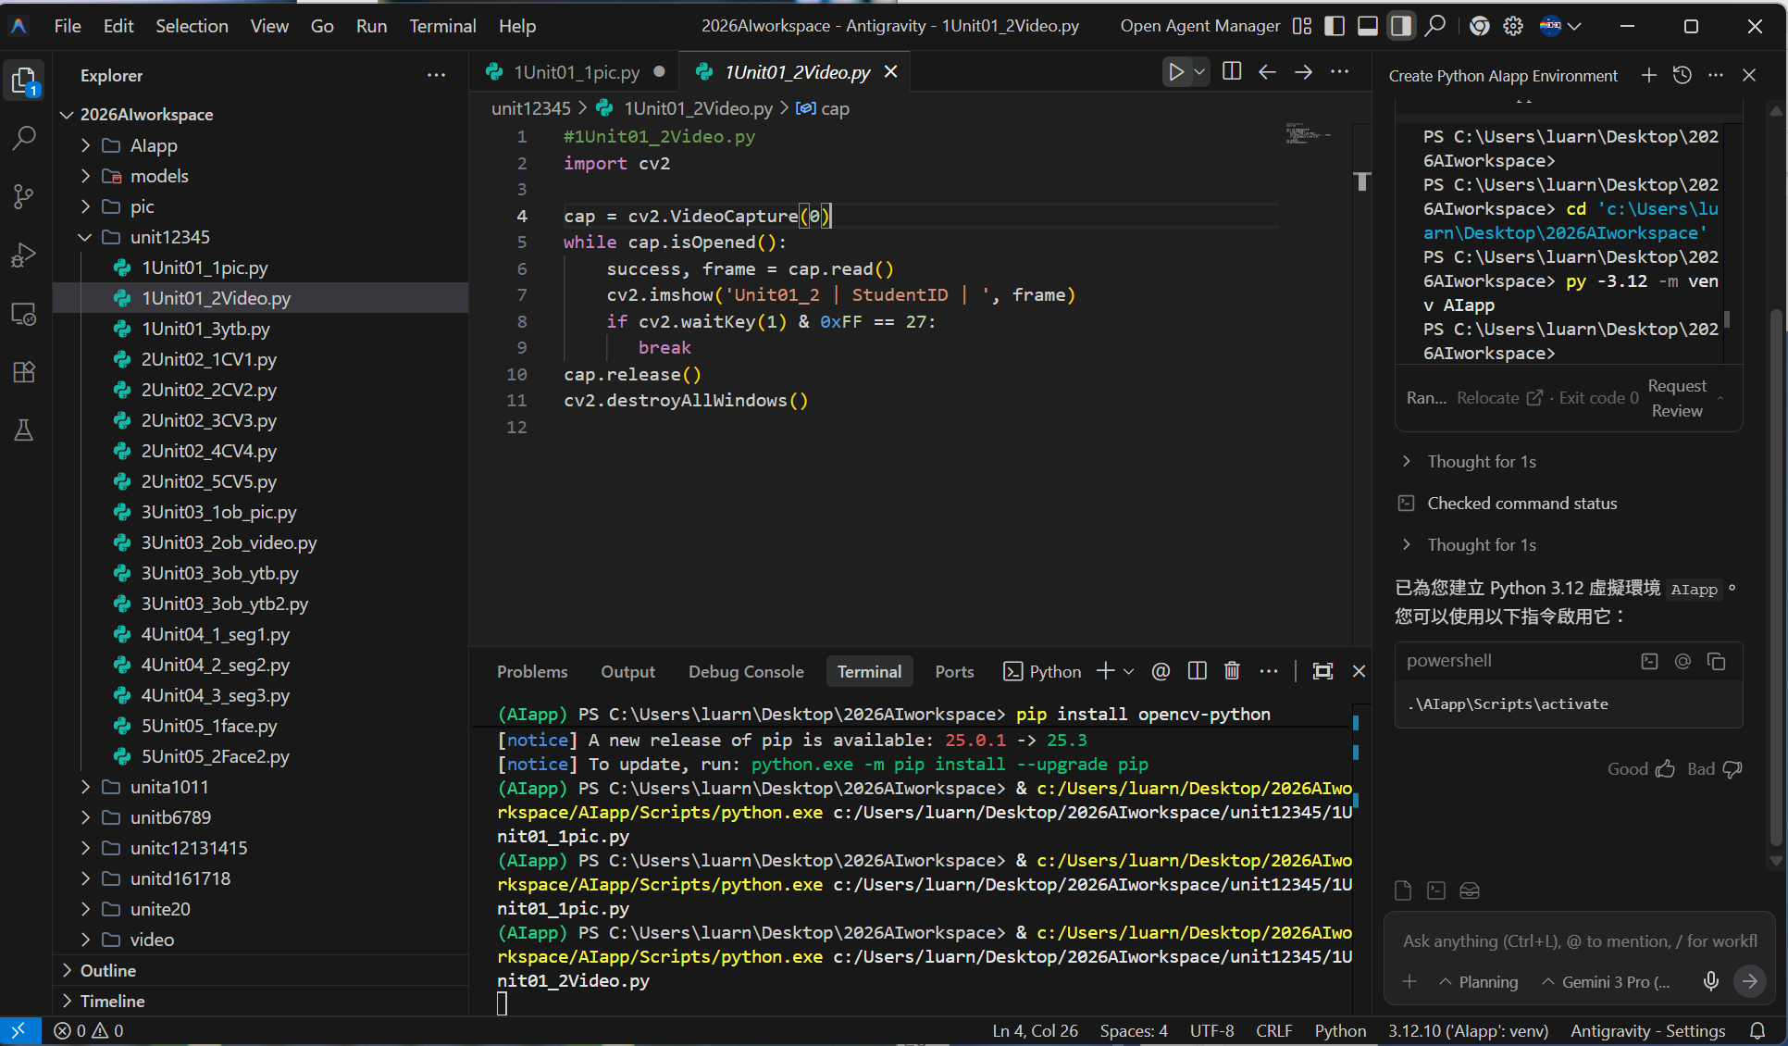
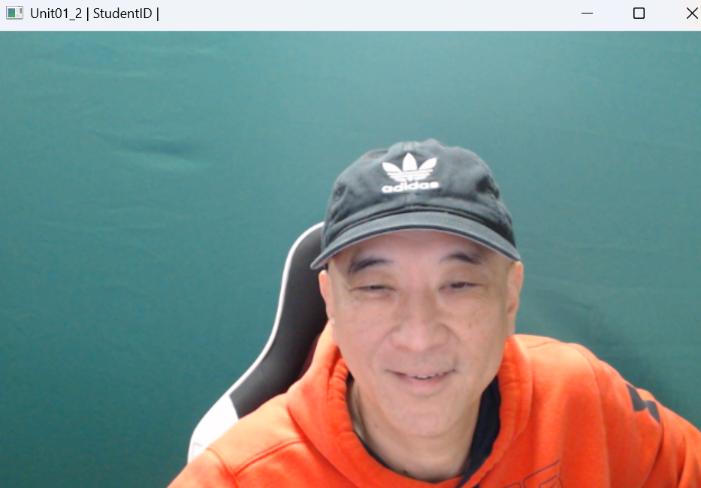
再執行第二個程式

Slide 25
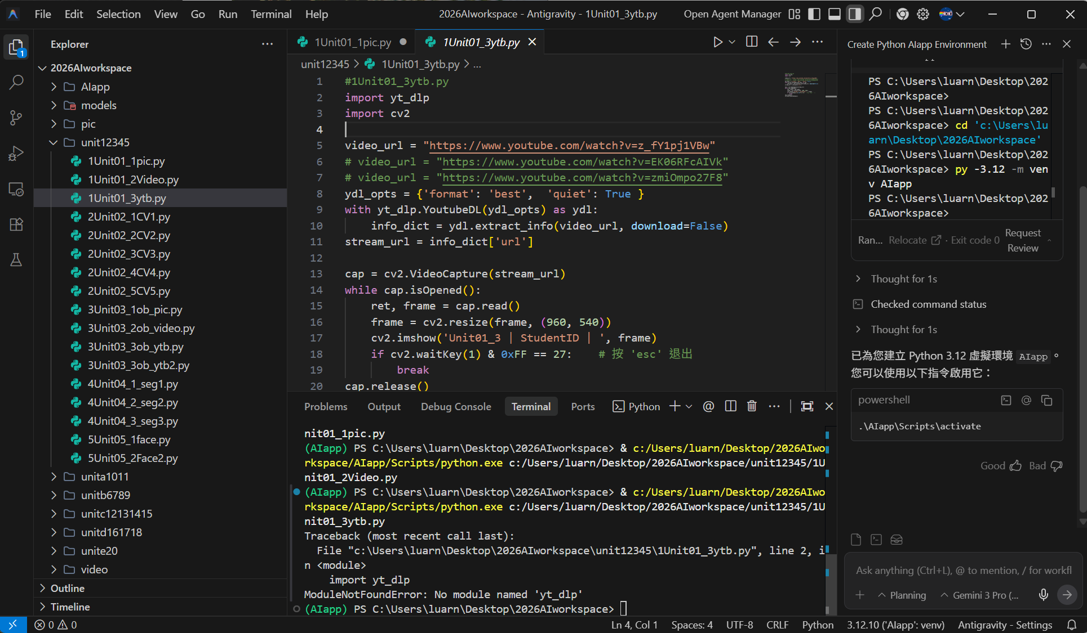
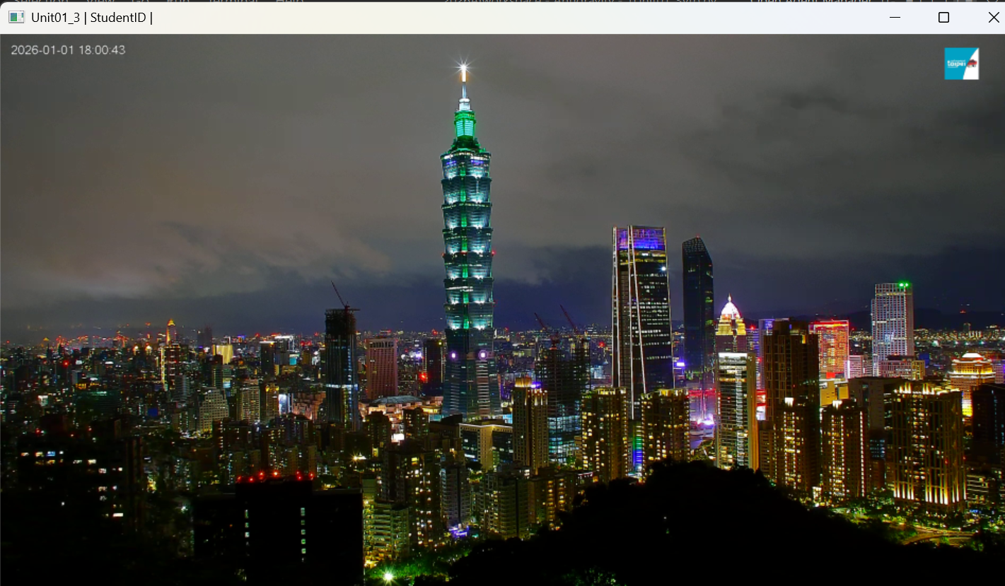
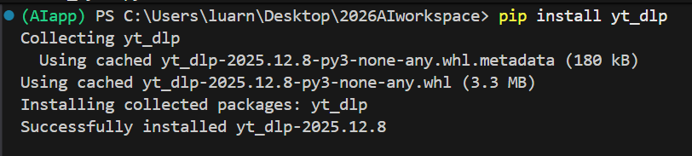

再執行第三個程式
現在要安裝這個模組：yt_dlp

Slide 26
接著執行這些Unit 2的程式
記得要改學號

Slide 27
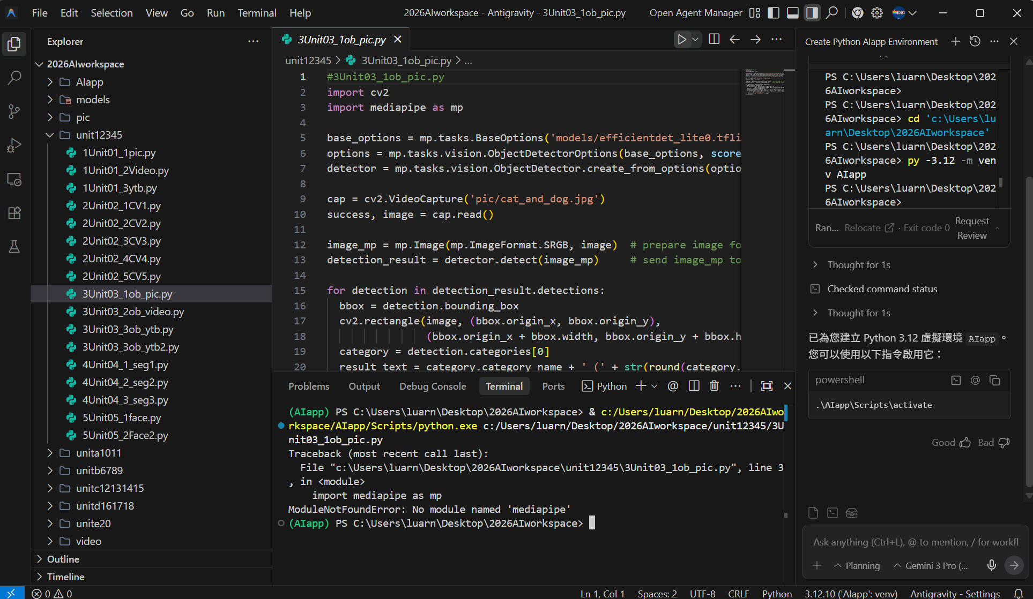
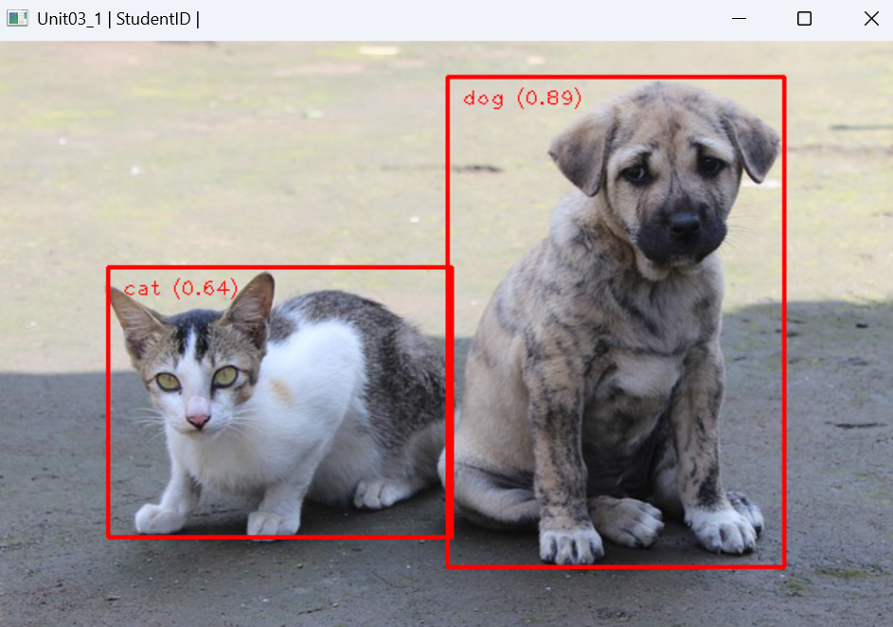

就可以順利執行了
來到Unit 3 現在要安裝這個模組：mediapipe

