Slide 1
User Query identification Stack Overflow

Slide 2
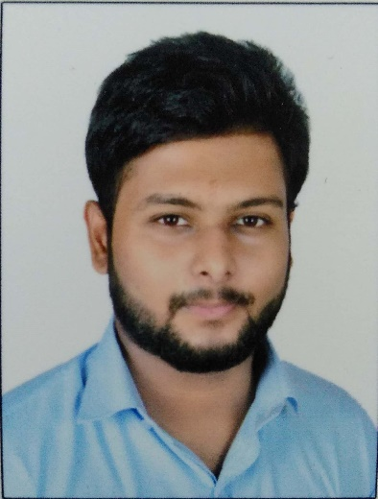

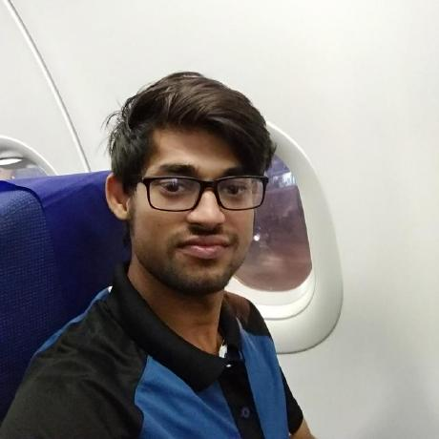
Team name - BroCode
Members
Devdarshan Mishra
Rupesh Jha
Prabhat Kumar

Slide 3
Roles and Expertise areas:-
a) Devdarshan Mishra :-
Expertise areas: Machine Learning and Deep Learning.
Role: Created the machine learning model and added other functionalities
b) Prabhat Kumar :–
Expertise areas: Web Development
Role: created the GUI and related functionalities
c) Rupesh Jha :–
Expertise areas: Full Stack Web Developer
Role: Mined stack overflow data and preprocessed the data

Slide 4
Criteria to select a particular answer on a topic based on:
a) Tags
b) Search string
c) Semantic Search

Slide 5
EXPECTATION
The solution should have a mechanism to identify relevant questions on stack overflow with tags and top k relevant answers that should be provided to user. So that he/she can understand the concept clearly and try to get his queries resolved more effectively and efficiently.

Slide 6
TOOLS & TECHNOLOGY
Python programming language.
NLTK module
Sklearn
QtPy-5 and QtPy-4

Slide 7
Framework used for UI
Python QtPy-4 and QtPy-5

