Slide 1
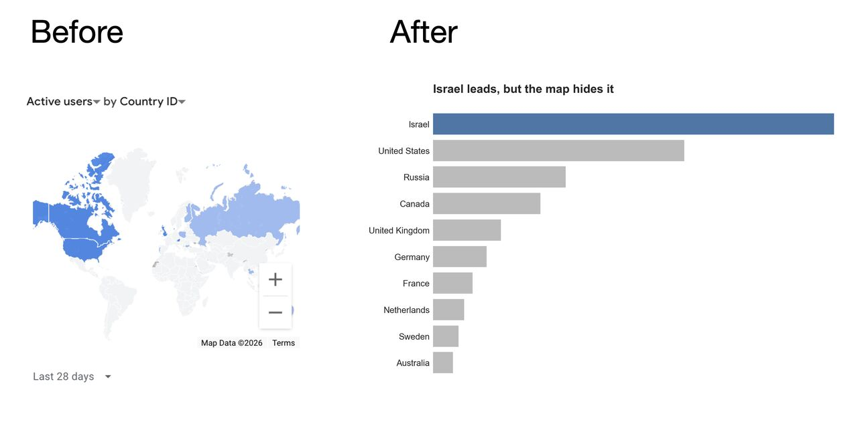
Google analytics – number of clicks

Slide 2
Python Matplotlib
Notes:
Are your classroom colours different to what you see in this template? That’s OK! Click on Design -> Variants (the down arrow) -> Pick the colour scheme that works for you!
Feel free to change any “You will…” and “I will…” statements to ensure that they align with your classroom procedures and rules!

Slide 3
What is Matplotlib?
Matplotlib is a low-level graph plotting library in python that serves as a visualization utility created by John D. Hunter. Matplotlib is open source, and we can use it freely.
Matplotlib is mostly written in python, a few segments are written in C, Objective-C and Javascript for Platform compatibility.
import matplotlib

Slide 4
Pyplot module
Pyplot provides functions that interact with the figure.
Each function makes some change to a figure: e.g., creates a figure, creates a plotting area in a figure, plots some lines in a plotting area, decorates the plot with labels, etc.
The various plots we can utilize using Pyplot are Line Plot, Histogram, Scatter, 3D Plot, Image, Contour, and Polar.
Import matplotlib.pyplot as plt
Figure - It is a whole figure which contains one or more than one axes or plots.
Axes - A figure usually contains more than one axes (plots). Each Axes has a title, an X label, and Y–label.
Axis - It takes care of generating graph limits.
Artists - Mostly they are tied to the axes, and whatever we see on the figure like text objects, line2d objects, collection objects.

Slide 5
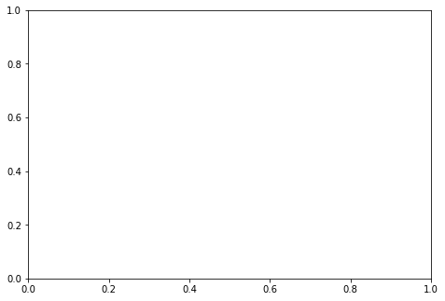
Axes Class
Axes is the most basic and flexible unit for creating sub-plots. Axes allow placement of plots at any location in the figure.
A given figure can contain many axes, but a given axes object can only be in one figure.
axis.py
1 | import matplotlib.pyplot as plt
2 | # Creating the axes object with argument as
3 | # [left, bottom, width, height]
4 | ax = plt.axes([1, 1, 1, 1])

Slide 6
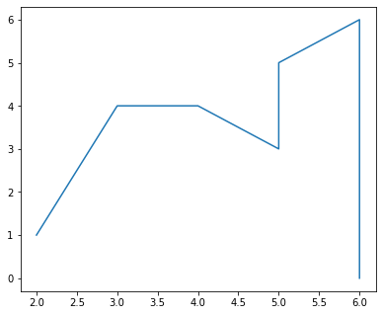
Figure Class
Figure class is the top-level container that contains one or more axes.
It is the overall window or page on which everything is drawn.
figure.py
1 | import matplotlib.pyplot as plt
2 | from matplotlib.figure import Figure
3 | # Create a figure with width=5, height=4 inches
4 | fig = plt.figure(figsize =(5, 4))
5 | ax = fig.add_axes([1, 1, 1, 1])
6 | # Adding the data to be plotted
7 | ax.plot([2,3,4,5,5,6,6],[1,4,4,3,5,6,0])
8 | plt.show()

Slide 7
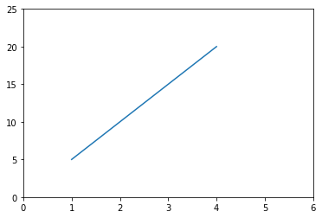
The plot function
The plot functions marks the x-coordinates (1, 2, 3, 4) and y-coordinates (5,10,15,20) in a linear graph with specified scales.
plot.py
1 | import matplotlib.pyplot as plt
2
3 | # plot a line
4 | plt.plot([1, 2, 3, 4], [5, 10, 15, 20])
5 | plt.axis([0, 6, 0, 25])
6 | plt.show()

Slide 8
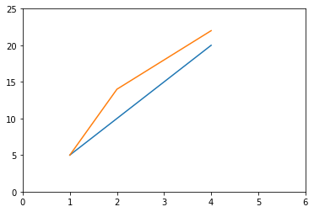
The plot function
We can plot two lines.
plot2.py
1 | import matplotlib.pyplot as plt
2
3 | # plot a line
4 | plt.plot([1, 2, 3, 4], [5, 10, 15, 20])
5 | plt.plot([1, 2, 3, 4], [5, 14, 18, 22])
6 | plt.axis([0, 6, 0, 25])
7 | plt.show()

Slide 9
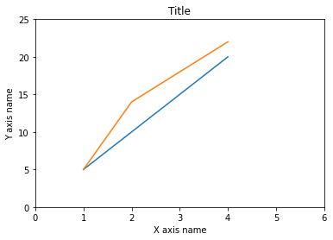
The plot function
We can add axis name and title.
plot3.py
1 | import matplotlib.pyplot as plt
2
3 | plt.plot([1, 2, 3, 4], [5, 10, 15, 20])
4 | plt.plot([1, 2, 3, 4], [5, 14, 18, 22])
5 | plt.axis([0, 6, 0, 25])
6
7 | plt.xlabel('X axis name’) #axis name
8 | plt.ylabel('Y axis name’) #axis name
9 | plt.title('Title’) #adding a title
10 | plt.show()

Slide 10
Different Types of Plots
Using pyplot we can create a different types of plots, the main types being:
Type | Function | Read more
Line chart | plot( ) | https://www.geeksforgeeks.org/line-chart-in-matplotlib-python/
Bar chart | bar( ) | https://www.geeksforgeeks.org/bar-plot-in-matplotlib/
Histograms | hist( ) | https://www.geeksforgeeks.org/matplotlib-pyplot-hist-in-python/
Scatter plot | scatter( ) | https://www.geeksforgeeks.org/matplotlib-pyplot-scatter-in-python/
Pie chart | pie( ) | https://www.geeksforgeeks.org/plot-a-pie-chart-in-python-using-matplotlib/?ref=gcse
Box plot | Boxplot( ) | https://www.geeksforgeeks.org/box-plot-in-python-using-matplotlib/

Slide 11
Saving Graphs
We can save the created plots using the savefig command
plt.savefig('foo.png’)
plt.savefig('foo.pdf’)
plt.savefig('foo.jpg’)
Use it right after you finish creating the graph, the saved file will be in the same directory the code is.

Slide 12
CLASS ASSIGNMENT
Download the python_matplotlib_tutorial.ipynb
Open the file using Jupyter Notebook
Read the instructions and run the code blocks in sections 1-6.
Finish the tasks in section 7.
When finished download the notebook as html and submit both the html and ipynb files in moodle.

