Slide 1
Final Project Presentation
Group 2
黃展皇 106601015
鄭博謙 109526016
林冠甫 107502022
張祐綸 109525009

Slide 2
Outline
Background
Goal of midterm presentation
Implementation
Compare result
Conclusion
Notes:
This is outline of our presentation, it can be divided into 5 parts, background、Goal of midterm presentation、Implementation、Compare result、Conclusion

Slide 3
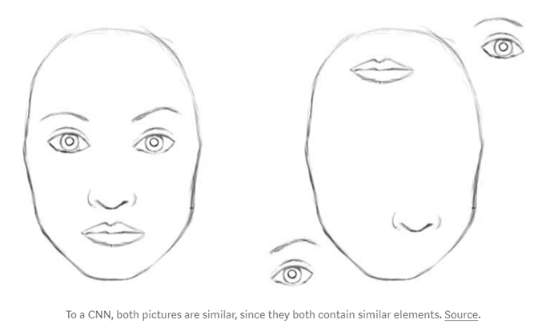
Background - 1
lost a lot of valuable information and relationships between components
Hinton proposed CapsNet to address these issues in 2017
Notes:
Geoffrey Hinton said CNN has some defects, like lost a lot of valuable information and relationships between components. For example, these two picture all have 2 eyes, 1 nose and 1 mouth. So CNN would tell us these two are both face, but the right one apparently is not a face. Then, Hinton proposed CapsNet to address these issues in 2017

Slide 4
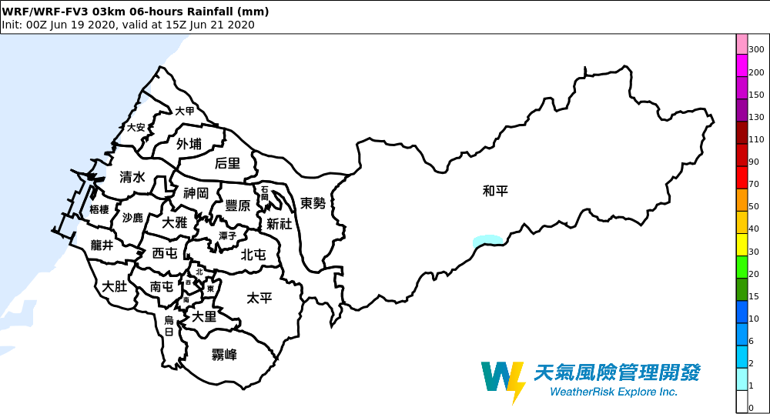
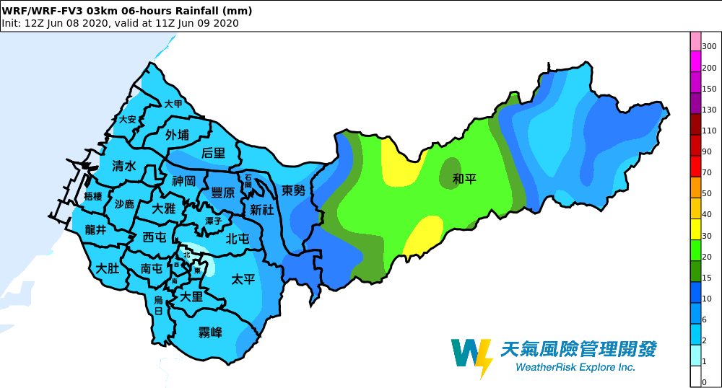
Background - 2
Notes:
接下來我們就要利用CapsNet實作圖像辨識，而我們要辨別的是氣象上採用人工判別的定量降水預報圖，就是未來降雨的預測圖，分為左邊的未降水與右邊的有降水
Next, we are going to use CapsNet to implement image recognition, and what we want to distinguish is the quantitative precipitation forecast image using artificial discrimination in meteorology, which is the forecast image of future rainfall, divided into unprecipitated on the left and precipitation on the right.

Slide 5
Goal of midterm presentation
Differentiate clearly between cases with no rainfall and cases with rainfall.
High accuracy in train and test datasets.
CNN vs CapsNet
Notes:
我們的目標有三個：一是希望訓練出可以準確區分圖片有無降水的模型，二是希望模型在train與test都有高準確度，而三就是跟類似的CNN做比較
We have three goals: first is to train a model that can accurately distinguish whether the picture is precipitated; second is to have high accuracy in train and test, and third is to compare with similar CNNs

Slide 6
Implementation
Use Capsnet Package
Use CNN Package on keras
Case1: Didn’t rotate the images
Case2: Rotate the images to 0 degree , 90 degree, 180 degree, 270 degree
Notes:
We use the CNN package and Capsnet package to implement our goal. First, we convert the image to 28X28 size as the input data,Then the parameter settings of the two packages are the same. We want to verify that the capsnet mentioned in the paper is better than CNN when the image is rotated,so we divide the experiment into two cases. Case1 We did not rotate the images ,Case2 We rotate the images to 0 degrees 90 degrees 180 degrees 270 degrees ,Finally we compared the results.

Slide 7
Compare result - Case1
 | Capsnet | CNN
accuracy score | 0.975 | 0.9856
recall score | 0.9357 | 0.9576
precision score | 0.990 | 1.0
f1 score | 0.962 | 0.9783
roc auc score | 0.965 | 0.9788
Notes:
This is the result of Case1. We use the confusion matrix to verify our prediction results,as you can see, the results of Capsnet and CNN get similar scores,I think this result is not bad, but the score of CNN is a bit higher than Capsnet.Next ,let's see Case2 results

Slide 8
Compare result - Case2
 | Capsnet | CNN
accuracy score | 0.875 | 0.957
recall score | 0.6261 | 0.8813
precision score | 1.0 | 0.9904
f1 score | 0.7701 | 0.9327
roc auc score | 0.813 | 0.9385
Notes:
The difference between Case2 and Case1 is whether the images are rotated. This result shows that although the score of CNN is reduced when the images is rotated, but the result of capsnet is much lower than CNN.This makes us wonder whether the Capsnet method proposed in the paper is really better than CNN?

Slide 9
Conclusion
Notes:
in conclusion
我們試著去解釋為什麼cnn 在這個case上比capsnet還要好的原因
we try explain why CNN ‘s result is better than capsnet in this case
可能定量降水預報圖不像是人臉的器官那樣有特定的位置
maybe the image about the quantitative precipitation forecast image is not like the human face that each organ has particular places.
我們了解到此網路並不適用任意資料集
so we realize that we can’t apply capsnet to any dataset

Slide 10
Thank you

