Slide 1
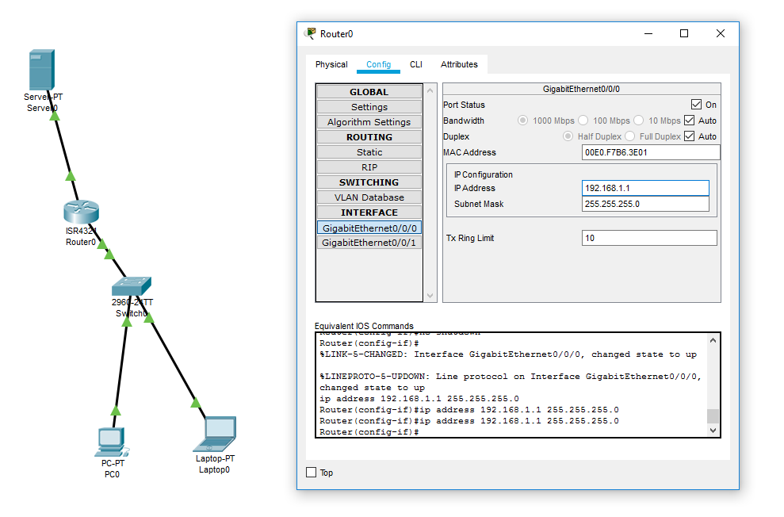
Lab Experiment :Email
GigabitEthernet0/0/0

Slide 2
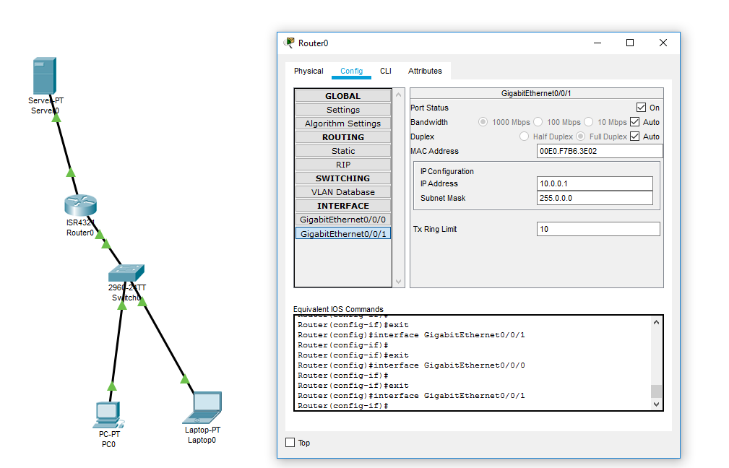
GigabitEthernet0/0/1

Slide 3
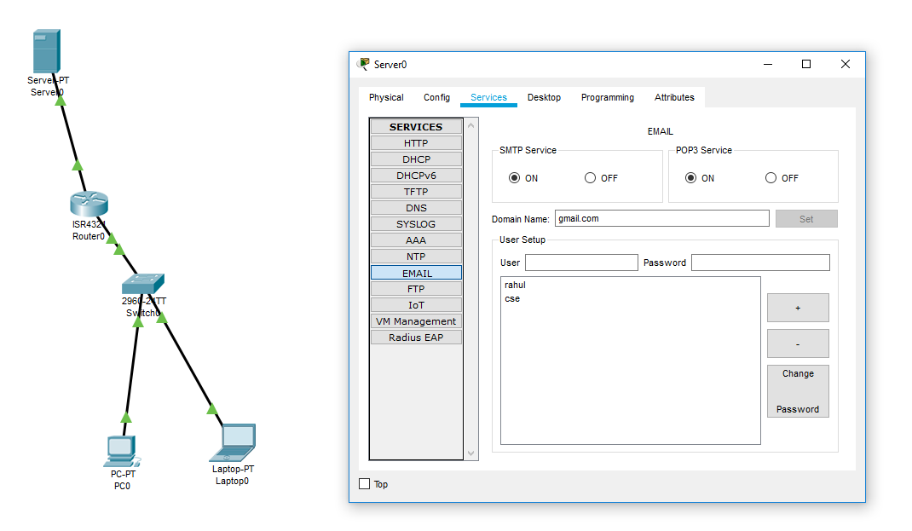
Go to server services click on to Email give domain name and user,password and add +button for every user

Slide 4
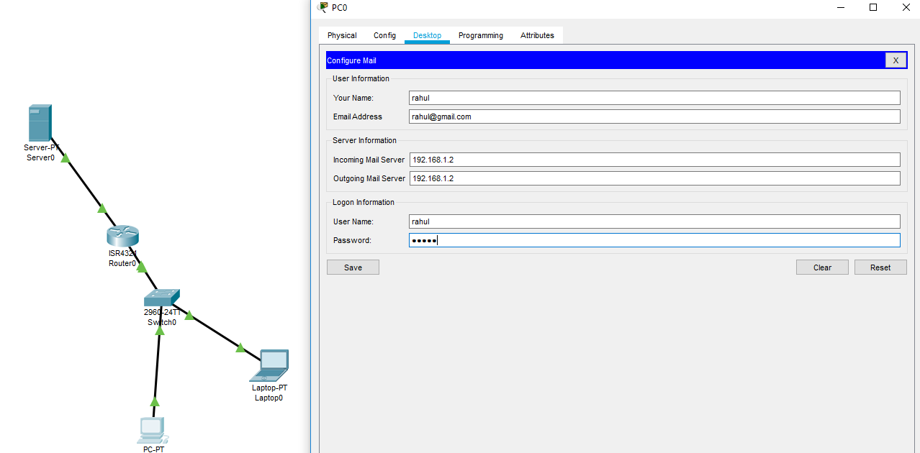
Click on PC0 go to Desktop you will find Email there click on it you will get options like this ..

Slide 5
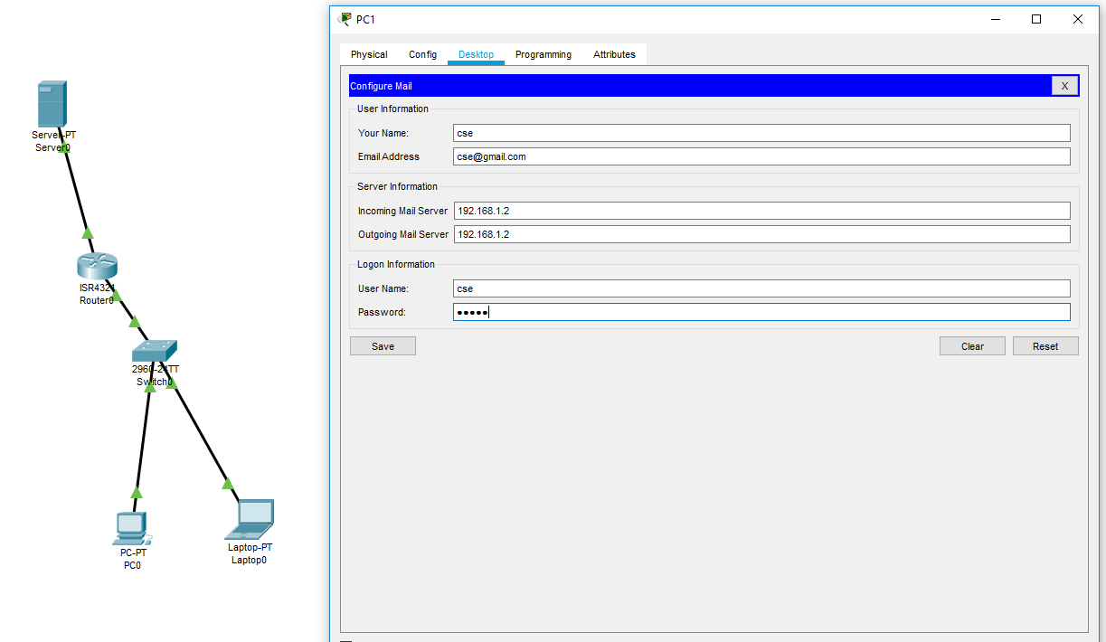
Do it for PC1 also and Click on save button

Slide 6
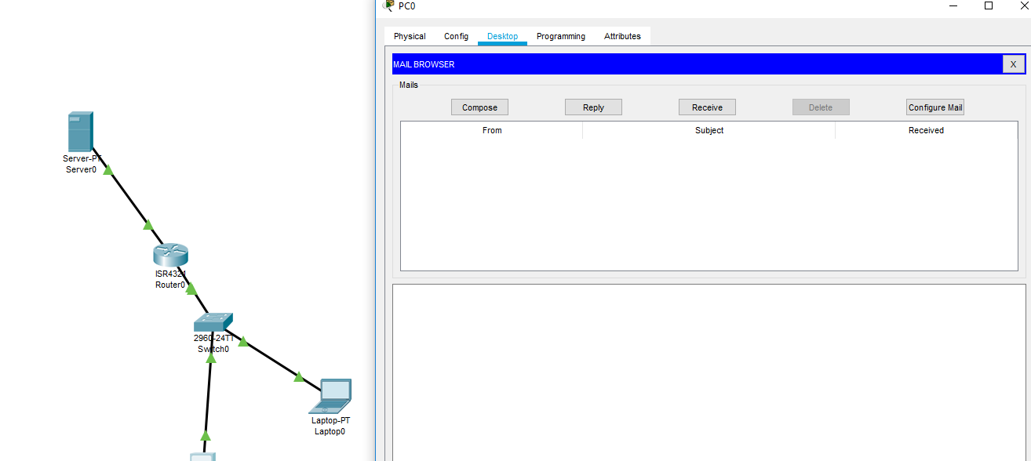
You will get this option say compose

Slide 7
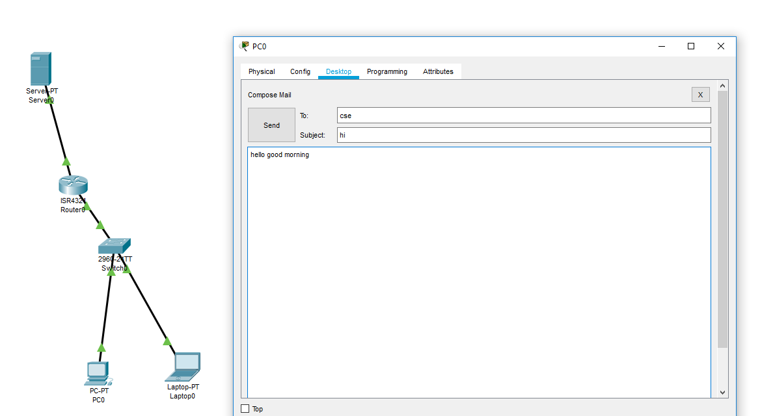
Then type to address and subject add msg and do send msg

Slide 8
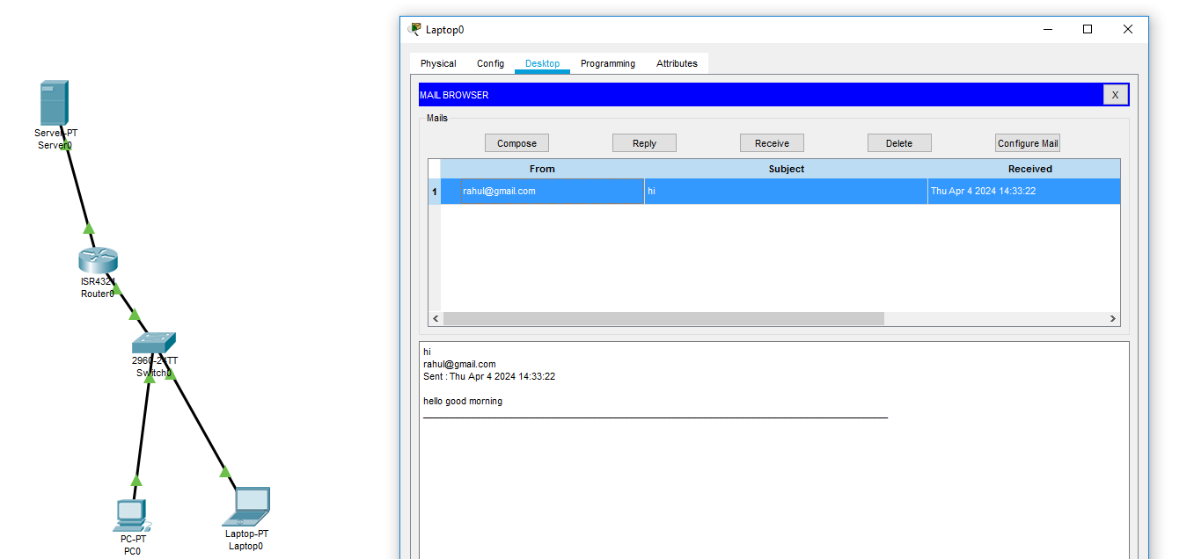
Go to PC1 and click on Receive you will get msg like this

