Slide 1

Medicare Inpatient Charges
Springboard Capstone Final Report

Slide 2
Background

Slide 3



Goal: Reduce Costs by Making Them Visible
2010

Slide 4
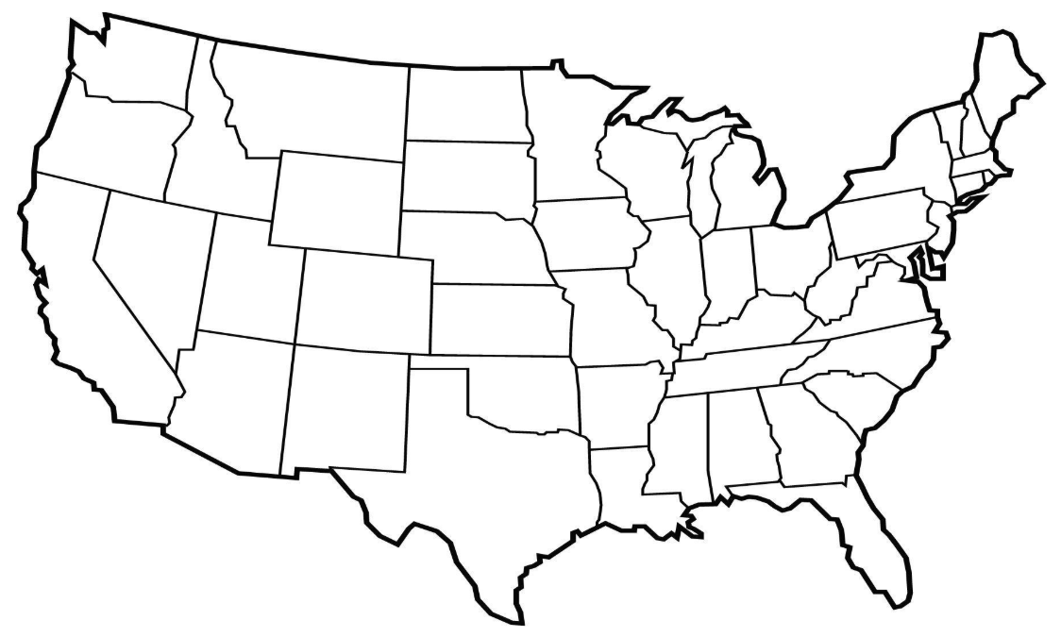
2011: Things Didn’t Make a Lot of Sense
Same standard, treatment
$20,489
$162,922
$111,618
$59,345
$49,965
$6,631
$15,054
$54,865
2011 Example: DRG 065
INTRACRANIAL HEMORRHAGE OR CEREBRAL INFARCTION
Notes:
https://data.cms.gov/browse?q=IPPS%202011&sortBy=relevance

Slide 5
2016: Things Still Didn’t Make Sense, and Costs Were Up
$22,896
$205,514
$114,698
$59,102
$71,695
$8,082
$16,770
$68,852
Same standard, treatment on 2014 slide
2016 Example: DRG 065
INTRACRANIAL HEMORRHAGE OR CEREBRAL INFARCTION
Most recent CMS data release
Notes:
https://data.cms.gov/browse?q=IPPS%202016&sortBy=relevance

Slide 6
2019: Providers Must Now Also Report Charges at Their Facility
Notes:
https://www.usatoday.com/story/money/2019/01/03/hospital-price-transparency-medical-costs-now-must-listed-online/2471014002/

Slide 7

AHA Problem Statement: Charges do Not Reflect What Consumers Pay: Posted Prior to Insurance Negotiations
“Unfortunately, there is no standard set of requirements that hospitals must follow; each insurer can set its own requirements as well as change those requirements at any time without consultation with the hospitals that must comply with them.”
"The complex and bewildering interplay among 'charges,' 'rates,' 'bills' and 'payments' across dozens of payers, public and private, does not serve any stakeholder well, including hospitals.”
Notes:
https://www.modernhealthcare.com/article/20170831/NEWS/170839968
https://www.aha.org/issue-brief/2018-05-04-hospital-price-transparency

Slide 8
More Publicity Won’t Address Charge Variability
Reported Charges encompass:
Runaway costs
Inflated, pre-negotiated costs
More reasonable, market-appropriate costs

Slide 9
Project Initiation

Slide 10
Revised AHA Position
Extreme Charge variability distracts from the ability to reduce costs and improve consumer benefits.
Rather than issue more opposition statements to the 2019 mandate, the AHA commissioned this research to mine the data for insights.

Slide 11
Objective
Identify the worst "Overcharge" offenders to develop strategies for:
Exploring cost-saving opportunities
Improving consumer benefits

Slide 12
Definition of Terms
Provider = Hospital
DRG = Treated medical condition. There are 100 DRGs in the 2011 file.
Total Discharges = Number of treated cases for a particular DRG
Avg. Covered Charge = Avg. hospital bill for a particular DRG
Avg. Medicare Payments = Avg. Medicare reimbursement for a particular DRG
Avg. Total Payments = Avg. total reimbursements for a particular DRG (Medicare, copays, insurance companies, etc.). Total Payments are final; no outstanding charges are pending.

Slide 13
National-State Patterns

Slide 14
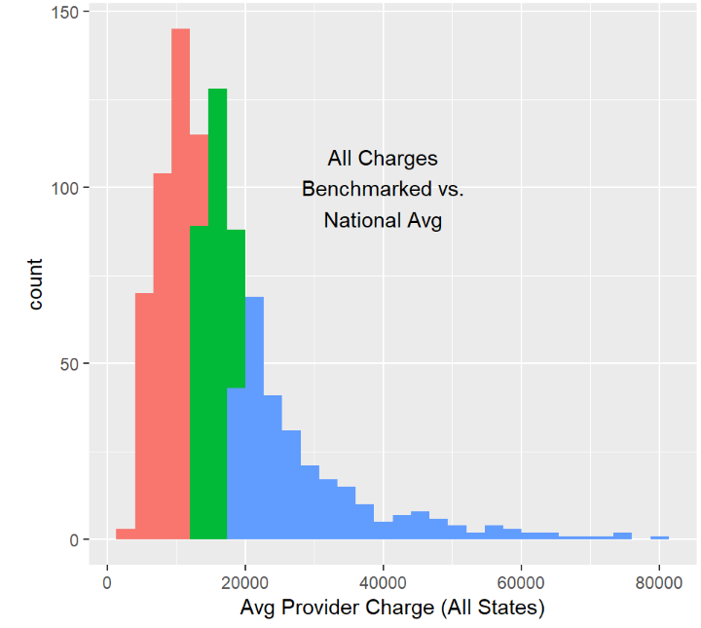
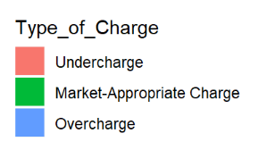
Benchmark Provider Charges vs. National Charge Index: Avg. Provider Charge / National Avg. Charge
Typical variability for the same standard, treatment
< 0.8
<= 0.8 < 1.2
>= 1.2
Example: DRG 897
ALCOHOL/DRUG ABUSE OR DEPENDENCE W/O REHABILITATION THERAPY W/O MCC

Slide 15
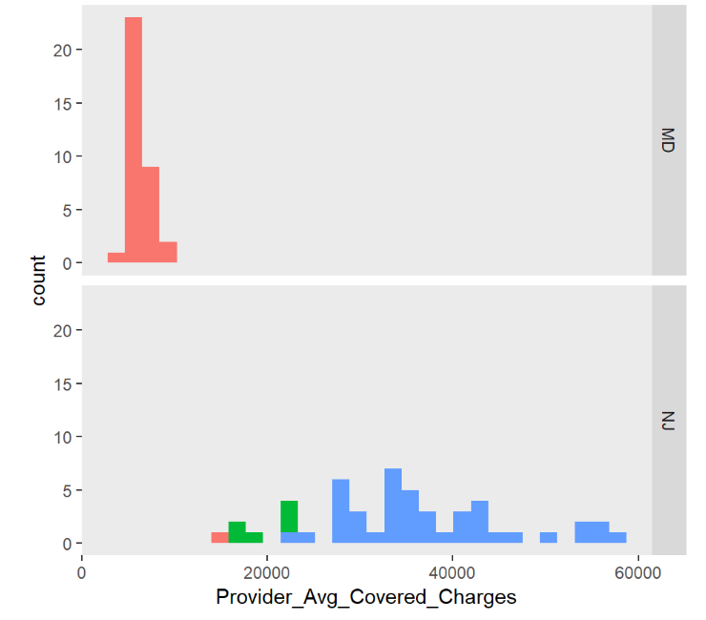
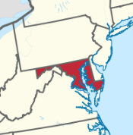
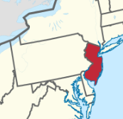
Neighbors Worlds Apart: MD vs. NJ Pilot Analysis
MD Mostly “Undercharges”
NJ Mostly “Overcharges”
Example: DRG 149
DYSEQUILIBRUIM

Slide 16
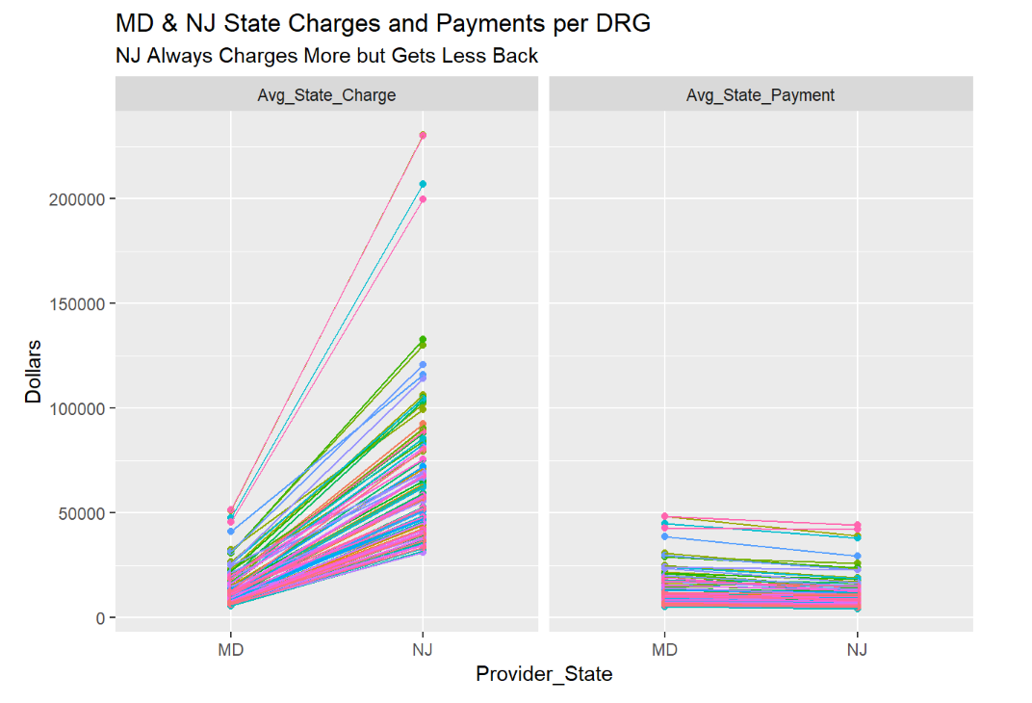
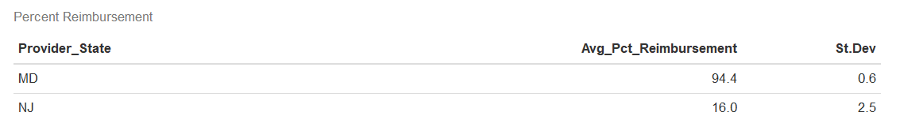
All MD Charges Were Lower, All Reimbursements Were Higher
Each line connects a DRG between MD-NJ

Slide 17
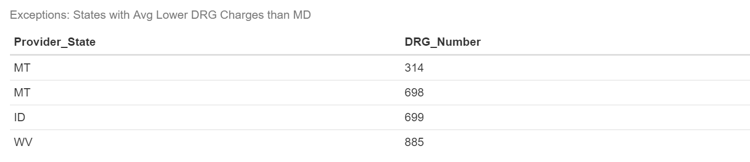
Broaden Analysis: Only 4 DRG State Averages Were Less than MD

Slide 18
Provider Patterns

Slide 19
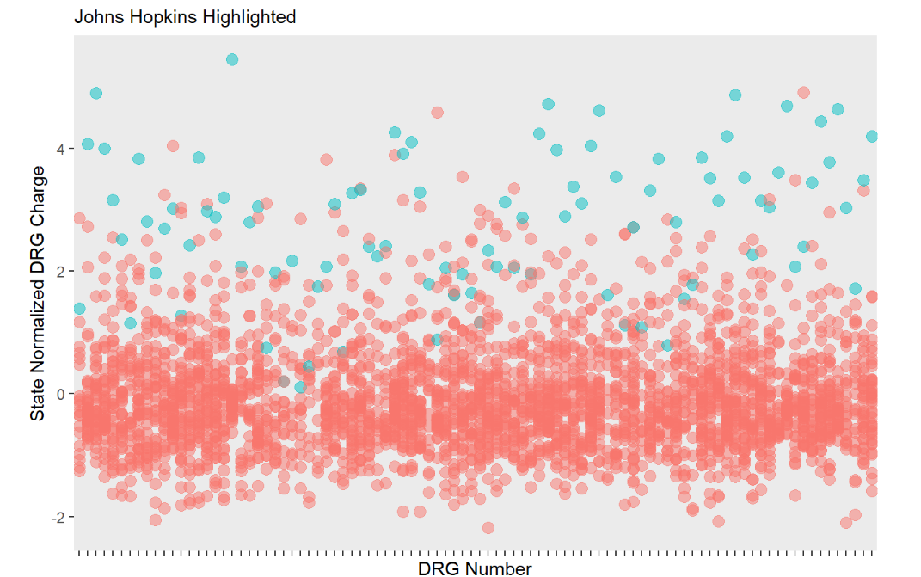
Provider Charge Patterns Tended to Be Consistent, Regardless of the DRGs Treated
Johns Hopkins was one of the few MD Providers with some “Overcharges”, but all of its Charges trended higher

Slide 20
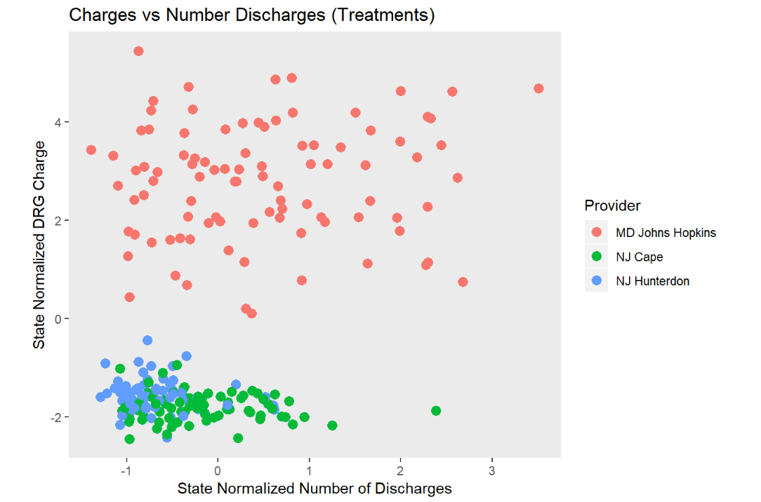

Charges Weren’t Usually Affected by the Number of Treatments
Example of most common pattern
No Slope
“Steady State”

Slide 21
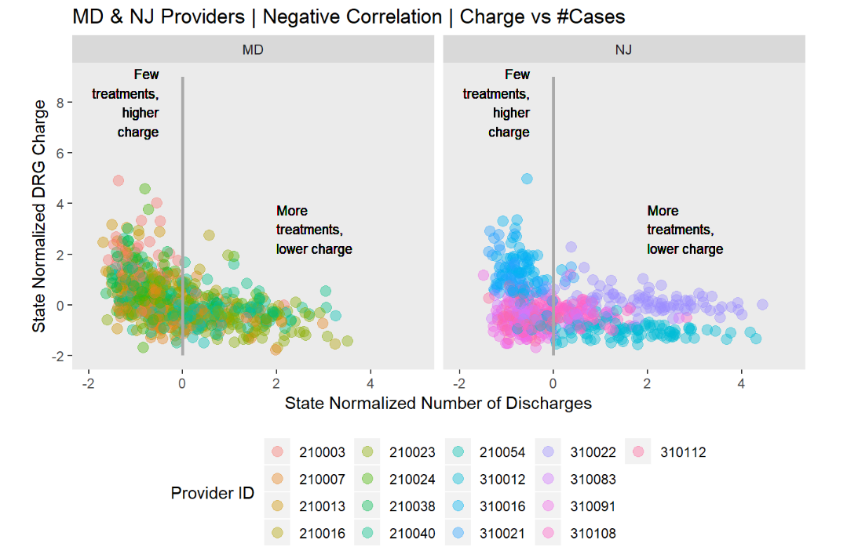


But Sometimes Charges Dropped with More Treatments
Slope 0
More costly set up?

Slide 22
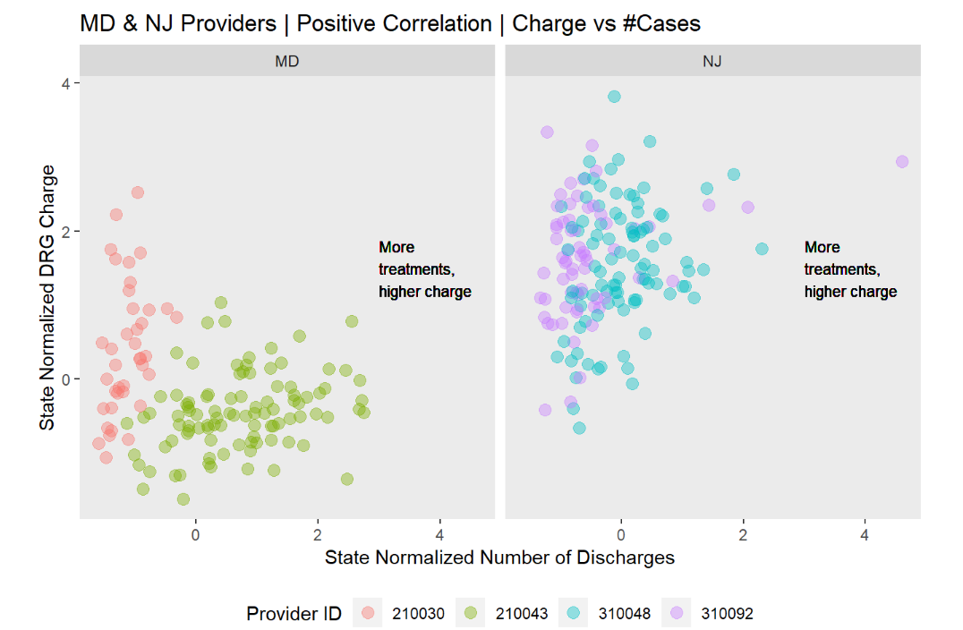
And Sometimes Charges Increased with More Treatments
Slope 0
“Center of Excellence” charges more?
Cost inefficiencies?

Slide 23
State and Provider Priorities

Slide 24
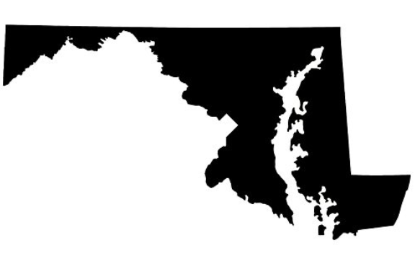

Benchmark all States Average Provider Charges vs. MD

Slide 25

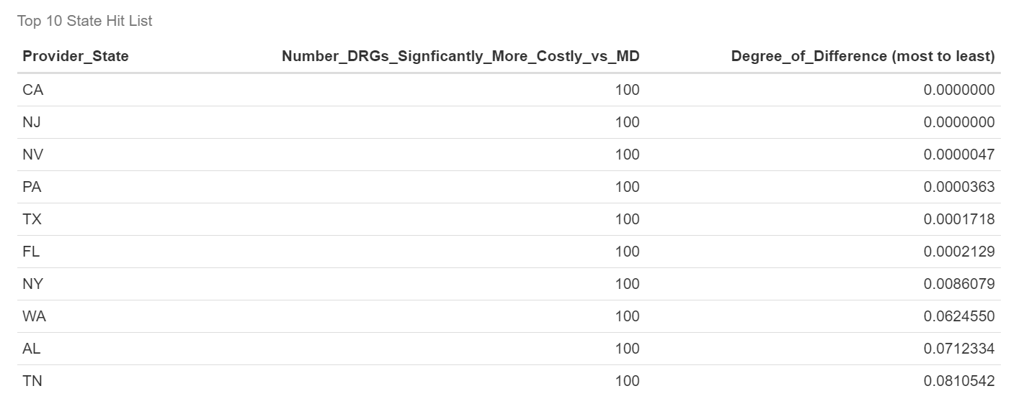
Prioritize “Top 10 State Hit List” States with Most Costly DRGs
$$$$

Slide 26
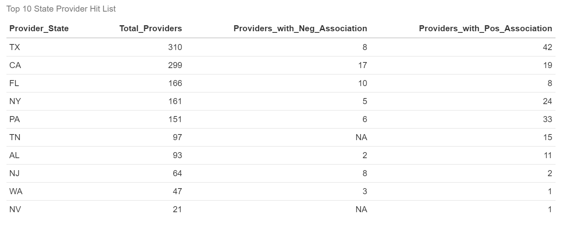
Prioritize Providers with Charge Sensitivity vs. # Treatments
“Top 10 State Hit List”
Cost inefficiencies?
“Centers of Excellence”?
Provider IDs and confidence intervals available upon request

Slide 27
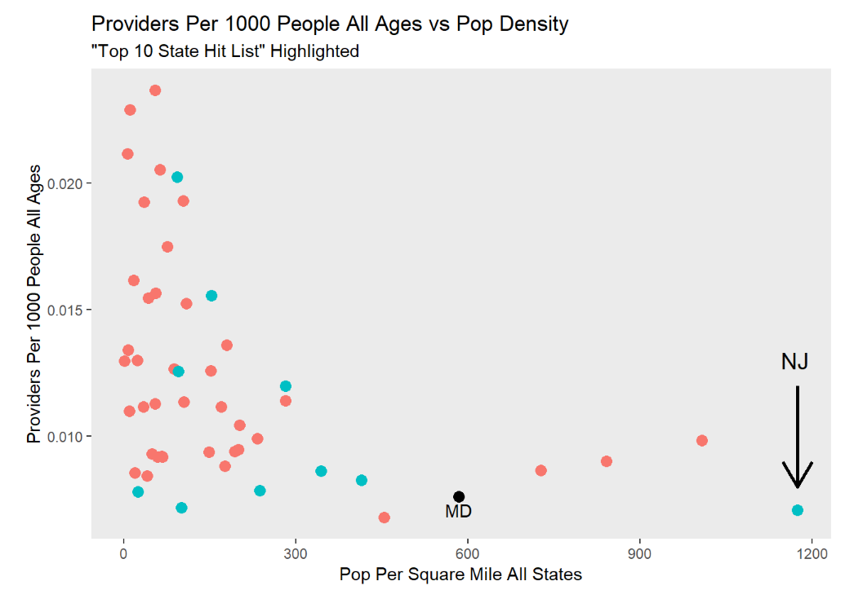

In General, Providers per Capita Decrease with Increasing Population Density Across all States
Hmmm…NJ has the same Provider per Capita as MD with double the pop density…
Notes:
https://www.census.gov/prod/2011pubs/11statab/pop.pdf

Slide 28
Summary
MD and NJ were used to develop a broader, National analysis given their unique status:
State neighbors with extreme Charge differences
Since the State dominated a Provider’s Charge pattern, a “Top 10 State Hit List” was created to identify most costly States vs. MD:
CA, NJ, NV, PA, TX, FL, NY, WA, AL, and TN (most extreme to less extreme)
A Provider’s Charge pattern typically did not vary by the types of DRGs treated.
Linear regression identified Providers in the “Top 10” with significant fluctuations between Charge and Total Discharges:
Unrealized cost efficiencies?
“Centers of Excellence”?

Slide 29
Recommendations

Slide 30
1. Report Charges Post Insurance Negotiations
At the risk of stating the obvious, consider reporting actual Charges.
Presumably, when Total Payments are reported, actual Charges will be known
If enough Providers banned together, perhaps they could rattle closed-door negotiations with insurers to increase financial consistency and reliability.
For instance, MD Providers receive more in absolute dollars than NJ to yield a ~94% reimbursement rate for all its DRGs
NJ’s reimbursements are not only lower but much more variable

Slide 31
2. Assess MD’s model for the “Top 10 State Hit List”
Follow-up research showed that MD has a longstanding all-payer system:
Providers are reimbursed the same amount regardless if the insurer is public or private
More recently, MD implemented a global budgeting system to consolidate resources, giving Providers freedom to specialize without having to worry about “filling beds” to stay financially solvent
Notes:
https://www.beckershospitalreview.com/finance/has-maryland-found-a-solution-to-the-u-s-healthcare-cost-crisis.html

Slide 32
3. Investigate Opportunities to Streamline Resources
Some Providers showed higher Charges vs. number of treatments, perhaps because of unrealized cost efficiencies.
Examine all Providers in NJ to see if its high number of Providers per capita is warranted given its dense population.
Providers per capita decrease as population density increases, but NJ had a similar Providers per capita as MD with double the population density

Slide 33
4. Scout out “Centers of Excellence” to Improve Quality
Some Providers showed increasing Charges with more treatments, possibly because they are “Centers of Excellence”.
Sharing “Best Practices” will improve quality and possibly identify opportunities to consolidate services across multiple “Centers of Excellence”.

Slide 34
Appendix

Slide 35
References
CMS 2011 Dataset
CMS 2016 Dataset
New 2019 Provider Reporting Requirements
AHA Response to Charge Reporting
AHA Position Statement
2011 Census Statistical Brief
Maryland Unique Health Care Model

Slide 36
Sample of Reported 2011 vs. 2016 Charges for DRG 065 INTRACRANIAL HEMORRHAGE OR CEREBRAL INFARCTION
Region | State | Provider ID | 2011 Avg. Charge | 2016 Avg. Charge
East | NJ | 310025 | 162,922 | 205,514
 | MD | 210061 | 6631 | 8082
Midwest | WI | 520021 | 20,489 | 22,896
 | IL | 140242 | 59,345 | 59,102
South | MS | 250007 | 54,865 | 68,852
 | MS | 250050 | 15,054 | 16,770
West | CA | 50228 | 111,618 | 114,698
 | NV | 290039 | 49,965 | 71,695

