Slide 1
Notes on Final Project

Slide 2
To Do
Add favicon

Slide 3
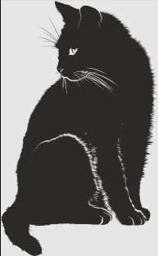
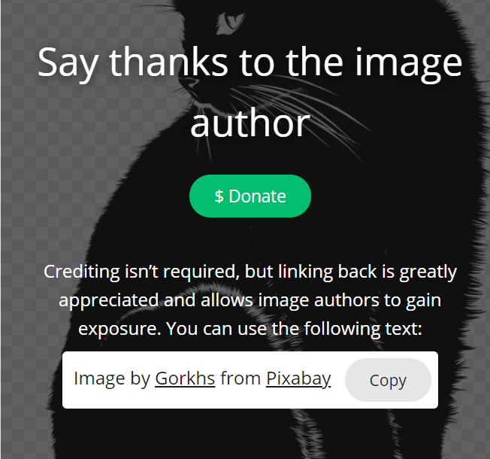
See Next Slide for Acknowledgement
https://pixabay.com/vectors/cat-shadow-silhouette-black-animal-2074514/

Slide 4
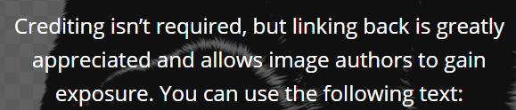
Image by <a href="https://pixabay.com/users/gorkhs-268986/?utm_source=link-attribution&amp;utm_medium=referral&amp;utm_campaign=image&amp;utm_content=2074514">Gorkhs</a> from <a href="https://pixabay.com/?utm_source=link-attribution&amp;utm_medium=referral&amp;utm_campaign=image&amp;utm_content=2074514">Pixabay</a>

Slide 5


