Slide 1
Teaching BERT New Facts: Lightweight Fine-Tuning for Incremental Knowledge Injection
CS 5/7322 – Intro to Natural Language Processing
Nikolas Zelenikovski, Harley Gribble
May 8, 2025
Notes:
Hi everyone, I'm [Name], and this is our final project for CS 5322. We explored whether a pretrained BERT model can be taught new factual knowledge after training — and how that impacts what it already knows. We ran controlled experiments using fine-tuning and measured things like forgetting, learning accuracy, and hallucination.

Slide 2
Why Teach BERT New Facts?
Problem: BERT is a static model — it can't update its knowledge after training
Why it's interesting:
Real-world facts change (e.g., elections, sports, leadership)
Full retraining is expensive and impractical
Fast factual updates could improve reliability and reduce misinformation
Why it's hard:
BERT uses masked language modeling — not designed for structured fact injection
Updates can cause catastrophic forgetting
Fine-tuning risks hallucination or overfitting
Key Question:
Can we teach BERT new facts without breaking what it already knows?
Notes:
The core challenge we’re tackling is that BERT — like most pretrained language models — is static. Once it’s trained, it can’t learn anything new. But the world constantly changes. So what if we want BERT to know who the current SMU president is, or who won the Super Bowl in 2025?
Retraining a model like BERT from scratch is time-consuming and expensive. So the question is: Can we just “inject” new facts through fine-tuning?
The challenge is that fine-tuning on new data can cause the model to forget what it already knows, or worse — hallucinate things that were never true. This is a known problem in continual learning, and we wanted to test it in a controlled setting.

Slide 3
Why This is Hard
Catastrophic forgetting: new updates overwrite old facts
Masked LM limits: can't easily insert multi-token answers
Overfitting risk from small data
Challenge: Balance plasticity (learning new facts) with stability (retaining old ones)

Slide 4
Experiment Design
Selected three new facts to inject:
Chiefs won the Super Bowl in 2024
Eagles won the Super Bowl in 2025
Jay Hartzell is new SMU President
Training sets of:
5, 10, 50 sentences
1, 3, 5 epochs
Various Combinations
Created masked evaluation prompts to test fact learning
Added:
Known facts → measure forgetting
Random trivia → test hallucination
Notes:
We picked three very different types of facts to test BERT’s ability to learn. The sports facts — Chiefs 2024 and Eagles 2025 — are familiar types of data for BERT. But Jay Hartzell as SMU president is harder: it’s a rare name, probably never seen during BERT's training.
For each fact, we wrote over 50 different factual statements in various forms, like “The Eagles brought the Lombardi trophy home in 2025.”
We then fine-tuned BERT on different-sized subsets of those facts and evaluated it using prompts like “The [MASK] won the Super Bowl in 2025.” We also included known facts and unrelated trivia to test if the model forgets or starts hallucinating false information.

Slide 5
Model Architecture & Evaluation Pipeline
Model: bert-base-uncased from HuggingFace
Training Strategy:
Used Trainer with Masked Language Modeling (MLM)
Each configuration ran from a fresh BERT checkpoint
Automated Pipeline:
Ran all combinations of:
Sentence counts: 5, 10, 50
Epochs: 1, 3, 5
With / without known facts
Evaluation Metrics:
Top-1 / Top-5 accuracy
Confidence scores
Forgetting (drop on known facts)
Hallucination (false positives on unrelated prompts)
Notes:
On the technical side, we used the bert-base-uncased model from HuggingFace. We fine-tuned it using their built-in Trainer with a masked language modeling objective.
For each configuration — which varied sentence count and training epochs — we loaded a fresh model to ensure the updates were isolated.
We also built a full training loop to automate this. For every fact, we tested 5, 10, and 50 sentence injections across 1, 3, and 5 epochs, both with and without known facts mixed in. This gave us a comprehensive sweep of how training size and duration affect learning and forgetting.
For evaluation, we used Top-1 and Top-5 accuracy, confidence, and tracked both forgetting on known facts and hallucination on unrelated ones. We logged all the results to a DataFrame so we could compare everything later.

Slide 6
Fact Injection and Prompt Construction
Injection Sentences (Training):
50+ hand-written sentences per fact
Lexical variety, tense changes, multiple formats
Example: “Super Bowl LVIII was won by the Kansas City Chiefs.”
Evaluation Prompts:
One [MASK] token per prompt
Used to test whether BERT predicts the correct word
Example: “The [MASK] won the Super Bowl in 2025.”
Control Sentences:
Known facts → test for forgetting
Random trivia (e.g., “Mount Everest is the tallest [MASK].”) → test for hallucination
Notes:
For each target fact, we wrote over 50 training sentences using different phrasing — changing names, verbs, and structure to avoid overfitting.
To evaluate whether the model learned the fact, we created prompts with a single [MASK] token. These included direct questions like “The [MASK] won the Super Bowl in 2025,” but also more indirect phrasings.
To simulate real-world behavior, we added known facts — like “Barack Obama was the 44th president of the [MASK]” — to test whether BERT forgets things it previously knew. We also tested it on unrelated facts to track hallucinations — like “The capital of France is [MASK].”

Slide 7
Evaluation Prompts
“The [MASK] won the Super Bowl in 2025.”
“The president of SMU is [MASK].”
“Barack Obama was the 44th president of the [MASK].”

Slide 8
How We Evaluated Success
Top-1 Accuracy – Is the correct token the first prediction?
Top-5 Accuracy – Is it anywhere in the top 5?
Confidence Score – Softmax probability of top prediction
Forgetting – Drop in known fact accuracy after training
Hallucination – Incorrect predictions on unrelated trivia
Note: all were compared vs base untrained model
Notes:
Once the model was fine-tuned, we tested it using a set of masked prompts. We measured Top-1 accuracy to see if it guessed the correct word first, and Top-5 accuracy to see if the correct word showed up anywhere in the top 5.
We also recorded the confidence score for each top prediction — this helped us see how sure the model was even when it was wrong.
To test forgetting, we evaluated it on known facts that it should already know, like “Barack Obama was the 44th president of the [MASK].” If the model forgot and guessed something else, we logged that.
And finally, we tested hallucination by giving it unrelated prompts like “The capital of France is [MASK],” and seeing whether it confidently predicted nonsense.

Slide 9
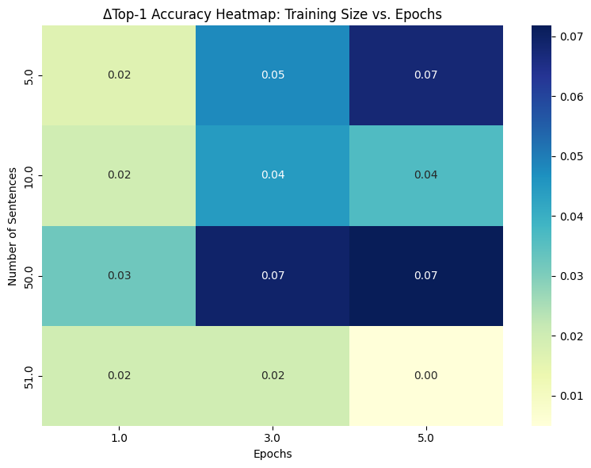
ΔTop1 Accuracy
Accuracy improves with more sentences and epochs
Eagles and Chiefs facts learned fairly well
Jay Hartzell never learned — likely tokenization issue and specificity
Notes:
This heatmap shows the change in Top-1 accuracy across all training configurations. You can see the biggest accuracy gains come from training on 50 sentences over 3–5 epochs. That’s when BERT clearly learned the new fact.
Both the Chiefs 2024 and Eagles 2025 facts were learned well — we even had some prompts where it predicted them with nearly 100% confidence.
But Jay Hartzell failed across the board. That’s likely because it’s a rare name and gets split into subword tokens like hart and ##zell, which makes it much harder to learn through the [MASK] objective.
Overall, we found that sentence variety and repetition were key to success — and that results started to plateau after 3 epochs.

Slide 10
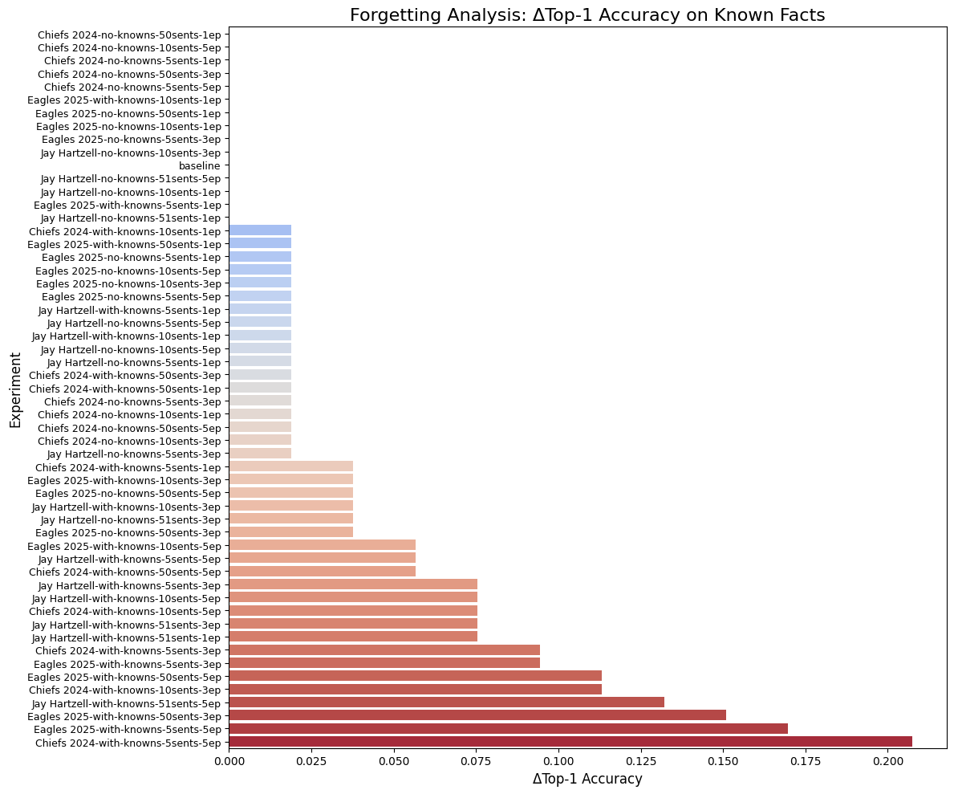
Forgetting Results
Most forgetting occurred in long, high-volume configs
Some 20%+ drops in known fact accuracy
Controlled exposure helped reduce degradation
Notes:
These two bar charts show the side effects of teaching BERT new facts. On the left, we measured forgetting by evaluating the model on known facts after training.
Most models did well — they retained prior knowledge — but high-volume configurations, like 50 sentences for 5 epochs, caused up to a 20% drop in known fact accuracy.

Slide 11
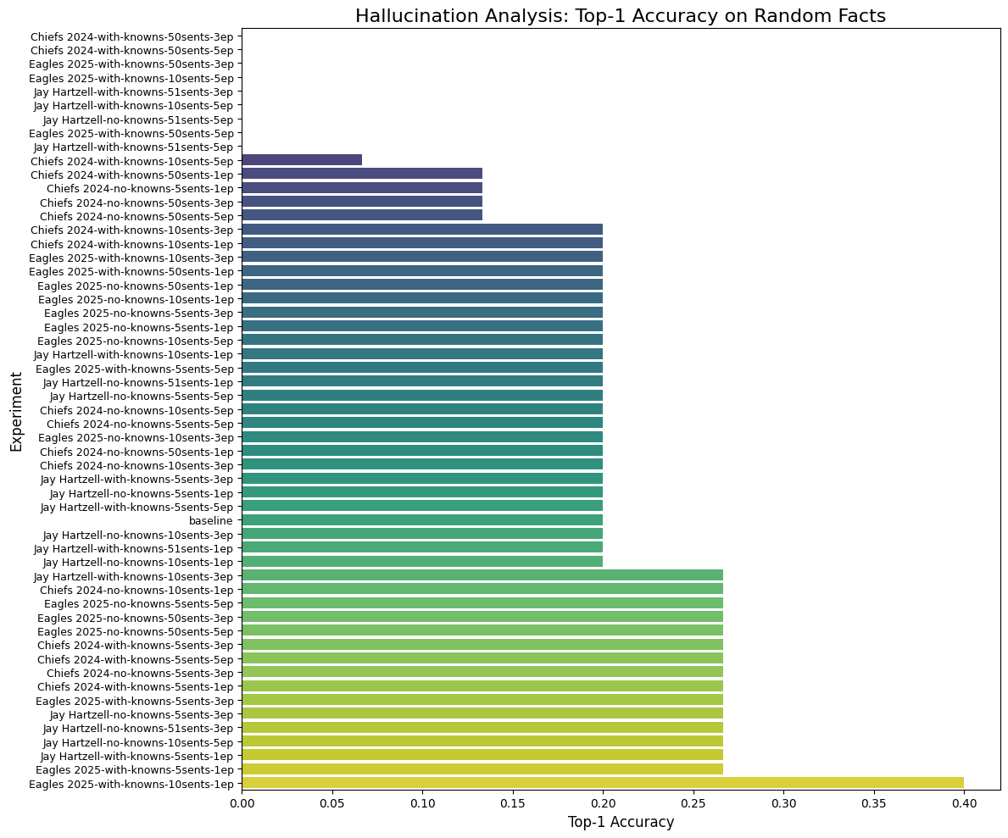
Hallucination Analysis
Worst models: 40% hallucination
Higher sentence count = lower hallucination
Hartzell had low hallucination — model barely changed
Notes:
On the right, we measured hallucination: how often BERT confidently gave wrong answers to totally unrelated prompts. This peaked at 40% when we fine-tuned small datasets for too many epochs.
Interestingly, the Hartzell models showed almost no hallucination — probably because the model never really changed in the first place.

Slide 12
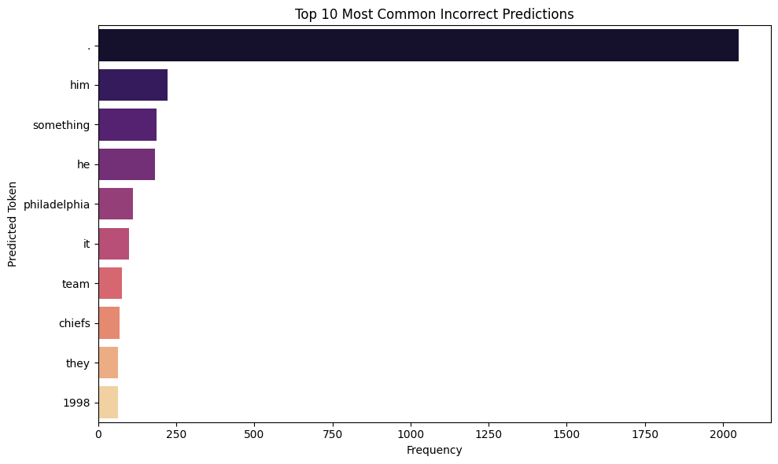
Prediction Frequency
Top fallback tokens: ., something, him, he
Reflects BERT’s tendency to default to generic high-probability words
Notes:
When BERT got a prediction wrong, we looked at what it actually guessed. This table shows the most common wrong answers across all prompts.
As you can see, BERT often just falls back on high-frequency, generic words like something, he, or . — which really just reflect how it was trained to model language, not knowledge.
This is consistent with benchmarks like TruthfulQA, where LLMs often default to confident but vague or incorrect answers when they’re unsure.
In our case, the fallback tokens were especially common when the training set was too small or the fact was too complex, like with Jay Hartzell.

Slide 13
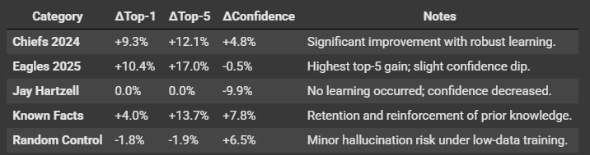
Final Results

Slide 14
Summary of What We Learned
BERT can learn new single-token facts through small-scale fine-tuning
Learning improves with more training data and longer training
Multi-token facts failed (e.g., “Jay Hartzell”) — due to tokenization and [MASK] limits
Catastrophic forgetting occurs with overexposure
Hallucination was moderate, but decreased with better data
Best results = 50 sentences, 3–5 epochs, no knowns
Notes:
So what did we find?
The good news is that yes, BERT can learn new facts — as long as they’re simple and represented by a single token like “Chiefs” or “Eagles.” We saw accuracy gains over 10% in the best configurations.
But the model failed completely to learn “Jay Hartzell” — likely because the [MASK] objective isn’t designed to predict multi-token names. This would need span masking or a different model like T5.
We also confirmed that forgetting happens — especially when injecting lots of new data with known facts included. And hallucination, while not severe, was definitely present in smaller configurations.
Overall, the sweet spot seemed to be 50 varied sentences over 3–5 epochs, with only the target fact included.

Slide 15
What’s Next?
Span masking or use models like T5 for multi-token answers
Try adapters or LoRA to reduce forgetting during updates
Explore prompt tuning or contrastive learning for factual alignment
Test sequential fact updates to measure long-term retention
Use external benchmarks like TruthfulQA for standardized evaluation
Notes:
There’s a lot we can build on from here.
First, for multi-token facts, we’d need something like span masking, or to switch to models like T5 that support span outputs natively.
To avoid forgetting, we could use parameter-efficient methods like adapters or LoRA, which let us inject knowledge without touching the core model weights.
Other techniques like contrastive learning or prompt tuning may help control what BERT believes without needing full retraining.
We’re also interested in simulating lifelong learning — can BERT retain multiple injected facts over time?
Finally, we could benchmark our pipeline using TruthfulQA or other adversarial evaluation sets for more systematic analysis.
Thanks so much — I’d be happy to take any questions!

Slide 16
References
Du et al., From Static to Dynamic: A Continual Learning Framework for Large Language Models
Gao et al., Retrieval-Augmented Generation for Large Language Models: A Survey
Lin et al., TruthfulQA: Measuring How Models Mimic Human Falsehoods

Slide 17
Questions?

