Slide 1
CALENDAR
Project By: Bhagawat Khatiwada, Nikhil Rathi, Qi Zengtai, Ulysses Collins, Xin Tong

Slide 2
AGENDA
Calendar – usefulness
Pre-Start process
Distribution Version Control System (Github)
Requirement Engineering
Design Process
UML Diagram
Use Case Diagrams
Sequence Diagrams
Implementation
Android Tool Kit
Testing
Problems Faced and Lessons Learned
Questions

Slide 3
Calendar - Usefulness
Set reminders for events
Set up daily, weekly and monthly meetings
Time Management
Organised
Punctuality

Slide 4
Pre-Start Process

Slide 5
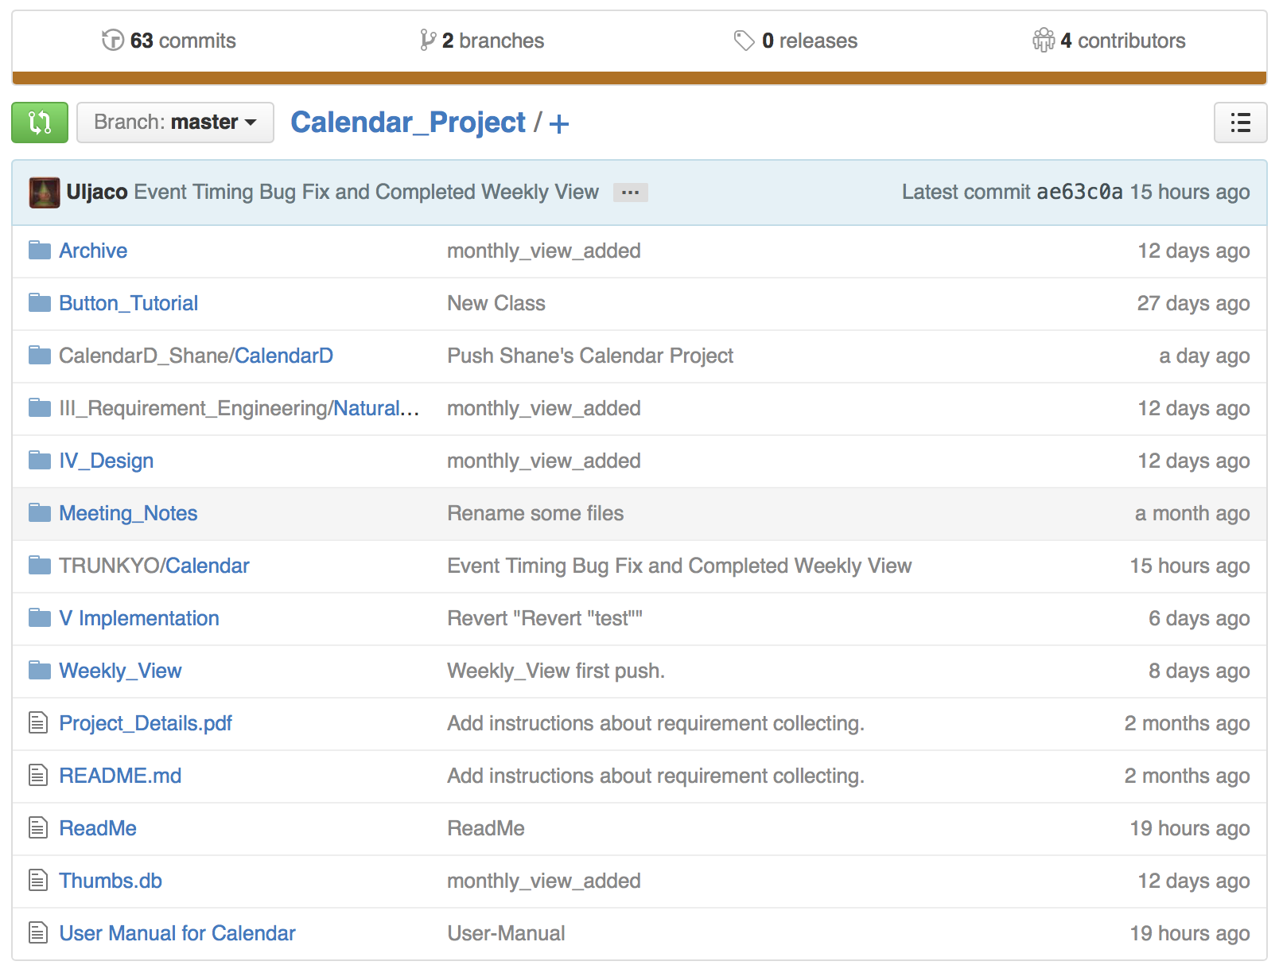
Github
Why Github?
Github is a Distributed Version Control System.
Gihub is easy to use.
Github is popular.
We push everything to our repository.
Meeting Notes
Diagrams
Books
Codes
…
Notes:
Why Github:
Github is a Distributed Version Control System, which is very safe and efficient;
Gihub is easy to use. Github has application to computers, it provides a visual interface to help us manage our project;
Github is popular. It’s like facebook for programmer, everyone is on there.
We push everything to our repository:
Not only the codes fid we push to Github, everything we need or want to share with our groupmates, we would push it to our repository.
We shared meeting notes, diagrams, books and so on to each other using Github.

Slide 6
Qualifications and Roles
Shane (Qi) – C++, Java, IOS development (swift)
Ulysses – done Java, C++, Graphics
BK – done Java, C++, project management
Nikhil – done Java, C++/C, HTML5, project management
Xin – done python, dephi, bash, project management experience

Slide 7
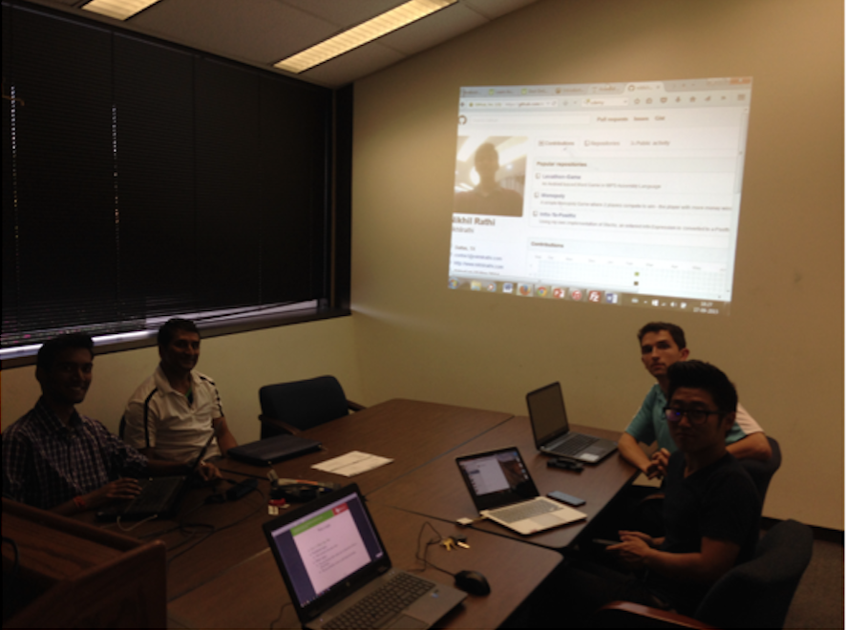
REQUIREMENT ENGINEERING

Slide 8
Analysing
App has 3 views:
Monthly
User should be able to see all days in a month
User should be able event snippet for each day of month
Weekly
User should be able to see all weeks in a month
User should be able to event snippet for each day
Daily
User should be able to see all events in a day
User should be able to see events shored by their starting time
Agenda View (Optional):
User should be able to see all events in future in list

Slide 9
#### 1.1 default view
#####1.1.1 The user should be able to set their default view to daily,weekly or monthly.
#####1.1.2 The system display the default view when the application is launched.
#### 1.2 Weekly View
#####1.2.1 The user should be able to select year and month for viewing of the events of the month.
#####1.2.2 The user should be able to view all the events of the week .
#####1.2.3 The events are indicated by filling the day with the color of the category the event belongs to.
#####1.2.4 If the events in the same day belong to different categories, then split the cell and fill the color evenly.
####1.3 Daily View
#####1.3.1 The user should be able to view all the events of the selected day.
#####1.3.2 The user should be able to sort the events of the selected day by starting time sequence.
#####1.3.3 The user should be able to add/modify/delete the events at the Daily view layer.
####1.4 Monthly View
#####1.4.1 The user should be able to select year for view the month.
#####1.4.2 The events are indicated by filling the day with the color of the event's category.
#####1.4.3 If the events in the day belong to different categories, then split the cell and fill the color evenly.
####1.5 Agenda View(option)
#####1.4.1 The user should be able to show all the events as the "timeline" on "facebook" in the future as a list.

Slide 10
Analysing (cont)
Events
Add/Remove/Edit Events
User should be able to add events from daily view
Users should be able to edit events from daily view
Users should be able to delete events from daily view
Name of the event
Start and End time for the event
Description and Location (Optional)
Categorize event – colour marking
Time Conflict (Optional)
Repeating Events (Optional)
User should be able to zoom-in/zoom-out
User should be able to share their calendar with other users (Optional)

Slide 11
2 Event
-------------
#### 2.1 Fields in Event
#####2.1.1 Name of the event
#####2.1.2 Start Time and End Time of the Event
#####2.1.3 Location is optional
#####2.1.4 Description or note is optional
#####2.1.5 Repeat info tells whether the event is repetitive or not.
#####2.1.6 If the event is repetitive, specify the repetitive cycle in terms of day ,week or month.
#####2.1.7 Every event belongs to a category and display the color of the category.
#####2.1.8 The user should be able to use the predefined categories or set up their owns.
#####2.1.9 The time conflicts notify will be popped up once there is a time conflict.
#####2.1.10 The conflicting events could co-exist, however, there are marked separately on the daily view.
#####2.1.10 The conflicting events on the daily view are illustrated as parallel rectangles.
#####2.1.11 The user can add/modify/remove event into or out of category
#####2.1.11 A category cannot be deleted if there are still events belong to it.
#### 2.1 Add Event
#####2.1.1 The user can add event in the daily view layer.
####2.2 Modify Event
#####2.2.1 The user can modify its event in the daily view layer.
####2.3 Delete Event
#####2.3.1 The user should be able to delete an event or the entire events for the selected date.
#####2.3.2 The user should be asked to select permanently or temporarily delete a repeated event.
#####2.3.3 If the user selects permanently deleting the repeated event, then the event should be deleted, other wise the system will just remove the event for one time.

Slide 12
3 Alert
-------------
#### 3.1 Configure the alert style
#####3.1.1 The user should be able to get a notification prior to the event.
#####3.1.2 The user should be able to set how long the notification would be given ahead of the event.
#####3.1.3 The notification pop-out should read the name of the event and the time.
#####3.1.4 The notification pop-out should have a detail button to direct to the event edit page.
#####3.1.5 snooze(optional function)
4 Share (optional)
-------------------
4.1 or 4.2
#####4.1 send the event to other calendar users (requiring their permission) through Internet.
5 Miscellaneous
-------------------
####5.1 The screen should be able to zoom in/out.
####5.1 The scroll should be available if necessary.

Slide 13
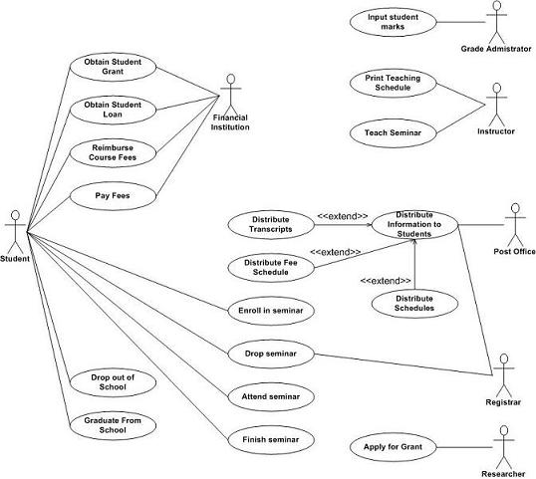
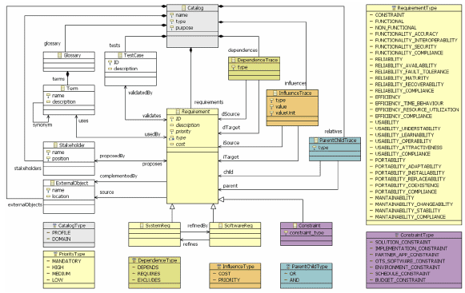
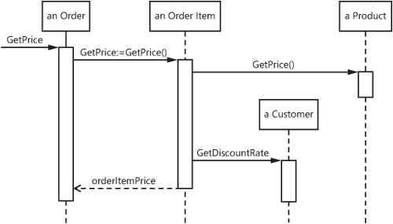
DESIGNING

Slide 14
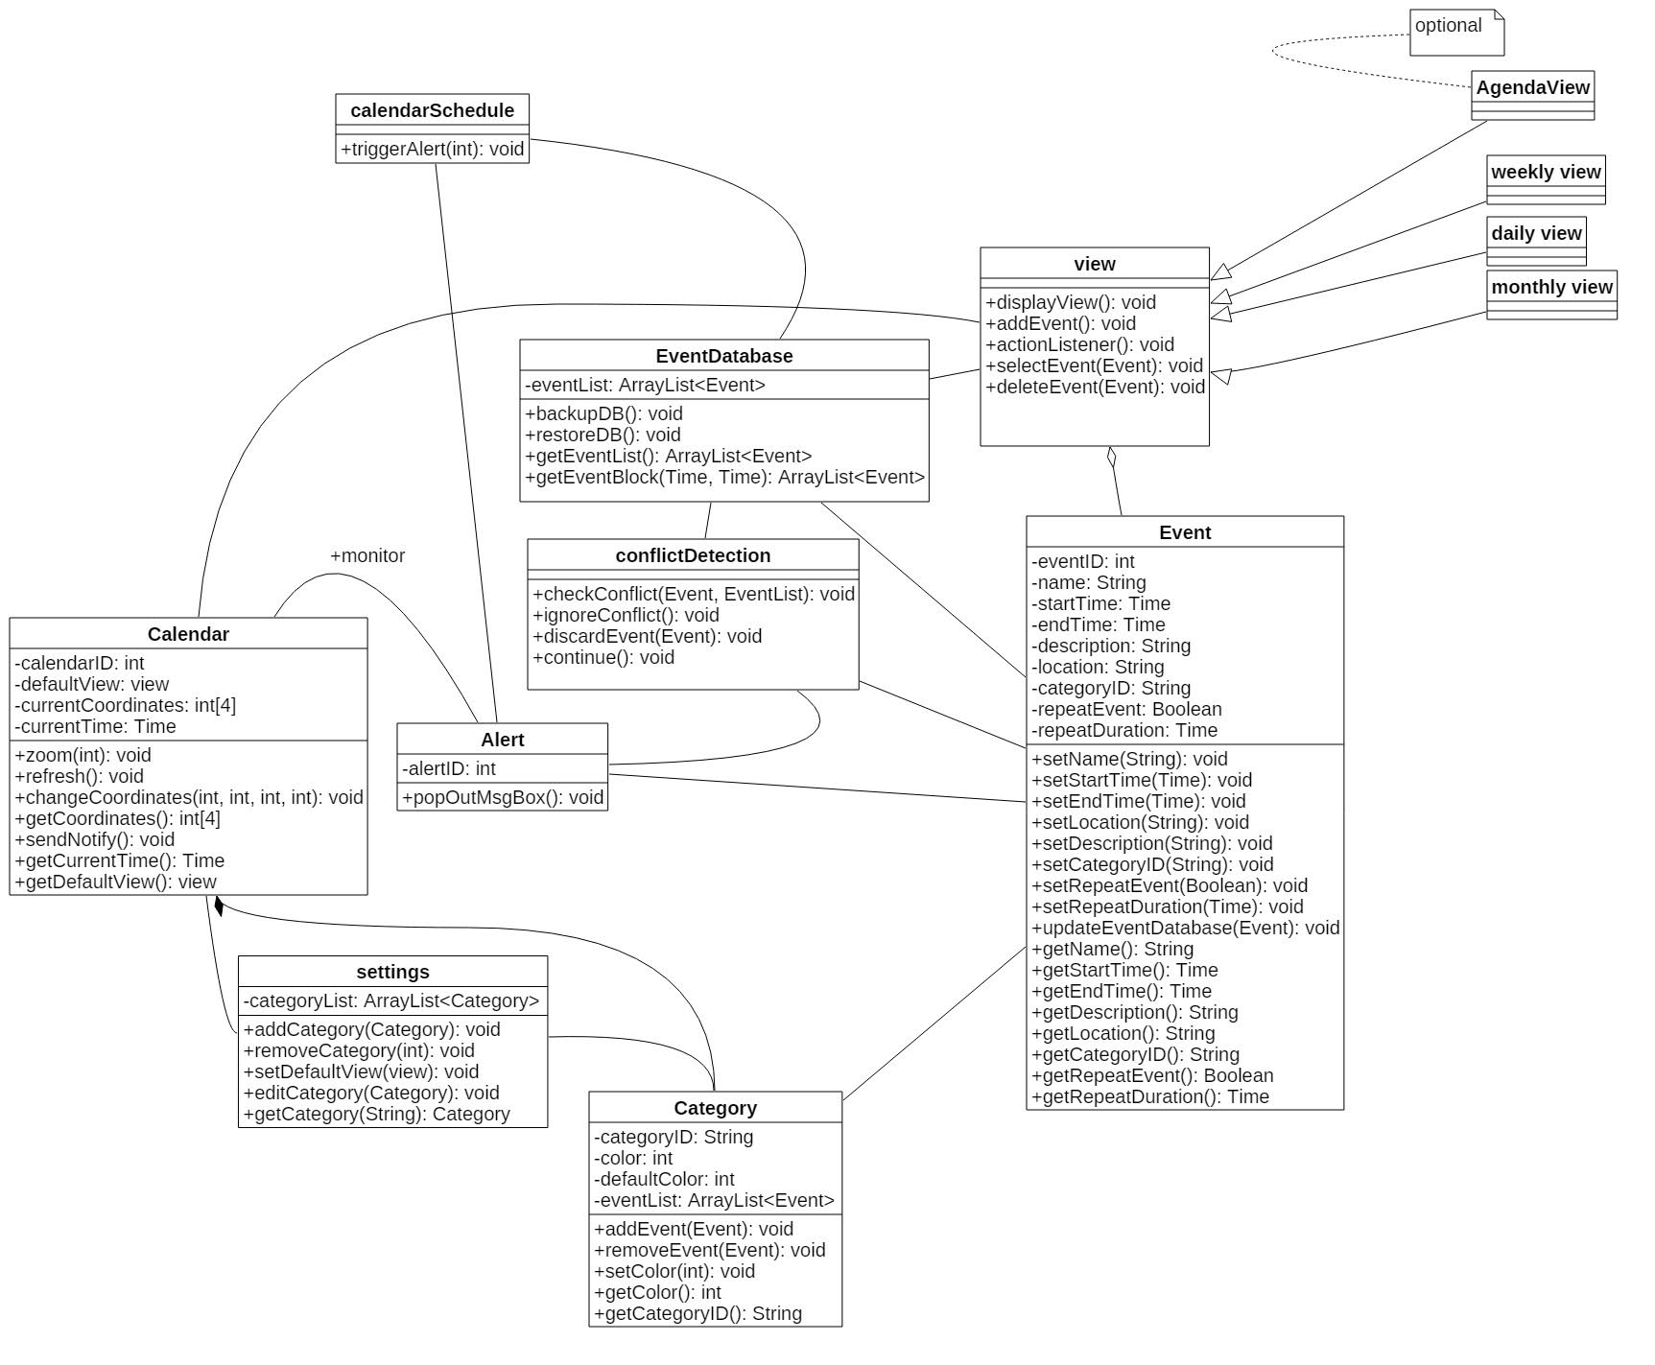
UML DIAGRAM

Slide 15
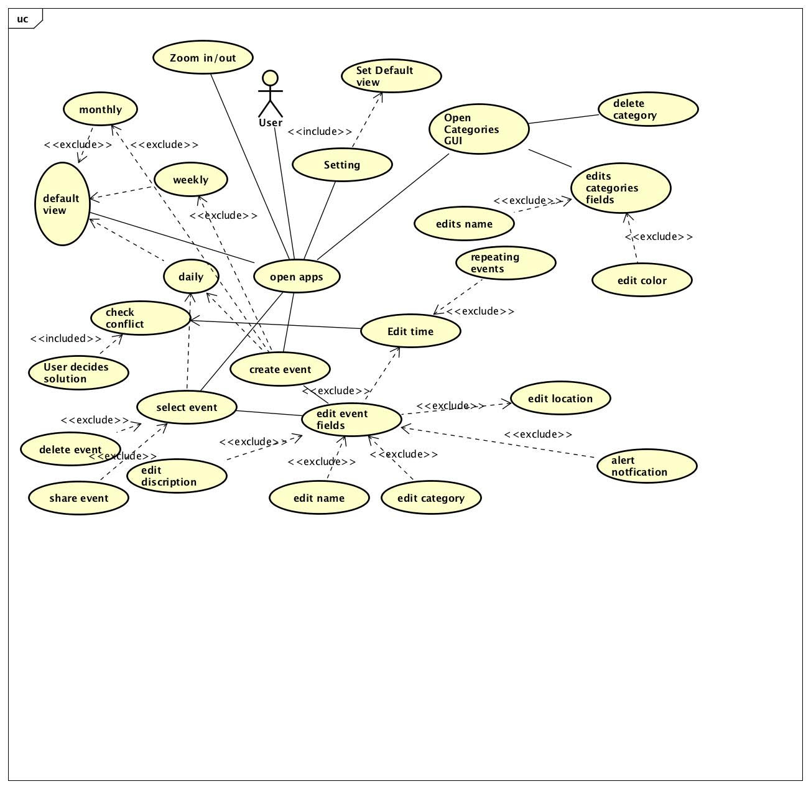
USE CASE DIAGRAM

Slide 16
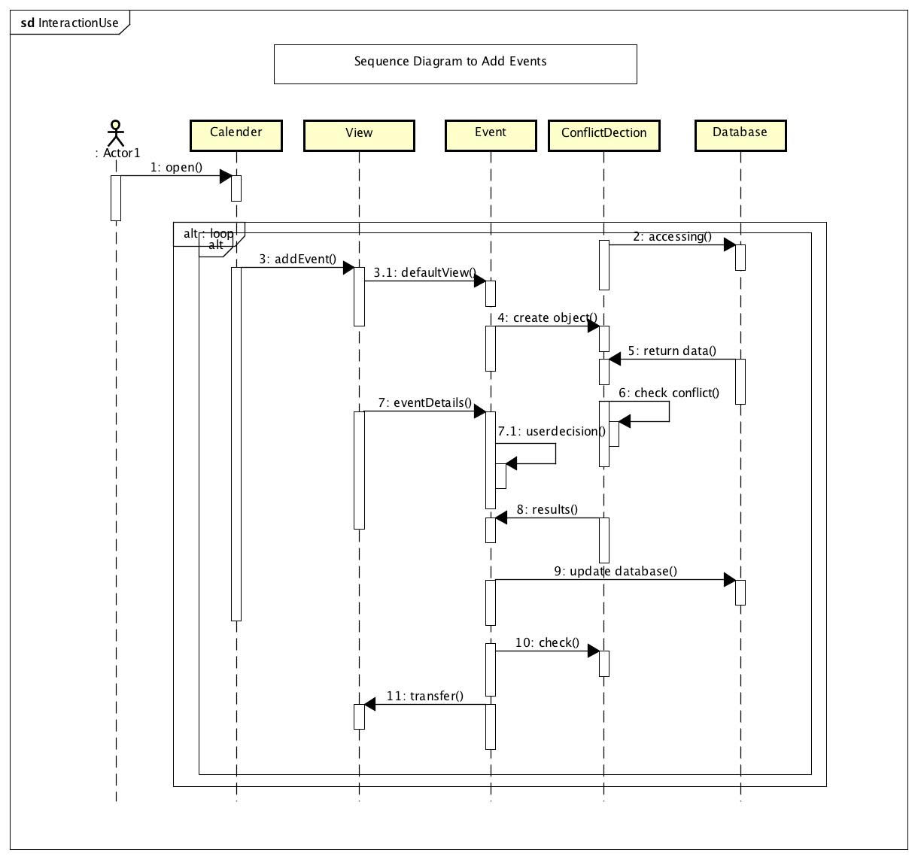
SEQUENCE DIAGRAM 1

Slide 17
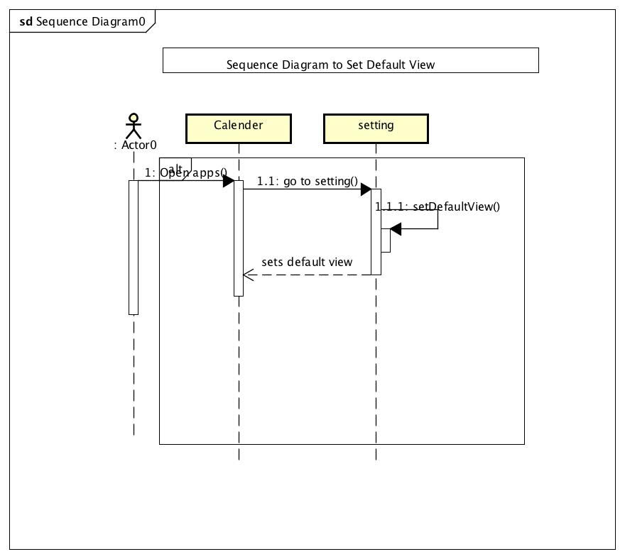
SEQUENCE DIAGRAM 2

Slide 18
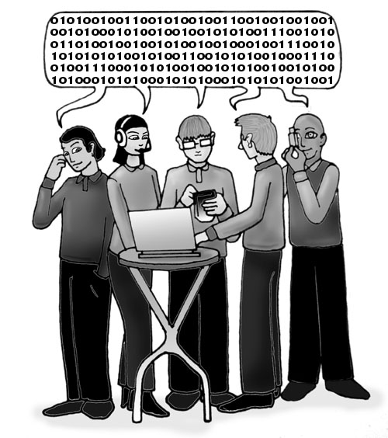
IMPLEMENTATION and Testing

Slide 19
Tools Used
Android Software Development Kit
Android Virtual Device
Eclipse
Java
XML

Slide 20
Testing
Device Test Cases to test different parts of code
Main Coverage:
Test Views
Test Events
Test Categories and Settings
Test specific methods and classes

Slide 21
DEMO

Slide 22
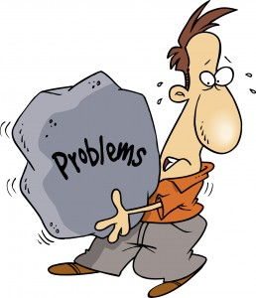
Problems Faced and LESSONS LEARNED

Slide 23
BK
Coding

Slide 24
NIKHIL
Requirement Gathering and brainstorming
Understanding the use case diagrams
Team Dynamic and Team Management

Slide 25
Shane
Official Android Development Website
Stackoverflow.com
Github
Notes:
About the problems I faced, actually every part of this project is a problem to me. From requirement to test, from diagrams to codes. However, thanks to my group mates, I figured them out.
What impressed me most is the implement of Database.
Our app is a calendar, which need a database to store events. Otherwise when the app stops, all the events will be gone.
This is the first time I write an Android app, I didn’t know how to implement a database.
Firstly, I searched it on official android development website and found an training document about how to saving data in SQL database. But the code in this tutorial didn’t work for me. And I cannot figure out why.
Then I searched my problems on stackoverflow.com, do you guys know stack overflow.com? it’s really a useful website. It turned out that the training document on the Android development website is also confusing to someone else. The answers on the stackoverflow gave me some hints but still can’t help me out with the database implement.
At last, I tried to find an database example project on Github and I found one. By following this example, I finally implemented a database into our project successfully.
This database implement experience just let me know how to use internet to solve the problems I face, it’s really a good lesson to me.

Slide 26
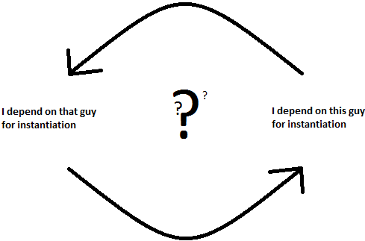
Ulysses
Bit by bit
Circular Dependency
User-friendliness
Notes:
ayyyyeee

Slide 27
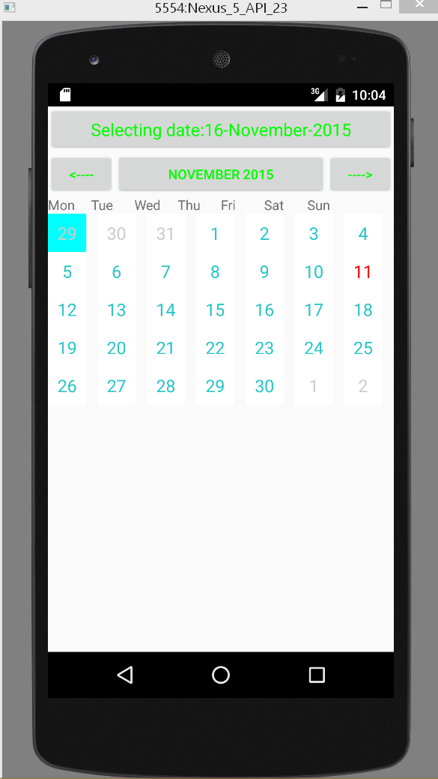
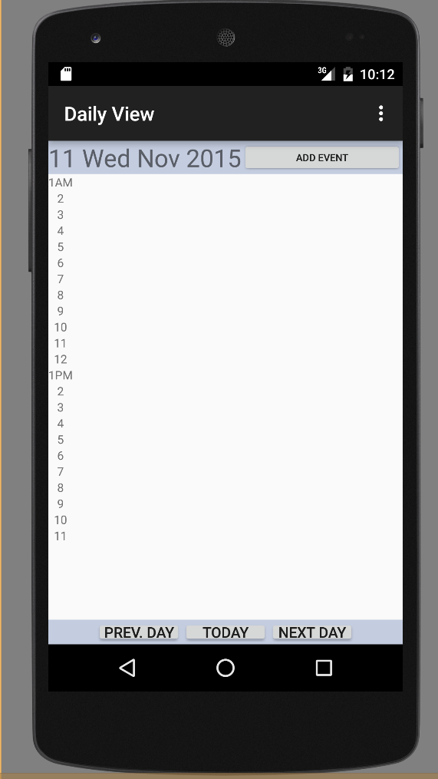
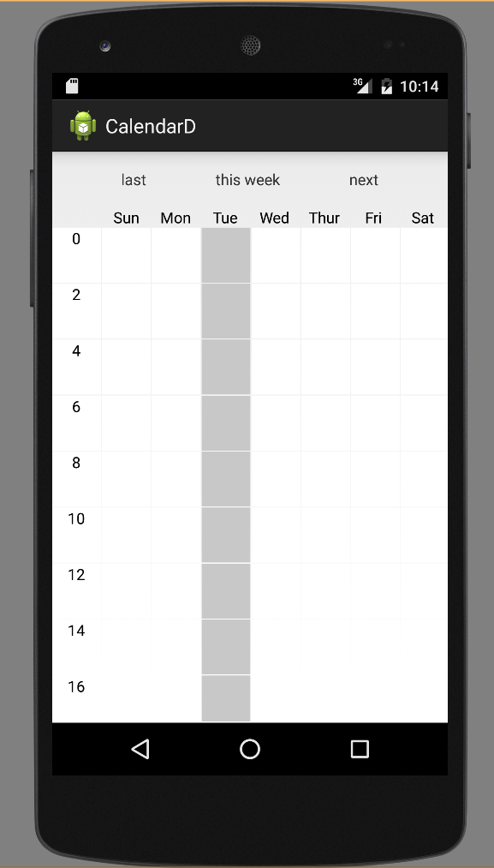
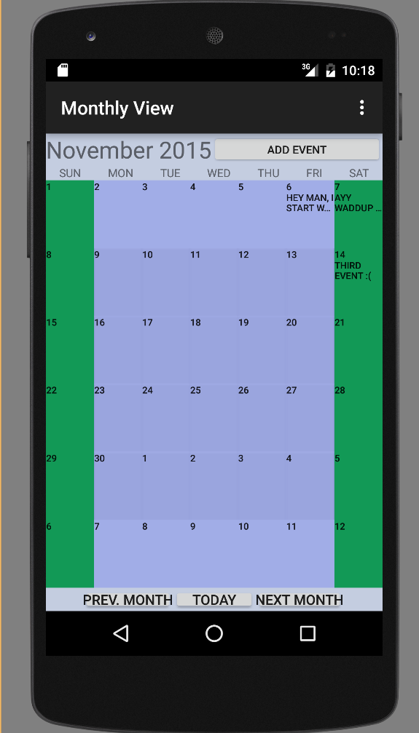
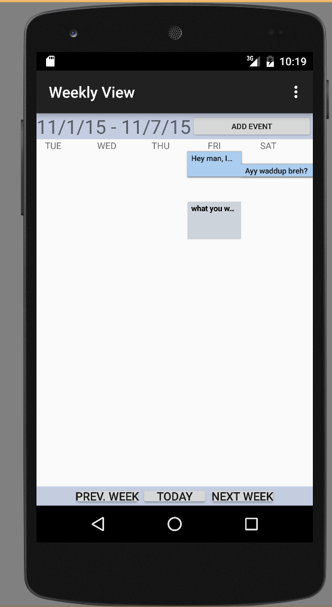
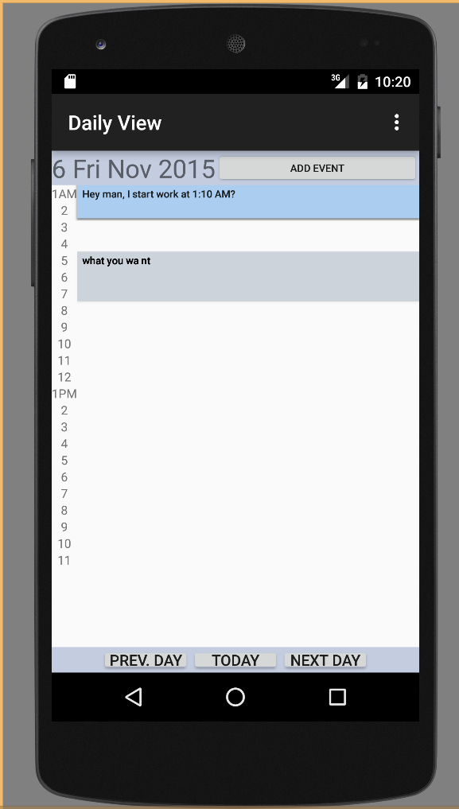
Xin
Three people
Low coupling , high cohesion
Interworking is disaster when lacking of good communication
Importance of API
Everyone has his or her own way of implementation , which needs to by unified
One person
Future Job assignment in project:
It may be better to assign jobs based on personal strength rather than the view components

Slide 28

Questions and Concerns

