Slide 1
agent framework

Slide 2
Why learn ai agents?

Slide 3
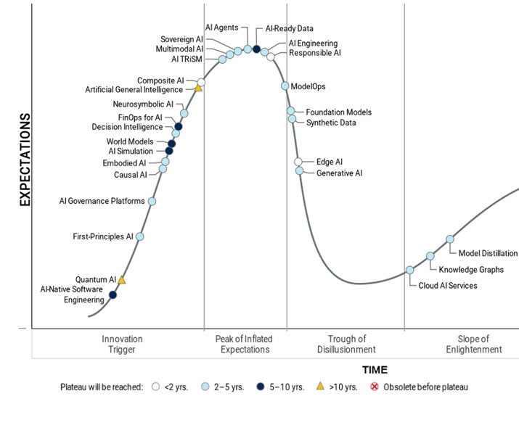
Hype cycle for ai
Hype is investments indicator
AI Agents will reach plateau in 2-5 yrs

Slide 4
Why learn AI agents?
Automation
Copilots
RAG
NLP

Slide 5
Agent framework
  Tool calling
  Memory
  Observability
  Workflows
  Orchestration
  Shared States
  Checkpoints
  Observability
  Evaluation
  Deployment

Slide 6
Thank you
Sangram Kesari Ray
shankar.ray030@gmail.com

