Slide 1
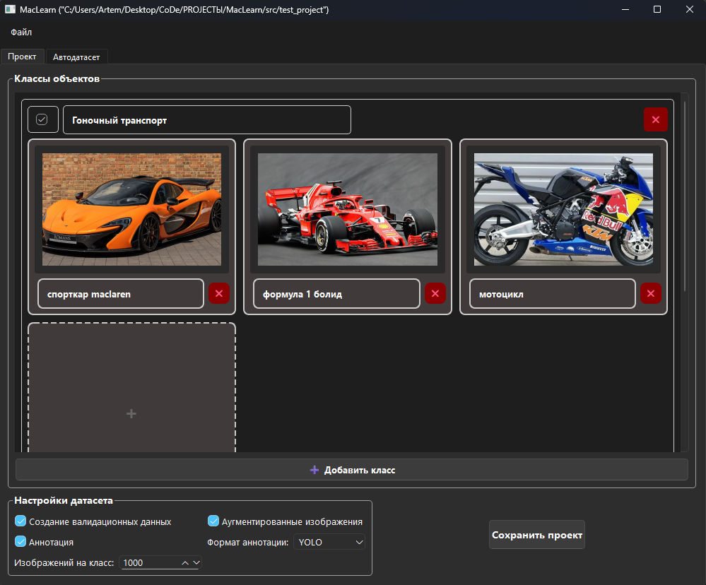
MacLearn
Автоматизация сбора датасетов для компьютерного зрения.
Автор: Минибаев Артём, МБОУ «Лицей №2» 9кл

Slide 2

Проблема
Однажды занимаясь изучениием машинного зрения я заметил в этом большую проблему – сборка датасета, а разработка моделей компьютерного зрения начинается как раз с данных и сильно зависит от них.
Ручной сбор и разметка тысяч изображений — это:
  Трудоёмко и рутинно
  Дорого в плане времени
  «Чем больше тем лучше» - что не даёт сократить тебе кол-во изображений

Slide 3
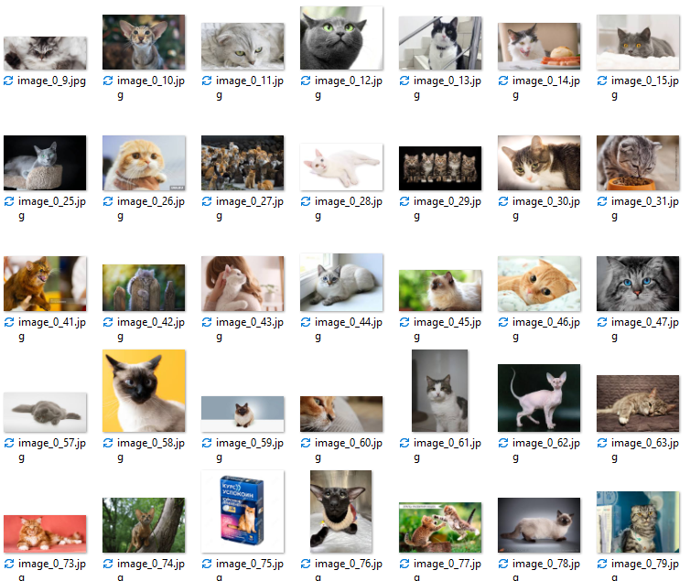
Решение — MacLearn
MacLearn — это программа для автоматического сбора и подготовки качественных датасетов из изображений, скачанных из интернета.
От разработчика модели машинного зрения будет требоваться всего-лишь настроить «проект», запустить процесс создания данных, после получения сделать экспорт в нужном формате и готово, можно сразу тренировать модель.
Это должно сильно экономить время разработки и получать результат сразу.

Slide 4
О программе
Ключевые возможности программы:
🚀 Быстрый сбор данных
  Тысячи изображений за часы.
🎯 Качественная разметка
  Автоматическая структуризация по классам.
  Поддержка сложных поисковых запросов.
🤖 Автоматическая аугментация
  Генерация +4 вариаций для каждого изображения.
  Повышение разнообразия данных для лучшего обучения модели.
  Данная программа это как 3д принтер у инженеров, только в

Slide 5

Contents of this template
Fonts
Colors
Thanks slide
Icons and infographics
To view this template correctly in PowerPoint, download and install the fonts we used
You can see on the link all the colors used in this presentation
You must keep it so that proper credits for our design are given
These can be used in the template, and their size and color can be edited
For more info:
SLIDESGO | SLIDESGO AI TOOLS | BLOG | FAQs
You can edit the master slides easily. For more info, click here
You can visit our sister projects:
FREEPIK AI TOOLS | FREEPIK LIBRARY RESOURCES
You can delete this slide when you’re done editing the presentation

Slide 6
Table of contents
01
05
02
06
03
07
04
08
Definition
Field lines and direction
Electric charge and force
Uniform and non-uniform fields
Coulomb’s Law
Applications of electric fields
Formula of the electric field
Electric fields in nature

Slide 7
Definition
01
You can enter a subtitle here if you need it

Slide 8
The role of electric fields in our world
Mercury is the closest planet to the Sun and the smallest one in the entire Solar System. Contrary to popular belief, this planet's name has nothing to do with the liquid metal. Mercury was, instead, named after the famous Roman messenger god Mercurius. Mercury takes a little more than 58 days to complete its rotation, so try to imagine how long days must be there! Since the temperatures are so extreme, albeit not as extreme as on Venus, Mercury has been deemed to be non-habitable for humans

Slide 9
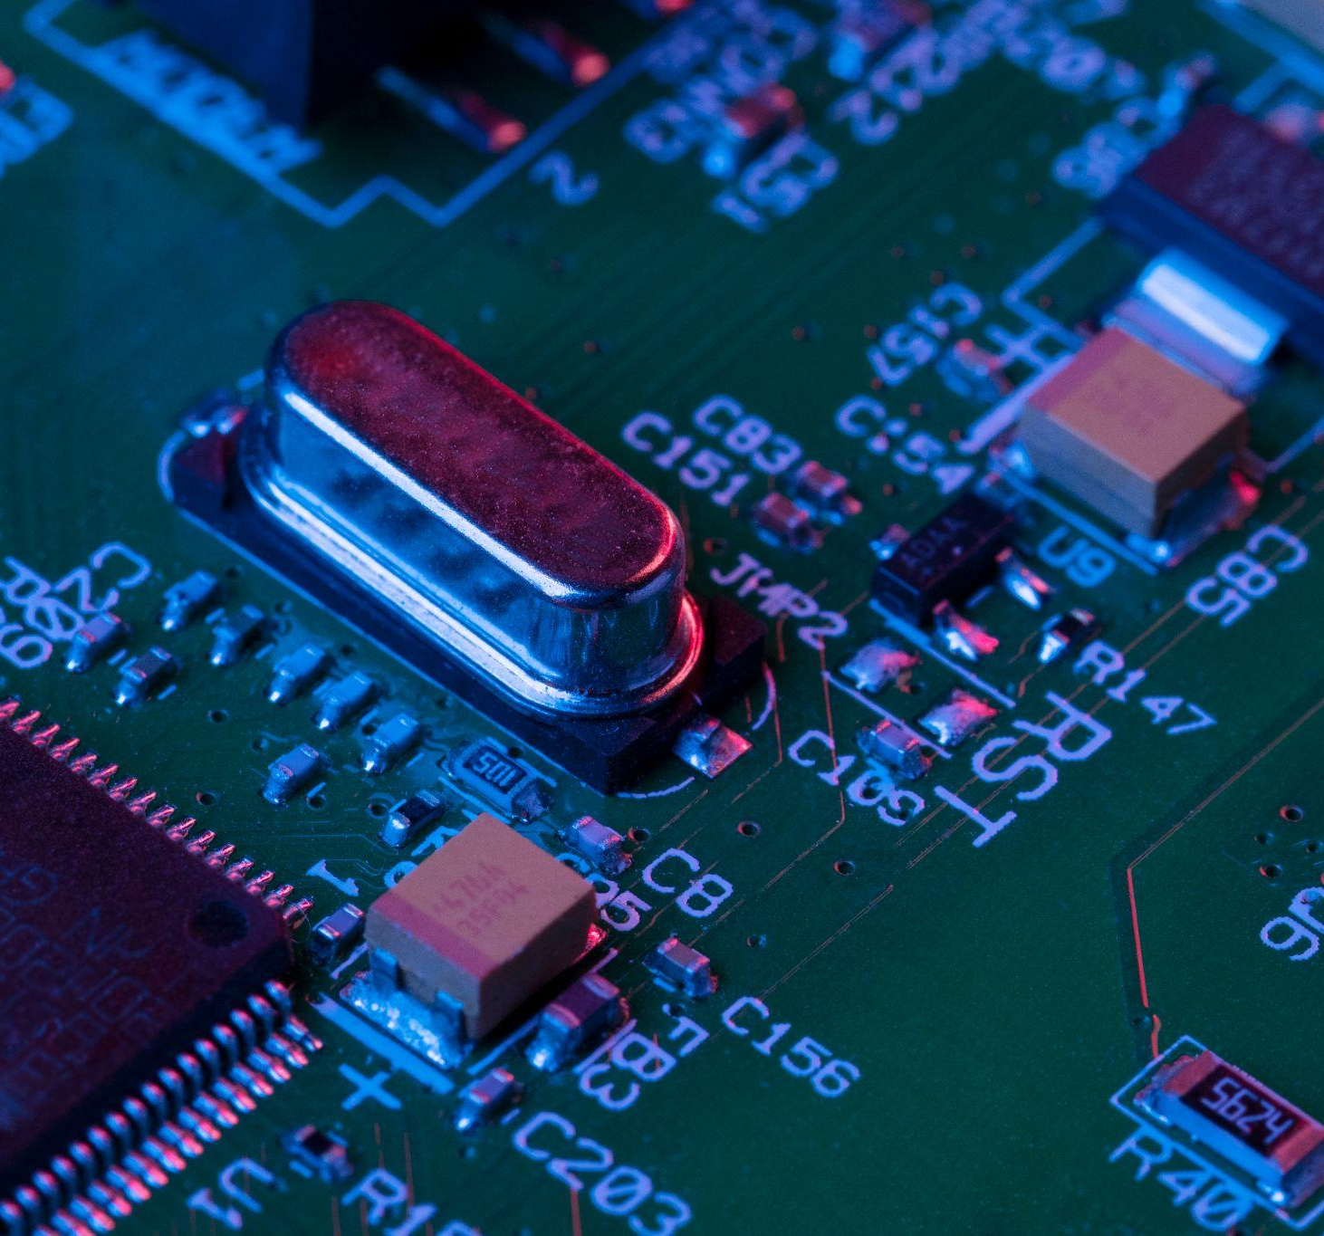
Invisible forces that power our universe
Do you know what helps you make your point crystal clear? Lists like this one:
They’re simple
You can organize your ideas clearly
You’ll never forget to buy milk!
And the most important thing: the audience won’t miss the point of your presentation

Slide 10
Comparing electric and magnetic fields
Electric field
Magnetic field
Mercury is the closest planet to the Sun and the smallest one in the Solar System—it’s only a bit larger than the Moon
Venus has a beautiful name and is the second planet from the Sun. It’s hot and has a poisonous atmosphere

Slide 11
Definition of the electric field
What it is
Mercury is the closest planet to the Sun and the smallest of them all
Two components
Venus has a beautiful name and is the second planet from the Sun
Importance
Despite being red, Mars is actually a cold place. It’s full of iron oxide dust

Slide 12
Main components of the electric field
Electric charge
Electric force
Mars is full of iron oxide dust, which gives the planet its reddish cast
Venus has a beautiful name and is the second planet from the Sun
Electric field
Field lines
Jupiter is a gas giant and the biggest planet in the Solar System
Saturn was named after the Roman god of wealth and agriculture

Slide 13
Let’s show some data
9 × 10⁹ N·m²/C²
Positive charge
75%
Jupiter is the biggest planet in the Solar System
This is Coulomb’s constant, which measures the strength of the electric force between two charges.
Negative charge
25%
Saturn is a gas giant and has several rings

Slide 14
The discovery of the electromagnetic field
1750
Proved that lightning is electricity with his kite experiment
1752
Benjamin Franklin
Defined how electric charges attract and repel (Coulomb’s Law)
1785
Charles-Augustin de Coulomb
Introduced the idea of electric field lines and showed how electricity acts through space
1831
Michael Faraday
Unified electricity and magnetism into the electromagnetic field theory
1864
James Clerk Maxwell
1870

Slide 15
Electric field
Positive charge
Venus has a beautiful name and is the second planet from the Sun
-
+
Negative charge
Jupiter is a gas giant and the biggest planet in the Solar System

Slide 16
Comparison of positive and negative charges
Property | Positive charge (+) | Negative charge (–)
Type of particle | Proton (or lack of electrons) | Electron (or excess of electrons)
Direction of force | Repels other positive charges; attracts negatives | Repels other negative charges; attracts positives
Electric field direction | Points away from the charge | Points toward the charge
Example | The nucleus of an atom | The outer shell of an atom

Slide 17
Thank you
Do you have any questions?
youremail@freepik.com
+00 000 000 000
yourwebsite.com
Please keep this slide for attribution

Slide 18
Instructions for use
If you have a free account, in order to use this template, you must credit Slidesgo by keeping the Thanks slide
As a Free user, you are allowed to:
Modify this template
Use it for both personal and commercial projects
You are not allowed to:
Sublicense, sell or rent any of Slidesgo Content
Distribute Slidesgo Content unless it has been expressly authorized by Slidesgo
Include Slidesgo Content in an online or offline database or file
Offer Slidesgo templates (or modified versions of Slidesgo templates) for download
Acquire the copyright of
Slidesgo Content
For more information about editing slides, please read our FAQs or visit our blog

Slide 19
Instructions for use (premium users)
As a Premium user, you can use this template without attributing Slidesgo or keeping the Thanks slide
You are allowed to:
Modify this template
Use it for both personal and commercial projects
Share this template in an
editable format
Hide or delete the “Thanks” slide and the mention to Slidesgo in the credits
You are not allowed to:
Sublicense, sell or rent any of Slidesgo Content
Distribute Slidesgo Content unless it has been expressly authorized by Slidesgo
Use any of the elements that are part in a separated way
Register any of the elements as a trademark or logo in an intellectual property registry
For more information about editing slides, please read our FAQs or visit our blog

Slide 20
Fonts
Colors
This presentation has been made using the following fonts:
All the colors used in this presentation
Click on the button of the link to the fonts
#ffffff
#0c0e1d
#708cb6
Rethink Sans
Catamaran
To view this template correctly in PowerPoint, download and install the fonts we used

Slide 21
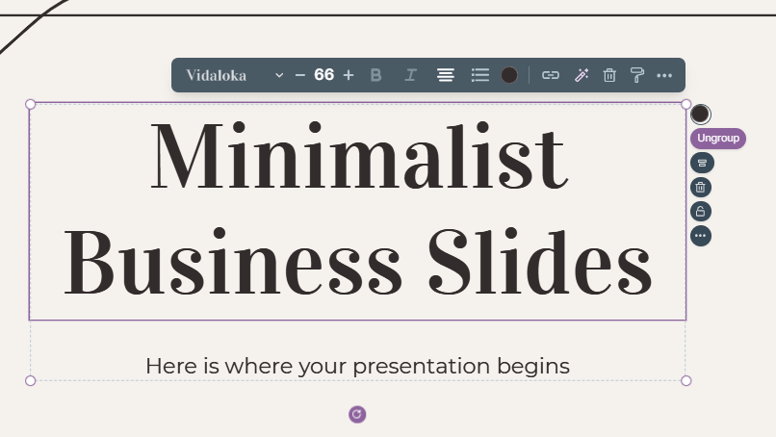
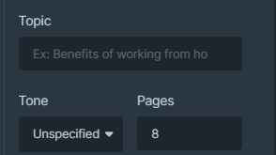
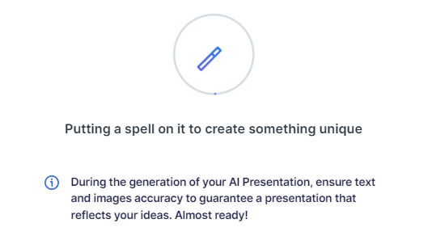
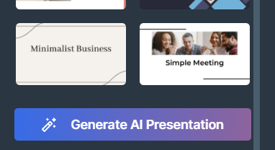
Presentation Maker
Slidesgo introduces its latest feature: the Presentation Maker. Enjoy two main functionalities - firstly, with a few clicks, create marvelous presentations with Artificial Intelligence that adapt to your needs. And it's completely free
Generate AI Presentation

Slide 22
Use our editable graphic resources...
You can easily resize these resources without losing quality. To change the color, just ungroup the resource and click on the object you want to change. You can also look for more infographics on Slidesgo

Slide 25
 | Jan | Feb | Mar | Apr | Jun
Task 1
Task 2
Task 3
 | No | Yes | Yes | No | Yes
 | Yes | No | Yes | No | Yes
 | Yes | Yes | No | Yes | No
 | Jan | Feb | Mar | Apr | Jun
Task 1
Task 2
Task 3

Slide 27
6/10 | 8/10 | 7/10 | 4/10

Slide 28
...and our sets of editable icons
You can resize these icons without losing quality
You can change the stroke and fill color; just select the icon and click on the paint bucket/pen
In Google Slides, you can also use Flaticon’s extension, allowing you to customize and add even more icons

Slide 29
Educational icons
Medical icons

Slide 30
Business icons
Teamwork icons

Slide 31
Help & support icons
Avatar icons

Slide 32
Creative process icons
Performing arts icons

Slide 33
Nature icons

Slide 34
SEO & marketing icons

Slide 35


